Slide 1
Statistical tables and graphs
By: christina mojum, pablo villatoro, Alijah pompilus

Slide 2
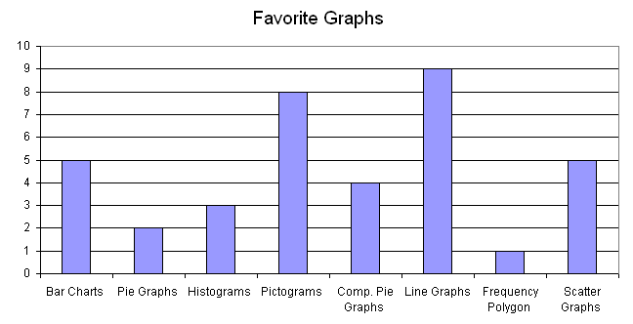
Statistical tables and graphs
THERE ARE MANY DIFFERENT TYPES OF STATISTICAL TBALES AND GRAPHS. SOME INCLUDE…
BAR GRAPHS (HISTOGRAMS)- a chart that uses either vertical or horizontal bar columns to represent values and display comparisons and/or contrasts.

Slide 3
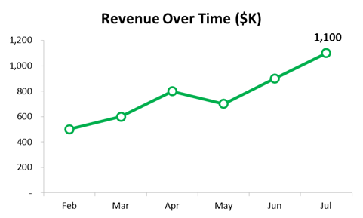
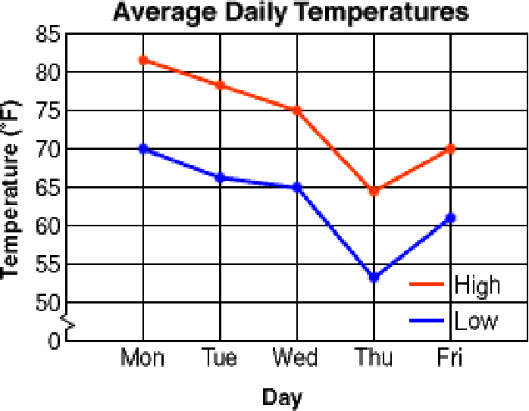
STATISTICAL TABLES AND GRAPHS
LINE GRAPHS- are used to track changes over a period of time.

Slide 4

Statistical tables and graphs
Our group chose to analyze covid-19 cases by using statistical tables and graphs.
Researchers speculated that covid-19 had been exposed to the public prior to the spike in cases in march.

Slide 5

Coronavirus 19 (sars)
The first case of COVID-19 was confirmed in New York State on March 1, 2020, in a 39-year-old health care worker who had returned home to Manhattan from Iran on February 25.On March 3, New York Governor Andrew Cuomo announced that the first recorded case of person-to-person spread in New York State had been confirmed via a New Rochelle man who was working at a law firm within One Grand Central Place in Midtown Manhattan.

Slide 6
As time progresses…more cases arise
March 9, Mayor Bill de Blasio announced that there were 16 confirmed cases of COVID-19 in New York City.
The virus then grew exponentially: by March 25, over 17,800 cases had been confirmed in New York City, with 199 deaths. At the time, the city’s infection rate was five times higher than the rest of the country, and its cases and were one-third of total confirmed US cases.
March 27, infection in New York City surpassed 23,000, with 365 deaths. Queens was the worst-affected borough by number of deaths, with over a third of total deaths. As of April 4, there were 1,200 medical military personnel serving on the USNS Comfort. 2,700 New York State National Guard forces had also been deployed.

Slide 7
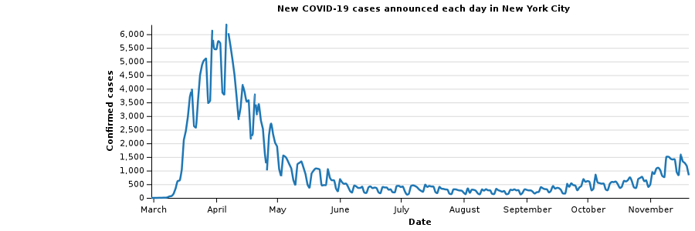
Coronavirus in nyc

Slide 8
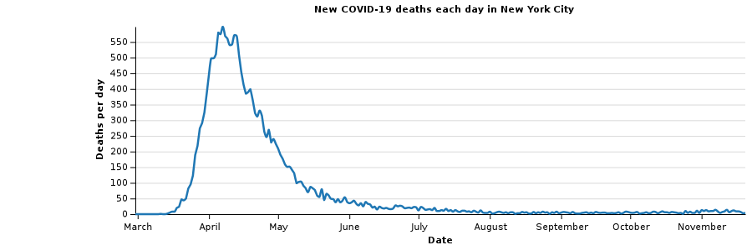
Coronavirus in nyc (cont’d)

Slide 9

correlation
As covid cases spike, more deaths occur. However after being advised by health care professionals, some ignore symptoms and maybe spreading the virus without knowledge.
Covid impacted the economy by causing businesses to close down.
Many restaurants were able to reopen at a certain capacity which still cannot make up for the income lost during the major shutdown nyc experienced.

Slide 10
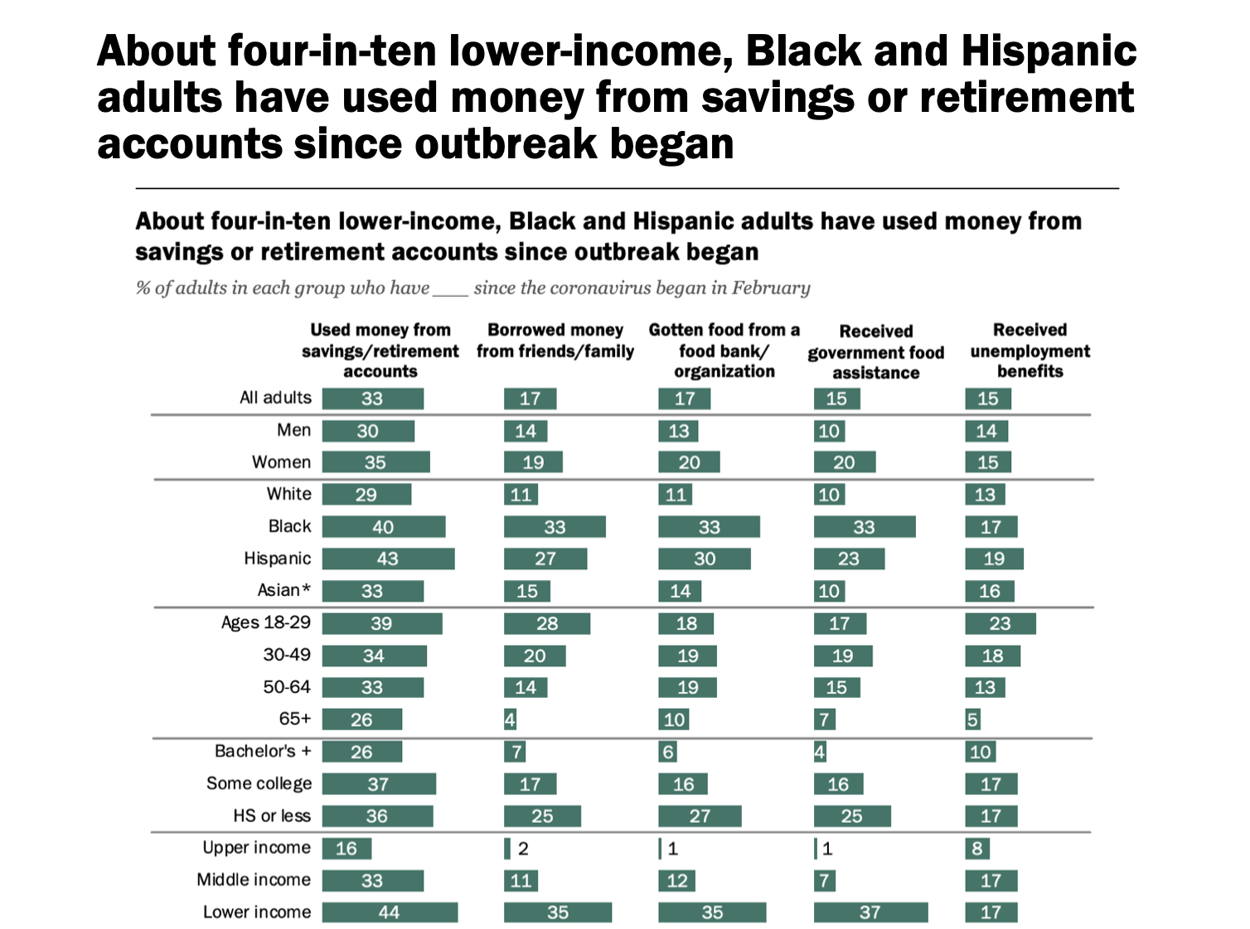
Economic impact
Coronavirus pandemic has caused major impacts on the economy in nyc. Many have lost their employment, furloughed, or forced to work from home.
The New York Times reported that hundreds of thousands of New Yorkers were unemployed, with at least $7.4 billion lost tax revenue projected over the year. Between 475,000 and 1.2 million jobs, mostly low-wage positions in the retail, transportation and restaurant sectors, were expected to be cut by the end of April.

Slide 11

Economic impact (cont’d)
After businesses began cutting employment, there arise the issue of if people would qualify for unemployment or any wages.
People began to fight for wages in the pandemic because many were unable to pay rent to keep a roof over their heads.

Slide 12
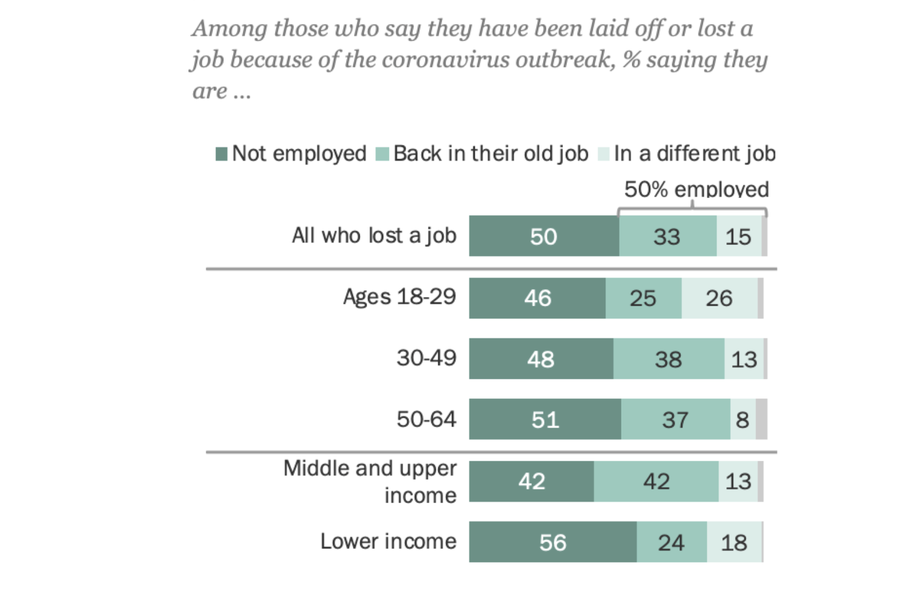
Economic impact (cont’d)
About four in ten adults state that someone in their household has lost their employment secondary to covid 19.
Younger adults laid off because of the outbreak are more likely to be in a new job than their older counterparts

Slide 13
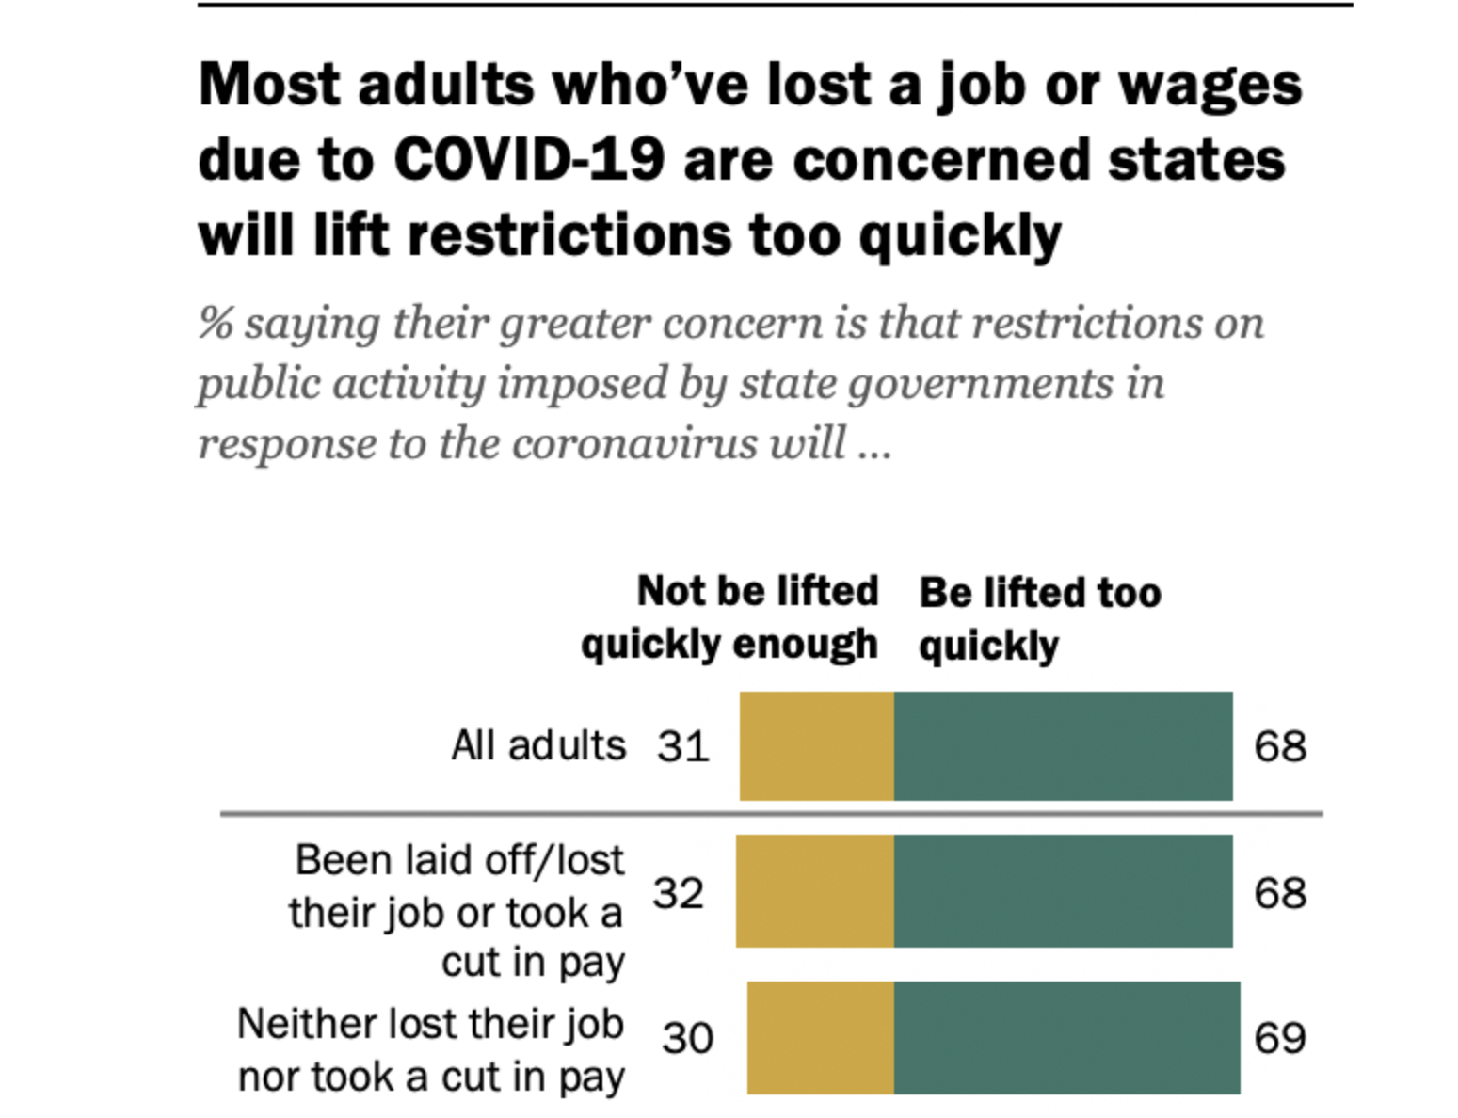
Economic impact (cont’d)

Slide 14
Corona virus pandemic
Spike one of covid
precautions
Proceed w/ caution
during the first covid 19 spike, our city faced a major lock down causing a huge deficit to health care facilities, businesses (big and small), and may have left some people homeless.
After taking certain precautions and more testing equipment became available, nyc residents began to follow some rules because they wanted to be able to enjoy their lives. People wanted to be able to perform the activities they would usually perform on a regular basis.
Once businesses started reopening, travel bans were lifted, and more tests became available, residents of the city began to return to normal activities.
Cases began to spike again.
As of 12/01 governor seeks a lockdown once again.

Slide 15
Statistical tables and graphs
As displayed in our project: statistical tables and graphs can be used in the media to recognize impacts of daily routine.
We chose covid 19 because it is current in the events and stats continue to develop daily.
Aside from our topic, in 2020 tables and graphs were used for census tracking.
Another major media covered topic that utilized tables and graphs was the presidential election.

