Slide 1
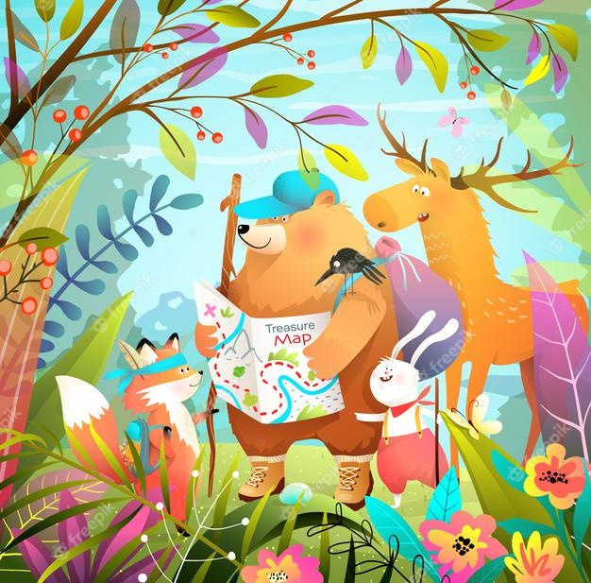
Nature adventures
Sum yi au-yeung
Fall 2021

Slide 2
introduction
The theme of my curriculum for pre-k is Nature adventures. The theme explores how learning occurs through play within the context of nature.
The preceding theme is personally interesting to me because it is intentionally designed for use in different educational environments, taking into consideration different educational, cultural, and philosophical approaches to teaching and learning.
It is curated without any particular ideological constraints to allow for its adaptation in line with the children’s diverse perspectives, preferences, and methodologies. The activities under this theme serve as windows that increase children’s awareness of the diversity found in nature. The activities are also sliding doors that allow children to connect with and learn from the natural environment and their exploration of it.
This thematic curriculum is bound to make students curious to discover because it takes advantage of the fact that they are natural explorers who utilize all their senses to analyze their environment. Since the observable opportunities for exploration and investigation are bound to the environment and the physical universe, I presume that the energy with which I expect the children to embrace the thematic activities is bound to foster plenty of opportunities for learning.

Slide 3
Exploring our habitats
Core Activities: (1) Storytelling: The learning prompts in this activity will be visual, spoken, and written cues. Inspired by the read aloud of An Egg is Quiet, students will be introduced to the beauty and classification of patterns found in natural materials such as eggs, plants, seeds, sticks, vegetables, and rocks of different shapes and sizes. We would use our bodies to perform movements to showcase the patterns evident in the natural materials. For instance, I could motion with my hands and spell out a shape. Then I would invite leaners to imitate the patterns with their own bodies. I could also ask each leaner to come up with a unique body pattern of their own and have the other learners imitate it.
(2) Aiding local habitat: Students will get involved in providing a little help for the local habitat. The students will learn about local birds and what they eat. They will then design, build, and place a simple bird feeder in the nearby schoolyard or the local area. This activity is designed to give students an opportunity to engage in the engineering design process, using their observations and creativity to design and then build a bird feeder.
(3) Bird drawings: Students will make drawings to communicate their recognition and understanding of the bird population in the local habitat. We will then analyze the drawings to discuss the students’ ideas about the birds. As an extension, we can have the students conduct research to try to figure out which populations of certain birds or species of birds in certain areas are increasing or decreasing.
(4) Fancy Egg shakers: In this music activity I decided to create simple DIY egg shakers from old Easter eggs to help my students explore rhythm and sound. I think egg shakers are a great exploratory learning tool to have in any preschool or home, and visually interesting shaker eggs are even better! This music activity connects well to this subtheme of my curriculum. The activity is inspired by Diana Hutts Aston's book, An Egg Is Quiet, which is beautifully illustrated and informative introduction to the beauty and classification of eggs in the natural environment. The book includes information about the variety of eggs found in nature and illustrates the patterns associated with their different shells. Working off of the book's premise, we would use old Easter Eggs to craft beautifully illustrated musical shakers that we can then use to incorporate sound and rhythm to our songs in the classroom.
Goal: this subtopic exemplifies the meaning-making concept of quality as it encourages subjectivity in the children as they explore natural habitats.
Books: An egg is quiet by Diana huts aston
Butterfly park by elly mckay
Nature spy by shelly rotner & ken kreisler

Slide 4
Get to know local animals
Core Activities: (1) Song & socio-dramatic play: This music and movement activity is inspired by the read aloud of Click, Clack, Moo. Students will be encouraged to sing and pretend play in the classroom. For the activity, I would create an accompanying prop called “Cindy the cow,” a small toy figurine for the children to hold when it’s their turn to speak. After reading the book, I will familiarize the children with the figurine of Cindy the cow. We will then discuss associated questions. “Do you think names have sounds? What sound does your name make?” As we pass Cindy the cow around the class we would all rhyme the call and response song “the cow goes moo! The child goes waa!” with every turn. We would structure the model of response in the activity as follows, Cindy the cow wants to know my name, “my name is Sum Yi.” “Cindy is asking what sound my name makes,” then proceed to make that sound. We would then pass Cindy the cow around the class while rhyming the activity song with everyone’s turn.
(2) Eating like a bird: Students will conduct an experiment with bird food to see which foods are preferred by which birds. Students will engage their scientific creativity to design and carry out experiments to explore the food preferences of birds that visit the schoolyard or other local areas. We can repeat the experiment at a different time of year to investigate (a) the preferences of year-round resident birds compared with those of migratory birds and/or (b) whether the preferences of resident birds change as seasons change.
(3) Field marks: Students will use field marks to figure out what kind of bird they’re seeing. Students will learn to observe birds, recognize and record field marks, and use field guides and other resources to identify the birds’ species. If we are unable to go on a field trip, we can do this activity using unlabeled photographs of local or regional bird species such as wading birds, swimming birds, woodpeckers, and birds of prey such as hawks and owls. In extension, the students will create their own birds, record, and describe its field marks of other kinds of birds.
Goal: in this subtopic, students will explore their recognition of local animals in addition to building phonemic awareness.
Books: click, clack, moo by Doreen Cronin
Owl moon by jane yolen
The Dandelion’s tale by kevin Sheehan & rob dunlavey

Slide 5
Wildlife in the city
Core Activities: (1) Natural changes: Students will observe seasonal changes as they tack changing conditions. With the help of the teacher, students will track changing high and low temperatures and sunrise and sunset times over a period of weeks and correlate them with observable changes in plants and animals. We will make it a class project to figure out how to create a chart(s) to record this data for several weeks. All data should be recorded at the same interval such as once a week so that any correlations are clear. We will make a schedule for students to be observational managers, responsible for collecting data and adding it to the chart(s).
(2) Schoolyard habitat survey: Students will work with the teacher to conduct a survey to answer the question what does the schoolyard offer wildlife? And, How can this habitat be improved? Students will survey the schoolyard or other nearby area to determine its suitability as a habitat for wildlife before subsequently creating an action plan for improving the habitat. The above survey will be preceded by a classroom discussion about what constitutes a habitat, that is—a place where living things (animals as well as plants) are able to get what they need for survival—food, water, shelter, space.
(3) Park life: Students will explore the importance of parks to wildlife and people. With the help of the teachers, students will collect information and create charts, markings, and other materials about local or regional parks and nature centers. We would set aside class time for students to present their markings to their classmates before planning a visit to some of the parks students have studied. As an extension, we could invite a park ranger or naturalist to come to the class to discuss his/her job.
(4) Unpredictable Lego tower: Students will work together in the block center to develop and express their understanding of wildlife habitats in the city. This experience is informed by the fact that the children would get a fun opportunity contribute to the creation of their knowledge about the concrete habitats of wildlife in the city. Moreover, this play-based activity would be used to access the children’s perspective and experiences by observing the children as they interact with each other during their turns with the Lego blocks.
Goal: Our city neighbors include assorted birds, mammals, reptiles, amphibians, fish, and insects, among other vertebrates and invertebrates. in this subtopic, students will learn about the Habitats of animals that live in urban and suburban settings.
Books: The tin forest by helen ward
The dream of the thylacine by Margaret wild and ron brooks
Step gently out by helen frost
Gummy toes by sean cassidy

Slide 6
Self-expression in the garden
Core Activities: (1) Outdoor group excursion & classroom discussion: Students will be Invited on a short excursion around the local environment to identify patterns and collect some uniquely shaped objects. These patterns might be present in the pavements, garden, plants, or fences. Document the most stand-out shapes using photographs and videos. It might also be useful to have the children draw the unique shapes they identify on another large and communal board. Once back inside the classroom, lay out the collected objects, the photographs taken, and the drawings made by each student. We would openly discuss the identity of each shape or pattern from the documentation and then working together to categorize the identified materials by arranging the objects according to the similarity of groups.
(2) Sensory & exploratory play: This activity is three-fold depending on the children's preferences in creative application. We would go outside on a mini-excursion in the school's surrounding environment, for example, a garden, forest, or a field. Depending on preference, some children will collect items in nature and create an art piece with the items they have collected, which will be displayed in the classroom. Others will take photographs of things they find beautiful, for instance animals, plants, scenery, or rocks. They will then choose about five of their favorite photos and present a showcase in the classroom. Similarly, some children will find something inspiring and make a drawing of it, which will also be displayed in the classroom.
(3) Mark-Making: In this activity, we would start a group project to decorate the schoolyard garden with messages for each other and the other living things that make up the garden. To do this, the students will paint rocks and leave them in the garden for all to see and enjoy. Students will paint the rocks using nontoxic acrylic craft paint and various means of mark-making such as traditional brushes, sponges, crumpled paper, cotton swabs, leaves, ferns, among others. When the rocks are ready and dry, we would visit your garden and let the students find special homes for them.
Goal: in this subtopic, Students will participate in art and language activities in the garden that will provide opportunities for self-expression.
Books: our tree named steve by alan zweibel
The imaginary garden by andrew Larson
Miss rumphius by Barbara cooney

Slide 7
Kindness in the garden
Core Activities: (1) Family Engagement: Each child will draft a brief document with their parents fleshing out the cultural and familial experiences that are relevant to the child’s development. Each child will also construct an artifact or draw a picture of cultural significance using natural materials at home to represent their heritage.
(2) Symbolic play & storytelling: In the classroom, the teacher takes the first turn to present her heritage artefact(s) in order to create a format for the children to emulate. Explain to the children that if they have questions during the presentation they can raise their hands and wait for the presenter to select them. Also, aid every child throughout their presentation as appropriate. This may include expounding on what the child is talking about when they find difficulty and to also advance their language proficiencies. To reinforce and evaluate comprehension, urge the children to share some things they’ve learned about each other from the presentations. Document what the children share regarding what they learned about each other and exhibit it on a chart board.
(3) Gardening program: This program will offer an opportunity for young students to practice showing kindness, compassion, and empathy to each other, to their community, and to our planet. The harvest of the garden can be shared, the beauty of a garden space can offer peace, and the skills learned through gardening can be used to help others. This activity draws from the concept of “pay it forward,” by which a person who has received a gift repays it by giving a gift to another instead of the original donor.
(4) The Garden Song: The Dinosaur Train feature show on PBS that is suitable for children in pre-Kindergarten. It sparks children’s interest in life science and natural history as they explore and inquire about a variety of animals and the natural environment. I chose the Garden Song from one of the Dinosaur Train features as a song I would share with students because it aligns well with my subtheme that uses the garden and natural materials to help the children learn how to express kindness and compassion. What I like about the song is how it simplifies very useful information about the process of nurturing plants. In the video clip, Tiny the dinosaur sings about waiting for the garden she planted to grow. The resource teaches children that plants need the sun, water, and time to grow. In the classroom, I would show the video and then help the children memorize the song therein for us to recite while doing the garden activity. In the gardening program activity, under this subtheme, we would recite the song throughout the program as we plant and nature our plants to maturity.
Goal: In this subtopic, students will use the garden and natural materials as tools for expressing kindness and compassion.
Books: If you plant a seed by kadir nelson
A place to grow by Stephanie bloom
Quiet in the garden by aliki
The curious garden by peter brown

