Slide 1
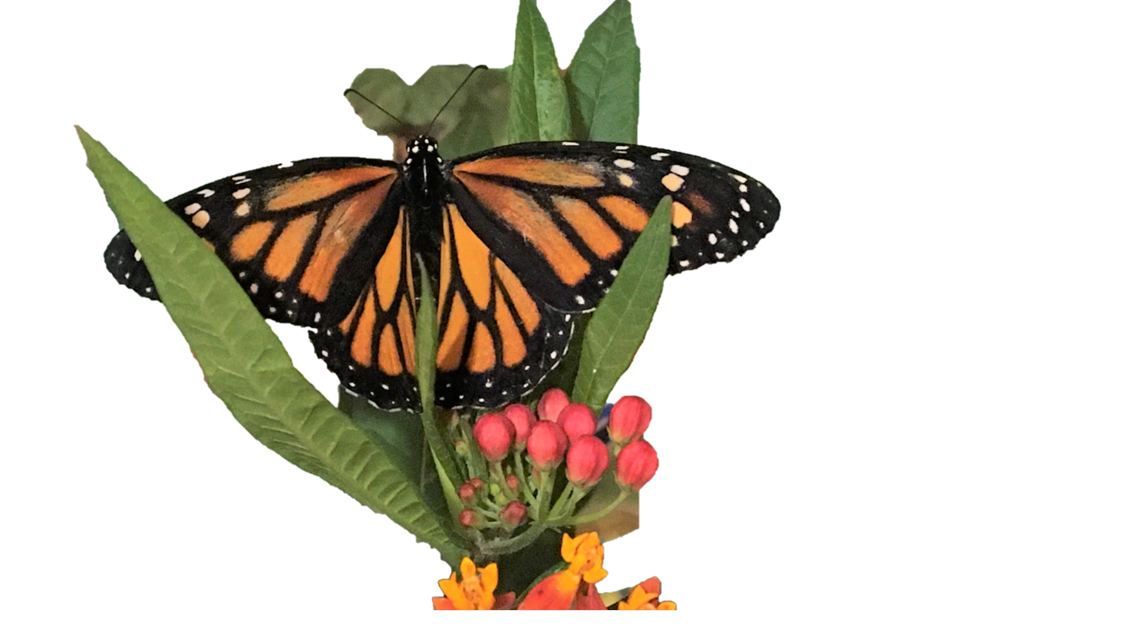
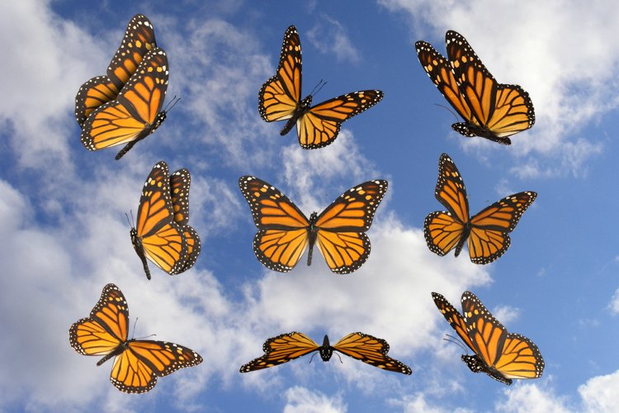

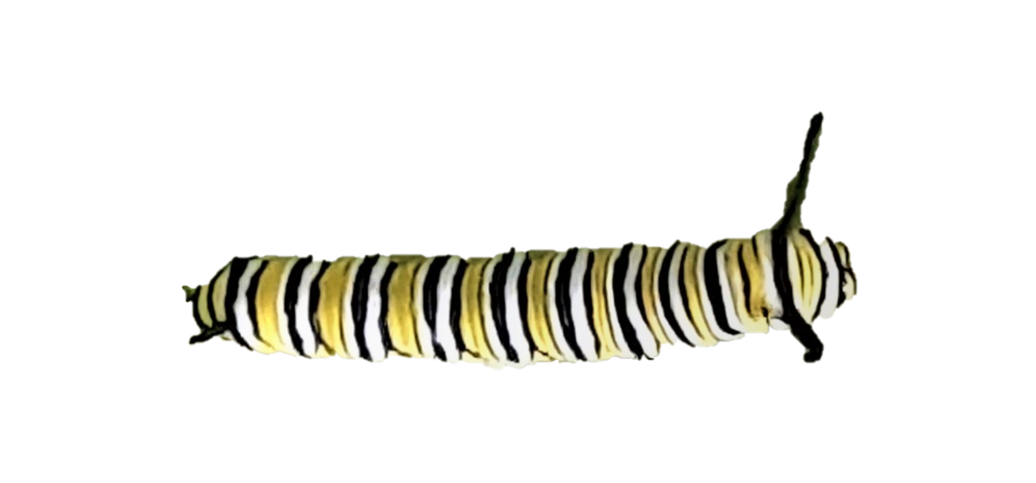
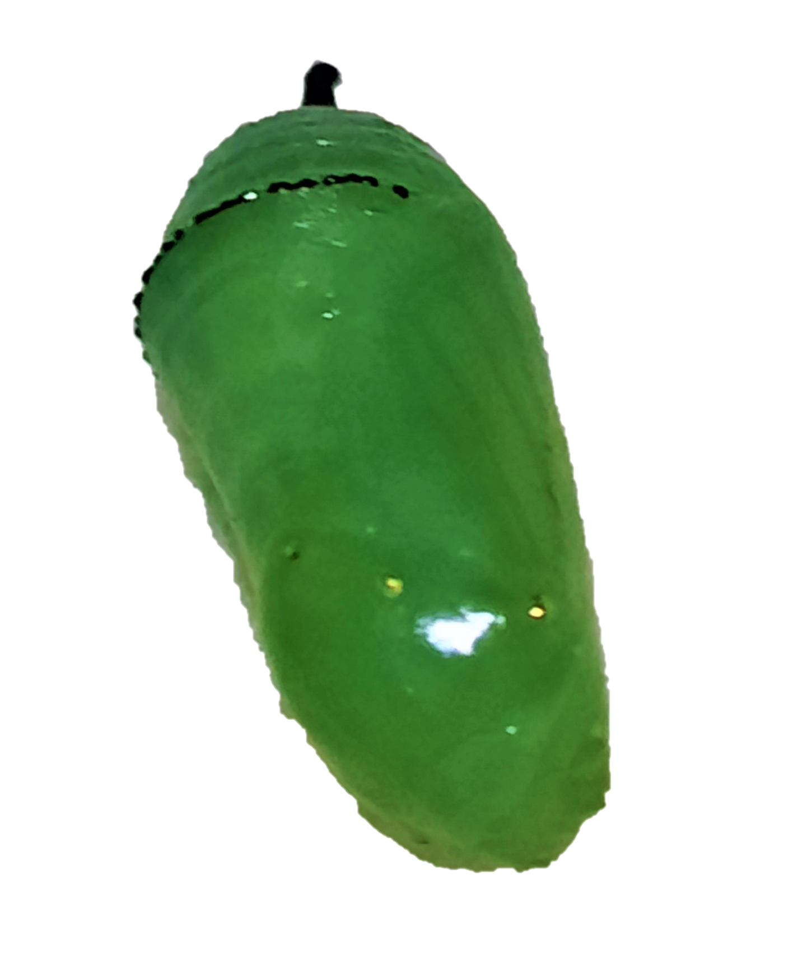
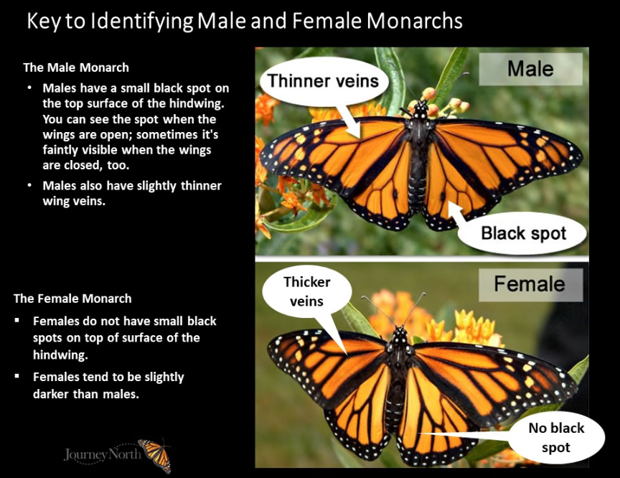
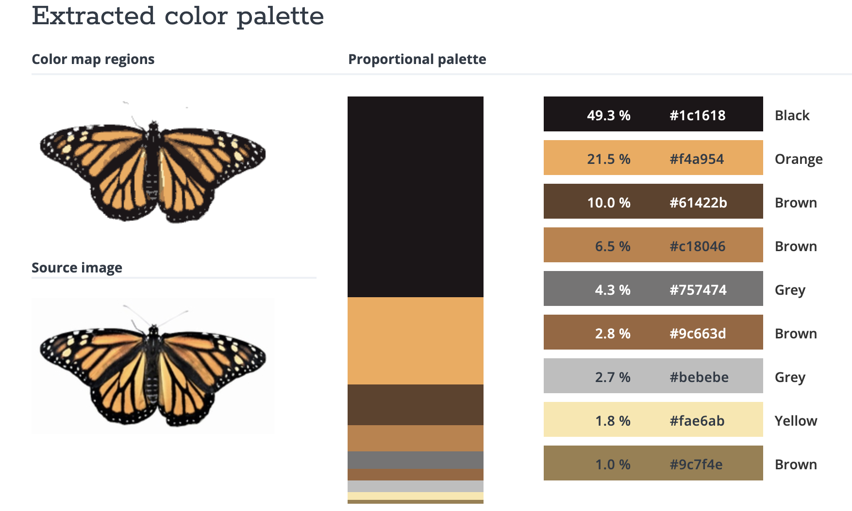
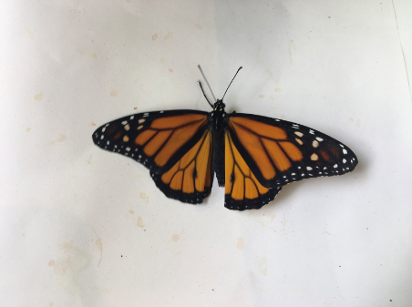
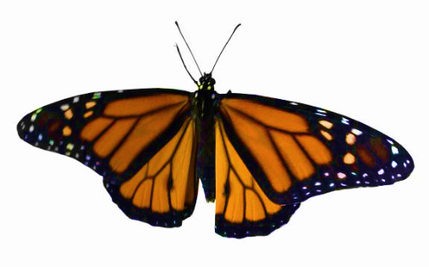
Color Ratios of male and female Monarch butterflies
By Laquanna Lynah
Mentor:
Dr. J.C. Familton
Introduction
The Monarch migration is endangered. We need to know as much as possible about them. The colors in these butterflies are very similar, and the differences are subtle, only the trained eye could tell the difference between male and female butterflies.
Finding that there is a difference between male and female orange/black color ratio of their wings is what we are investigating.
Data Analysis
Once this is done I added all the color percentages, both the “Black” and “Orange”, of each butterfly. Separating the male and female butterflies on separate sheets.
I took the mean and standard deviation of all the male and female butterflies I analyzed. I then took the ratio of “Black”/”Orange” of each gender.
MALES FEMALES
Males: “Black”/”Orange” = 1.11 Females: “Black”/”Orange” = 1.99
Method-Continued
Color Extractor
When the butterflies are uploaded to this program it breaks down each color by percentages for you to analyze. This process is not straight forward. You must compare the color percentages to the actual colors you see on the wings of the butterfly. The color percentages and the color you see on the wings may not always match therefore you much use your best judgement to determine the actual color of the wing.
Identifying Male and female Monarch Butterflies
Aside from the picture on the picture above, the males have extra black dots on their wings, the
females usually have more and larger white
dots around the perimeter of their wings.
mean | 47.6 | 42.70333
stdev | 4.17193 | 2.687006
ratio B/O | 1.114667
mean | 60.64839 | 30.48387
stdev | 4.242641 | 1.131371
ratio B/O | 1.989524
Conclusion
The expected results would be that the males have more orange and less black when compared to the females. This indeed turned out to be true based on our analysis.
The only issue is that the “Black” standard deviation was high for both male and female, 4.17 and 4.24, respectively, while the “Orange” was closer to acceptable range, 2.69 and 1.13 respectively. This could be, in part due to our small data set: 28 males and 31 females.
Method
Pre-Photoshop Photoshop
The approach I took to solve this problem is to photoshop the butterfly pictures that Dr. Familton took of the butterflies he raised so that they can be analyzed by a color extractor.
Acknowledgements
Thanks to CUNY Research Scholars Program and our mentor Dr. Familton for giving me the opportunity to conduct research at BMCC.

