Slide 1
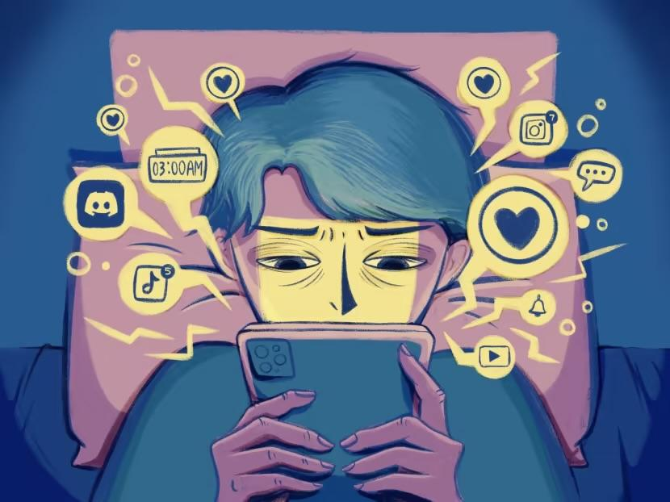
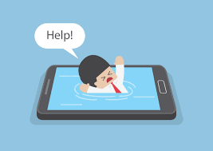
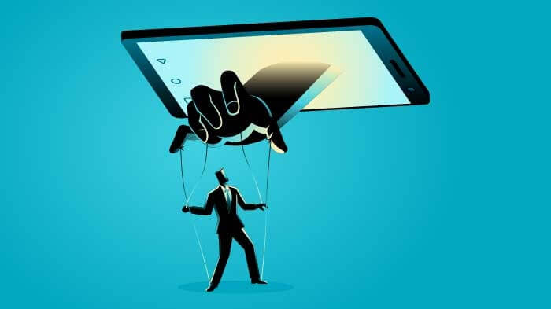
Social and media and its influence
Special culley
English 101
proff:Yolande brenner

Slide 2
Social media creates anxiety In people
People who spend endlessly time on social media are more prone to develop anxiety and depression.People who are on social media also may develop anxiety by comparing themselves to others by feeling inferior or behind in life because they don't have the same lifestyle as other people. Social media can be a source of destruction to people‘s self esteem if its not used in a balanced way.

Slide 3
Social Media tend to make people anxious
Social media can be a very education source but If Its handle responsibly . Apps like tiktok can be Informative as well Tik Tok has a lot of good information that we can Incorporate in our daily lives.It can also be toxic when your addicted to scrolling endlessly on it and forget your daily duties do to that.Im a victim of it i spend a good amount of time on TikTok scrolling my life away. Social media has also impacted people negative in a way that they prefer to socialize less since they can do it online causing them to become awkward.

Slide 4
My intentions for this essay.
My intentions are for people to not rely on social media that much to make people understand that they should be comparing themselves to others . People should live their life outside of social media not be so harsh on themselves because they haven't met the “Standards” that superficial people have created.I plan on proving my positions by providing you all with credible and valuable information.

Slide 5
Research Analysis 1
In the text called “Is google making us stupid“ By Nicholas Carr This quote “For me the net is becoming a universal medium ,the conduit for most of the information that flows through my eyes and ears and into my eyes” I can connect this quote to my thesis because it shows how a lot of people are immerse in social media that although it has it good sides someone people depend on it in a toxic way.

Slide 6
Research source 2
A quote from a article named “Selective Exposure In the internet age:The interaction between anxiety and information utility” Is “The functionality of the internet makes passive exposure more difficult ,and selective information seeking easier , than in the past” This quote shows how social media is a tool for people that are seeking easier information social media has also its benefits.

Slide 7
Research source 3
A quote from the text called “48% of gen z say social media makes them feel anxious, sad or depressed 58% are “seeking relief” from social media” Is “ Among the most compelling finding: even more Gen’Zers are thinking about quitting social media 61% are taking a break from social media ,24% consider quitting because of negative self-esteem” This quote proves my arguments that the the overuse of social media are a harm to people's self esteem te constant comparison can ruins people identity

Slide 8
Reflection…
In this research I have learned more about what about social media causes Insecurity in people and Its the fact that we compare ourselves to others about what we see on there. I’m in fact a victim of this because when I see other people having things that I wished for i feel inferior to them when I shouldn’t feel that way. This topics is very informative to teenagers who constant flash their life on it and who are in constant competition with others , They should know that not everything that you see on social media isn’t true everybody has their own struggles and imperfections .

Slide 9
Works cited list
https://cuny-cc.primo.exlibrisgroup.com/discovery/fulldisplay?docid=cdi_crossref_primary_10_1108_IJLMA_08_2022_0179&context=PC&vid=01CUNY_CC:CUNY_CC&lang=en&search_scope=NZPhysical&adaptor=Primo%20Central&tab=NZPhysical&query=any,contains,Does%20social%20media%20make%20people%20anxious&offset=0A., Apoorva, et al. “Social Media Usage and Its Impact on Users’ Mental Health: A Longitudinal Study and Inputs to Policymakers.” International Journal of Law and Management, vol. 64, no. 5, 2022, pp. 441–65, https://doi.org/10.1108/IJLMA-08-2022-0179.
https://cuny-bm.primo.exlibrisgroup.com/discovery/fulldisplay?docid=cdi_gale_infotracmisc_A604631607&context=PC&vid=01CUNY_BM:CUNY_BM&lang=en&search_scope=IZ_CI_AW&adaptor=Primo%20Central&tab=Everything&query=any,contains,Gen%20z%20says%20social%20media%20makes%20you%20anxious&offset=A., Apoorva, et al. “Social Media Usage and Its Impact on Users’ Mental Health: A Longitudinal Study and Inputs to Policymakers.” International Journal of Law and Management, vol. 64, no. 5, 2022, pp. 441–65, https://doi.org/10.1108/IJLMA-08-2022-0179.
https://cuny-bm.primo.exlibrisgroup.com/discovery/fulldisplay?docid=cdi_proquest_miscellaneous_60024099&context=PC&vid=01CUNY_BM:CUNY_BM&lang=en&search_scope=IZ_CI_AW&adaptor=Primo%20Central&tab=Everything&query=any,contains,Does%20social%20media%20makes%20you%20anxious%20&mode=A., Apoorva, et al. “Social Media Usage and Its Impact on Users’ Mental Health: A Longitudinal Study and Inputs to Policymakers.” International Journal of Law and Management, vol. 64, no. 5, 2022, pp. 441–65, https://doi.org/10.1108/IJLMA-08-2022-0179.

