Slide 1



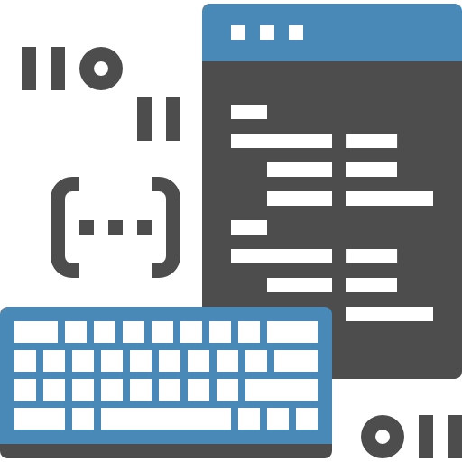

Photoshop
MMP 100 Intro to Multimedia

Slide 2
[2] Images

Slide 3
Canvas
Photoshop Big Idea

Slide 4
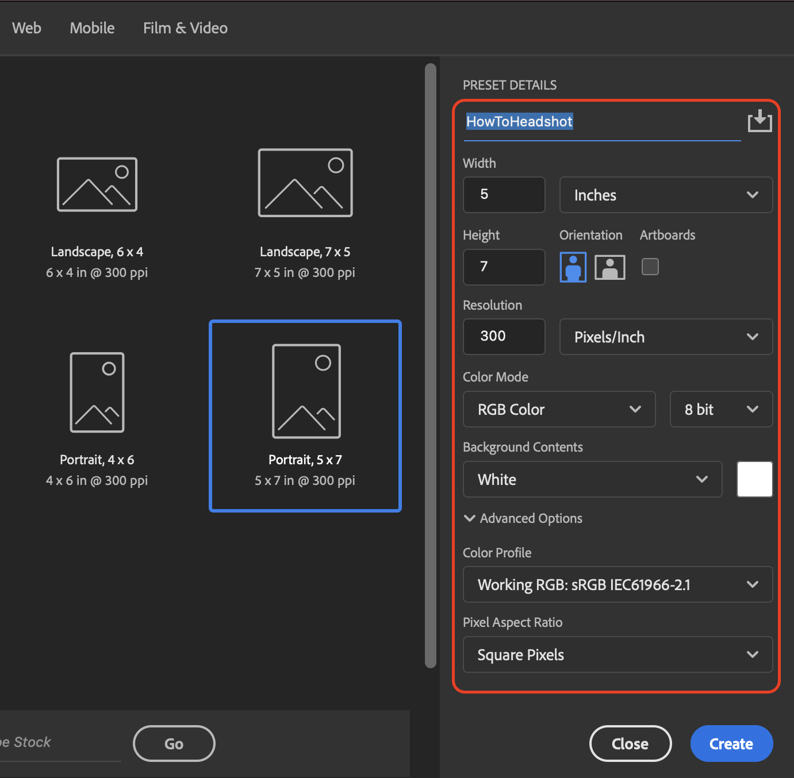
New Canvas

Slide 5
Layers
Photoshop Big Idea

Slide 6
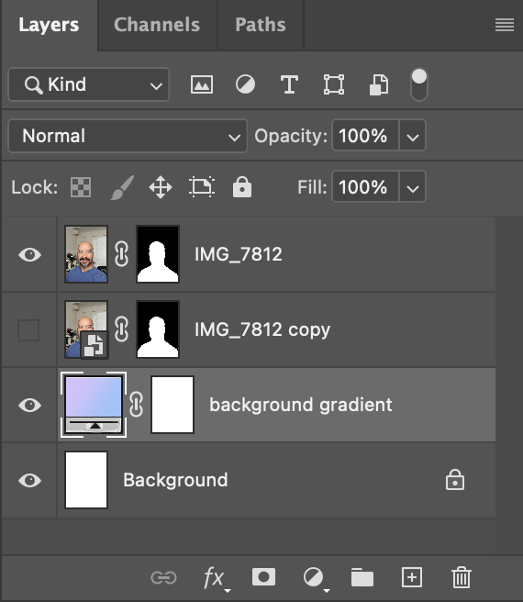
Layers

Slide 7
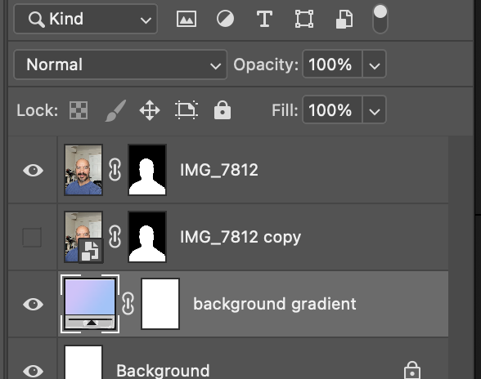
Layers Description
Photoshop allows you to work with multiple layers, which can be stacked on top of each other and edited individually.
This gives you more control over your edits and allows for non-destructive editing.

Slide 8
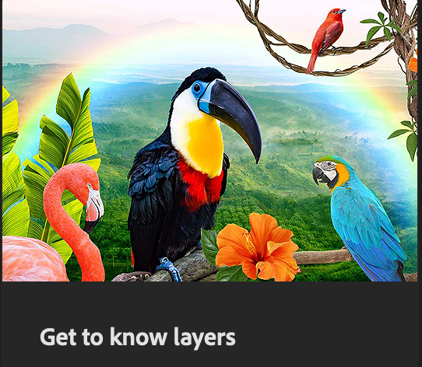
Layers Hands-On
This hands-on tutorial built into Photoshop helps you learn more about layers.

Slide 9
Selection
Photoshop Big Idea

Slide 10
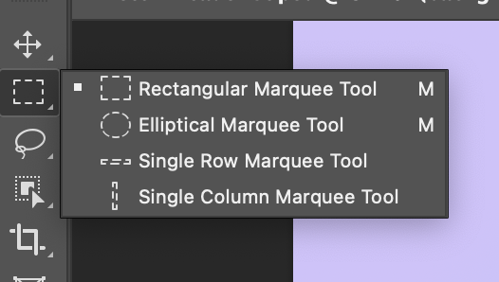
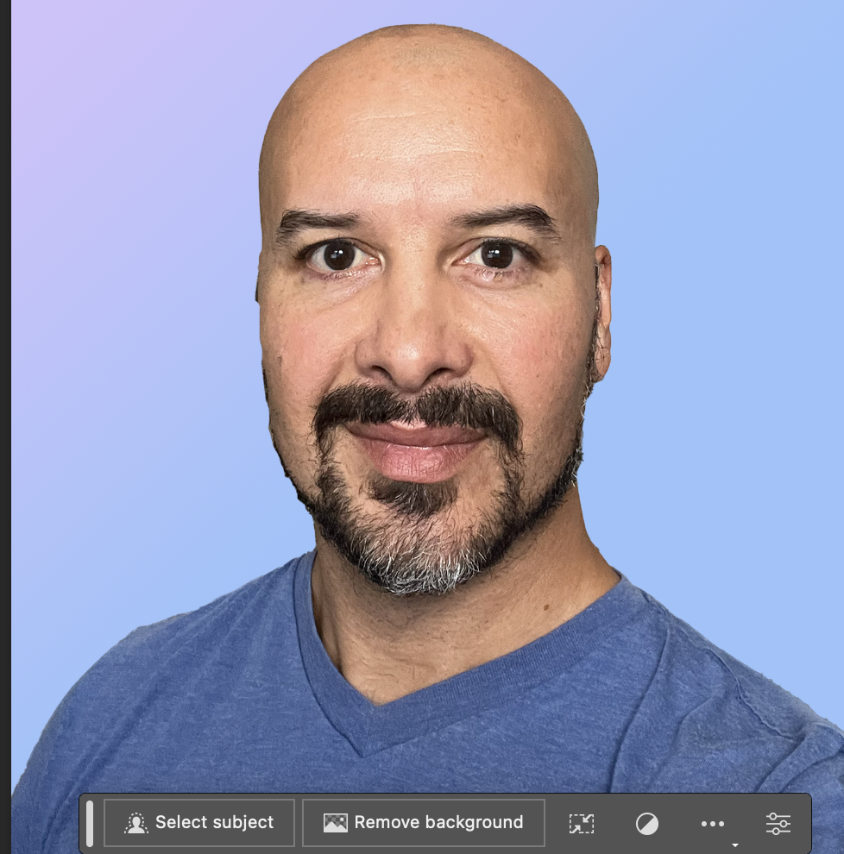
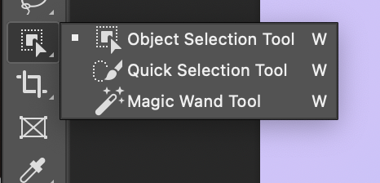
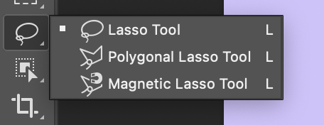
Selections

Slide 11
Selections Description
Photoshop provides various tools for making selections, such as
the Marquee tool
Lasso tool
Object Selection Tool.
Selections allow you to isolate specific areas of an image for editing.

Slide 12
Contextual Task Bar
The Contextual Task Bar allows you to easily select a subject or remove a background with the click of a button. The subject must be something the AI in Photoshop can recognize for the button to appear.

Slide 13
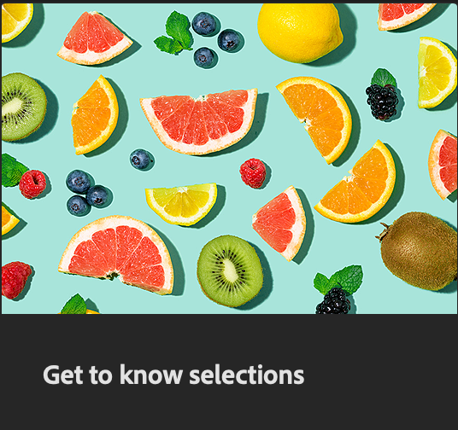
Selection Hands-On
This Hands-On tutorial built into Photoshop helps you to learn more about selections.

Slide 14
Masks
Photoshop Big Idea

Slide 15
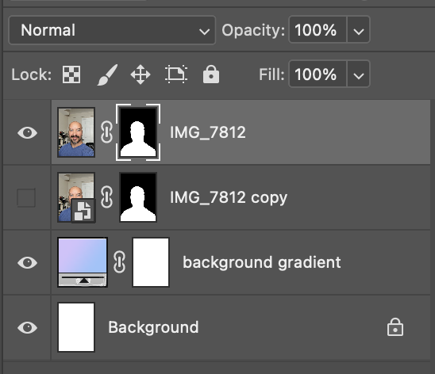
Layer Mask

Slide 16
Layer Mask Description
Masks are used to hide or reveal certain parts of a layer. By using masks, you can apply edits selectively to specific areas without permanently altering the original image.

Slide 17
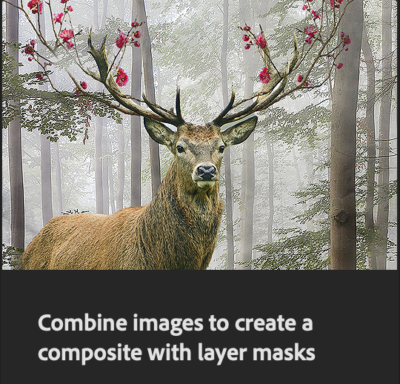
Masking Hands-On
This Hands-On tutorial built into Photoshop helps you to learn more about masking and combining multiple images.

Slide 18
Adjustments
Photoshop Big Idea

Slide 19
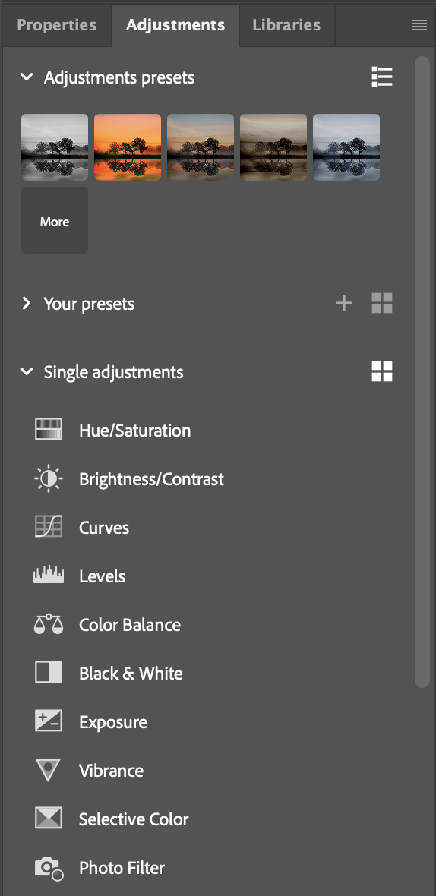
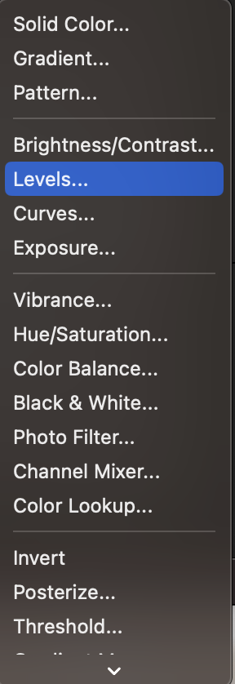

Adjustment Layers

Slide 20
Masking Hands-On
This Hands-On tutorial built into Photoshop helps you to learn more about masking and combining multiple images.

Slide 21
Adjustments
Photoshop Big Idea

Slide 22
Adjustment Layers Description
Adjustment layers allow you to make non-destructive edits to your images. They provide a wide range of adjustment options, such as brightness/contrast, levels, and color balance.
There are two quick ways to add adjustments.
1. Through the Adjustments tab (seen right)

Slide 23
Adjustment Layers Description (part 2)
And:
2. Using the adjustment layer button on the bottom of the layers window.

Slide 24
Generative AI
Photoshop Big Idea

Slide 25
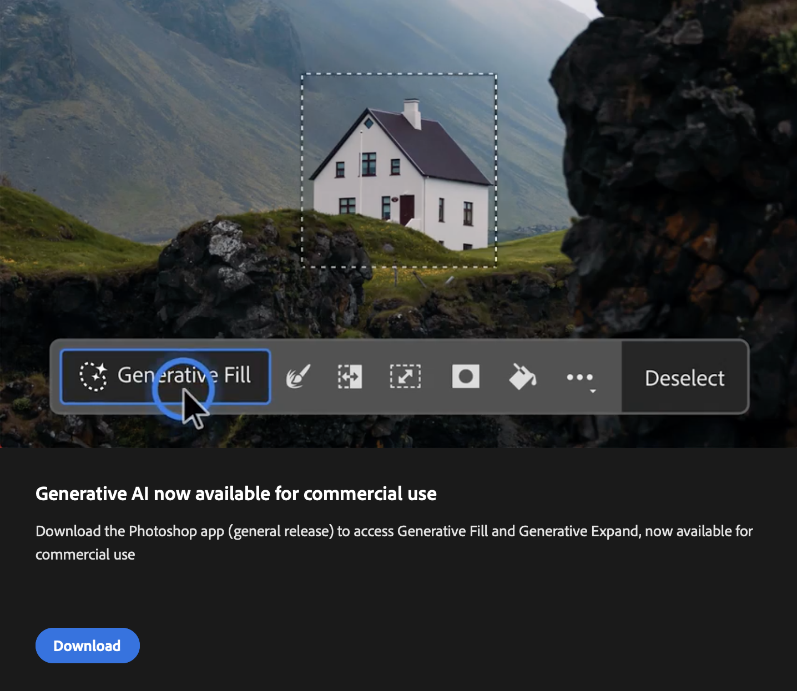
Generative Fill

Slide 26
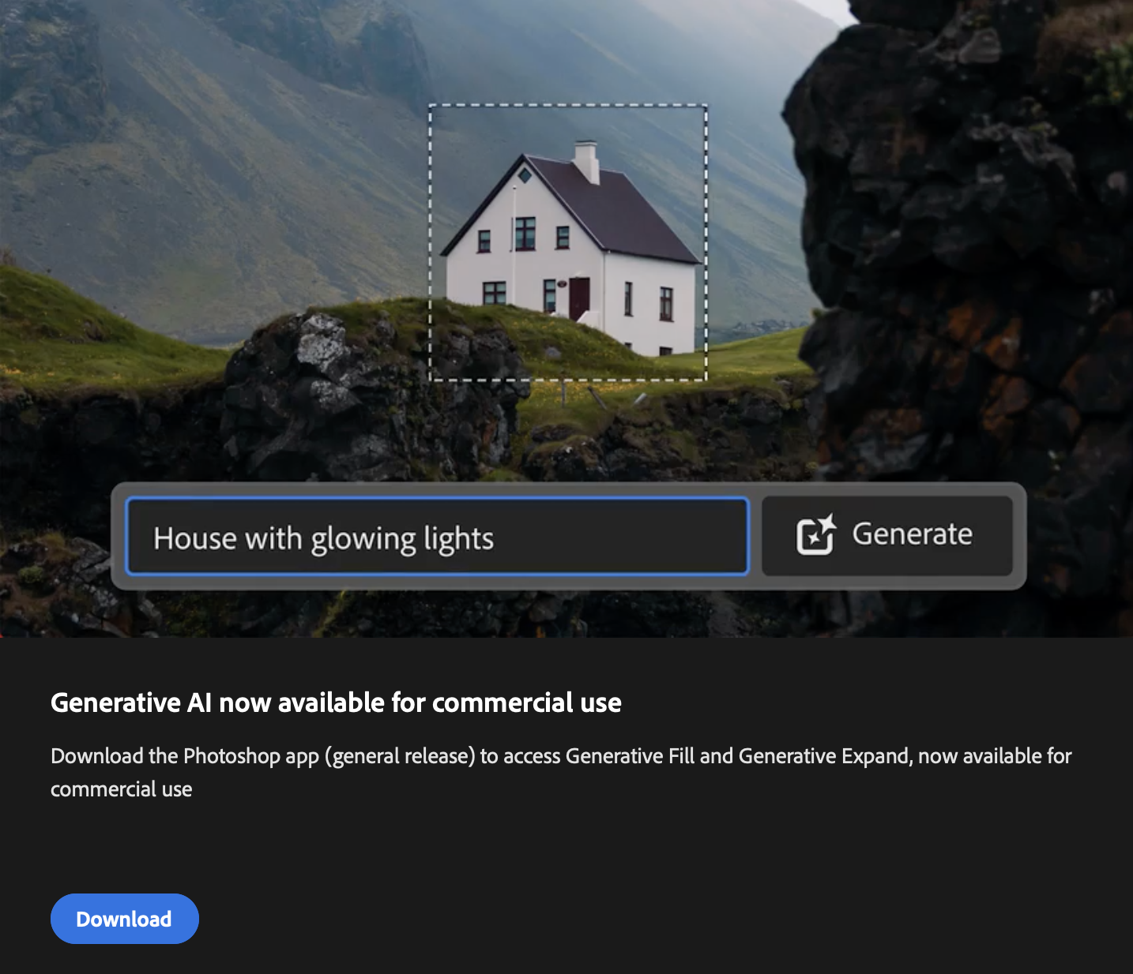
Generative Fill Prompt

Slide 27
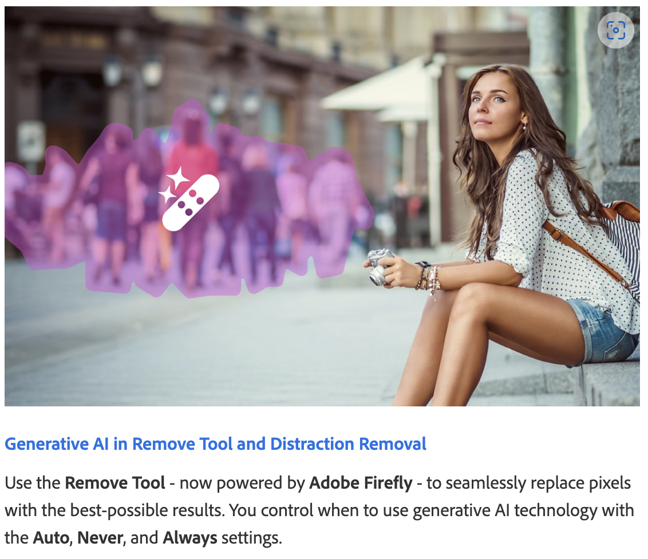
Remove Tool

Slide 28
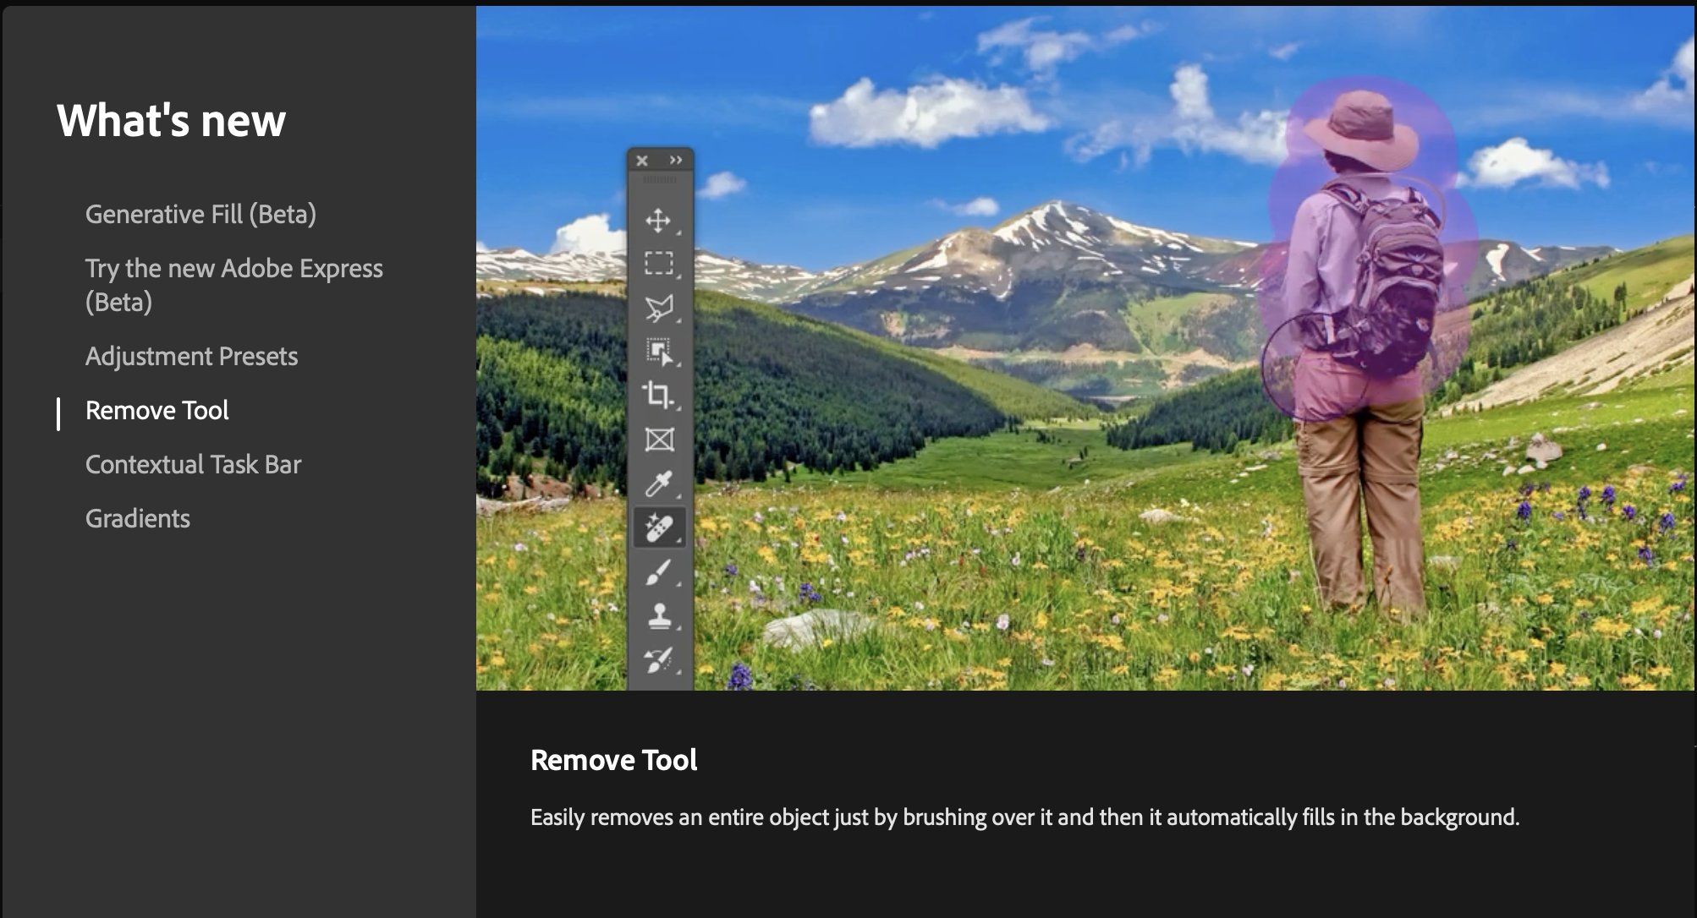
Remove Tool

Slide 29
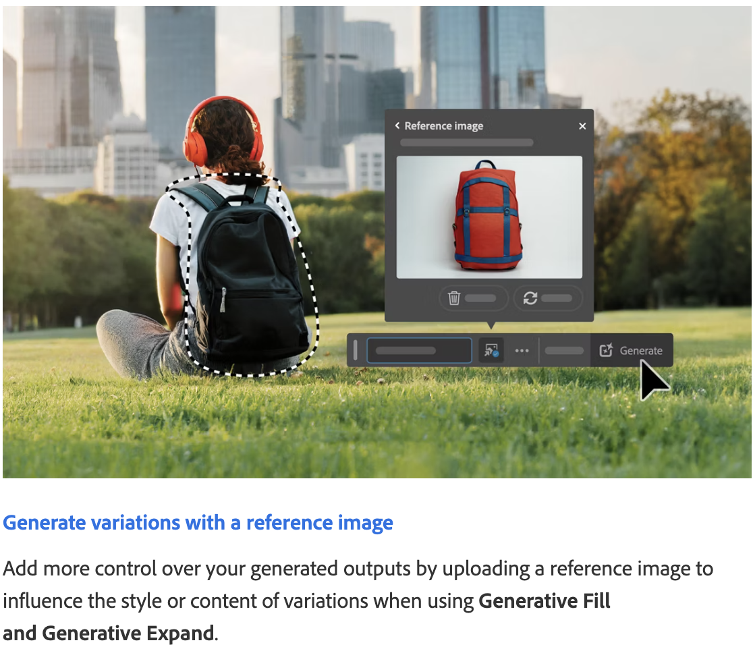
Reference Image

Slide 30
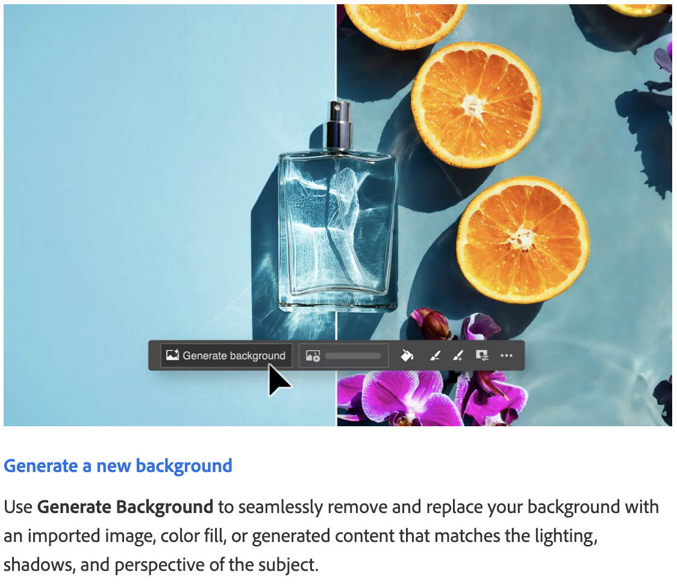
Generate Background

Slide 31
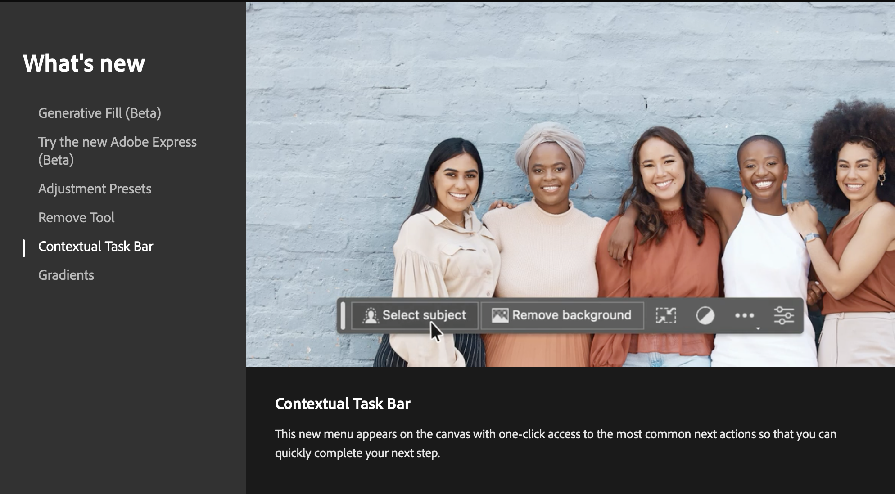
Contextual Task Bar

