Slide 1





Illustrator
MMP 100 Intro to Multimedia

Slide 2
Vector Images

Slide 3
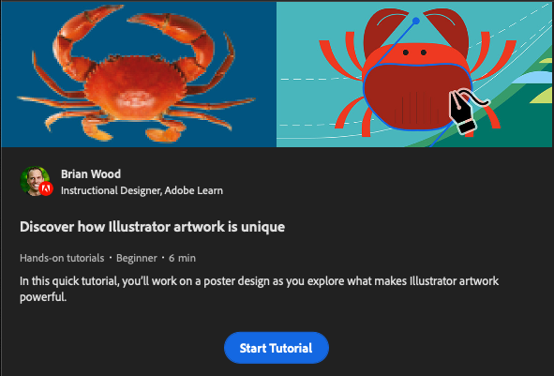
Discover how Illustrator artwork is unique
Adobe Hands-on
Learn basics of Illustrator and vector vs raster images.

Slide 4
Artboard
Ilustrator Big Idea
Notes:
In illustrator the thing you work on is called an Artboard (it was called a canvas in Photoshop.

Slide 5
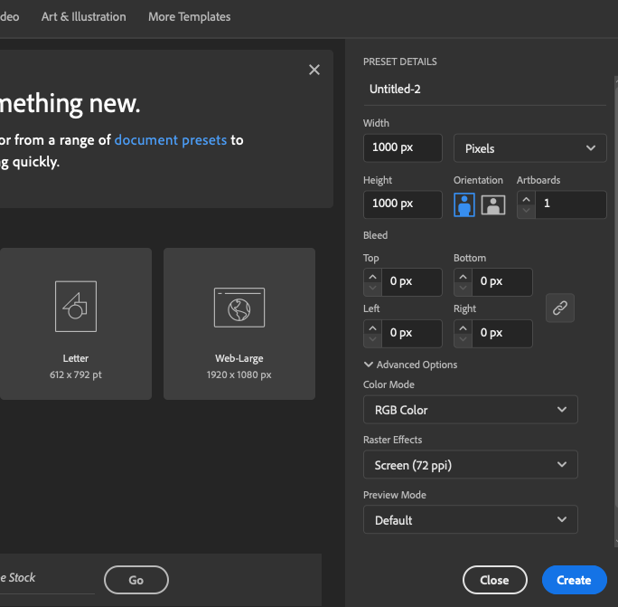
New Artboard

Slide 6
Layers
Illustrator Big Idea
Notes:
Just like Photoshop, Illustrator uses layers to

Slide 7
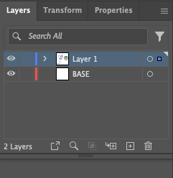
Layers

Slide 8

Layers Description
Like Photoshop, Illustrator uses layers to organize and manage different elements of your design.
Layers allow you to work on individual components separately, making it easier to edit and rearrange objects.

Slide 9
Shapes and Paths
Illustrator Big Idea

Slide 10
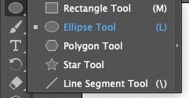



Shapes and Paths

Slide 11
Shapes and Paths Description
Illustrator provides a number of tools to draw shapes and lines. Some are
Rectangle, Ellipse, polygon and star tools
Pen Tool
Paintbrush and pencil tools
Shapes are made up of paths and you can also manipulate paths using anchor points and handles to create custom shapes or modify existing ones.

Slide 12
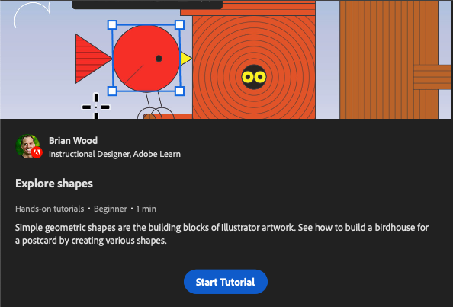
Explore Shapes
Adobe Hands-on
Learn how to create and manipulate shapes using anchor points and the Shape Builder tool

Slide 13
Combining Shapes
Illustrator Big Idea

Slide 14
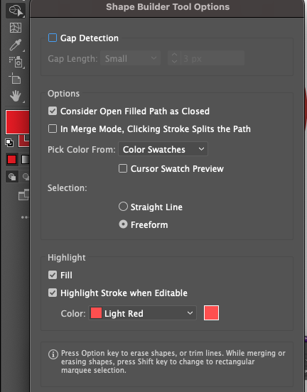
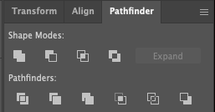
Shape Builder and Pathfinder Tools

Slide 15
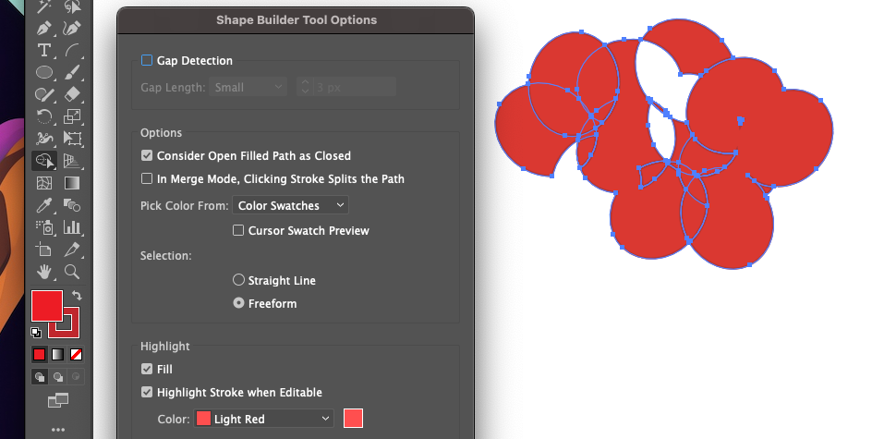
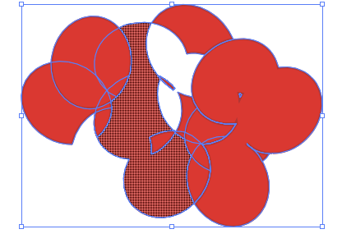
Shapebuilder Description
The Shape Builder allows you to easily create and modify complex shapes by combining or subtracting overlapping shapes.
It works in a more interactive way as you draw a path through overlapping parts of shapes to combine or remove them.

Slide 16
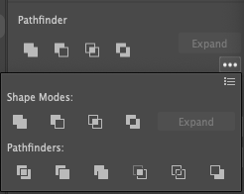
Pathfinder Descriptions
The Pathfinder tool allows you to combine, subtract, divide, and intersect multiple shapes to create complex and custom shapes.
To use it you select two overlapping shapes and then click on what kind of combination you want (ie divide, trim, merge, outline)

Slide 17
Color
Illustrator Big Idea

Slide 18
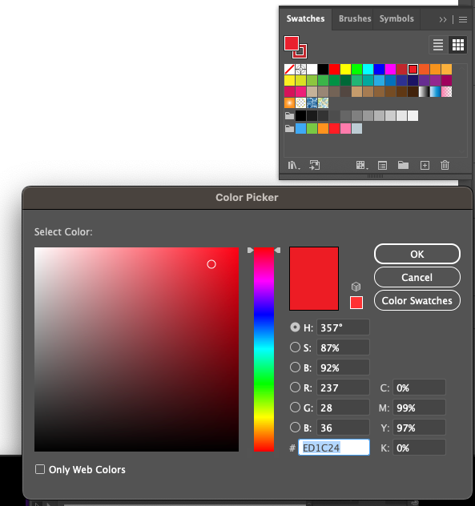
Swatches and Color Picker

Slide 19
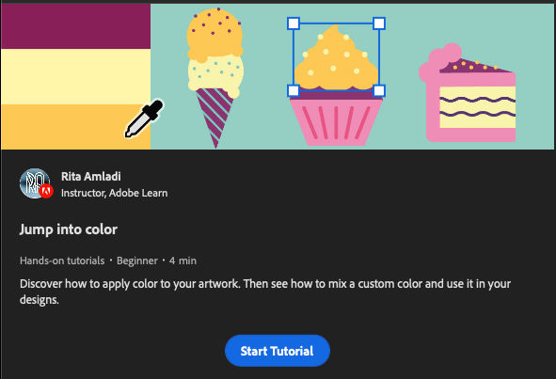
Jump into color
Adobe Hands-on
Hands on tutorial to learn about how to apply and change color in Illustrator.

Slide 20
Creating an Apple
Illustrator Example

Slide 21
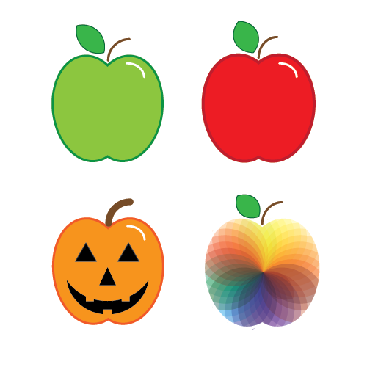
Apple Tutorial
This is not an Adobe tutorial. We will just do this in class together.

Slide 22
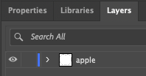
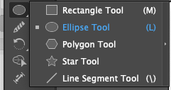
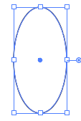
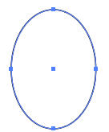
1. Draw an Oval with the Ellipse Tool
Create a Layer named Apple
Select the Ellipse Tool
Draw an oval
Adjust shape to be about ½ an apple

Slide 23
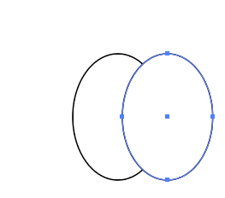
2. Duplicate the oval
Hold the Option key (mac) or Alt key (Windows)
Click on the oval and drag to duplicate
An alternative is copy and paste.

Slide 24
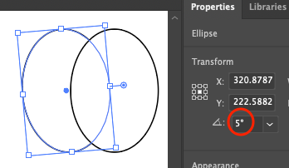
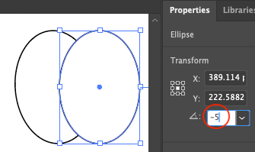
3. Rotate both Ovals
Click on the left Oval. In Properties enter 5 by Rotation
Click on the right Oval. In Properties enter -5 by Rotation*
*It will change to 355

Slide 25
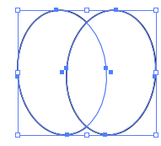
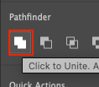
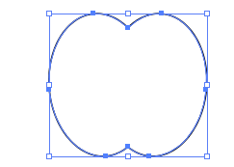
4. Unite with Pathfinder
Select both ovals with the Selection tool (V)
In Properties under Pathfinder click on Unite
Use the handles to adjust if you want.

Slide 26

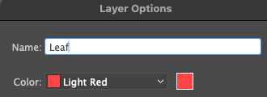
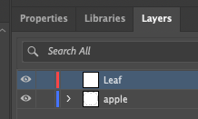
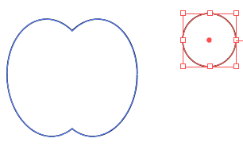
4. Draw a Circle
Create a new Layer named Leaf
Draw a perfect Circle with the Ellipse Tool (hold the shift key)
It should be smaller than the apple

Slide 27

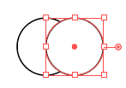

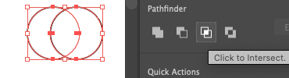

6. Finish the Leaf
Duplicate the circle.
Drag the second one until it is halfway over the first. You should see ”center” or “intersect”
Select both circles with Selection tool (V)
Use the Pathfinder – Intersect to create the leaf

Slide 28
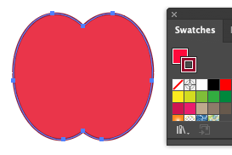

7. Add Color
Open Swatches from Window > Swatches
Double click Fill (solid square) and Stroke (hollow square) to change colors to red for fill and darker red for stroke
Do the same for the leaf but green and darker green.

Slide 29

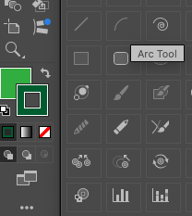

7. Make a Stem
Select Window > Stroke and choose round cap
Select the Arc Tool.
If you don’t see it click the three dots to see all tools
Draw an arc
Change Stroke color to brown and width to 4

Slide 30

9. Move Pieces into Position
Using the Selection tool, move the leaf and stem into position by the apple.
You will have to rotate the leaf. Hover by one of the corners to get the Rotate handles, or type in a rotation like you did earlier for the apple halves.

Slide 31

9. Create a light shine
To add highlight shine:
Duplicate the stem
Move it down on the apple
Change the color to white
Drag the handles to make it smaller.

