Slide 1
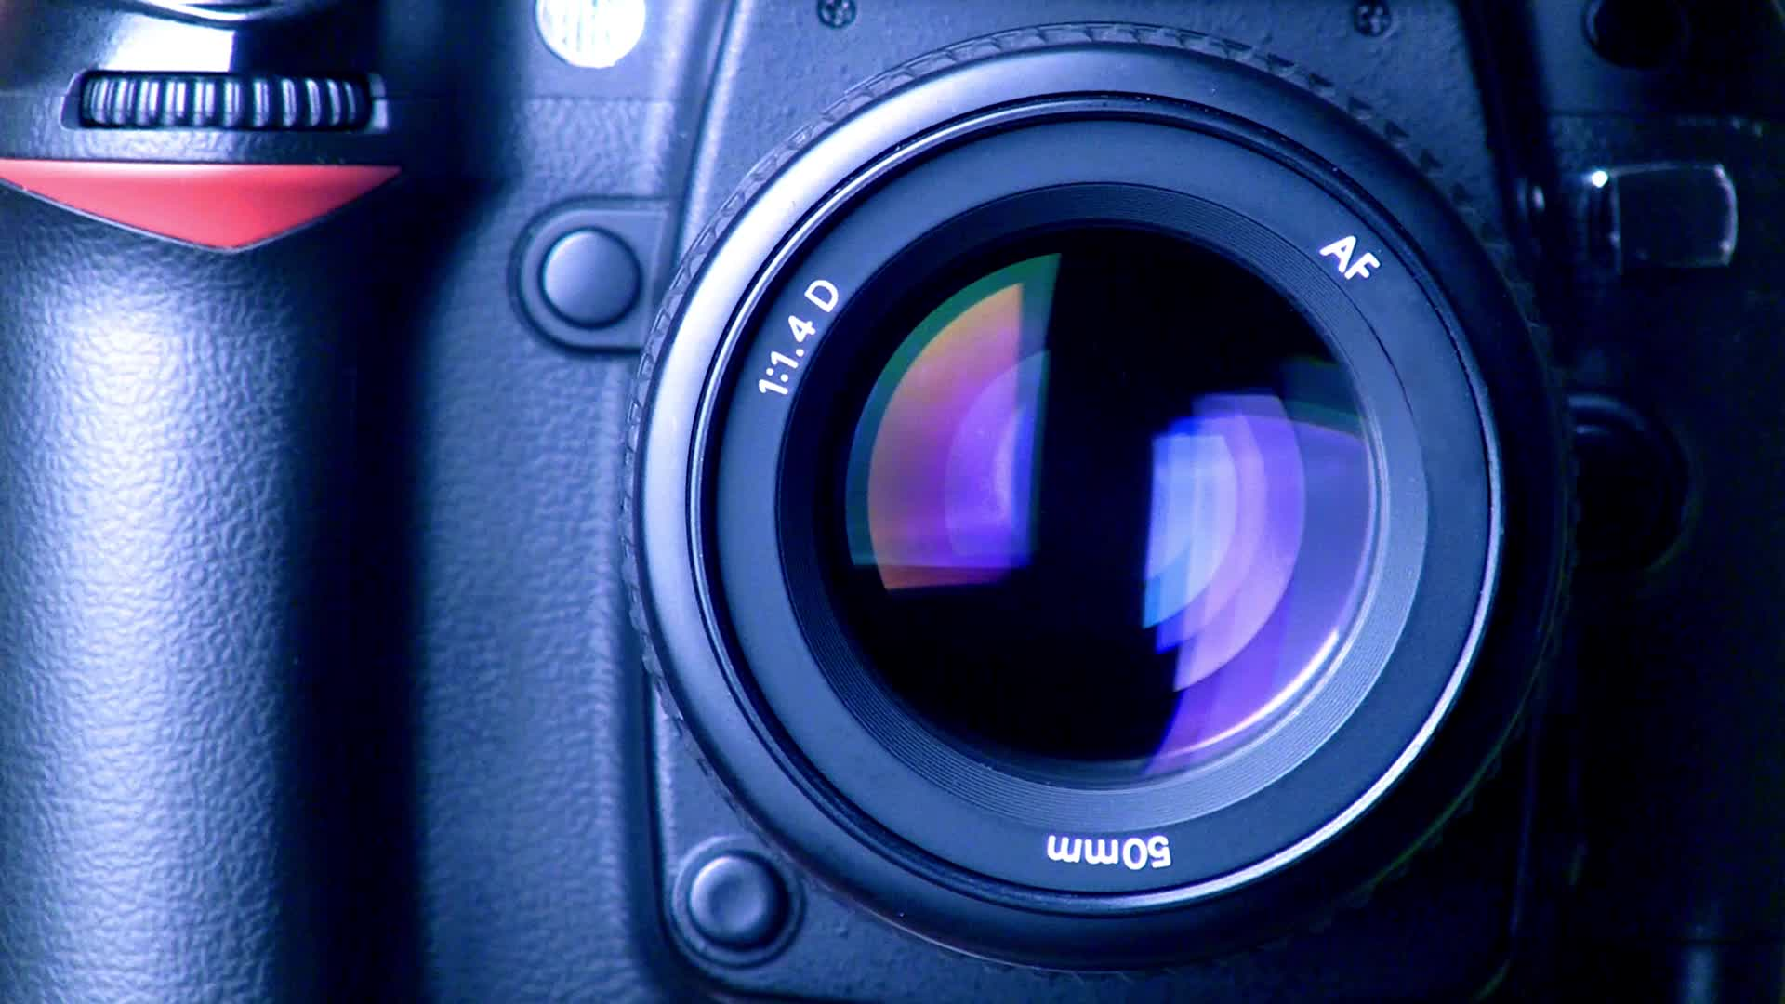
DIGITAL IMAGING
MMP100

Slide 2
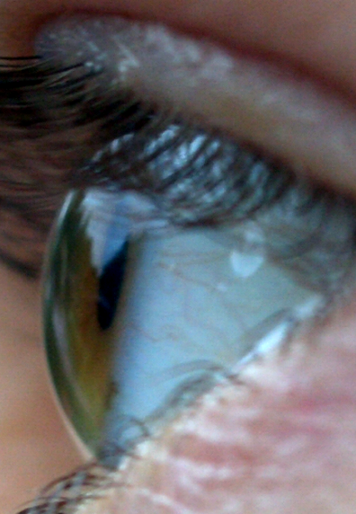
Eye and Vision
How the human eye works.
Paul Savage, CC BY 2.0, via Wikimedia Commons

Slide 3
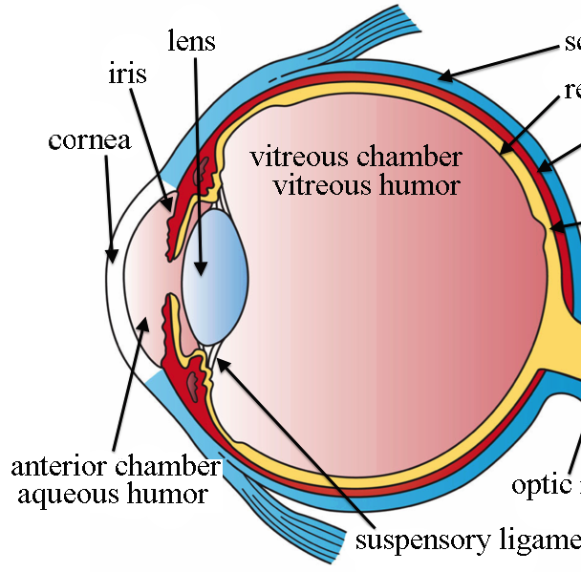
Eye and Vision
How the human eye works.
Artwork by Holly Fischer, CC BY 3.0, via Wikimedia Commons

Slide 4
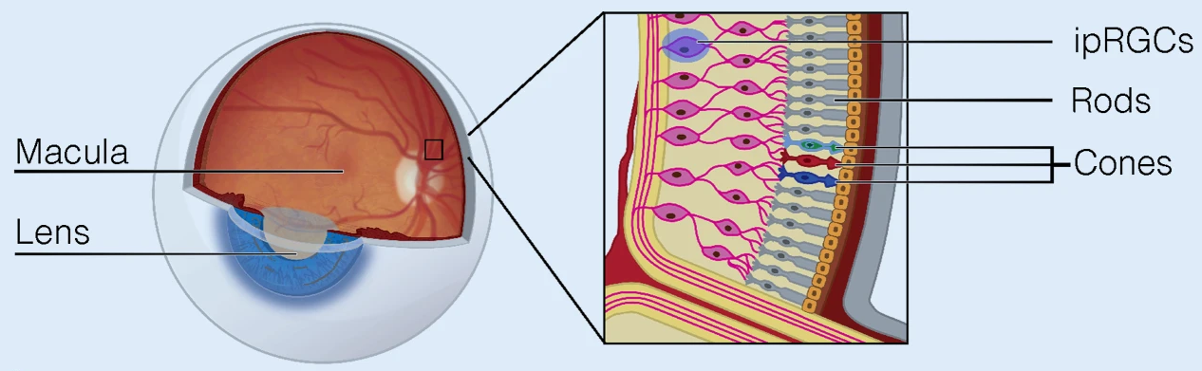
Eye and Vision
How the human eye works.
Christine Blume, Corrado Garbazza & Manuel Spitschan, CC BY 4.0 , via Wikimedia Commons

Slide 5
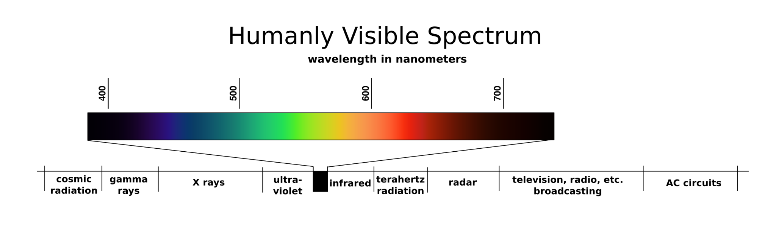
Color Vision: Electromagnetic Spectrum
Visible light is a small part of the electromagnetic spectrum.
https://en.wikipedia.org/wiki/Color_vision
YouTube Video with visual explanation:
https://youtu.be/m4t7gTmBK3g?si=pGkbnsXjCtQagYQJ

Slide 6
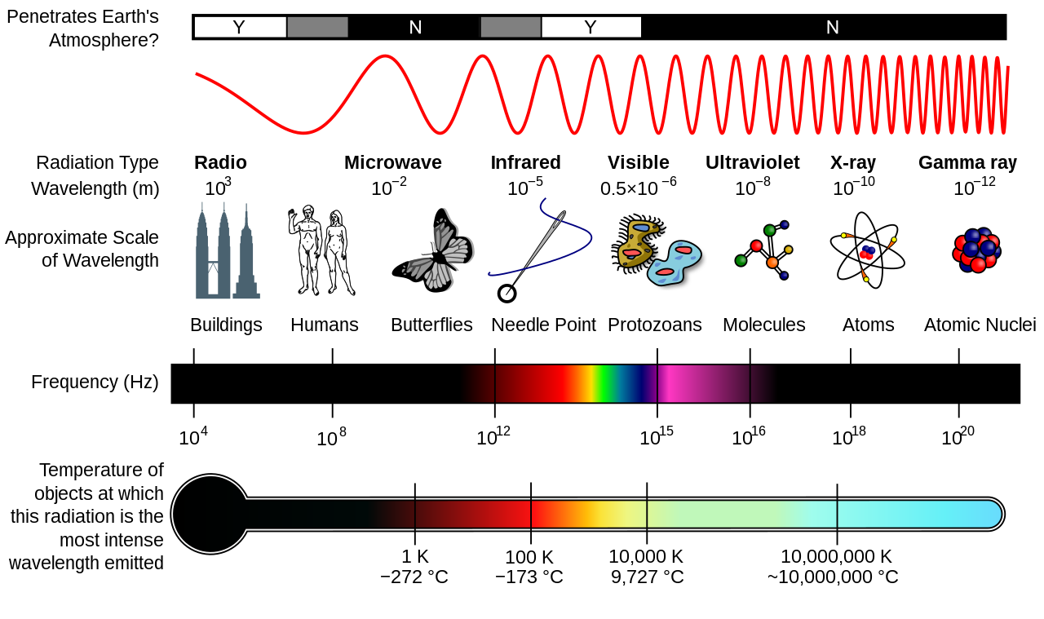
Color Vision: Electromagnetic Spectrum
Visible light is a small part of the electromagnetic spectrum.
https://en.wikipedia.org/wiki/Color_vision

Slide 7
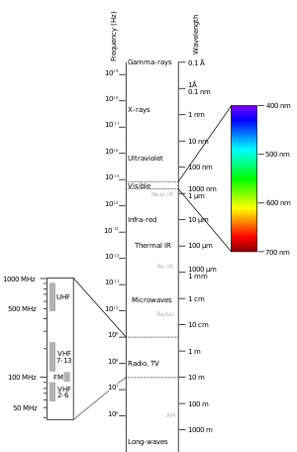
Color Vision: Electromagnetic Spectrum
Colors are different wavelengths (frequencies) of electromagnetic radiation. We can see about 10 million colors.
https://en.wikipedia.org/wiki/Color_vision

Slide 8

Photo by Wilmer Martinez on Unsplash
Notes:
In some ways the idea that we could see radio waves or other forms of electromagnetic waves is not too far from the truth.

Slide 9
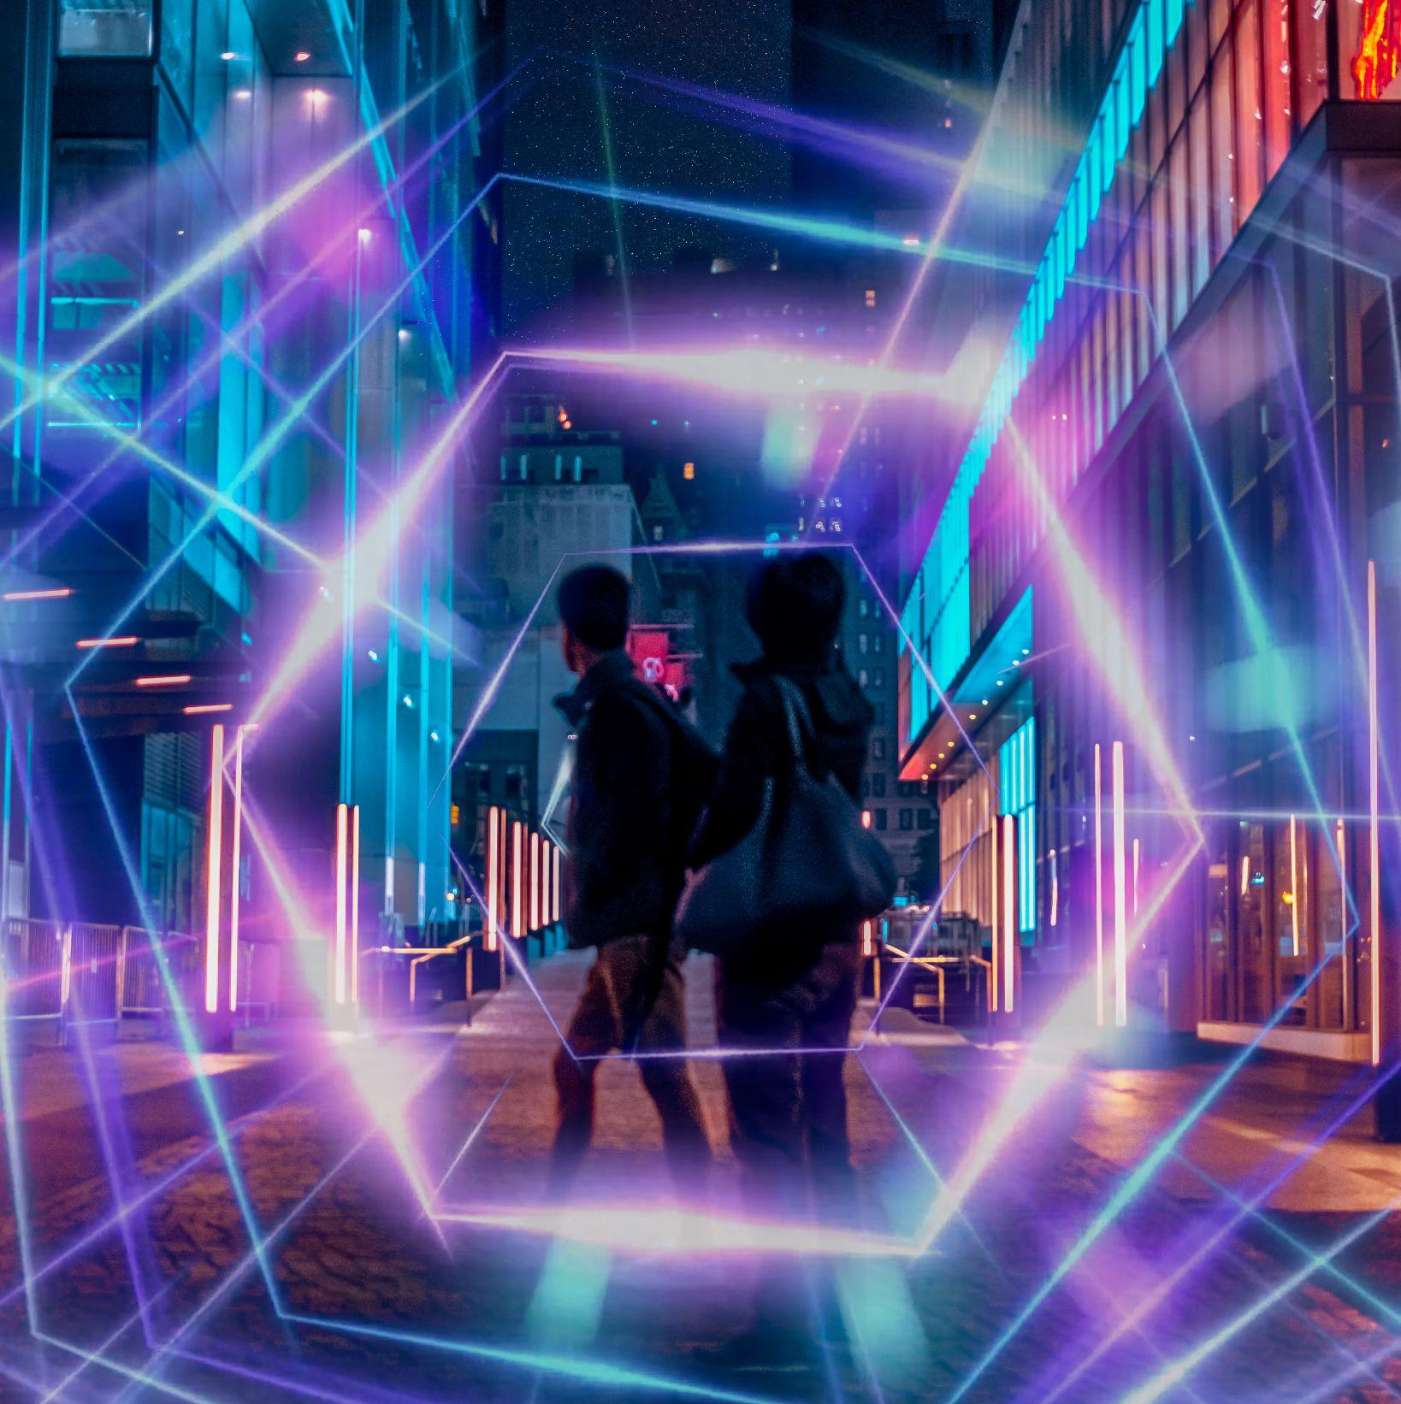
What would the world look like if we could see more of the electromagnetic spectrum?
Photo by Wilmer Martinez on Unsplash

Slide 10
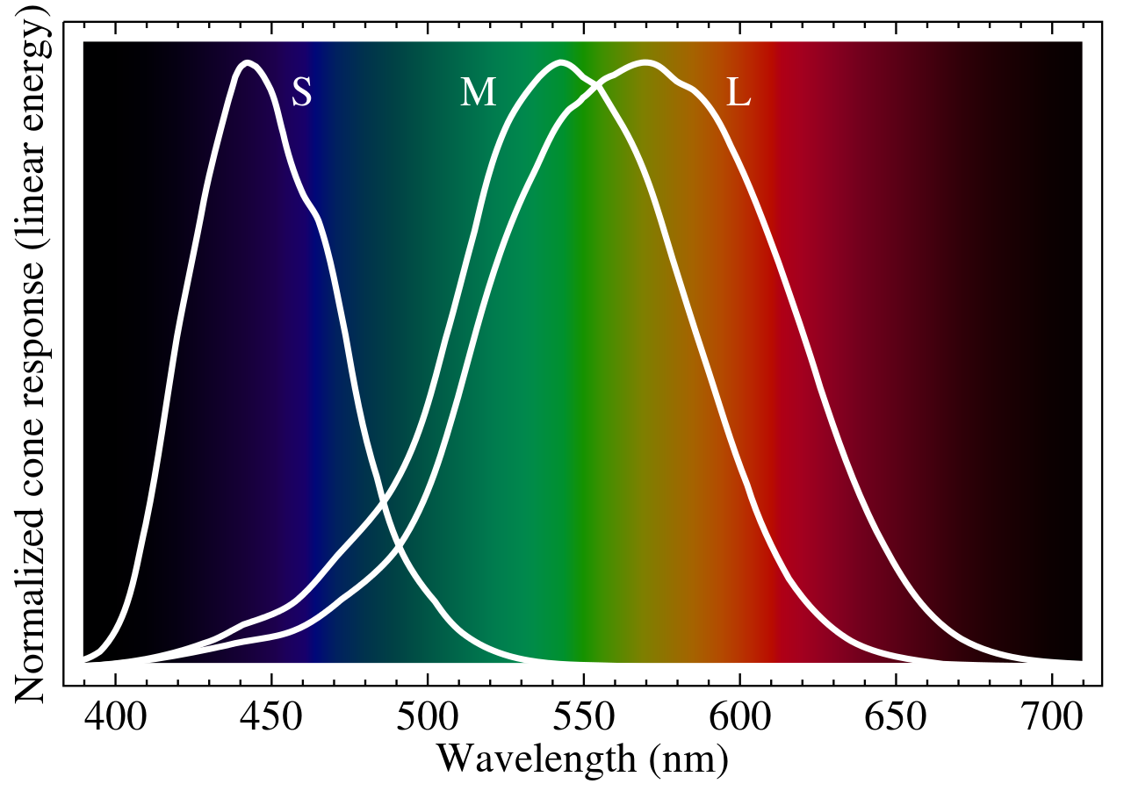
Color Vision: Rods and Cones and RGB
Rods are sensitive to amount of light we see and cones help us see color.
Different types of cones are more sensitive to different colors: Red, Green and Blue.
BenRG, Public domain, via Wikimedia Commons
Notes:
S = Short, M = Medium, L = Long wavelengths that cones are receptive to

Slide 11
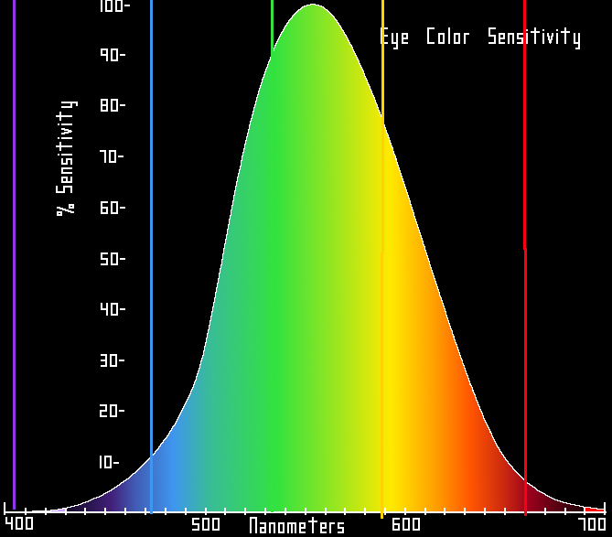
Color Vision: Rods and Cones and RGB
Our eyes are most sensitive to Green light. This will be important in digital image creation.
Transferred by Sreejithk2000, Public domain, via Wikimedia Commons
Notes:
S = Short, M = Medium, L = Long wavelengths that cones are receptive to

Slide 12
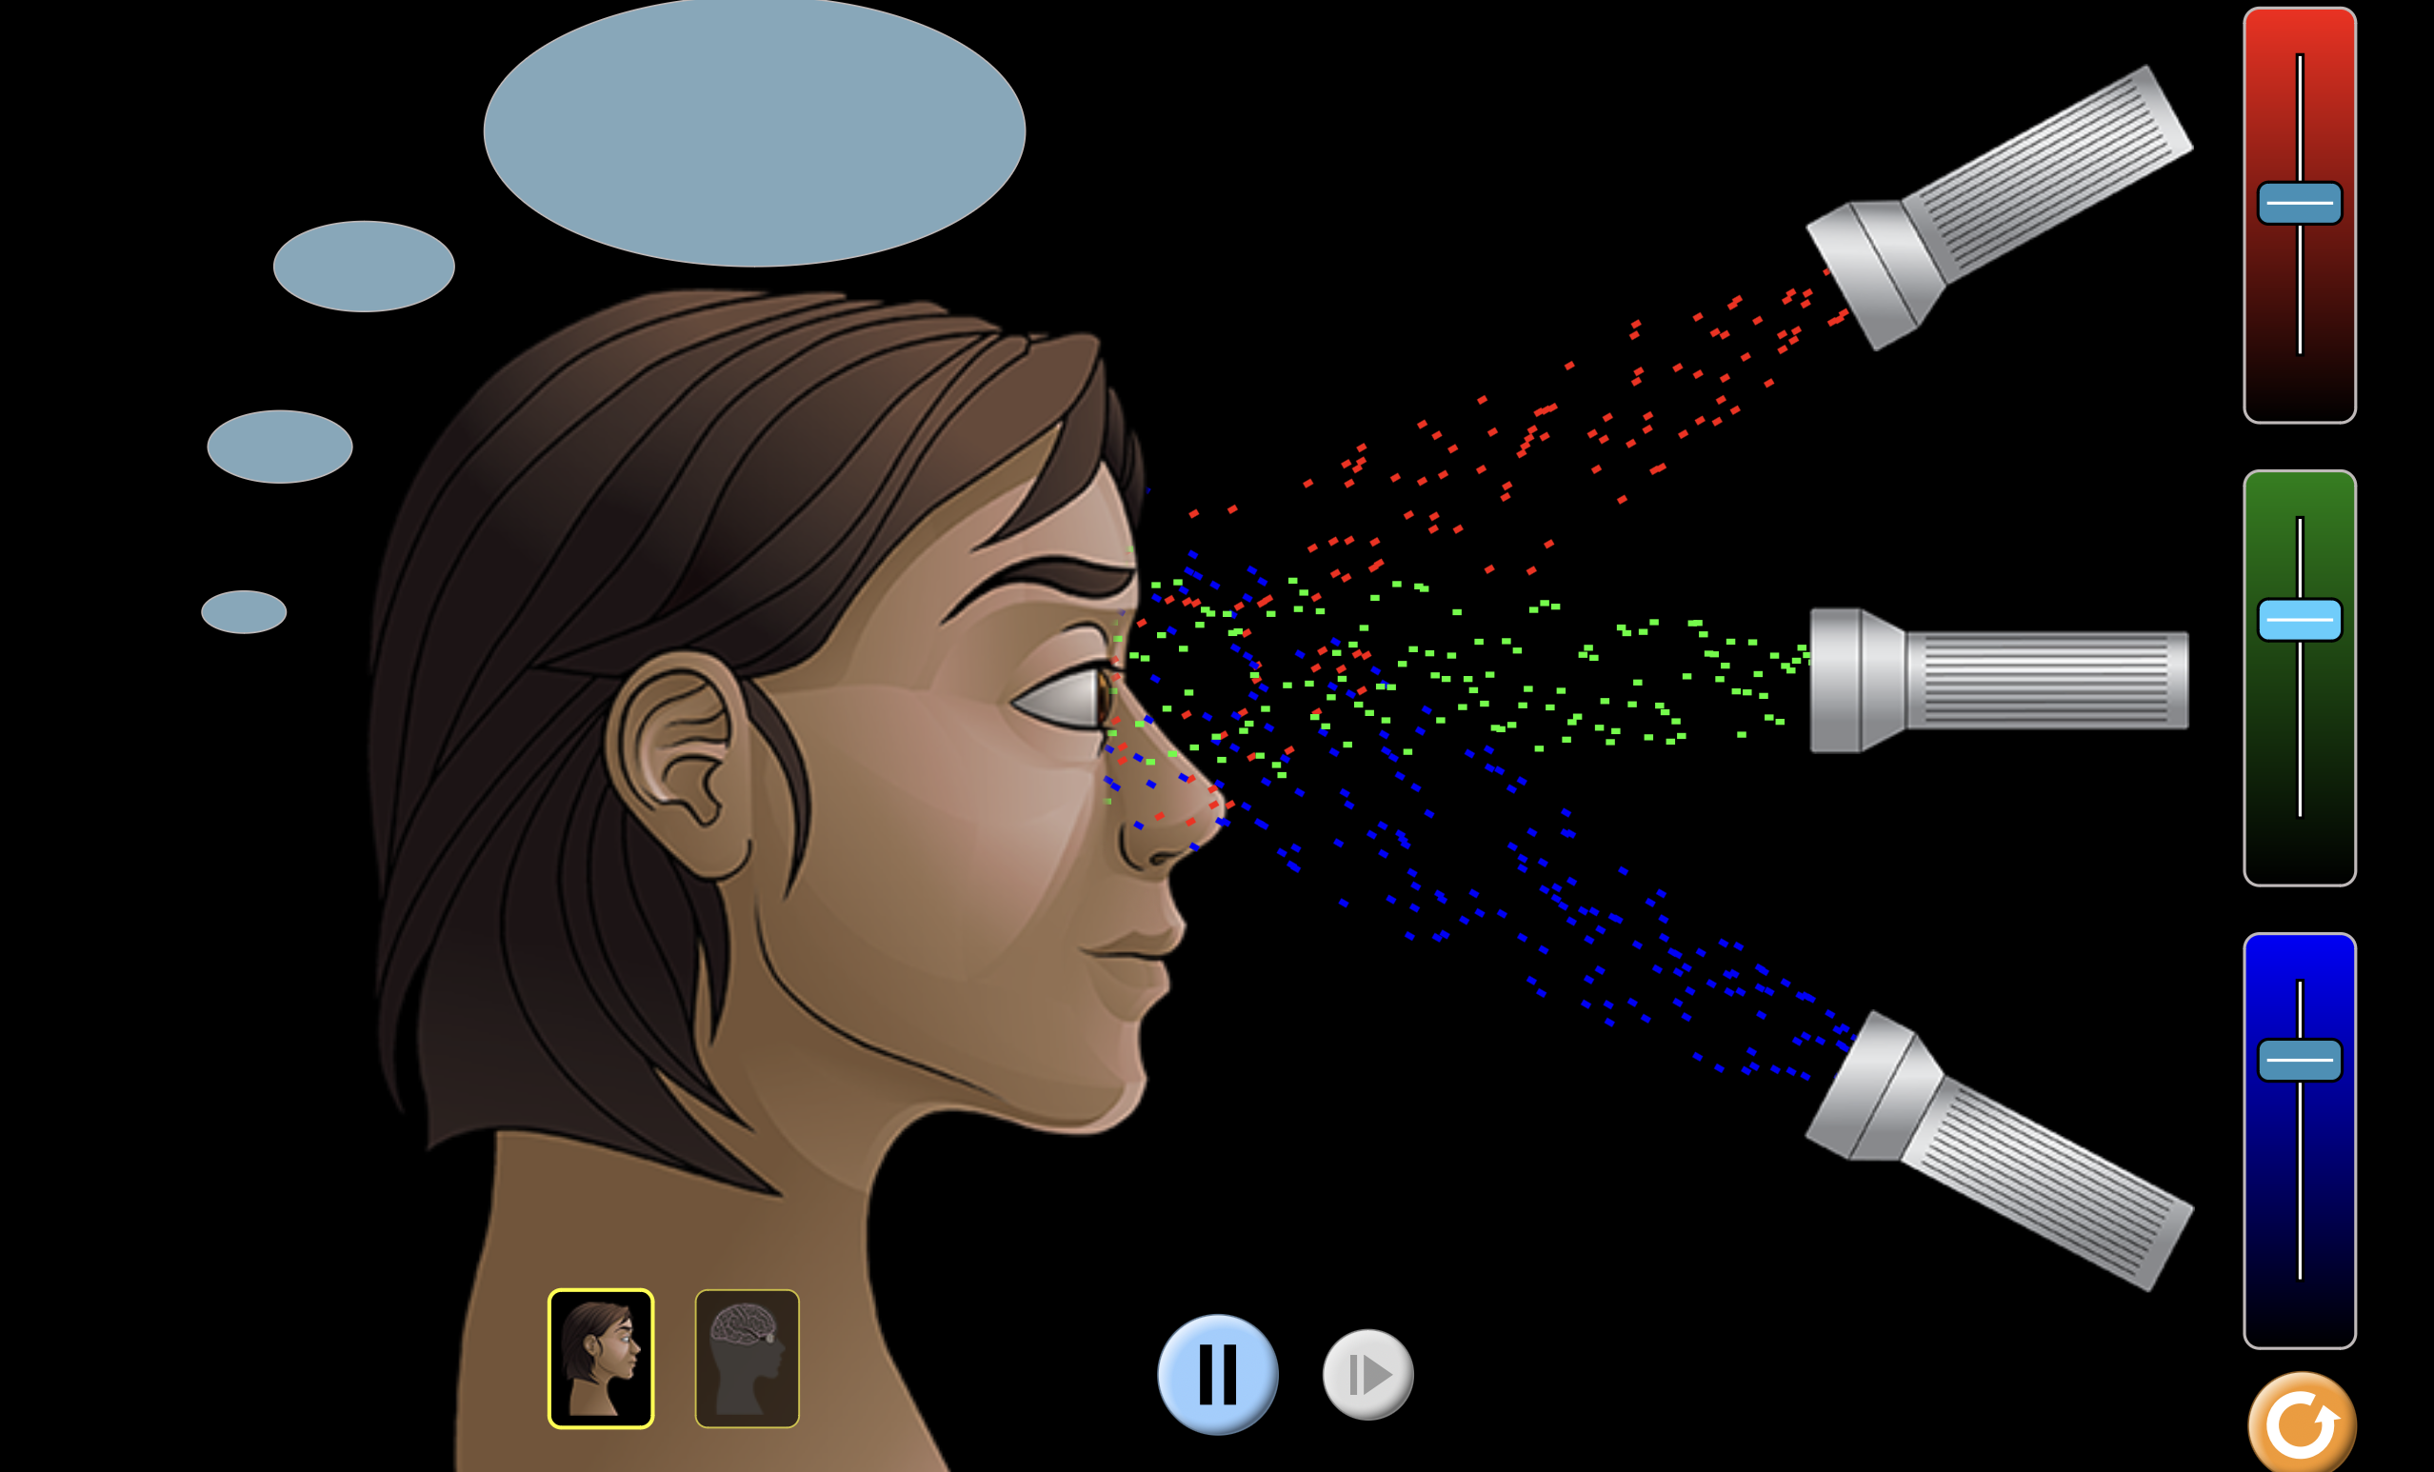
Color Vision: Simulator
This tool helps to visualize how RGB colors combine.
https://phet.colorado.edu/sims/html/color-vision/latest/color-vision_all.html
Notes:
S = Short, M = Medium, L = Long wavelengths that cones are receptive to

Slide 13
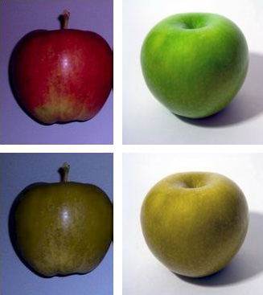
Rods and Cones and RGB
Color Blindness
https://mobilityquotient.com/article/ux-design-accessibility-designing-with-colorblindness-in-mind
https://en.wikipedia.org/wiki/Color_blindness

Slide 14
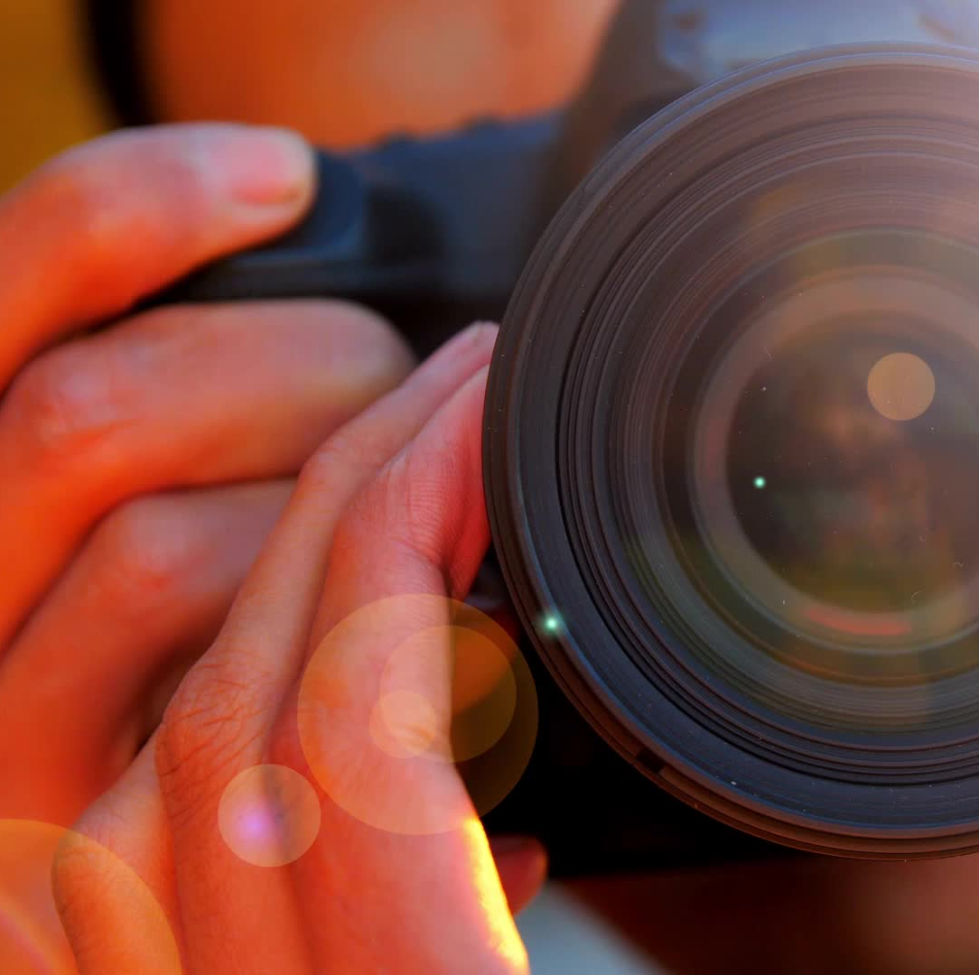
Sampling & quantization
The process of capturing an image with a digital camera consists of 2 parts:
sampling and quantization.

Slide 15

Sampling & quantization
Sampling:
There are millions of small light sensors in a camera sensor each samples the light.
Sampling Rate is the number of sensors (ie megapixels). Higher sampling rate means more accurate, detailed images
Quantization:
a value is assigned to each sample.
Bit Depth is the number of bits used for each sample. Bigger bit depth means more possible colors

Slide 16
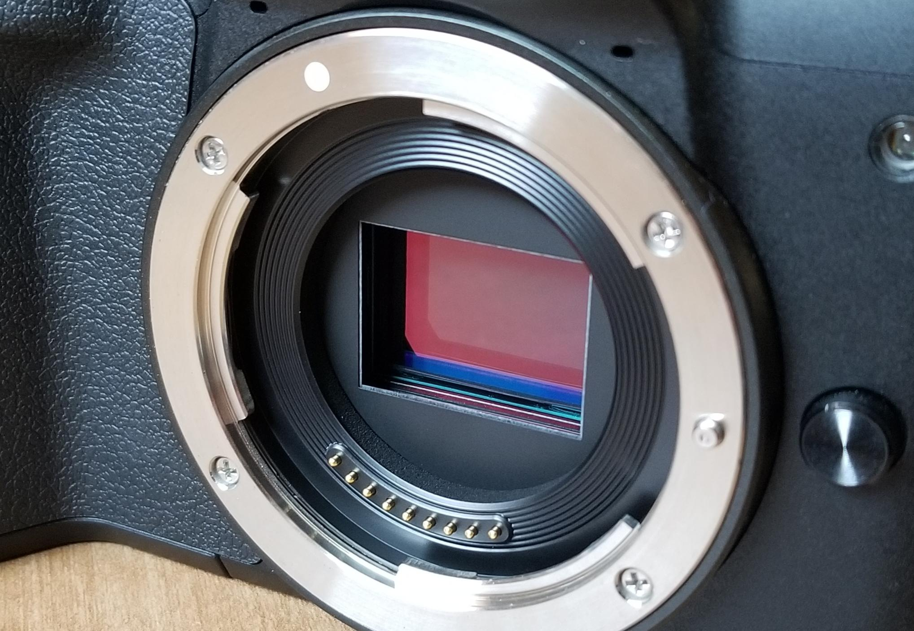
Image Sensor
An image sensor does the sampling and quantizing of an image
Nulcheck, CC BY-SA 4.0, via Wikimedia Commons
https://en.wikipedia.org/wiki/Image_sensor

Slide 17
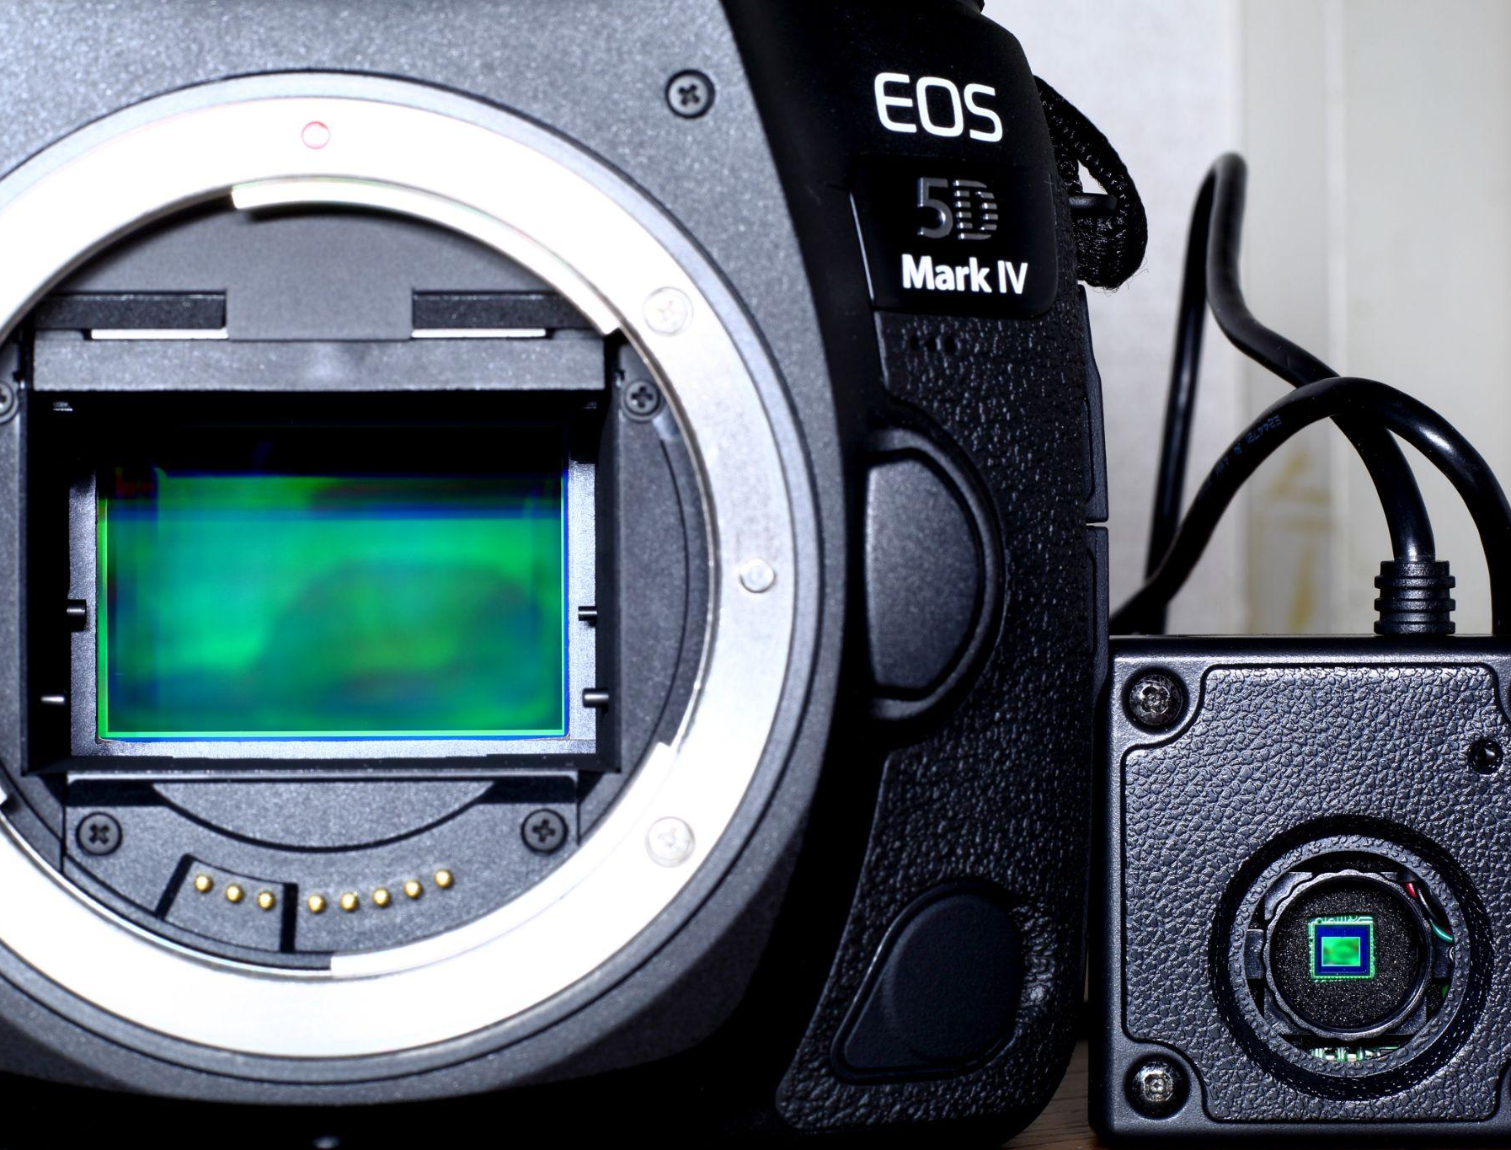
Image Sensor
Megapixels how we define Sampling Rate in image sensors.
Generally more megapixels = higher sampling rate = better image quality.
BUT physically larger sensors are also better.
根川孝太郎, CC BY-SA 4.0, via Wikimedia Commons

Slide 18
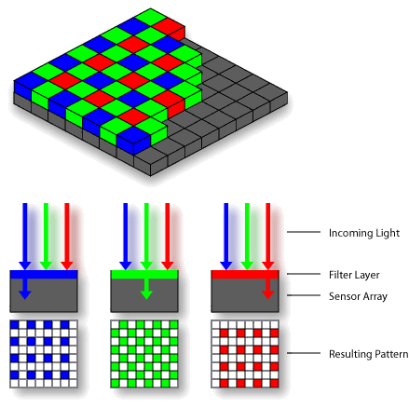
Image Sensor
A Bayer matrix filters the light so each individual light sensor (called a photosite) receives red, green or blue light.
25% are
Blue
50% are
Green
25% are
Red
The original uploader was Interiot at English Wikipedia., CC BY-SA 3.0, via Wikimedia Commons

Slide 19
Image Sensor
So each photosite is only measuring the amount of red, green or blue light depending on where it is in the matrix.
The original uploader was Interiot at English Wikipedia., CC BY-SA 3.0, via Wikimedia Commons

Slide 20
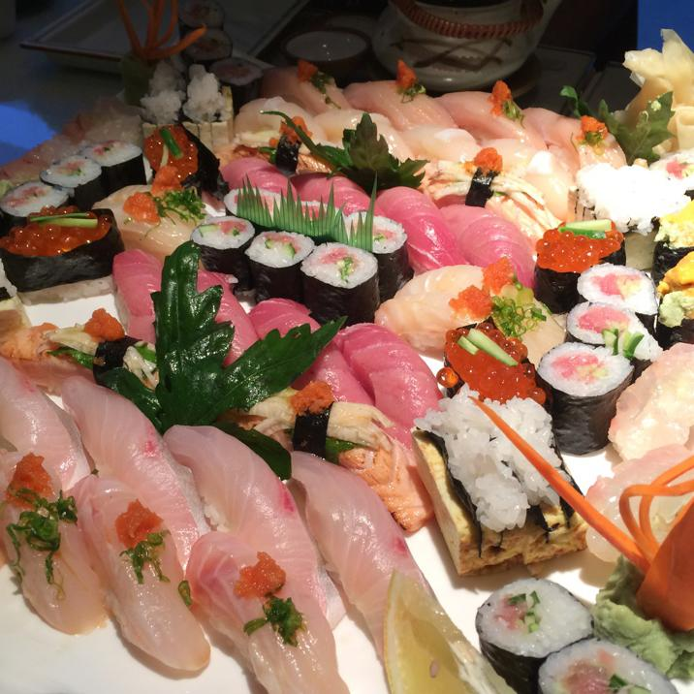

Pixels
Pixels are the basic unit for raster images and digital displays. Each pixel is a square with a given color value.
This pixel’s color value is: 40,65,23(rgb)

Slide 21
RGB
RGB is the standard color model for screens and inkjet printing. Each pixel in a RGB image has 3 channels/values: red, green and blue.
The maximum value is 255 and the lowest value is 0.
0%
Everything:
Black
100%
Everything:
White
Dark Green example color
100% Red
100% Green
100% Blue
255,0,0
0,255,0
0,0,255
0,0,0
255,255,255
40,65,23
red
green
blue

Slide 22
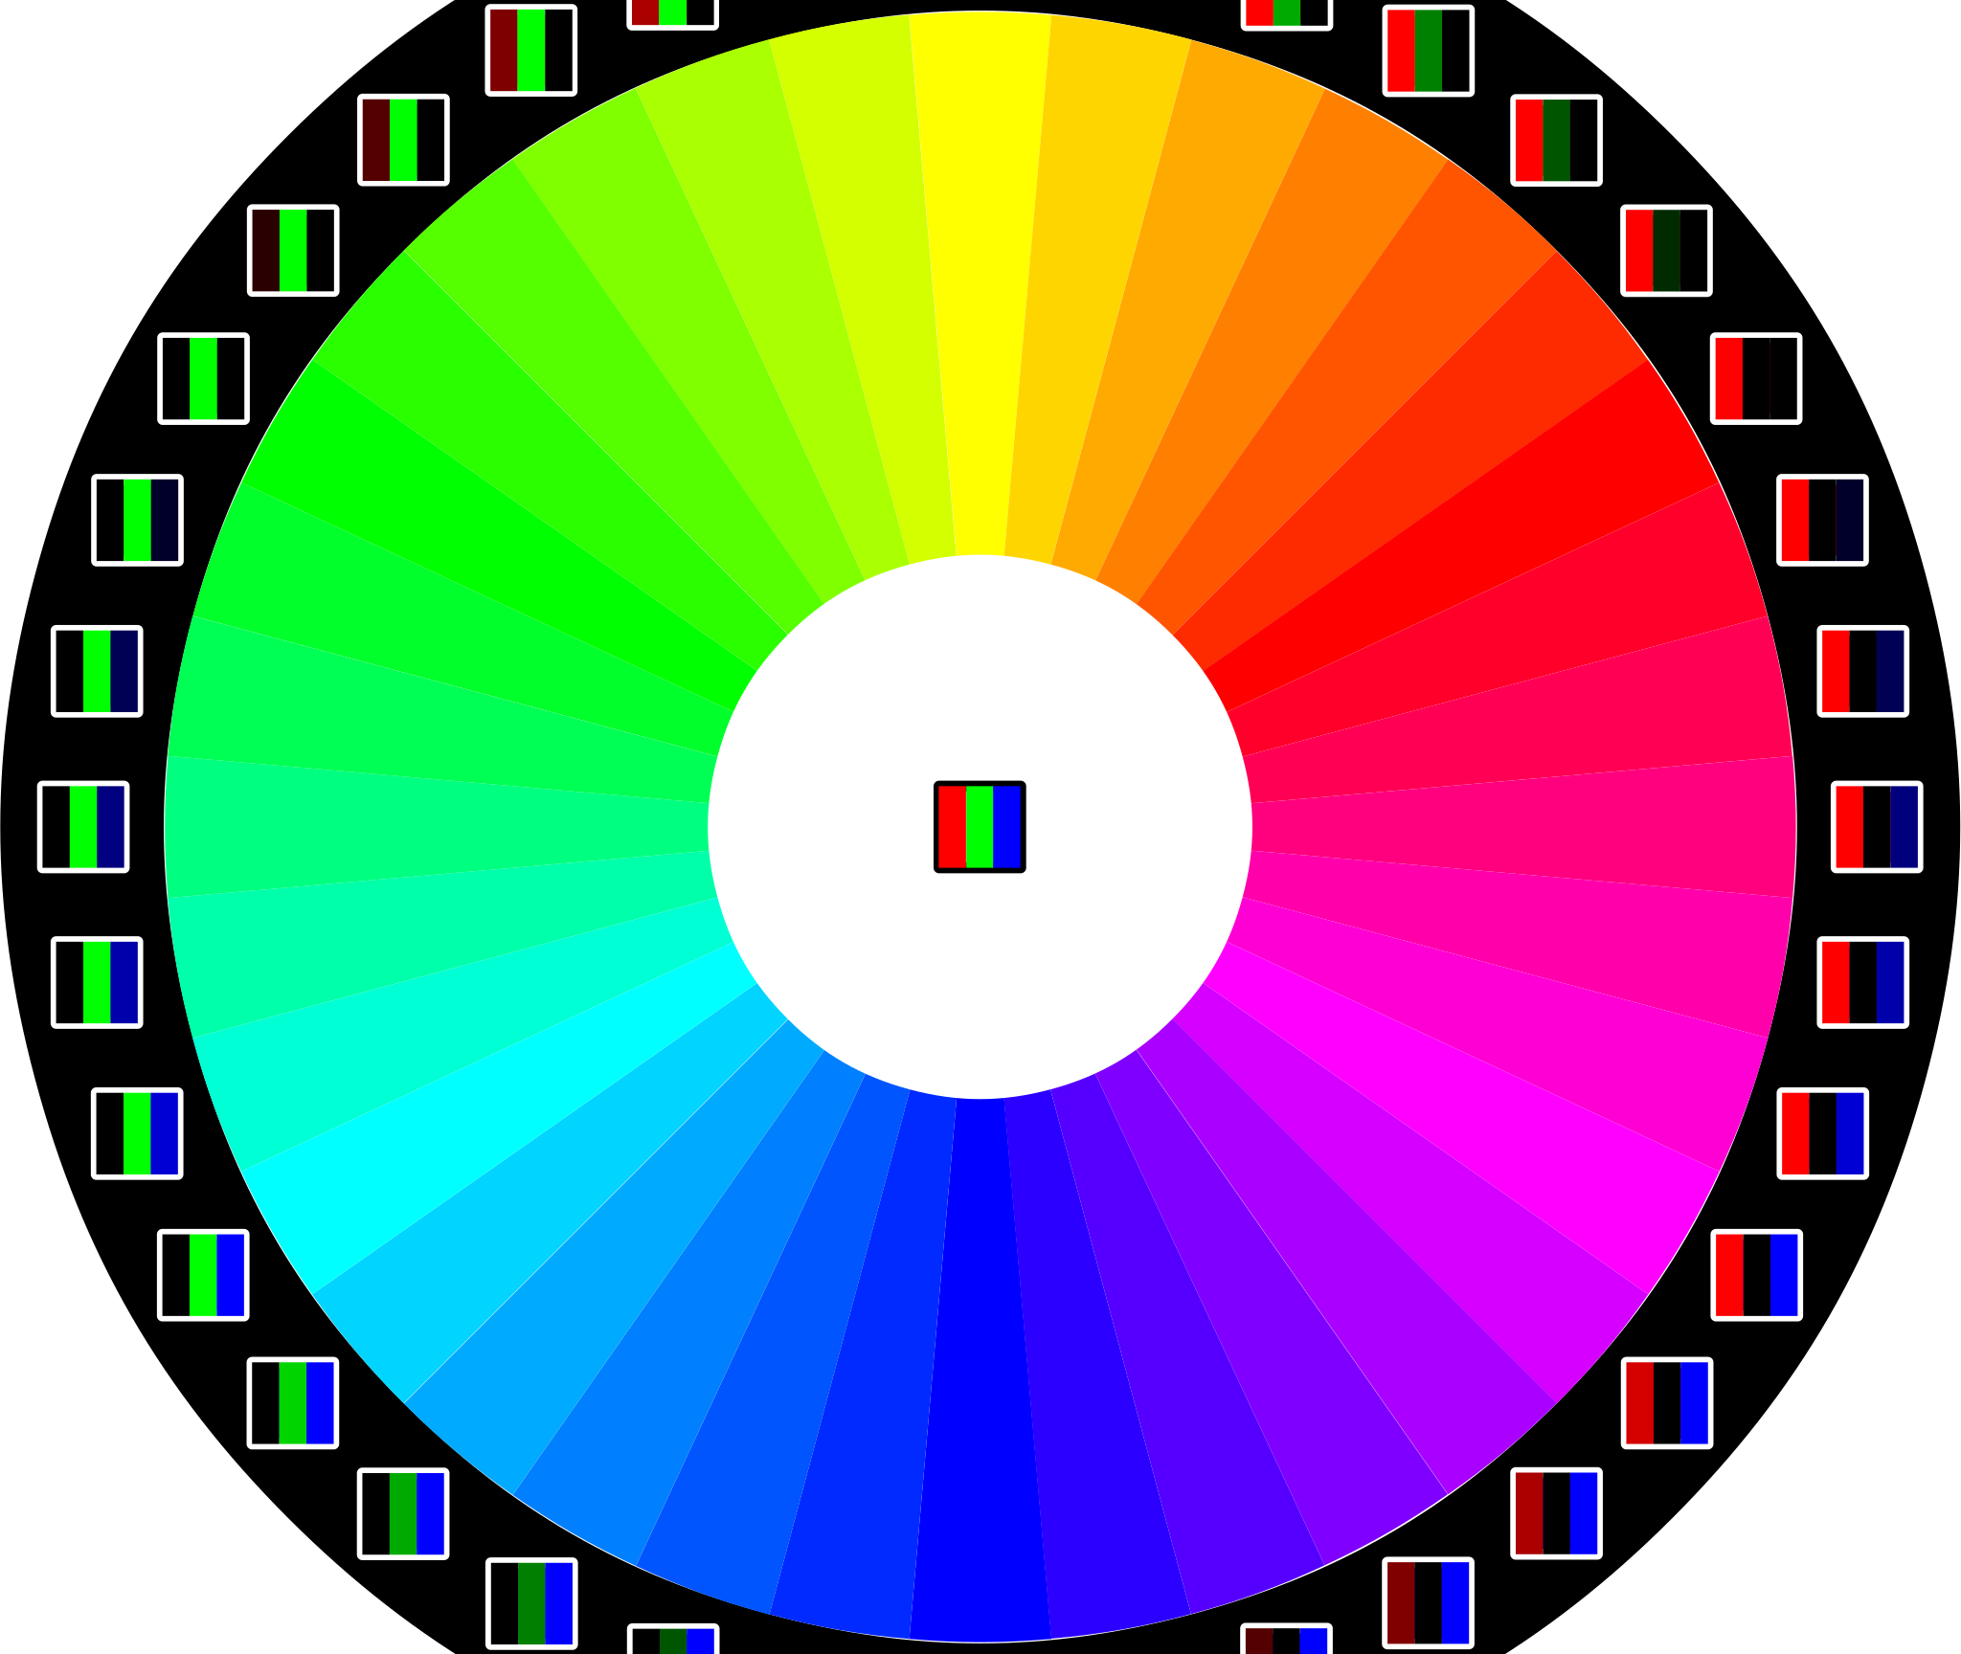
RGB
In a typical file each color has 8 bits (256 values) Each pixel has all three colors (24 bits) and 16,777,216 possible colors.
Wikipedia Color Depth
"File:RGB color wheel 10.svg" by László Németh. CC0 1.0.

Slide 23
Bit depth
The bit depth refers to the number of bits used to describe the color of a pixel. Bits are the basic unit of all digital files. A bit can only be one of two things: a 1 or a 0
1 bit = 2 possible values (black or white)
2 bits = 4 possible values (grayscale)
...
8 bits = 256 possible values (most RGB images have 8 bits per channel)
16 bits = 65,536 possible values
Each pixel has 3 channels: red, green and blue. Each channel has a value. With 16 bits per channel, there are 65,536 x 65,536 x 65,536 = over 281 trillion possible colors for each pixel.

Slide 24
Bit depth
Bits are the basic unit of all digital files.
A bit can only be one of two things: 1 or 0
The bit depth refers to the number of bits used to store the color of a pixel.
1 bit = 2 possible values (black or white)
2 bits = 4 possible values (grayscale)
...
8 bits = 256 possible values
16 bits = 65,536 possible values

Slide 25
Bit depth
In RGB images each pixel has 3 channels: red, green and blue.
Normally each channel uses 8 bits which is 256 possible values.
Since each pixel has 3 channels there are 256 x 256 x 256 = 16,777,216 possible colors.
There are cameras and systems with more than 8 bits.
In the case of a 16 bit/channel image, there are 65,536 x 65,536 x 65,536 = over 281 trillion possible colors for each pixel.
The bit depth refers to the number of bits used to store the color of a pixel.
Notes:
Note that this is more than we can see. Even so, the data can be helpful when processing the image and then there is still a higher quality output in the end, even if output as 8bit/channel jpeg image.

Slide 26
Bit depth
Some examples and explanations:
Bit Depth Tutorial
Bit Depth and Photoshop Prefs

Slide 27
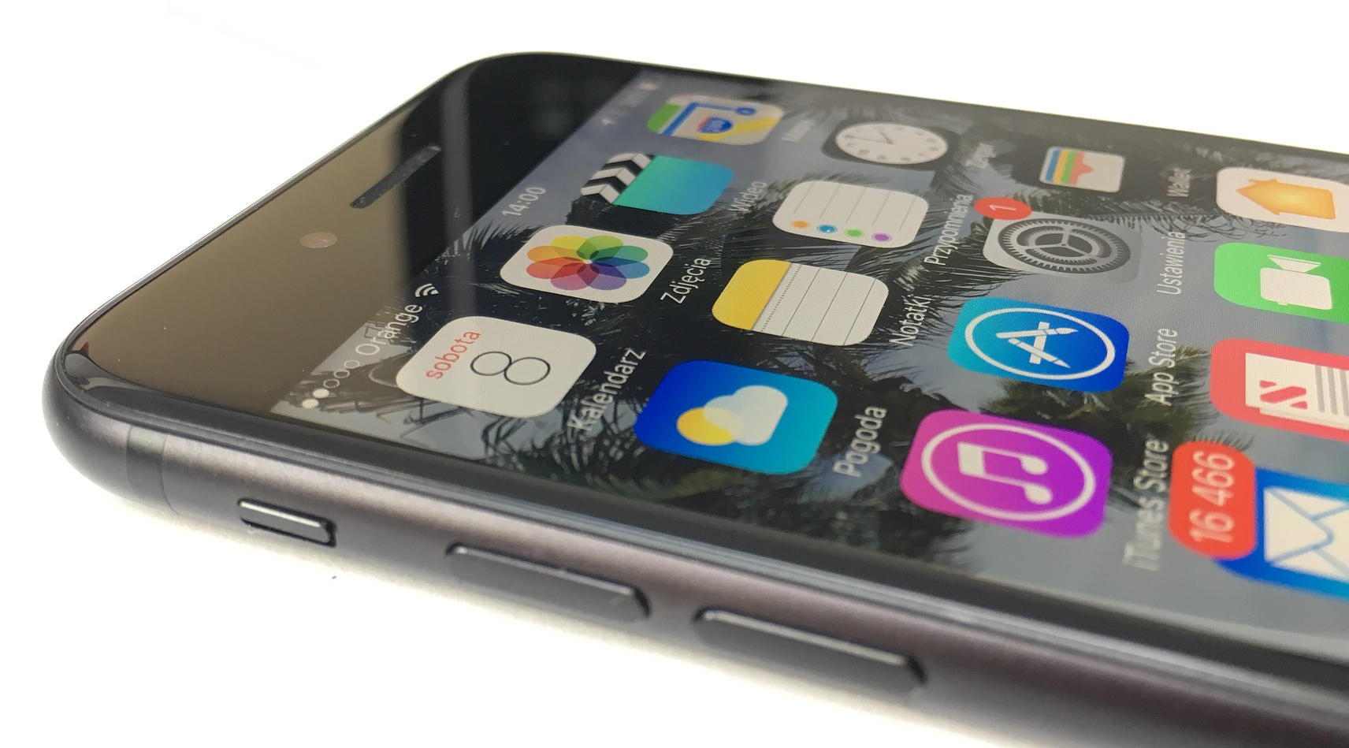
Image size
The total number of pixels in an image is known as the image size.
When sizing an image to display on a screen, you should always set dimensions of the image in terms of pixels (not inches).
App icons on an iPhone 7 screen are
120 x 120 pixels (14,440px total)

Slide 28
Image resolution
Resolution is the number of pixels packed into a linear inch or millimeter.
For screens, the DPI/PPI (dots/pixel per inch) will vary based on the targeted device (i.e: 326 for an iPhone 7, 220 for a MacBook Pro 15”).
For print, anything lower than 300PPI will look pixelated on paper.

Slide 29
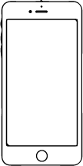

Display resolution
The resolution of the display/screen is the number of pixels represented on it. On most computers you can increase and decrease that number.
In general, newer computers/smartphones/tablets have a vastly higher screen resolution than older ones.
The original iPhone’s resolution was 320x480
The iPhone7’s resolution was 1080x1920
The iPhone 16 Pro’s resolution is 1206x2622
1080x1920
320x480
iPhone (2007)
iPhone7 (2016)

Slide 30


Vector vs. Raster
There are two categories of digital images:
VECTOR RASTER

Slide 31
Raster images...
Are defined by a grid of pixels
Cannot be enlarged without losing quality
Adobe Photoshop is the industry standard for raster imaging
Are saved in the following formats:
  .jpg (lossy, no transparency, web-ready)
  .png (lossless, range of transparency, web-ready)
  .gif (lossless, limited palette, 2-level of transparency, web-ready, allows short animation)
  .tiff (uncompressed)
  .psd (Photoshop’s proprietary format)

Slide 32
Vector images...
Are defined by a set of coordinates and color information
Can be enlarged or reduced without losing quality (resolution independent)
Adobe Illustrator is the industry standard for vector imaging
Are saved in the following formats:
  .ai (Illustrator’s proprietary file format)
  .svg (web-ready)

Slide 33
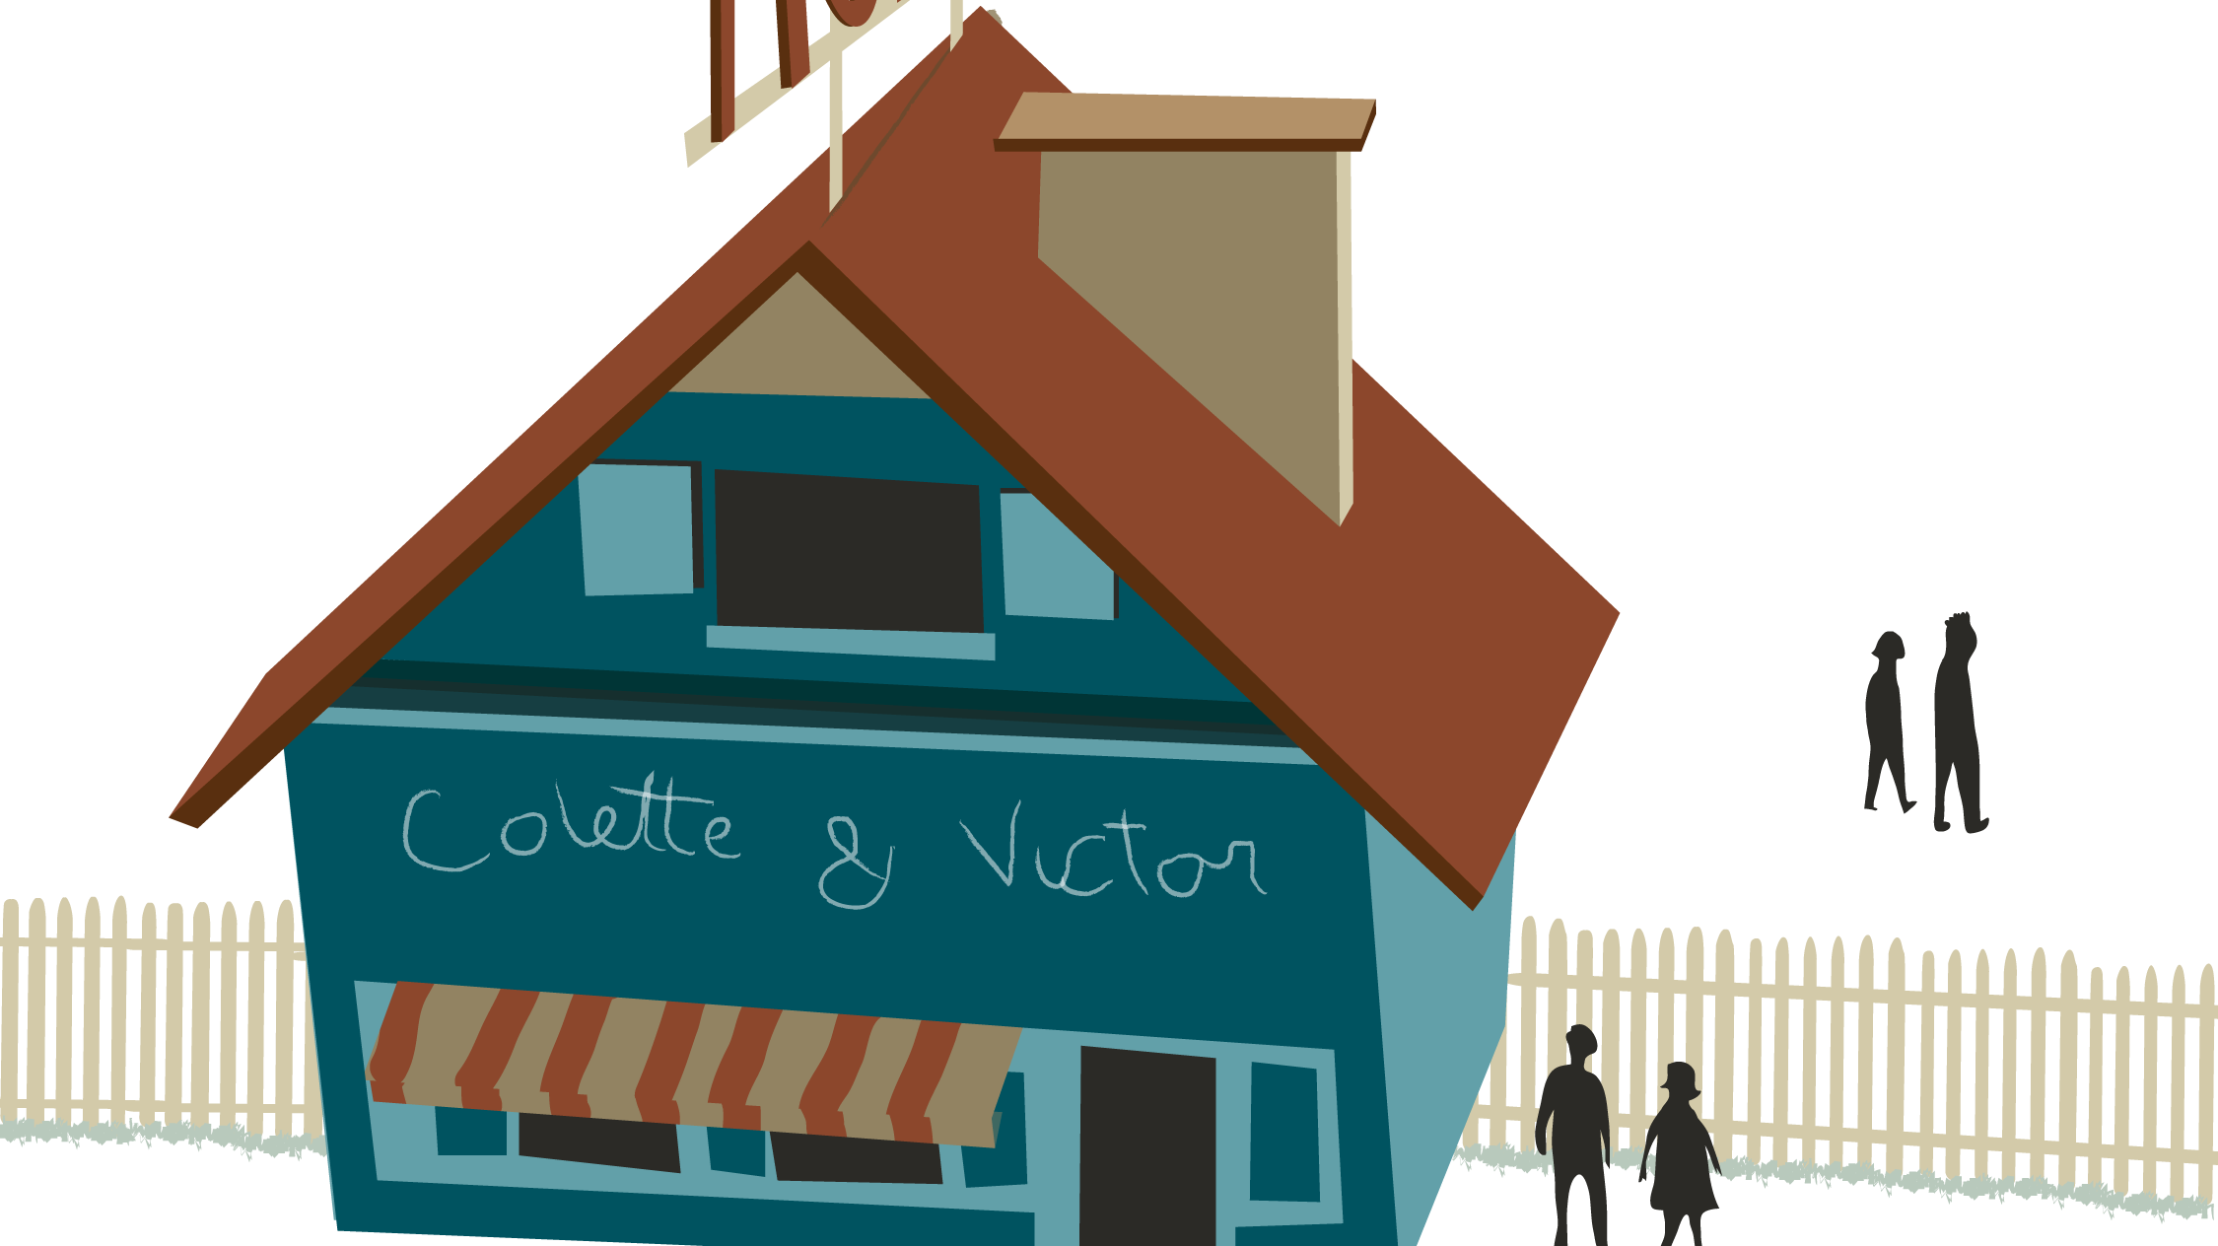
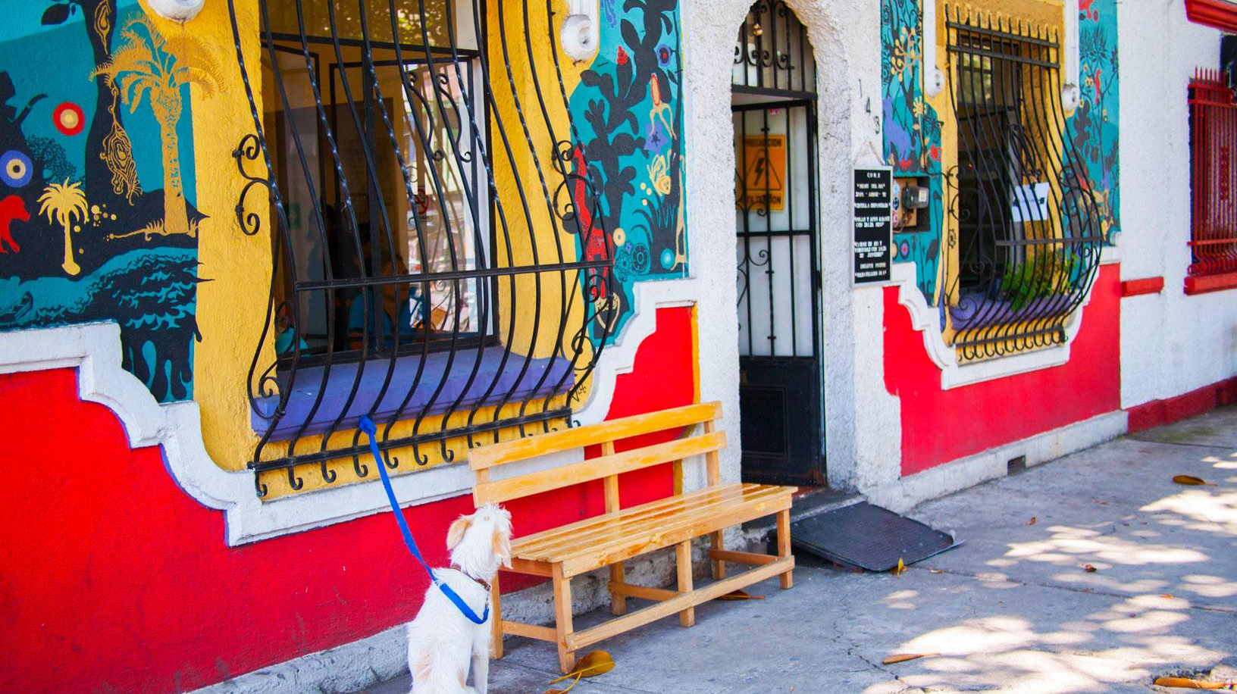
Examples
A drawing created in Illustrator.
A photo taken with a DSLR camera and adjusted in Photoshop.

Slide 34
In practice: images for screens
Whenever you are creating/saving an image for digital displays/the web you must:
Base the image size on how big the display is and how much space you want your image to occupy on it.
Base the image resolution on the targeted device (start at least 300ppi and downsample later if necessary)
Select an appropriate format (.jpg, .png, .gif or .svg) (see slides 10 & 11 for more information)

Slide 35
In practice: images for print
Whenever you are creating/saving an image for print you must:
Base the image size on how big you want to print it (in inches)
Set the image resolution to 300ppi
Save as .jpg or .pdf

Slide 36
In practice: for all images
ALWAYS start with the highest resolution possible.
You can reduce the resolution when exporting for final use.

Slide 37
FILE NAMING
You should always pay attention to the way you name your digital files. Here are best practice rules to follow:
Use a name that refers to the content of the file.
Abbreviate words whenever possible. (nyc.jpg)
Never use spaces.
Use capitalization to separate two words within an element (selfPortrait.jpg)
Use an underscore to separate two elements (selfPortrait_raster.jpg)
Avoid calling any file “final”. Use V+2 digits for version control (selfPortrait_raster_V02.jpg)

Slide 38


Copyright
Although using the web to source images for your projects is very tempting, you must pay attention to whether or not you have the right to use a specific image.
Unless an image is explicitly in the public domain or under a Creative Commons (CC) license, assume it is under copyright and that you do not have the rights to use it.
In the case of CC content, make sure you credit the original author.

Slide 39
Citing sources
Here's an example of how to cite a CC licensed or public domain web source:
“Title of Work or Page” by Author's last name, first name (or username). CC License (or CC0 for Public Domain). Title of Website. Date uploaded/updated. URL
Here's an example of an image citation. You don’t have to use these colors, they are to help you see the different pieces of information:
"Cat" by Tony. CC BY 2.0. Flickr. 9/13/2014 https://www.flickr.com/photos/7788419@N05/15218475961

Slide 40
All images by anna pinkas or in the public domain unless otherwise noted

