Slide 1
AUDIO
Sound Wavs and Microphones
MMP 100

Slide 2
Sound Waves

Slide 3
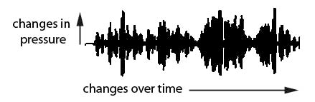
Waveform
Sound is often represented graphically by a waveform that shows changes over time on the horizontal axis and changes in pressure on the vertical axis.

Slide 4
Properties of a sound wave
Wavelength
Amplitude
Frequency

Slide 5
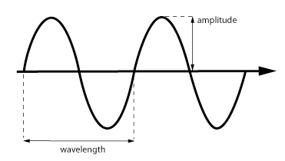


Wavelength
Wavelength is the distance between any point on a wave and the corresponding point on the next wave.

Slide 6

Amplitude
Amplitude refers to the distance between the highest and lowest point on a waveform. Amplitude determines volume or loudness- the higher the peak of a waveform the louder its volume. Amplitude is measured in decibels (dB).

Slide 7

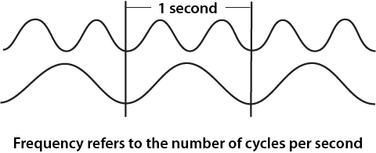
Frequency
Frequency refers to the number of complete cycles of a wave per unit of time. For example, frequency would be used to measure how many times a sound wave completes a cycle in one second. Frequency is measured in hertz (Hz). The range of human hearing is approximately 20 Hz to 20,000 Hz.

Slide 8

Frequency and Pitch
Pitch is related to frequency, the higher the frequency, the higher is the pitch of the sound. If the frequency is lower, so is the pitch of the sound. A sound with a frequency of 20,000 would have an extremely high pitch.
Photo by yeowatzup
The Philippine tarsier cries out in the 70,000 Hz range - far beyond the human hearing range.

Slide 9
Human Voice Frequency Ranges
Speaking Voice:
Men: average speaking pitch for men is 85 Hz to 180 Hz.
Women: average speaking pitch for women is 165 Hz to 255 Hz.
Singing Voice:
• Men:
  • Bass: 82 Hz to 294 Hz
  • Baritone: 98 Hz to 392 Hz
  • Tenor: 130 Hz to 523 Hz
• Women:
  • Alto: 175 Hz to 698 Hz
  • Mezzo-Soprano: 220 Hz to 880 Hz
  • Soprano: 261 Hz to 1046 Hz

Slide 10
Microphones and Recording
Sound

Slide 11

How does a Microphone work
https://www.youtube.com/watch?v=d_crXXbuEKE

Slide 12
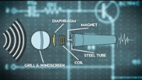
Two common Microphone Types
The two main types are
Dynamic
And
Condenser
https://www.youtube.com/watch?v=PE6Qn4ZiEyo

Slide 13
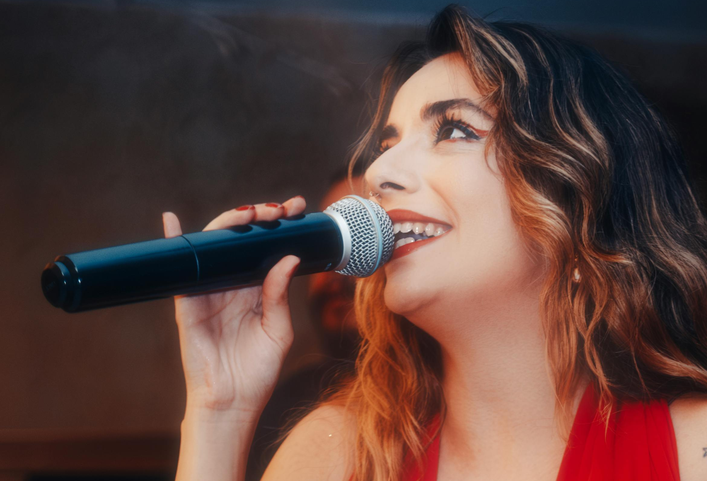
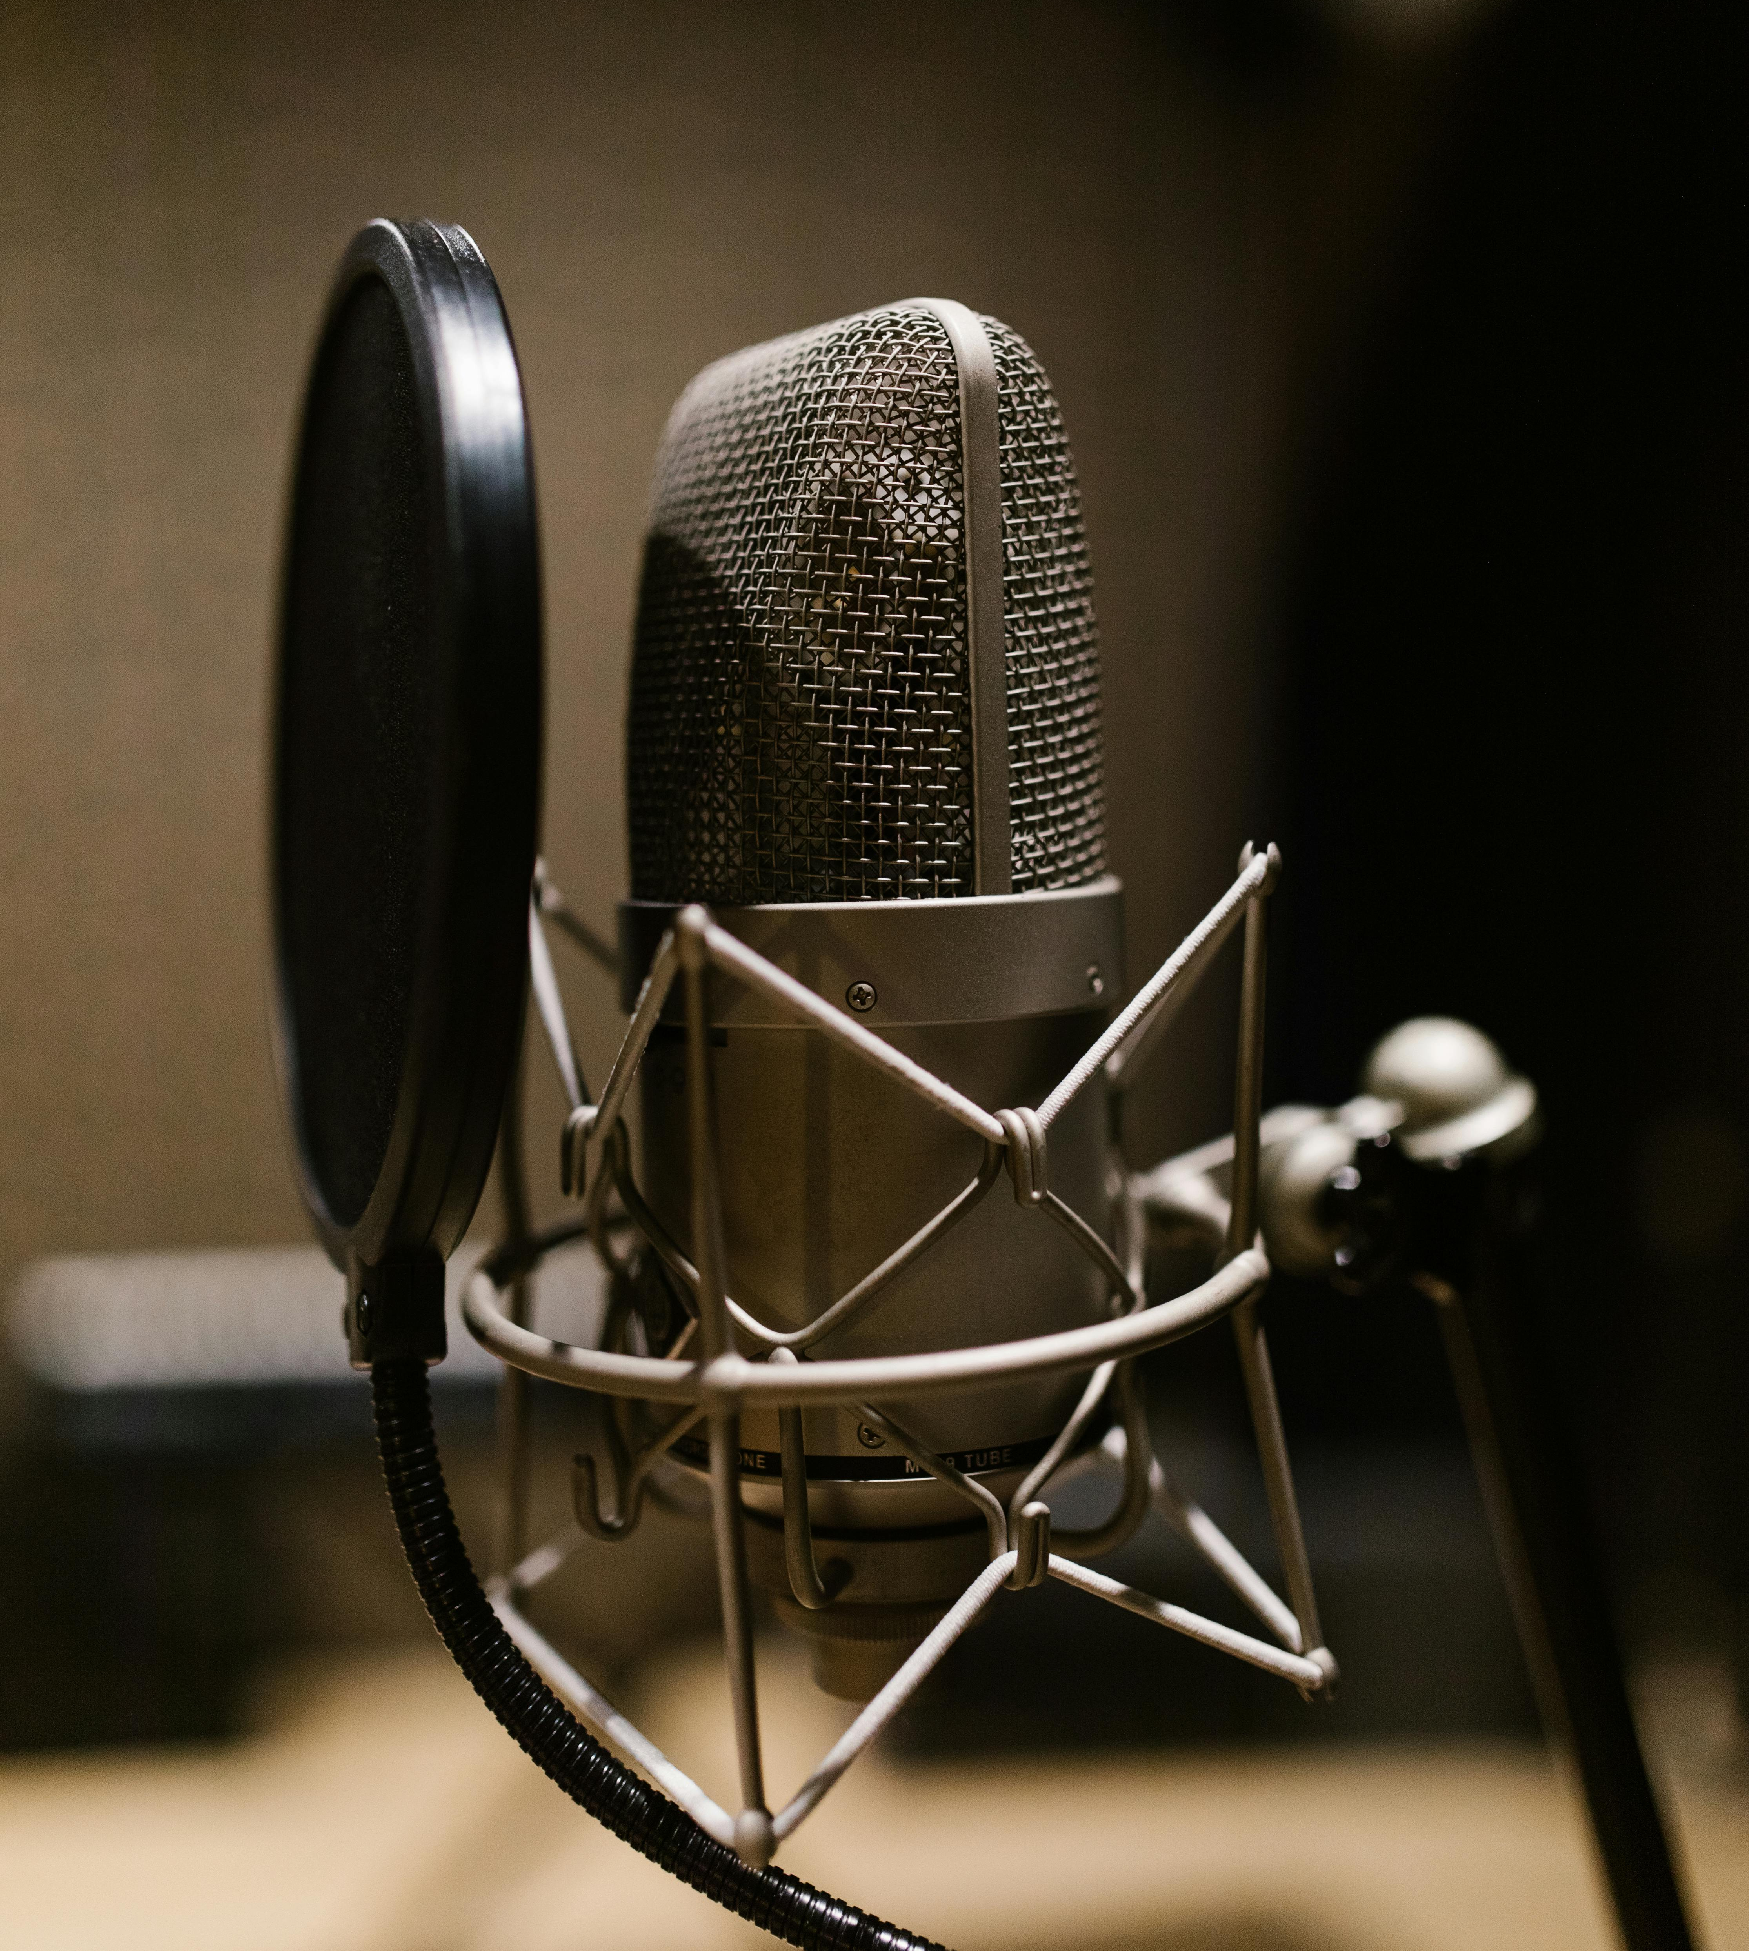
Dynamic vs
Condenser Mics
Dynamic
Condenser
Durability: Dynamic microphones are known for their robust construction,
Lower Sensitivity: They are less sensitive to high frequencies and quiet sounds
No External Power Required
USES
  Live Performances
  Podcasting and Broadcasting:
Sensitive: operate based on the principle of capacitance.
Higher Sensitivity: Condenser capture more detail and higher frequencies.
Wider Frequency Response: ideal for capturing the nuances of voice and acoustic instruments.
•Phantom Power Required: they require phantom power for the capacitor and to amplify the signal.
USES
  Studio Recording
  Voiceover work

Slide 14
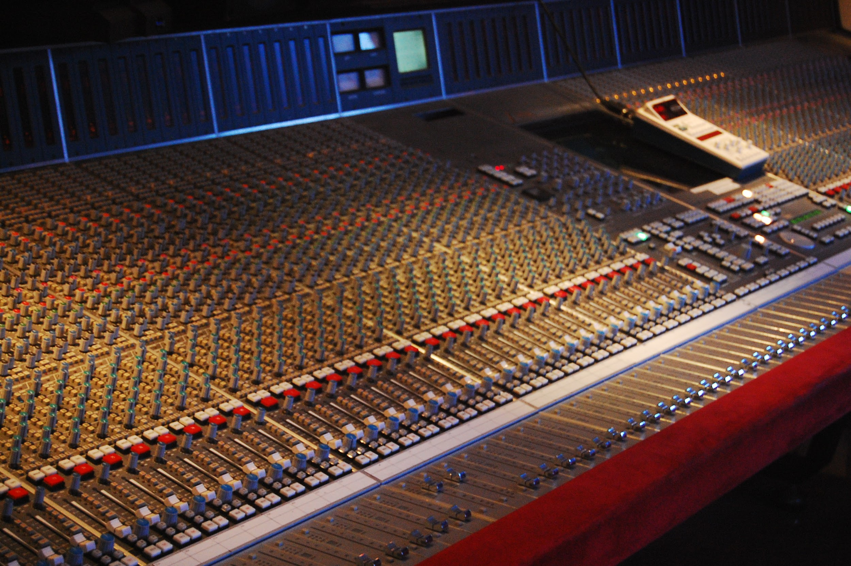
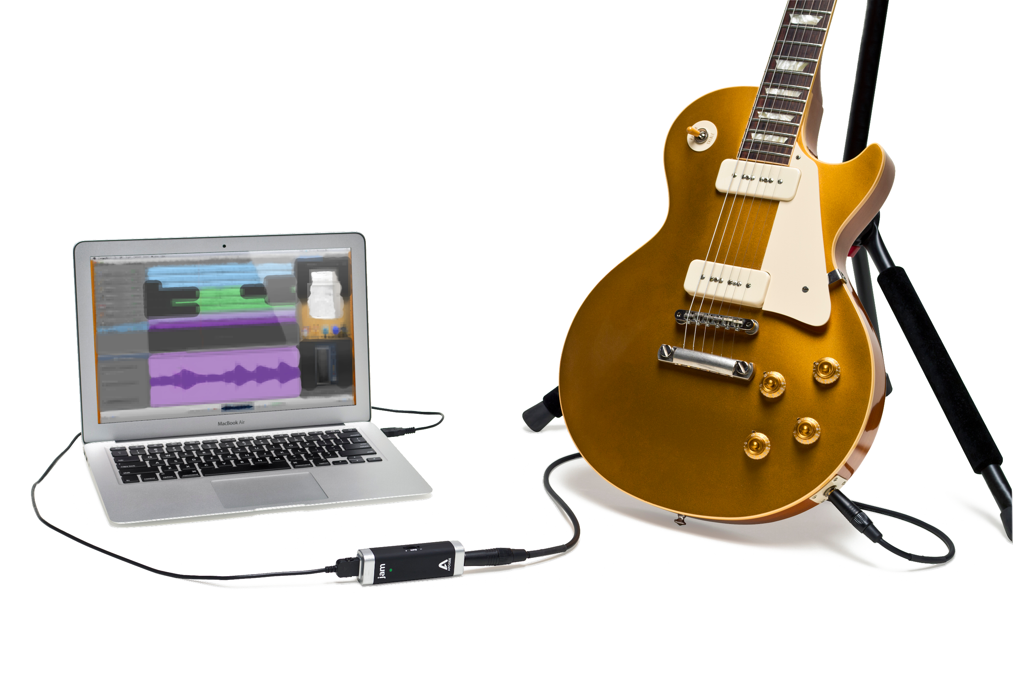
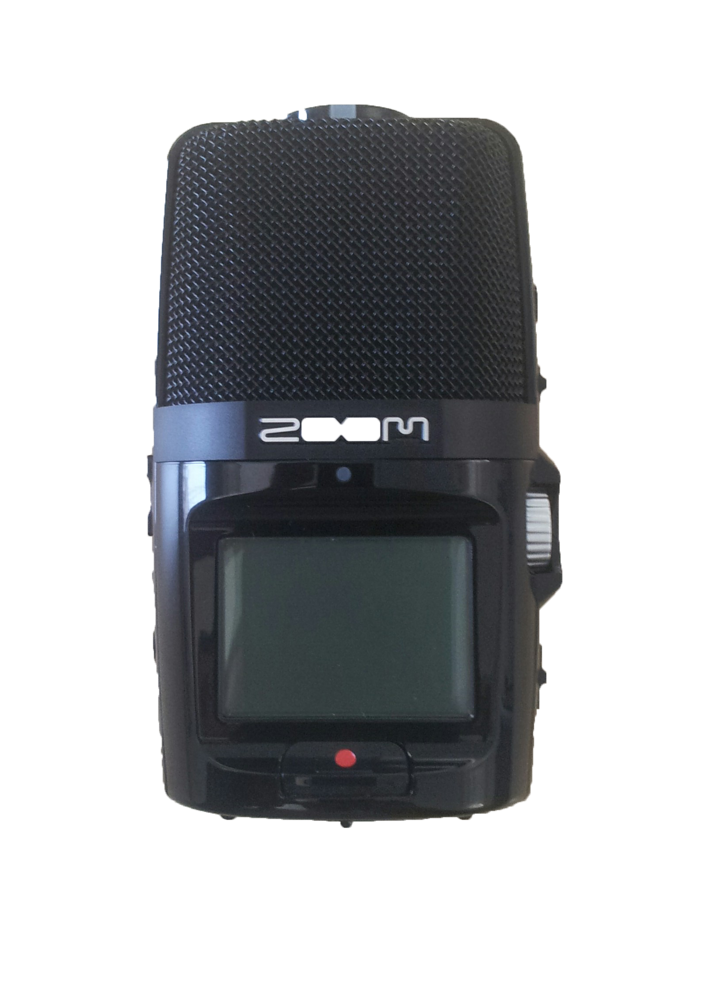

Recording audio: capturing sound
Handheld digital recorders (Tascam DR 40, Sony ICD-UX 533, Zoom H2n)
Smartphones, with or without microphone (iPhone, Android)
Computers with built-in or USB microphones and recording software (Mac, Windows)
Digital Audio Workstation (DAW)
Mixers
There are many, many other options
Photo by Rebecca Wilson
Photo by David Podosek
Photo by Nicolas Rück
Image by Zach Vega

Slide 15
Credits
All images created by Jody Culkin, Anna Pinkas or in the public domain unless otherwise noted

