Slide 1
AUDIO
MMP 100

Slide 2

Overview of Sound
Sound is a wave that is generated by an object vibrating in a medium such as air producing changes in pressure.
Water reacting to the vibrations emitted by a sound of 11 Hz
Water under 11 Hz vibration.jpg by Jordi Torrents is licensed under CC 4.0
Notes:
Will add image

Slide 3

Sound Waves
https://www.youtube.com/watch?v=px3oVGXr4mo

Slide 4

Sound Waves
https://www.youtube.com/watch?v=aPswnDcteS4

Slide 5
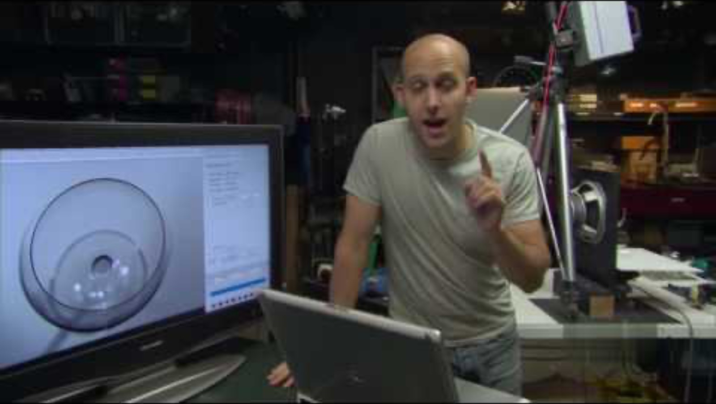
Sound Waves
https://youtu.be/BE827gwnnk4?si=3XlAosRgzO06TrEh

Slide 6
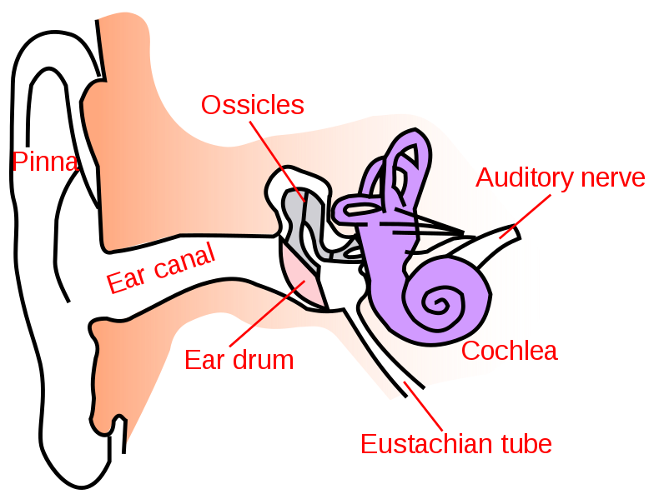
How Do We Hear Sound?
Outer
ear
Middle
ear
Our ears are designed to move with the pressure waves that make sound. The pressure waves are converted to signals that are sent to the brain to be interpreted.
Inner Ear
Sound waves
Iain at English Wikipedia, SVG conversion by User:Surachit, CC BY-SA 3.0 via Wikimedia Commons
Notes:
1. The Outer Ear
The outer ear is the part we can see, known as the pinna or auricle, along with the ear canal. The main function of the outer ear is to collect sound waves from the environment and funnel them into the ear canal toward the eardrum (tympanic membrane). The shape of the pinna helps to capture sound waves more efficiently, particularly those coming from in front of us, and slightly alters them to help the brain determine the direction of the sound.
2. The Middle Ear
Once the sound waves reach the eardrum, they cause it to vibrate. The eardrum is a thin membrane that separates the outer ear from the middle ear. These vibrations are then transferred to three tiny bones in the middle ear, known collectively as the ossicles.
These bones amplify the vibrations and transmit them to the oval window, which is the entrance to the inner ear. The middle ear also contains the Eustachian tube, which helps maintain equal air pressure on both sides of the eardrum, allowing it to vibrate properly.
3. The Inner Ear
The inner ear is where the mechanical vibrations are converted into electrical signals that the brain can interpret. This process occurs in the cochlea, a spiral-shaped, fluid-filled structure. Inside the cochlea is the basilar membrane, which is lined with tiny hair cells (cilia). As the vibrations cause the fluid inside the cochlea to move, it creates waves along the basilar membrane.
These waves cause the hair cells to bend, which opens ion channels, leading to the generation of electrical impulses. The specific location on the basilar membrane where the hair cells are activated depends on the frequency of the sound: high-frequency sounds activate hair cells at the base of the cochlea, while low-frequency sounds activate hair cells closer to the apex.
4. Transmission to the Brain
The electrical signals generated by the hair cells are transmitted via the auditory nerve to the brainstem and then to the auditory cortex in the brain. The auditory cortex processes these signals, allowing us to perceive sound, including its pitch, volume, and location.
In summary, human hearing is a complex process where sound waves are captured by the outer ear, transmitted and amplified by the middle ear, and finally converted into electrical signals by the inner ear, which the brain interprets as sound. Understanding this process lays the foundation for understanding how we can digitally capture and manipulate sound.

Slide 7
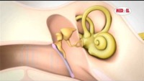
How Hearing Works
https://youtu.be/7O-adw-HyrQ?si=RAKaLgZpzQQ8hqUc

Slide 8
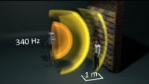
Frequency – Hertz also written as Hz
https://www.youtube.com/watch?v=kgAQy4a8Q2w

Slide 9
Human Range of Hearing
20 Hz
(lowest sound frequency we can hear)
to
20,000 Hz
(highest sound frequency we can hear)

Slide 10

20kHz Podcast
As a side note, this high end of human hearing range is where the podcast Twenty Thousand Hertz gets its name.
It's a great podcast and I have links to some episodes in the module on our site.
https://www.20k.org/

Slide 11




Dog: 40 Hz to 60,000 Hz
Bat: 1,000 Hz to 120,000 Hz
Cat: 48 Hz to 85,000 Hz
Elephant: 16 Hz to 12,000 Hz

Slide 12
Credits
All images created by Jody Culkin, Anna Pinkas or in the public domain unless otherwise noted

