Slide 1
AUDIO
Digitizing Sound
MMP 100

Slide 2
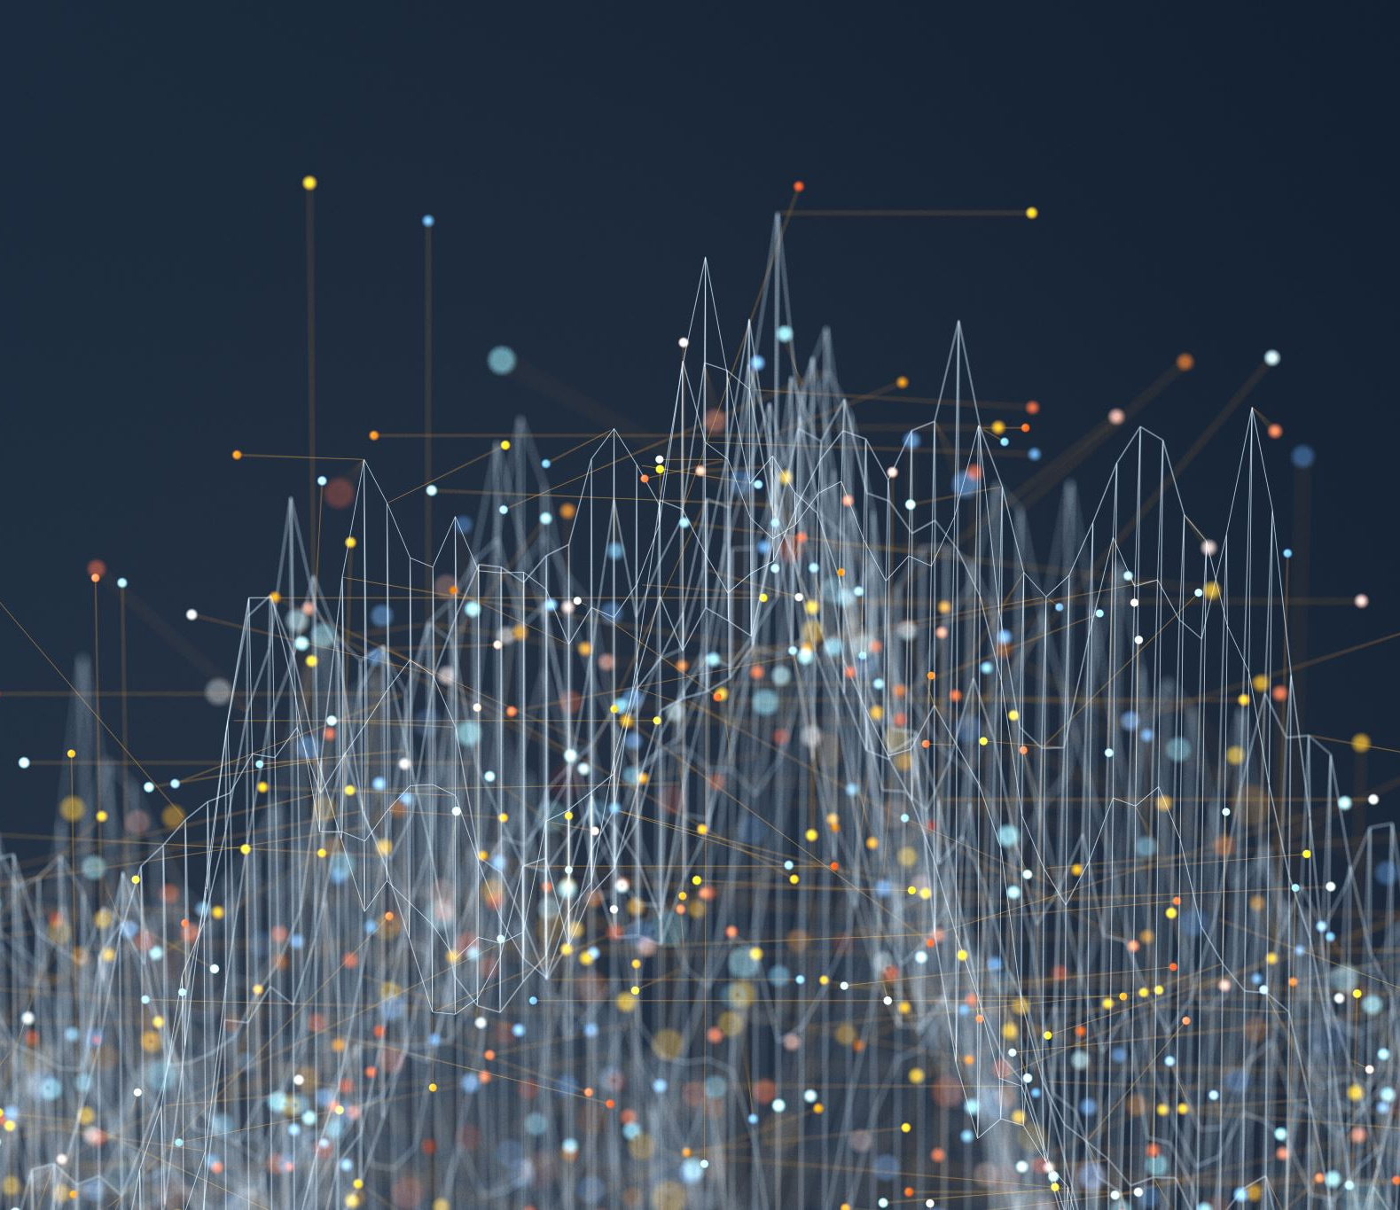
Digitizing Sound
Sound is analog.
Digitizing it entails two steps:
Sampling
  Measured by Sampling Rate
Quantizing
  Measured by Bit Depth

Slide 3
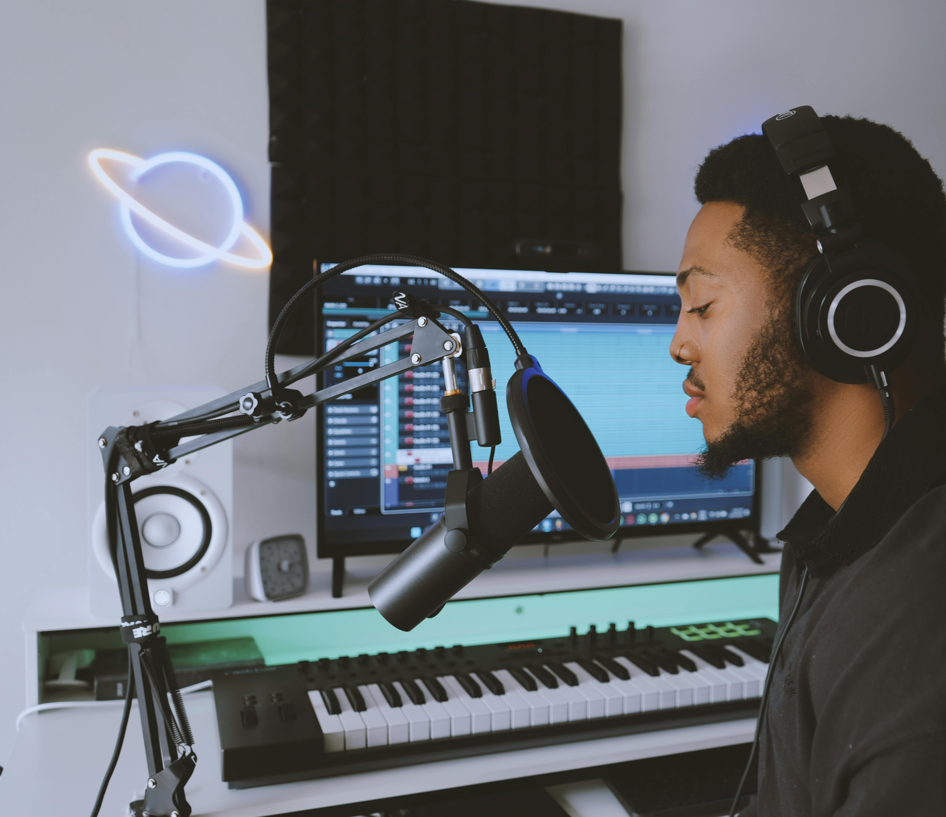
Digitizing Sound
ADC
  Analog to Digital Converter
This is the device that converts the analog signal into a digital file using Sampling and Quantizing.
Photo by Usman Precious: https://www.pexels.com/photo/preetyboy-psoul-21826690/

Slide 4

Digitizing Sound
In class your computer does with with its sound card and the Audacity software.
But you phone can also do this when it records audio.
Photo by Los Muertos Crew: https://www.pexels.com/photo/sitting-businesswoman-talking-on-phone-10041259/

Slide 5
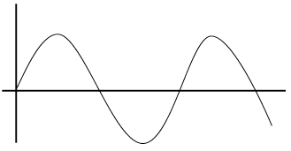
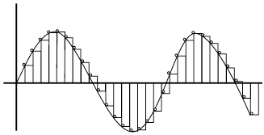
Sampling
In the sampling step, the aplitude (height) of the sound wave is sampled a specific number of times per second. The number of times per second is called the Sampling Rate.
Notes:
Will add image

Slide 6
Sampling
If the Sampling Rate is higher, the data captured will be more accurate. However, a higher sampling rate will generate a larger amount of data, and a bigger file size.
Notes:
Will add image

Slide 7
Nyquist-Shannon Sampling Theorem
This is an important idea in sampling audio. It states that when converting analog audio signals into digital format the Sampling Rate must be at two times the highest frequency of the audio.
Notes:
Will add image

Slide 8
Nyquist-Shannon Sampling Theorem
Since humans can hear sounds up to 20,000 Hz, we have to at least sample at 40,000 Hz to make sure all hearable sounds are accurately captured.
Notes:
Will add image

Slide 9
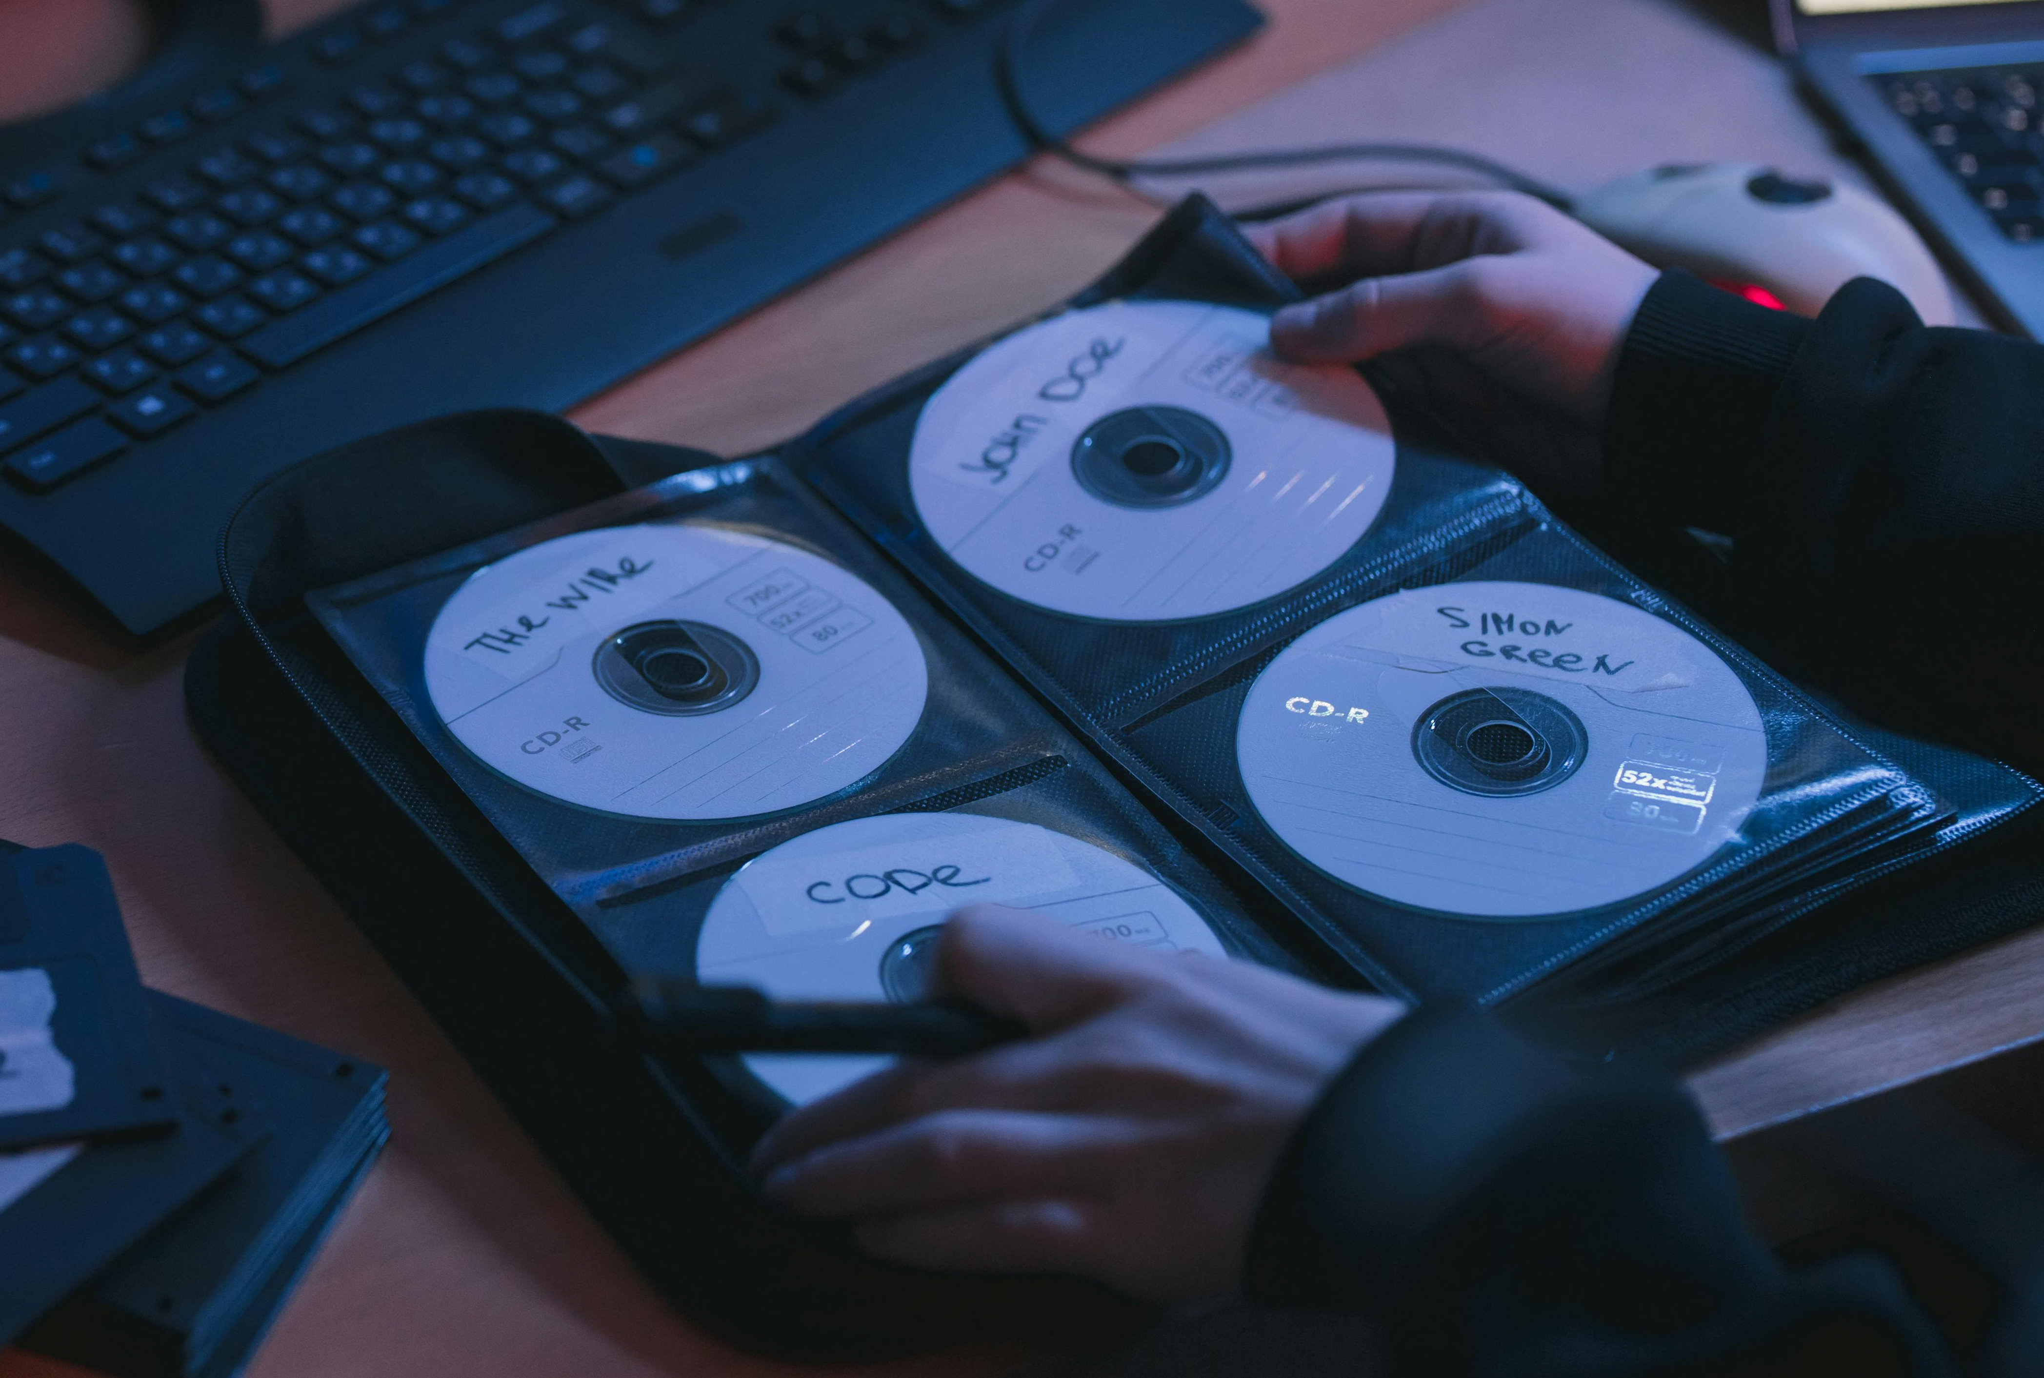
Sampling
This is why the sampling rate for CD quality audio is 44 kHz, or 44,100 samples per second.
Photo by cottonbro studio:
https://www.pexels.com/photo/person-holding-cds-5473399/
Notes:
Will add image

Slide 10
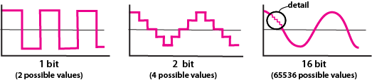
Quantizing
In the quantizing step, each of the discrete samples of amplitude values from the sampling step will be mapped and rounded to the nearest value on a scale of discrete levels: Bit Depth.
Notes:
Will add image

Slide 11
Quantizing
The more levels available in the scale (the higher the bit depth), the higher the accuracy in reproducing the sound—referred to as higher resolution. However, higher resolution will require more storage space.
Notes:
Will add image

Slide 12
Quantizing
The more levels available in the scale (the higher the bit depth), the higher the accuracy in reproducing the sound—referred to as higher resolution. However, higher resolution will require more storage space.
Notes:
Will add image

Slide 13
Quantizing
The bit depth for CD quality audio is 16 bits.
Photo by cottonbro studio:
https://www.pexels.com/photo/person-holding-cds-5473399/
Notes:
Will add image

Slide 14
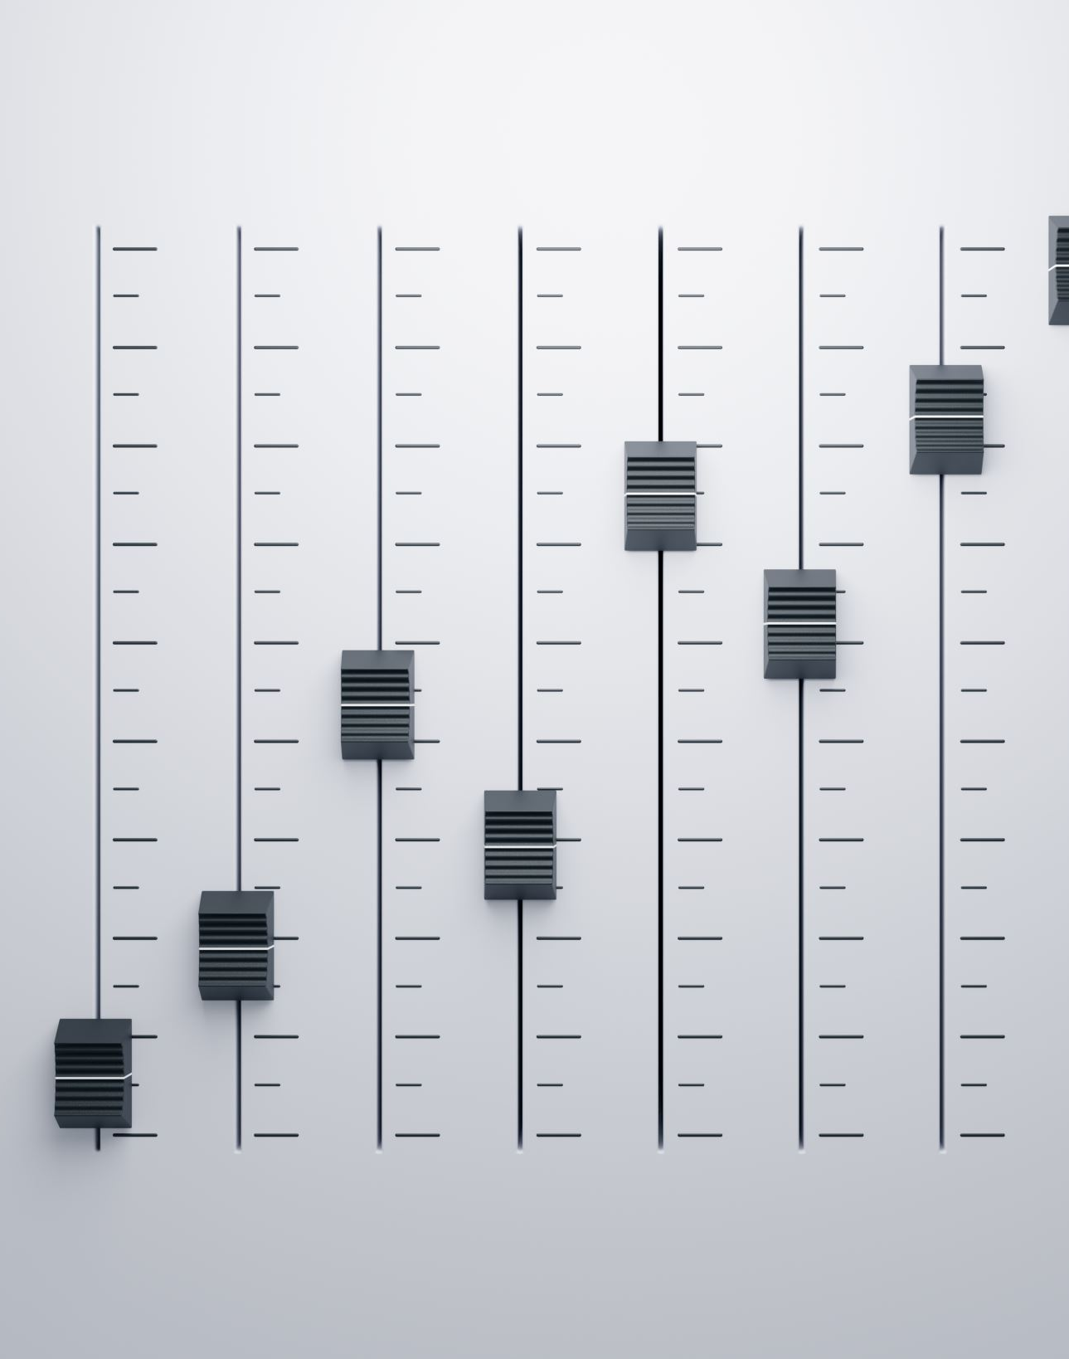
Sampling and Quantizing: Project Settings
What sample rate and bit depth should be used in an audio project?
While there are different needs for different projects, having to do with quality and file size, generally these settings should work for your audio assignments:
Sample Rate: 44,100Hz
Bit Depth: 32 bit
Notes:
Will add image

Slide 15
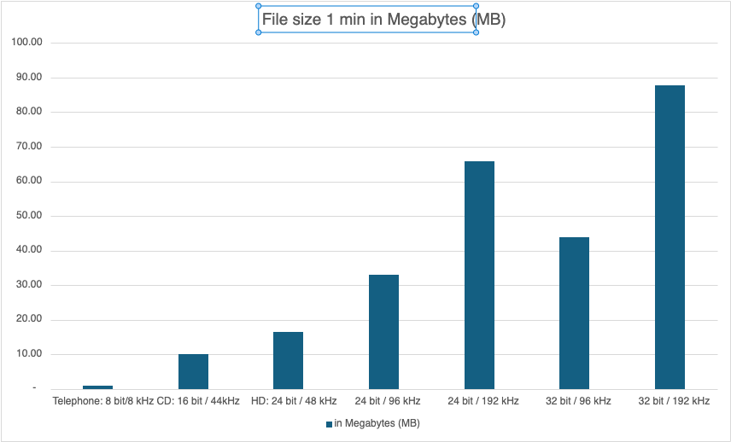
Sampling Rate, Bit Depth and File Size
Higher sampling rate and higher bit depth equals larger file size
shown here in megabytes (MB)
Notes:
Will add image

Slide 16
Audio Files and Lossy and Lossless Compression

Slide 17
Why is Compression Needed?
File Size and Storage:
Raw Audio Files: Uncompressed audio files (like WAV) can be very large, consuming significant storage space.
Compression: Reduces the file size, making it easier to store and share audio files without losing too much quality.

Slide 18
Why is Compression Needed?
Speed:
• Efficient Data Transfer: Smaller file sizes give faster upload/download and smooth streaming.
• Bandwidth Optimization: Compressed files use less bandwidth, good for streaming audio over the internet, especially with limited data plans or slower connections.

Slide 19
Why is Compression Needed?
Compatibility:
• Standard Formats: Many audio players and devices across platforms support compressed formats like MP3 and AAC.

Slide 20
Lossy vs. Lossless Compression
Lossy Compression
Reduces file size by permanently removing certain data that is considered less important for the human ear.
Lossless Compression
Reduces file size without losing any audio data; the original file can be perfectly reconstructed.

Slide 21
Lossy vs. Lossless Compression
Lossy Compression
  Size: Significantly smaller, making it ideal for everyday use
  Speed: fast, easy to stream
  Common Formats:MP3, AAC, OGG
  Quality: Some loss of audio quality, but usually imperceptible to casual listeners.
Lossless Compression
  Size: Larger than lossy but smaller than uncompressed; good for archiving and professional work.
  Speed: slower than lossy
  Common Formats: FLAC, ALAC, These are not common, WAV (uncompressed) is common
  Quality: No loss of audio quality—sounds exactly like the original recording.

Slide 22
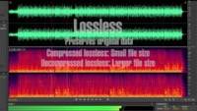
Lossy vs Lossless and Data Compression
https://www.youtube.com/watch?v=eN49E0cRGME

Slide 23
Some common audio file types
File Type | Full Name | Description (compression) | Created by
.wav | Waveform Audio File Format | Usually uncompressed | Microsoft and IBM
.aiff | Audio Interchange File Format | Usually uncompressed | Apple
.pcm | Pulse-code Modulation | Digital representation of raw analog files, used in CDs and DVDs. Uncompressed
.mp3 | MPEG-1 Audio Layer 3 | Highly compressed; common audio format for consumer audio storage | Moving Picture Experts Group
.aac | Advanced Audio Coding | Highly compressed. Designed to replace .mp3 format, higher quality sound with similar bit rates | Group of companies including AT&T Bell Laboratories, Dolby, Sony Corporation and Nokia
.ogg (Vorbis) | Vorbis format in ogg container | Highly compressed. | Open source

Slide 24
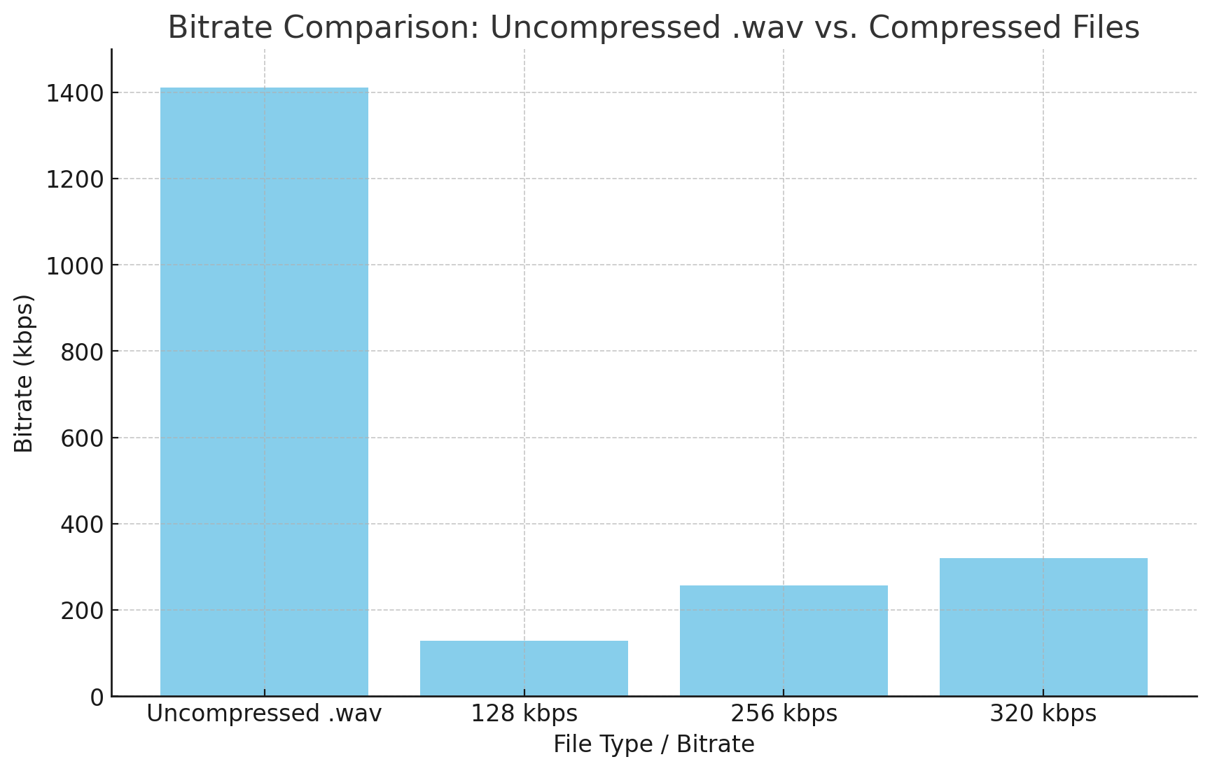
Bit Rate: Raw vs Compressed

Slide 25
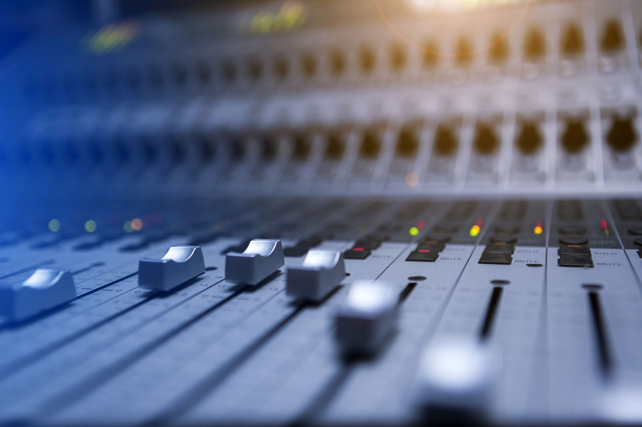
Files You will use for your Project
Audacity There is a special .aup file format that is used to edit the audio. This is not what you give to people.
Lossless Mixed down file: .WAV
Any files you recorded or used from other people. These should be in the file format you found or recorded them in. Common file formats:
  Waveform Audio File Format: .wav
  Mpeg Layer 3: .mp3 (lossy)
  Audio Interchange File Format: .aiff (lossless)
  Ogg Vorbis: .ogg (lossy)
  Windows Media Audio: .wma (lossy or lossless)

Slide 26
Recording/editing audio: a sampling of software
Audacity free, commonly used for recording and editing
Pro-tools professional level, industry standard
Acid Pro used with music, started as sequencer
Logic Pro music synthesis, software instruments
Garage Band uses Logic’s audio engine, free with Mac OX
Adobe Audition part of the Creative Cloud

Slide 27
Recording and editing audio: things to consider
Know your equipment: test it first
Monitor sound when recording: use headphones
Minimize noise when recording
Use layers to create richness

Slide 28
Audio Resources
Free audio recording/editing software: Download Audacity | Audacity Tutorials
Free sound effects: Freesound.org
Public domain music and radio segments: Internet Archive Audio
Creative Commons licensed tracks on SoundCloud: Creative Commons search
Royalty Free Music by Ben Sound

Slide 29
Credits
All images created by Jody Culkin, Anna Pinkas or in the public domain unless otherwise noted

