Slide 1





Teaching Children about gender roles

Slide 2
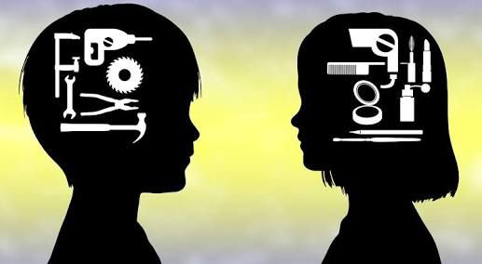
Early gender socialization
Gender role socialization is dictated by the way in which parents, teachers, friends, schools, religious institutes, media and others, send messages about what is acceptable or desirable behavior for males and females. (Lumen) Gender role socialization is the process by which people learn to behave in a certain manner. For instance, the color designated for boys is blue. They are told not to weep, not to panic, and to be assertive and strong. They are supplied with toy trucks, toy guns, and superhero figurines, Girls on the other hand, their assigned color is pink. They are asked not to be demanding, to be forgiving, and ‘ladylike.’ Unlike boys, girls are supplied with baby dolls, princess costumes, and toy kitchen sets.

Slide 3
Gender role development
CULTURE
Play
As children develop, they begin to explore gender roles and the differences between a boy and a girl. One of the ways in which children learn about gender role is through culture. Culture provides specific expectations depending on whether you are a male or female. These norms are implemented through their family and their practices.
Children also explore gender roles through the messages that the world around them displays. Through play and interactions, children begin to identify themselves and others. Children may present questions to teachers and parents regarding gender, they may take on their opposite gender roles in dramatic play and notice the differences between the boys and girls they know. They may choose certain toys they believe is acceptable according to their gender. They may also make statements about toys or activities that they believe are only for girls or for boys,

Slide 4

Rigid periods of gender identity
According to researchers, there are several stages of gender development that are defined as the most “rigid” periods of gender identity. During this period, a child is most likely to do or wear certain things that are not typical for his gender. For example, a boy is with his mother at a toy store, when he is suddenly intrigued by a baby doll. Now, according to gender socialization, because he is a boy, he should not want or have this item. “A child who wants to do or wear things that are not typical of his gender, is probably aware that other children find it strange. The persistence of these choices, despite the negative reactions of others, show that these are strong feelings” (Early Childhood National Centers). As children age, gender rigidity decreases. With this change, children develop stronger moral impulses about what is “fair” for themselves and others. Let’s take a look at the several stages of gender development.

Slide 5

Infancy
Children observe messages about gender from adults’ appearances, activities, and behaviors. Most parents’ interactions with their infants are shaped by the child’s gender, and this in turn also shapes the child’s understanding of gender” (Early Childhood National Center). A child always seeing his mother cooking in the kitchen might come to the conclusion that only woman cook. Observing dad build the new furniture that just arrived, might give the child the impression that only men can construct items.

Slide 6
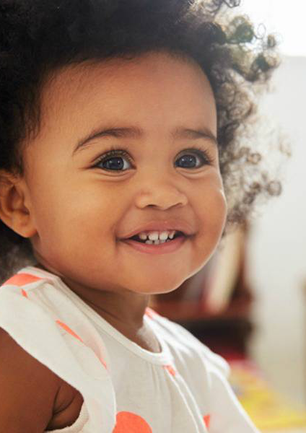
18-24 months
As they develop a sense of self, toddlers look for patterns in their homes and early care settings. Gender is one way to understand group belonging, which is important for secure development” (Early Childhood National Center). Children recall the observations they have made both at home and school which allows them to pick up on patterns on what boys and girls do. This allows them to understand what group they belong to.

Slide 7
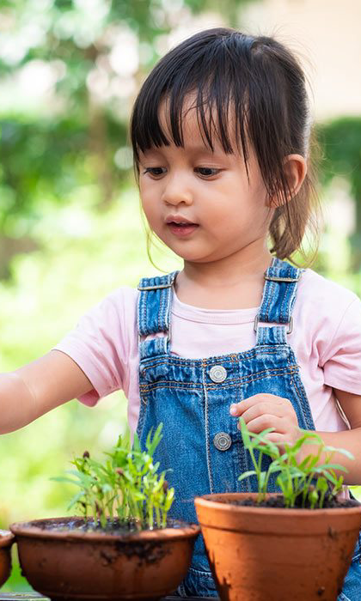
Ages 3-4
Gender identity takes on more meaning as children begin to focus on all kinds of differences. Children begin to connect the concept “girl” or “boy” to specific attributes. They form stronger rules or expectations for how each gender behaves and looks” (Early Childhood National Center). At this age, children are aware of what boys and girls should and should not be doing. For instance if Jacob sees Olivia playing with the toy trucks he is most likely to announce that the item she is playing with is for boys and not for girls.

Slide 8

Ages 5-6
“Children’s thinking maybe rigid in many ways. [They] are very aware of rules and of the pressure to comply with them. They do so rigidly because they are not yet developmentally ready to think more deeply about the beliefs and values that many rules are based on” (Early Childhood National Center). At this age, children are aware that the toy they are chosen to play with, according to identity norms, it is wrong. Unfortunately they are unable to analyze the situation further and figure out the “why?” So they continue with their toy.

Slide 9
Parents influence on their child’s gender development
One of the ways in which parents might influence their child’s gender development is by having stereotypical expectations. “[parents hold] traditional expectations and some expressing egalitarian expectations for their daughters and sons. Some parents may support egalitarian views about some domains (e.g., occupation) but remain more traditional about other domains (e.g., family roles). Finally, parents (especially fathers) tend to be more rigid in their expectations for sons than daughters” (Martin 2).
Egalitarian is defined as a trend of thought in political philosophy. It refers to someone whom favors equality of some sort: people should get the same, or be treated the same, or be treated as equals, in some respect.
Even though parents may have an open mind and accept certain views, they still hold restrictions on others.. A child should be able to express themselves however they please, whether it be through the way they dress, the color they chose to paint with, the tv character they chose to admire or the toy they select.

Slide 10
The affect parents have on child’s gender development
Parents restricting or on preventing their child from doing or choosing certain items or activities because they don’t pertain to their child’s gender, prevents the child from crossing traditional gender roles.
Jamie Solomon is a teacher who has researched and published her findings on how pedagogy takes a critical stance on gender stereotyping and maps onto disparities in opportunity within our society. During her research she discovered that their were few examples where boys would cross traditional gender role boundaries.
In this case, crossing traditional gender role boundaries means that the boys, were not open to conducting activities that were considered to be for girls, for instance playing in the toy kitchen or with dolls.
Some researchers believe this phenomenon, a common finding in gender studies, results from our male-dominated culture, in which being male or having male characteristics is associated with power, opportunity and prestige” (Solomon 2).
Solomon states that young boys demonstrate awareness of these desirable qualities and perhaps worry about loosing such advantages if they were to cross gender lines.

Slide 11
Parents influence on their child’s gender development (continuation)
Another way in which parents might influence their child’s gender development is by parents initiating different treatments depending on whether their child is a male or female.
The most consistent manner by which parents treat girls and boys differently is through the encouragement of gender-stereotyped activities” (Encyclopedia on Early Childhood Development).
Gender-stereotyping activities refers to the practices of ascribing to an individual woman or man specific attributes, characteristic, or roles by reason only of her or his membership in the social group of woman or men. These practices have been set for us by society, families and culture. From the minute parents know the sex of the child they are expecting, they begin to follow these practices.
An example of this would be the kind of toys that parents purchase or the activity they might allow their child to participate in. Toy trucks, action figures, sport equipment are for their sons; dolls, kitchen sets and dress up costumes are for their daughters.

Slide 12
The affect parents have on child’s gender development (continuation)
Children are negatively impacted by parents treating their children differently based on whether they are a female or male; children feel they need to comply with gender rules in order to avoid rejection. “As the child becomes part of the community (…) they will adhere to gender roles and statements like “no, this is for girls/boys” unless [someone intervenes], [parents] would have the effect of discouraging some children in any play that breaks the establishing gender roles” (Vasileva 2018).
When playing, children might try to mimic what they have seen their parents do. For instance, Noah saw his mom give his baby brother milk from a bottle, and so Carter takes a baby doll and feeds the baby too.
Other children and parents themselves, might call the boy out for doing something that people of his sex wouldn’t do. This might cause the child to feel embarrassed, it might even prevent him from playing with any other toy that might be considered for the opposite sex.

Slide 13
Why should the topic of gender roles be addressed? Reason # 1
the topic of gender role should be addressed is because it helps the child in identifying his/herself internal gender.
The point is that all children tend to develop a clearer view of themselves and their gender over time (…) Researchers suggests that children who assert a gender-diverse identity know their gender as clearly and consistently” (Rafferty 2018).
Gender diverse identity is an umbrella terms to describe an ever-evolving array of labels people may apply when their gender identity, expression, or even perception does not conform to the norms and stereotypes others except. Children who have reached this decision, are clear and confident about their gender identity. This is a positive example of what a good gender development looks like.

Slide 14
Why should the topic of gender roles be addressed? Reason # 2
the topic of gender role should be addressed is because it helps the child to recognize and accept all gender types.
Children may show “curiosity about peoples bodies [which] is natural for children as they begin to notice differences and think of themselves as a boy or girl” (Early national childhood center). Because children are figuring out their identity, I believe it is important for children to see the variety of identity’s that they can chose to be.
One of the ways in which parents and educators can introduce the topic of gender identity is through the use of literature.

Slide 15
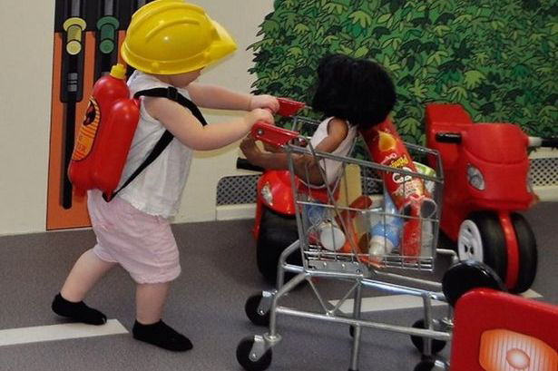
Ways in which parents and educators can help promote a healthy internal gender development
Expose children to a wide range of activities that allow males to be caregivers or nurturers and females in traditional masculine roles such as firefighter and/or construction worker..

Slide 16
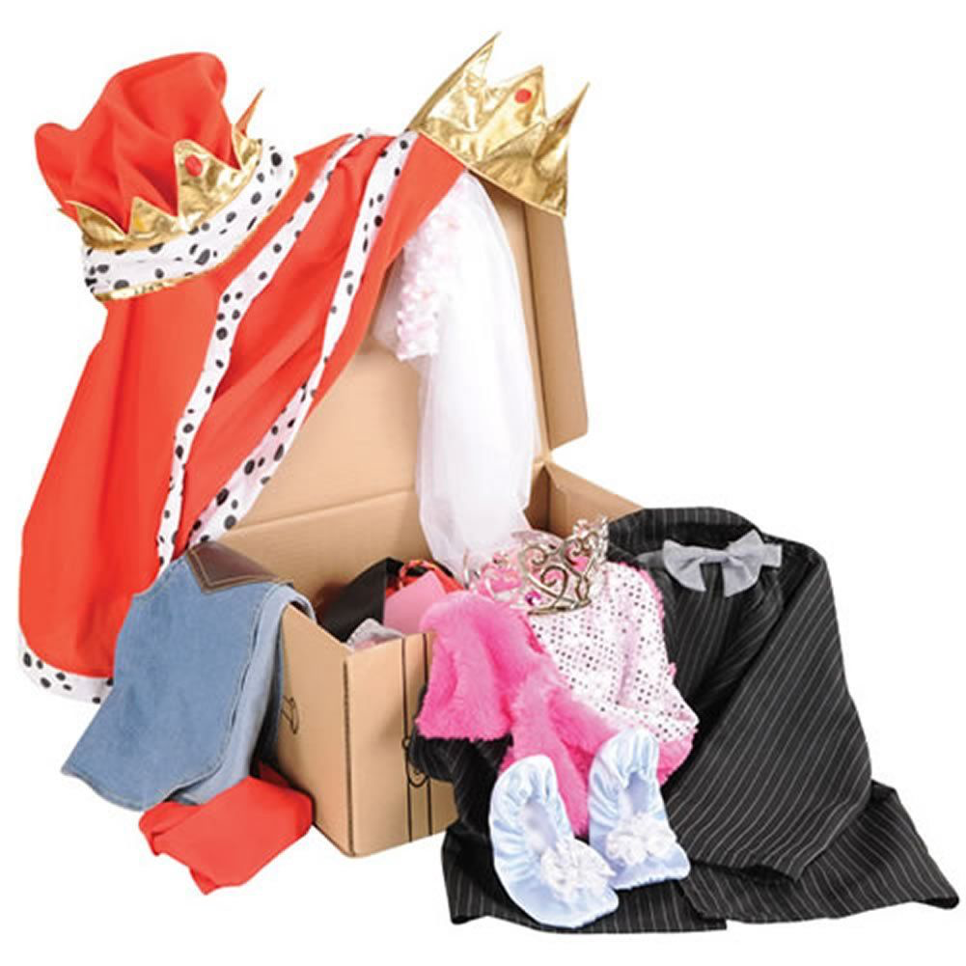
Ways in which parents and educators can help promote a healthy internal gender development
Provide dramatic props that provide children the freedom to explore and develop their own definition of gender and gender roles.

Slide 17

Ways in which parents and educators can help promote a healthy internal gender development
Develop classroom phrases that emphasize gender neutral language. (“All children can…”)

Slide 18
Ways in which parents and educators can help promote healthy internal gender development
Because children are figuring out their identity, I believe it is important for children to see the variety of identity’s that they can chose to be. One of the ways in which parents and educators can introduce the topic of gender identity is through the use of literature. Here are some books to consider:

Slide 19

Books that promote gender development
Annies Plaid Shirt by Stacy Davids
It’s Annies uncles wedding! Annie plans to wear her favorite plaid shirt, the one that she always wears, every day. Annies mom says girls wear dresses to weddings, but dresses make Annie feel lie she isn’t herself. What will she do?
This book is great for kids 3- 8 years old. Annies plaid shirt addresses how her mom worries about Annie and wonders if she made the right decision in asking her to wear a dress.. this shows. That parents and adults aren’t always sure of themselves. The book also shows how girls can be masculine too.

Slide 20

Books that promote gender development
Neither by Airlie AndersonS
In a world full blue bunnies and yellow birds, a baby that is not quite a bunny or a bird hatches. In the land of This and That, what happens to those who don’t fit either?
This book is great for kids 3-7 years old. With colorful pictures and clear, simple text, this book provides solace for those who feel as though they don’t fit in. This story allows you to discuss with your child a variety of situations such as what it means to be gender non conforming, intersex, or genderqueer.

Slide 21

Books that promote gender development
I am Jazz by Jessica Herthel and Jazz Jennings
Jazz likes the color pink, playing with dolls and wearing a mermaid tail. While she likes to talk to her older sister about her “girl thoughts,” Jazz was designated as a male at birth. This story describes Jazz struggle as a young child feeling like she was in the wrong body, and the challenges she and her family face.
This book is great for kids 4-8+. It shows kids that it’s okay to be confused about your gender sometimes. In the end whatever you chose will make you happy.

Slide 22

Books that promote gender development
What make a baby? By Cory Silverberg
This book is perfect for 4-8 years old children who are asking a lot of “how’s” and “why’s.” The text uses gender-neutral language, such as “people with eggs” and “people with sperm” expanding our ideas about conception.

