Slide 1
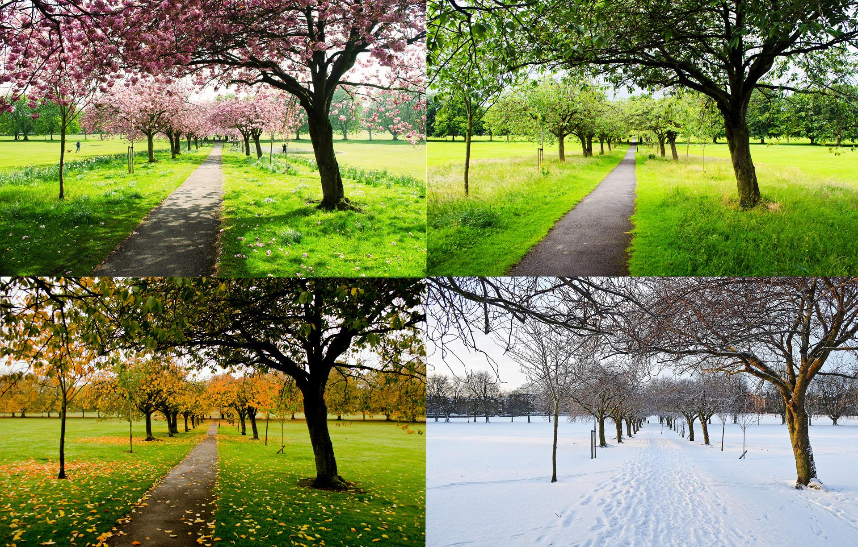
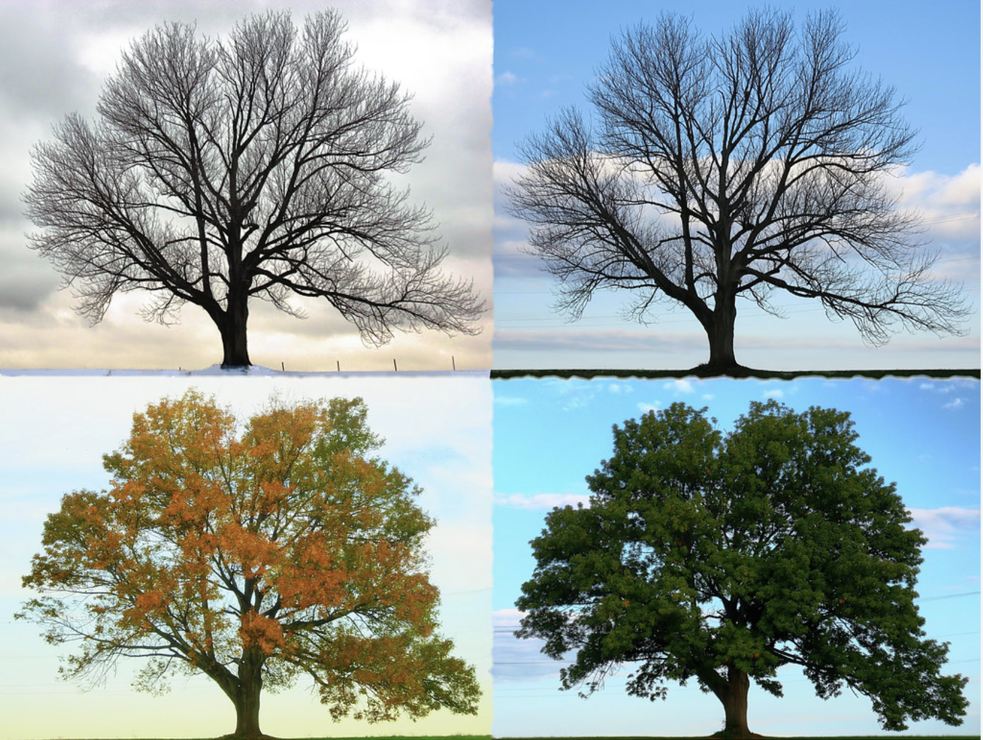
Seasons
Group 4: Evelyn F, Maria R, Destiny R, Gina R, Shapla Z

Slide 2
Why We picked Seasons?
We all picked seasons because we wanted to talk about each of the 4 seasons. It is also a great way for children to learn about the months, different weather patterns and the holidays that occur during these seasons. Children will learn how to correlate months to their correct seasons and learn how weather changes drastically during the seasons. Seasons are also good for art activities because using arts and crafts, children can draw the trees throughout the 4 seasons. It gives the children the freedom to create the seasons how they see fit and will give them the opportunity to see how many aspects make up seasons.

Slide 3
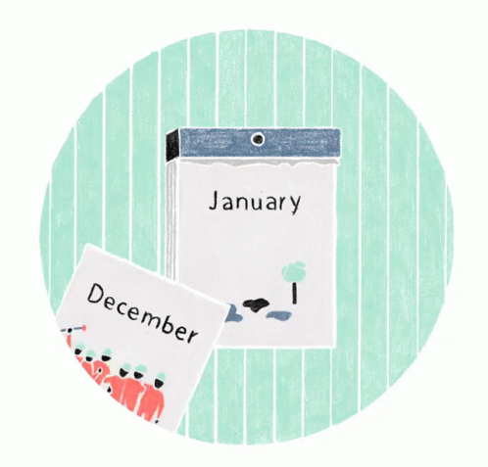
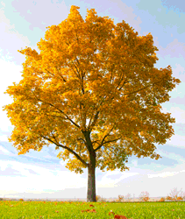


Subtopics:
Months
Weather
Season Trees
Clothing
Exploring the Seasons

Slide 4
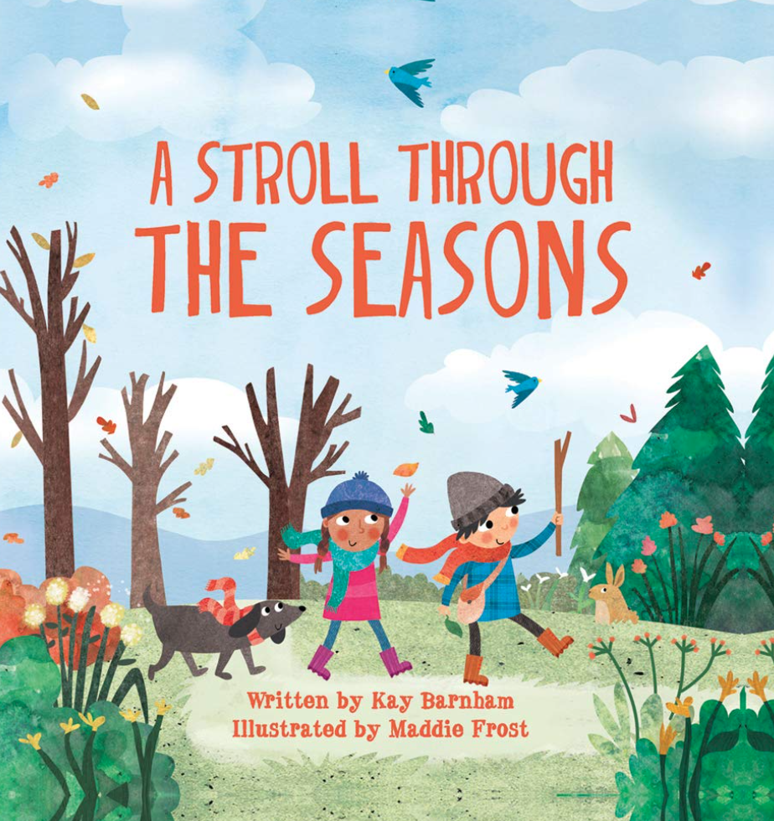
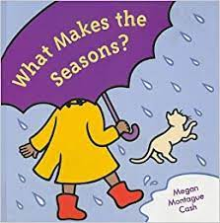
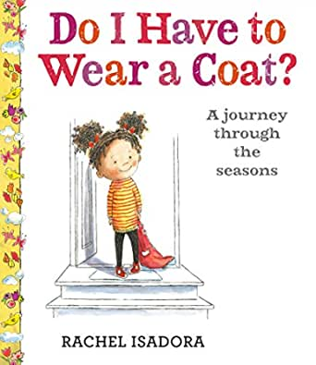
Books:
Book: What Makes the Seasons? by Megan Cash. This book was published in 2003. This is a easy rhyming book. It describes how plants grow and respond to seasonal changes.
Book: A Stroll Through the Seasons (Look and Wonder) by Kay Barnham. This book was published in May 11, 2017. This book will help them discover many amazing and wonderful scientific facts about nature.
Book: Do I Have to Wear a Coat by Rachel Isadora. This book was published in 2020. This book is about all the 4 seasons. Also makes children want to learn the cycle of all the seasons.

Slide 5

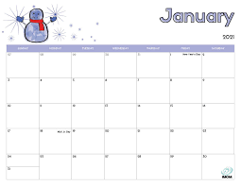
Months
Christmas Eve is December 24th
Christmas Day is December 25th
Music: Sing songs with children so that kids learn their months.
Visual Art: Have the months printed out and ask them to put it in order and sort out months by each season.
Learning about different holidays in each month and season, such as Halloween, Christmas, Easter, Valentine’s Day, Chinese New Year, Hanukkah and Thanksgiving.
Crafts: Create a calendar with the students and they can color it in and label each month.
Chinese New Year- February 1
Thanksgiving- November 25(Usually the date changes)
Hanukkah - Sunday, November 28 to Monday, December 6
Valentine Day- February 14th
Halloween-
October 31
Easter- April 4th

Slide 6
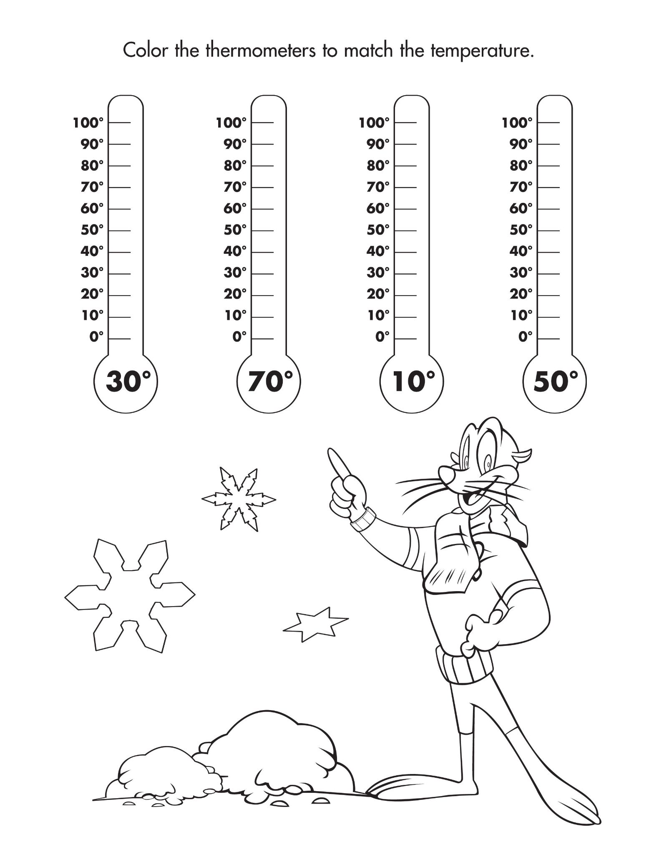
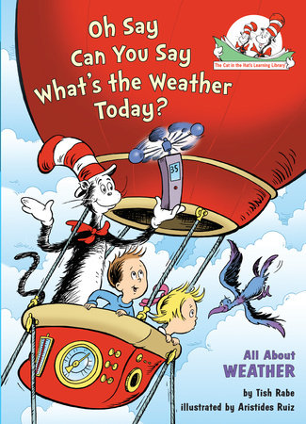
Weather
Book: Oh Say Can You Say What's the Weather Today by Tish Rabe, Aristides Ruiz. This book was published 2004. This book is about the cat in the hat exploring on top of the air ballon and the way that the weather is changing. Also on how to stay safe as well.
Music and Movement: Sing “the season songs” and dance along with it.
Arts & Crafts: Kids color in a temperature degree with the number on the side. Materials needed is temperature worksheet, markers or crayons.
Movement: On warm days we can go out to the field and run around play “ I spy” on cold days we can also play “ I spy”

Slide 7
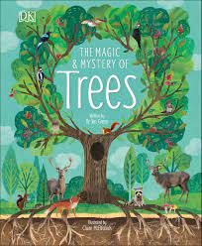
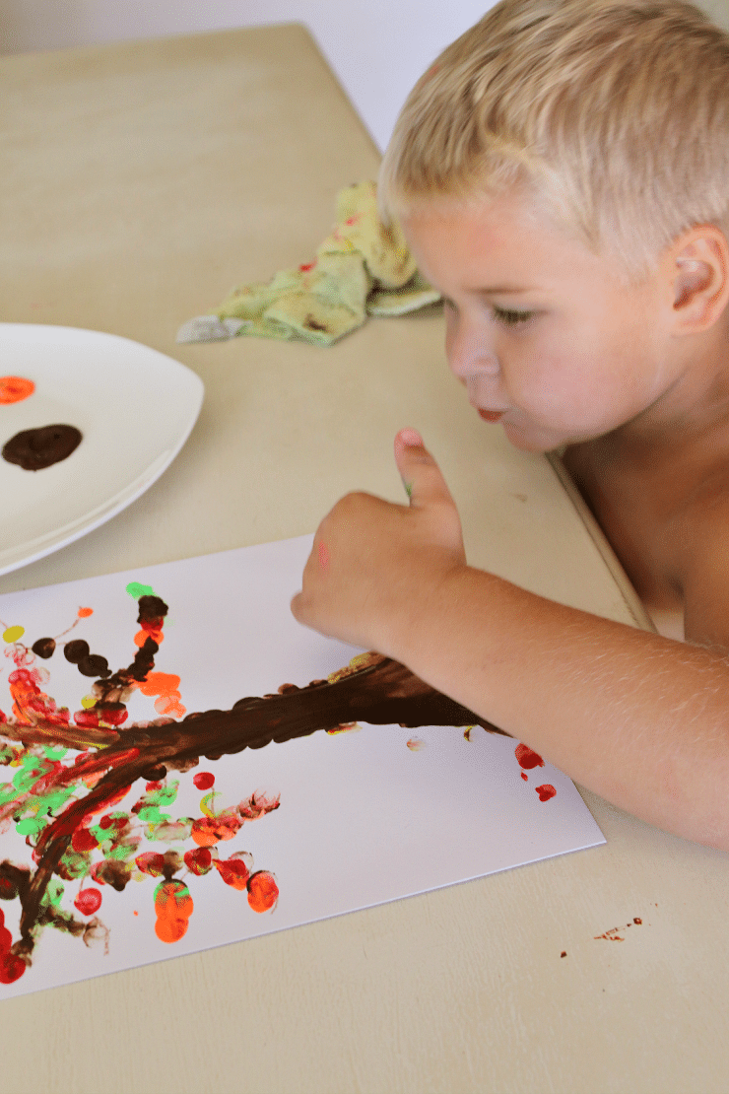
Season Trees
Arts and Crafts: children can use their finger to paint trees or they can draw the leafs for the tree. Materials needed is paint, leafs, color pencils and paper.
Movement: Collecting leaves to learn about how leaves change color during seasons.
Science: Learn about animals that live in trees, such as squirrels hibernating during winter and butterflies growing during spring.
Book: The Magic & Mystery of Trees by Dr Jen Green. This book was published in March 5, 2019. This book is more about trees. Works well for children to explore about Trees and the different leafs colors..

Slide 8
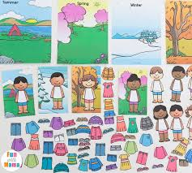
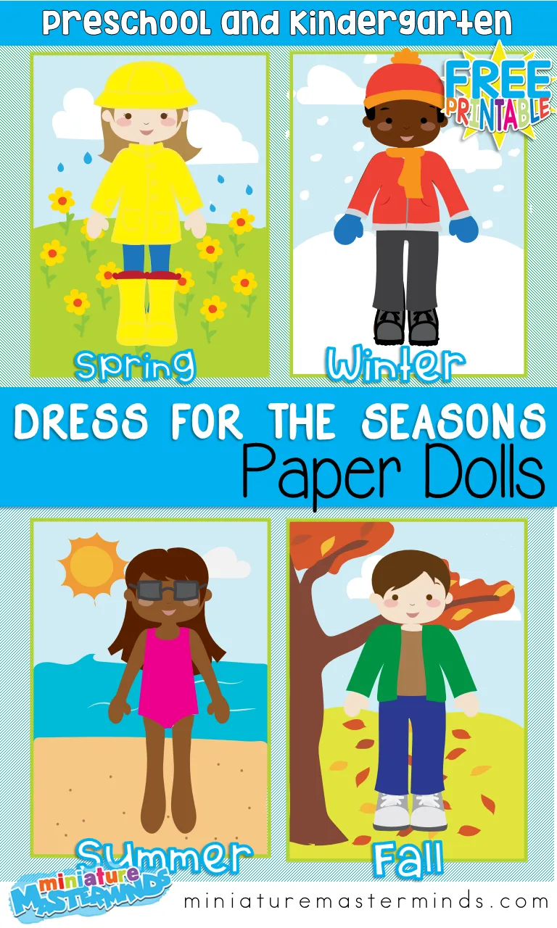
Clothing
Arts & Craft: Dress up paper dolls.
Music: The Weather and Clothing Song! ( song is upbeat and explains the types of weather and how one would correctly dress)
Dramatic Play: Playing dress up for each season and match what goes with what.

Slide 9
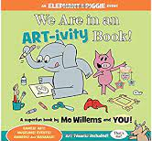
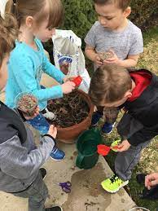

Exploring the Seasons
Science: Planting seeds during spring
Art & Craft: Making gingerbread houses during winter. Materials needed is gingerbreads, and seeds.
Movement: Outdoor activities such as pumpkin picking, sledding, playing in the sprinklers.
Book: We are in an Art-ivity Book ! by Mo Willems and You. This book was published in September 5, 2017. This book is more on children to be able to draw, create, build, color and do puzzles as having different activity to create inside the book.

Slide 10
References:
Books : Amazon
Isadora, Rachel. “Do I Have to Wear a Coat?: a Journey through the Seasons.” Amazon, Nancy Paulsen Books, an Imprint of Penguin Random House, 2020, www.amazon.com/Do-I-Have-Wear-Coat/dp/0525516603/ref=asc_df_0525516603/?tag=&linkCode=df0&hvadid=430938287403&hvpos=&hvnetw=g&hvrand=10788640734406223106&hvpone=&hvptwo=&hvqmt=&hvdev=c&hvdvcmdl=&hvlocint=&hvlocphy=9004357&hvtargid=pla-903321424921&psc=1&ref=&adgrpid=98871180663
Willems, Mo. We are in an Art-ivity Book ! September 5, 2017. https://www.amazon.com/Are-ART-ivity-Book-Elephant-Piggie/dp/1484798163
Green, Dr Jen. The Magic & Mystery of Trees. March 5, 2019. https://www.amazon.com/Magic-Mystery-Trees-Jen-Green/dp/1465479368/ref=asc_df_1465479368/?tag=hyprod-20&linkCode=df0&hvadid=416883074292&hvpos=&hvnetw=g&hvrand=4790737652869730071&hvpone=&hvptwo=&hvqmt=&hvdev=c&hvdvcmdl=&hvlocint=&hvlocphy=9004148&hvtargid=pla-658803224583&psc=1&tag=&ref=&adgrpid=94182732856&hvpone=&hvptwo=&hvadid=416883074292&hvpos=&hvnetw=g&hvrand=4790737652869730071&hvqmt=&hvdev=c&hvdvcmdl=&hvlocint=&hvlocphy=9004148&hvtargid=pla-658803224583
Activities: Pinterest
Paper Dolls for the Seasons - Royal Baloo
Season trees

Slide 11
References:
Books: Amazon
Rabe, Tish, and Aristides Ruiz. Oh Say Can You Say What's the Weather Today. 2004. https://www.amazon.com/Say-Can-Whats-Weather-Today/dp/0375822763/ref=sr_1_1?dchild=1&keywords=Oh+Say+Can+You+Say+What%27s+the+Weather+Today+by+Tish+Rabe%2C+Aristides+Ruiz.&qid=1619224488&s=books&sr=1-1
Barnham, Kay. A Stroll Through the Seasons. May 11, 2017. https://www.amazon.com/Stroll-Through-Seasons-Look-Wonder/dp/1438050410/ref=sr_1_1?dchild=1&keywords=A+Stroll+Through+the+Seasons+%28Look+and+Wonder%29+by+Kay+Barnham.&qid=1619224695&s=books&sr=1-1
Cash, Megan. What Makes the Seasons? by Megan Cash, 2003. https://www.amazon.com/What-Makes-Seasons-Megan-Montague/dp/067003598X/ref=sr_1_1?dchild=1&keywords=What+Makes+the+Seasons%3F+by+Megan+Cash&qid=1619224734&s=books&sr=1-1
Songs: The Weather and Clothing Song! - https://www.youtube.com/watch?v=g5UULVTf0mw
Sing "The Seasons Song" - https://www.eslkidstuff.com/lesson-plans/seasons.html#songs-readers

