Slide 1
Week 6
Consumption & Saving
Keynesian Consumption Function
Savings Decisions

Slide 2
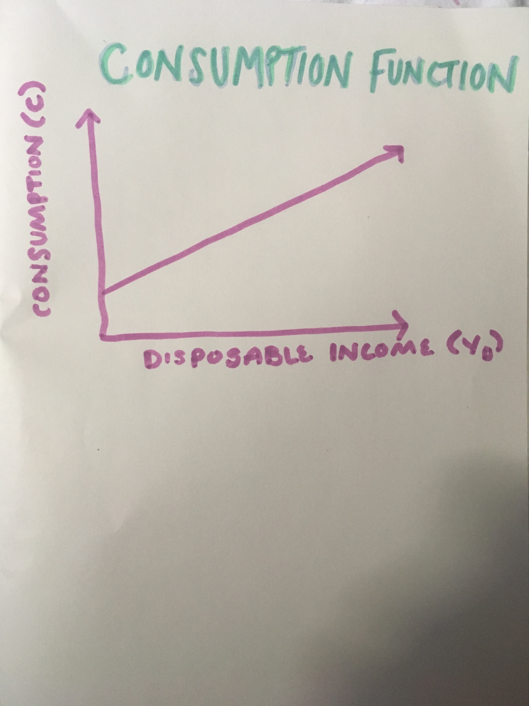
Keynesian Consumption Fuction

Slide 3
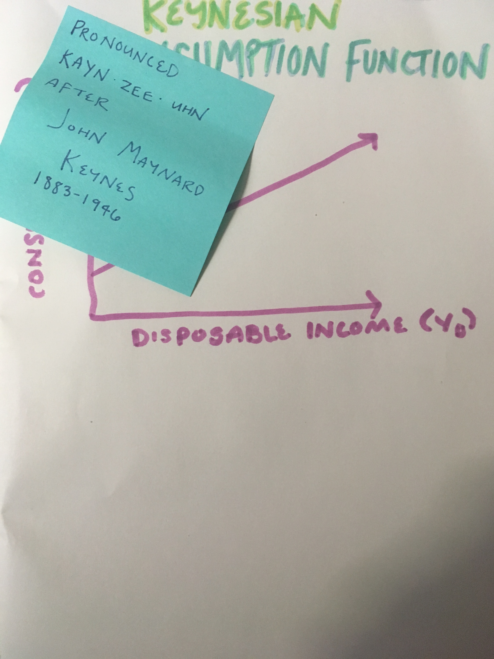
Keynesian Consumption Fuction

Slide 4
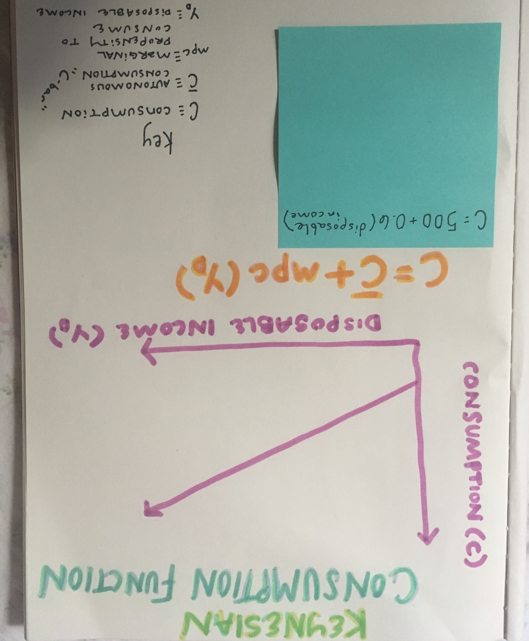
Keynesian Consumption Function

Slide 5
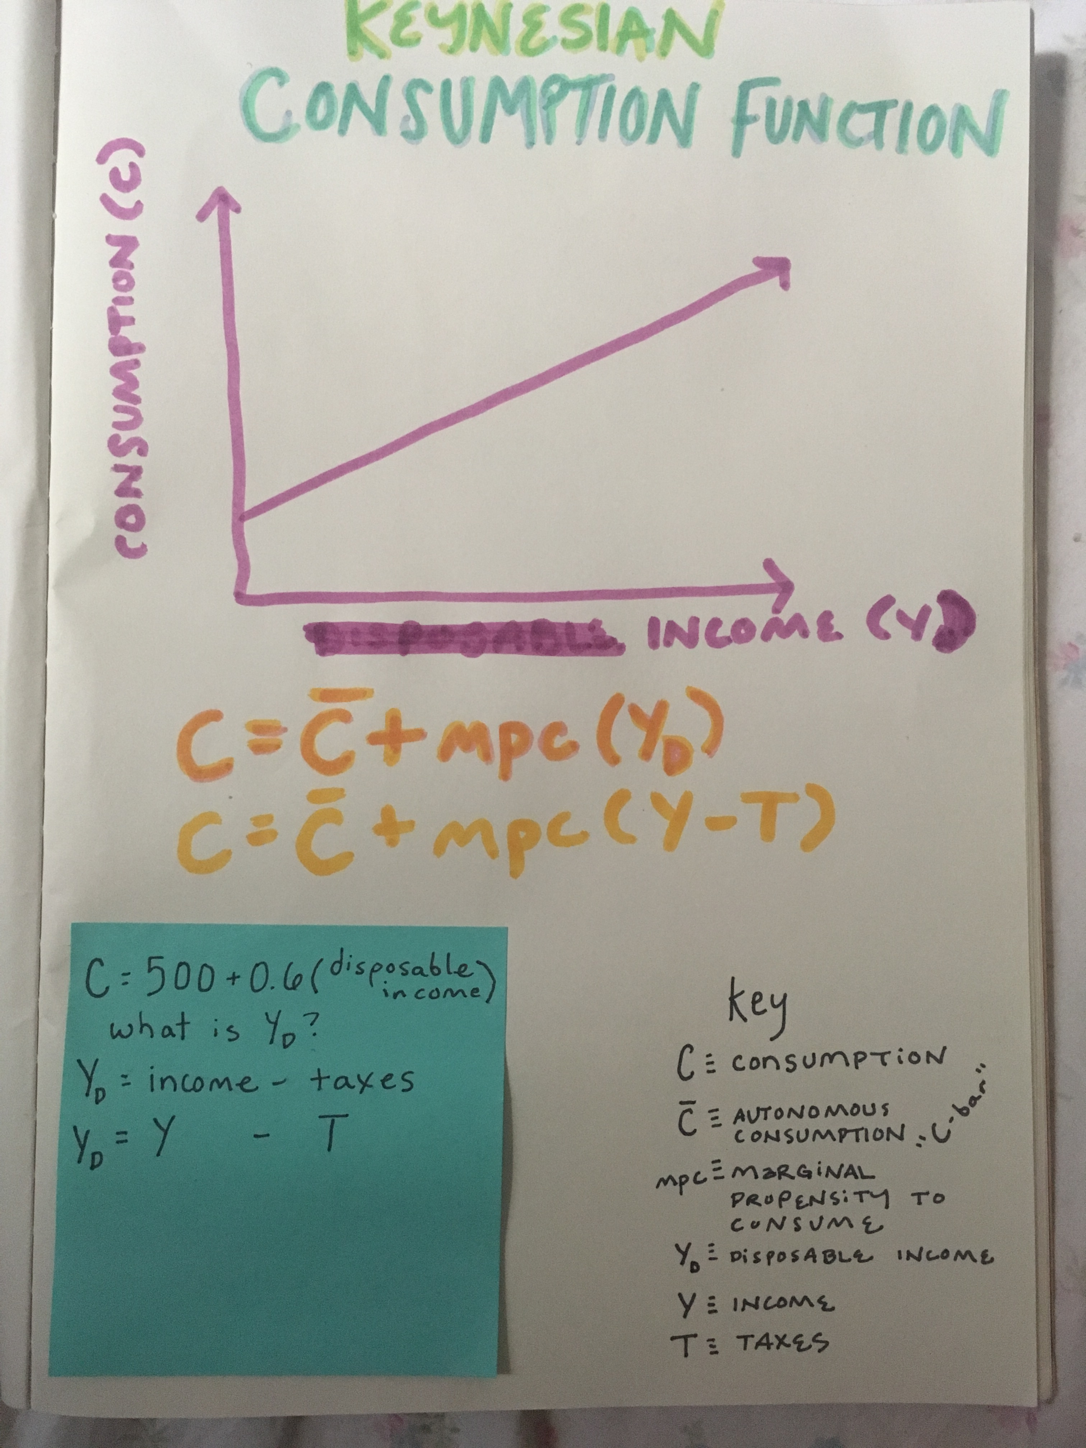
Keynesian Consumption Function

Slide 6
Saving Decisions
*consider for yourself*
Do you save?
Why or why not?
If you do save (or if you did save) how would you decide how much money to save?

Slide 7
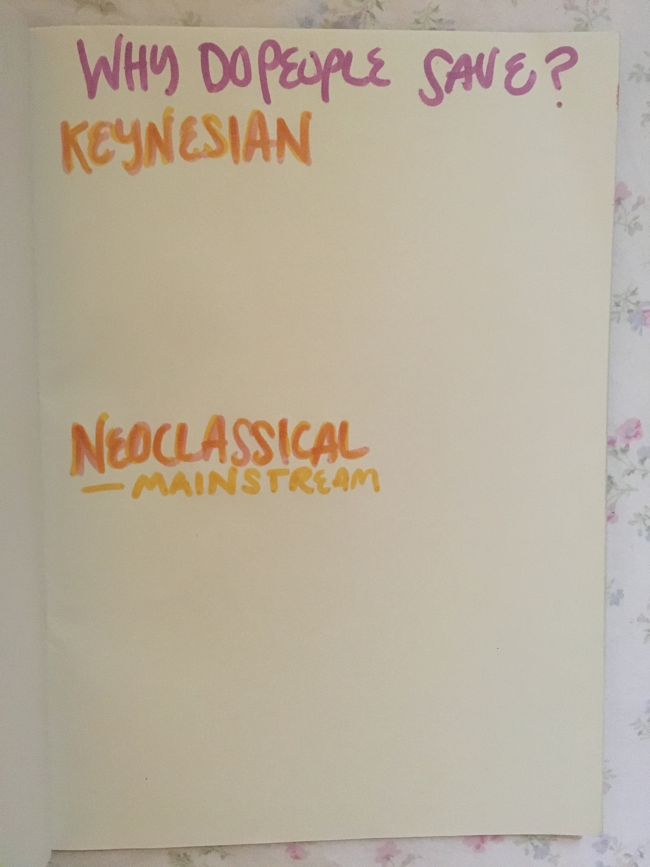
Saving Decisions
Keynesian Vs. Neoclassical

Slide 8
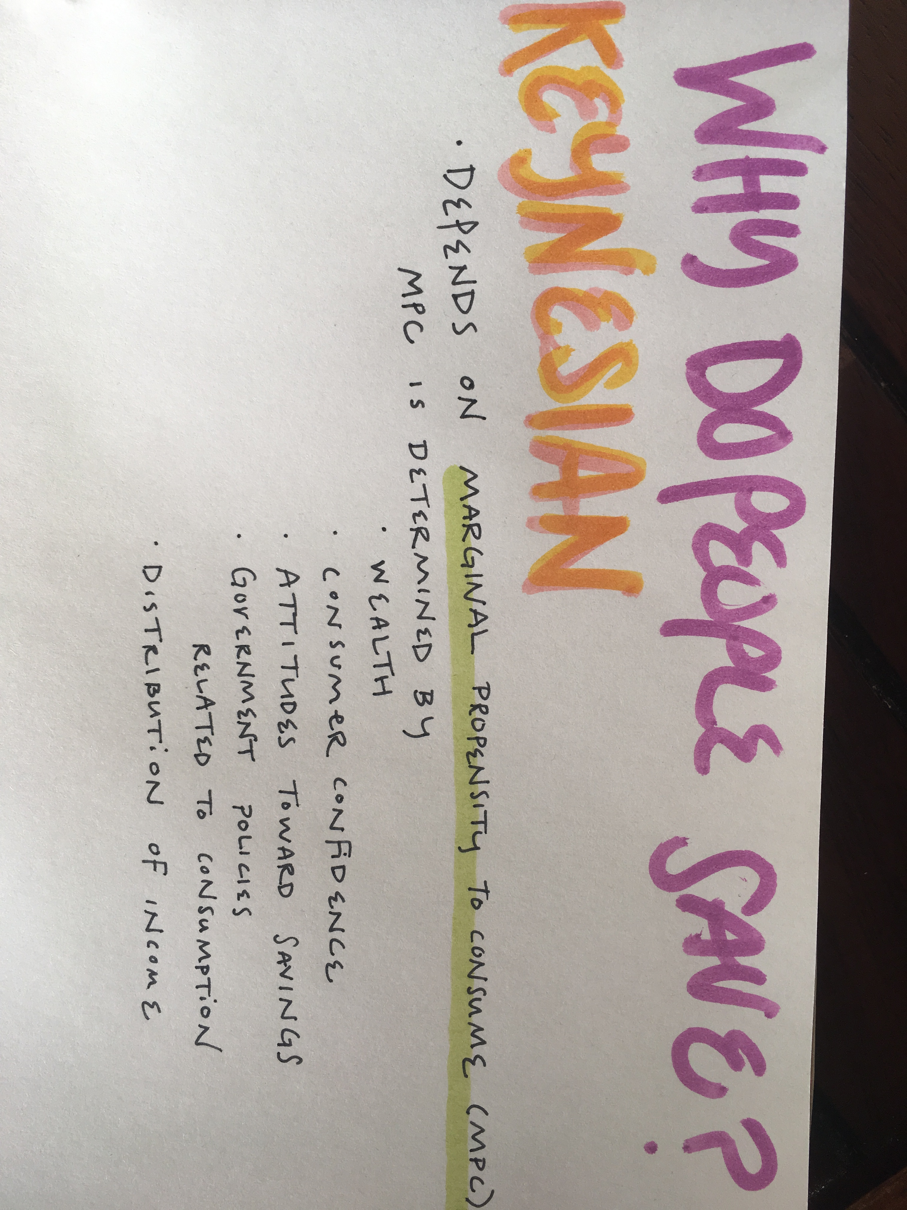
Saving Decisions
Keynesian Vs. Neoclassical

Slide 9
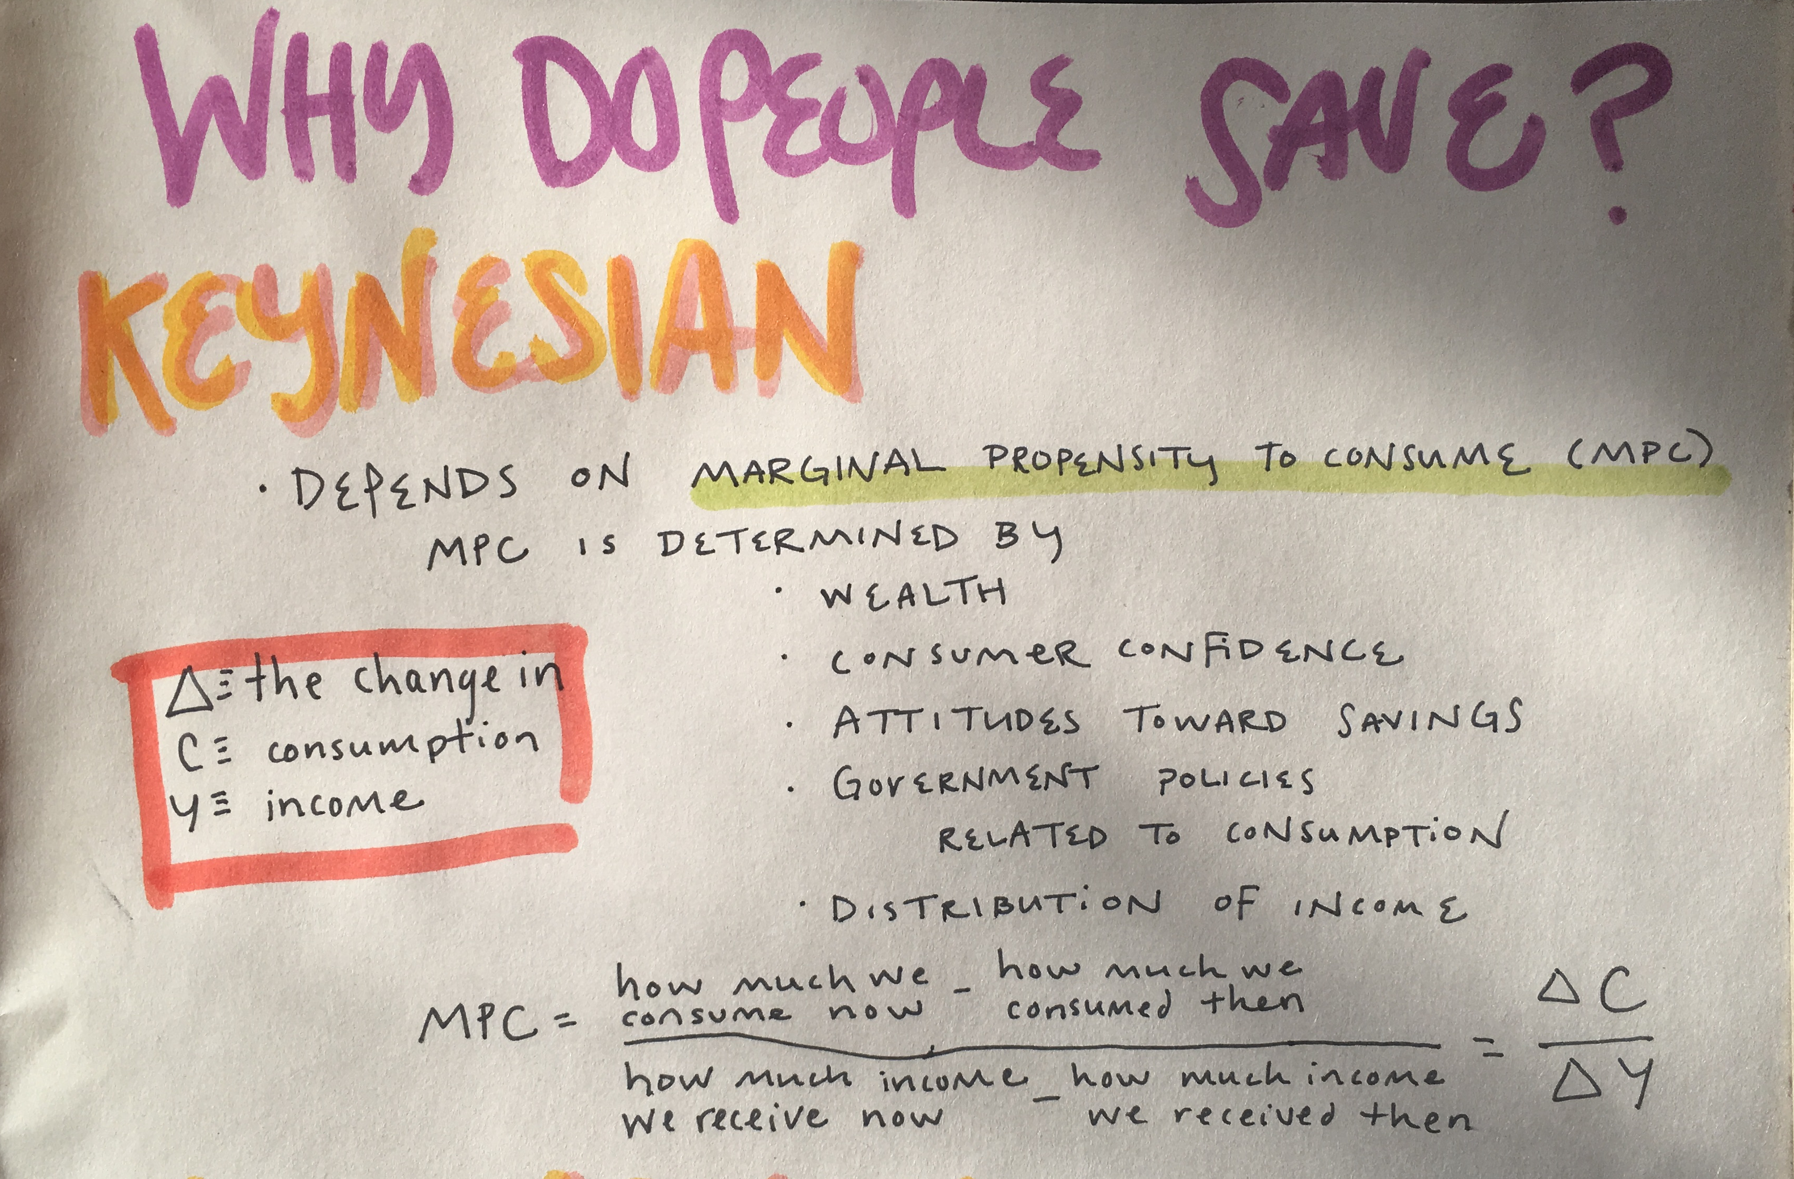
Saving Decisions
Keynesian Vs. Neoclassical

Slide 10
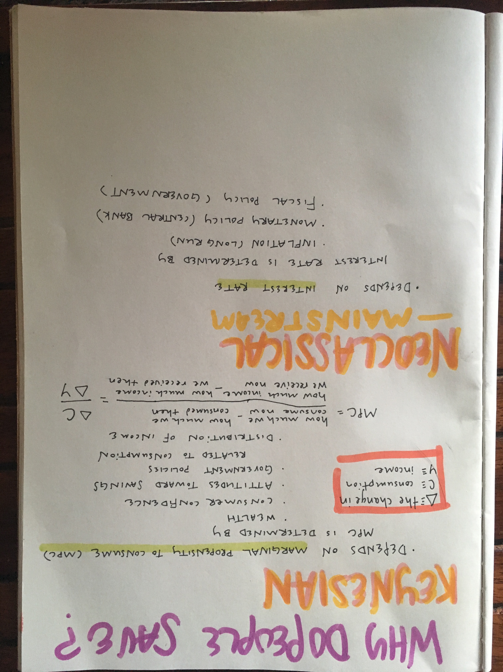
Saving Decisions
Keynesian Vs. Neoclassical

