Slide 1
Macroeconomics
ECO 201
Week 1 - What Is Economics? & What is Capitalism?

Slide 2
What is Economics?
And what do we know about it?
Notes:
Break first or no?

Slide 3
What is economics?
Pause and make some notes for yourself
Take at least 3 minutes
What is Economics?
What makes Economics different from Political Science or Sociology?
What are some examples of questions Economists might ask?
What types of data do Economists look at?

Slide 4
What is economics?
Learn the Langage of Power (Chang 2019)
  While watching, notice:
  What surprises you?
  What do you like?
  What do you already know?
  What do you disagree with?

Slide 5

What is economics?
Learn the Language of Power! (Chang 2019)
Image Source: (University of Cambridge, 2019)

Slide 6
What is economics?
Learn the Language of Power (Chang 2019)
  What did you notice:
  What surprised you?
  What did you like?
  What did you already know?
  What did you disagree with?
Pause and make some notes for yourself
Take at least 3 minutes

Slide 7
What is Economics?
“Economics is the study of the way people organize themselves to sustain life and enhance its quality” (Goodwin, Nelson, and Harris, 2019, 3).
“Economics is the science which studies human behaviour as a relationship between ends and scarce means which have alternative uses” (Robbins, 1932, 16).

Slide 8
What is Economics?
For the purpose of our class,
Economics is the study of economies.
where
an economy (or economic system) is a particular solution to
1) an allocation problem
&
2) a production problem

Slide 9
What is Economics?
For the purpose of our class,
Economics is the study of economies.
where
an economy (or economic system) is a particular solution to
1) an allocation problem – who gets what?
&
2) a production problem – what do we make and how do we make it?

Slide 10
What is Economics?
For the purpose of our class,
Economics is the study of economies.
where
an economy (or economic system) is a particular solution to an allocation problem & a production problem
Micro: this experience at the individual or household level
Macro: this experience at the community or national level

Slide 11
What is Economics?
Production Questions
Allocation Questions
What do you make?
What do you use to make it?
What do you consume?
How do you get what you use?
What do you do with what you have?
Macro Micro
What do we make?
What institutions support the stuff we make?
What is the unintended impact of what we make?
What resources do we use?
What institutions are in place to facilitate distribution?
Are their patterns to who gets what?

Slide 12
What is Economics?
Scarce
Finite
Efficient
Attainable

Slide 13
What is Economics?
Scarce – An insufficient quantity available (supplied) to cover all uses (demands) at a particular price level
Finite – Having a relevant, but not necessarily pressing, limit
Efficient – Generating the most output for the least amount of input
Attainable - A quantity of output of (a) good(s) that can be produced with presently available resources

Slide 14
What is Capitalism?
most prevalent economic system today

Slide 15
What Is Capitalism?
Capitalism is an economic system characterized by private property, markets, and firms.
OR
Capitalist societies solve production and allocation decisions with private property, markets, and firms.

Slide 16
What Is Capitalism?
Capitalism is an economic system characterized by:
private property
markets &
firms.
INSTITUTIONS

Slide 17
What Is Capitalism?
Capitalism is an economic system characterized by:
private property
markets &
firms.
THE CONCEPT THAT THINGS ARE OWNED BY PEOPLE, ENFORCED BY OTHER INSTITUTIONS
Notes:
What’s ownership?

Slide 18
What Is Capitalism?
Capitalism is an economic system characterized by:
private property
markets &
firms.
THE CONCEPT THAT THINGS ARE OWNED BY PEOPLE, ENFORCED BY OTHER INSTITUTIONS
ownership : the right to decide how things are used and by whom
Notes:
Under Capitalism, societies organize production and allocation decisions through the following institutions:
Private Property – the concept that things are owned by people, enforced by other institutions (social norms, legal systems)
ownership - the right to decide how things are used and by whom
Markets – method of transferring ownership of goods and services that is voluntary, reciprocal, and competitive
Firms – method of production where labor is performed by individuals who receive a wage to work on privately owned capital goods for the purpose of making the owners a profit
Capital goods - things used to make commodities
Commodities are goods and services produced for the purpose of making a profit

Slide 19
What Is Capitalism?
Capitalism is an economic system characterized by:
private property
markets &
firms.
THE CONCEPT THAT THINGS ARE OWNED BY PEOPLE, ENFORCED BY OTHER INSTITUTIONS
METHOD OF TRANSFERRING OWNERSHIP OF GOODS AND SERVICES THAT IS VOLUNTARY, RECIPROCAL, and COMPETITIVE
ownership : the right to decide how things are used and by whom
Notes:
Under Capitalism, societies organize production and allocation decisions through the following institutions:
Private Property – the concept that things are owned by people, enforced by other institutions (social norms, legal systems)
ownership - the right to decide how things are used and by whom
Markets – method of transferring ownership of goods and services that is voluntary, reciprocal, and competitive
Firms – method of production where labor is performed by individuals who receive a wage to work on privately owned capital goods for the purpose of making the owners a profit
Capital goods - things used to make commodities
Commodities are goods and services produced for the purpose of making a profit

Slide 20
What Is Capitalism?
Capitalism is an economic system characterized by:
private property
markets &
firms.
THE CONCEPT THAT THINGS ARE OWNED BY PEOPLE, ENFORCED BY OTHER INSTITUTIONS
METHOD OF TRANSFERRING OWNERSHIP OF GOODS AND SERVICES THAT IS VOLUNTARY, RECIPROCAL, and COMPETITIVE
ownership : the right to decide how things are used and by whom
METHOD OF PRODUCTION WHERE COMMODITIES ARE MADE WITH PRIVATELY-OWNED CAPITAL GOODS BY LABORERS WORKING FOR A WAGE
Notes:
Under Capitalism, societies organize production and allocation decisions through the following institutions:
Private Property – the concept that things are owned by people, enforced by other institutions (social norms, legal systems)
ownership - the right to decide how things are used and by whom
Markets – method of transferring ownership of goods and services that is voluntary, reciprocal, and competitive
Firms – method of production where labor is performed by individuals who receive a wage to work on privately owned capital goods for the purpose of making the owners a profit
Capital goods - things used to make commodities
Commodities are goods and services produced for the purpose of making a profit

Slide 21
What Is Capitalism?
Capitalism is an economic system characterized by:
private property
markets &
firms.
THE CONCEPT THAT THINGS ARE OWNED BY PEOPLE, ENFORCED BY OTHER INSTITUTIONS
METHOD OF TRANSFERRING OWNERSHIP OF GOODS AND SERVICES THAT IS VOLUNTARY, RECIPROCAL, and COMPETITIVE
ownership : the right to decide how things are used and by whom
commodities : goods and services produced for the purpose of making a profit
capital goods : goods that make commodities
METHOD OF PRODUCTION WHERE COMMODITIES ARE MADE WITH PRIVATELY-OWNED CAPITAL GOODS BY LABORERS WORKING FOR A WAGE
Notes:
Under Capitalism, societies organize production and allocation decisions through the following institutions:
Private Property – the concept that things are owned by people, enforced by other institutions (social norms, legal systems)
ownership - the right to decide how things are used and by whom
Markets – method of transferring ownership of goods and services that is voluntary, reciprocal, and competitive
Firms – method of production where labor is performed by individuals who receive a wage to work on privately owned capital goods for the purpose of making the owners a profit
Capital goods - things used to make commodities
Commodities are goods and services produced for the purpose of making a profit

Slide 22
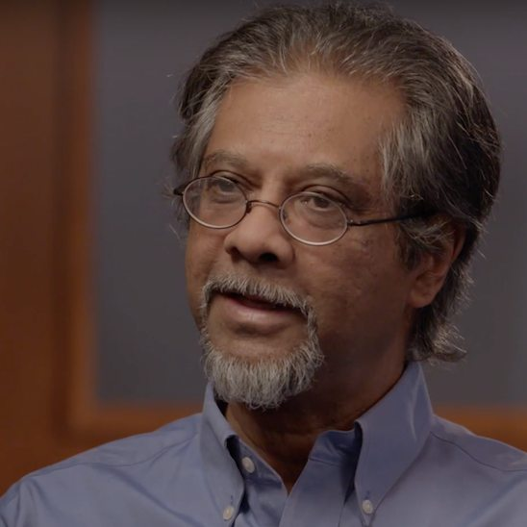
Before Class next Monday
1. Watch Shaikh (2020)
Anwar Shaikh is a Professor of Economics at The New School for Social Research and Associate Editor of the Cambridge Journal of Economics.
From many places including Pakistan and New York City.
week 1
2. READ @SYWTTA (2020)
@SYWTTA is an IG/TW/FB account run by one person who collaborates with others – this is literally all I know about this person
3. READ EISENBARTH (2020)
Argumentation (make sure its this one)

Slide 23
Instructions weekly Reflection 1
Due next Thursday 02/11
Available on OpenLab
We Will Grade In Class
You can change your answers before you turn it in on Blackboard
week 1

Slide 24
Reference List
Chang, Ha-Joon.(2016). Economics is for Everyone! RSA Animate. Retrieved from https://www.thersa.org/discover/videos/rsa-animate/2016/economics-is-for- everyone
Goodwin, Neva, Julie A. Nelson, & Jonathan Harris. (2009). Macroeconomics in Context. Armonk, NY: M.E. Sharpe.
Robbins, Lionel. (1945). An Essay on the Nature & Significance of Economic Science (2nd ed.). London: Macmillan and Co., Limited.
University of Cambridge. (2019). Dr Ha-Joon Chang | Faculty of Economics. Retrieved September 2, 2019 from http:// www.econ.cam.ac.uk/people/faculty/hjc1001

