Slide 1

A look at early literacy
Drawing and writing

Slide 2

Rethinking the paths to literacy
Semiotics: The study of signs and symbols
Mode: An organized means of representation
Media: The manner in which meaning is presented
Before children learn to read and write, they are already experienced makers of signs and makers of meaning in a variety of media: building with blocks and other construction toys; creating "Not A Box" with cardboard boxes, blankets and chairs; pretending with scarves and hats and other dress-up; drawing and painting and designing with crayons, watercolors, fingerpaints, collage materials...

Slide 3

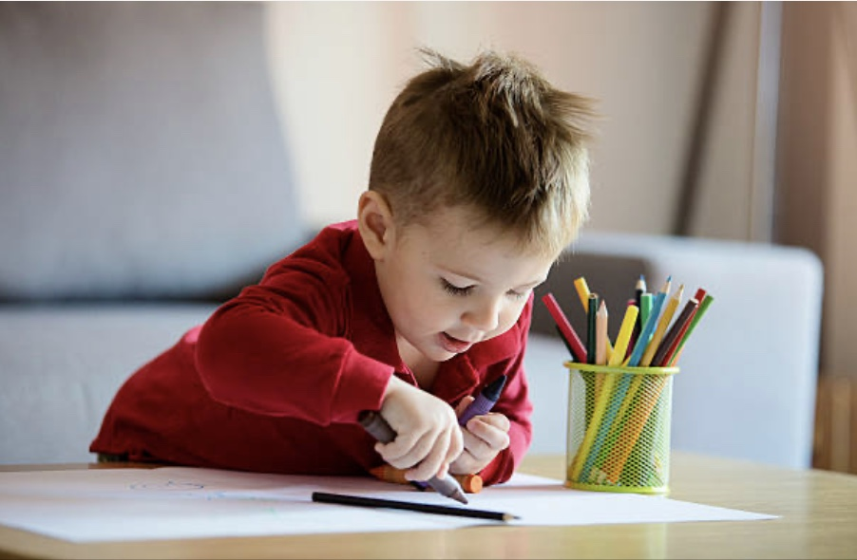
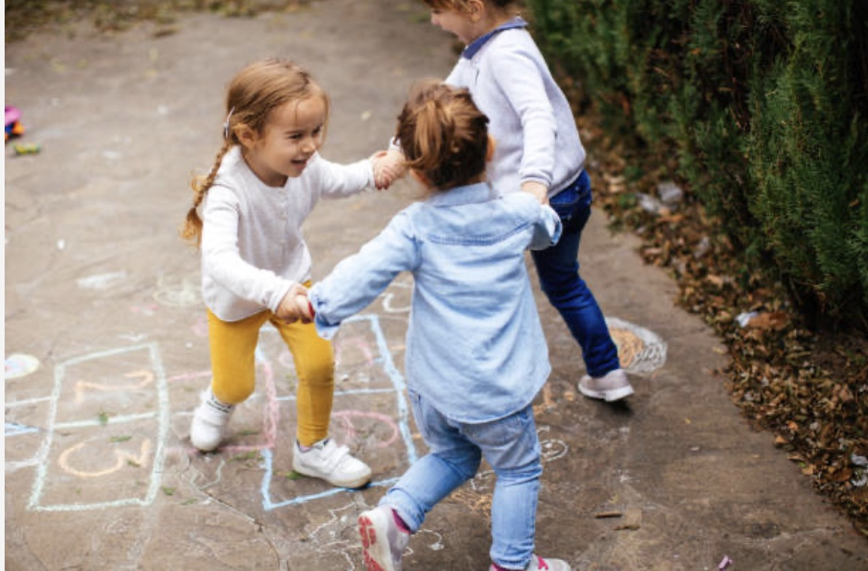
The transition of meaning-making to writing
When children enter school, they are already competent makers of signs and meaning in many different modes of representation.
The task for early childhood educators is to bridge from what children already know to learning to write.
Teachers need to “reflect on the social, cultural, and cognitive implications of the transition from the rich world of meanings made in countless ways, in countless forms, in the early years of children’s lives to the…world of written language.”
(Kress, 1997)

Slide 4
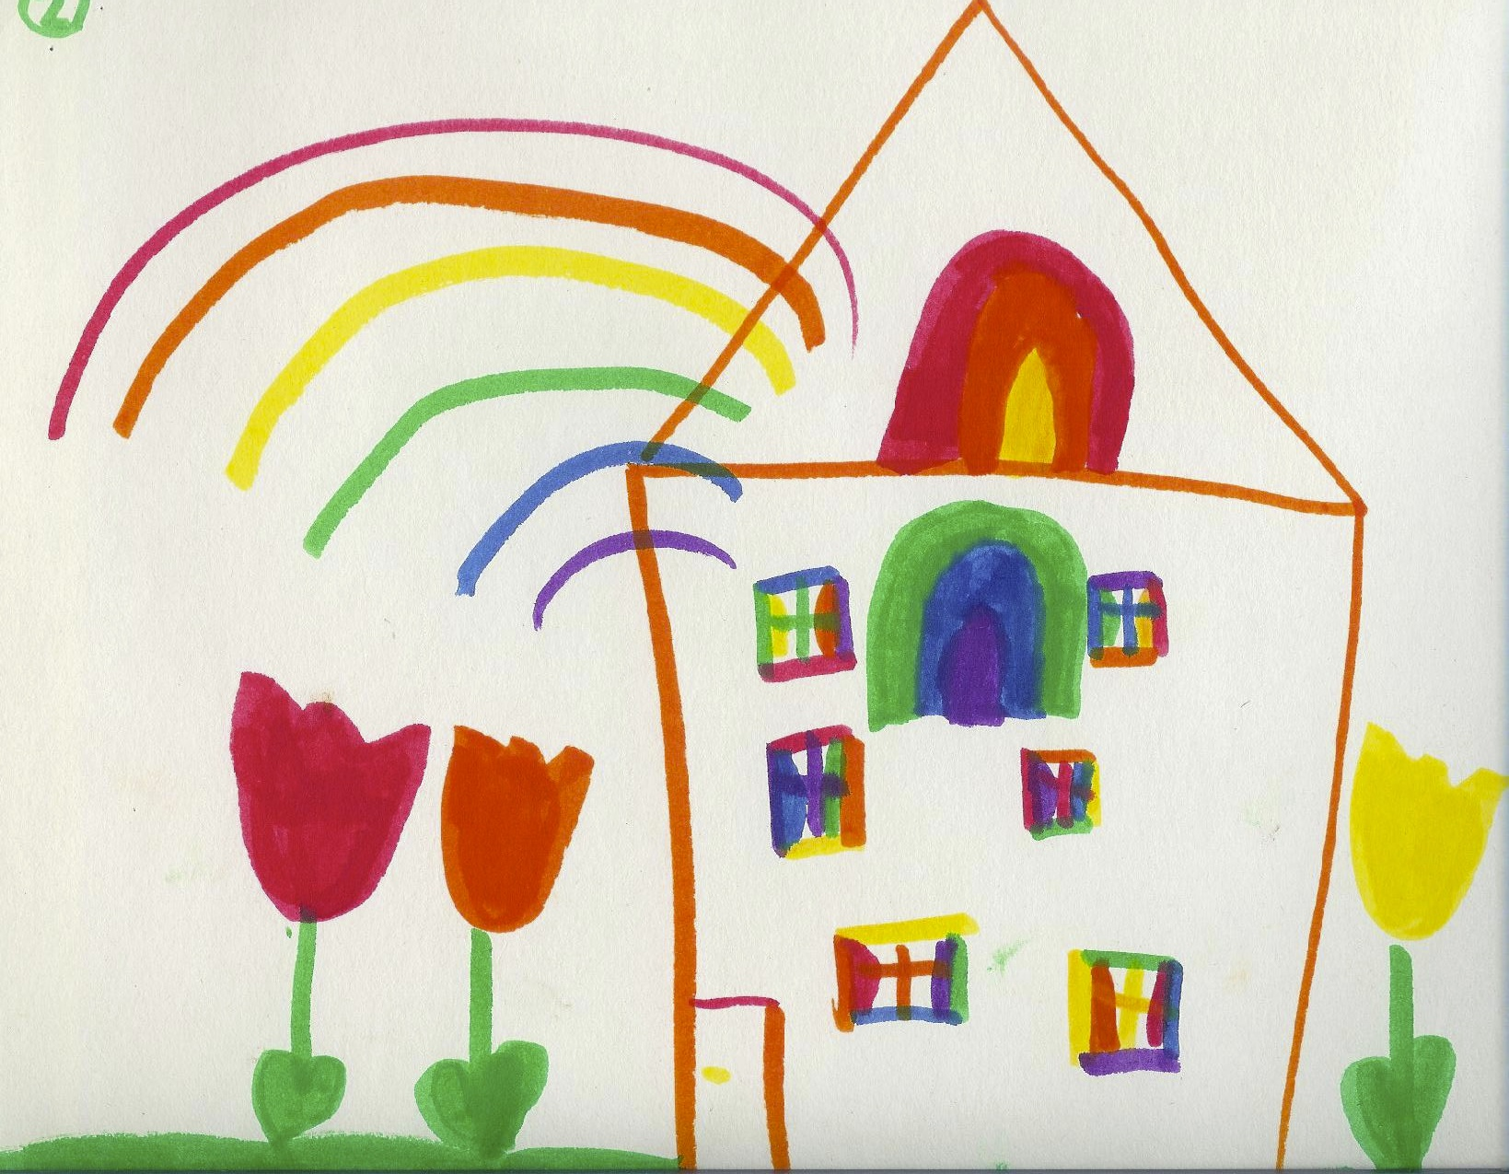
The connection between drawing and writing
What is the connection between drawing and writing for children who are in the stage of emergent literacy?
According to Baghban (2007), “Children draw pictures and write to organize ideas and construct meaning from their experiences.”

Slide 5
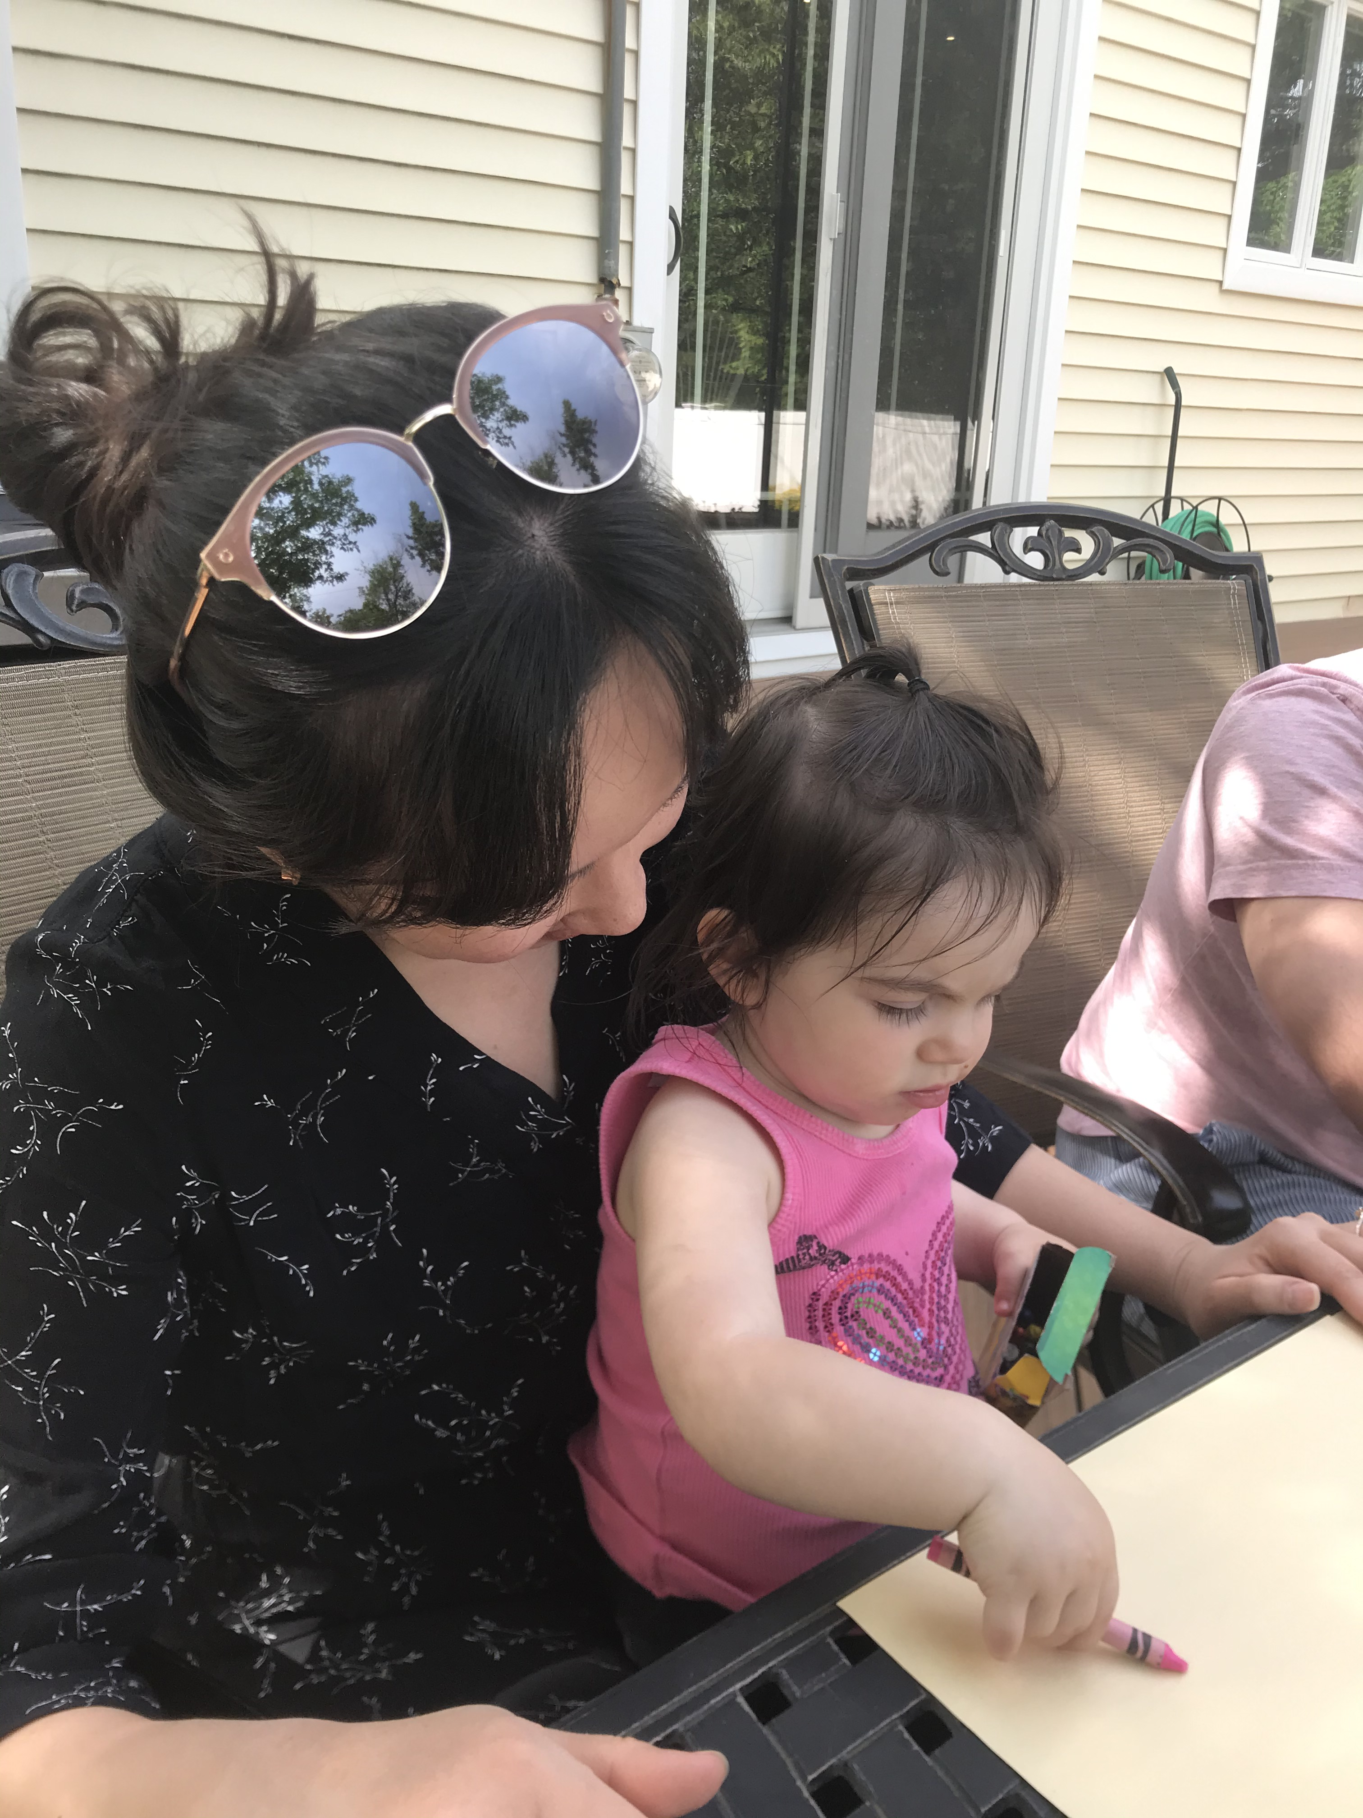
From Scribbling to Storytelling
From the scribbling of toddlers to the realism of early elementary age students, the drawing/writing of young children shows increasing complexity, symbolic representation and meaning-making.
What stories do children tell as they draw/paint?
How do children share observations and discoveries as they share their drawings/paintings in museum walks
As children move into the stage of representation, what is the focus of their work?

Slide 6

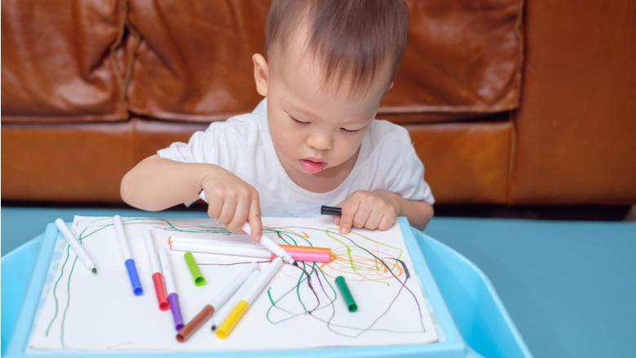
Scribbling Stage –
Kinesthetic Exploration
(18 months – 3 years old)
Children are engaged in the physical activity of drawing (kinesthetic)
They are experimenting with making marks on paper (color, movement)
At the beginning of this stage, the marks are not yet symbolic or representational; toward the end of this stage, marks begin to have meaning

Slide 7
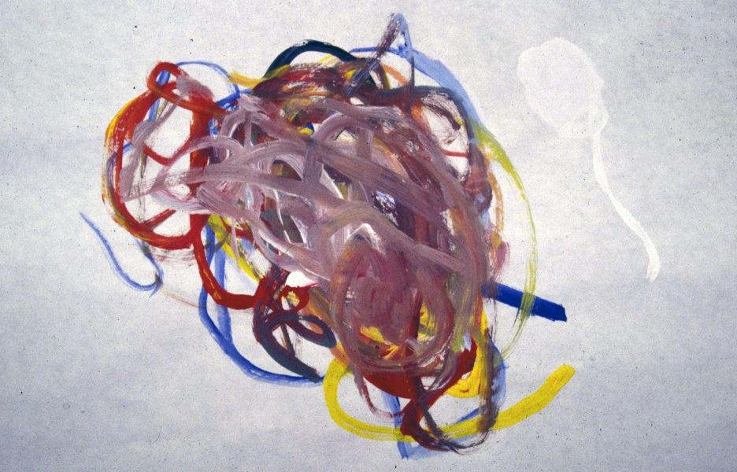
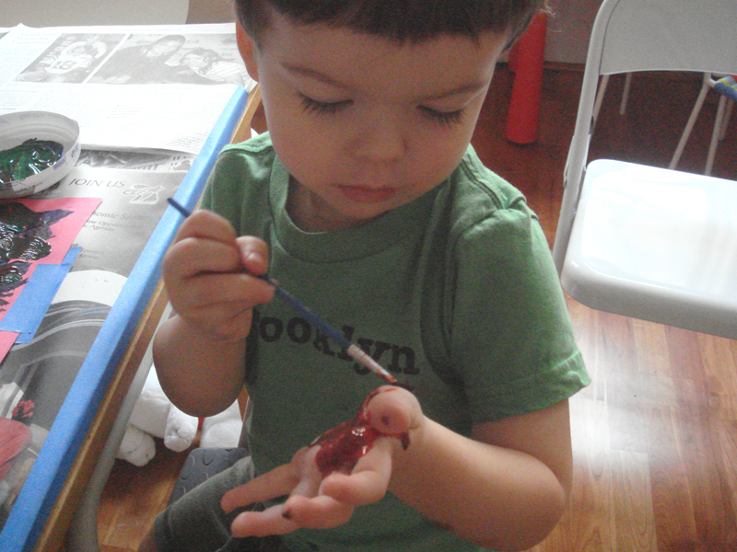
Explorers are not focus on the viewer.
In this stage, children have little to no interest in or understanding of how their artwork can be representational.

Slide 8
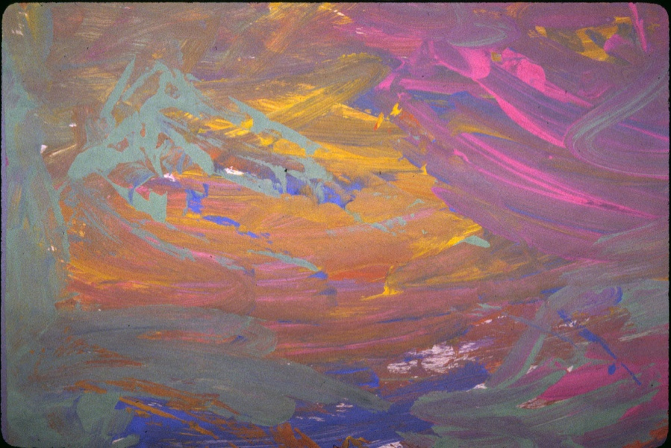
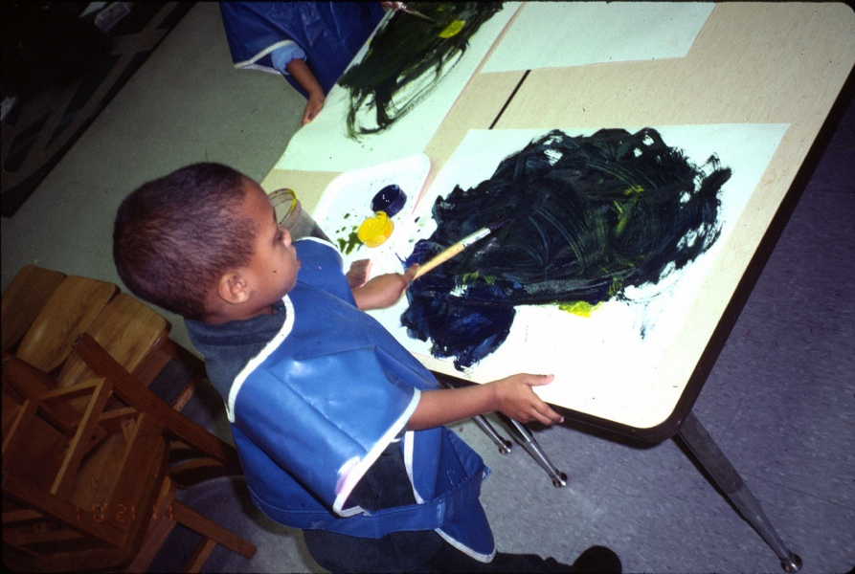
Materials invite sensory motor activities and exploration to discover what the material can do.
Explorers are trial-and-error thinkers. Ideas are fluid in relation to the materials.
They are learning that their physical actions have visual consequences.

Slide 9
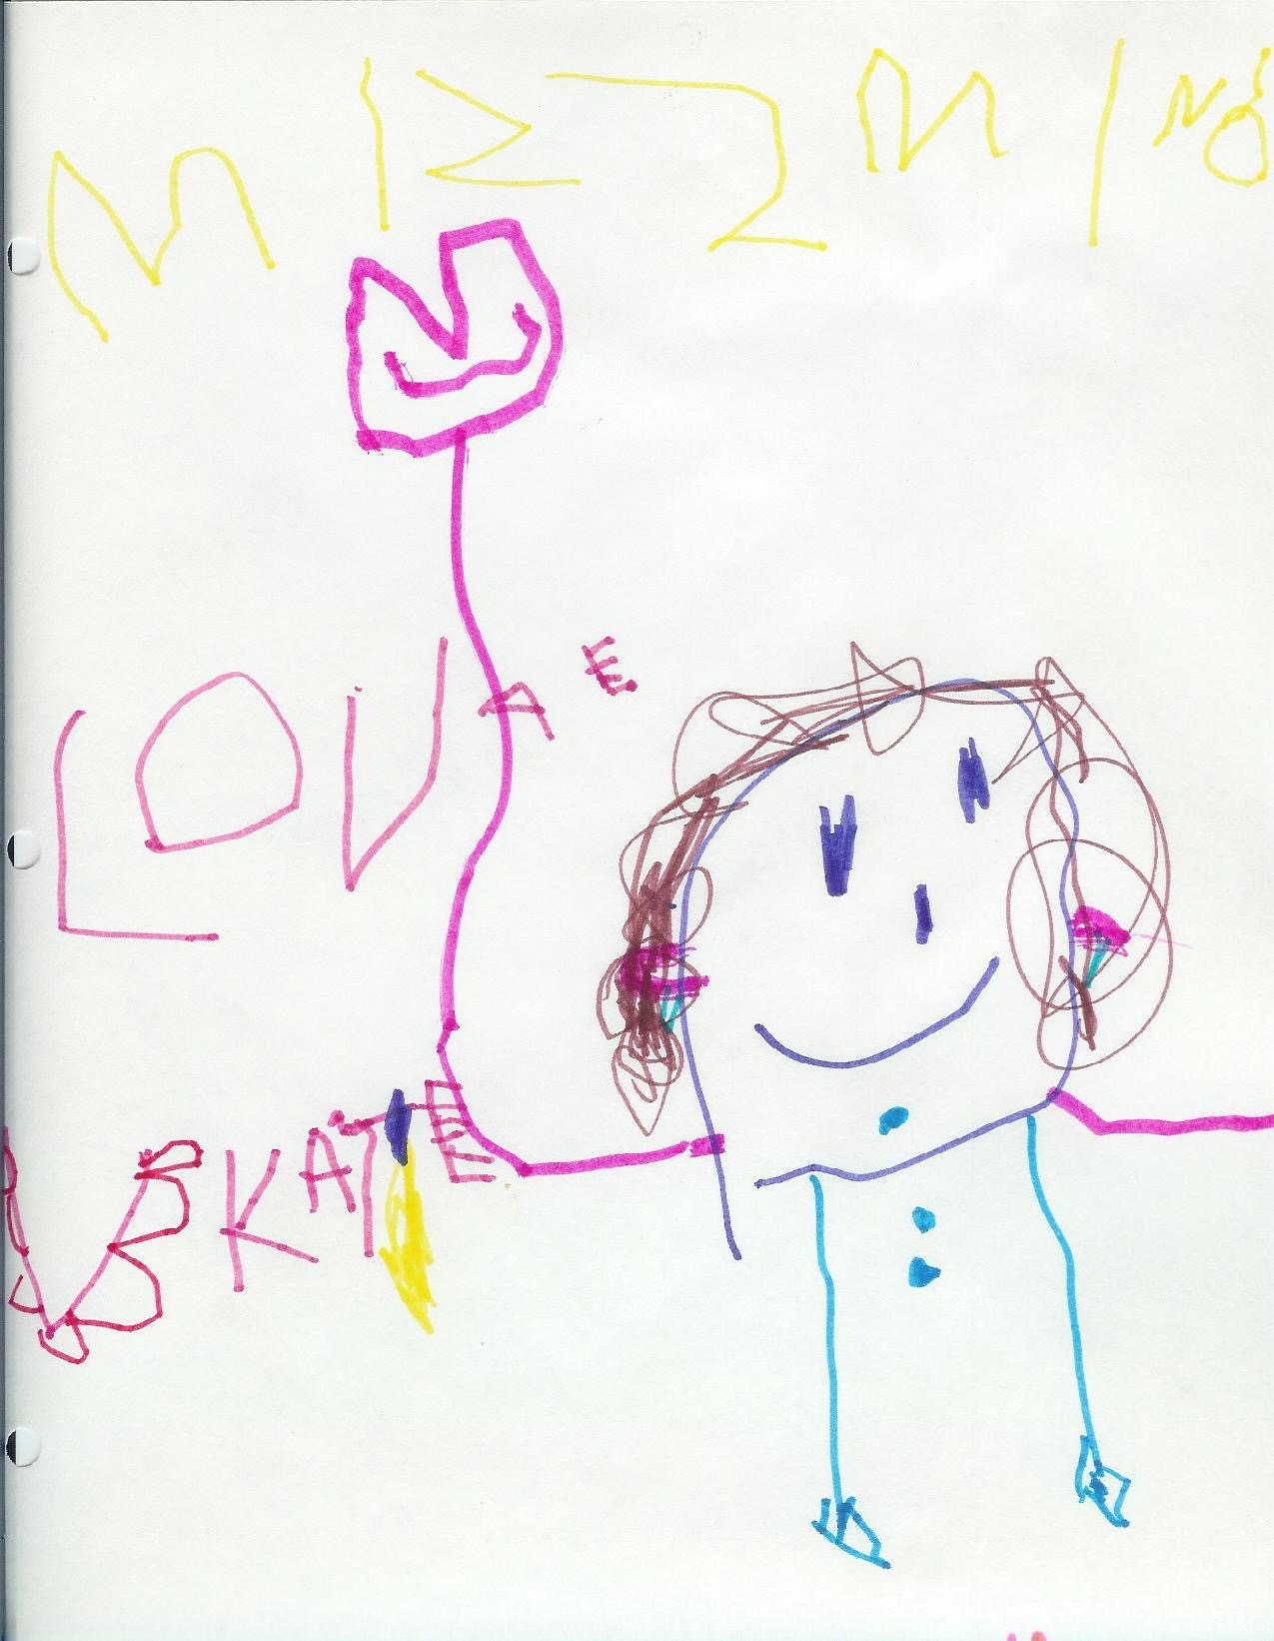
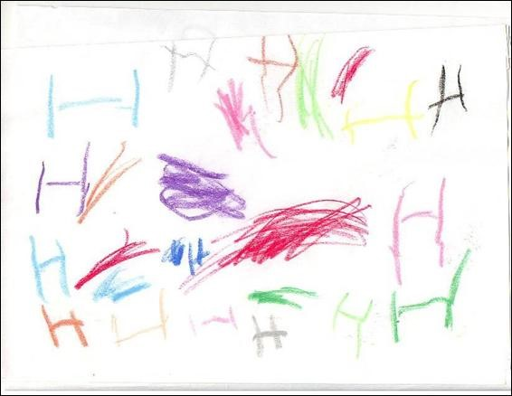
Pre-Schematic Stage –
Connecting to the Physical World
(3 – 4 years old)
Drawings are more complex, though not yet realistic. Children understand that drawings are symbolic, representing ideas, rather than real-life depictions.
Children at this stage begin to see connections between the shapes that they draw and the physical world around them. Circles and lines may be described as people or objects that are physically present in the child’s life.
Drawings are often self-portraits.
Children at this stage are beginning to understand that drawings can be used to communicate ideas (emergent literacy).

Slide 10
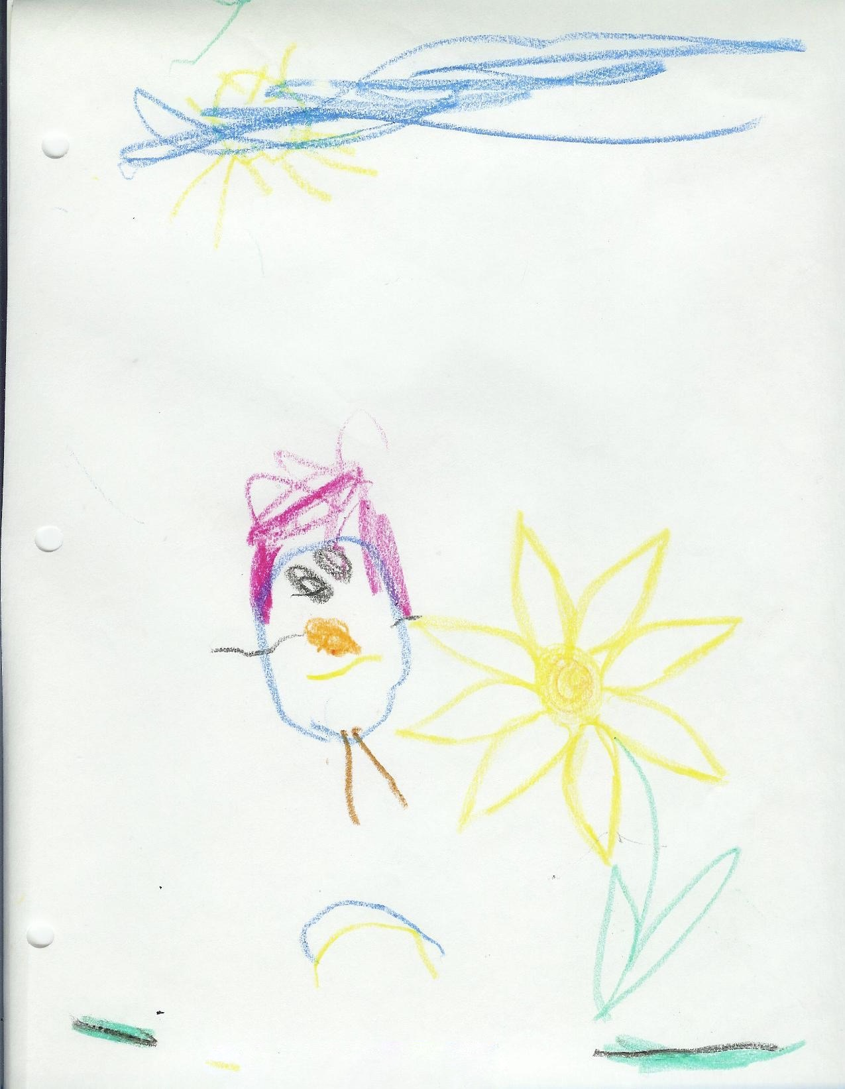
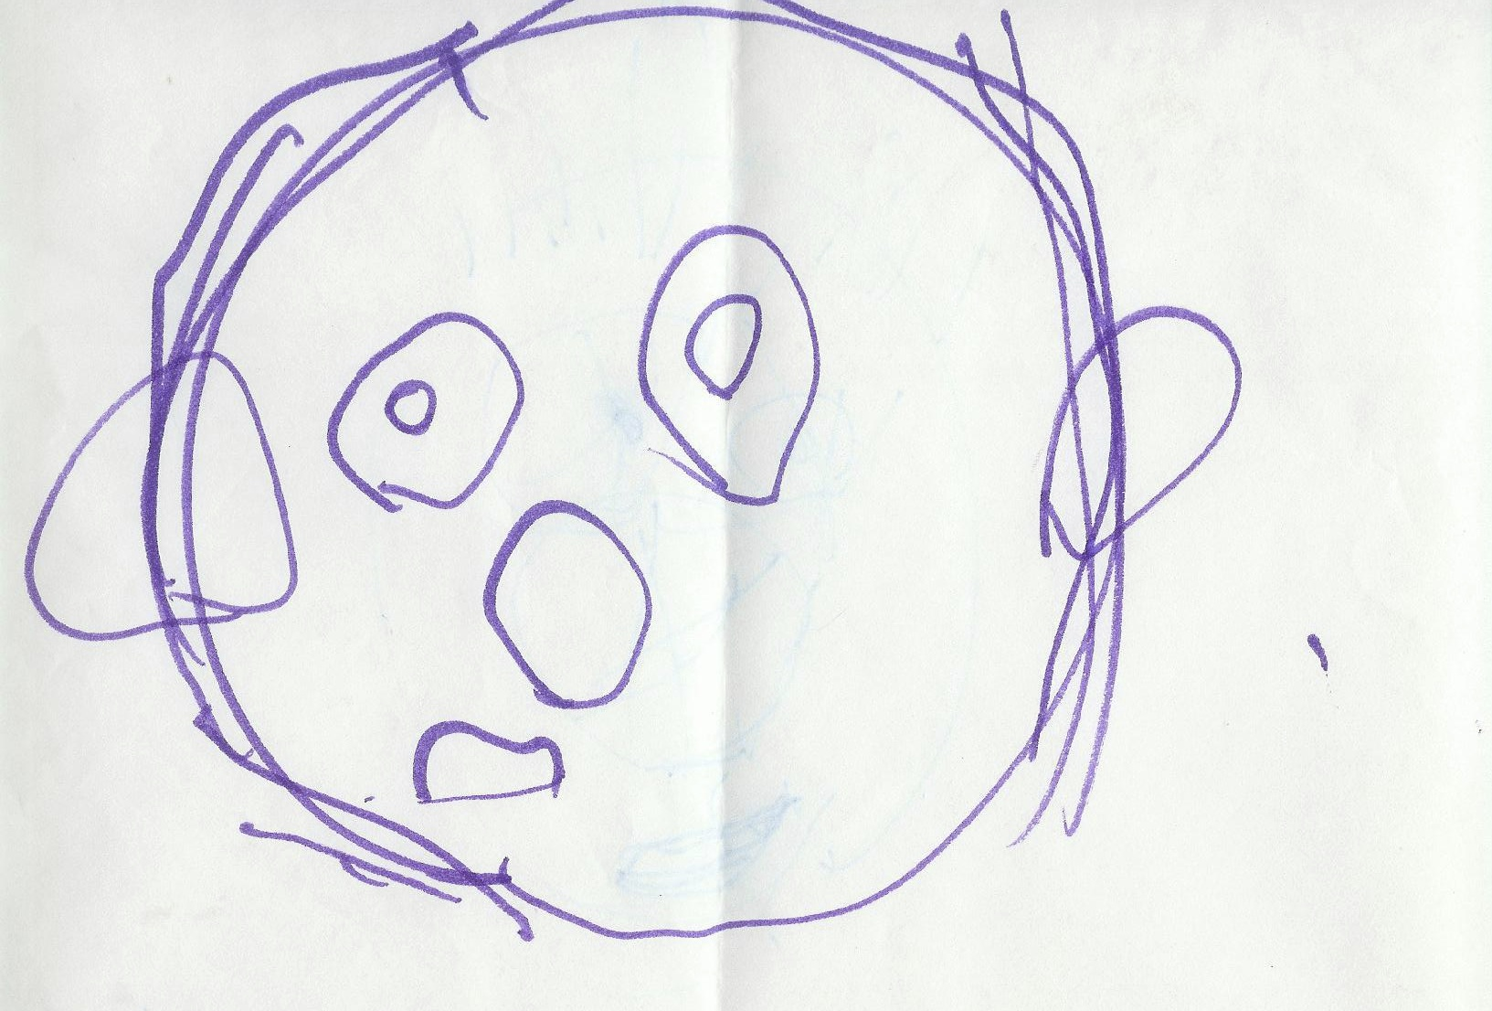
Children at this stage are becoming aware of symbolization and there are signs of emerging representation in their artwork.

Slide 11
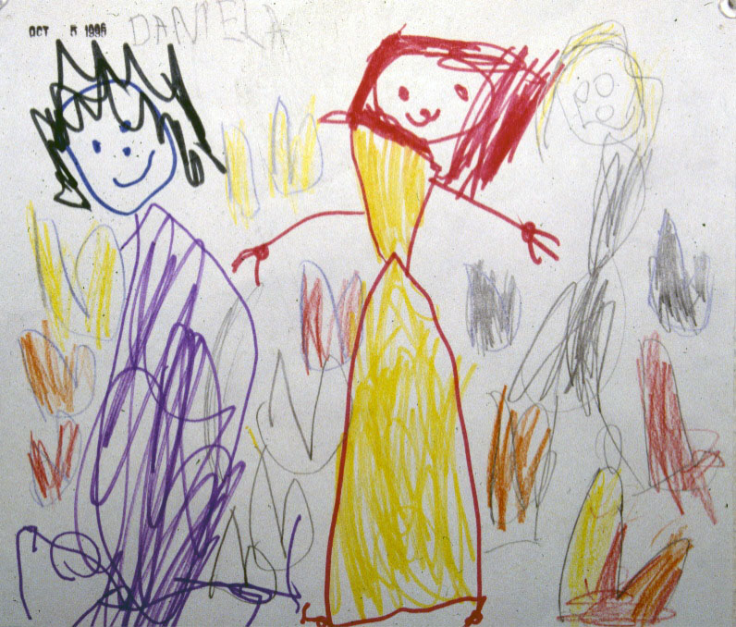
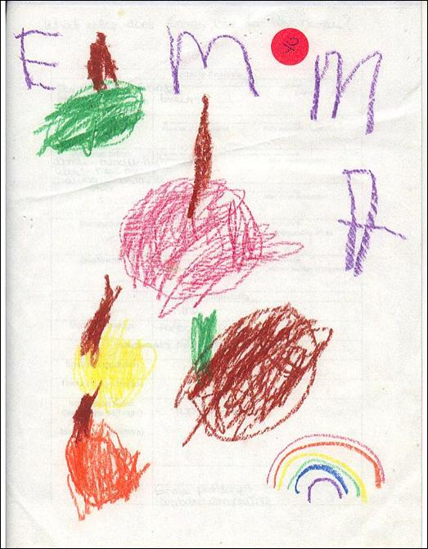
Toward the end of this stage, as they move into a more representational phase, they may label or sign their artwork

Slide 12
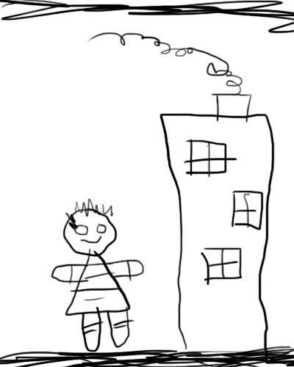
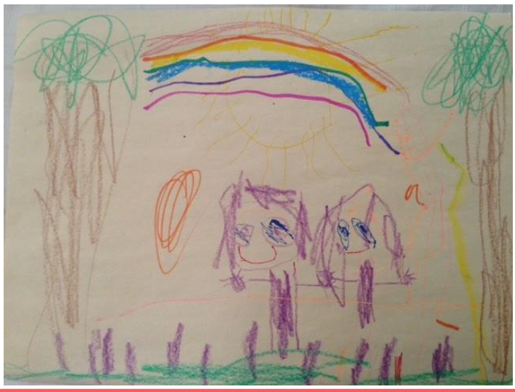
Early Schematic Stage – Meaning-Making
(5 – 6 years old)
Children at this stage are beginning to understand spatial relationships and are developing a sense of visual perspective.
Drawings of people are more proportional and detailed. Children clearly assign shapes to objects that they are attempting to communicate.
Drawings have a clear separation between sky and ground. Often the sky is a strip of blue at the top of the paper, while the ground is a strip of green at the bottom. Typically, all objects are on the baseline and all figures are looking directly at the viewer.
Colors are more realistic and stereotypical (e.g., green grass, blue sky).
Objects of importance are often drawn larger than objects of lesser importance.

Slide 13
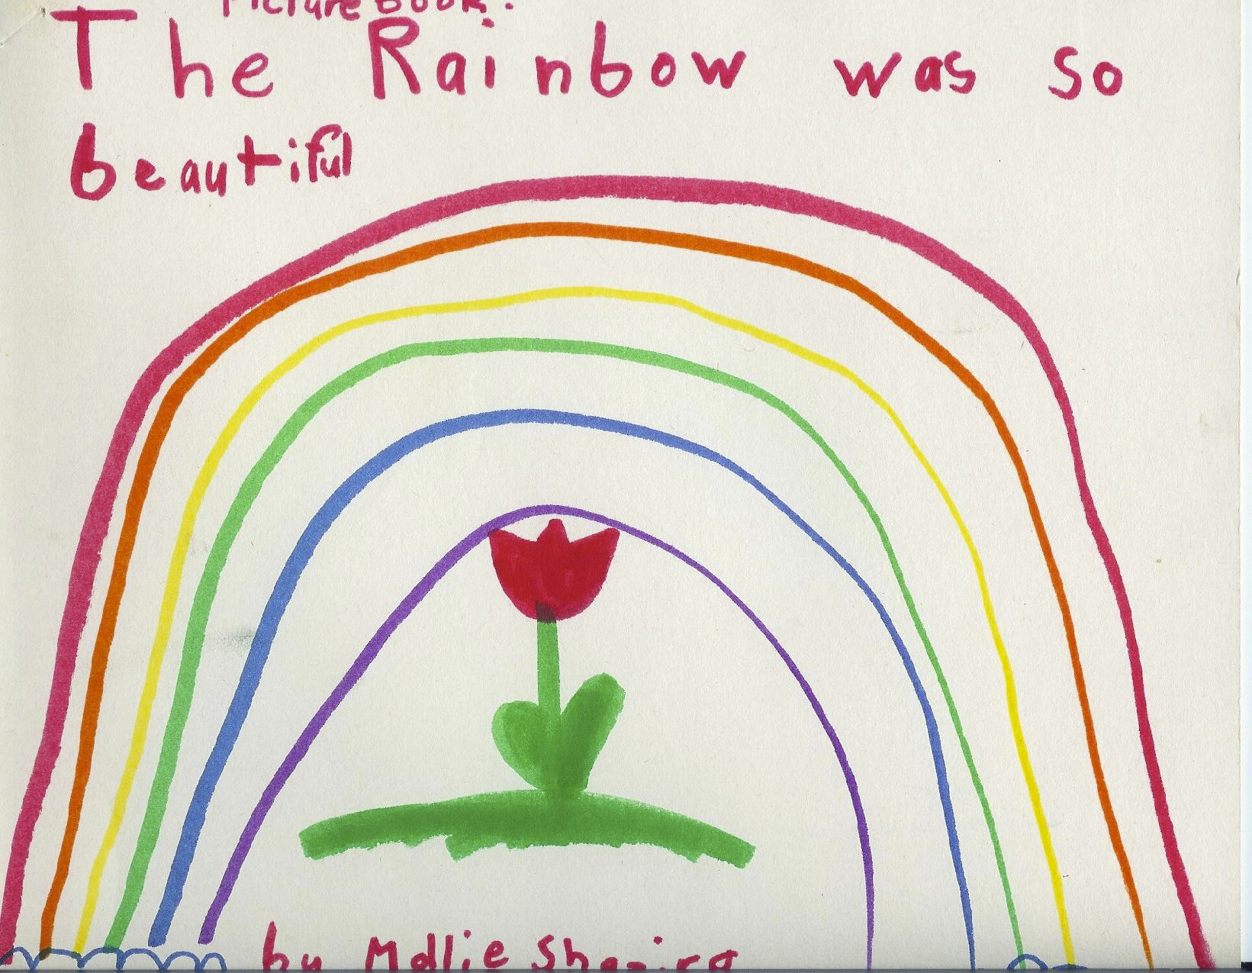
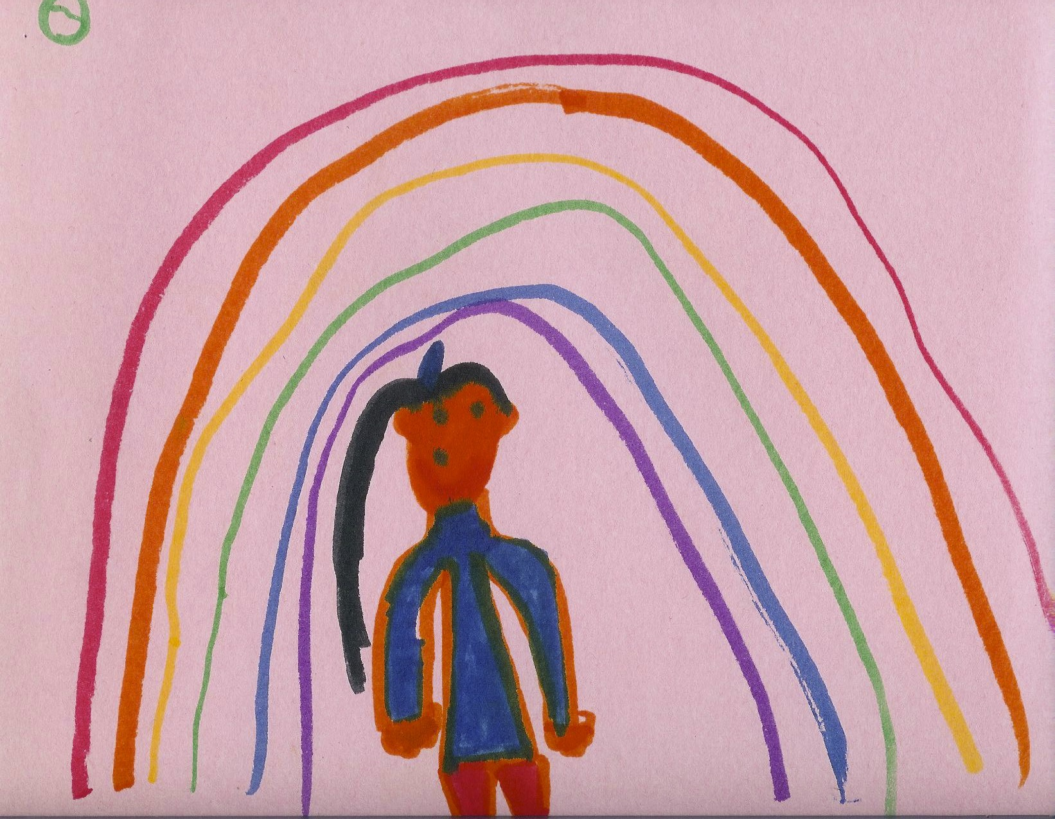
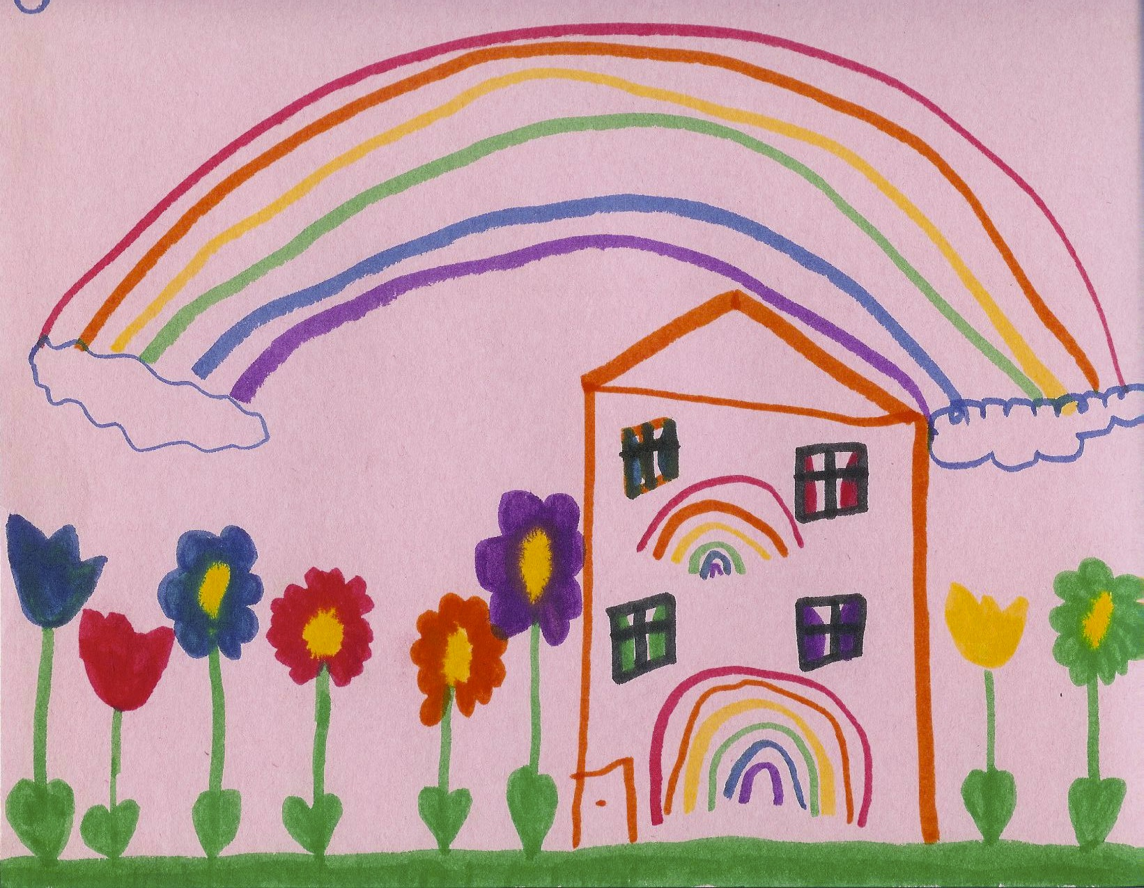
Early Schematic Stage – Meaning-Making
(5 – 6 years old)
As their repertoire of symbols grows, their drawings become more complex.
They often have developed a schema for creating drawings. There is a defined order in the development of the drawing.
Drawing can be a form of storytelling.
Children may label objects in the drawing or add text.

Slide 14
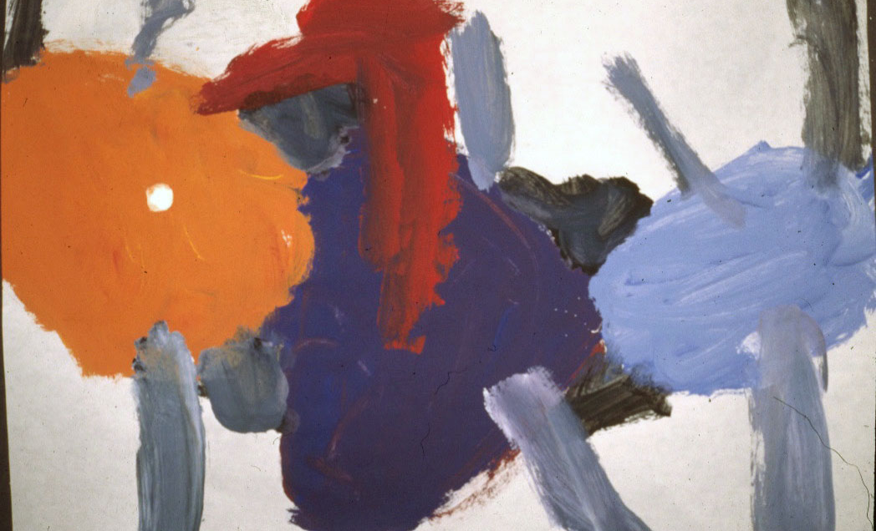
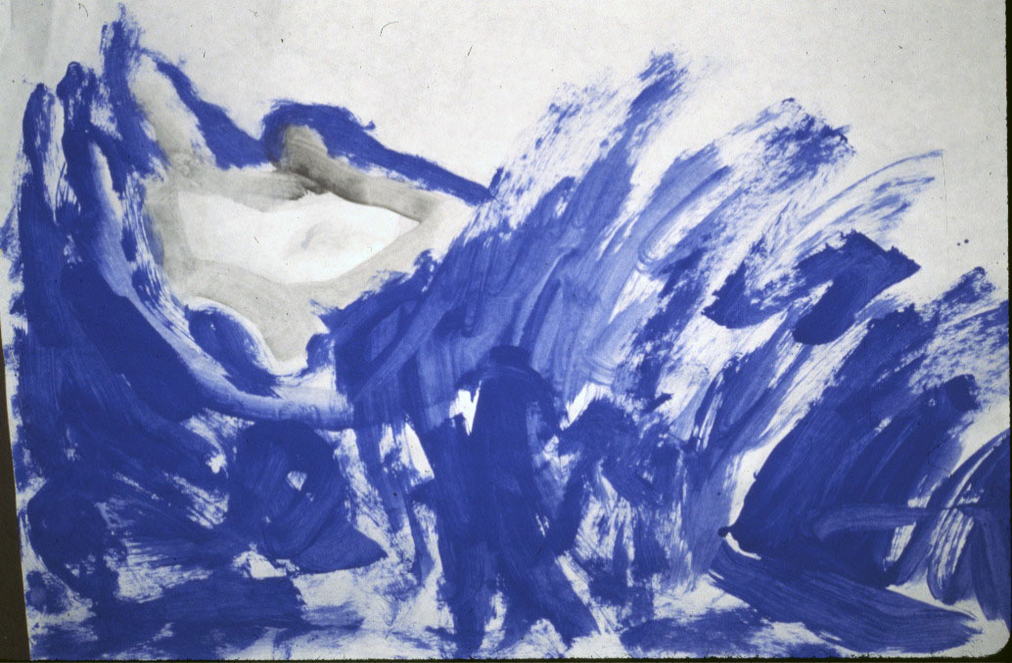
Trial and error process gives way to inductive thinking and deliberate patterns.
Children use materials in a deliberate way to create visual effects.
They begin to make associations between visual effects and personal experiences outside the artwork.

Slide 15
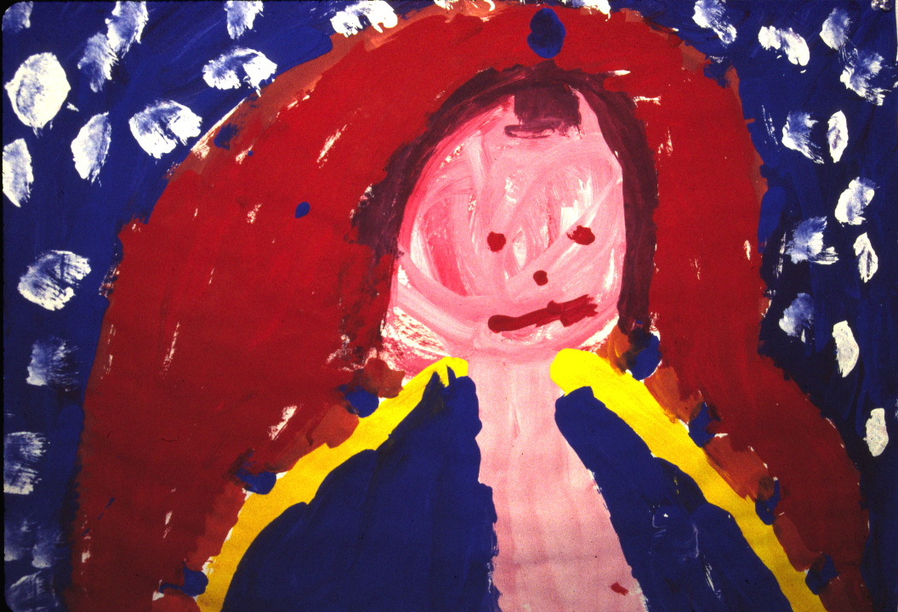
The experience of making is a representation of an object, person, action or event.

Slide 16
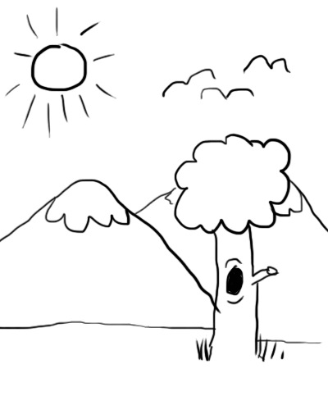
Later Schematic Stage - Dawning Realism
(7 – 9 years old)
Children at this stage are intentionally planning as they create works of art. Their drawings have a new complexity and show signs of deductive reasoning.
Overlapping can be seen and a sense of spatial relationships is more evident.
Children begin to draw with more detail. Later in the phase, they become more focused on drawing realistically.
They move from a baseline to creating layers using the horizon.

Slide 17
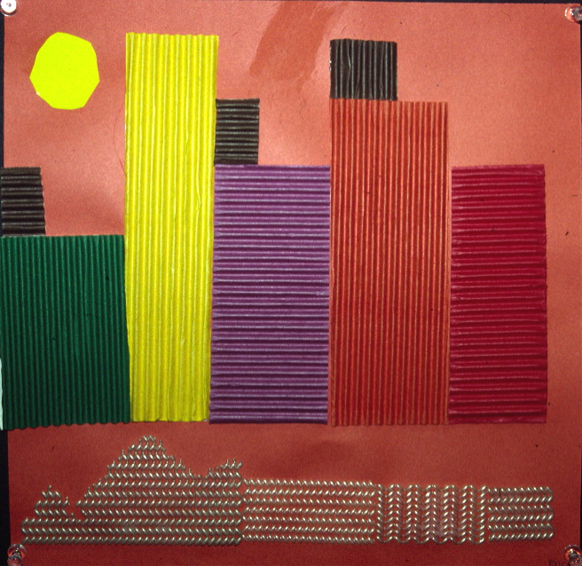
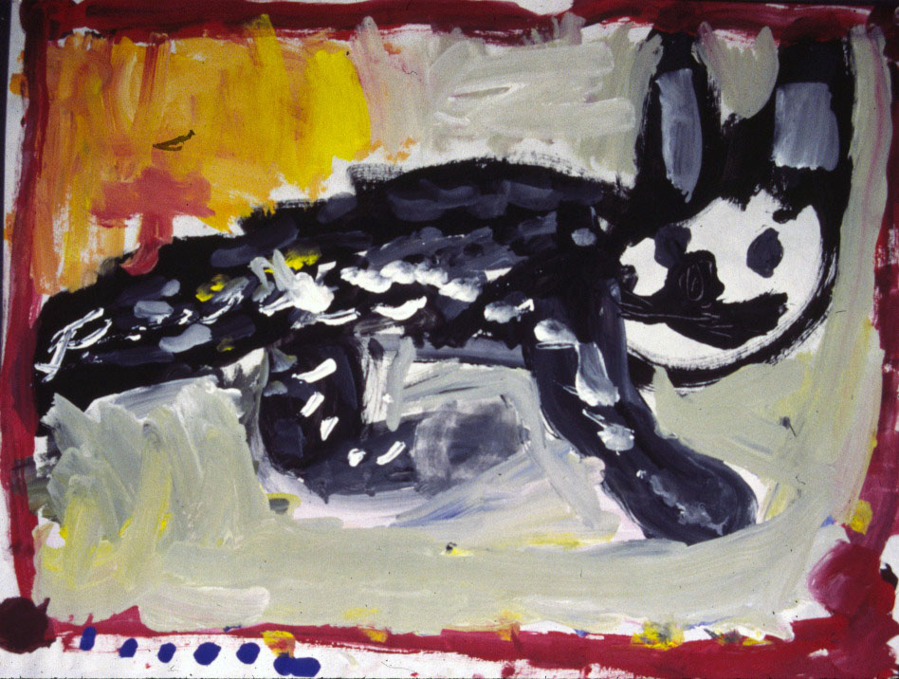
In this stage, children’s artwork is intentionally representational.
They use visual effects to support representational intentions.

Slide 18
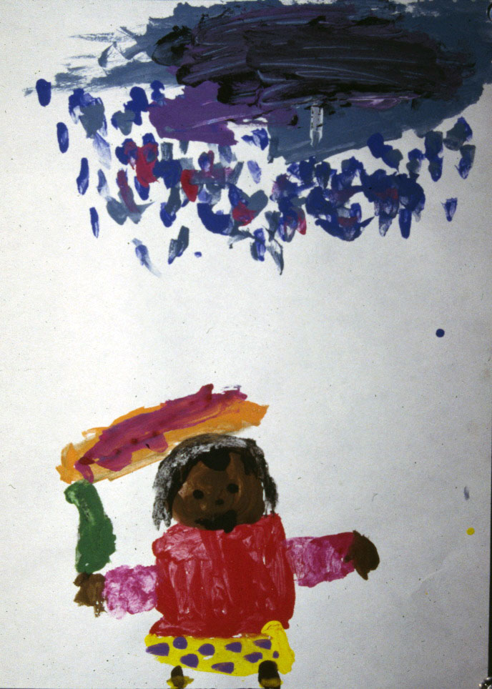
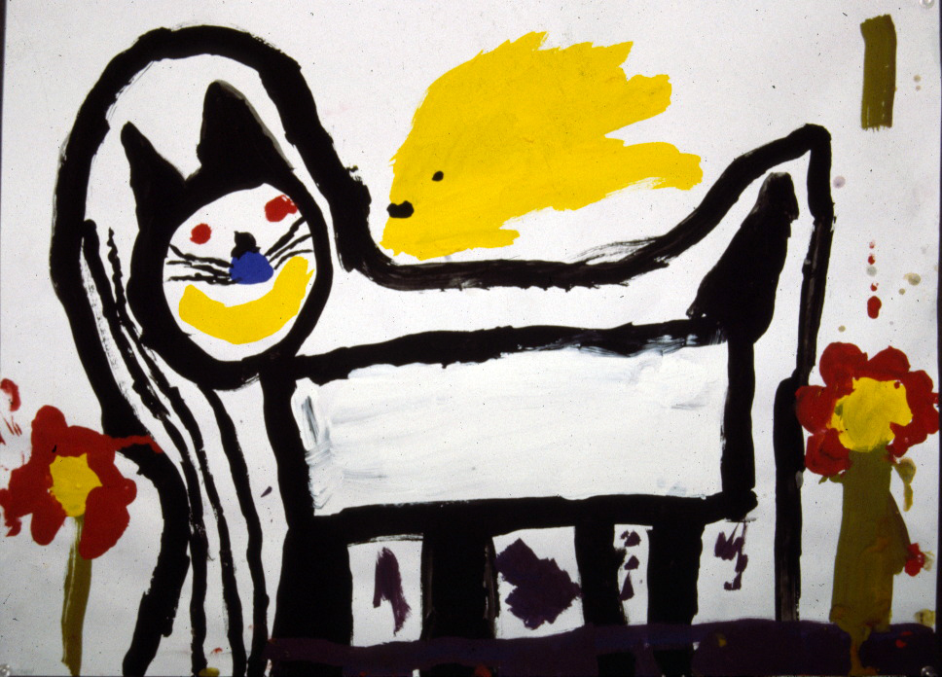
Children realize that their drawings, paintings, and other works of art have a role to play in communicating meaning.
The experience that concerns them is primarily personal.

Slide 19
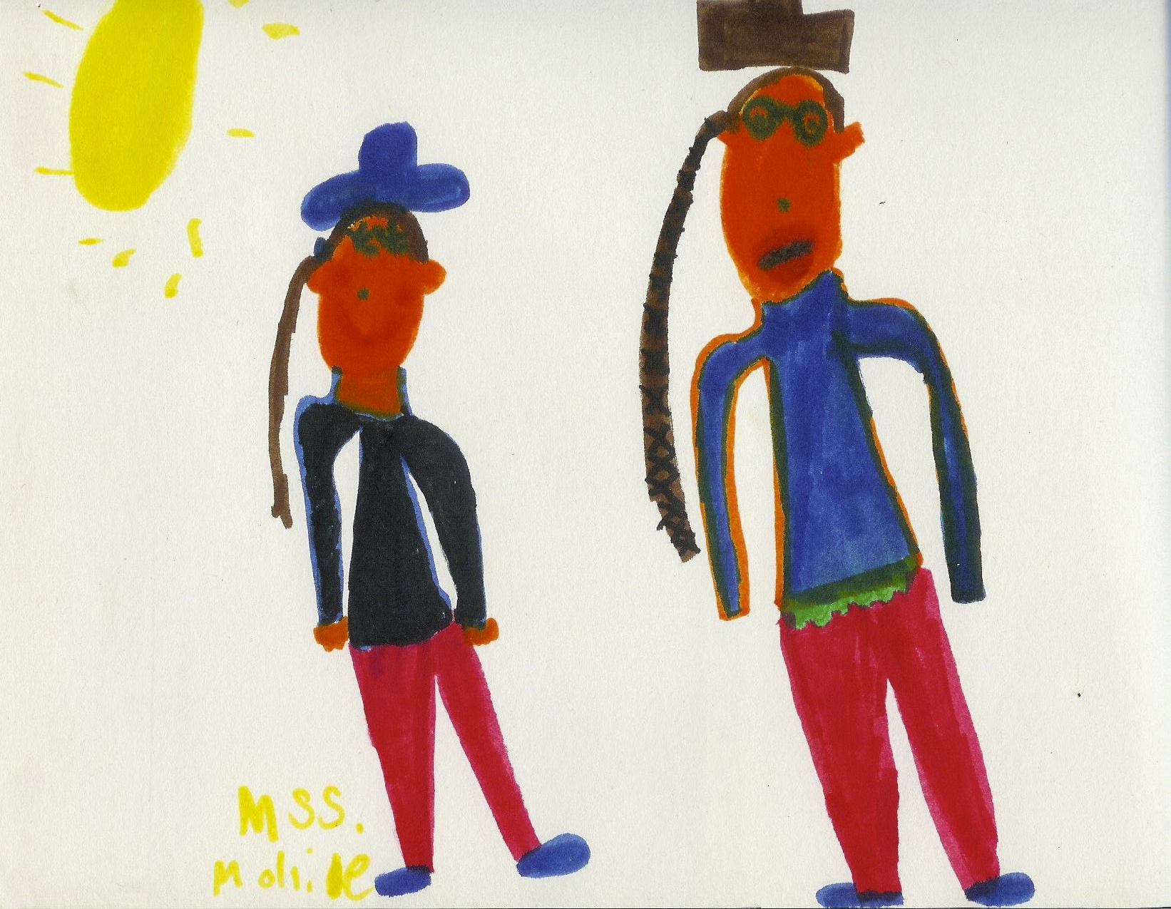
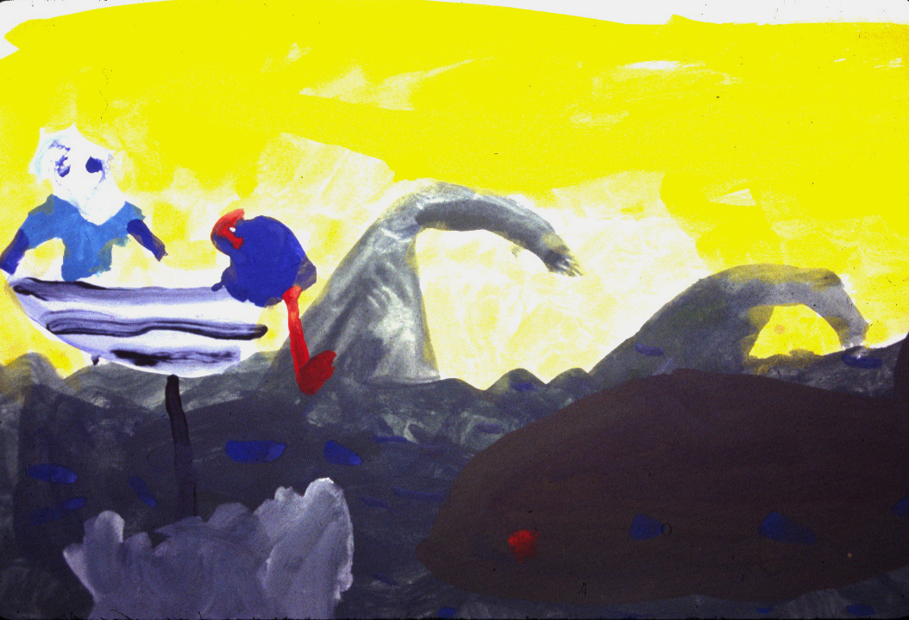
Their artwork tells a story…

Slide 20
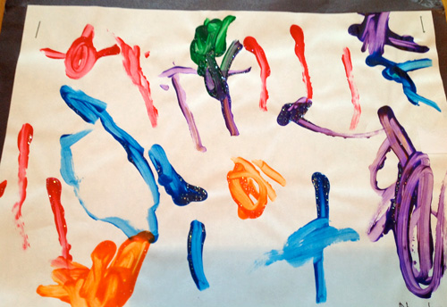
“I’m writing a story about a rainbow.”
Drawing and Telling
Meaning-making in art can be verbal or non-verbal or both.
Drawing and telling:
Allows each of these symbolic domains to enrich and inform the other.
Gives children the opportunity to create and share meaning using both verbal and non-verbal modes of communication.
Increases children’s capacity to use multiple forms of representational thinking and to mentally manipulate and organize images, ideas and feelings.

Slide 21
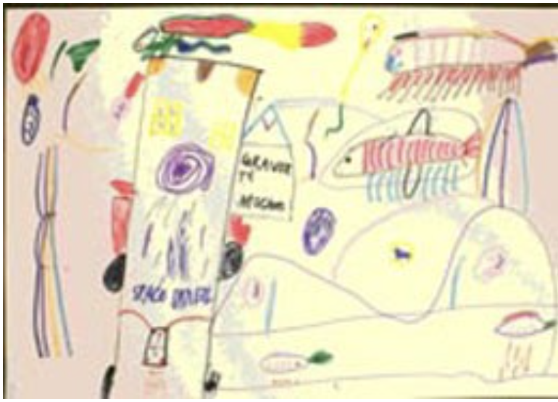
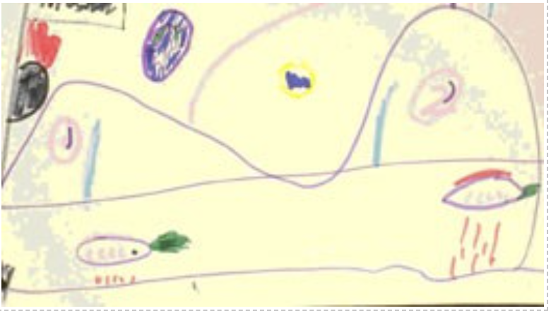
Art as storytelling
Child (8-year-old): And this is a roadway now. The road is like a tunnel type of thing.
Adult: A tunnel type thing. Is part of it underground?
Child: Yeah, what it is is a tunnel so the cars can just go through the tunnel. They got cars that hover above the ground about eight centimeters…All the cars they run….What do they run on? Grass (adds green ‘whoosh’ lines behind the cars). Most of the people have to go to Earth to get the grass. Petrol stations, but they call them grass stations…Well, it’s up on space I suppose there is no gravity there.

Slide 22
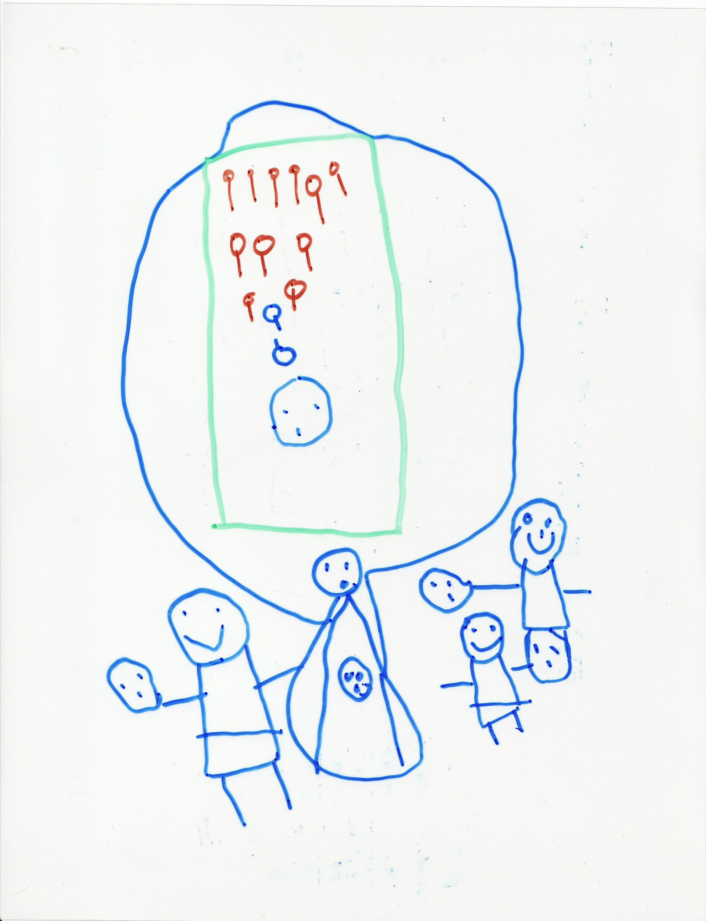
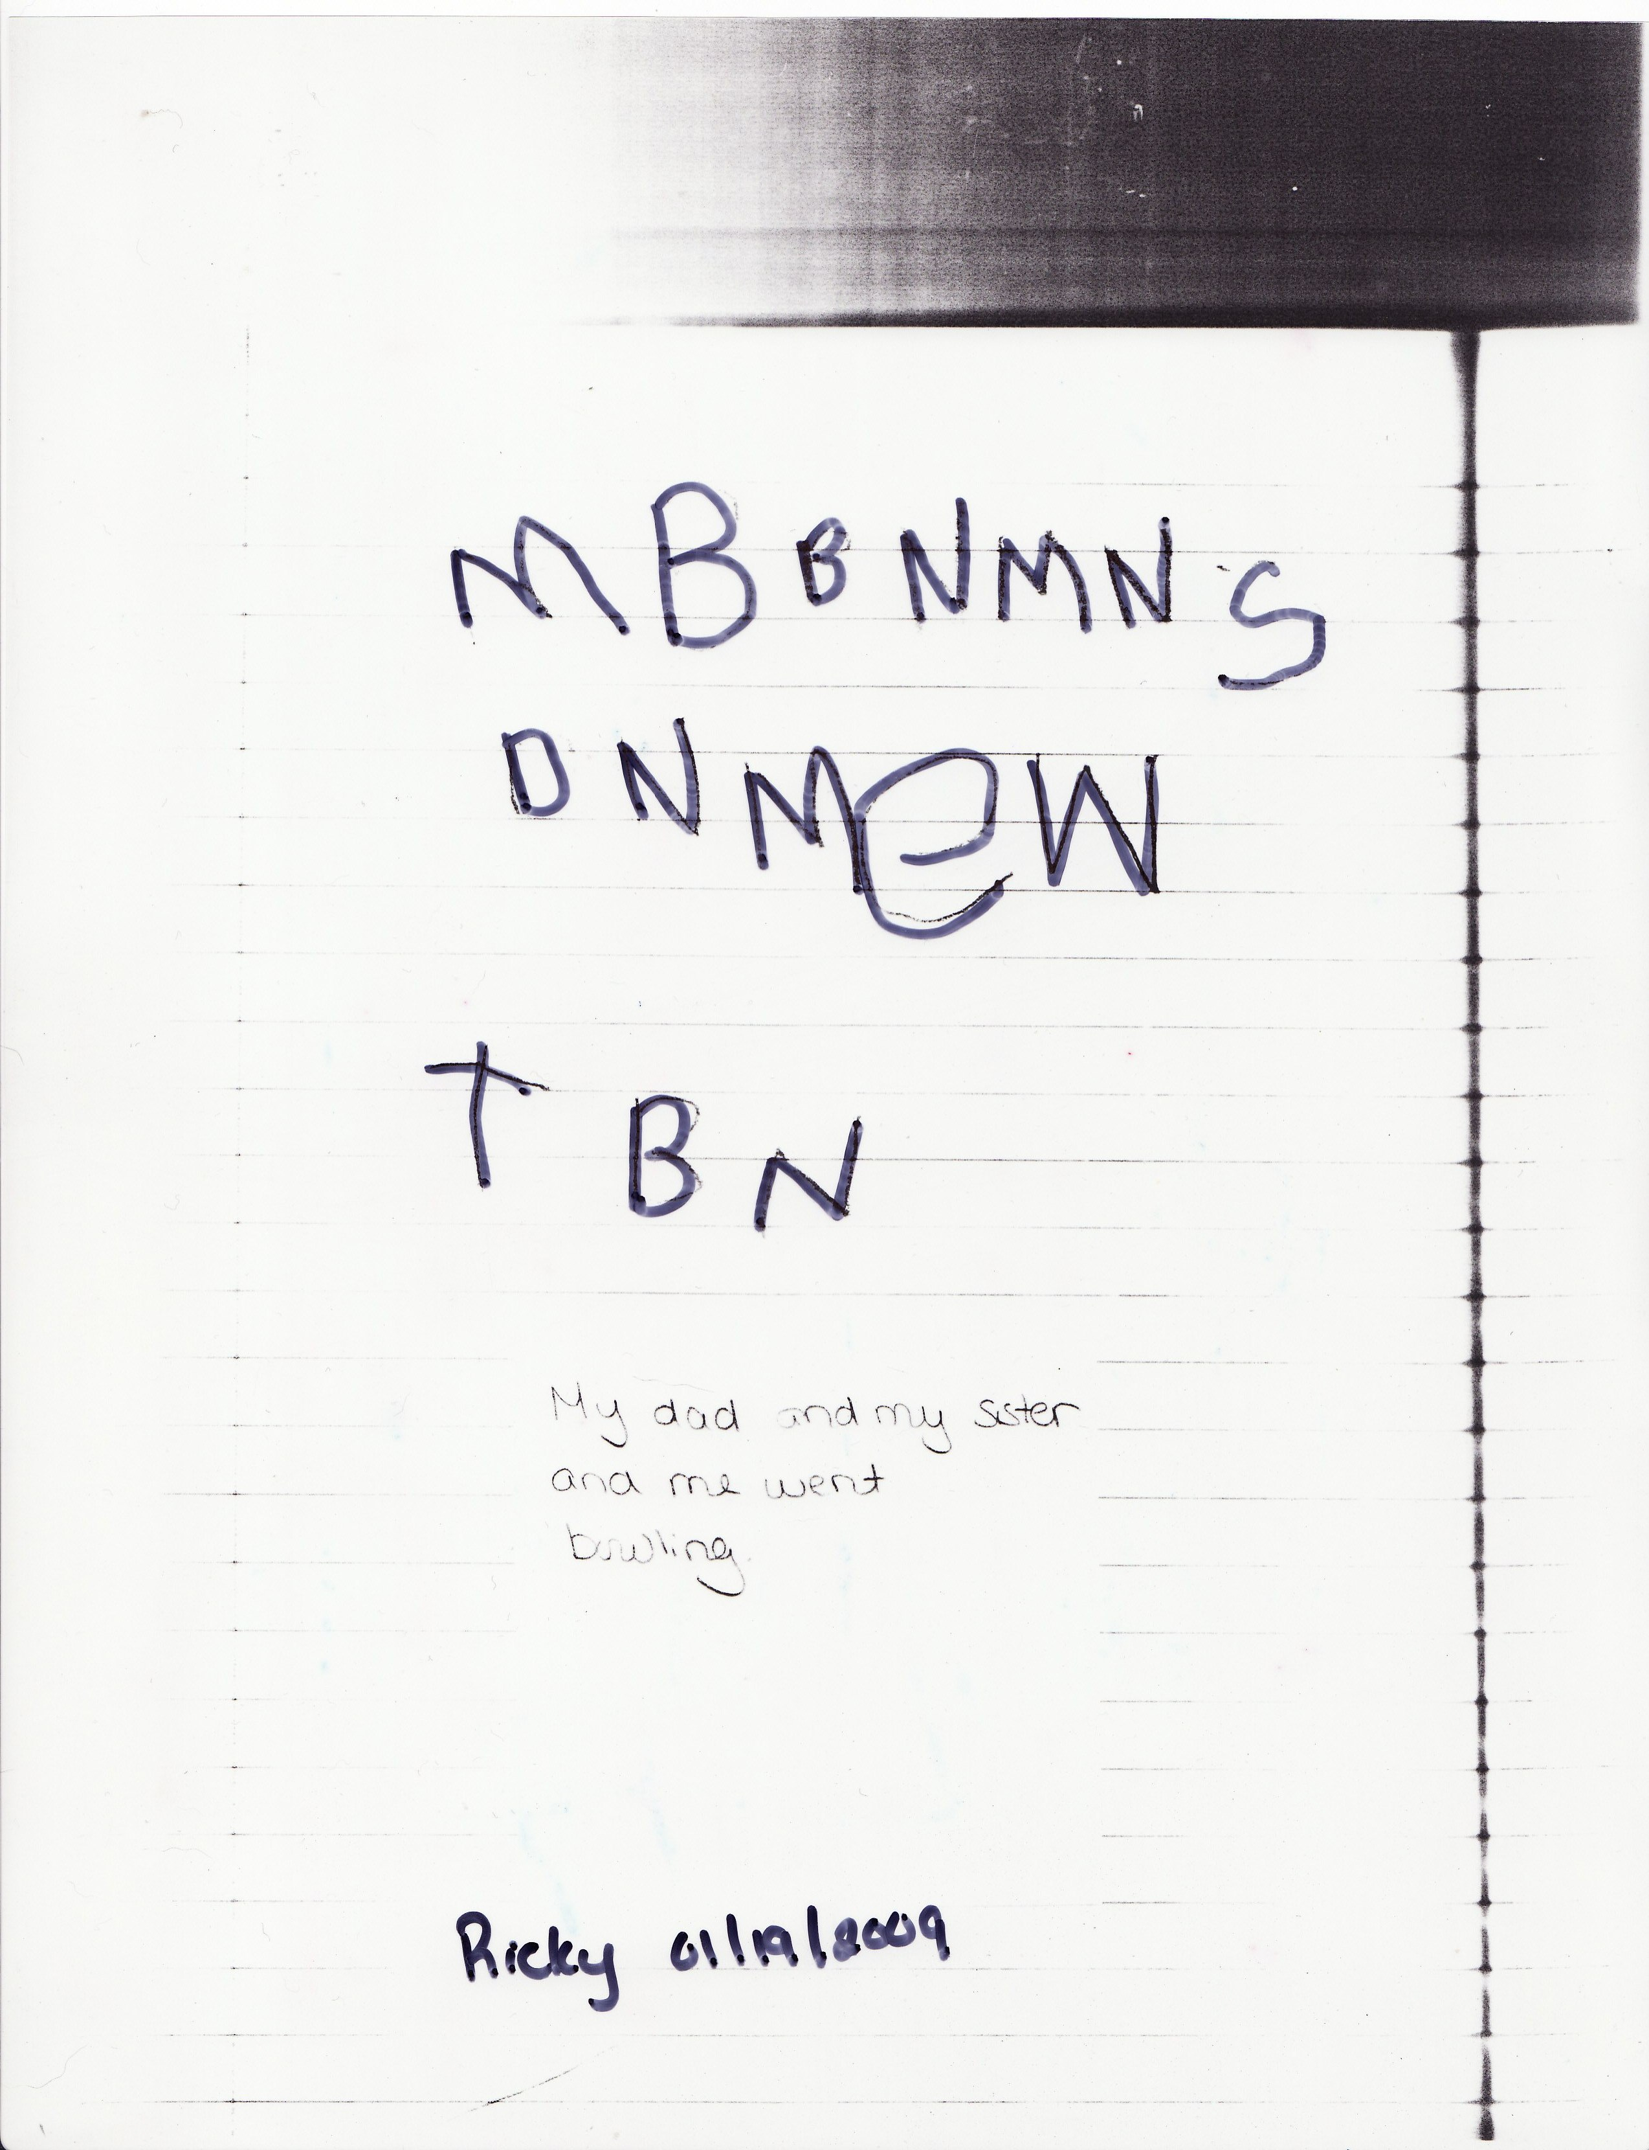
Principles of Writing and Drawing

Slide 23
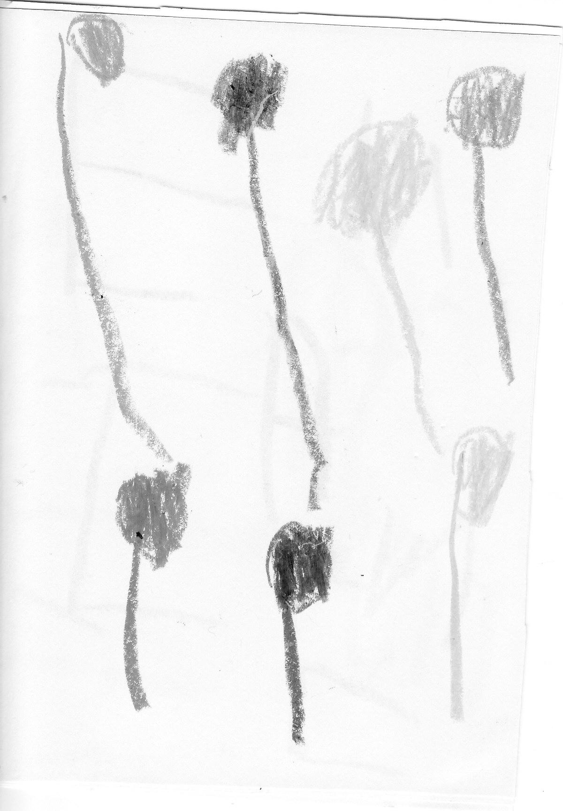
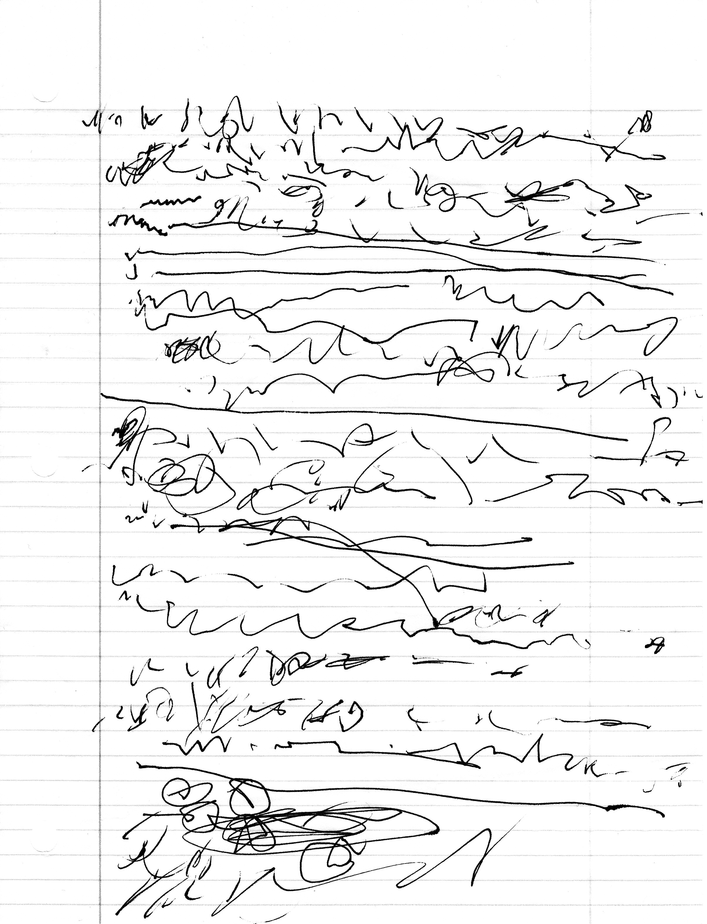
Recurring Principle
Children will use repeated forms in their writing and drawing

Slide 24
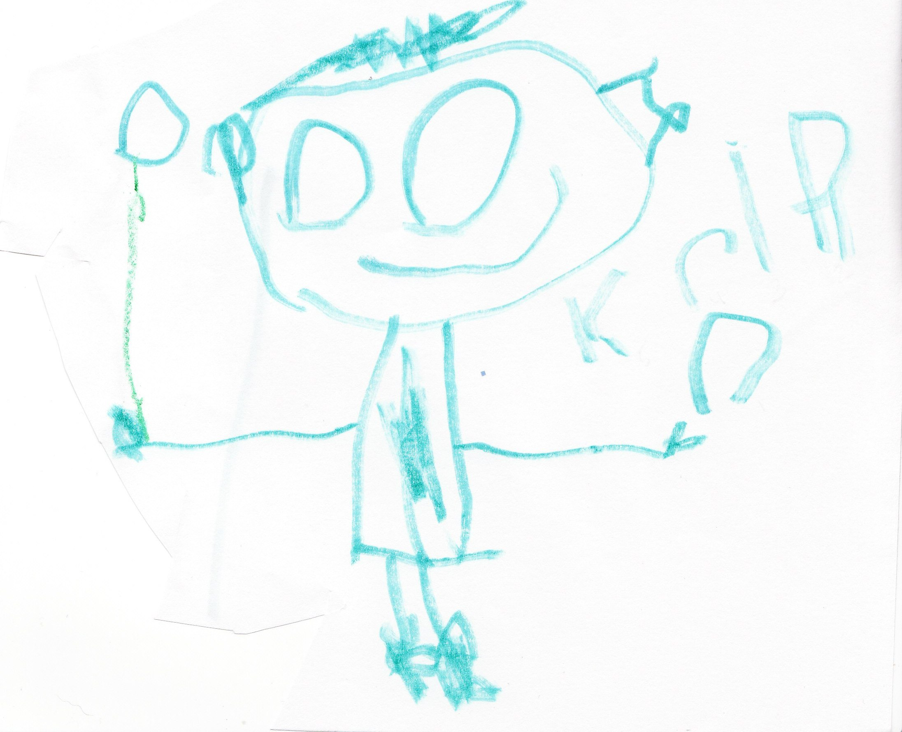
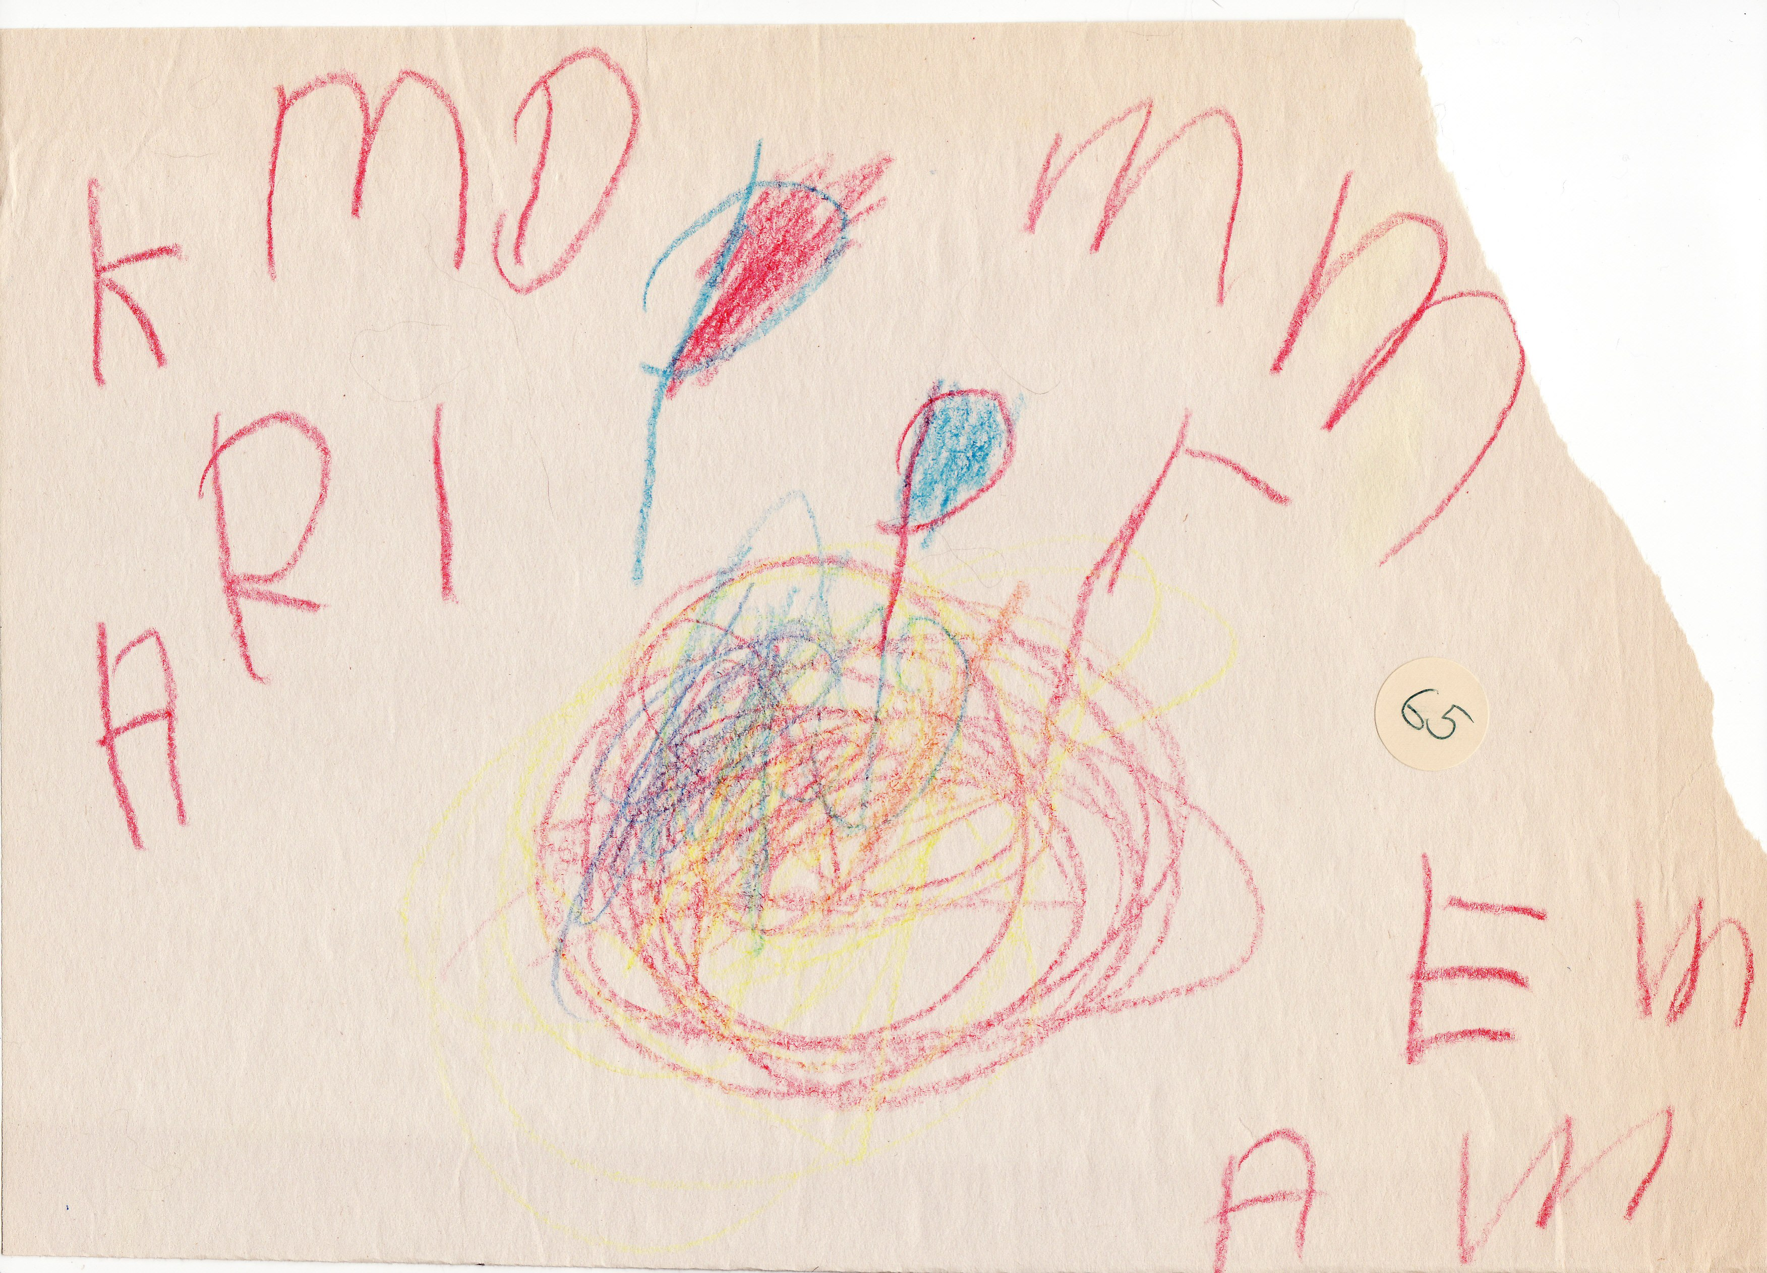
Directional Principle
Children will start at the top left (or right), move left to right (or right to left) across the word or line, return down the left (or right), and locate the next starting point.

Slide 25
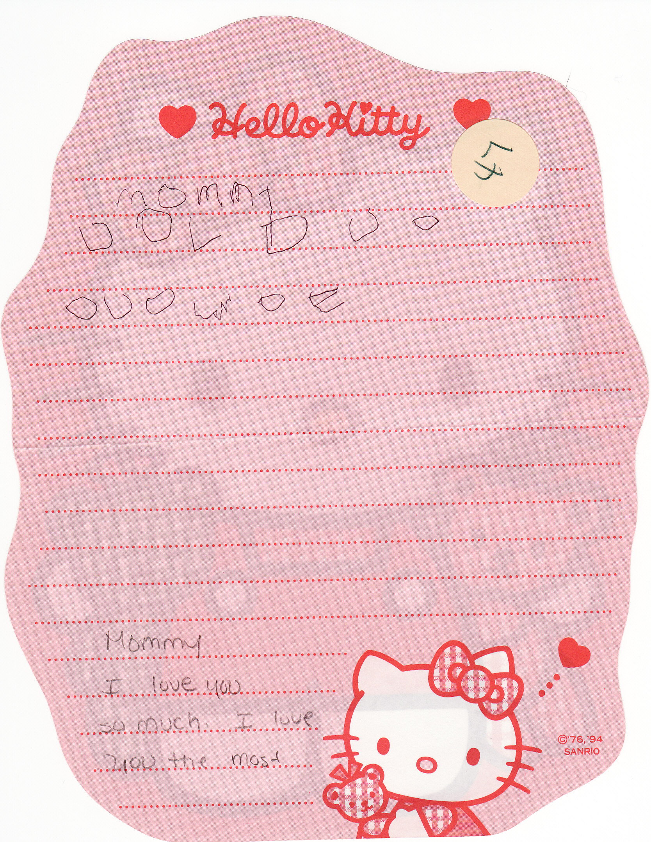
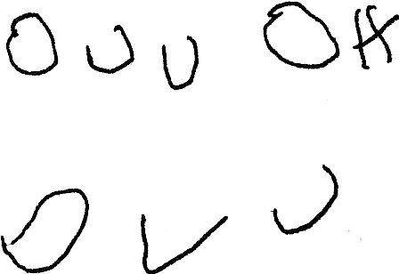
Generating Principle
Writing and drawing can be generated from a limited number of symbols.

Slide 26
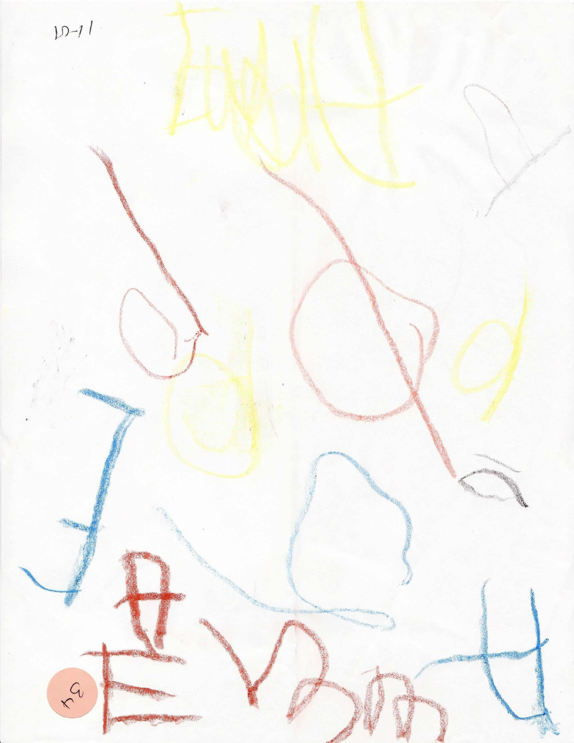
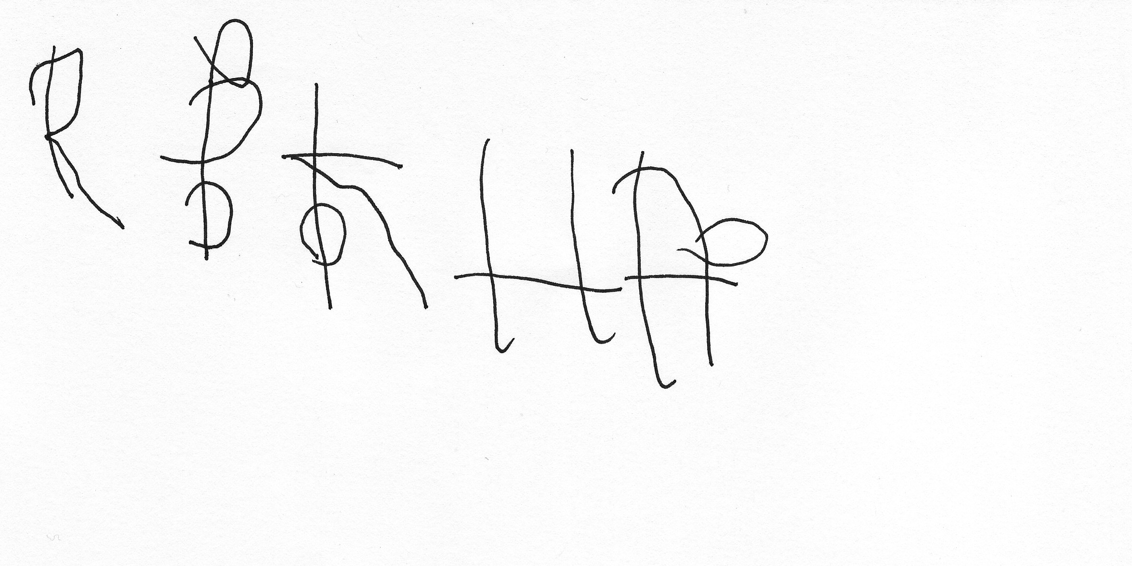
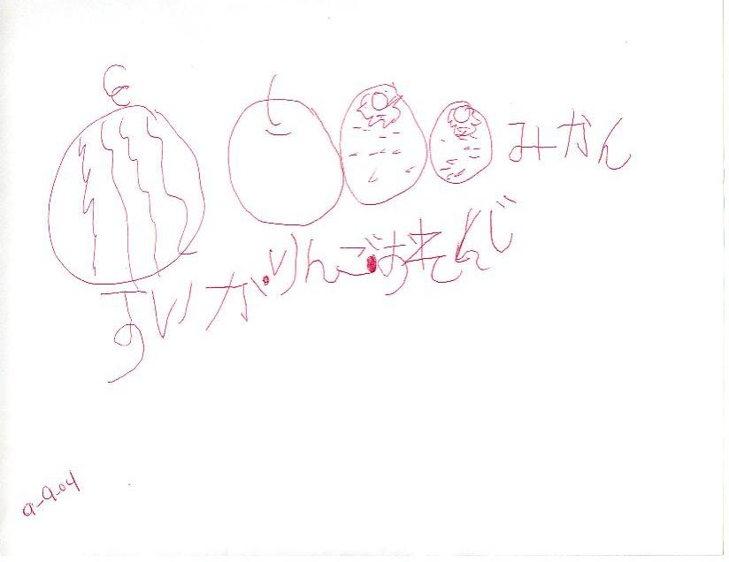
Flexibility Principle
Children explore the limits of allowable variations in the written forms through active discovery during which children invent new forms.

Slide 27
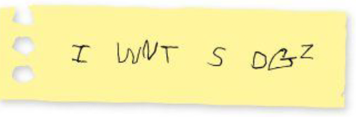

Inventive Spelling
Supports risk taking
  There is no wrong way to write
Self-expression
  Children can express themselves with words and images as soon as they learn how to form letters
Natural development
  Children self-correct their writing as they develop their literacy skills through phonics (sounding out) and word families, memorization of sight words, and recollection of words they see through reading

Slide 28
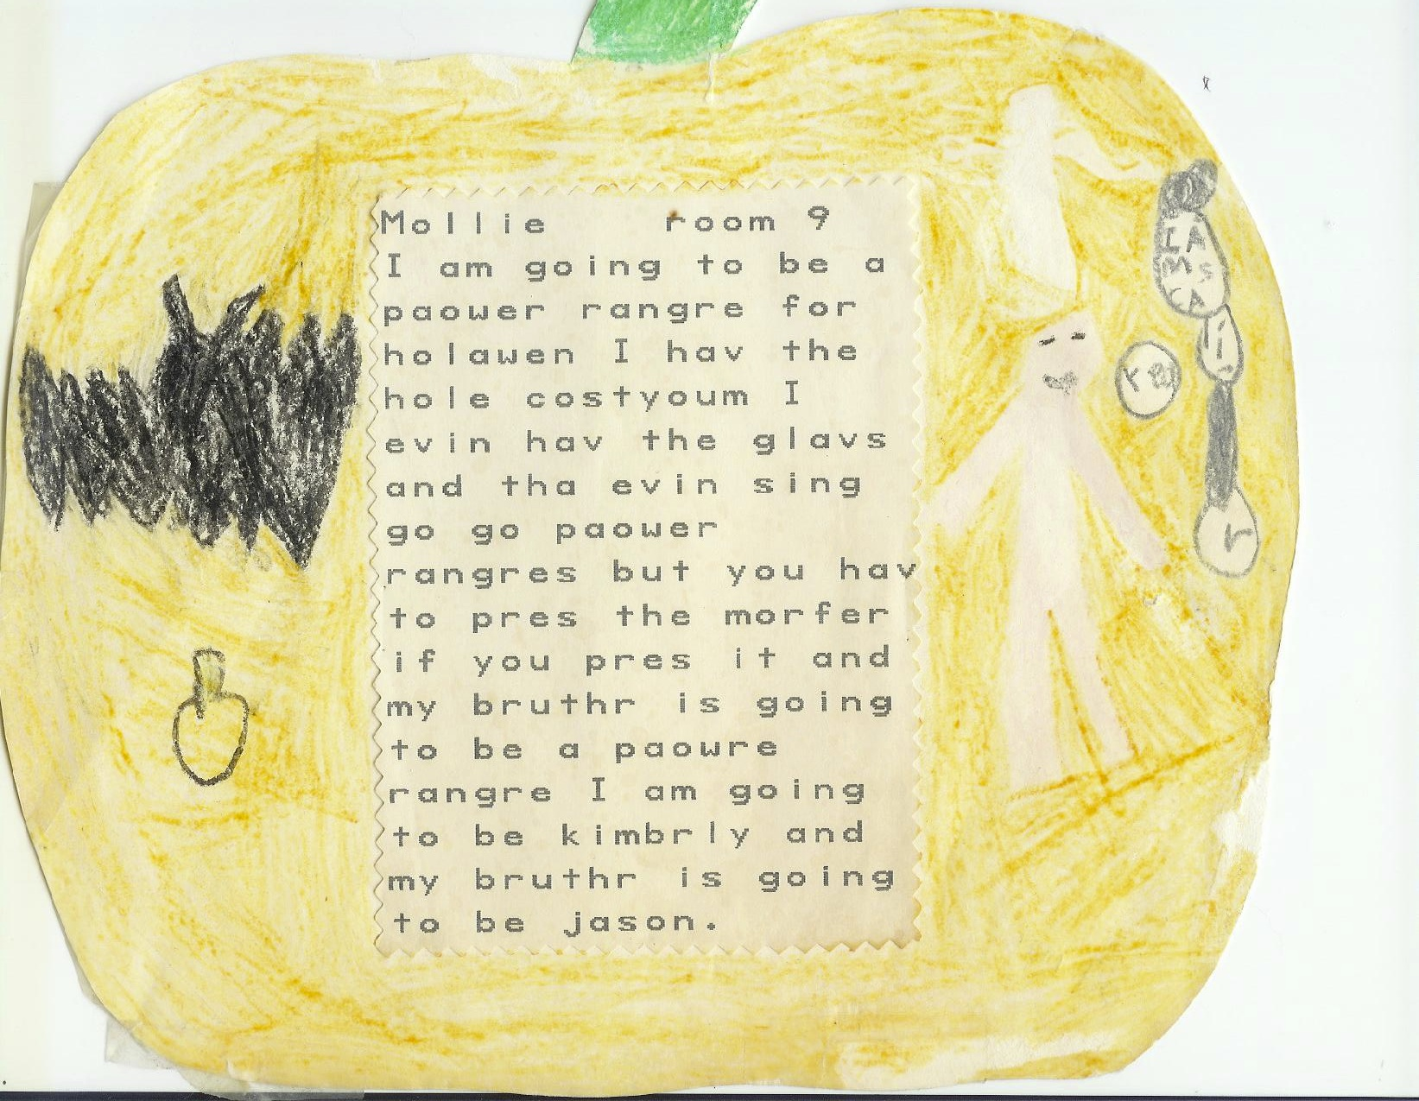

Slide 29
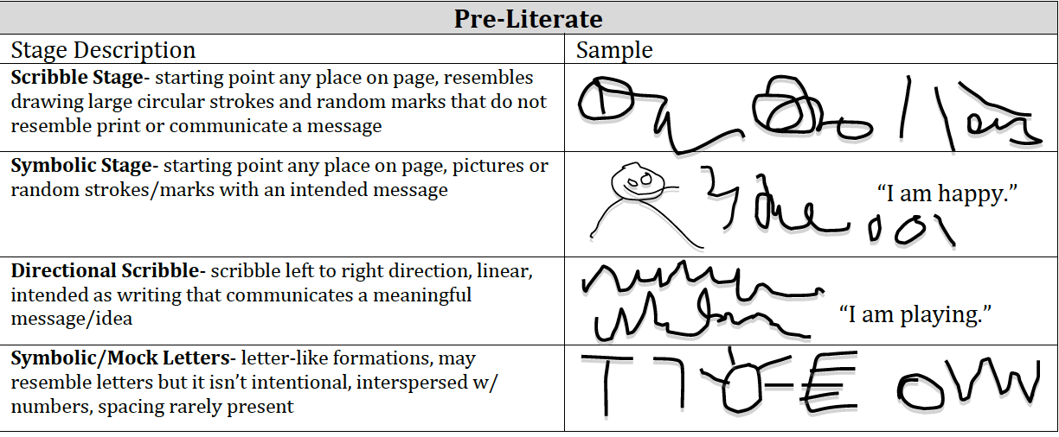
Developmental Stages of Early Writing

Slide 30
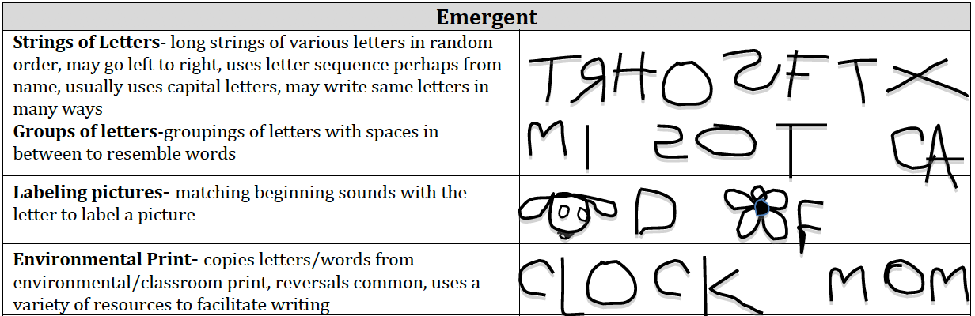
Developmental Stages of Early Writing

Slide 31
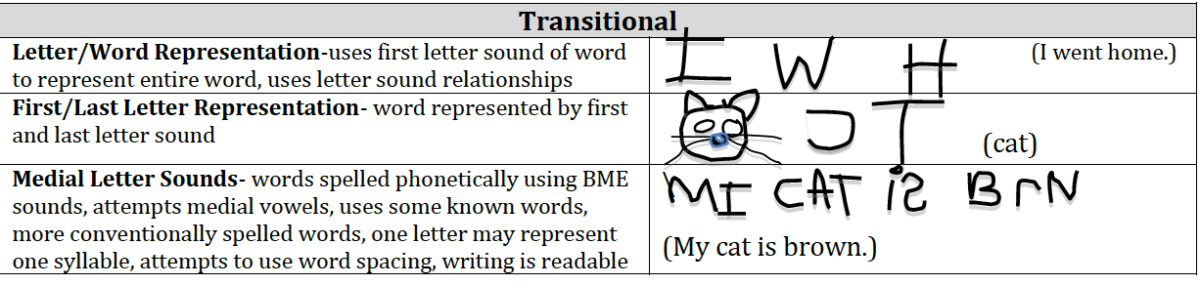
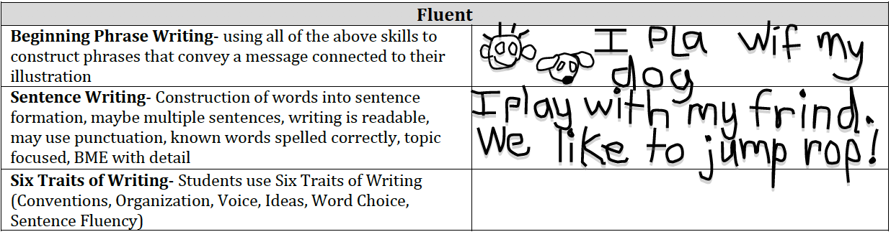
Developmental Stages of Early Writing

Slide 32

Beginning Writing: Form and Function

Slide 33


Slide 34



Slide 35

“Once upon a time lived a man
He lived on a hill.
One day the house fell down the hill.
Thud”

Slide 36




