Slide 1
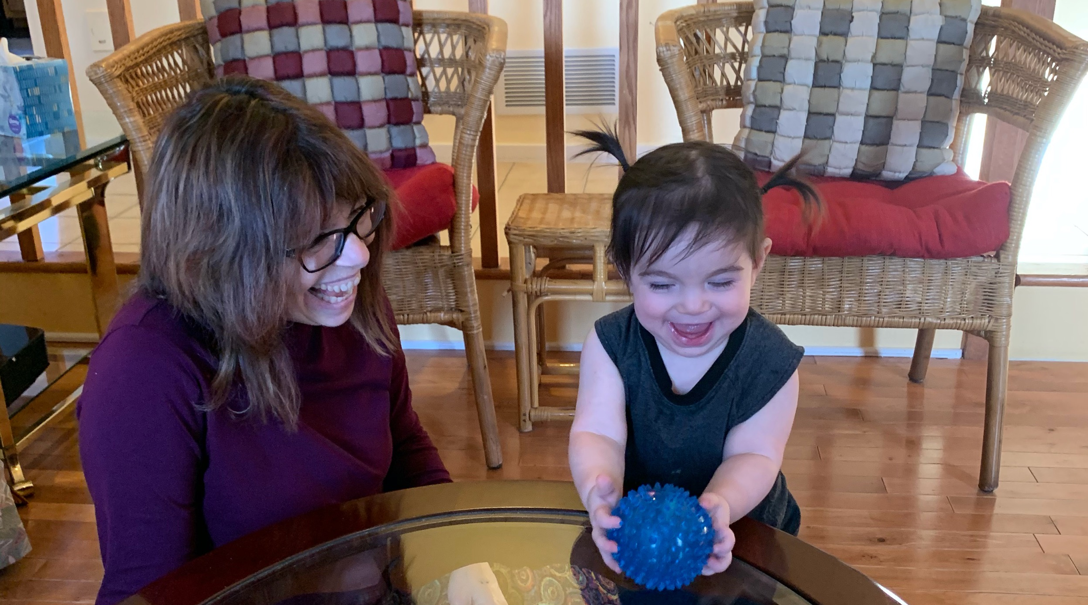
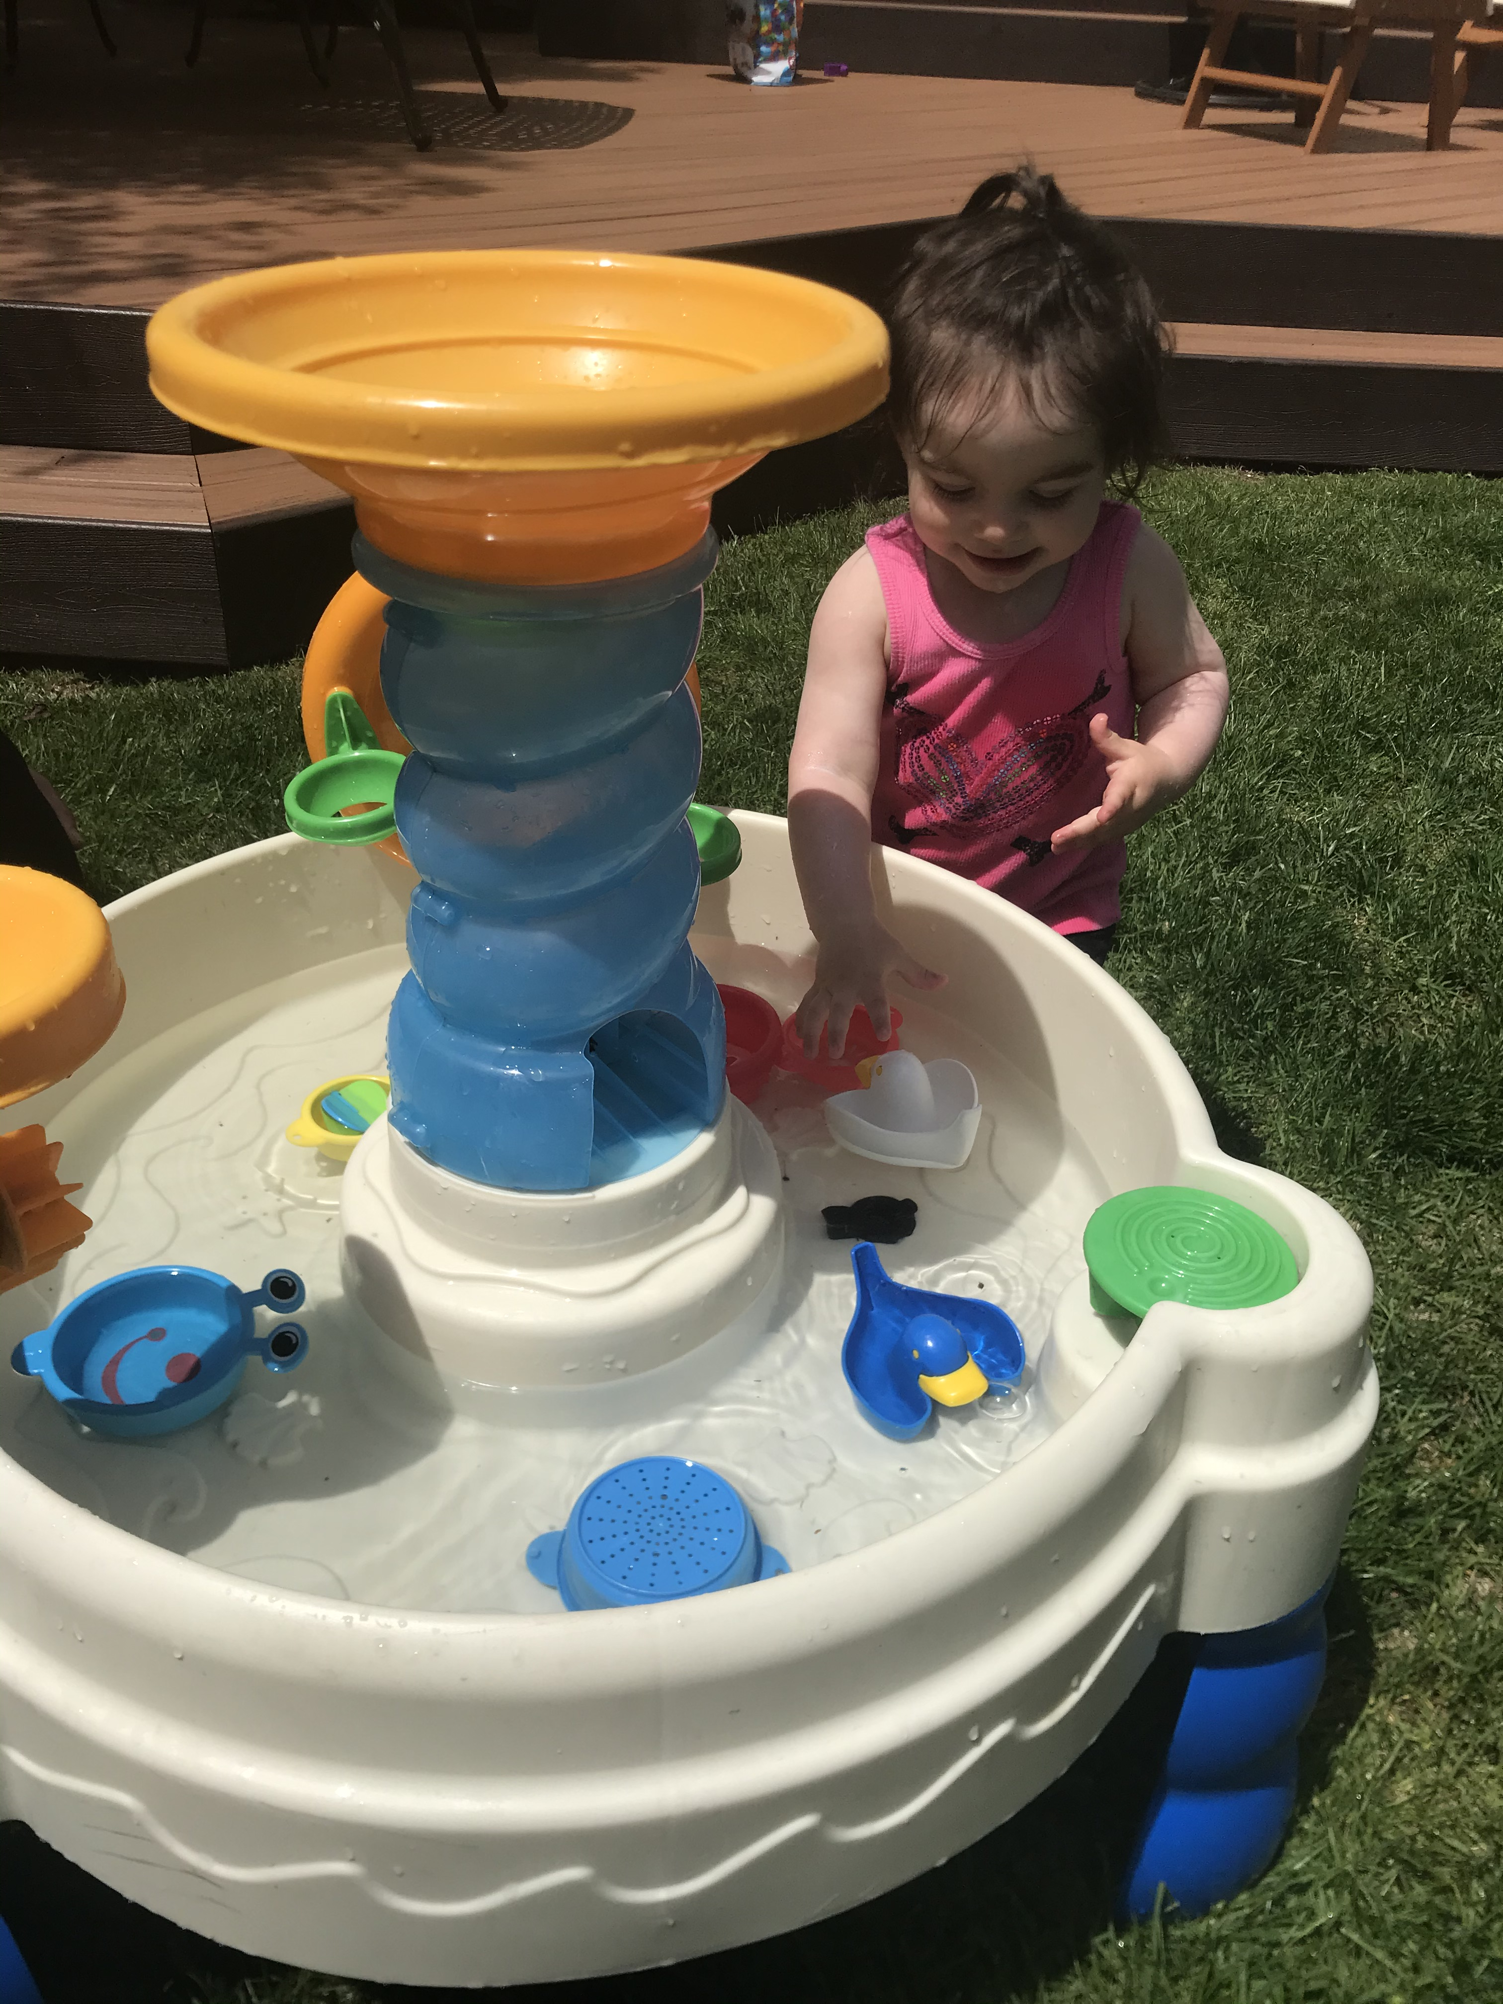
The Power of
Play
ECE 211
Professor Reich-Shapiro

Slide 2


What are the characteristics of play?
Play is voluntary and intrinsically motivated
Play is symbolic, meaningful and transformational
Play actively engages the players
Play is process oriented
Play is governed by rules, but not rule-bound
Play is controlled by the players
(Rubin, Fein and Vandenberg, 1983)

Slide 3

Play is voluntary and intrinsically motivated
Play is spontaneous.
It does not focus on external demands or expectations.
It involves free choice and self-expression.

Slide 4

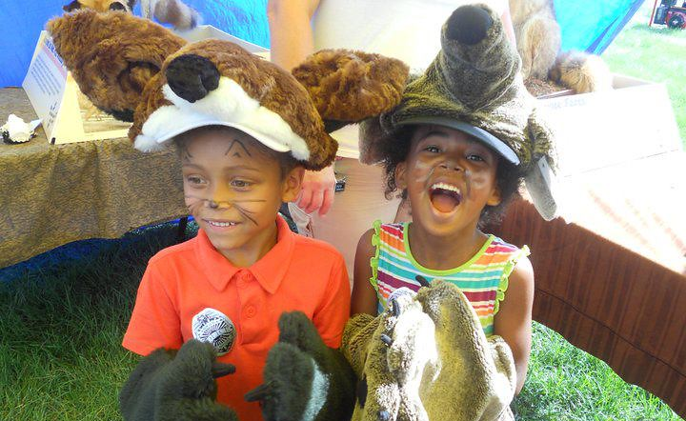
Play is symbolic, meaningful and transformational
Creativity and imagination are central to play.
It allows builds on and connects to children’s prior experience of the world
Play opens children up to a “what if” attitude as they take on other roles, generate ideas and try them out

Slide 5
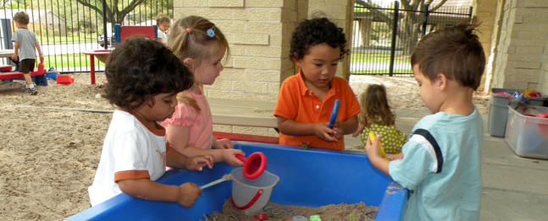
Play actively engages the players
Play is active—it is about “doing”
Play involves the whole child:
  Thinking
  Communicating
  Expressing self and engaged with others
  Physically active

Slide 6

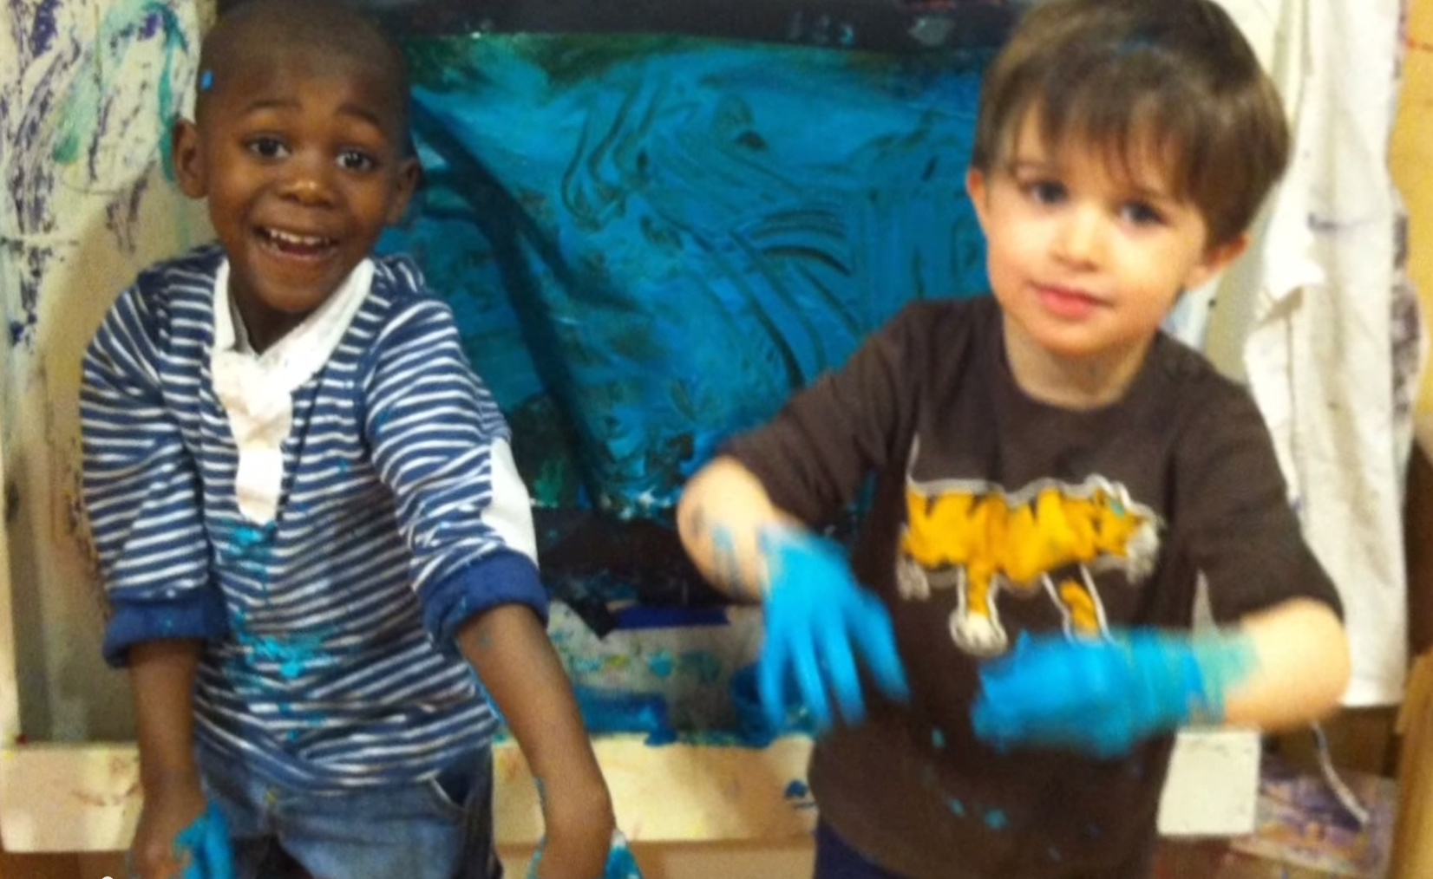
Play is process oriented
Play is important in and of itself, regardless of outcome (product)
It is about doing and being in the moment, not where the play ends up

Slide 7

Play is governed by rules, but not rule-bound
Play has internally-imposed rules
  Explicit: conscious, aware, often verbalized
  Implicit: unconscious or automatic
The goals are flexible, self-imposed and may change, depending on role behavior and object use

Slide 8
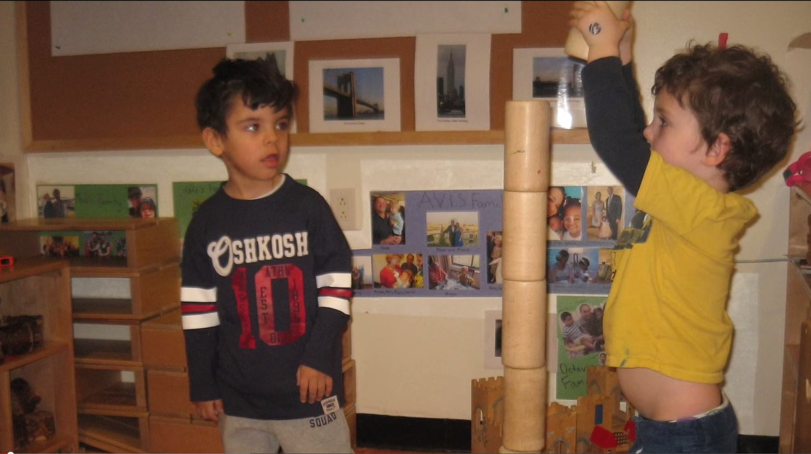
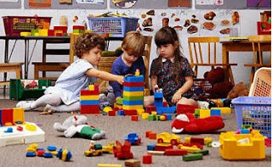
Play is controlled by the players
It makes sense
It is satisfying
Children are intrinsically motivated to participate

Slide 9

Benefits of Play
Increases tolerance for dissonance
Empowers children in self-concept
Increases social perspective, participation, cooperation and impulse control
Supports language and literacy skills
Encourages flexibility and openness
Builds conceptual awareness
Provides a risk-free environment for practicing problem-solving skills
(Bruner, 1985)

Slide 10
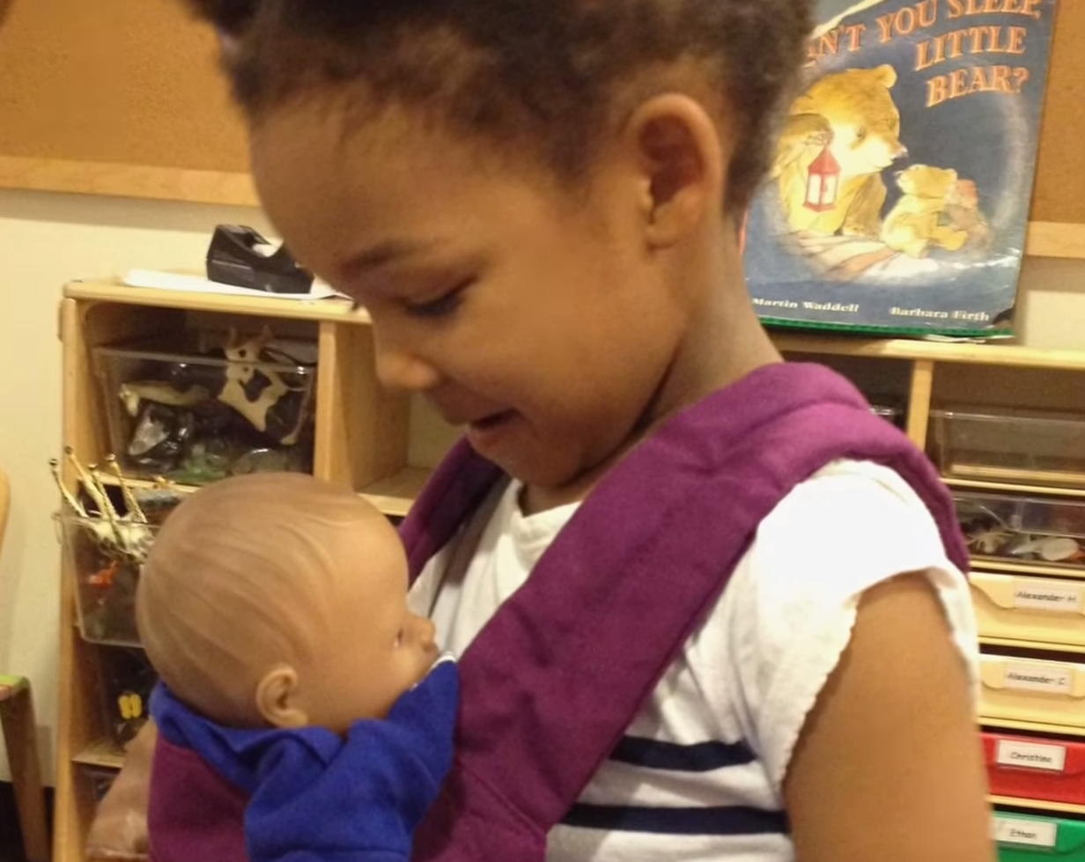
Classical Theories of Play
Surplus Energy Theory (Spencer)
Play relieves stress and tension
Play focuses on the need for physical activity
and outdoor time
Relaxation Theory (Patrick)
Play replenishes energy
Play helps to balance quiet and active time
Practice Theory (Groos)
Play prepares children for future roles and responsibilities
Play provides a safe and risk-free opportunity to practice skills needed as adults
Play provides opportunities for strategic thinking and creative problem solving

Slide 11


Modern Theories of Play

Slide 12
Play provides children new and more complex understandings of the world
Play is a way to develop cooperative relationships and mutual trust
Play is a vehicle for self-identity
Play allows children to master skills needed for everyday life
Psychosocial Theory
(Erikson)

Slide 13
Constructivist Theory
(Piaget)
Play allows children to actively build an understanding of their experiences
Play provides opportunities for children to reason, communicate, and express themselves
Play facilitates assimilation and accommodation of new ideas
Play supports cognitive flexibility (thinking outside the box) and problem solving in action
Play allows for the discovery of new ideas and building of instinctive knowledge without instruction

Slide 14
Sociocultural Theory
(Vygotsky)
Play is the leading factor in development
Social interaction in play supports cognitive development
Play contains embedded cultural rules
Play acts as a support/scaffolding to negotiate reality
Children engaged in play are within the zone of proximal development and always acting above their cognitive level

Slide 15
Designing Lessons: Play – Debrief - Replay
Play
Activities requiring higher-order thinking opportunities (designed by the teacher) provide children with an introduction to the concept being taught
Debrief
Open-ended questioning gives students the opportunity to reflect on their investigations and explore meanings
Replay
Allows continued and expanded exploration and reflection on the concept being taught
(Wasserman, 1990)

Slide 16
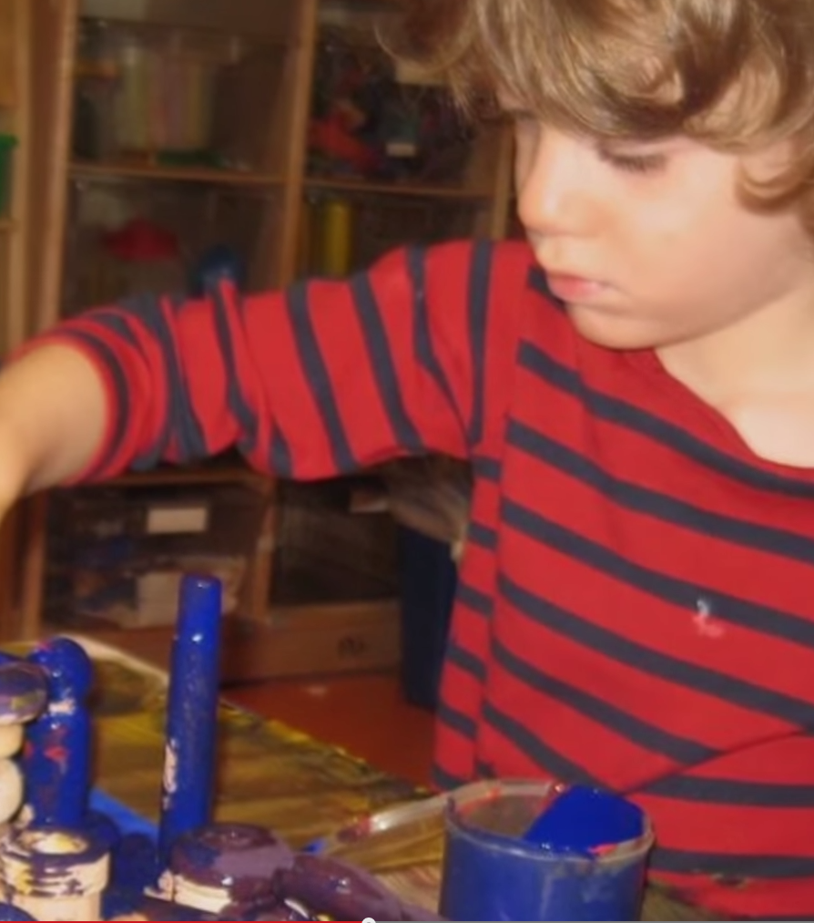
Development and Play

Slide 17

Cognitive
Play is goal-oriented, using materials to build, create, imagine and experiment
Play provides opportunities to practice language skills
Play develops creativity and critical thinking
Play allows children to explore, try out new ideas, engage increasingly complex strategies and problem solve
Exploratory play increases in complexity through early childhood

Slide 18
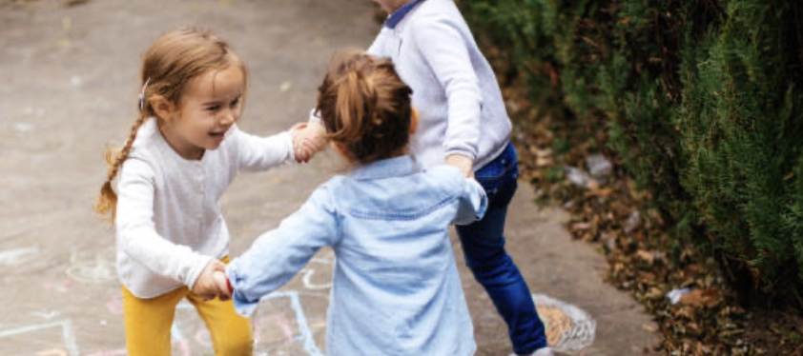
Social
Play involves rules that are agreed upon by the players
Dramatic play allows children to explore status and relationships
Play helps to develop empathy and perspective taking
In play, children can explore nuanced gender roles
Play requires the cooperation and collaboration of the players
Play provides a safe environment in which children can develop perseverance, without fear of failure

Slide 19

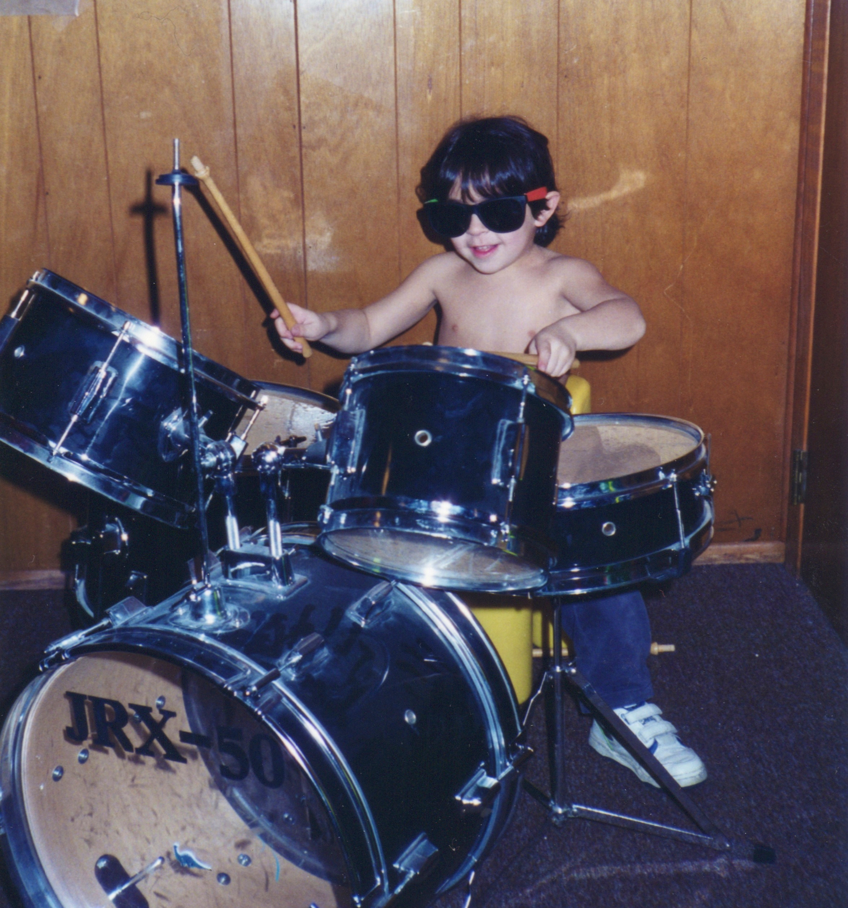
Emotional
Play provides opportunities for self-expression and self-understanding
In play, children are actively engaged without externally-imposed expectations or rules
Play allows children to explore different roles and practice skills they will need as adults
Play requires self control and perseverance

Slide 20

Physical
Play provides children with opportunities to develop large motor and fine motor skills
Play involves physical motor coordination and organization
Play helps children develop their perceptual skills (e.g., eye-hand coordination)

Slide 21
Criteria for Productive Play Activities in the Classroom
Children are actively involved in the learning (“the players”)
Open-ended investigative tasks generate questions, rather than yielding answers
Higher-order thinking challenges are built into each task
Tasks focus on the “Big Ideas”
Each task provides opportunities for children to grow in their ability to understand larger concepts
Children are working together in cooperative investigations

Slide 22
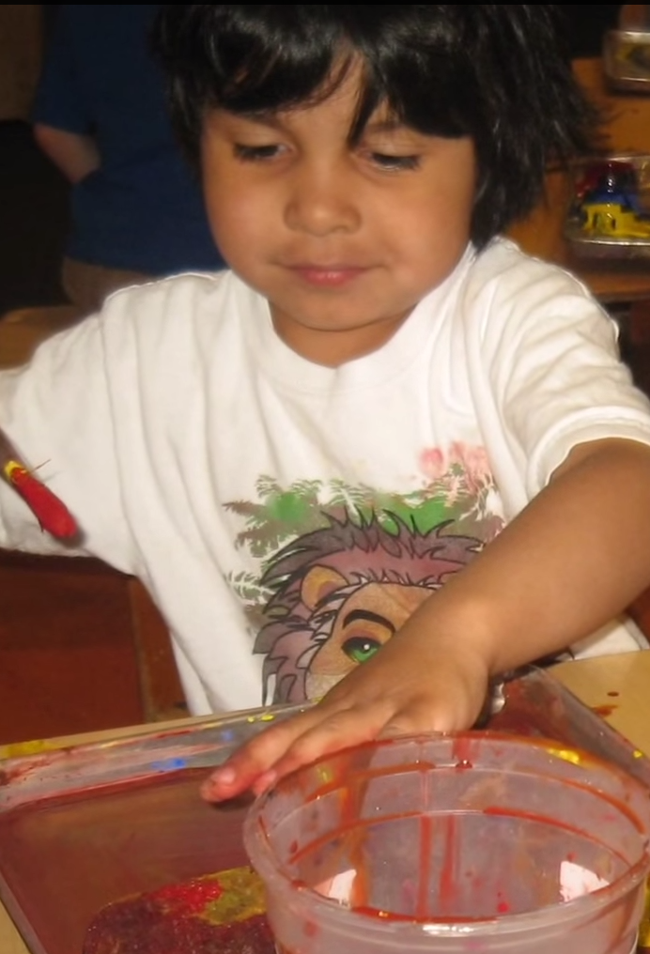
Children at play in the classroom are:
Solving problems
Exploring, investigating and making decisions
Designing experiments
Observing and comparing
Sorting and classifying
Analyzing and interpreting data
Suggesting hypotheses and examining assumptions
Developing language and literacy skills

