Slide 1

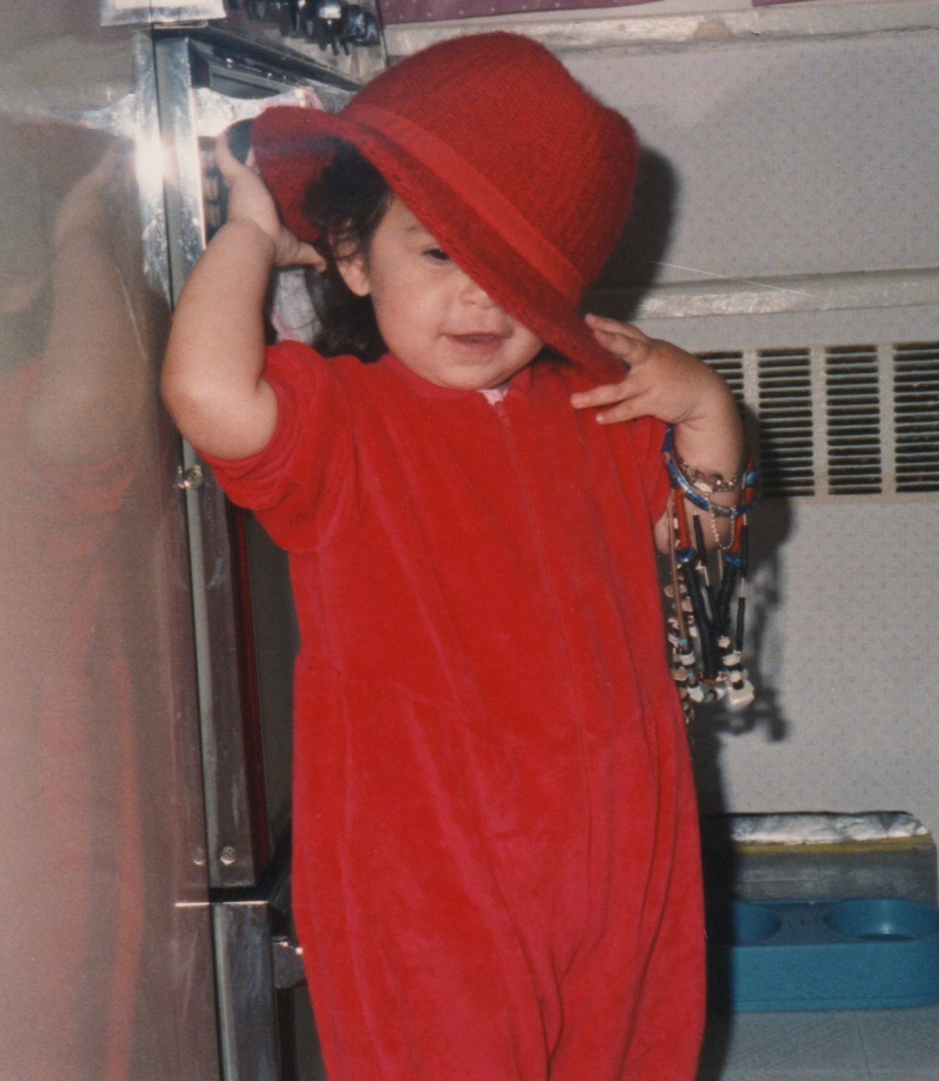
All About Me
A Themed Curriculum Web
Created by Kristin Scarola
Adapted by Mindi Reich-Shapiro

Slide 2

All About Me
This themed curriculum unit is adapted from the NYCDOE prekindergarten unit of study, "All About Us"
It is designed in conjunction with the NYS Pre-K Foundation for the Common Core. It applies both developmentally appropriate and culturally responsive practice.
Through this curriculum, Pre-K students will consider the question “What makes me, me?” They will learn to value their unique attributes and, at the same time, learn to value, respect, and build relationships by exploring how they are similar and different from their classmates.
Each subtheme explores the main theme "Me and You" through a different perspective while providing students with activities to support development across all domains. Each subtheme represents approximately two weeks of work.

Slide 3
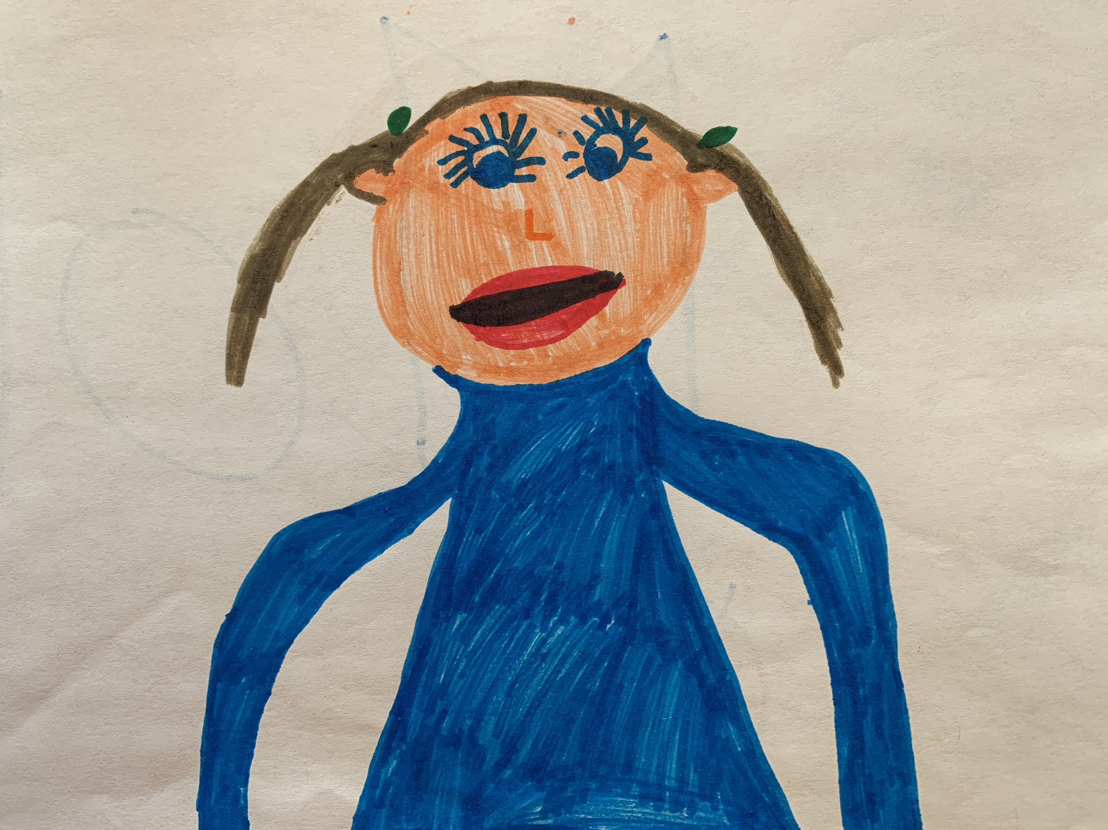
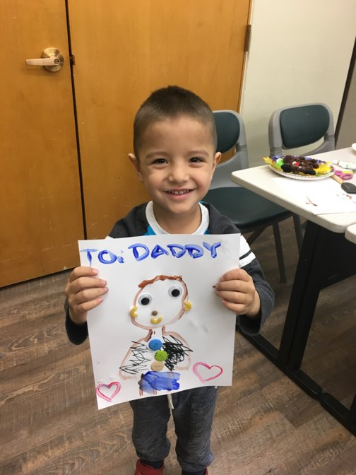
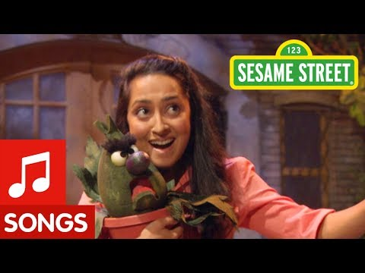
Faces and Bodies
Goals: Students will: (1) explore their physical attributes, (2) develop language and self-awareness describing themselves, (3) practice fine motor skills drawing a self-portrait, and (4) express understanding of similarities and differences with classmates and that each unique individual is a valued member of our class.
Activities:
(1) Self-portrait: Students will use a mirror to study their physical features and represent them. (They will repeat this activity at the end of the school year to document their growth, self-concept, symbolic representation, and drawing ability.
(2) Songs: We will sing together at morning meeting and closing circle a variety of songs that celebrate each child's uniqueness, such as "I Am Special" and "It's Nice To Be Me" and "You Are Unique."
(3) Class Portrait Quilt: Inspired by the book It’s Okay to Be Different by Todd Parr, each student will contribute a self-portrait to a class quilt.
Books: ​
It’s Okay to Be Different, Todd Parr​
I Like Myself, Karen Beaumont​
I Like Me, Nancy Carlson​
The Colors of Us, Karen Katz
We're Different, We're the Same, Bobby Jane Kates
Note:
These are just a sample of books. In each sub-theme, there would usually be a minimum of 10 books selected by the teacher.

Slide 4
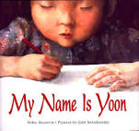
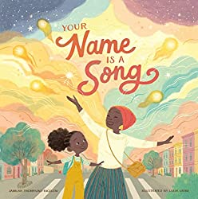
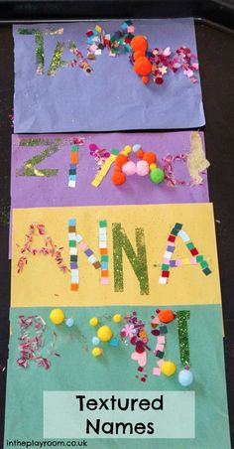
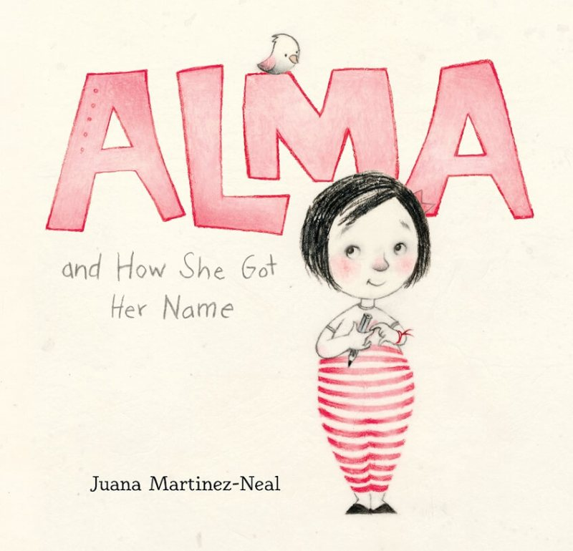
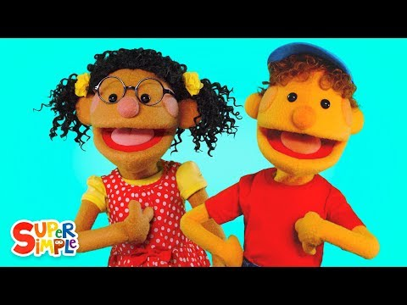

My Name is...
Goals: Students will: (1) explore spelling, pronunciation and story of their name (self-concept), (2) develop language and understanding of others as they share the stories of their names, (3) practice fine motor skills writing/creating their name.
Activities:
(1) Family Engagement: We will read Alma and How She Got Her Name. Then each will learn their name story, no matter how simple. Each child will contribute to a page of our class book called, “My name is…”Students will each illustrate a page, write their name and the teacher will write each child’s story. This will serve as a document to see each child’s growth to compare with mid-year and end-of-year writing.
(2) Songs: "Hello, What's Your Name" song. Variations on "BINGO" with each child's name.
3) Name Art: In this sensory art activity, children will fill in each letter of their name with a range of textured collage materials. It will support memorization and letter formation.

Slide 5
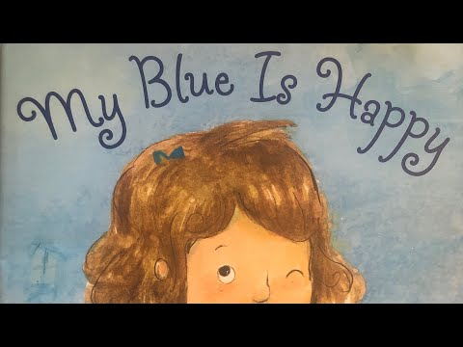

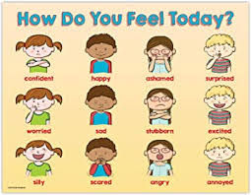
My Blue is Happy
Goals: Students will: (1) learn how to identify their different emotions, as a step to self-regulation, (2) explore and learn to recognize and describe more nuanced emotions, (3) practice fine motor and large motor skills as they draw, make collages and sing and dance, and (4) begin to understand that they may have more than one emotion at a time.
Activities:
(1)Color My Feelings Art: We will read My Blue is Happy and talk about feelings, moods and how we can express our feelings with colors. Children will use pastels or watercolors to create their own feelings pictures.
(2) Feelings Collages: We will read The Feelings Book (or another book). The children will then make colorful collages and use their emotion vocabulary to describe their feelings.
(3) Music, Emotion and Motion: At the listening center, students will put on headphones and listen to a song. Listening to the song, they will draw how the song makes them feel. As a class, we will also listen to a playlist of songs each day at Morning Meeting. Students will dance to one song on the playlist and discuss how the music makes them feel.
Books
My Blue is Happy – Jessica Young
Happy – Mies Van Hout
In My Heart: A Book of Feelings – Jo Witek
When Sophie's Feelings Are Really, Really Hurt – Molly Bang
Listening to My Body – Gabi Garcia
The Feelings Book – Todd Parr
My Many Colored Day – Dr. Suess

Slide 6
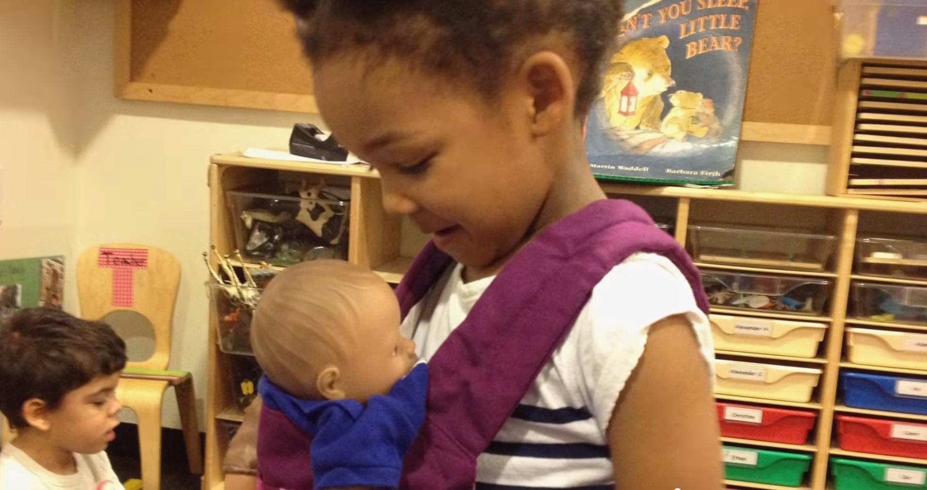
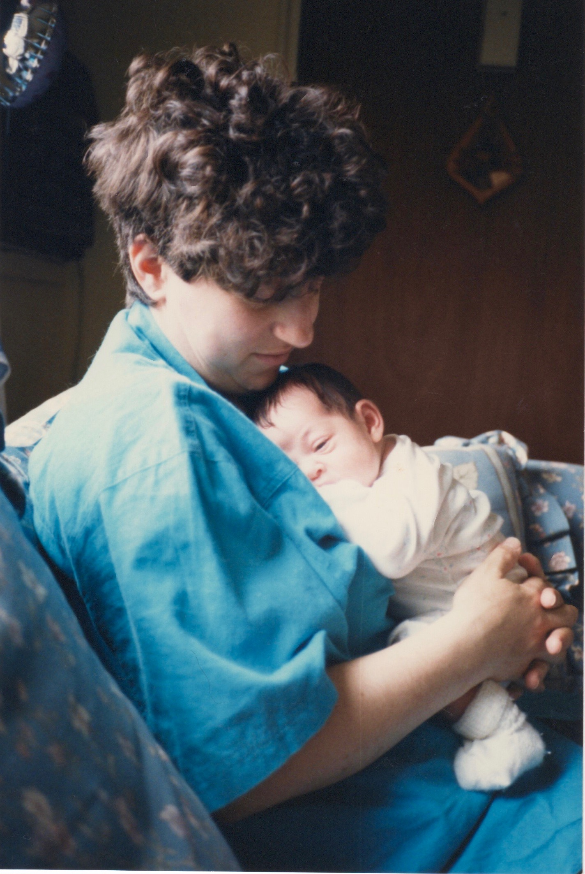
When I Was Little
Goals: Students will: (1) Reflect on how much they have grown and how much more independent they are, (2) develop language as they describe their self-help skills, and (3) practice fine and large motor skills in the dramatic play and art center.
Activities:
(1) Timeline: Students will bring in three pictures of themselves to create a timeline of their lives. They will explain how they have changed.
(2) Dramatic Play: In the dramatic play center, a baby station will be set up with a changing table, high-chair, pretend food and bottles, baby clothes, and a bath with water. As a class, we will learn lullabies and sing them each day before rest time.
(3) Look How I've Grown Art: Children will use drawing materials and/or collage materials to make a picture that shows something they can do now that they could not do when they were babies.
Books:
”More, More, More,” Said the Baby – Vera B. Williams
Knuffle Bunny- Mo Willems
All By Myself – Mercer Mayer
When You Were Small – Sarah O'Leary

Slide 7
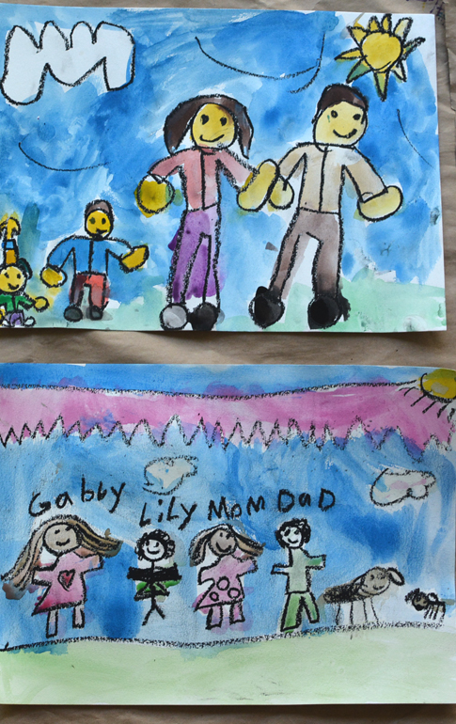
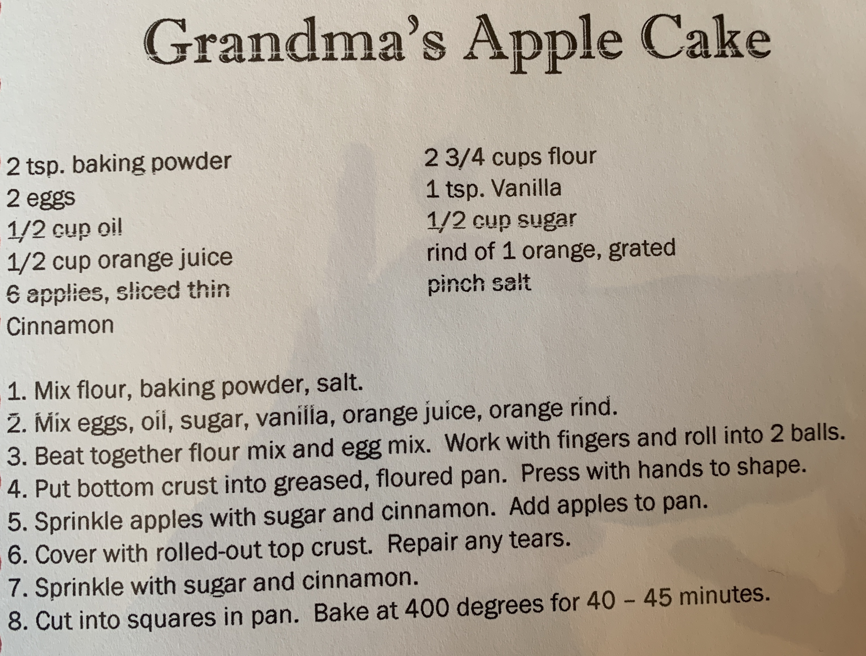
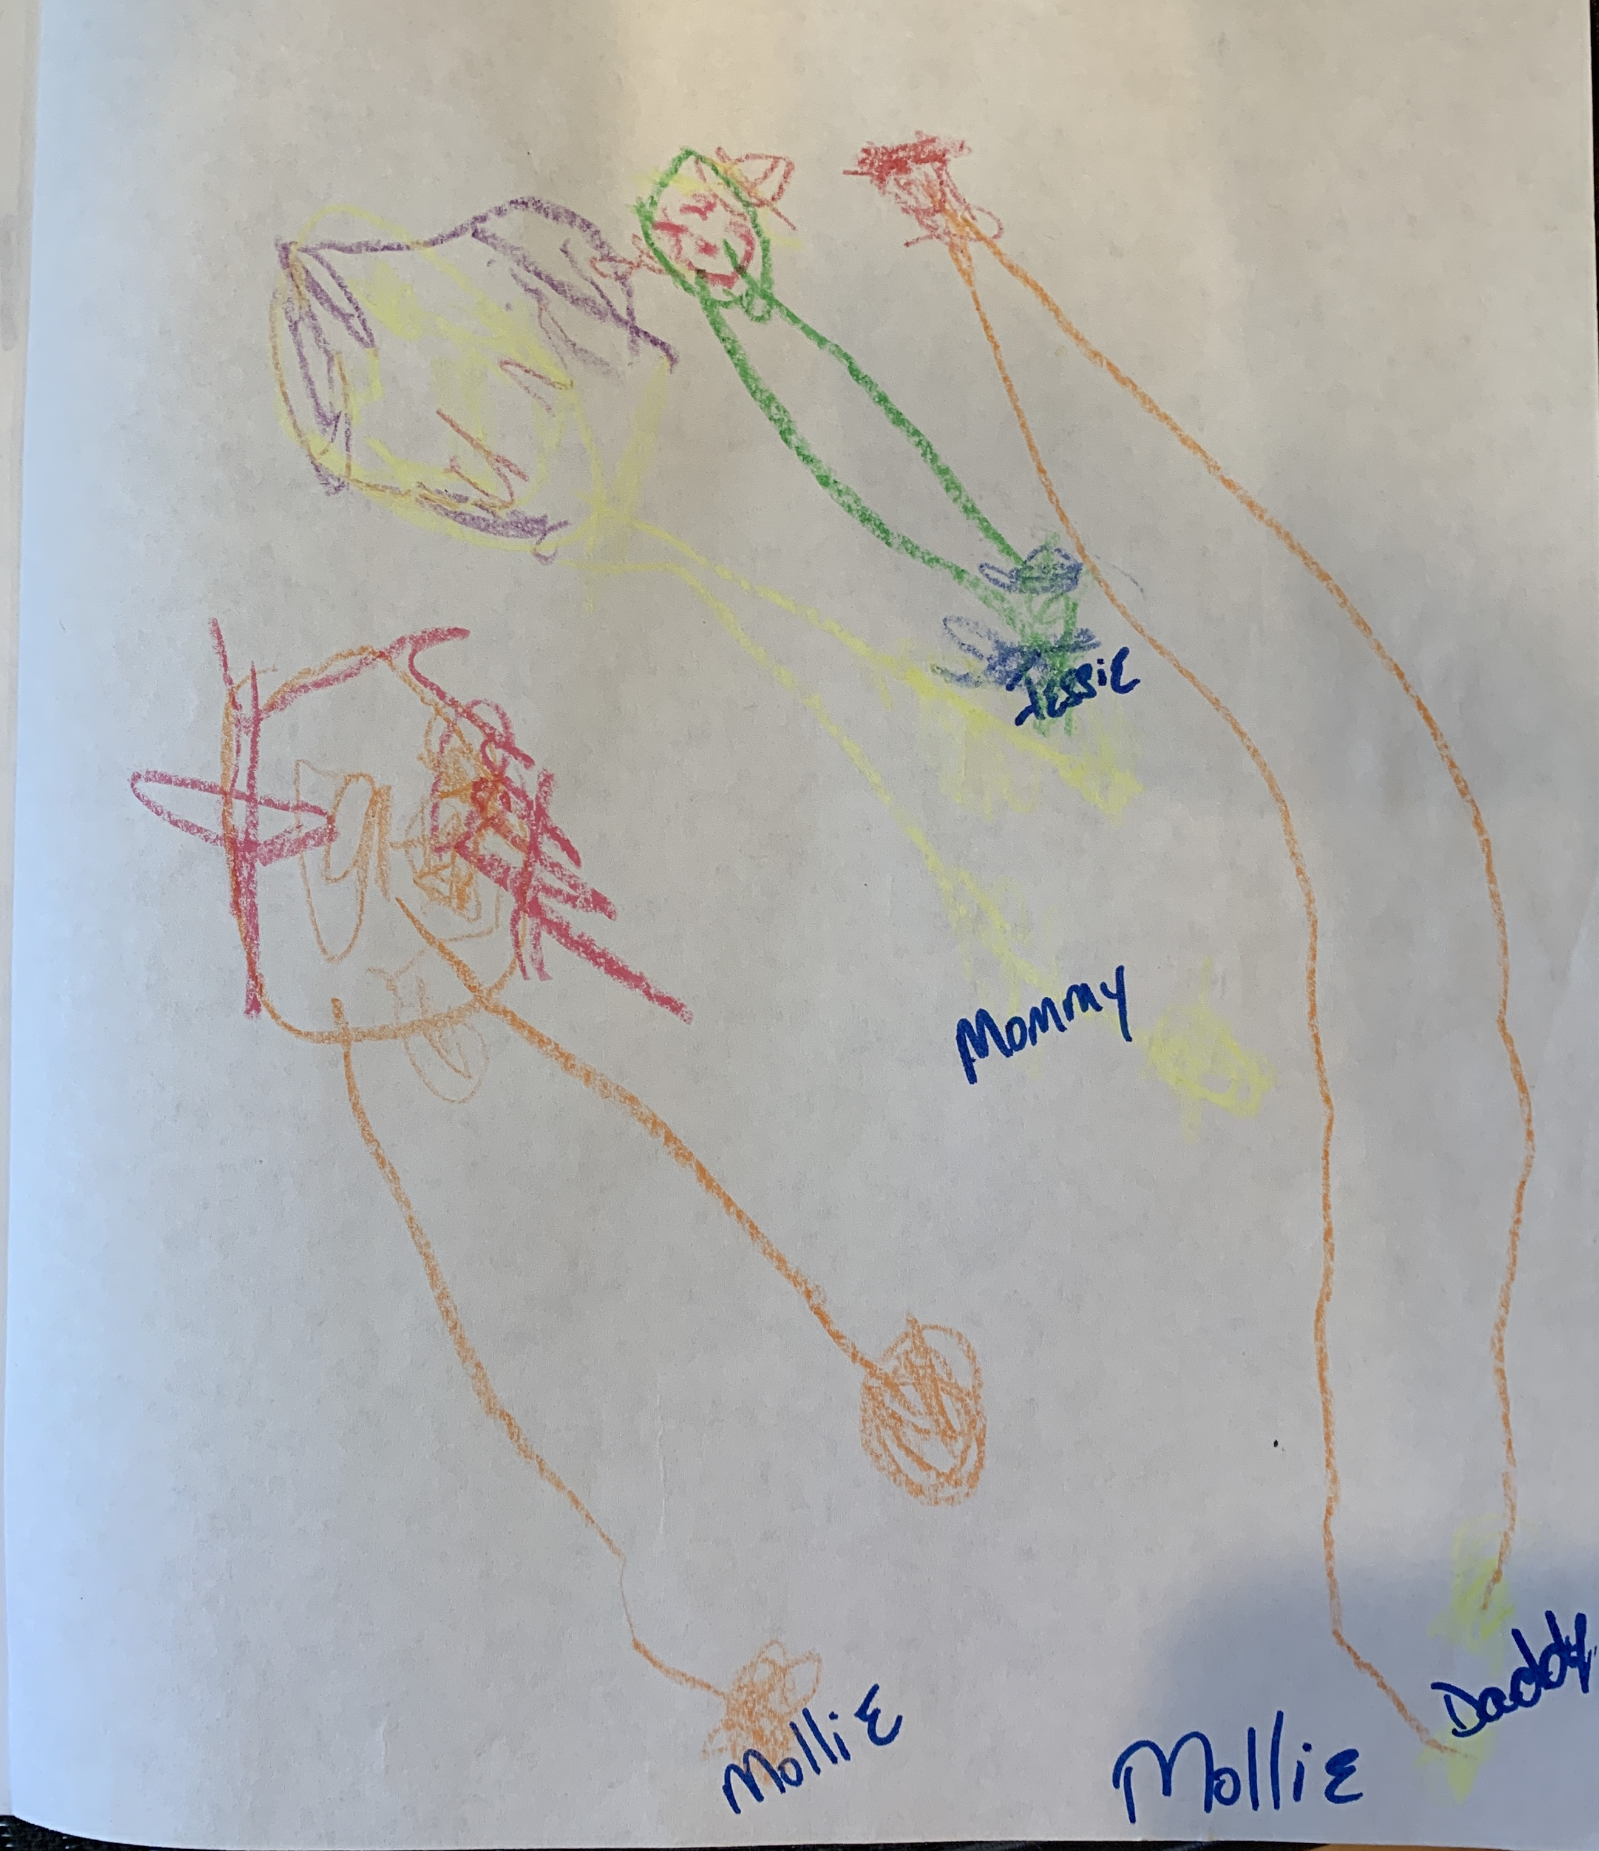
Me and My Family
Goals: Students will: (1) forge a connection between home and school, (2) learn about their classmates families and traditions, (3) develop language skills learning songs in different languages, (4) practice fine motor and large motor skills in the art center and pretend center.
Activities:
(1) Family Portrait: Students will use drawing materials and/or photographs to make a picture/collage of the people who they share their home with. Through this activity, each child learns that everyone's family is different, but all (hopefully) create a loving home together.
(2) Favorite Recipes: Each family will send in their favorite recipe to share with the class. The class will create a book that provides the recipe and a student illustration of their favorite meal.
3) Hello Song: Students will teach everyone how to say hello in the language they speak at home. Each day at morning meeting, students will sing ”Hello” in three different languages.
Books:
I Love Saturdays y Domingos - Alma Flor Ada
Who's in My Family – Robie Harris
The Doorbell Rang – Pat Hutchins
The Family Book – Todd Parr

Slide 8
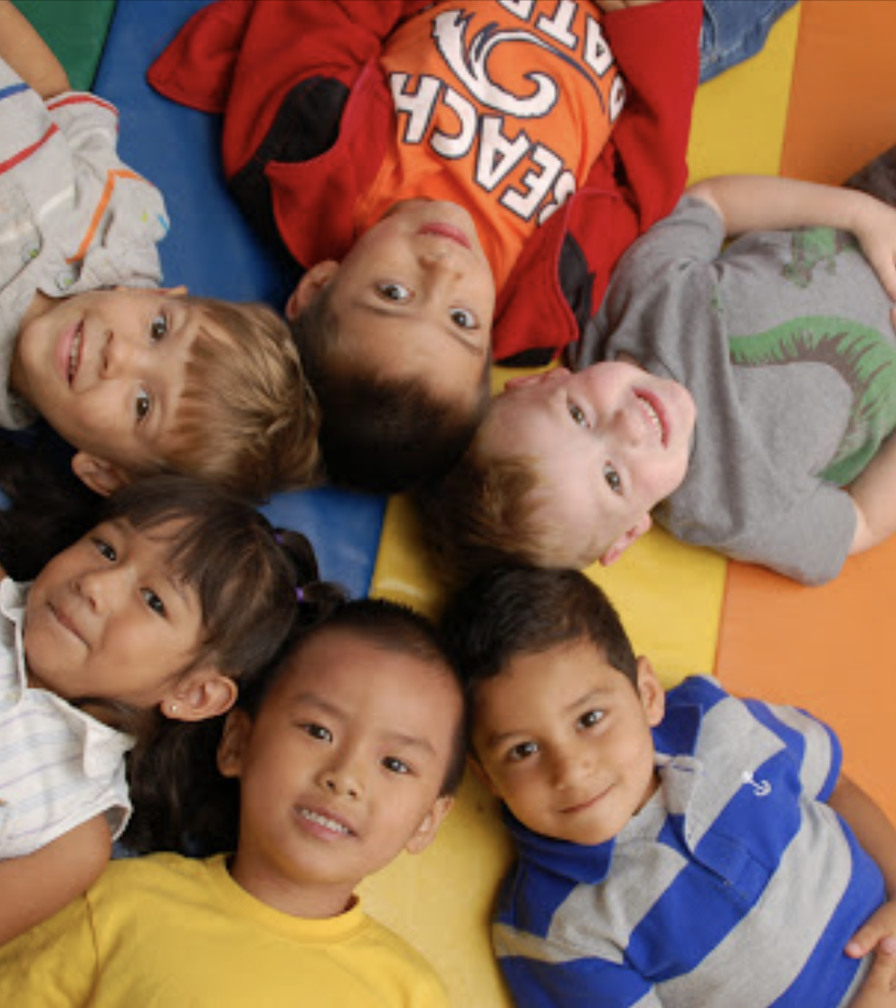
Next Curriculum Unit: Me and You
We will transition from self to family, friends and community in the next curriculum unit.
In this unit, children will the consider the people in their lives and the lives of their classmates. They will deepen relationships and continue to develop self-awareness and understanding of the perspectives of others.
Subthemes
My Family
My friends
Our Classroom Community
Sharing Feelings
I Am Thankful

