Slide 1
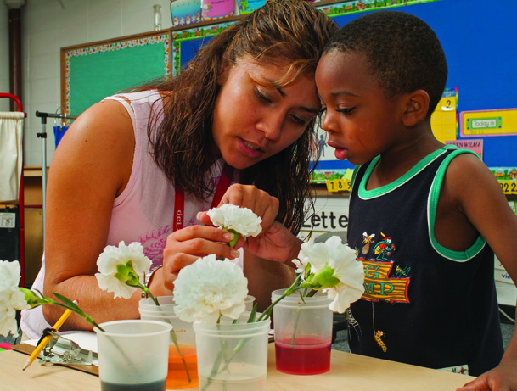
A Look at Project-Based Integrated Curriculum
Long-Term Investigations in Early Childhood Classrooms

Slide 2
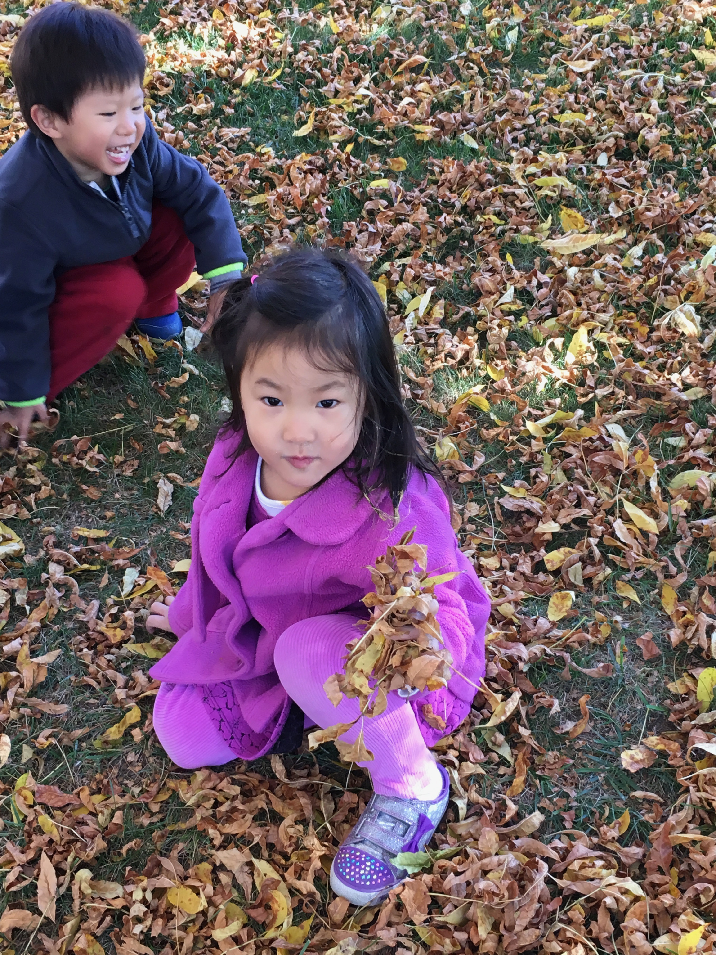
Constructivist philosophy of project-based curriculum
Young children actively make sense of the world using prior knowledge and experiences to construct understanding and make meaning (Piaget)
Young children are curious about how the world around them works
Young children co-construct knowledge with peers and teachers (Vygotsky)
Young children grow intellectually when their thinking is challenged (Piaget) and when they are working within their Zone of Proximal Development (Vygotsky)

Slide 3
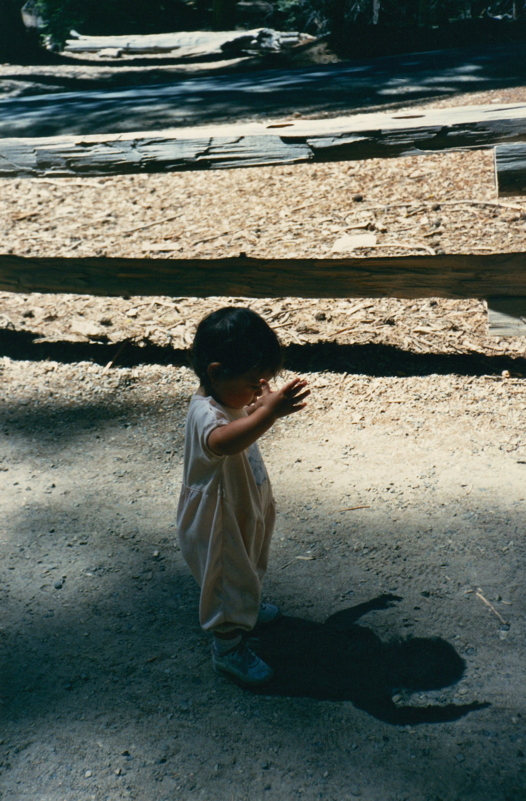
What is project-based curriculum?
Project-based curriculum planning is a dynamic and child-centered approach in which curriculum emerges from children’s curiosity and exploration of the world.
Project-based curriculum begins with identifying a real problem or question to resolve.
Take a look at this video:
https://vimeo.com/238435342

Slide 4
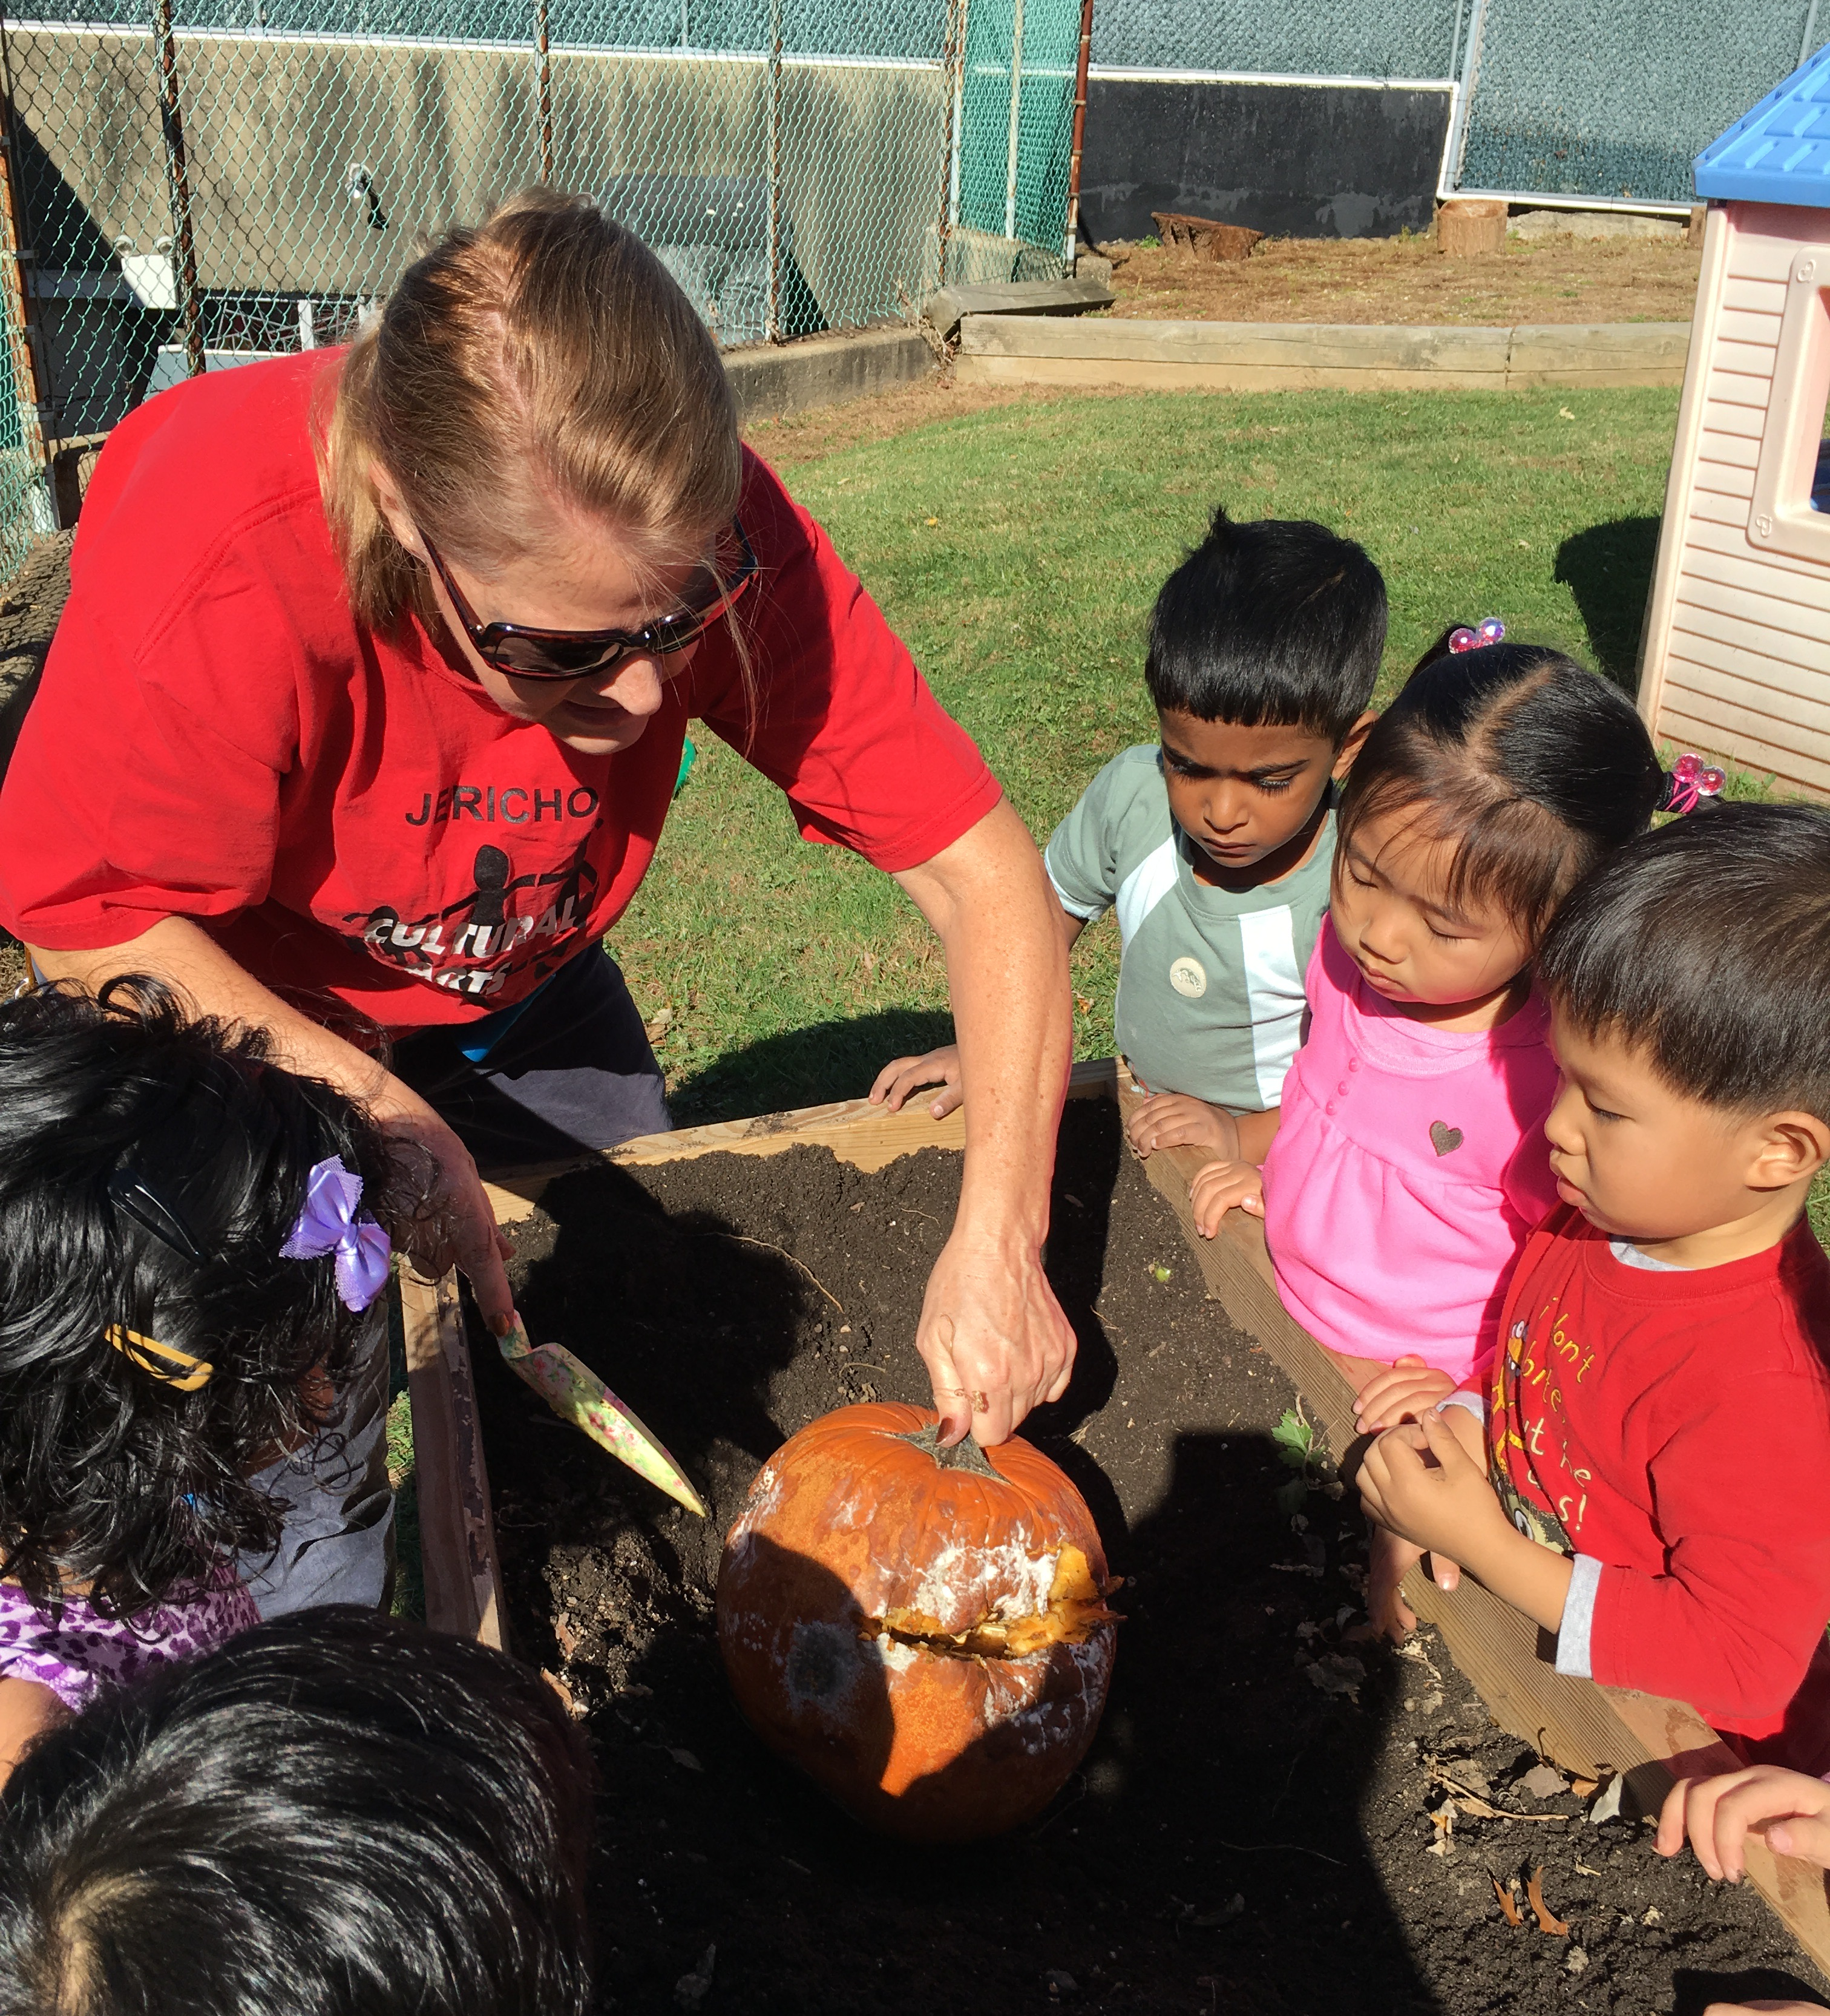
Why is project-based curriculum important?
Project-based curriculum motivates inquiry and exploration. Children acquire deeper knowledge through active exploration of real-world challenges and problems.
Project-based curriculum activities include:
Planned whole group experiences
Teacher-guided play
Intentional transitions
Cooperative learning groups
Child-guided play experiences in learning centers

Slide 5
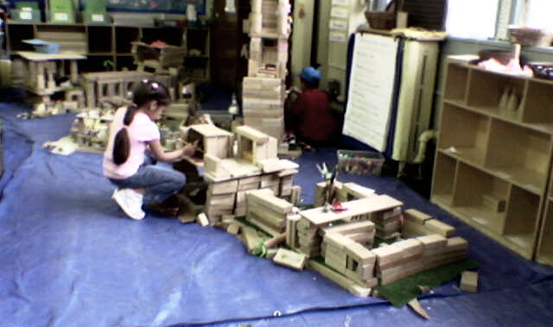
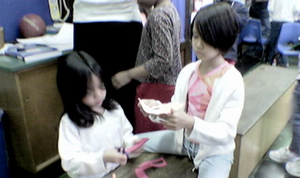
Elements of intentional classroom design
Schedule supports a variety of activities: whole group, small group, partner, teacher-guided, child-guided, learning center play and investigation, outdoor play and investigation,
Evidence-based classroom arrangement: design reflects developmentally appropriate and culturally responsive practice supported by research
Interdisciplinary thematic curriculum webs
Teachers observe and scaffold learning center play to encourage participation, challenge thinking, and support language
Portfolio assessment:
  Collection of evidence supporting child’s development
  Child participates in creating and choosing artifacts for portfolio

Slide 6

Project-based curriculum: learning through inquiry
Spark inquiry: Your learning activity begins with a “spark” that encourage young children to explore and deepen their understanding of the world by posing questions that build on current knowledge and extend thinking
Explore: Learning centers and activities are designed to provide opportunities for children to investigate and gather information. Intentional teaching means that each element of your classroom design supports your curriculum objectives.
Reflect: Once children have had the chance to explore and investigate, they should have the chance to reflect on their investigations. Teachers should scaffold learning with questions that engage higher-order thinking. The next step of the curriculum should build on this new knowledge and provide opportunities to further investigate and analyze the topic.
Create: Children should be given opportunities to act upon the new knowledge developed from their investigations and reflections, to create something that they can share.

Slide 7

What is a Spark?
A spark introduces everyone to the topic of your curriculum and to your learning activity.
The class gathers together for a wholegroup learning experience that is accessible to all the students in the class.
A whole group lesson for young children should be no longer than 10-15 minutes.
Through conversation, you learn about the students’ prior knowledge so you can evaluate where to begin and what to build upon.

Slide 8
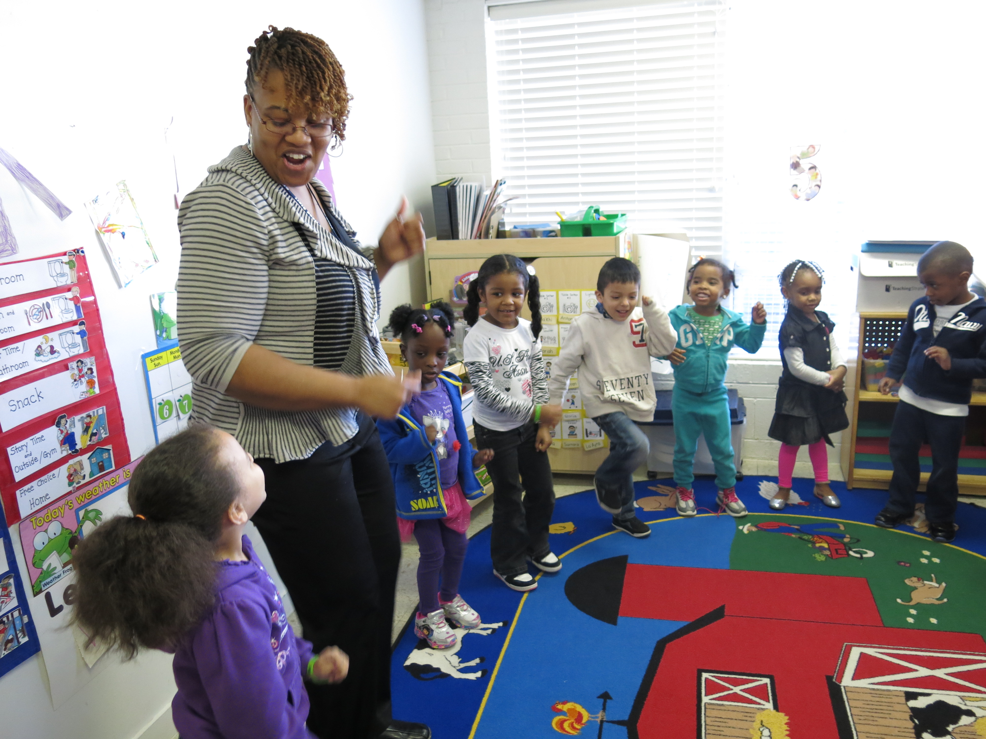
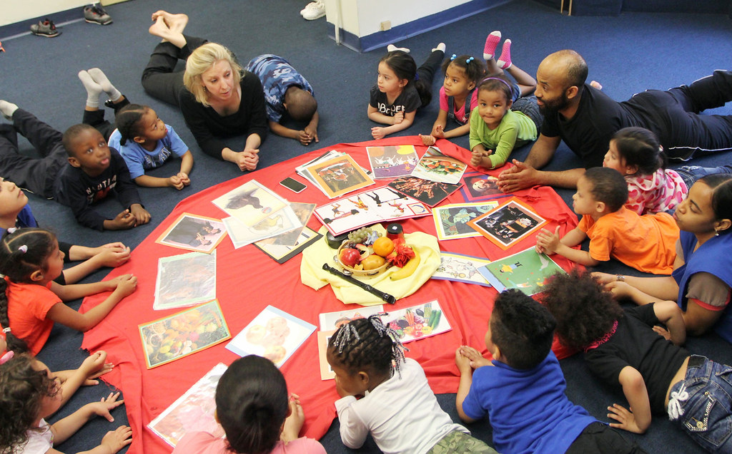
A spark should be:
Exciting: It inspires children’s curiosity about your curriculum topic, so that they want to learn more through exploration and investigation.
Active: There should be multiple activities within the 10 - 15 minutes such as a read aloud, song, movement, and conversation.
Accessible: It should be engaging to all learners at all levels of prior knowledge and experience. For some, this will be an entirely new concept, while others may have background knowledge and need to be challenged.

Slide 9

Project-Based Curriculum:
Know your learners
What are your students’ interests? What makes them excited to learn?
  What are their talents and strengths?
  How can you support their growth in multiple learning domains
What do you know about your students’ families and culture?
  In what ways might you involve families?
  What literature, songs, and craft techniques might you choose that will support understanding of their heritage and that of their classmates?
What are your students’ challenges?
  Academic
  Social / Behavioral
  Physical

Slide 10


Explore to discover and learn
Now that students know a little about the topic and objective, they are ready to participate in independent and small group activities related to the learning goal. The sum of the activities must engage the whole child in the learning experience.
Create activities where children can:
Investigate and manipulate a variety of materials
Move, dance, be physically active
Sing and make music
Question and discuss
Collaborate
Make
Pretend and imagine
Activities can include:
Dramatic play and puppet shows
Experiments and explorations with materials
Outdoor investigations
Quiet reading
Projects
Visual arts
Games
Long-term, multi-day investigations and projects

Slide 11

Teacher-guided and child-guided activities
Scaffold learning by providing a variety of different activities, both guided and independent exploration.
Teacher Guided activities support students as they develop new ideas and skills. These activities:
Require adult support (e.g., cooking)
Demonstrate a process, such as for an art project or science experiment
Teach a new skill
Support sustained focus
Model prosocial behaviors
Encourage students to try new activities
Provide teachers the opportunity to connect with students and assess their understanding
Child Guided activities provide opportunities for students to explore, experiment, practice skills and learn through independent play and peer interaction. Teachers may participate and scaffold, but do not direct the play. These activities:
Allow children to choose and explore freely
Do not require instruction
Provide opportunities for in-depth learning without risk or fear of failure
Give teachers opportunities to observe and assess student understanding

Slide 12
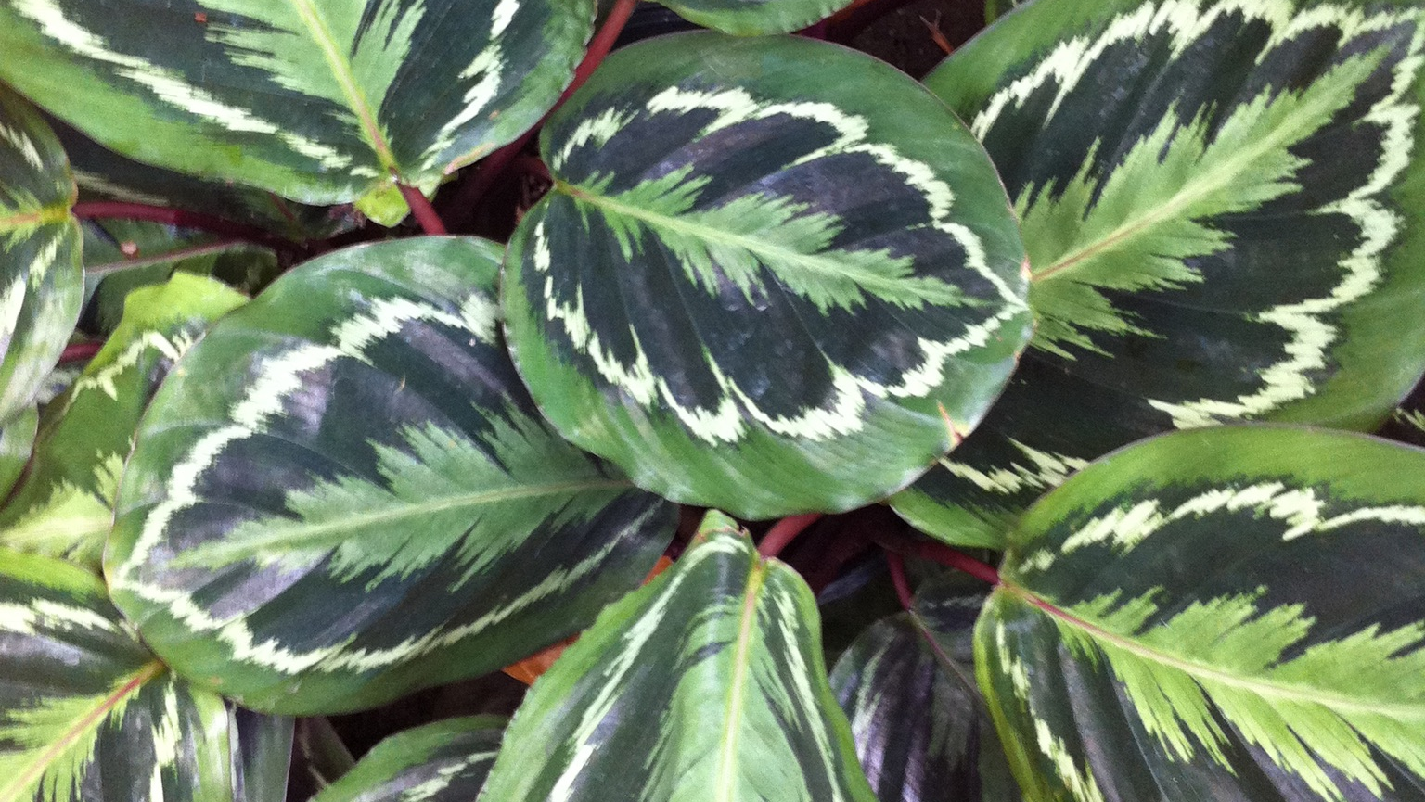
Leaf Study: Trees and Plants in the City
An example of a project-based and interdisciplinary thematic lesson

Slide 13
Leaf Study: Trees and Plants in the City
A sub-theme such as this can be part of multiple different thematic curriculum units that emerge from the interests of the children in your class: Growth and Change; The Seasons; Nature in the City...
Here is one possible thematic curriculum planning web:
Theme: | Nature in the City
Subthemes | Observing Our Urban Environment | Urban Habitats | Leaf Study: Trees and Plants in the City | Birds and Animals in the City | Protecting Our Natural Urban Environment
Goals | Students will explore their urban environment to discover how we live with nature in the city. | Students will recognize different natural habitats in the city and the flora and fauna that live in these urban habitats. | Students will use their observation skills, especially of color, shape and size, to learn about trees and plants in the city. | Students will learn about the birds and animals that make their home in natural habitats in the city. | Students will apply what they have learned about nature in the city to explore ways to protect the natural environment.

Slide 14
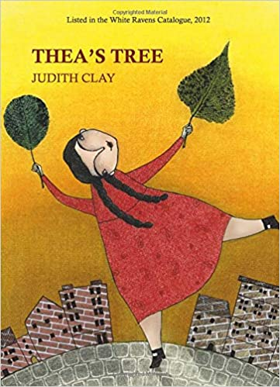

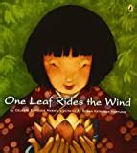
Leaf Study Sub-Theme: Children’s Literature
High-quality children’s literature sparks imagination, opens new windows onto the world and connects to children’s prior knowledge and experience
Reading aloud, books in the reading center, and books placed in different learning centers offer children multiple ways to understand and explore the topic through both teacher-guided and independent learning.

Slide 15

The Spark: A Read Aloud
For this lesson, you can spark children’s interest and imagination with a read aloud.
Red leaf, Yellow Leaf by Lois Ehlert is one book you may choose to read during the whole group meeting.
The read aloud may be followed with a song or movement activity about leaves.
If you can’t see the video, cut and paste this link in your browser: https://www.youtube.com/watch?v=PJPAcC7tQto

Slide 16
Activities for Teacher-Guided and Independent Exploration
Nature walk: Take a walk with your students through the neighborhood or to a nearby park and let them collect leaves.
Sorting and classifying: Back in the classroom, leaves can be added to your Sensory Center or your Science Center. Children can sort leaves, observe them closely with a magnifying glass, and compare attributes of different leaves.
Observing change: Over time, the leaves will change color and texture. Children can document those changes.

Slide 17
The next day…
Children will be doing a lot of observation, so I have created centers that support close looking.
Center Activities:
Leaf Sensory Bin
Discovery Center with magnifying lenses and leaves
Art Center: Leaf colors at the easel
  Sticky paper for students to collage leaves
Library: Bin of leaf themed books
Other centers would be open, but unrelated to the topic.
* I don’t recommend rereading all books, but The Little Yellow Leaf has a lot that can be explored in it.
Creating Routines in the Study.
Young children thrive with repetition, so the next day we replicate the activities, but with some variety to help them go deeper into their understanding about the colors and shapes of leaves.
The Little Yellow Leaf
We read the book again and talk about the social emotional lesson of the story.
I play music and students dance in the wind, first alone, the find a partner to dance to reenact the story.
We go outside and collect more leaves for the sensory bin- the students are getting very excited!

Slide 18

Continuing the learning at meeting time
Repeated Interactive Read Aloud: The following day, read Red Leaf, Yellow Leaf again. Young children learn from repeated read alouds: new ideas and deeper understanding emerge when you revisit a story.
Explore the lessons in the story.
Have the children engage in a dramatic re-enactment of the story or play music and have the children imagine through movement the leaves changing as the seasons change.
Take another nature walk and collect more leaves…

Slide 19
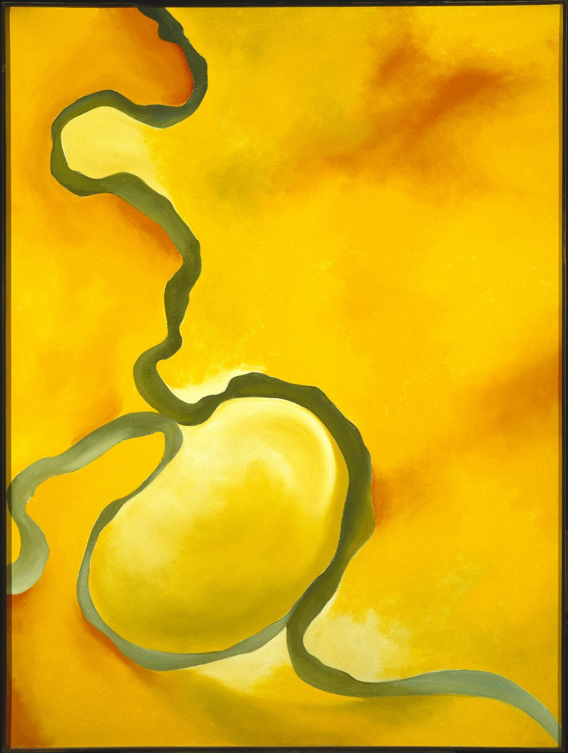

Building a lesson around a Work of Art
Georgia O’Keeffe. Green, Yellow and Orange, 1960. Oil on Canvas.
Georgia O’Keeffe. Two Yellow Leaves, 1928. Oil on Canvas

Slide 20
Overview of the Planning Process
Select a work of art and get to know it:
  What do you notice in the work of art?
  What questions occur to you about the work of art?
  What surrounds this work socially, culturally, historically?

Slide 21
Another Day, Another Spark…
Now that students have spent some time exploring and observing leaves, scaffold the learning to help students go deeper into their leaf study.
Look closely at this painting, Two Yellow Leaves by the artist Georgia O’Keeffe.
Georgia O’Keeffe closely observed nature and then created her own interpretations of what she observed.
What do you notice?
What colors do you see?
What shapes do you see?
How do you think these leaves might feel to touch? Why?
What else do you notice.
Now, let’s look at another painting by Georgia O’Keeffe…

Slide 22
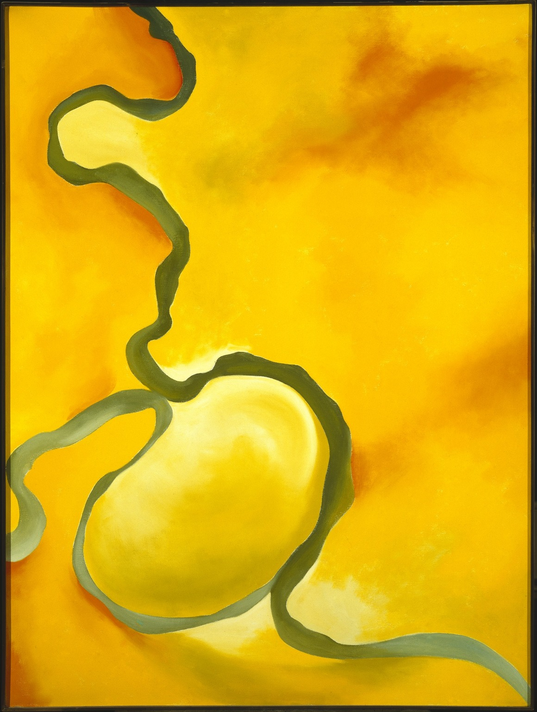
The Learning Activity
Georgia O’Keeffe also made this painting.
How are they the same? How are they different?
Trace the green line with your finger. What do you notice?
Introduce the learning activity:
Today, we are going to make leaf portraits, just like Georgia O’Keefe did with her leaves.

Slide 23
The Learning Activity
Classroom Set-Up
Location: Art Center
Table set for four students
Tray with leaves and magnifying glasses.
Tray with art-making materials
Books on topic in library, science center, art center
Materials:
Leaves
Magnifying glass
A pencil
Paper
Watercolor paints
Paint brushes
A sharpie or a black crayon

Slide 24
The Learning Activity
Teacher Guidance
Model, or show how you closely observe one leaf.
Encourage students to observe.
  Talk together about what you notice.
Students will draw what they see.
  Encourage students to make the leaves in their own way, like Georgia O’Keeffe did
  Remind them that this is their own interpretation of what they see, not an exact copy.
After drawing, they will trace over the lines with sharpie or crayon.
Paint with watercolors.

Slide 25
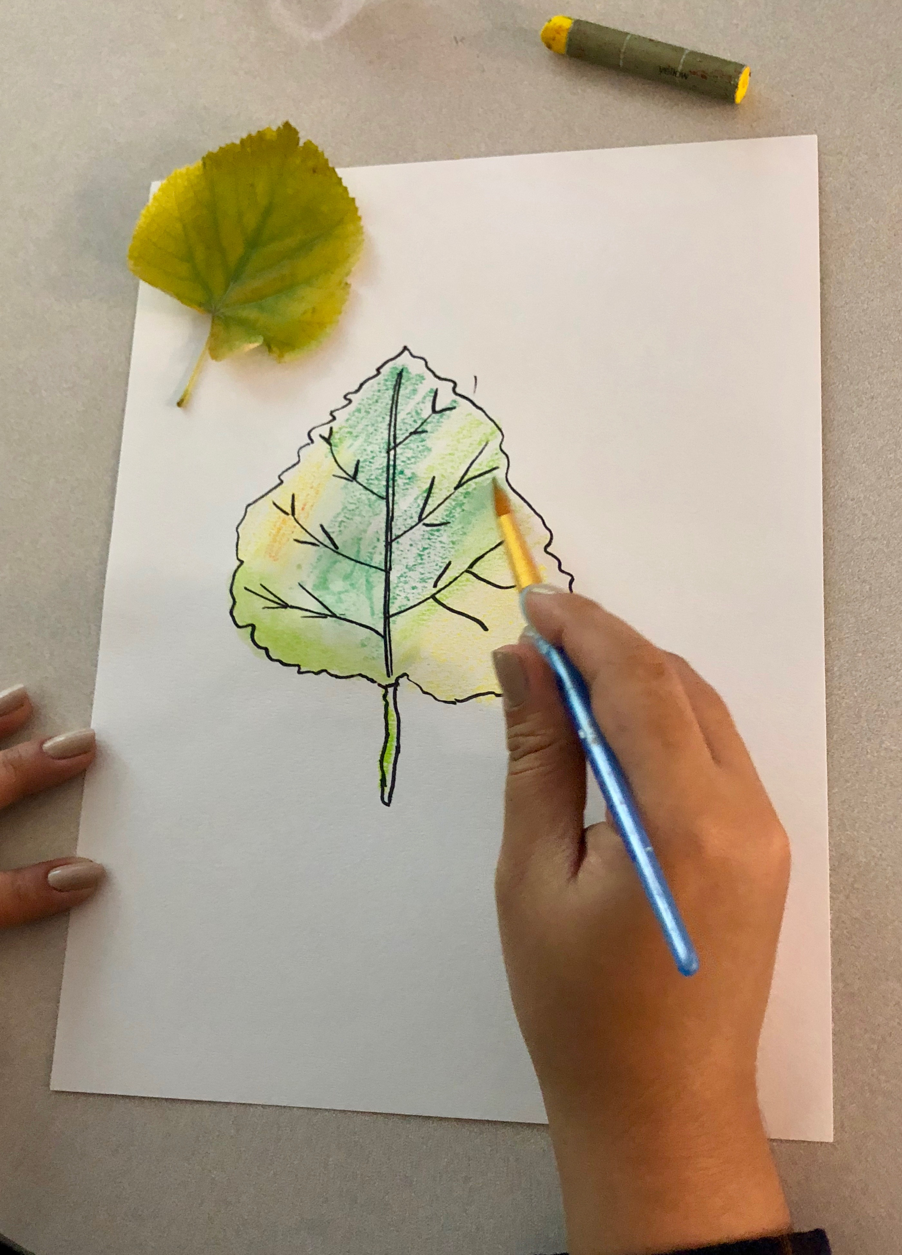
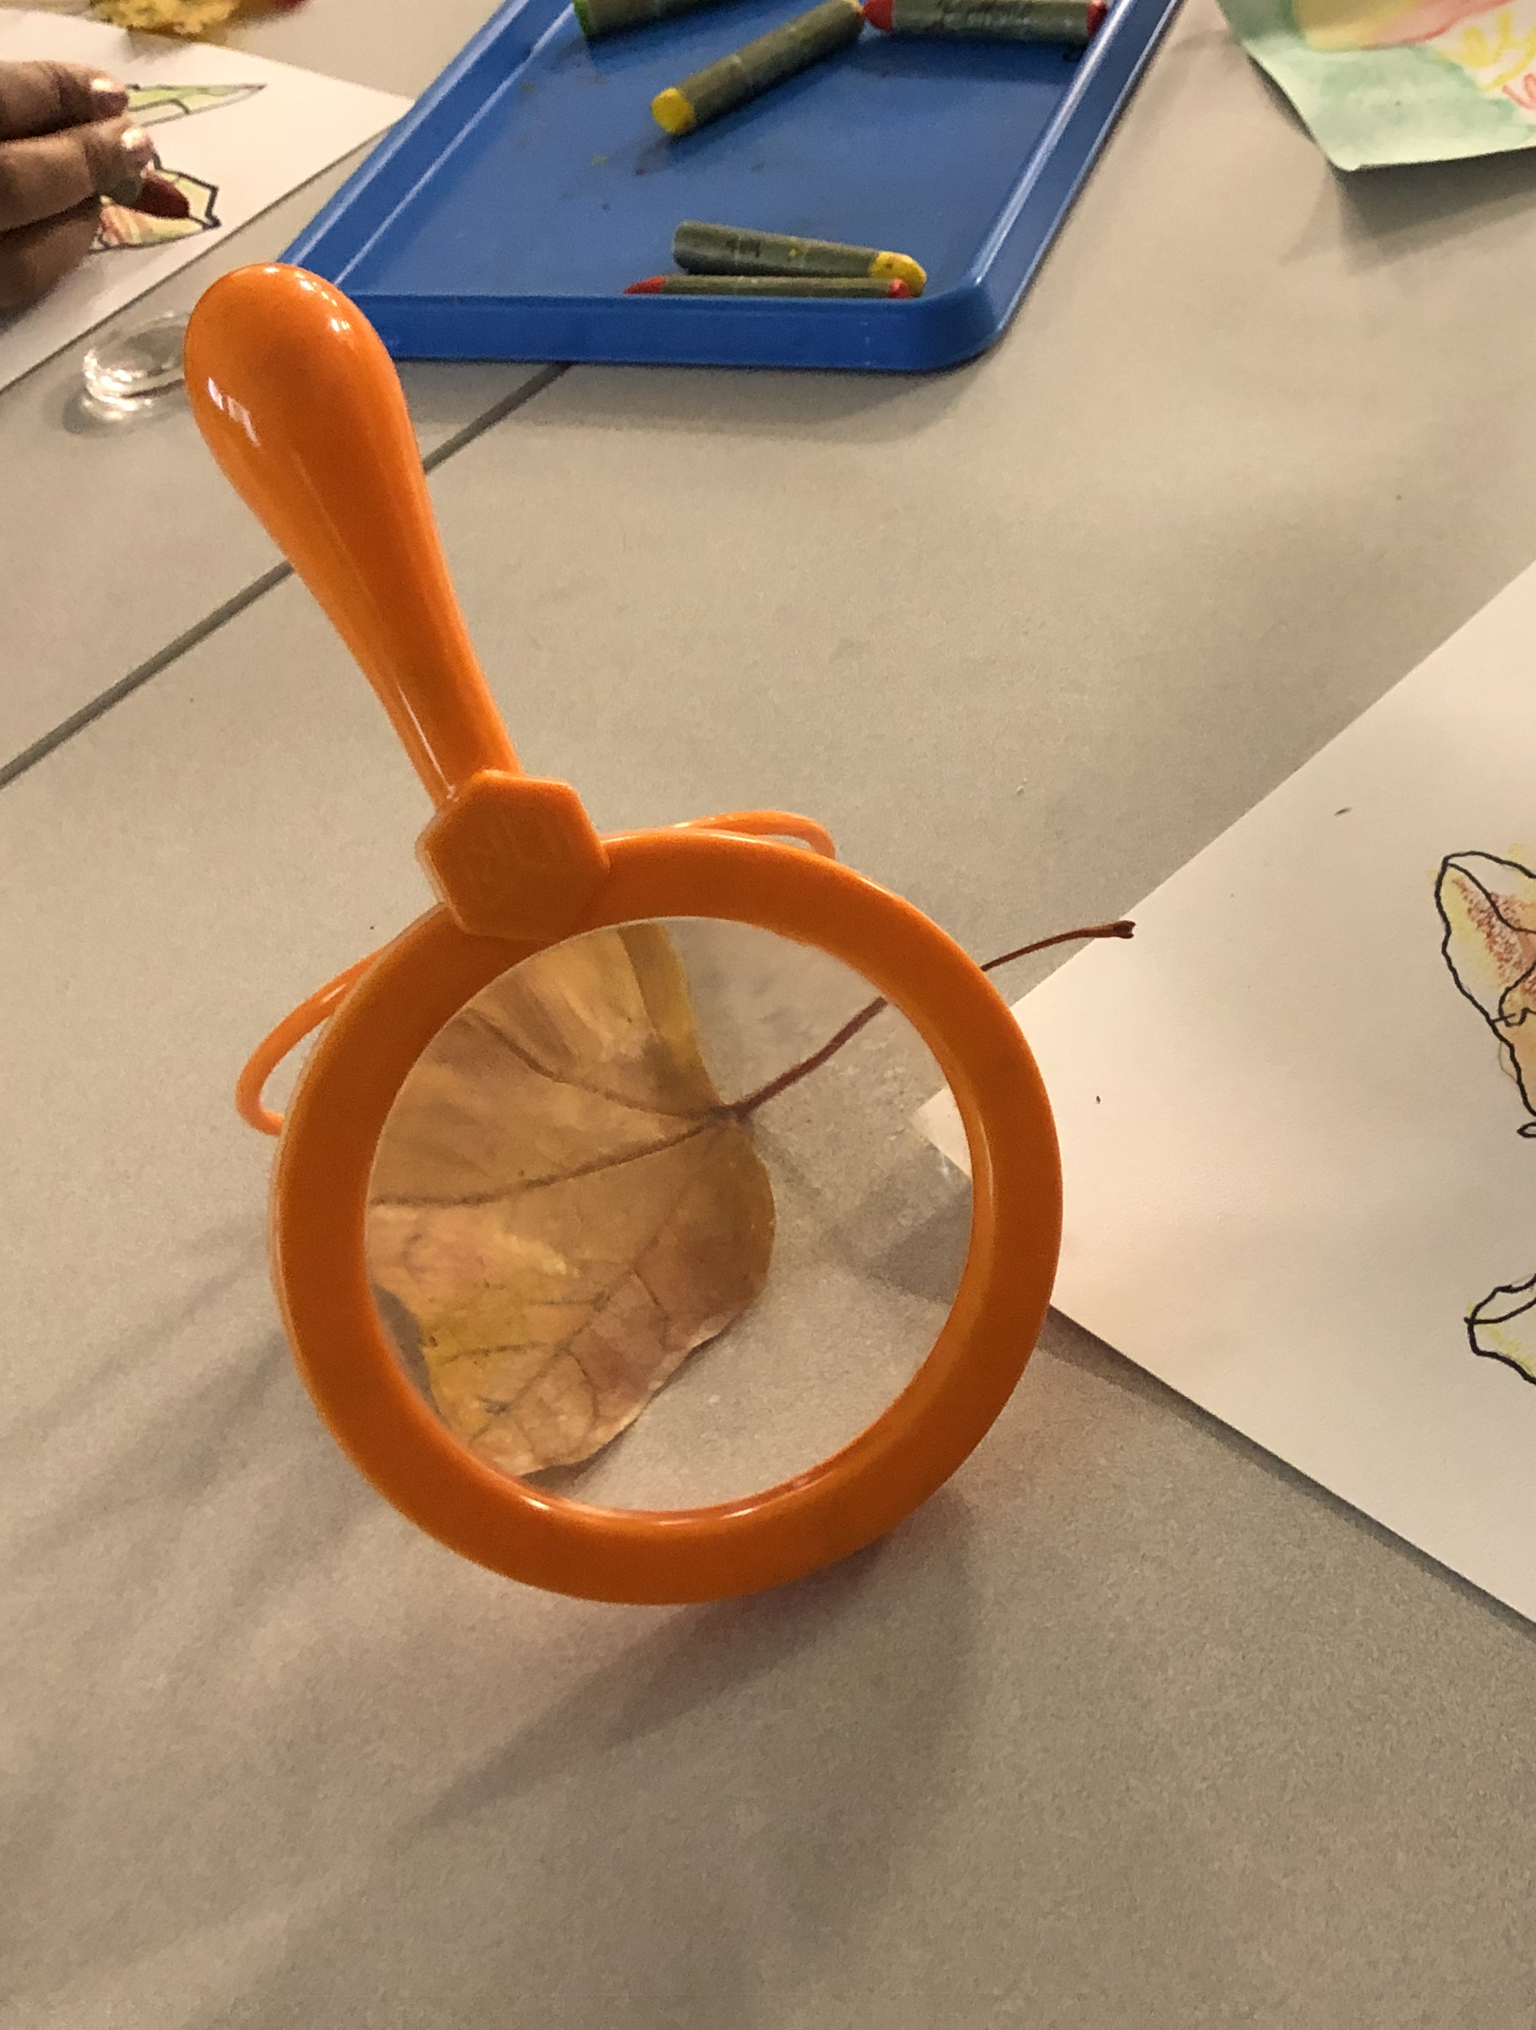
The Leaf Study: A Teacher Workshop
“There has always been a common misconception of what it means to be creative, some believe that only the “gifted” people have creativity. In my opinion, this is not true. When we were children, we were full of creativity, we would make up our own stories and share them with others, we would bring a building that we had in our imaginations and physically create it by using blocks or boxes.”

