Slide 1
ECE 211
Curriculum for Young Children I
Introduction

Slide 2
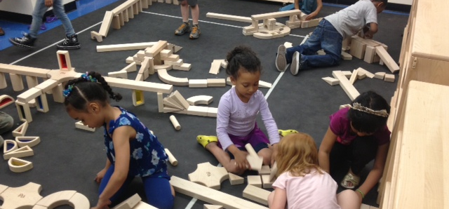
What is curriculum?

Slide 3
Curriculum is an organized framework that…
…articulates the information/knowledge the children will be engaged in constructing,
…considers the process through which teaching and learning will occur,
…anticipates what the learning environment will entail,
…envisions a role for the teacher in facilitating the learning process.

Slide 4
What do you think is happening here?

Slide 5
Developmentally Appropriate Practice
Based on:
Knowledge of child development and learning
Knowledge about strengths, interests, and needs of each individual child
Knowledge of the social and cultural context in which children live
NAEYC, 1999 (National Association for the Education of Young Children)

Slide 6
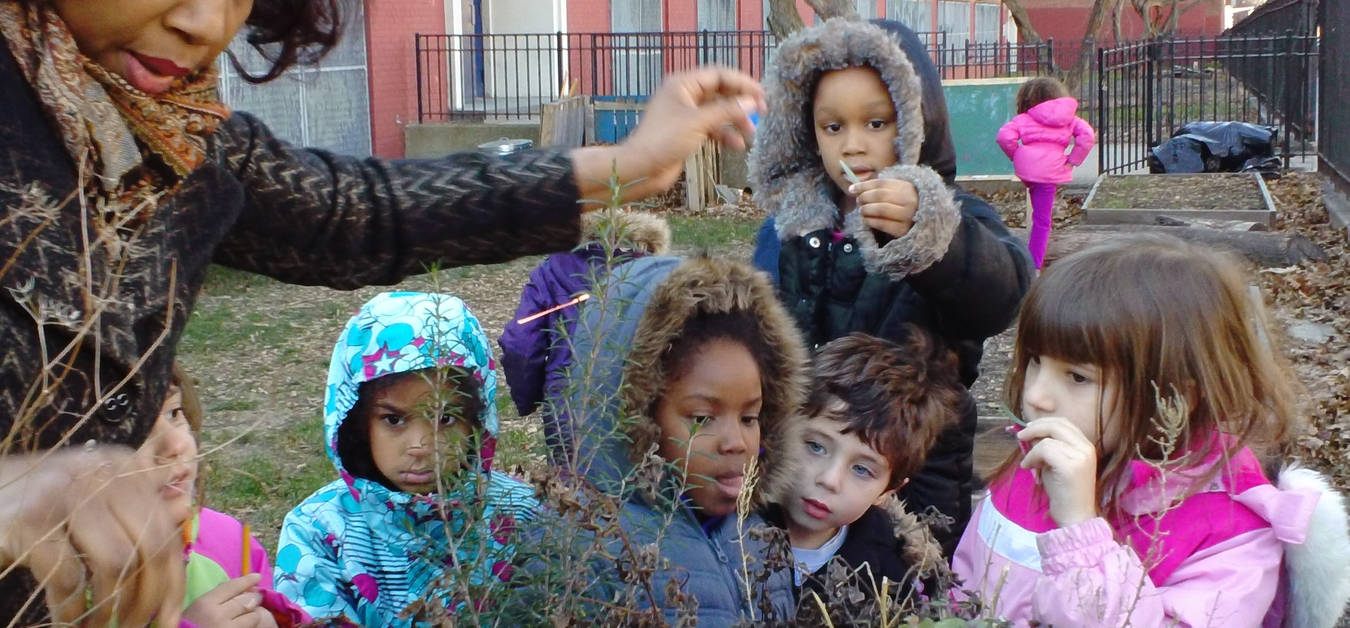
Knowledge of Child Development and Learning

Slide 7
Domains of Child Development
Cognitive
Language (includes Literacy)
Physical
Social-Emotional
Curriculum needs to consider all domains because ALL work together to help children find meaning and learn from their world

Slide 8
Expectations of Development by Age
Marianna
3.5 years old
Juan
7.2 years old
What do you know about each based on their age?
Cognitive?
Language?
Social-Emotional?
Physical?
How would they differ? What does this mean for curriculum design?

Slide 9
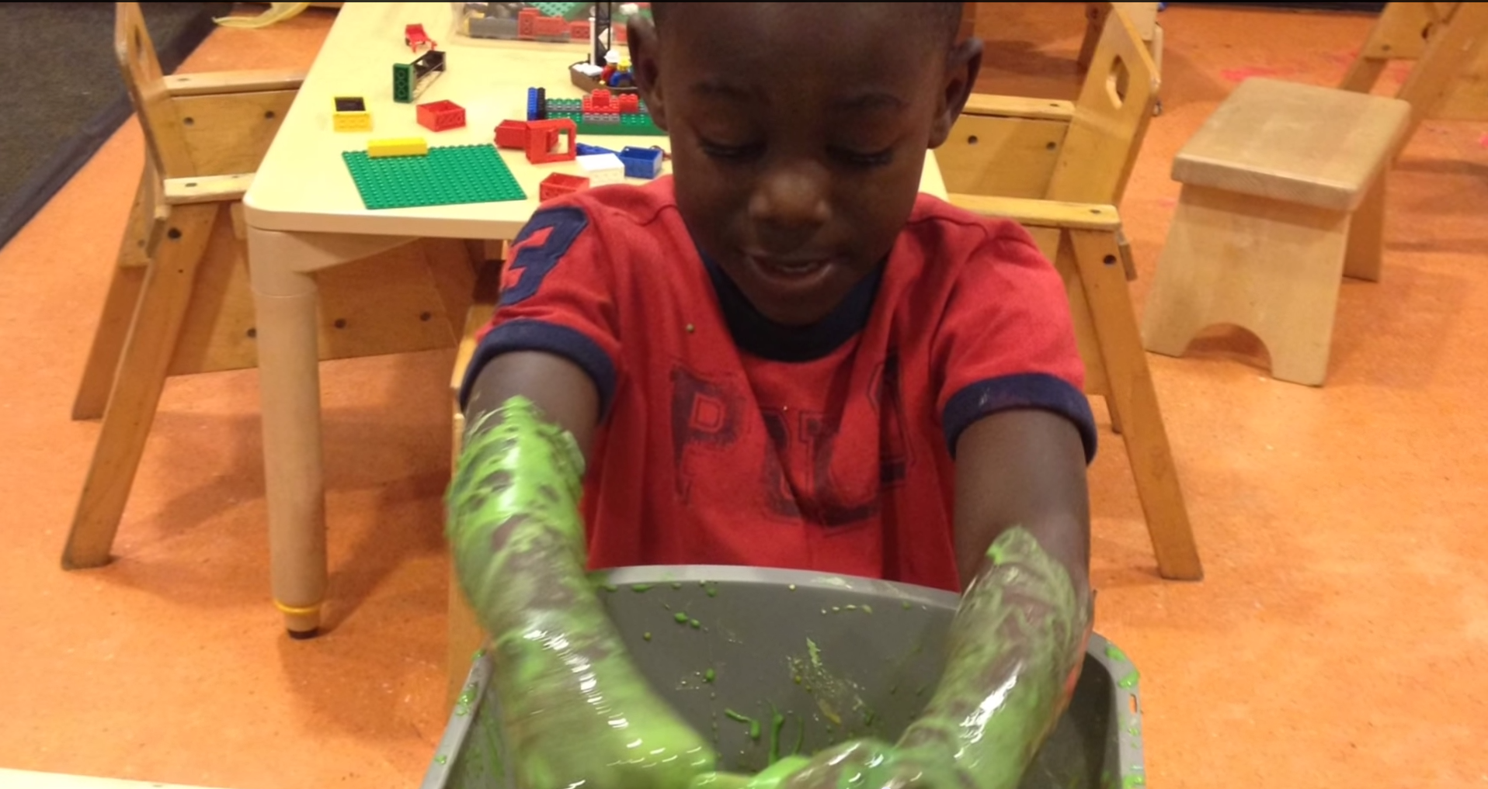
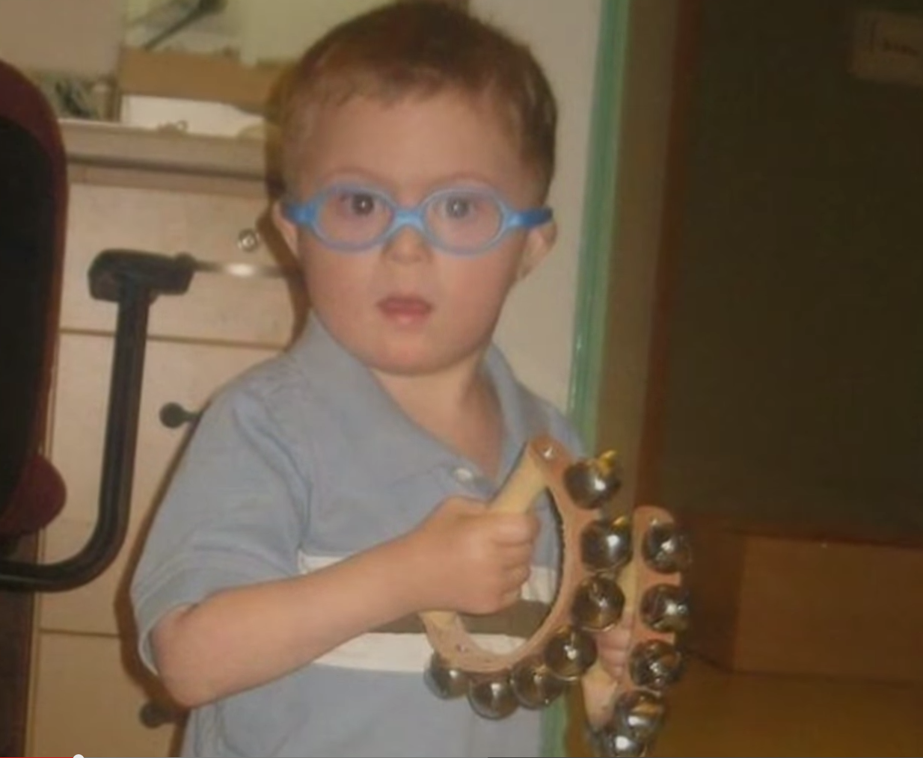
Teaching to the Individual
What is “appropriate” for the age group may not be appropriate for the individual

Slide 10

Teaching to the Individual
Teaching To The Individual
Need to adapt for cultural and linguistic needs
Need to adapt for individual strengths and interests
Observation and family interaction are key

Slide 11
Knowledge of the Social and Cultural Context
Teachers need to be aware of the family culture and traditions of ALL children in the class
Young children need to be valued as unique individuals and contributing members of their community.
ECE provides opportunities to:
Explore gender, racial/cultural identity, developmental abilities/disabilities
Challenge stereotypes
Address biases/prejudices

Slide 12
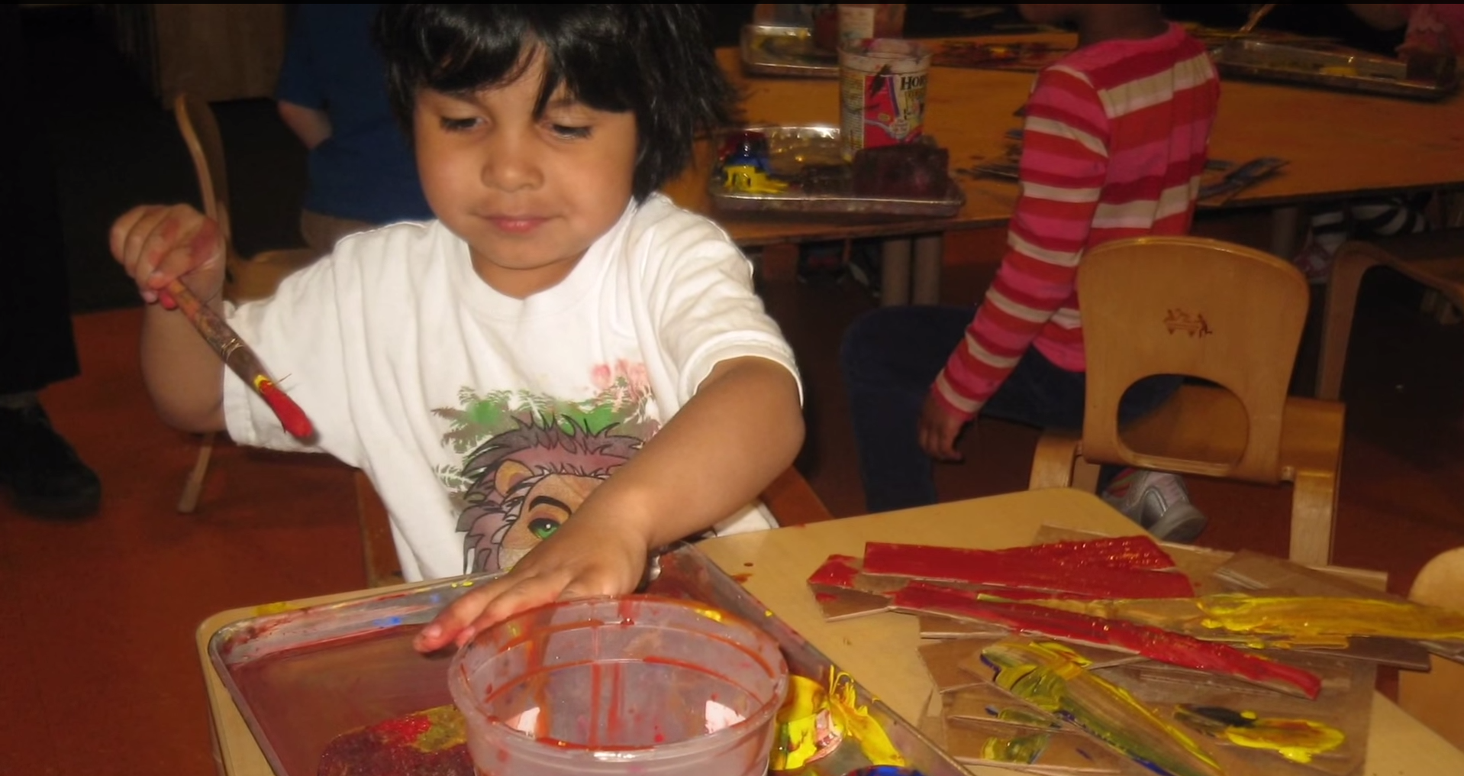
Developmentally Appropriate Practice (DAP) in Early Childhood Curriculum
Child centered
Experience centered
Knowledge centered
KEY FEATURES: Socializing, Constructing, Inquiring, Questioning, Creating, Experimenting, Expressing,

Slide 13
Theories of Child Development
  Development occurs in a relatively ordered sequence with later abilities, skills and knowledge building on those already acquired
  Psychosocial Theory (Erikson)
  Hierarchy of Needs (Maslow)
  Cognitive Development Theory (Piaget)
  Sociocultural Theory (Vygotsky)
  Multiple Intelligences Theory (Howard Gardner)
  (*see handout)

