Slide 1
Mark Making
By Jonette Julien

Slide 2
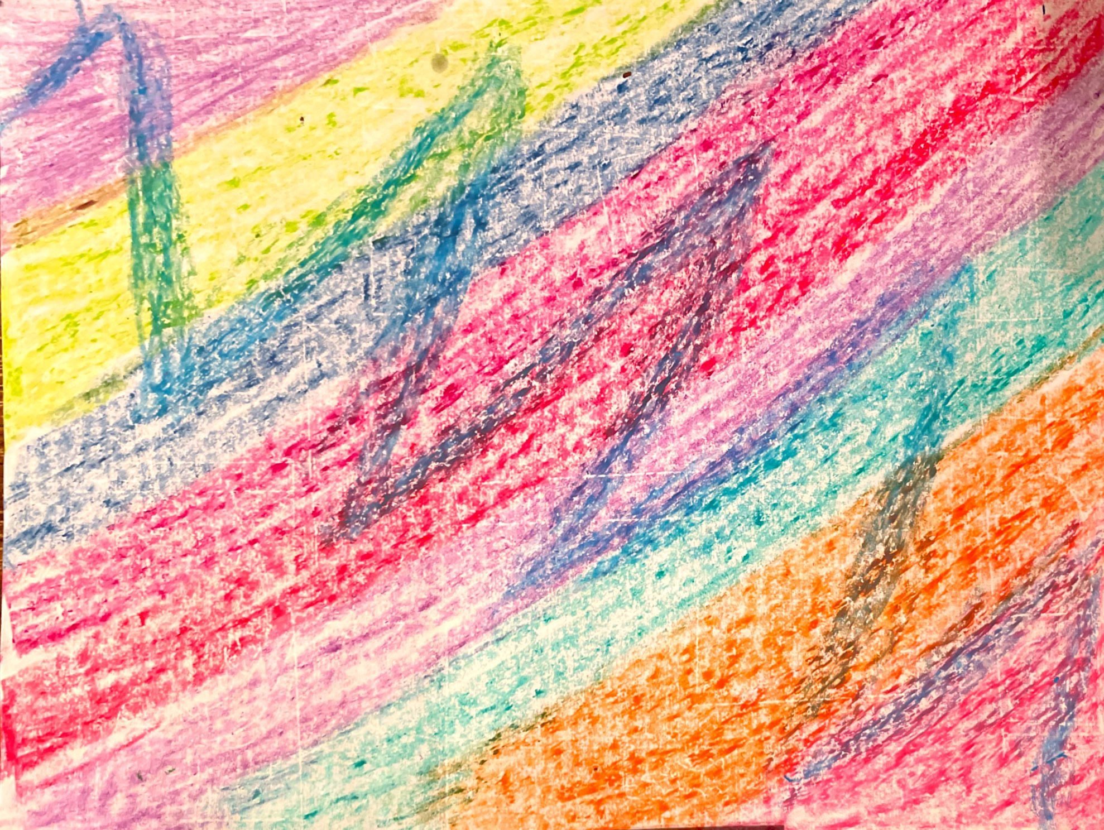
White copy paper and oil pastels

Slide 3
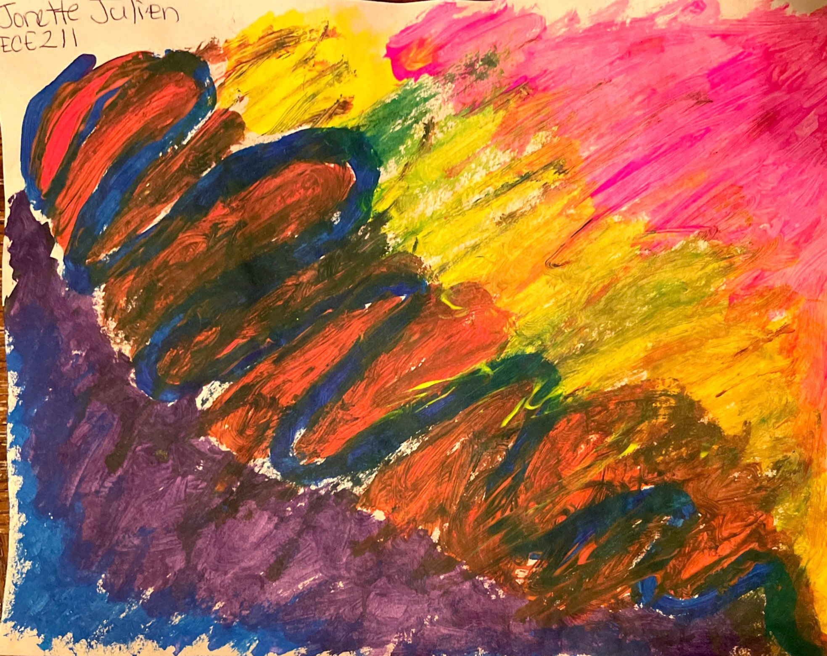
Cream construction paper, tempera paint and brush

Slide 4
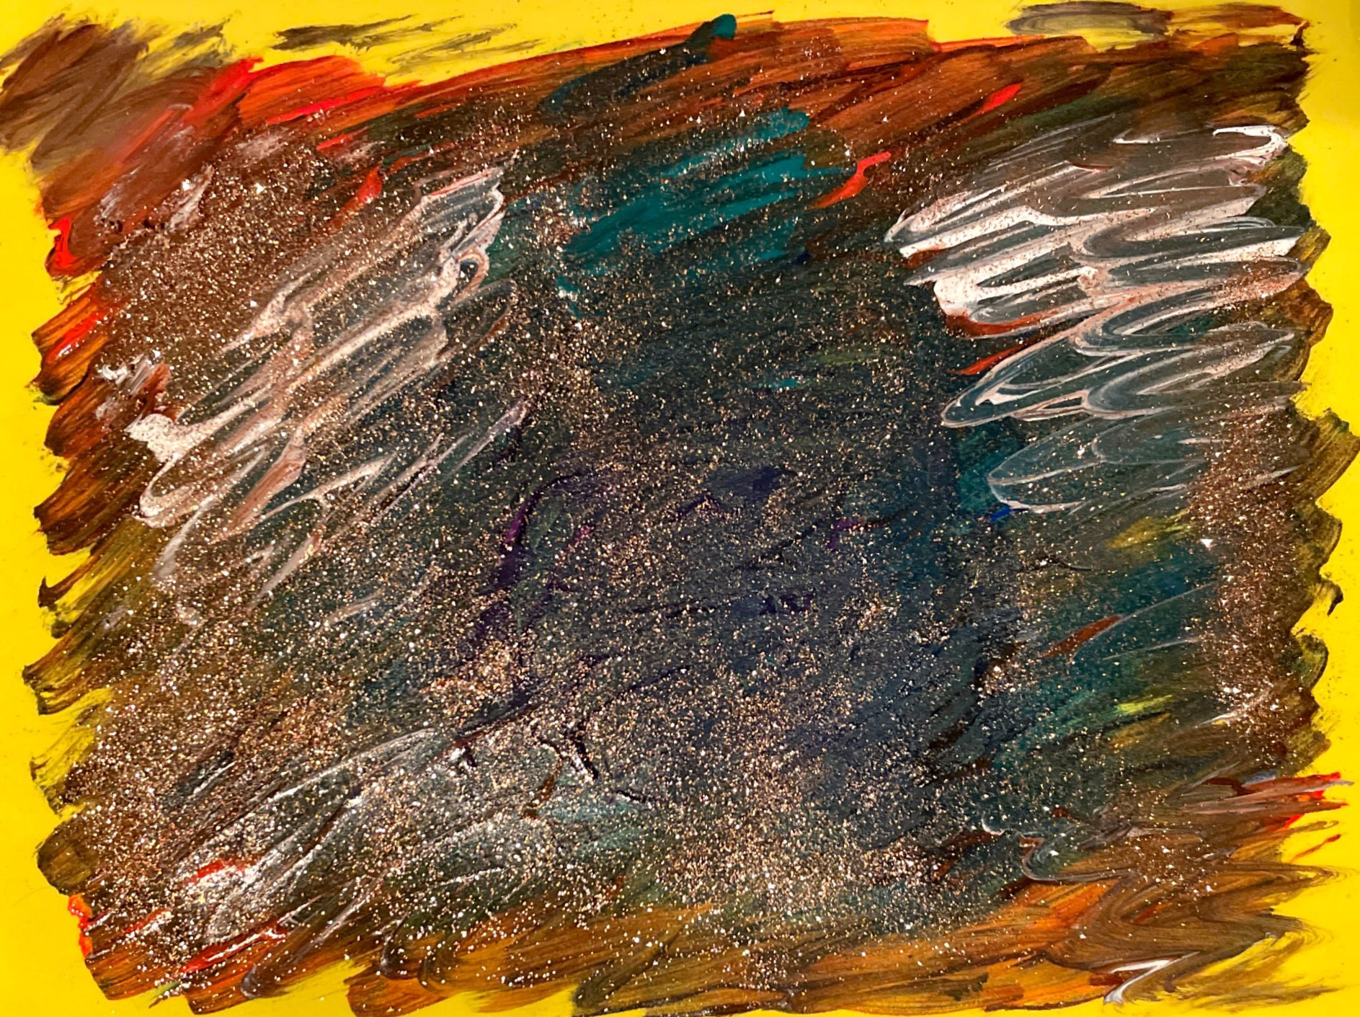
Foam sheet (yellow)
Acrylic colors
Disappearing purple glue Bronze glitter
And a smile.

