Slide 1
Mark Making
Tonanzintl Huerta

Slide 2
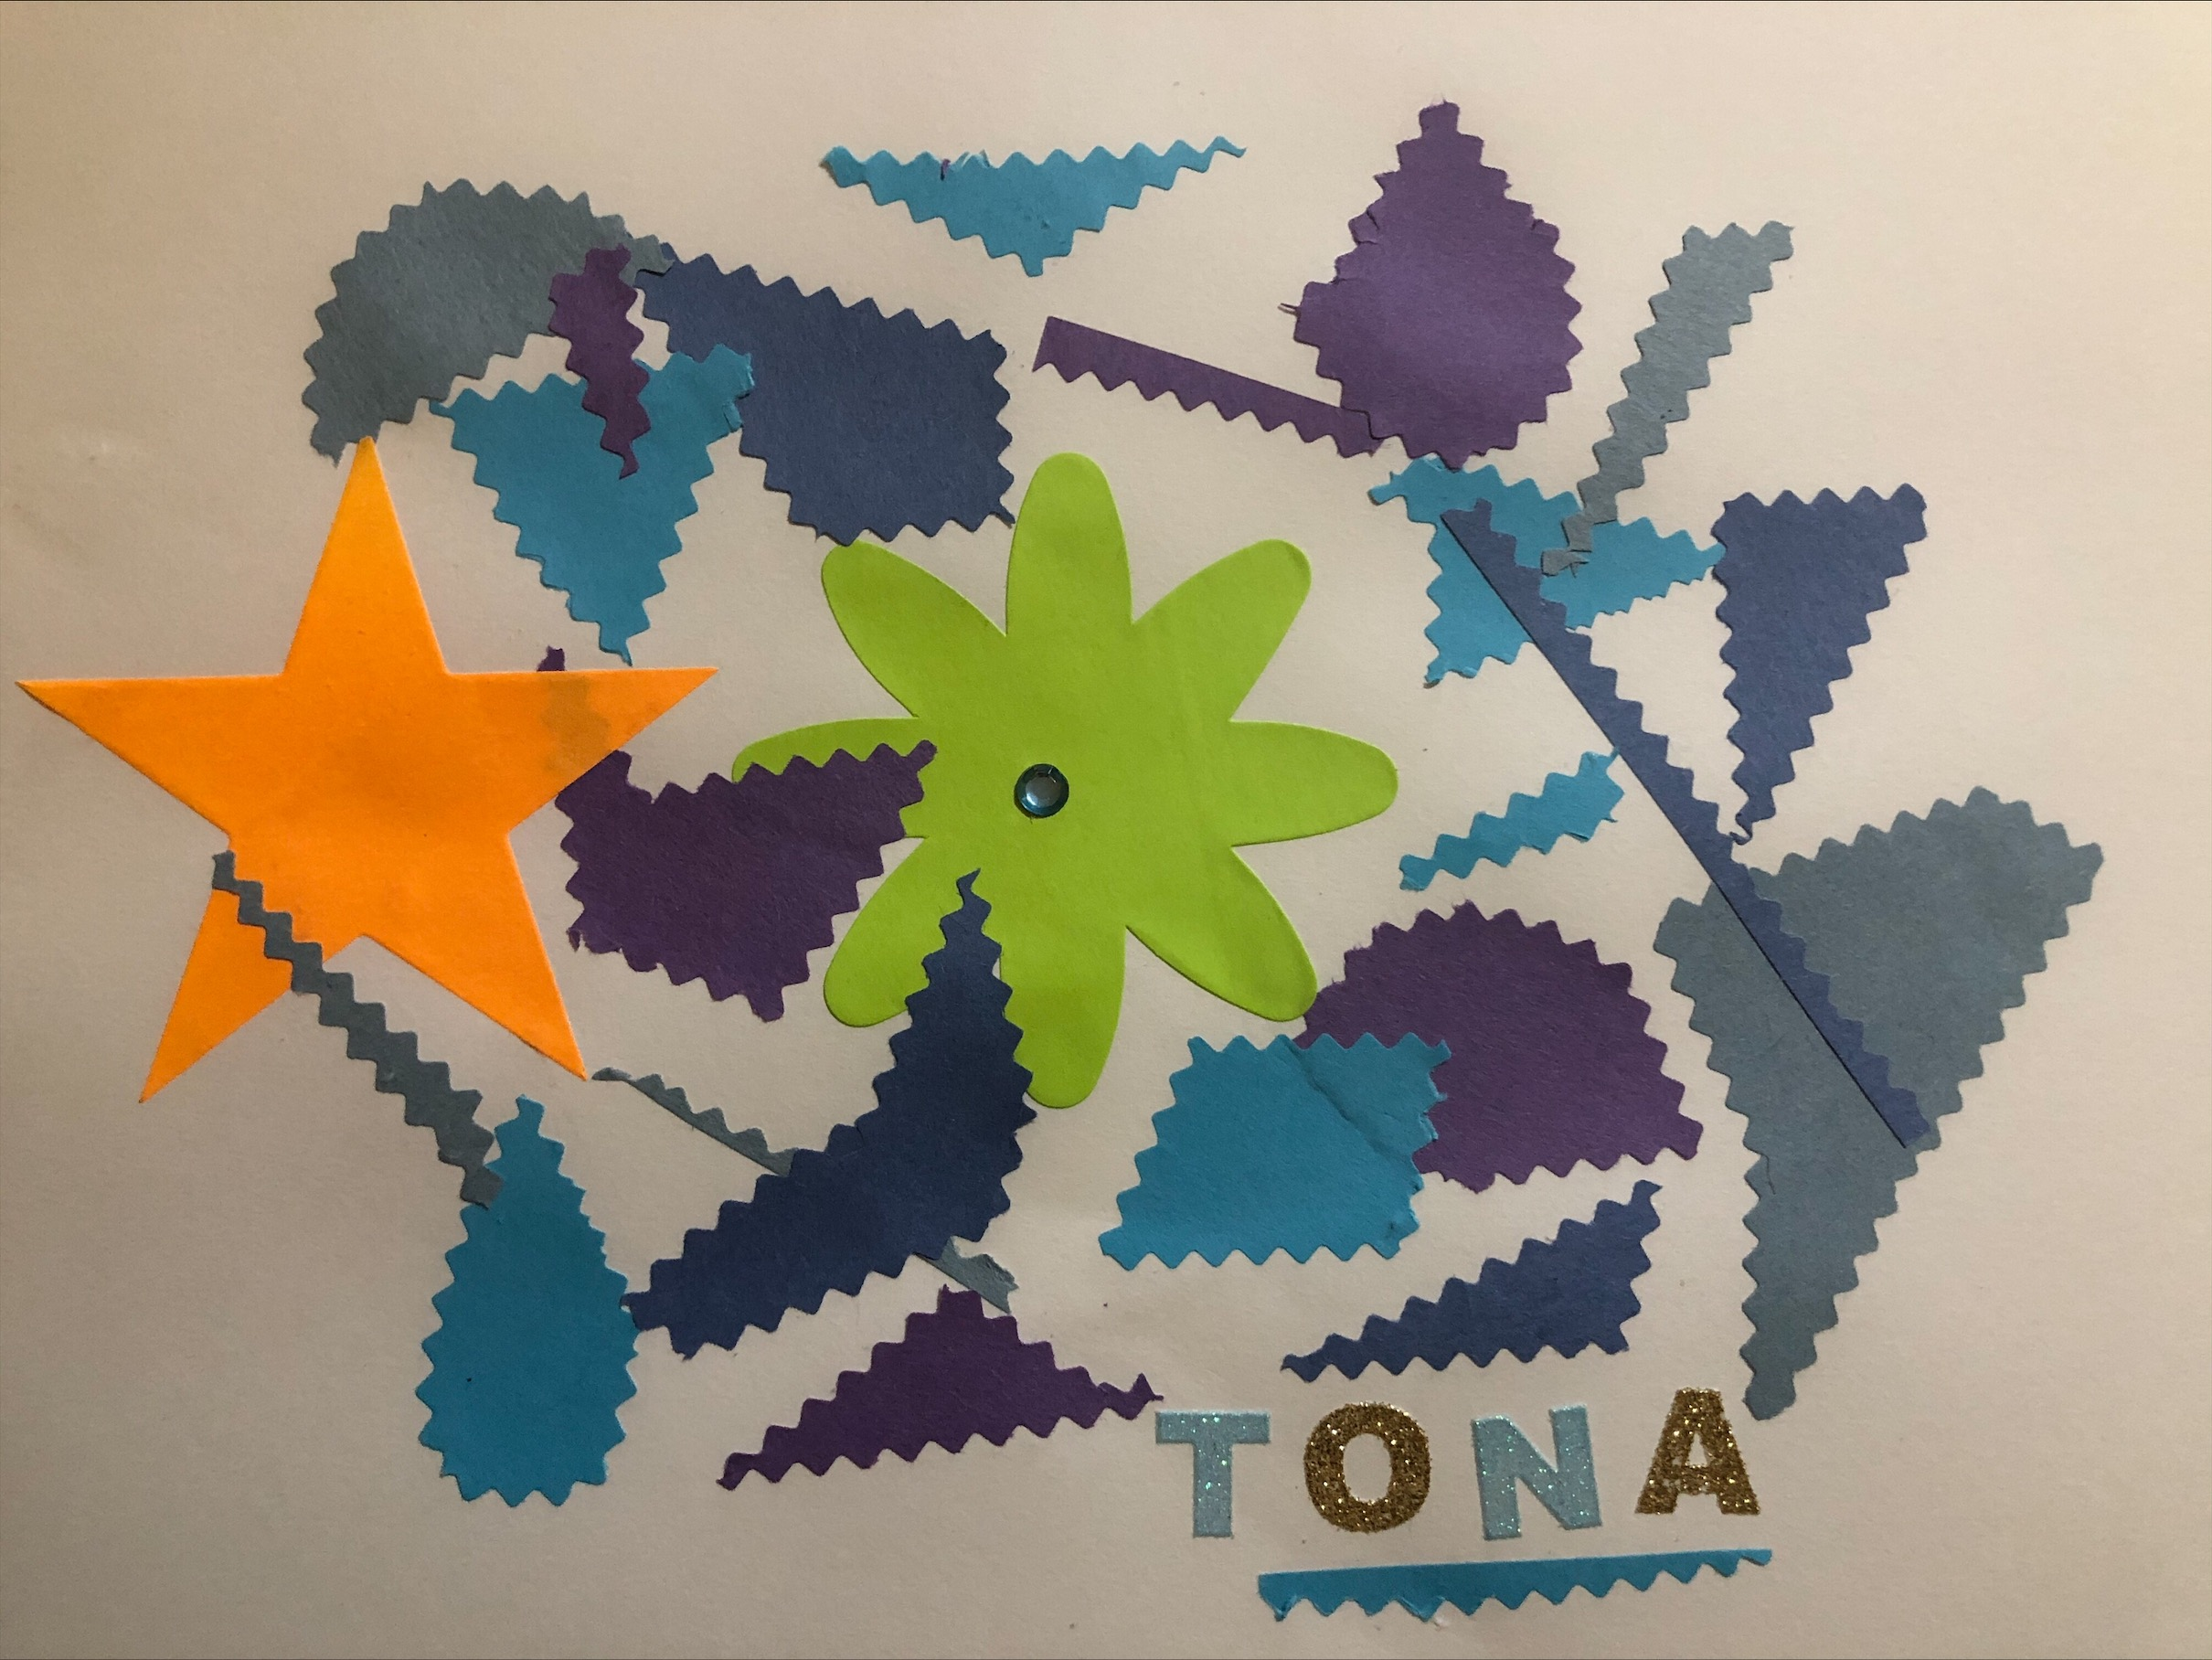
To make it I use some stickers, glue, Decorative Scissors, and some construction paper.
First I started by cutting the construction paper in different shapes And I glued them randomly.

Slide 3
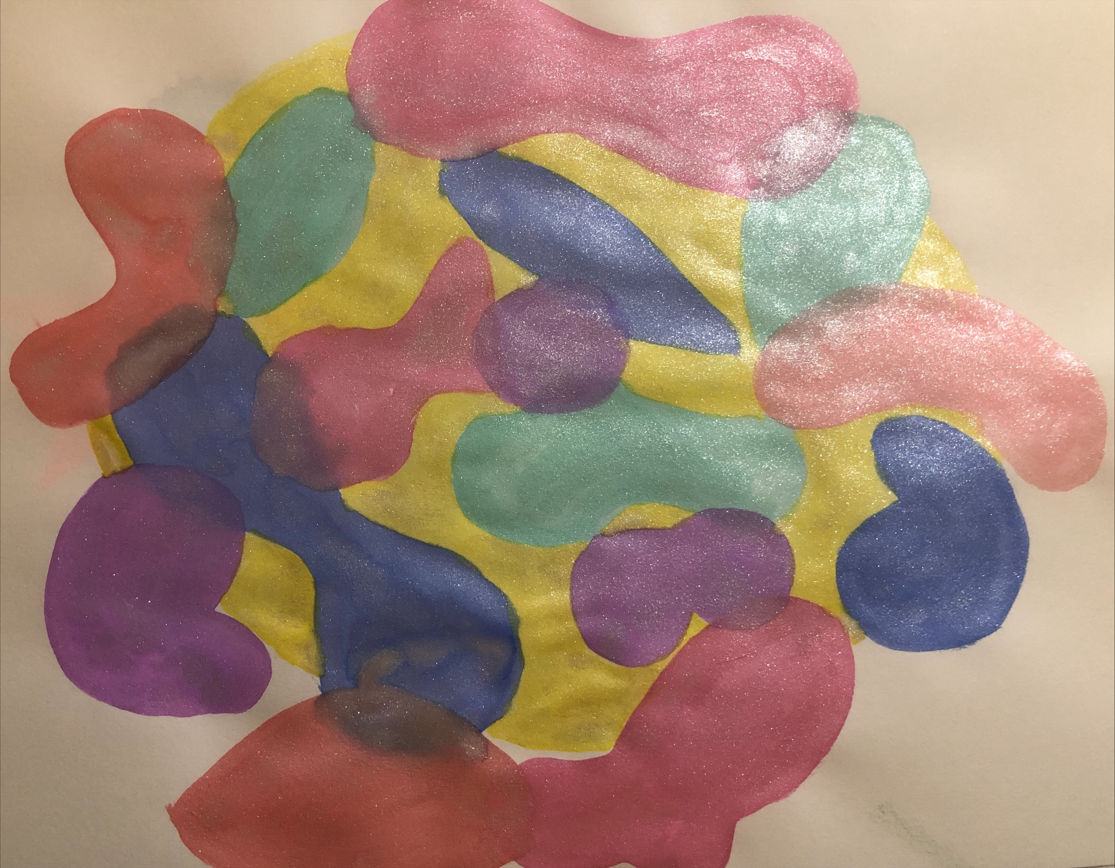
For this one I use water color
With each color I try to do diferentes shapes and try to put them apart from each other.

Slide 4
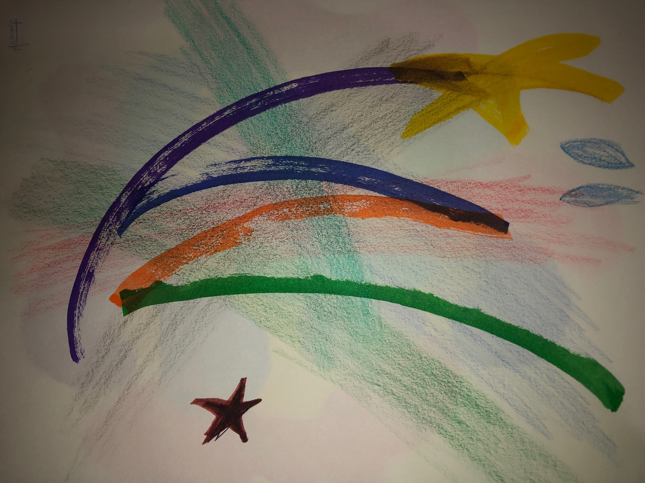
For this I used color pencils, markers and a crayon.
I start with the color pencils then a got the markers and start to draw some lines, I try to make some starts and at the end with a crayon I try to make some leaves.

