Slide 1
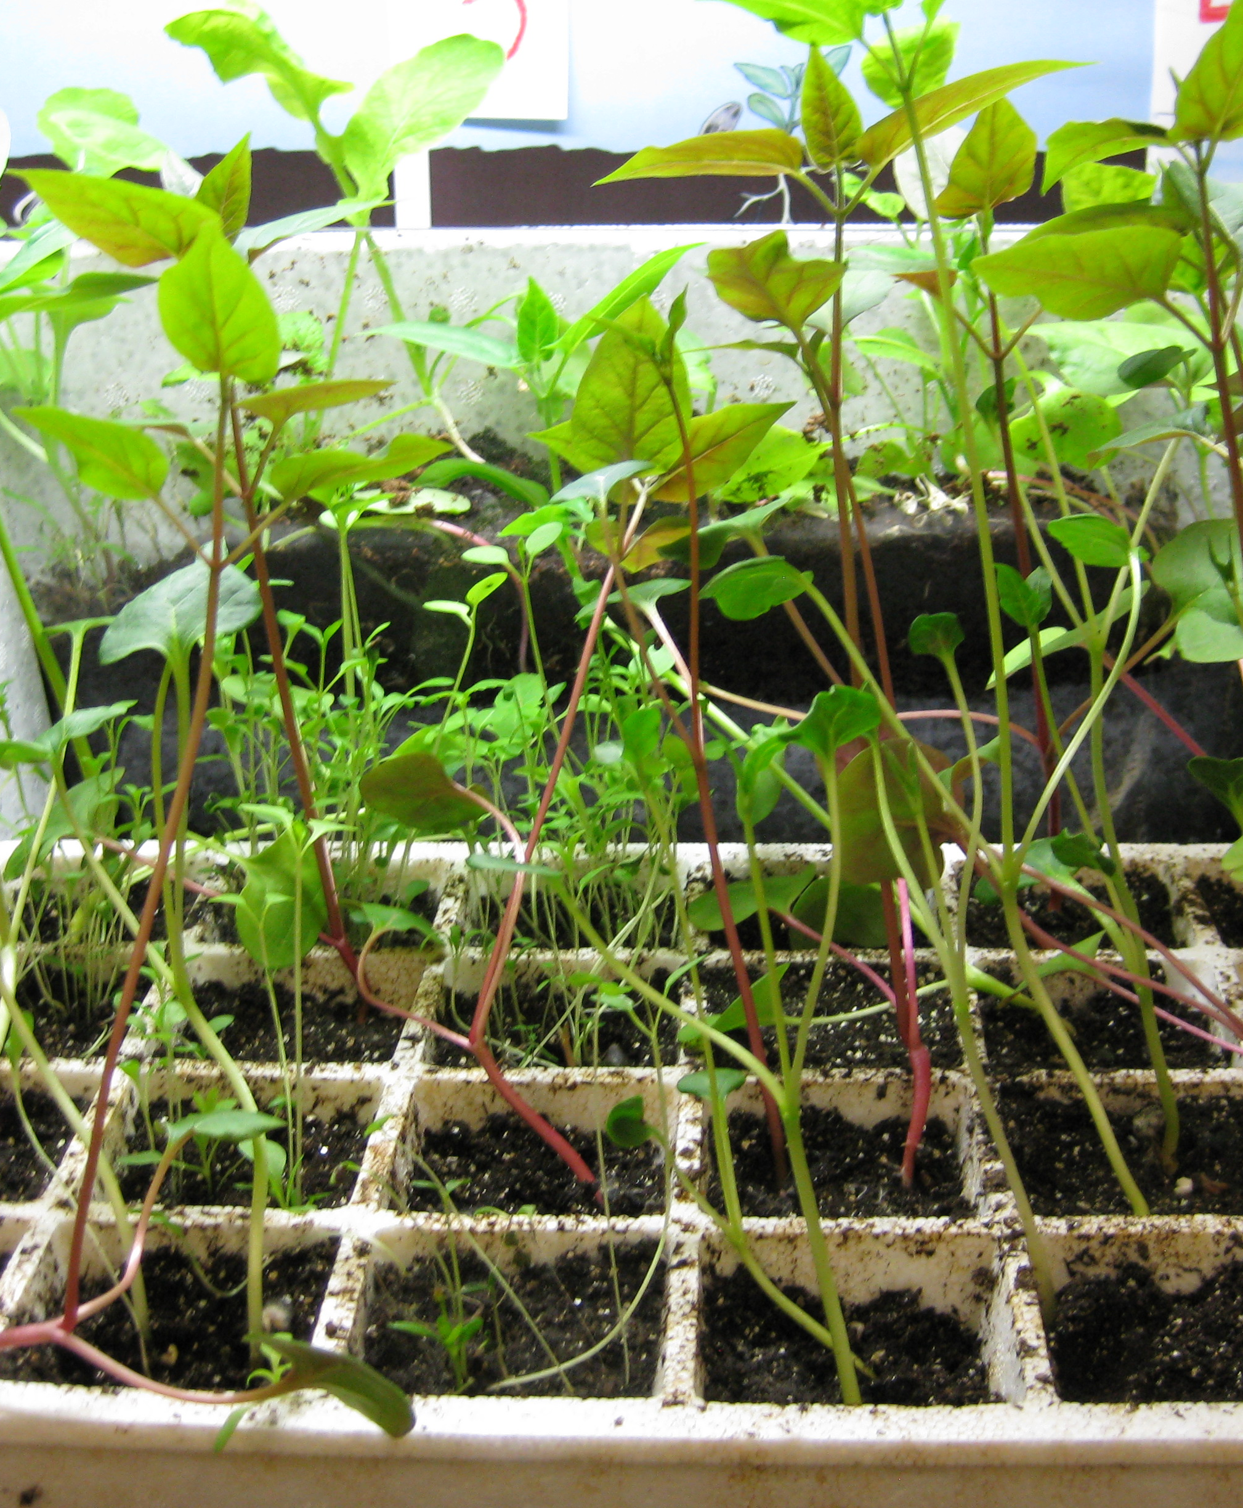
Threes’ Classroom:
Plants Study

Slide 2
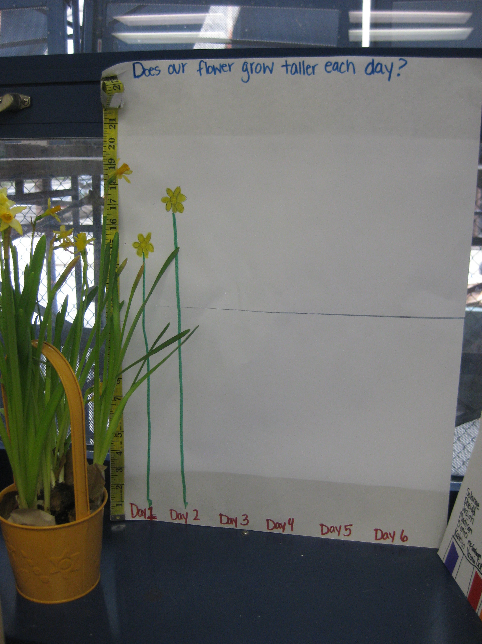
Beginning Our Study
Early in the spring season one of the teachers brought a daffodil plant into the classroom.
The students were immediately intrigued by it. The daffodil plant became the center piece at many of our meals.
Students had much to say!
“What color will be the flowers be?” “What kind of flower is it?” “Is it growing taller?” “Make sure you give it water!” “Look its blooming!”
“What color will be the flowers be?” “What kind of flower is it?” “Is it growing taller?” “Make sure you give it water!” “Look its blooming!”

Slide 3
Beginning Our Study
When the students and teachers returned from spring break all were upset and concerned to find that the daffodil plant looked like it was beginning to die. Its leaves were turning brown and stalks drooped.
As a class we discussed why this might have happened. We noticed that the plant was near the window therefore we concluded it must have been getting sunlight. Hmmm… What else do plants need to stay alive?
One of the students spoke up, “Water! Ms. Pettinicchi, did you water it?”

Slide 4
Beginning Our Study
From the students’ interest in the daffodil plant teachers asked the students what they knew about plants. From their ideas we planned many interdisciplinary experiences for the students to further explore plants.
We used our bodies to act out the growing cycle of seed to plant.
We planted beanstalks and read Jack and the Beanstalk
We planted a variety plants. Students took care of them and observed and measured their growth.
We set up a garden center with dirt, shovels, stones, seeds, and other gardening tools.
We conducted an experiment to observe how plants “soak up water”

Slide 5
Beginning Our Study
We began by asking students to differentiate between things that are and are not plants.
Students sorted pictures of various items into a group of “plants” and “not plants” and talked about why they chose the group they did.
Students were particularly interested in talking about fruits and vegetables and if they grew on a tree or on the ground.

Slide 6

Science
Science naturally became a big focus area for us during our plant study.
We used our bodies to act out the growing cycle from seed to plant and then planted a variety of seeds to observe how a plant grows.

Slide 7
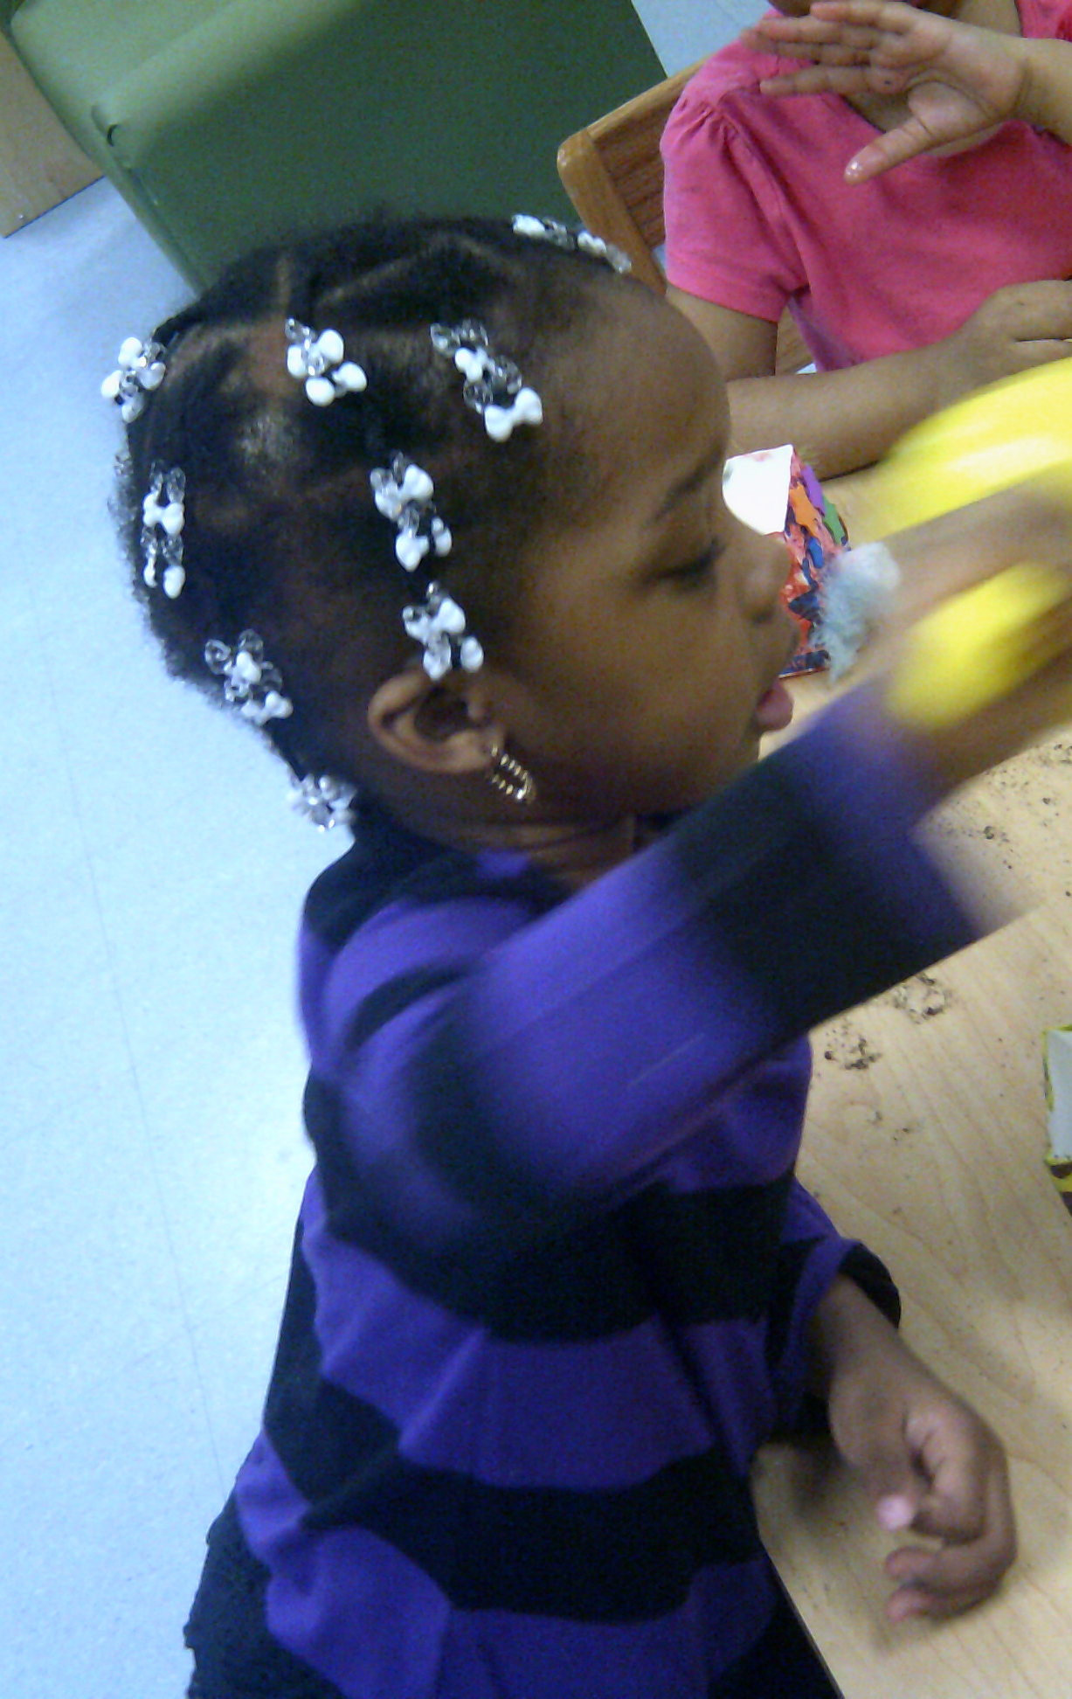
Students recycled milk cartons, decorated them, and then used them as planters for cat grass seed.
They talked about what their cat grass seeds would need in order to grow.
We learned a new word for dirt – SOIL!
And the students selected a sunny spot near a window so their plants would get plenty of sun.
They observed when their seeds began to sprout, and teachers recorded the dates.

Slide 8
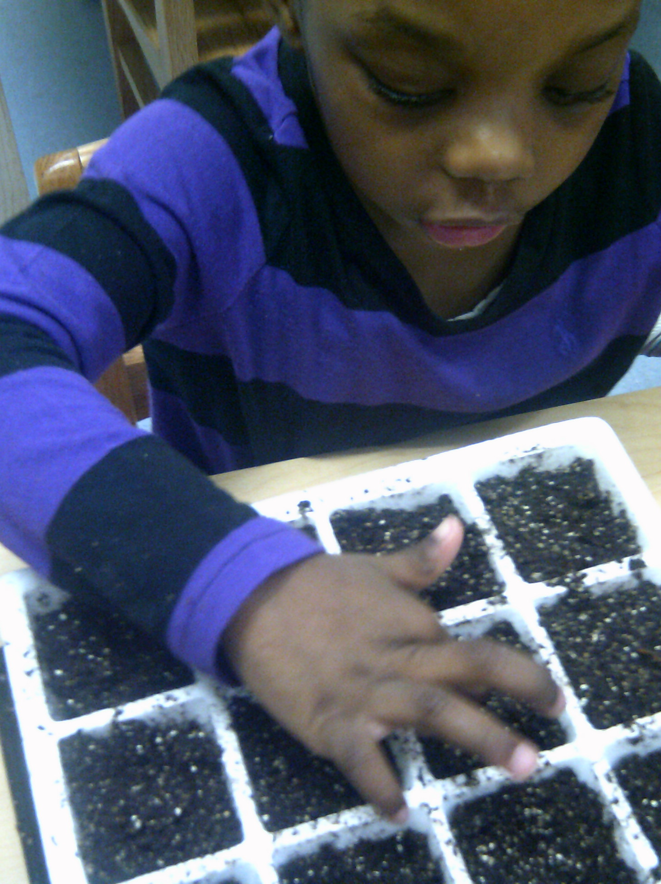
Our classroom discovery area became a place for students to observe plants growing, use rulers to measure the plants’ heights, and use magnifying glasses to observe other natural things such as seeds, rocks, branches, and shells up close.

Slide 9
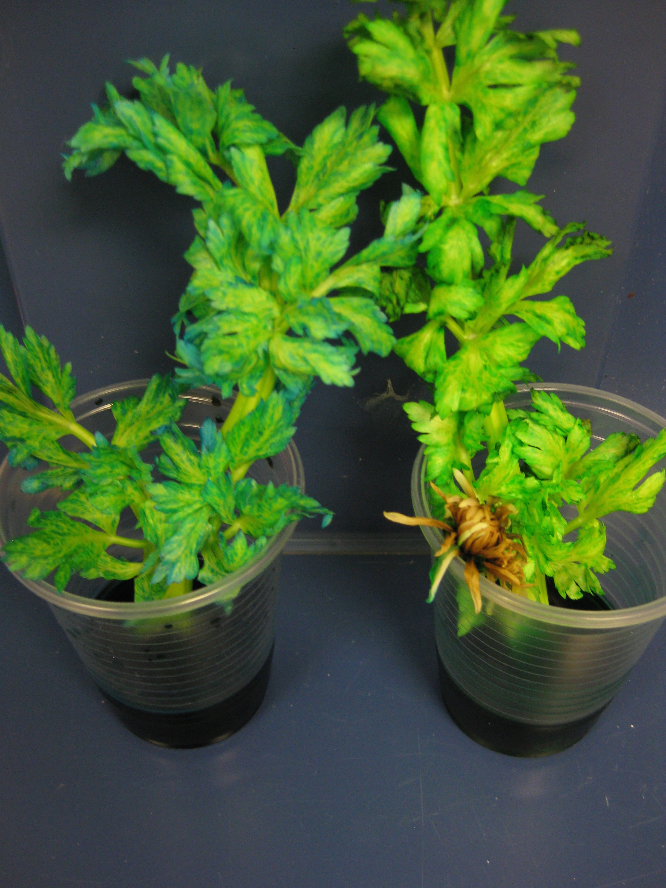
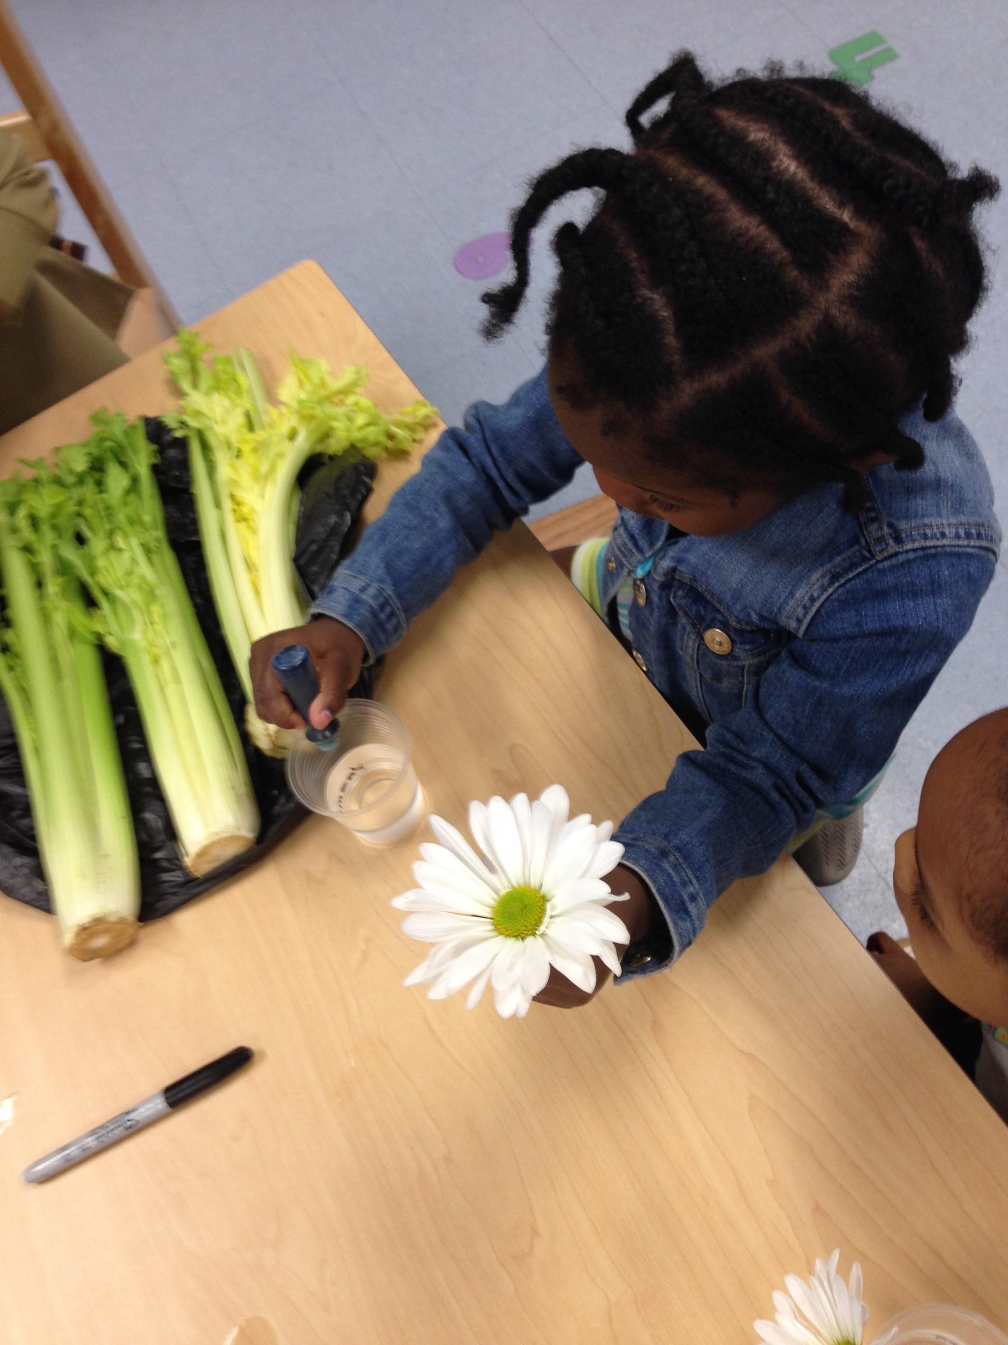
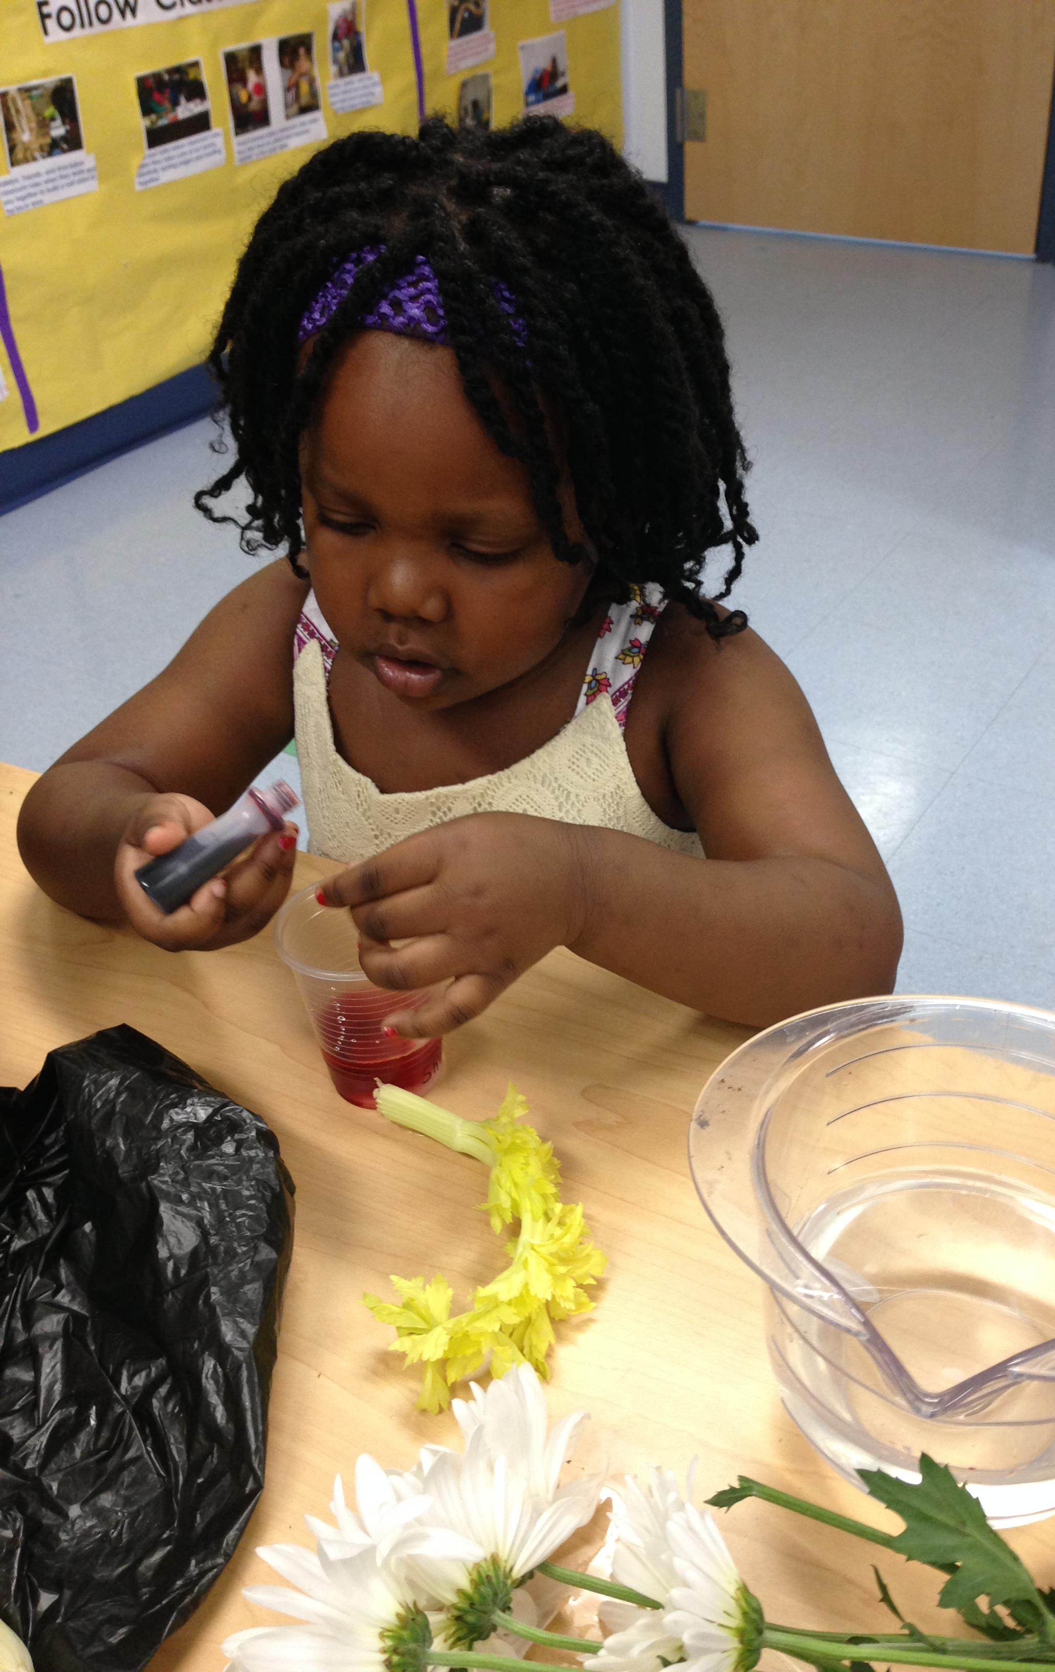
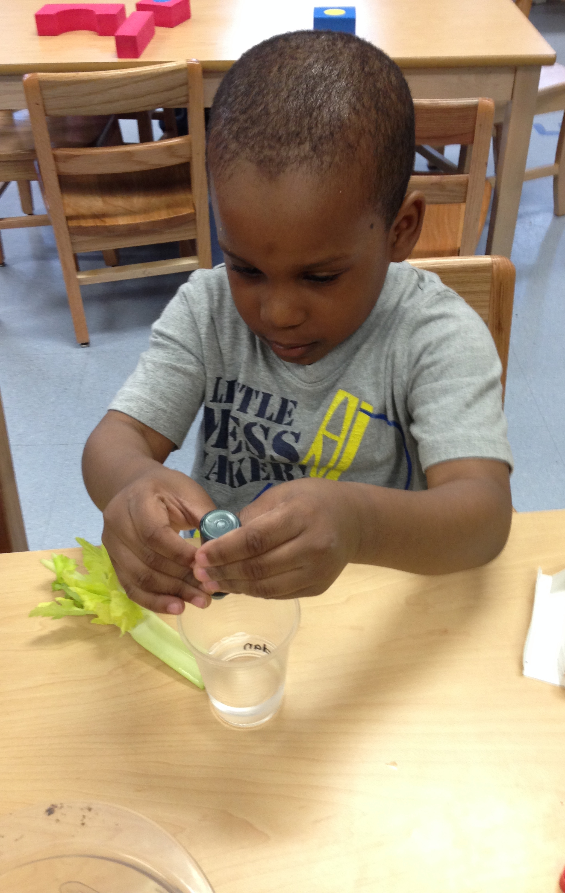
Where does the water go?
Students were talking about how the roots of a plant “drink” the water. But we wondered where it went from there.
Teachers helped students set up an experiment. We took two different types of plants, daisies and celery, and placed them in cups with colored water.
Students observed how the colored water traveled up the stem of the celery and daisy to their leaves and petals.

Slide 10
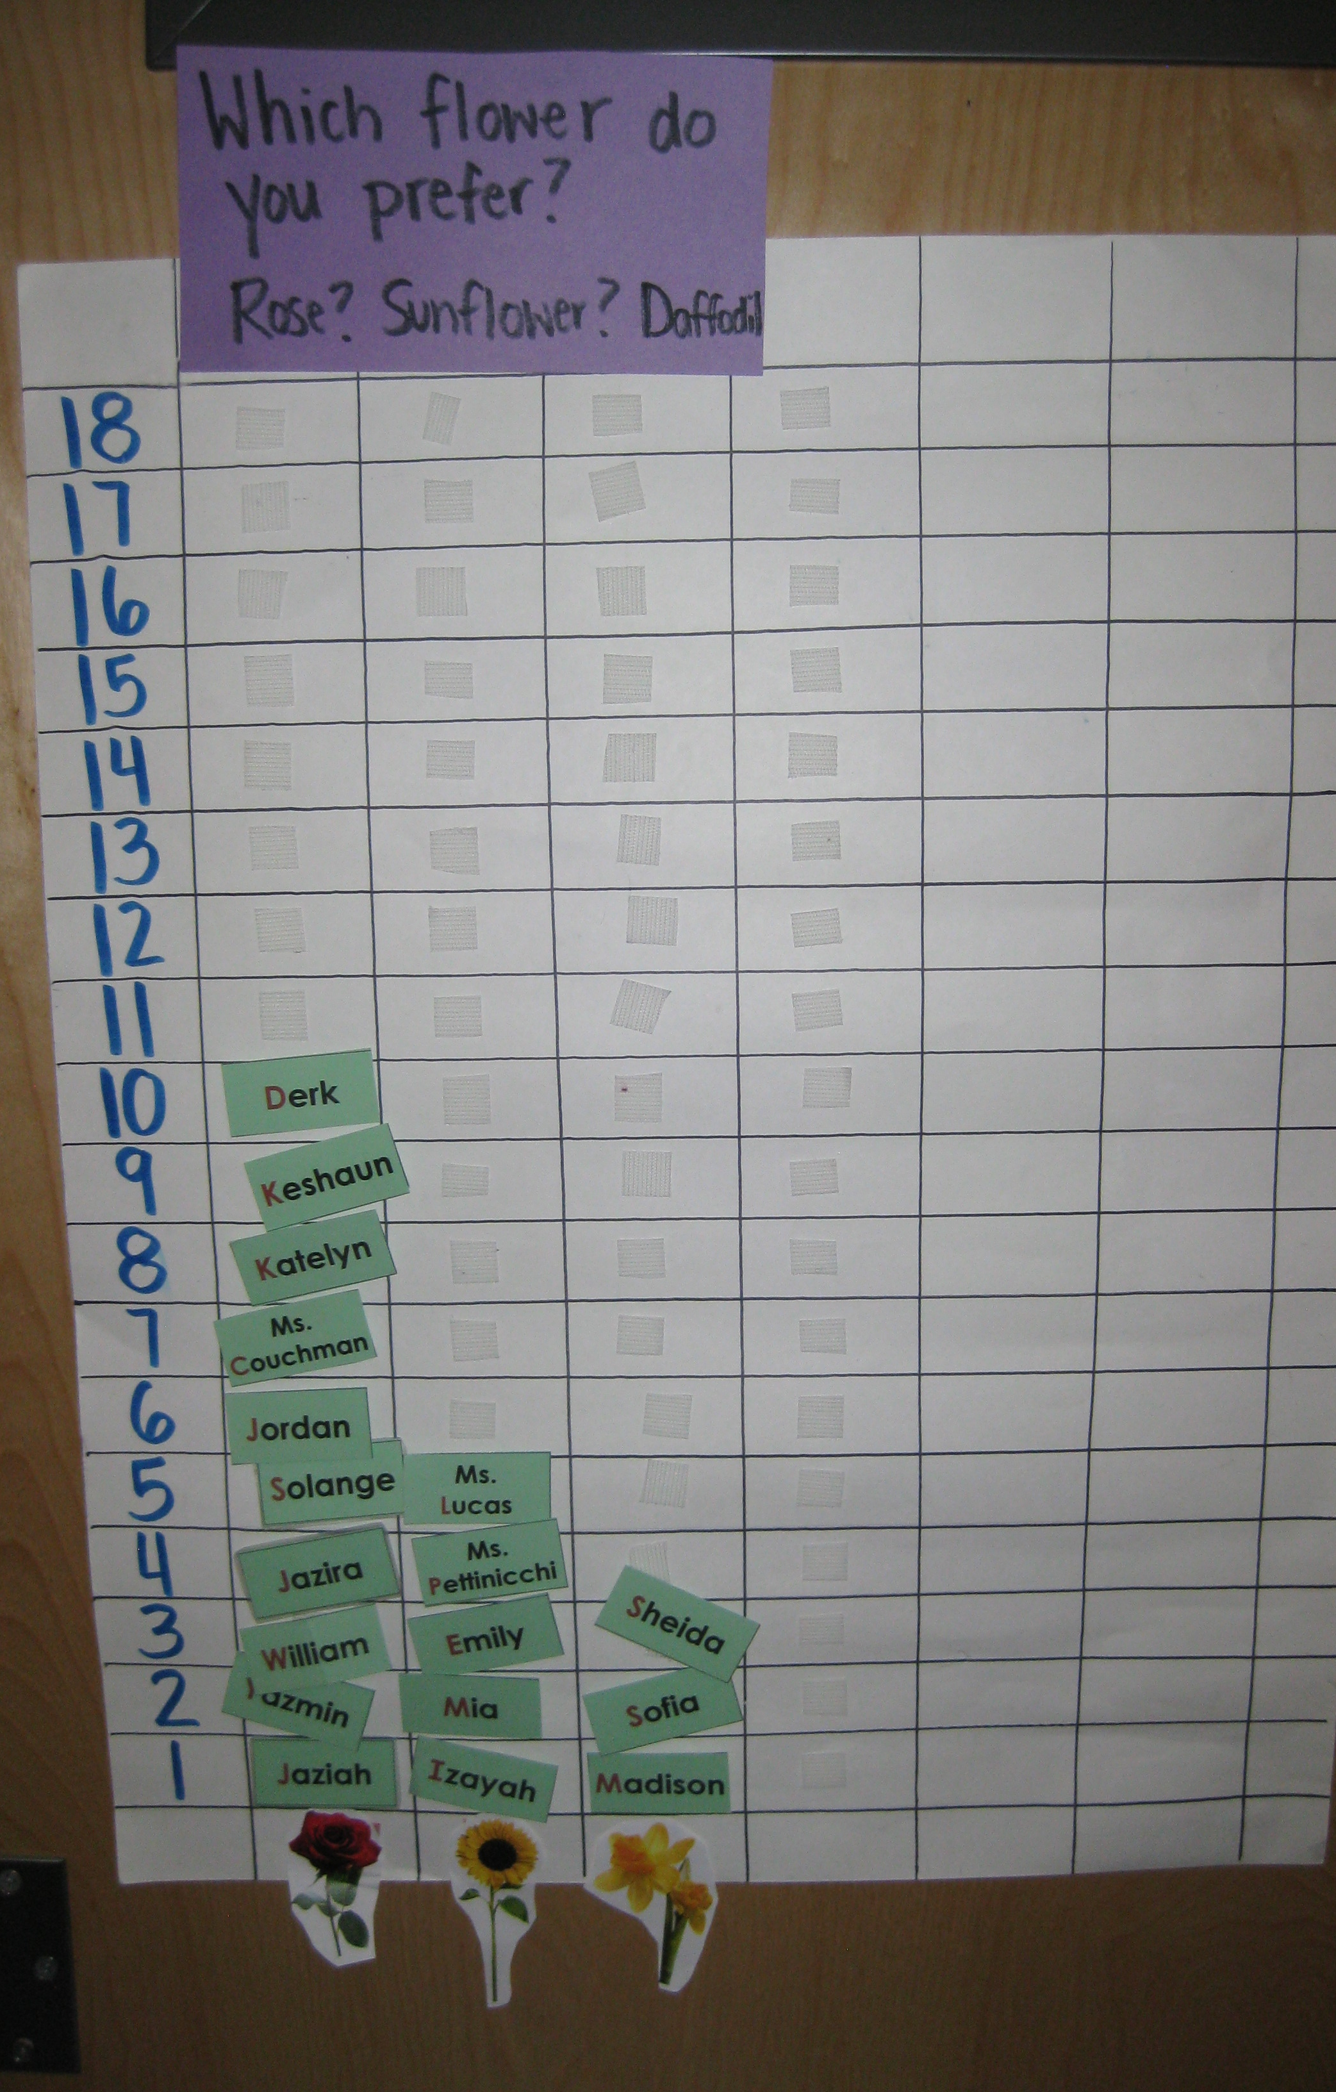
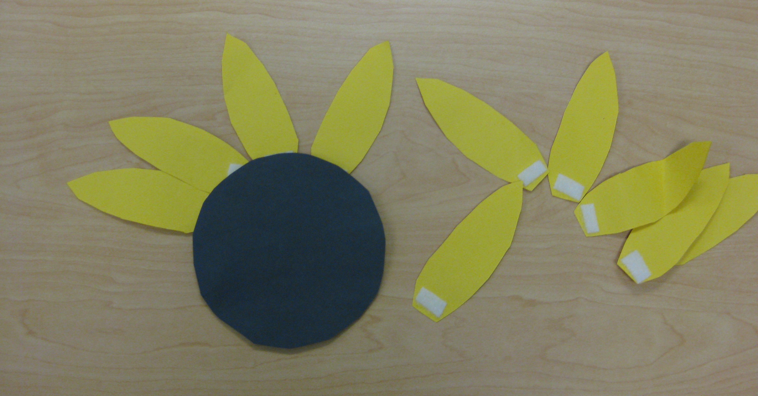
Math
We focused a lot on subsitizing (counting without counting):
“Without counting, tell me how many petals are on this flower.”
“Four!”
This became a fun game for us to transition between different activities throughout the day.
Students voted on which flower they preferred and then we connected the numeral on the graph to how many names were listed for each flower.
“Most of us prefer roses!”
“Only three like daffodils.”

Slide 11
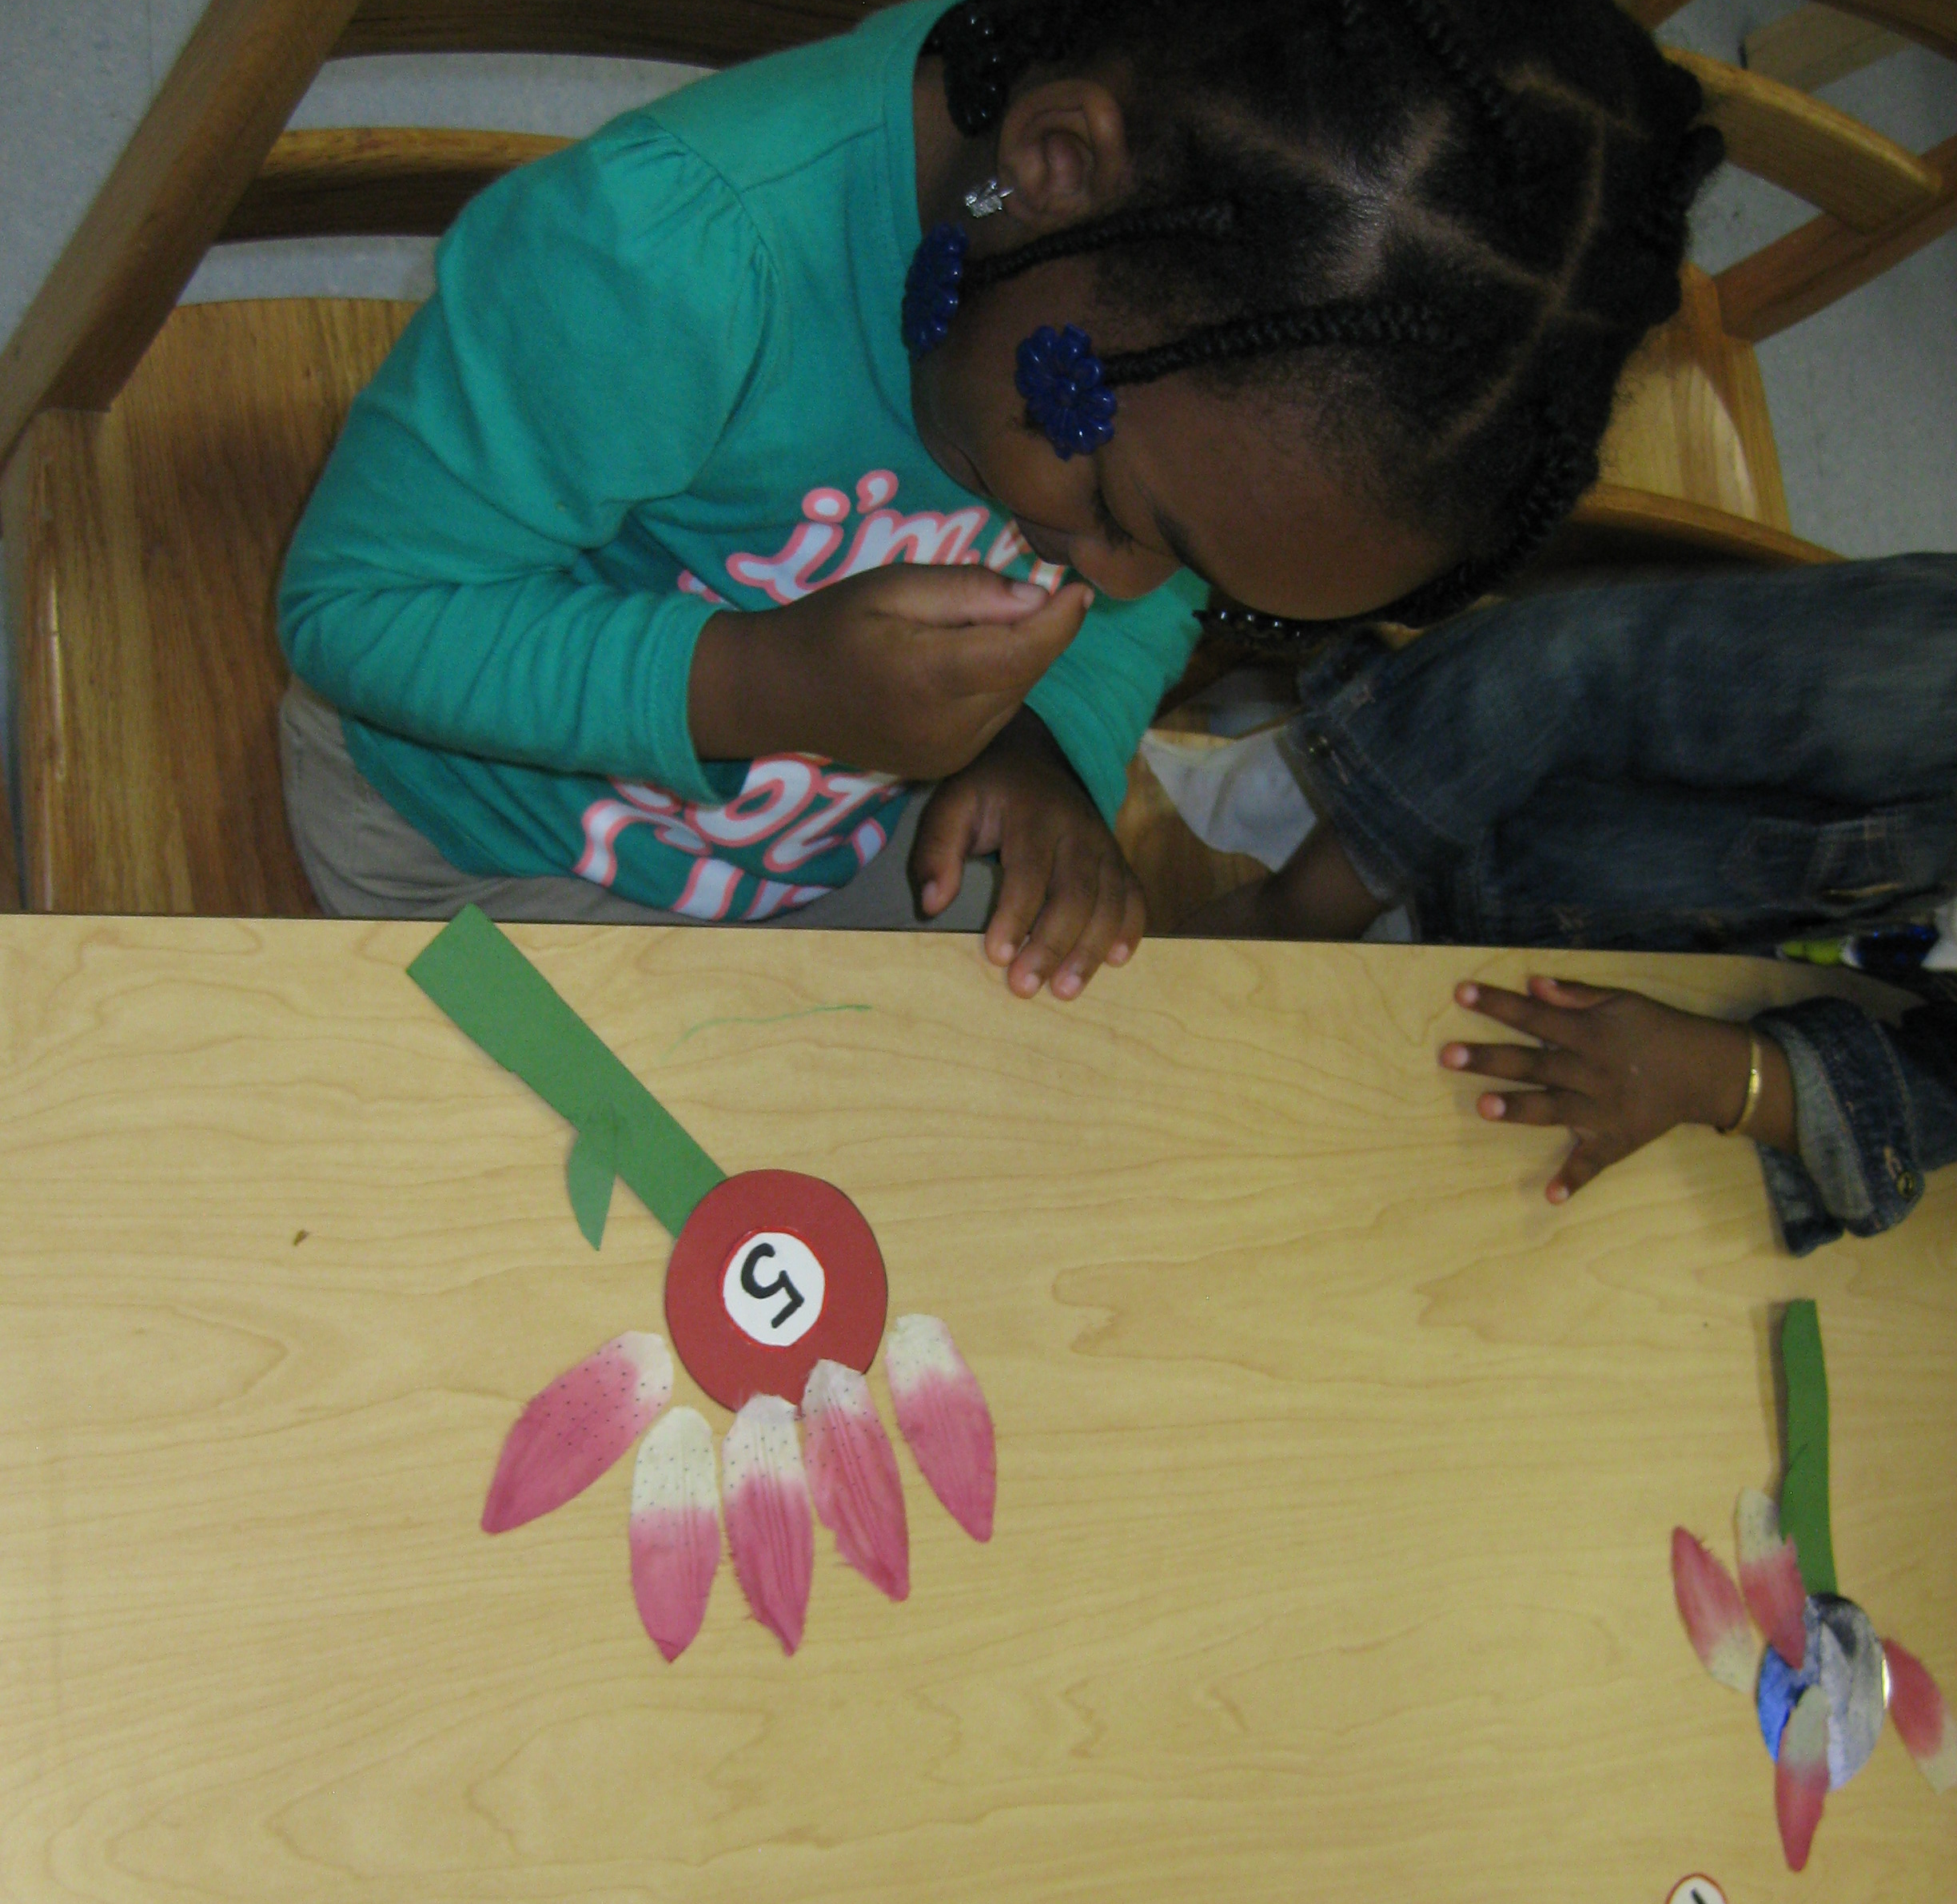
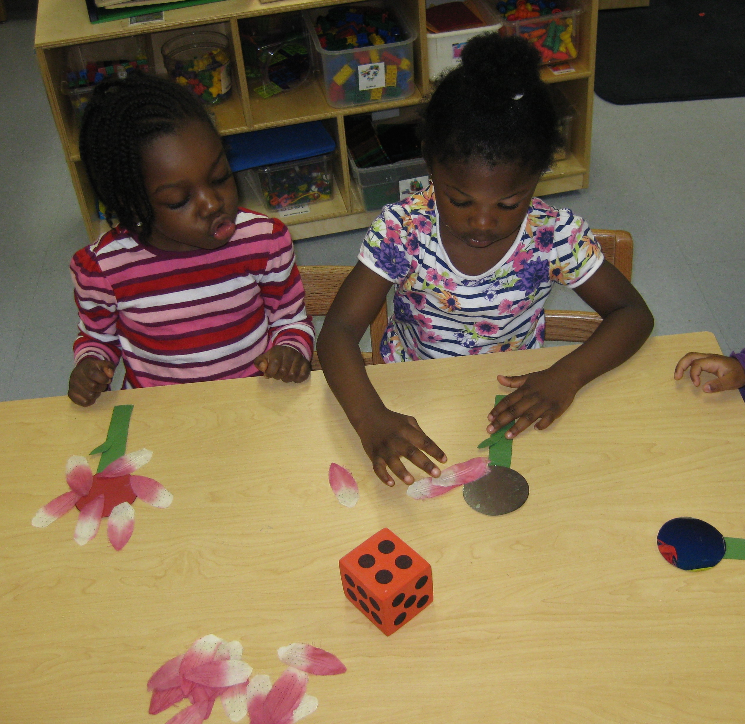
Math
Students played a flower petal counting game where they rolled a die and counted out that number of flower petals to add to their flower.
This supported their counting and quantifying skills.
We later played the same game and students then matched the numeral to the number of flower petals they had on their flower.
This supported connecting numerals with their quantifying skills.

Slide 12
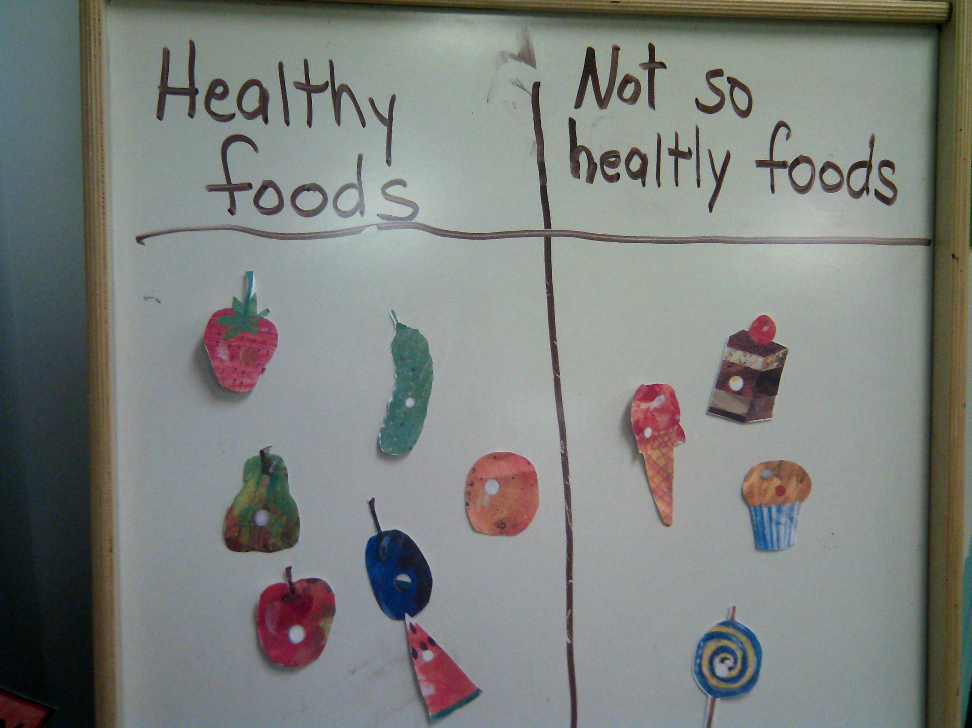
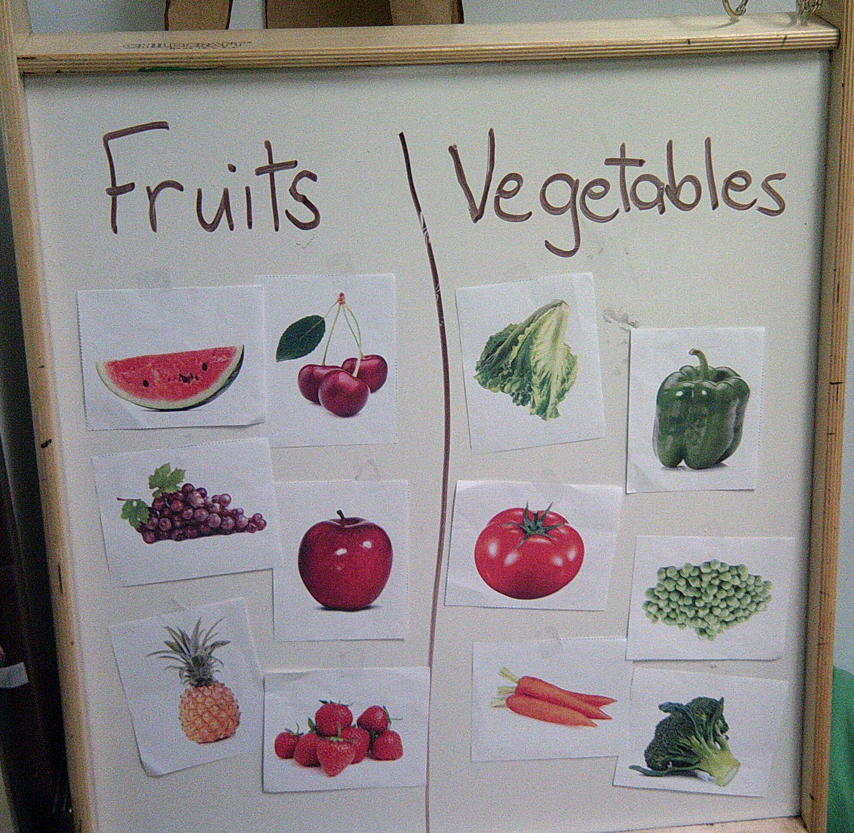
Sorting
We used the foods represented in the story The Hungry Caterpillar to sort healthy foods from unhealthy foods.
We sorted fruits and vegetables and talked about if they grew on trees or on the ground.

Slide 13
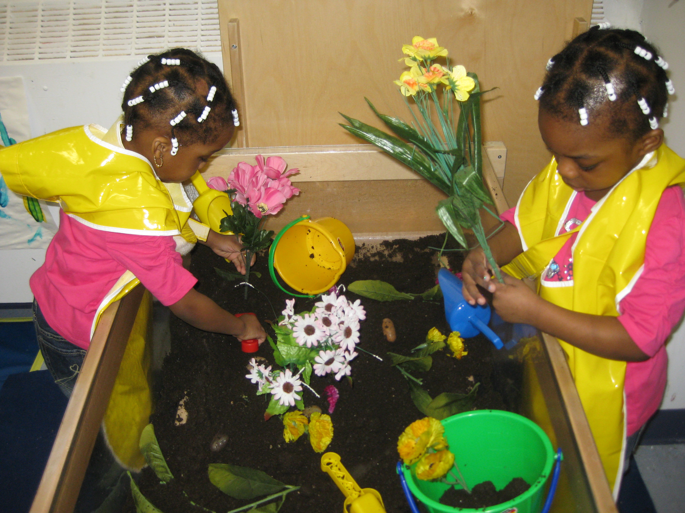
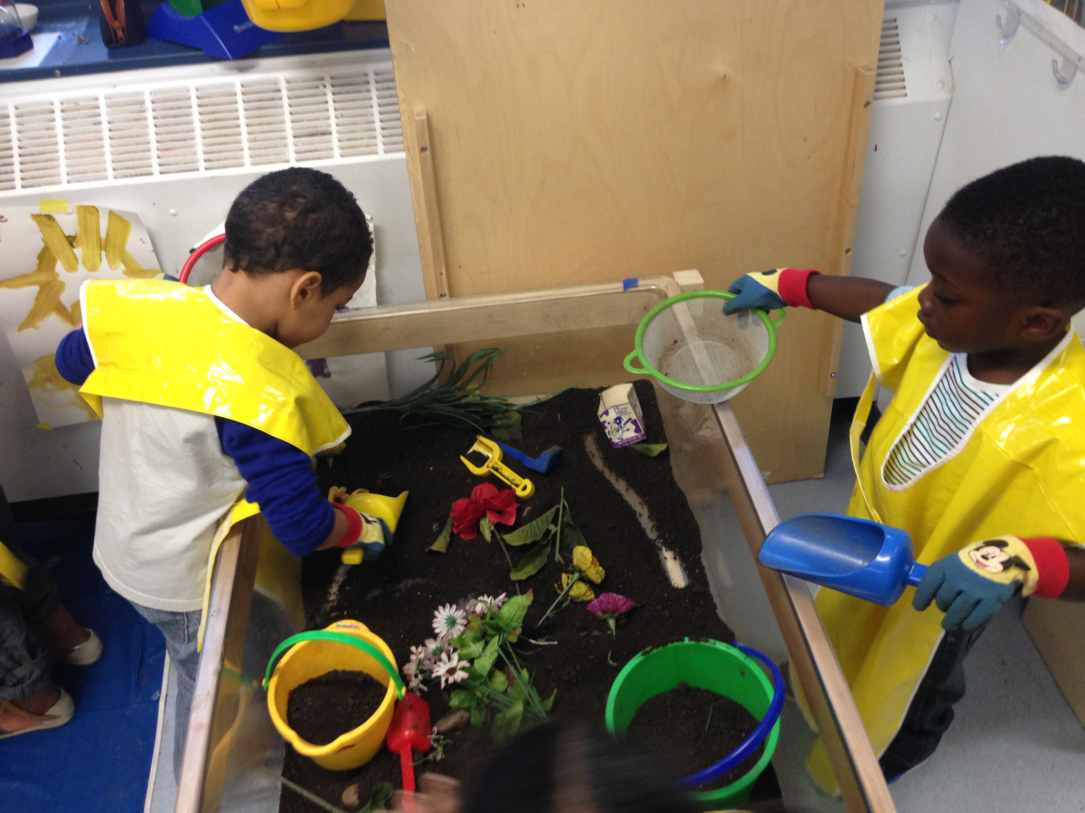
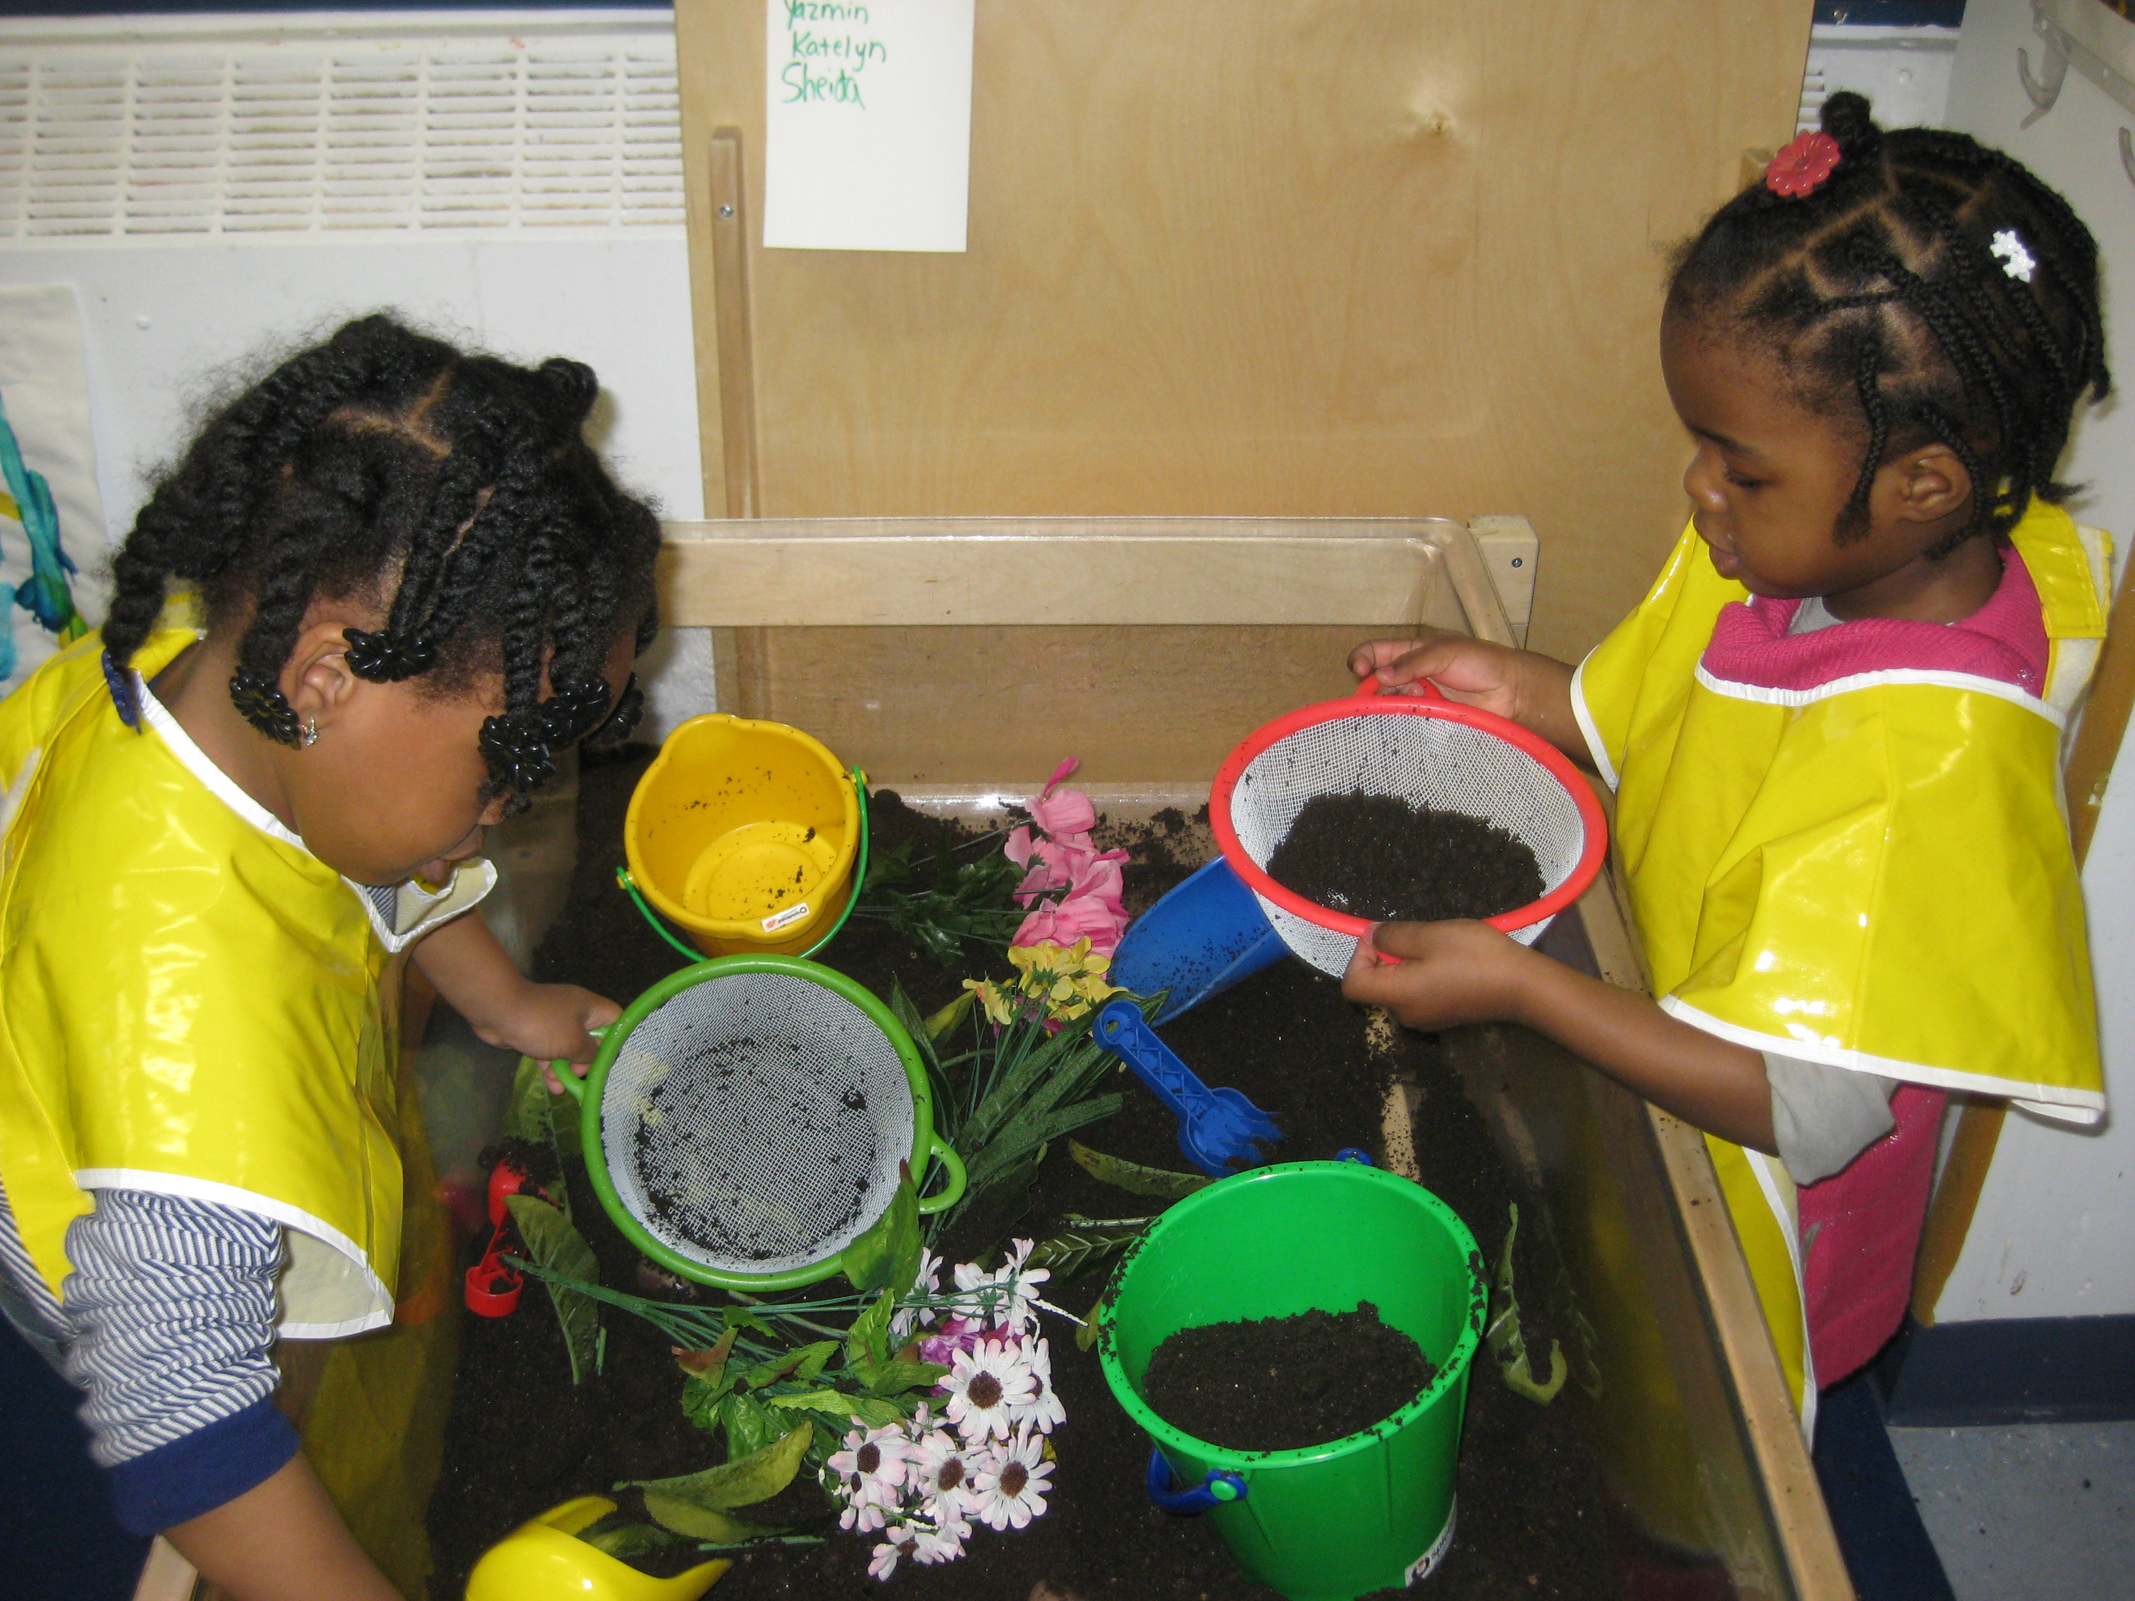
Social Studies
Students explored various tools that gardeners might use, including rakes, shovels, and pails.
We changed our water table into a garden center. Students role played and experienced what it might be like to be a gardener.
Students experienced what it felt like to garden with and without gloves and thus how gloves protect gardeners’ hands.

Slide 14
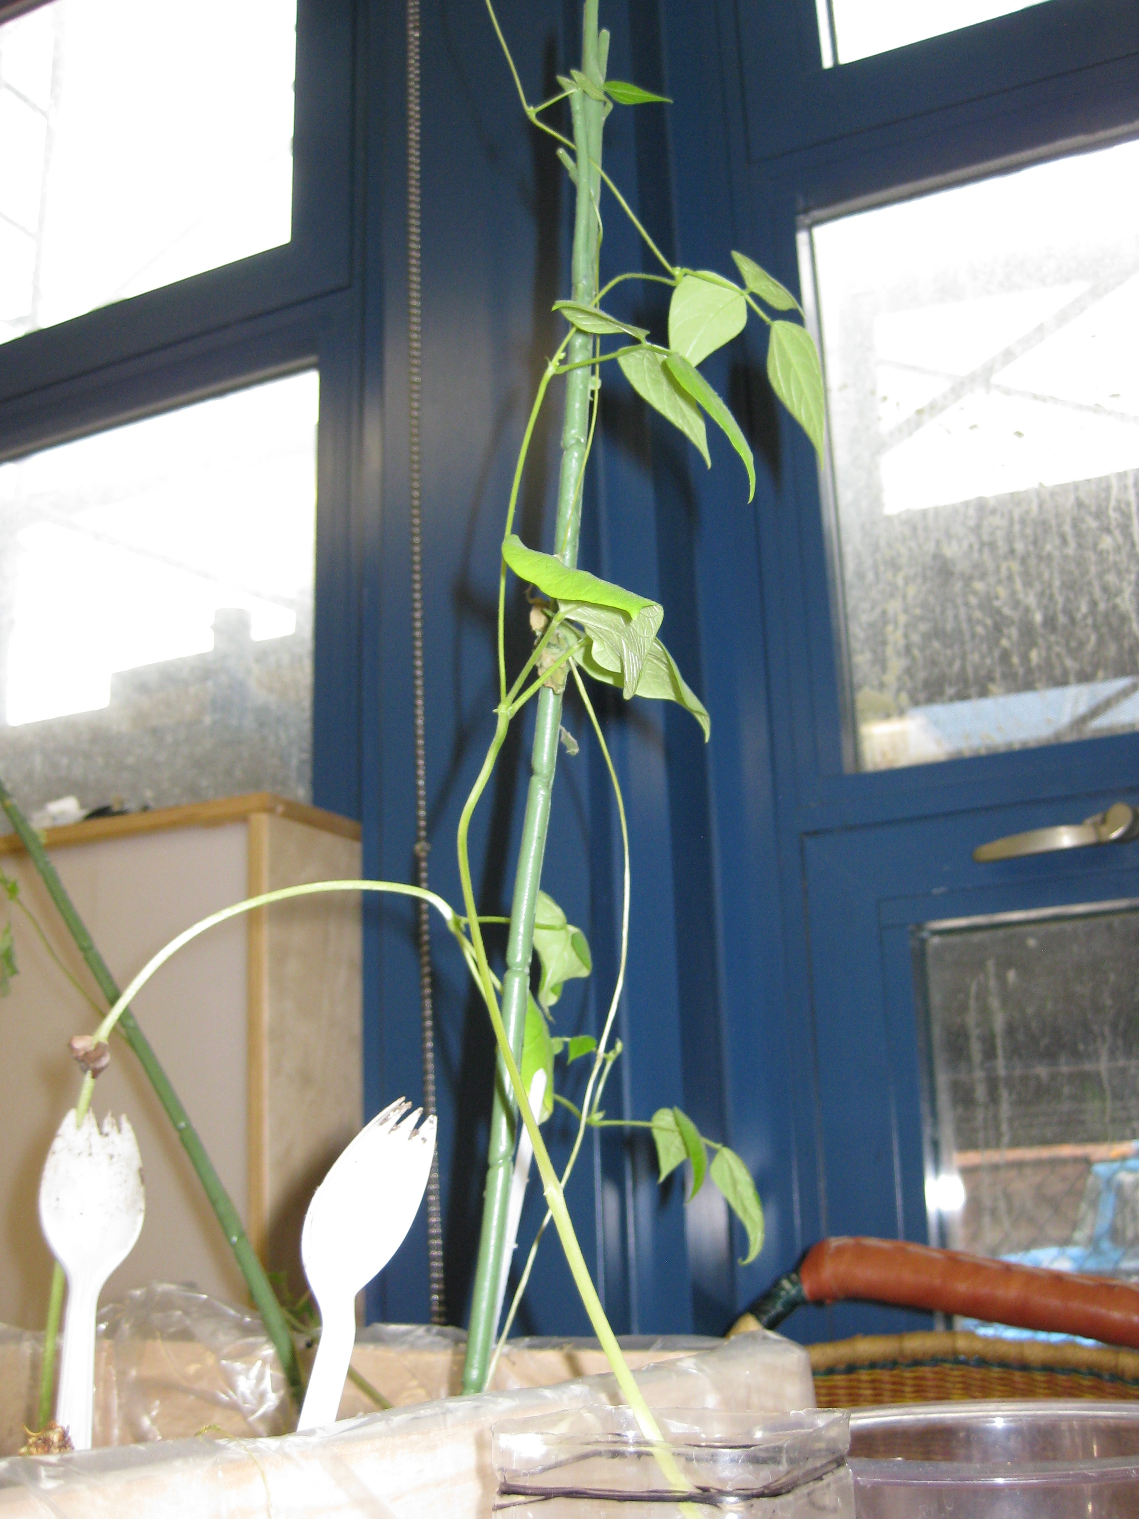
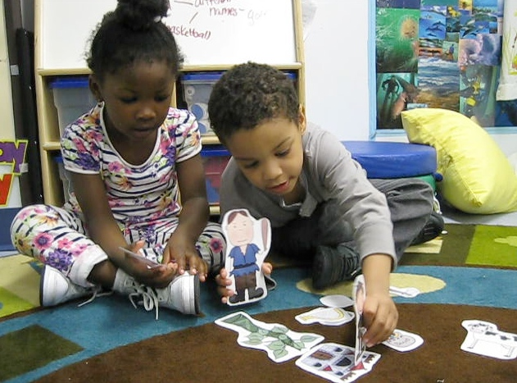
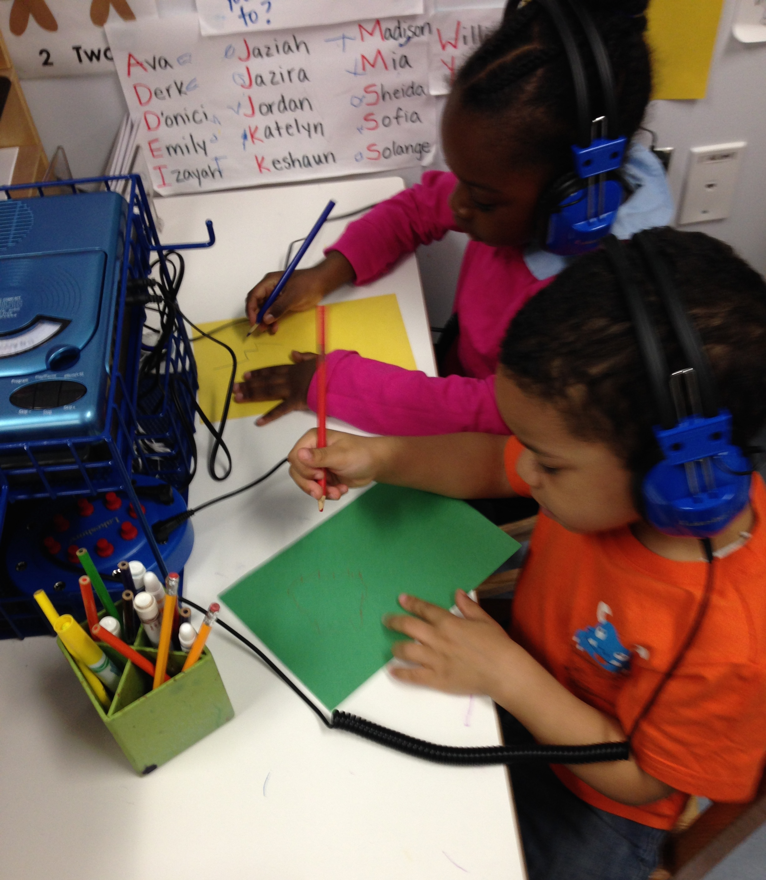
Literacy
We read the story Jack and the Beanstalk and discussed how Jack’s beanstalk was similar and different from the beanstalks we were growing in our classroom. Students took turns acting out the story with partners.
In May we introduced the listening center. This was a great way to support students’ writing skills. They enjoyed listening to music while drawing and writing.

Slide 15
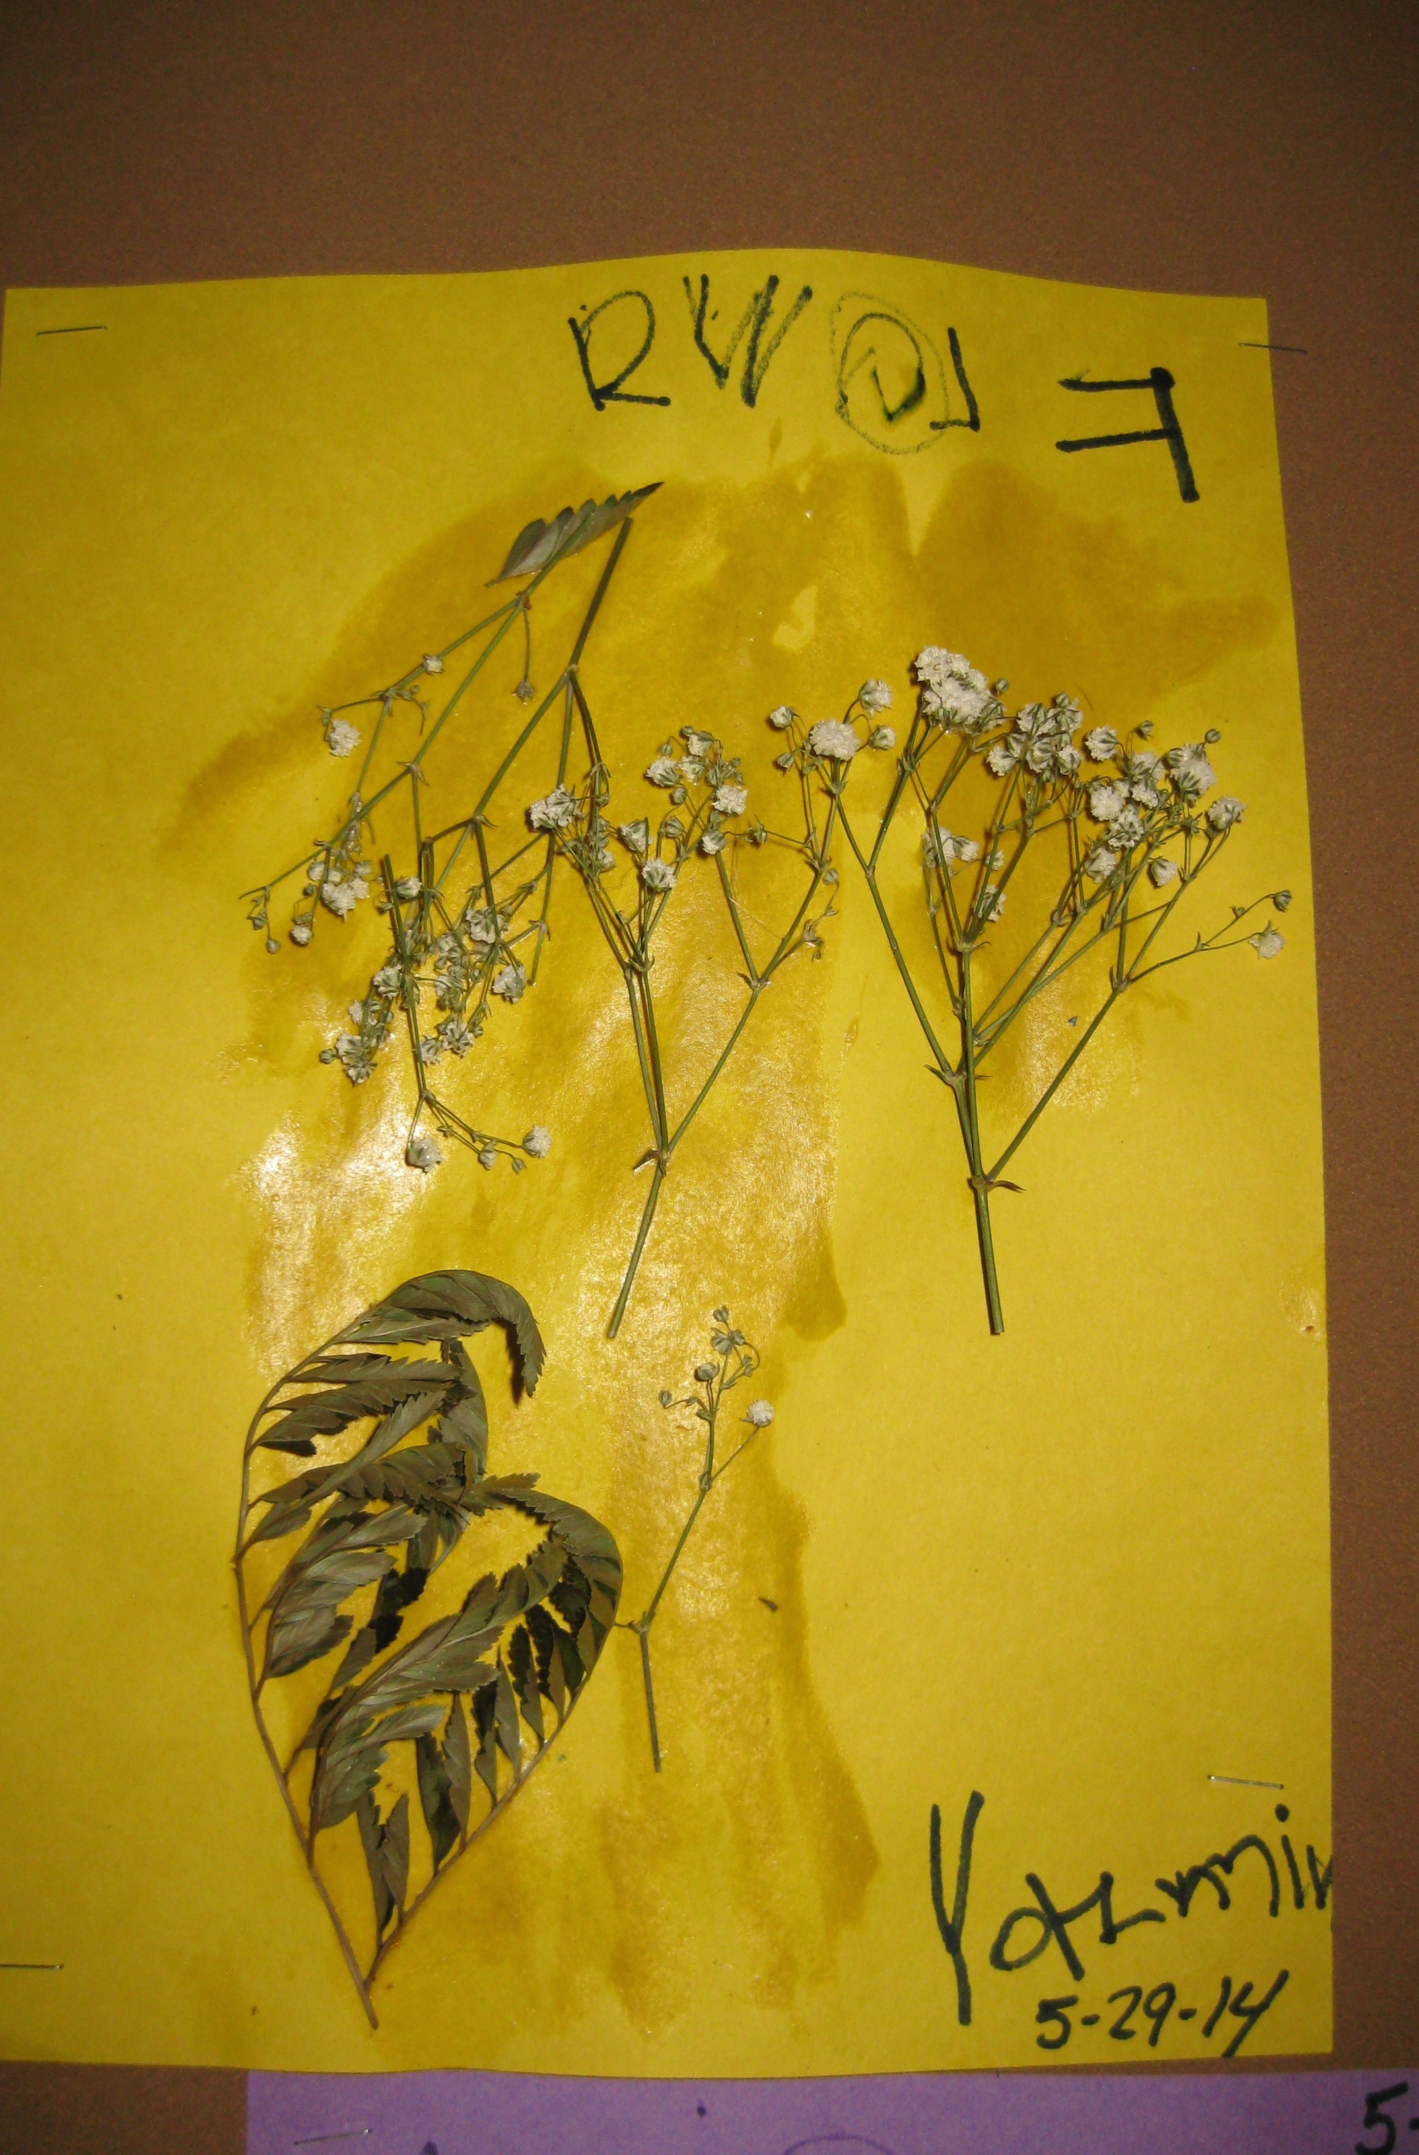
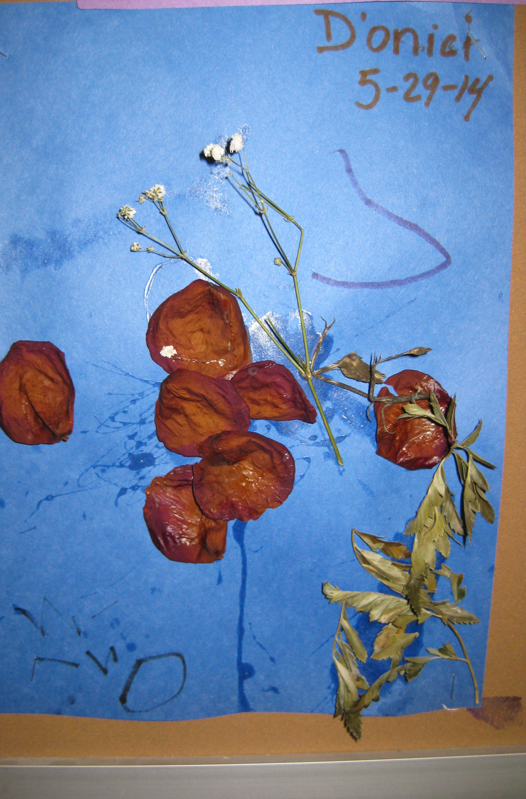
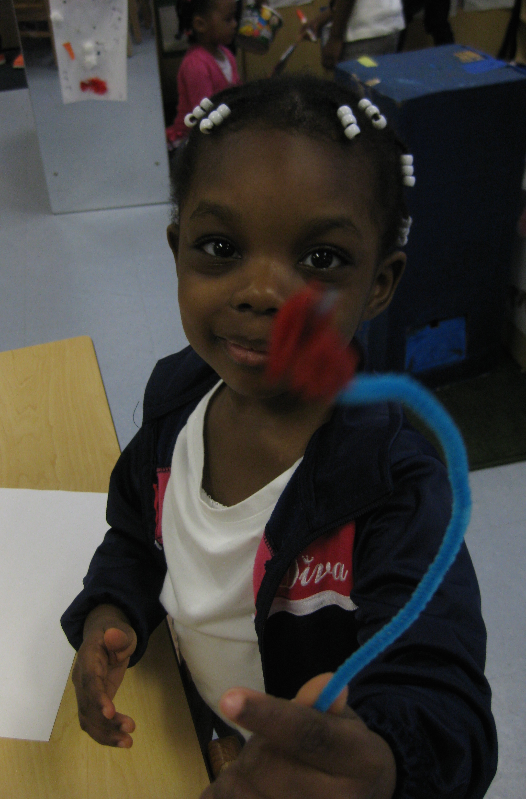
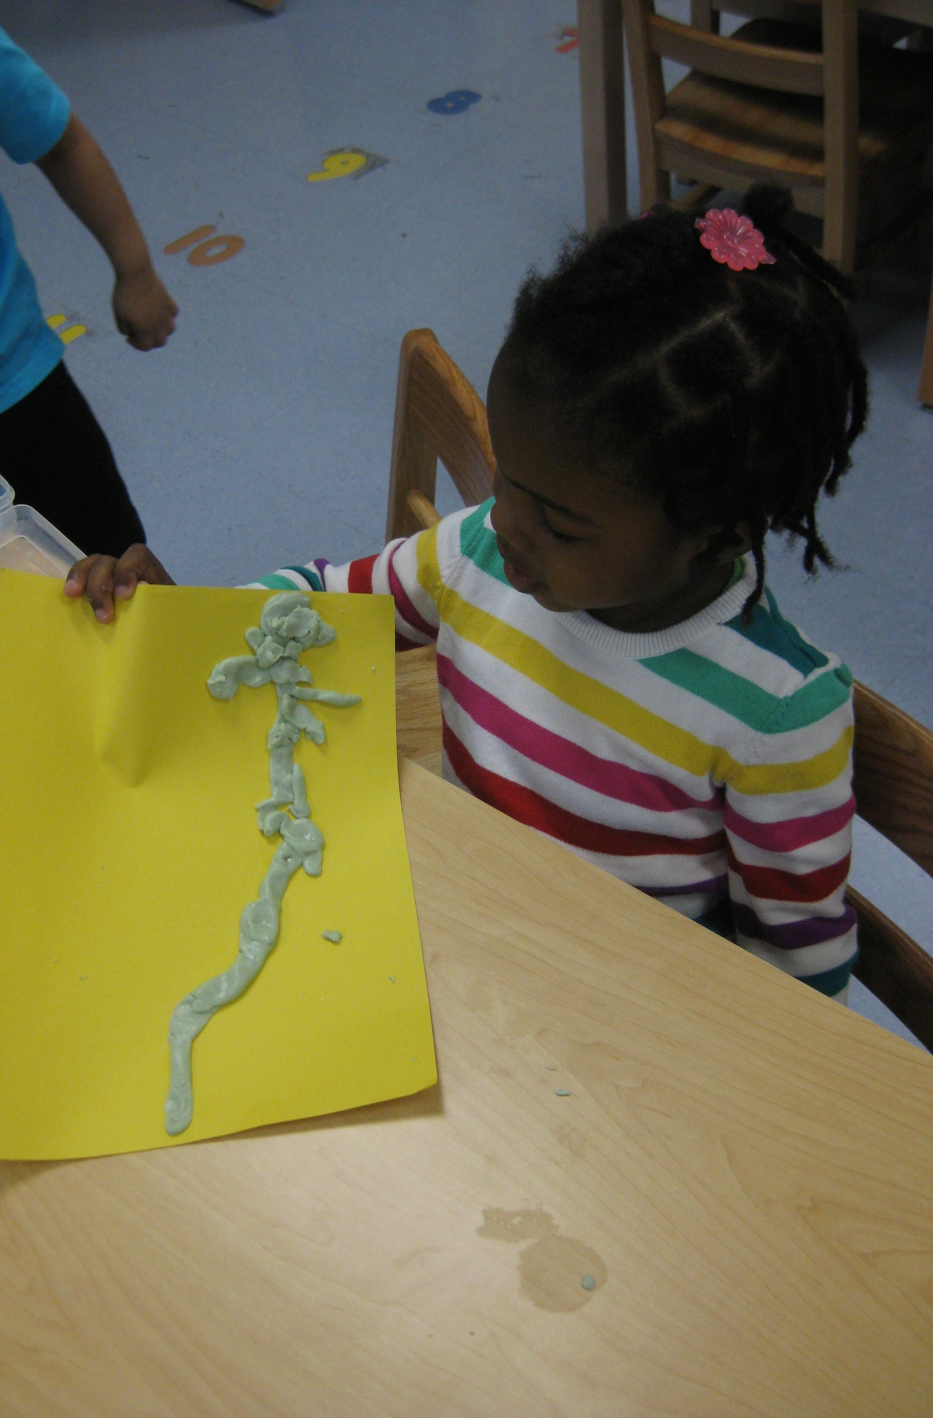
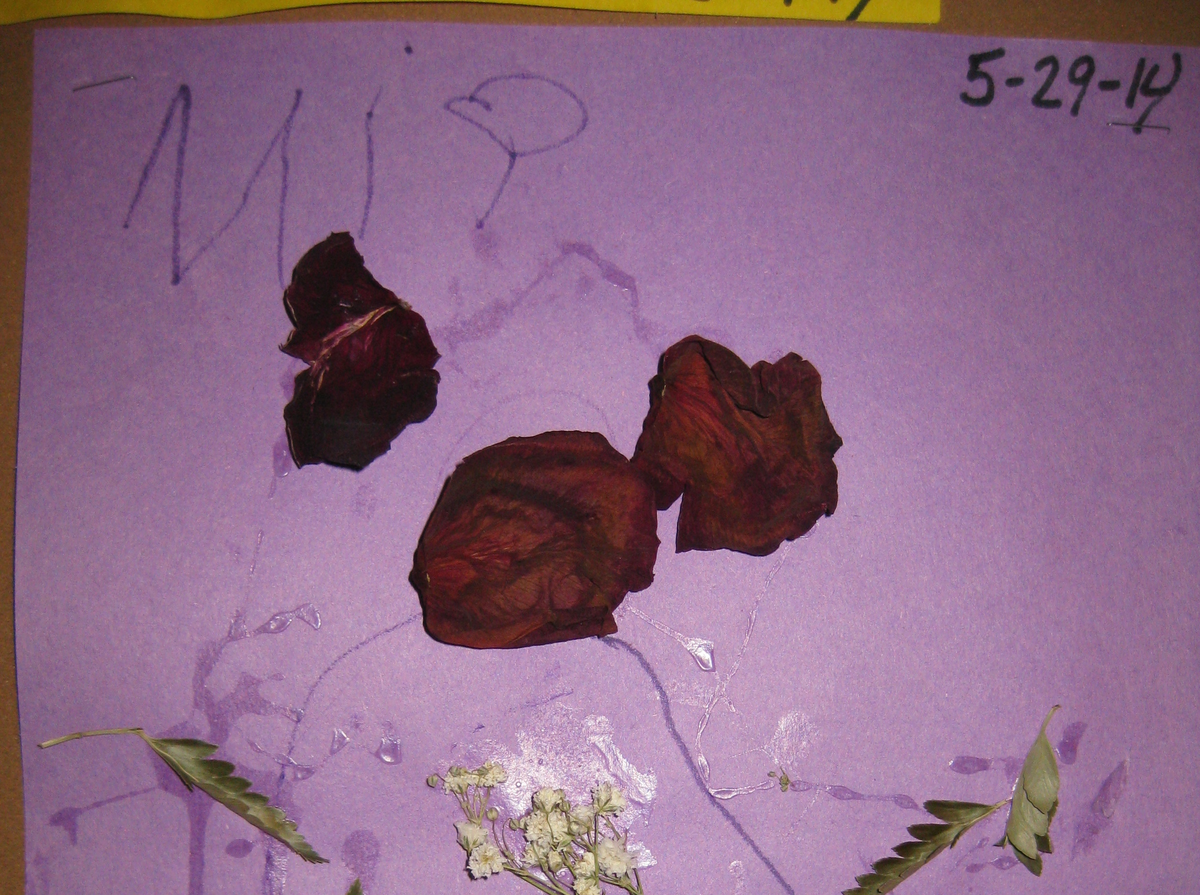
Art
Students used parts of a real flower and glue to create flower part pictures.
J. constructed a flower using pipe cleaners and tissue paper.
E. created a flower from playdough.
Students expressed their interest in plants, particularly flowers, through their art experiences.

Slide 16
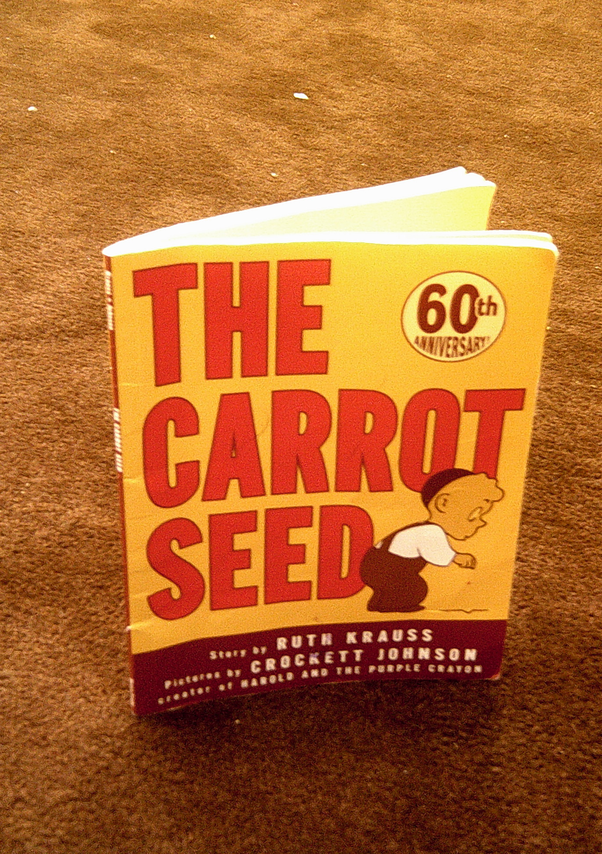
Social and Emotional
In the story The Carrot Seed many people told the boy that his carrot seed would not grow. But no matter what they told him the boy continued to nourish his carrot seed and waited patiently for it to grow. Sure enough, it did!
This translated to many social and emotional conversations in our classroom about persistence, being patient, acknowledging the feelings of others, and that its okay for us to think differently about things.

Slide 17
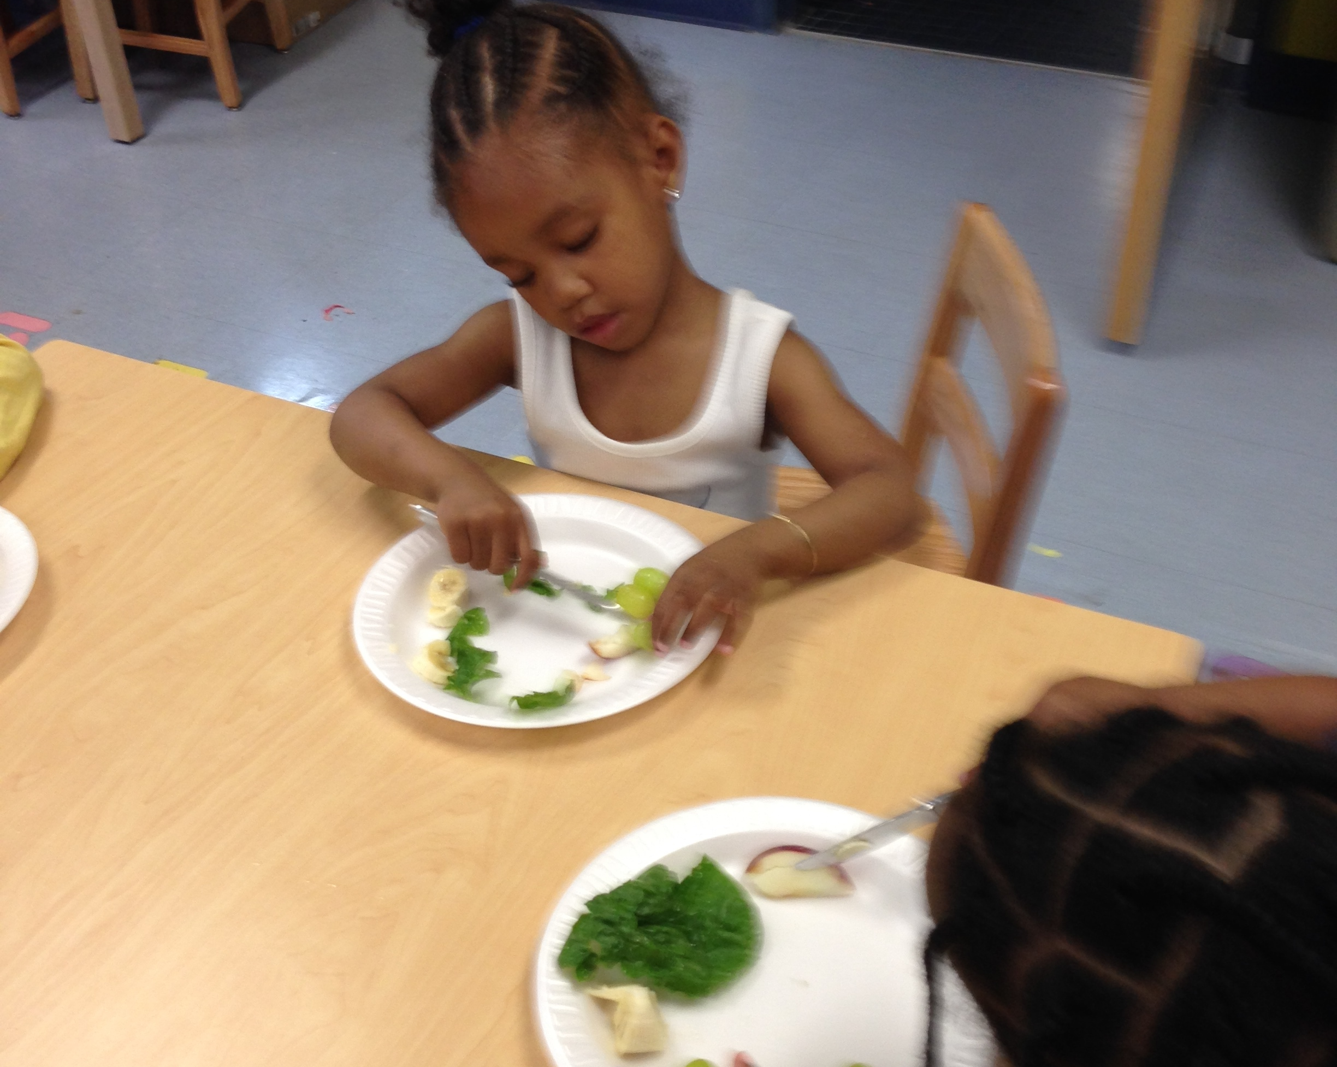
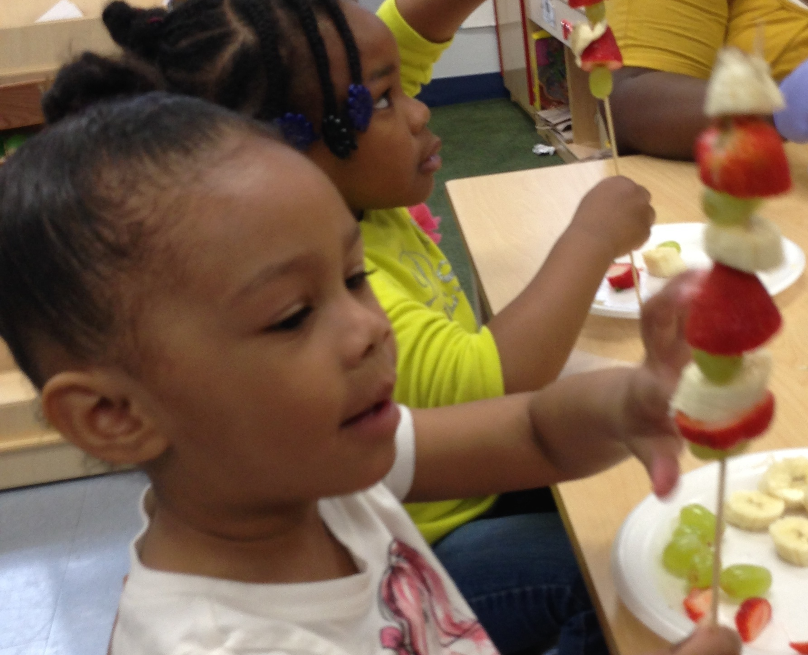
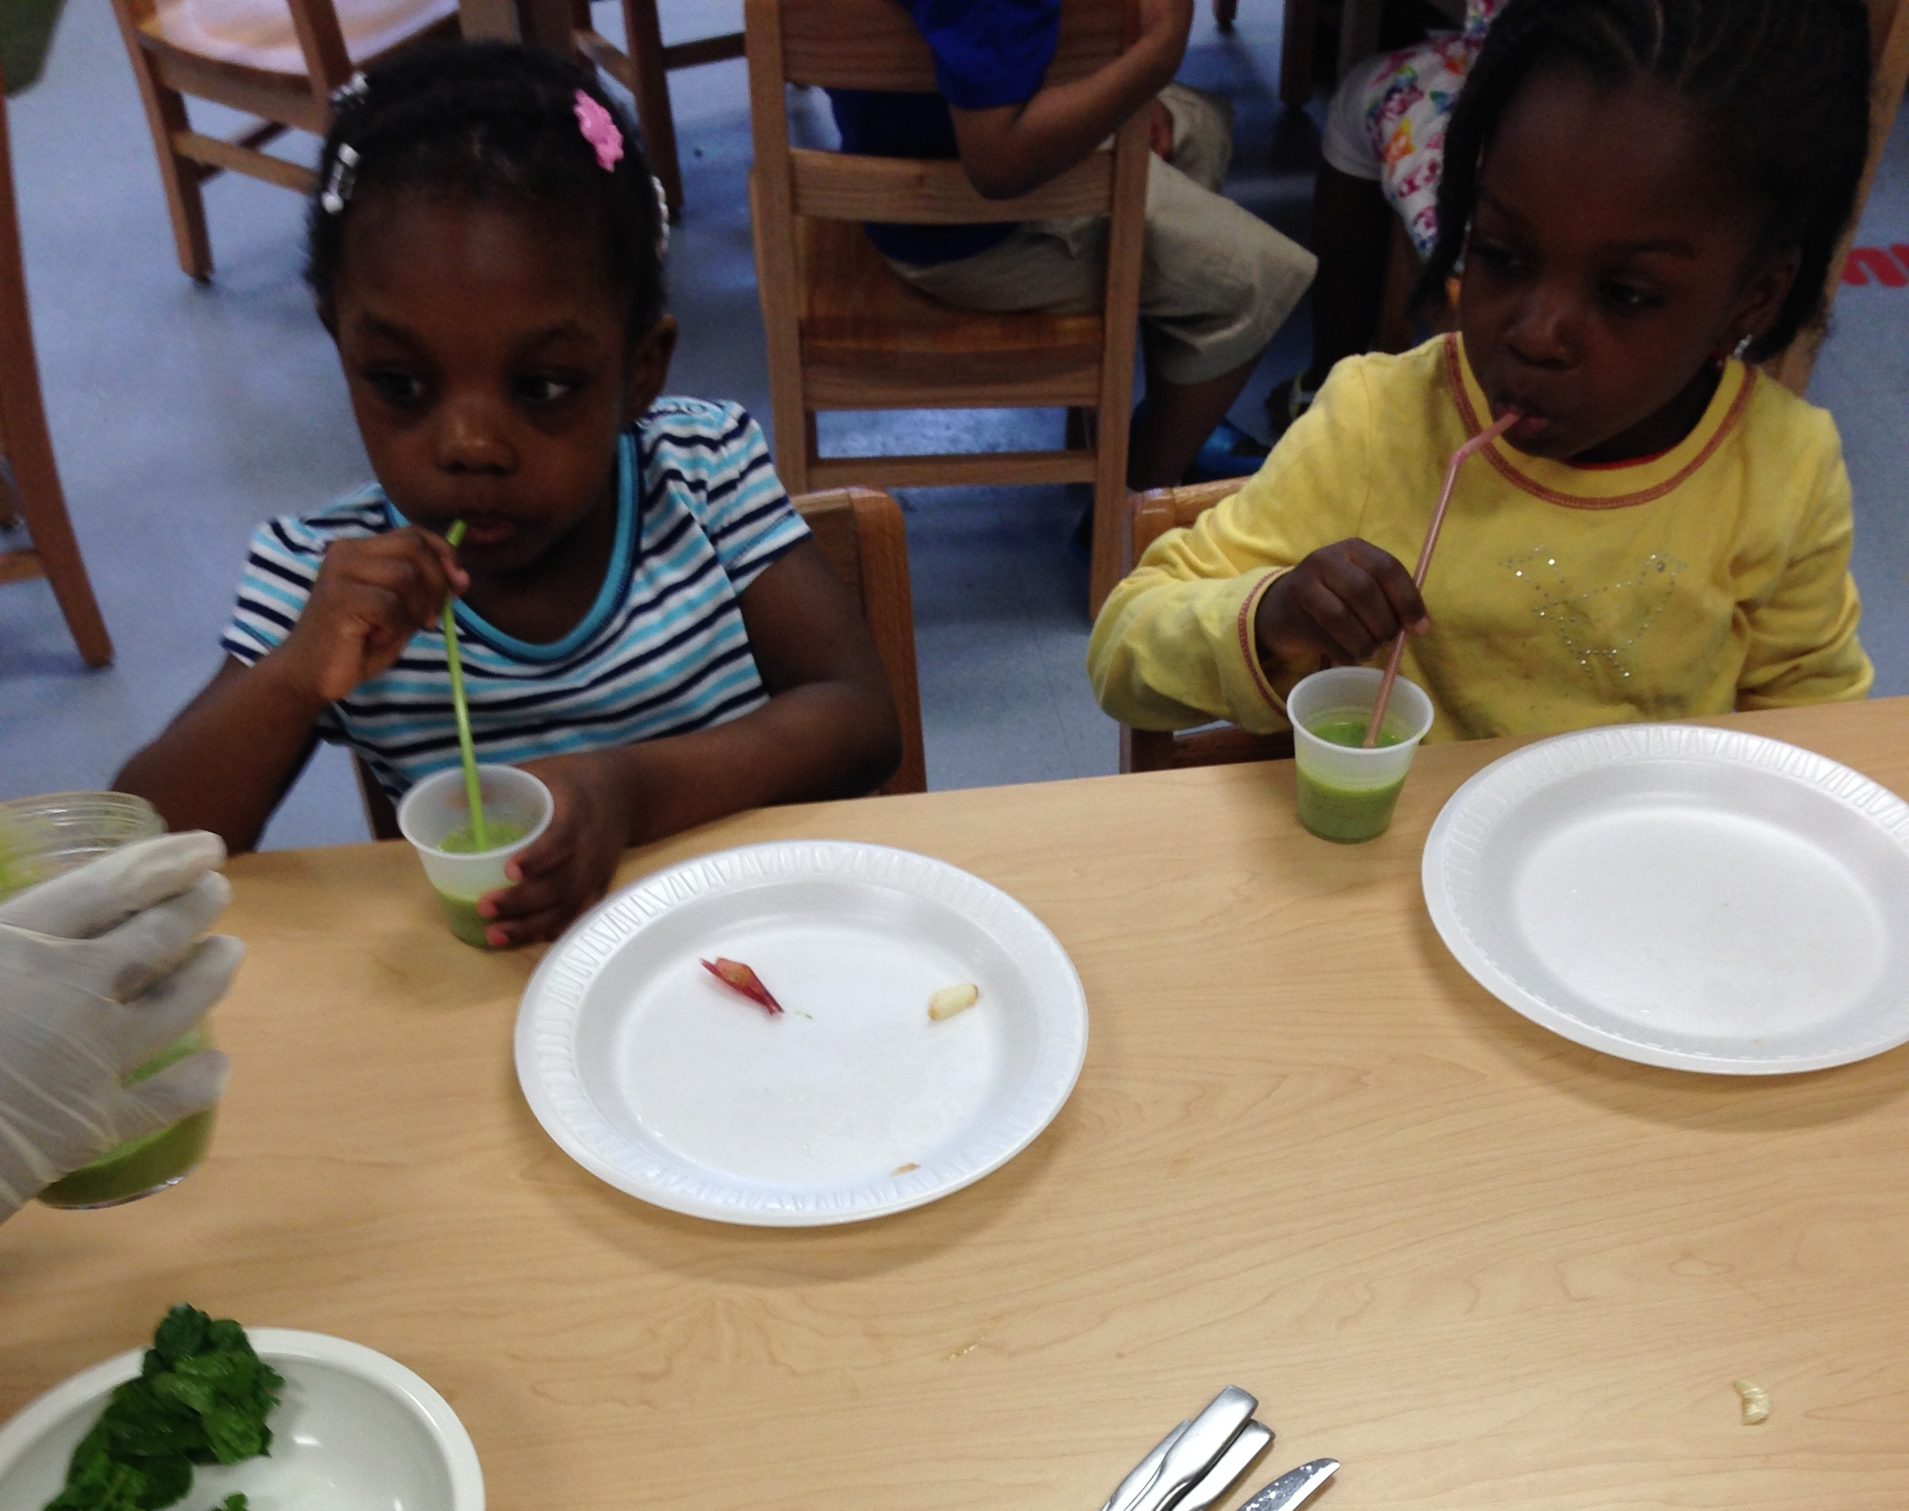
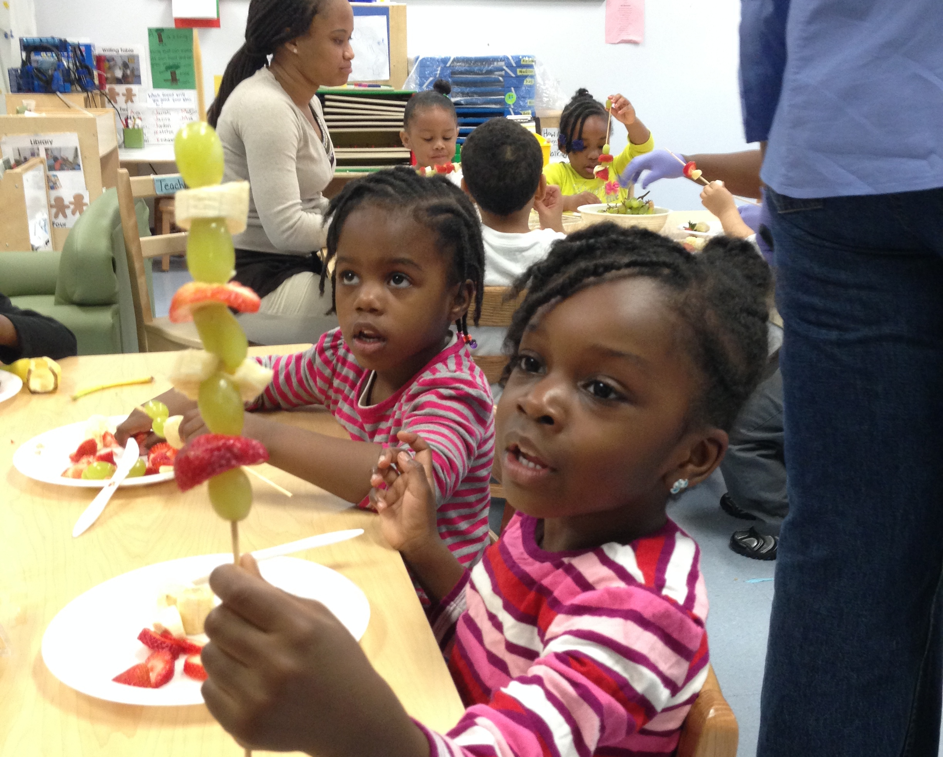
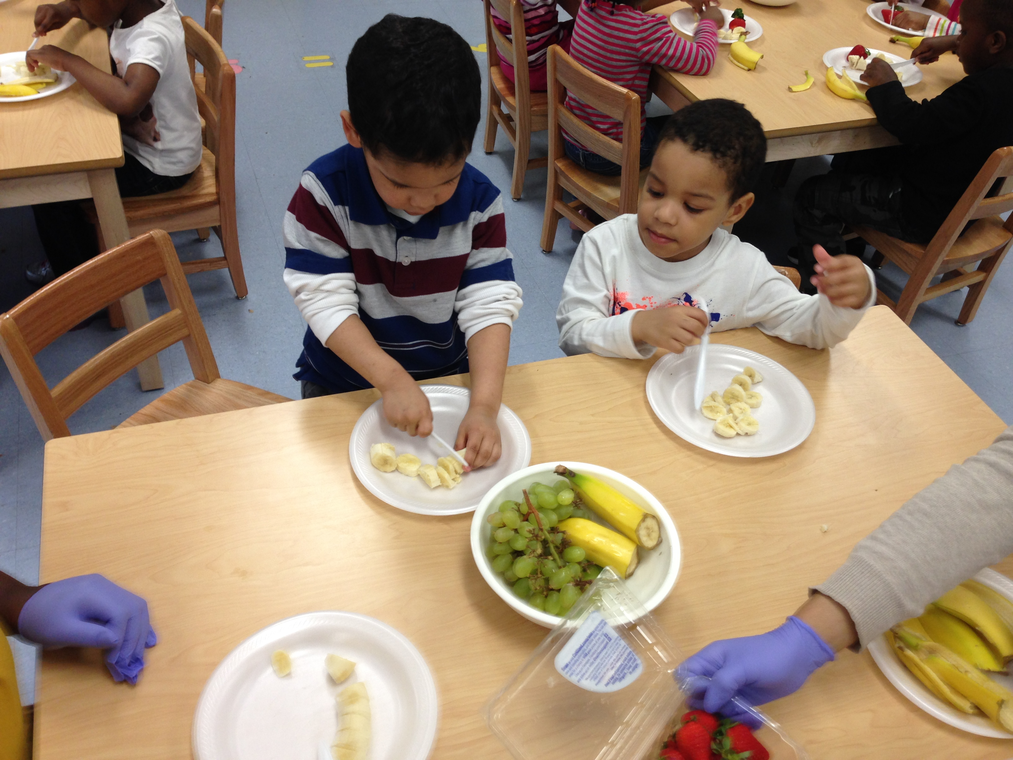
Food Experiences
Some of the students’ favorite experiences were with the food we get from plants. Students chopped strawberries, bananas, and grapes and then used a skewer to arrange their fruit in a pattern of their choice.
Students also made green smoothies with spinach, grapes, bananas, apples, yogurt, and apple juice. We talked about which ingredients came from plants, which were fruits, and which were vegetables. They loved drinking green juice!

