Slide 1
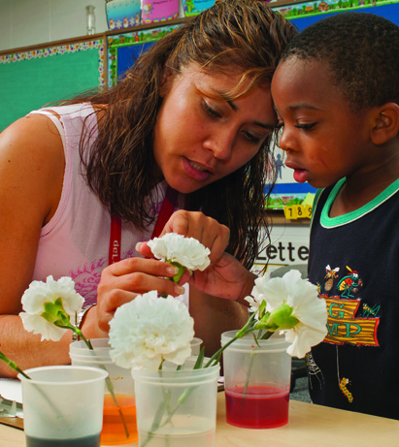
Curriculum Design
Project-Based Curriculum and Long-term Investigations

Slide 2
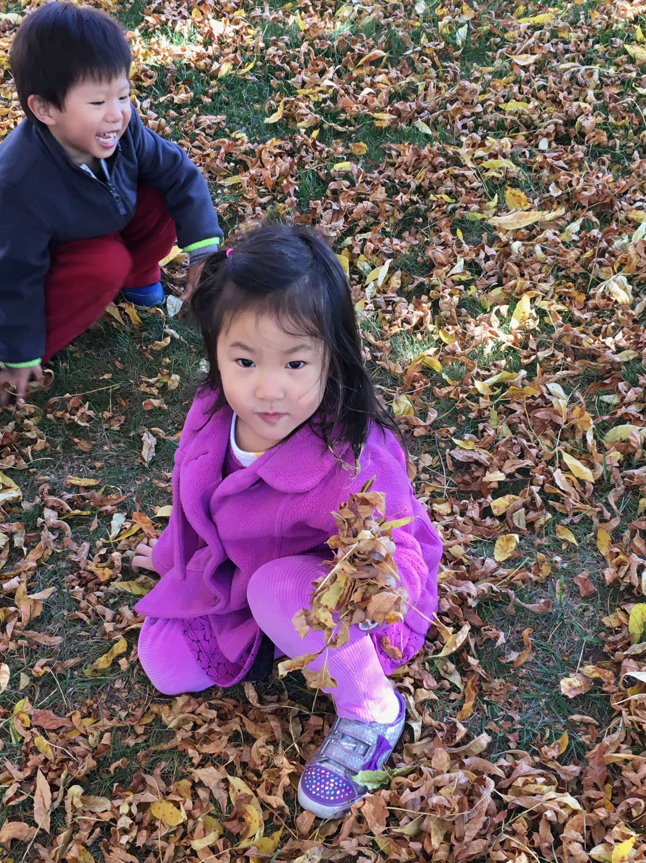
Constructivist philosophy of project-based curriculum
Young children actively make sense of the world using prior knowledge and experiences to construct understanding and make meaning (Piaget)
Young children are curious about how the world around them works
Young children co-construct knowledge with peers and teachers (Vygotsky)
Young children grow intellectually when their thinking is challenged (Piaget) and when they are working within their Zone of Proximal Development (Vygotsky)

Slide 3
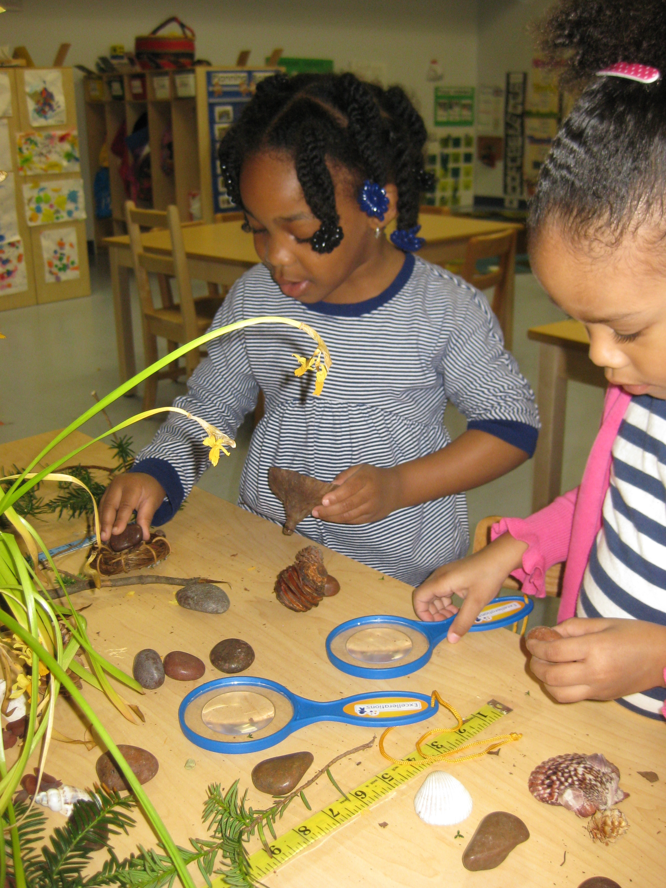
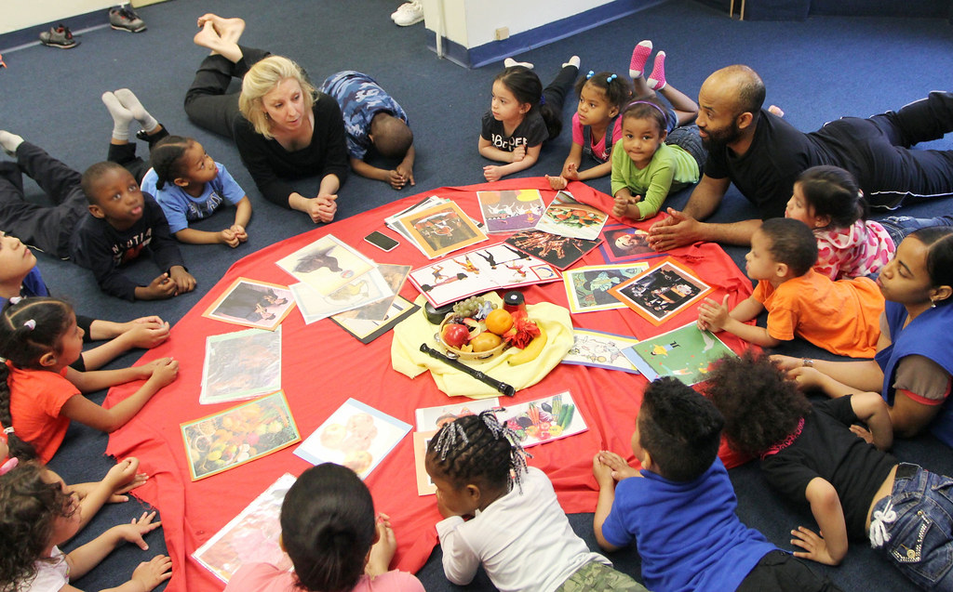
Elements of intentional classroom design
The schedule supports a variety of activities: whole group, small group, partner, teacher-guided, child-guided, learning center play and investigation, outdoor play and investigation.
The classroom design reflects developmentally appropriate and culturally responsive practice supported by research.
The curriculum is long-term interdisciplinary thematic units.
Teachers observe and scaffold learning center play to encourage participation, challenge thinking, and support language.
Teachers use multiple methods to provide authentic assessment of children’s progress and understanding.

Slide 4
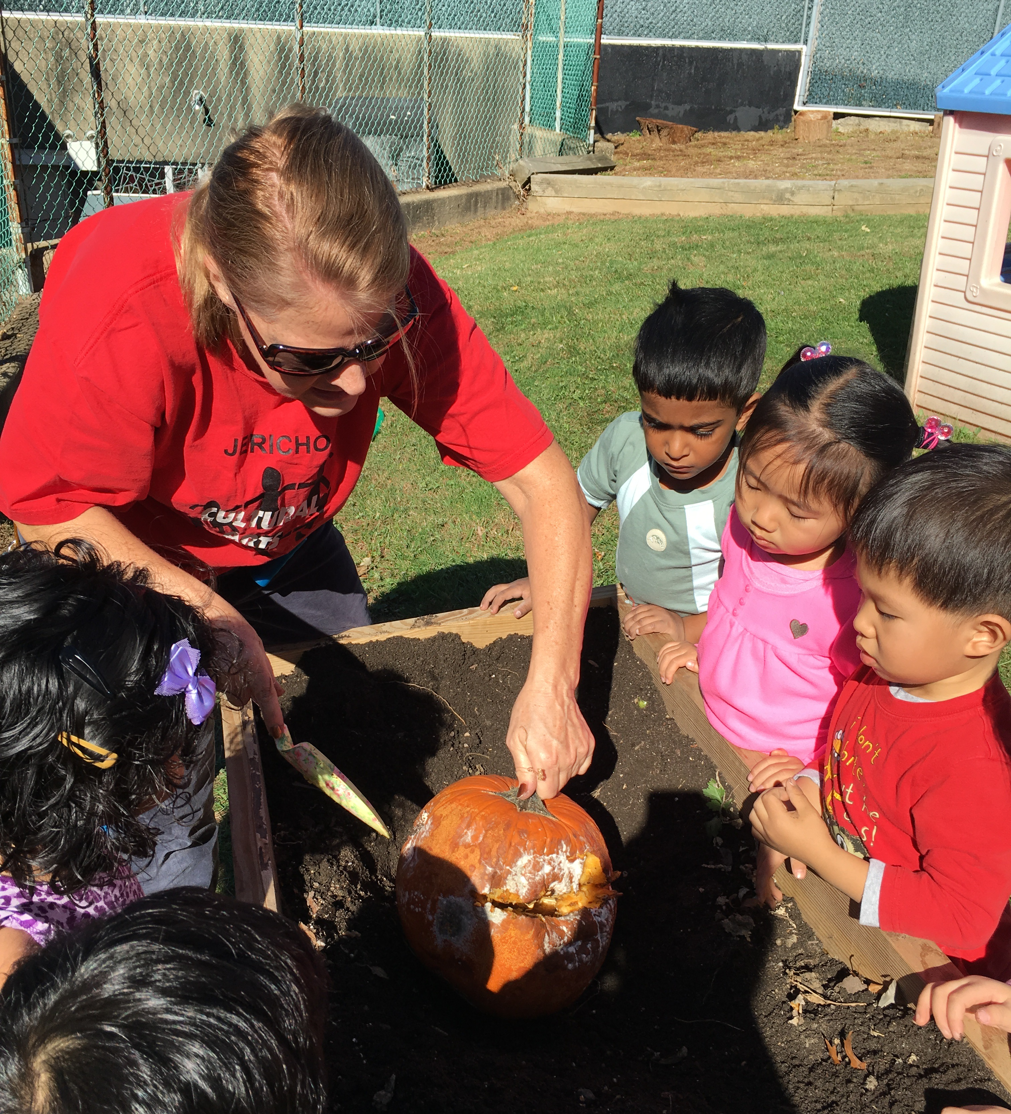
Project-based curriculum and long-term investigations
Project-based curriculum planning is a dynamic and child-centered approach in which curriculum emerges from children’s curiosity and exploration of the world.
Project-based curriculum begins with identifying a real problem or question to resolve.
Project-based curriculum is thematic and supports long-term investigations.

Slide 5
Why is project-based curriculum important?
Project-based curriculum motivates inquiry and exploration. Children acquire deeper knowledge through active exploration of real-world challenges and problems.
Project-based curriculum activities include:
Planned whole group experiences
Teacher-guided play
Intentional transitions
Cooperative learning groups
Child-guided play experiences in learning centers

Slide 6
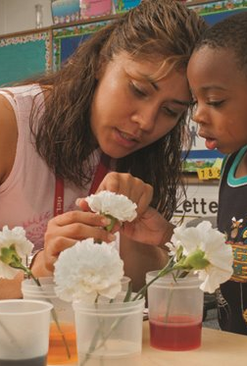
How does project-based thematic curriculum support long-term investigations?
Remember these videos?
Walking Alongside the Learner: https://vimeo.com/184928043
Choice Time and Inquiry in Fanny’s Kindergarten Classroom: https://vimeo.com/238435342
What learning activities did the children engage in to pursue their long-term investigations?
What was the teacher’s role in supporting these long-term investigations?

Slide 7

Planning curriculum: Know your learners
What are your students’ interests? What makes them excited to learn?
What are their talents and strengths?
How can you support their growth in multiple learning domains
What do you know about your students’ families and culture?
In what ways might you involve families?
What literature, songs, and craft techniques might you choose that will support understanding of their heritage and that of their classmates?
What are your students’ challenges?
Academic
Social / Behavioral
Physical

Slide 8

Project-based curriculum: Learning through inquiry
Spark inquiry: Your learning activity begins with a “spark” that encourage young children to explore and deepen their understanding of the world by posing questions that build on current knowledge and extend thinking
Explore: Learning centers and activities are designed to provide opportunities for children to investigate and gather information. Intentional teaching means that each element of your classroom design supports your curriculum objectives.
Reflect: Once children have had the chance to explore and investigate, they should have the chance to reflect on their investigations. Teachers should scaffold learning with questions that engage higher-order thinking. The next step of the curriculum should build on this new knowledge and provide opportunities to further investigate and analyze the topic.
Create: Children should be given opportunities to act upon the new knowledge developed from their investigations and reflections, to create something that they can share.

Slide 9
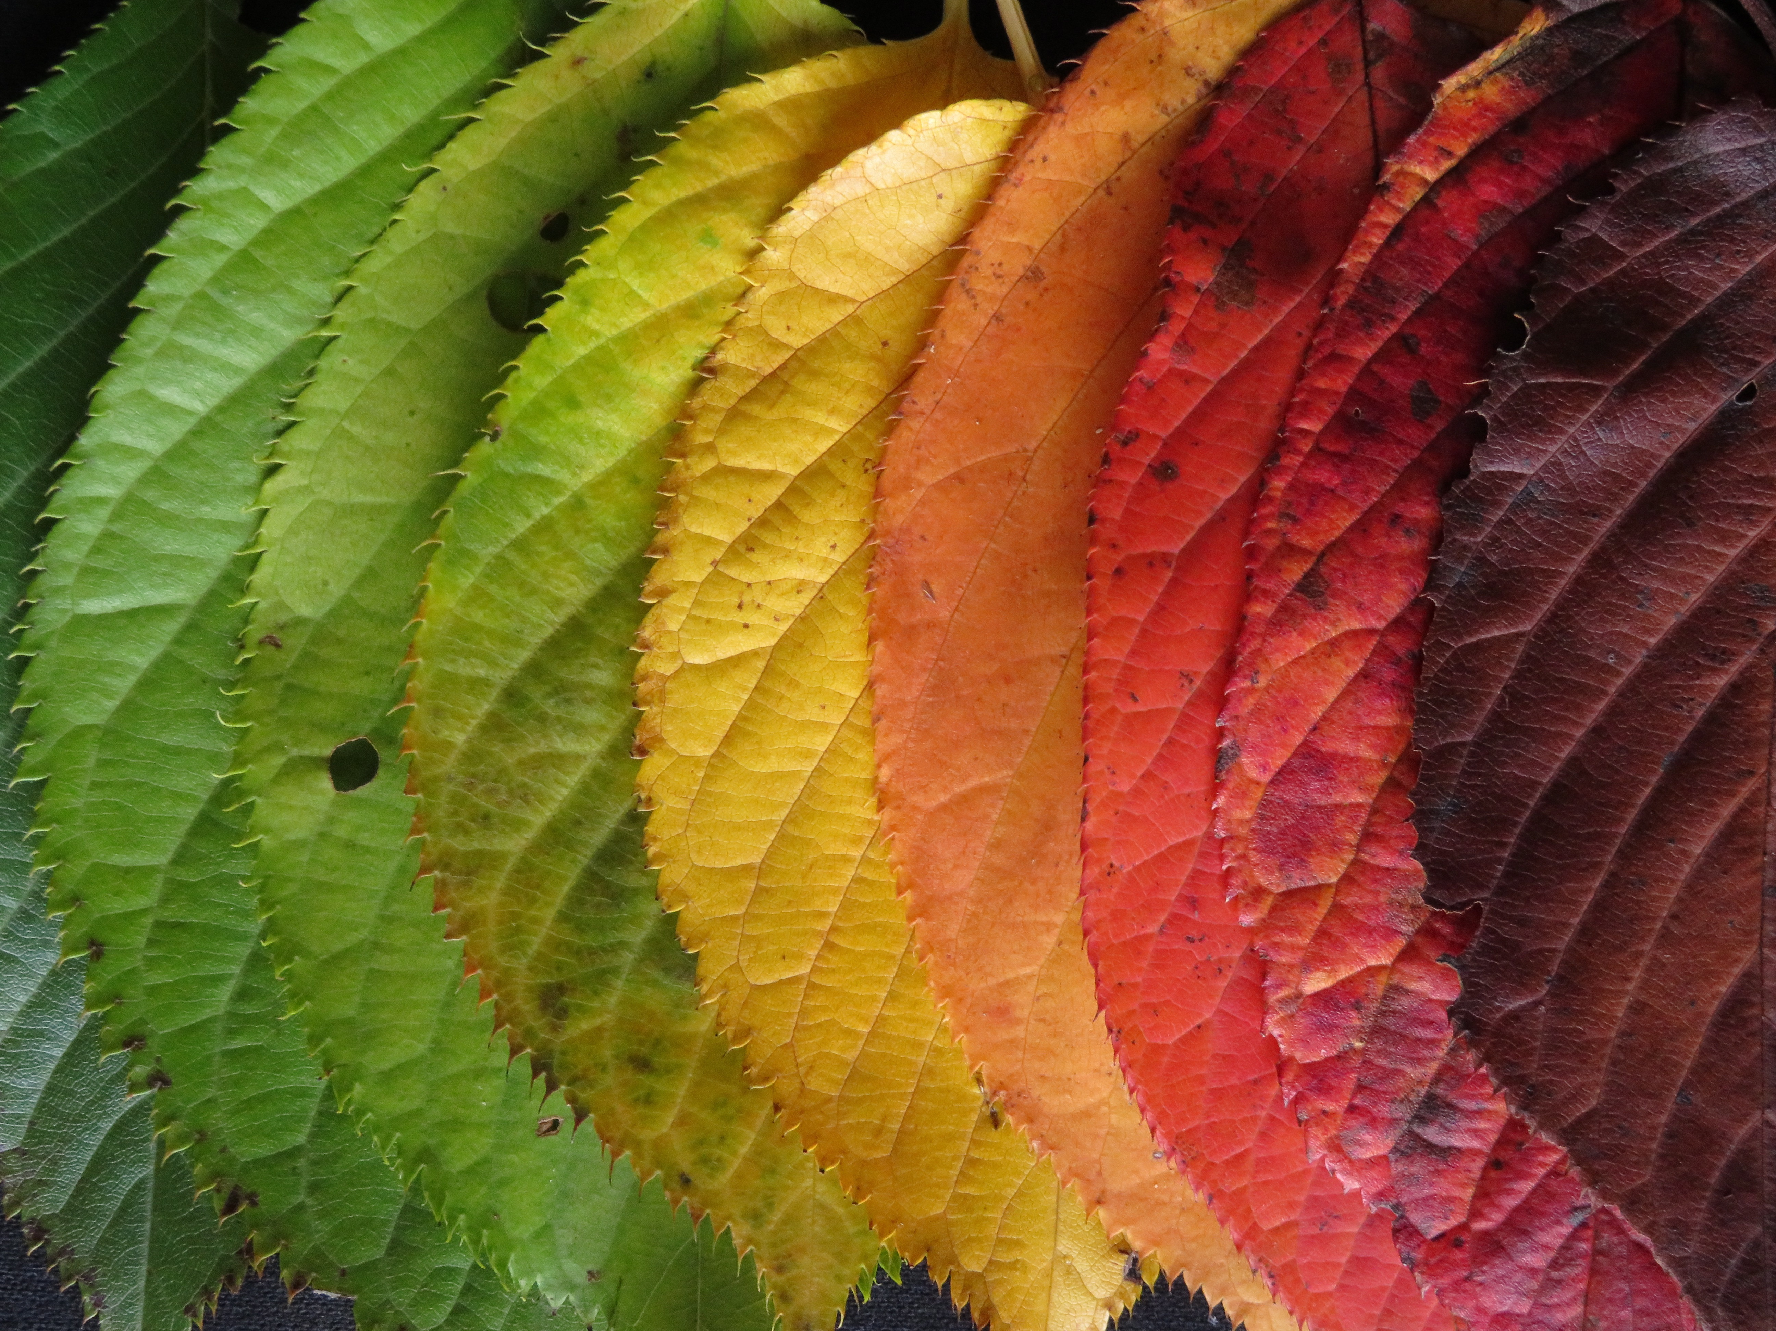
What is a spark?
A spark introduces everyone to the topic of your curriculum and to your learning activity.
The class gathers together for a whole group learning experience that is accessible to all the students in the class.
A whole group lesson for young children should be no longer than 10-15 minutes.
Through conversation, you learn about the students’ prior knowledge so you can evaluate where to begin and what to build upon.

Slide 10
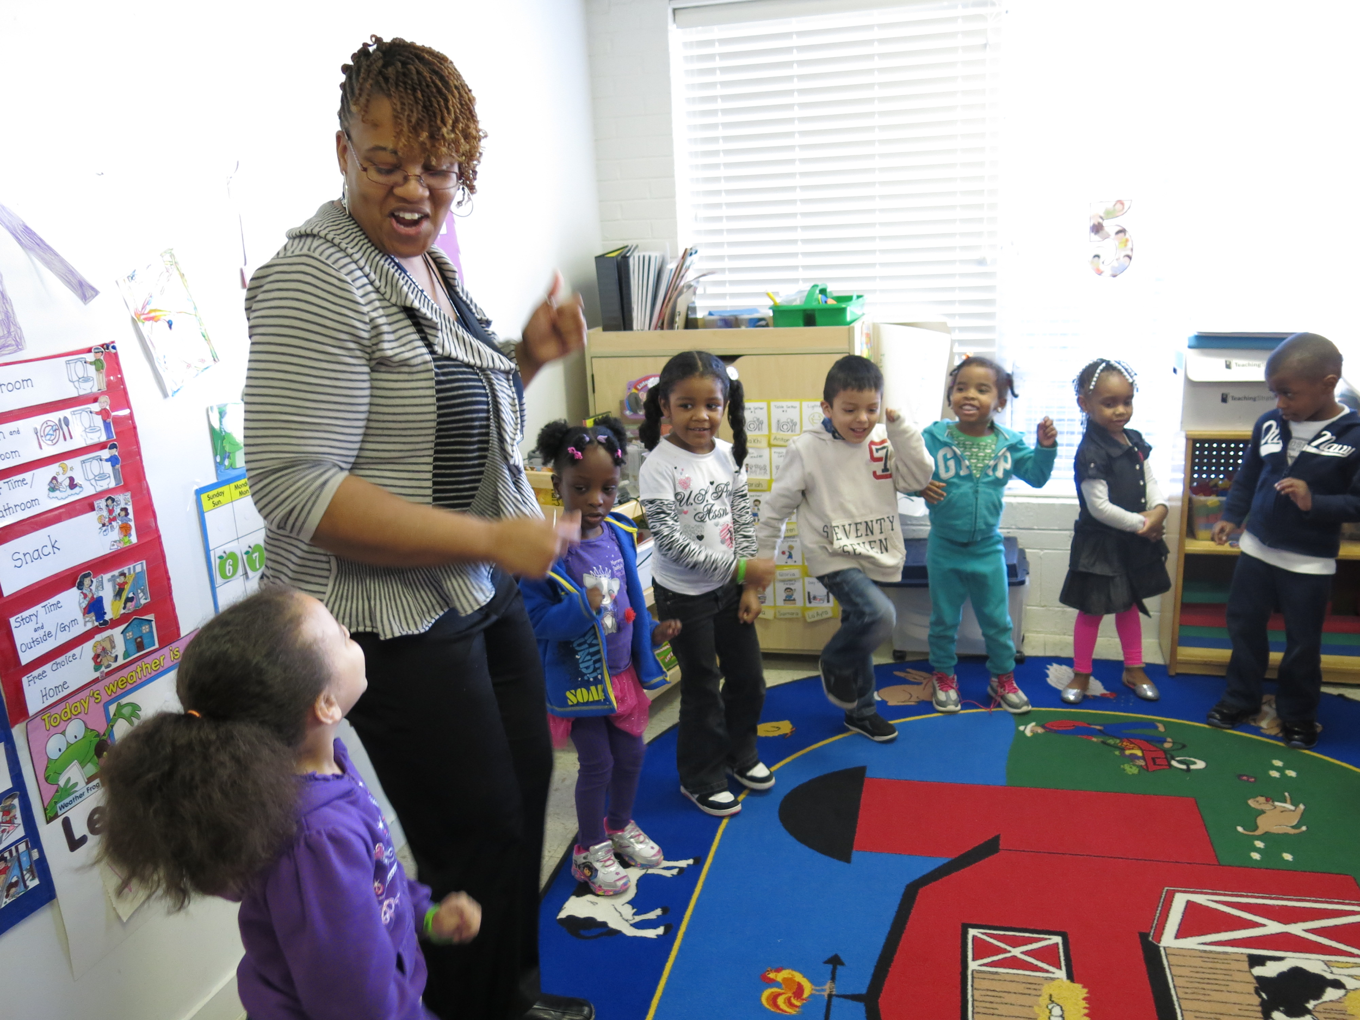
A spark should be:
Exciting: It inspires children’s curiosity about your curriculum topic, so that they want to learn more through exploration and investigation.
Active: There should be multiple activities within the 10 - 15 minutes such as a read aloud, song, movement, and conversation.
Accessible: It should be engaging to all learners at all levels of prior knowledge and experience. For some, this will be an entirely new concept, while others may have background knowledge and need to be challenged.

Slide 11


Explore to discover and learn
Now that students know a little about the topic and objective, they are ready to participate in independent and small group activities related to the learning goal. The sum of the activities must engage the whole child in the learning experience.
Create activities where children can:
Investigate and manipulate a variety of materials
Move, dance, be physically active
Sing and make music
Question and discuss
Collaborate
Make
Pretend and imagine
Activities can include:
Dramatic play and puppet shows
Experiments and explorations with materials
Outdoor investigations
Quiet reading
Projects
Visual arts
Games
Long-term, multi-day investigations and projects

Slide 12

Teacher-guided and child-guided activities
Scaffold learning by providing a variety of different activities, both guided and independent exploration.
Teacher Guided activities support students as they develop new ideas and skills. These activities:
Require adult support (e.g., cooking)
Demonstrate a process, such as for an art project or science experiment
Teach a new skill
Support sustained focus
Model prosocial behaviors
Encourage students to try new activities
Provide teachers the opportunity to connect with students and assess their understanding
Child Guided activities provide opportunities for students to explore, experiment, practice skills and learn through independent play and peer interaction. Teachers may participate and scaffold, but do not direct the play. These activities:
Allow children to choose and explore freely
Do not require instruction
Provide opportunities for in-depth learning without risk or fear of failure
Give teachers opportunities to observe and assess student understanding

Slide 13

Creating learning experiences
Many different activities in an early childhood classroom support students in learning through discovery.
Whole Group: Group gatherings are good for brief (10-15 minutes) learning experiences that introduce an activity and build classroom community.
Learning Center: Self-directed play-based activities organized in centers throughout the classroom: library, science exploration, music and movement, block construction, puppets and dramatic play, sensory table, visual arts (painting, drawing, sculpture).
Small Group: Young children learn best in small group(3-5) lessons that are hands-on, active, playful and creative, and provide opportunities for reflection.

Slide 14
Curriculum Design
Theme
The theme frames the learning, providing a developmentally appropriate and interesting topic that guides students to consider a big-picture, essential question.
Subthemes
Subthemes (sub-topics) support children in exploring the theme through varied perspectives. Each subtheme has a broad learning goal (or focus question) for students.
Activities
The learning happens through the activities. Each activity scaffolds the learning so that students may reach the subtheme’s goal.

Slide 15
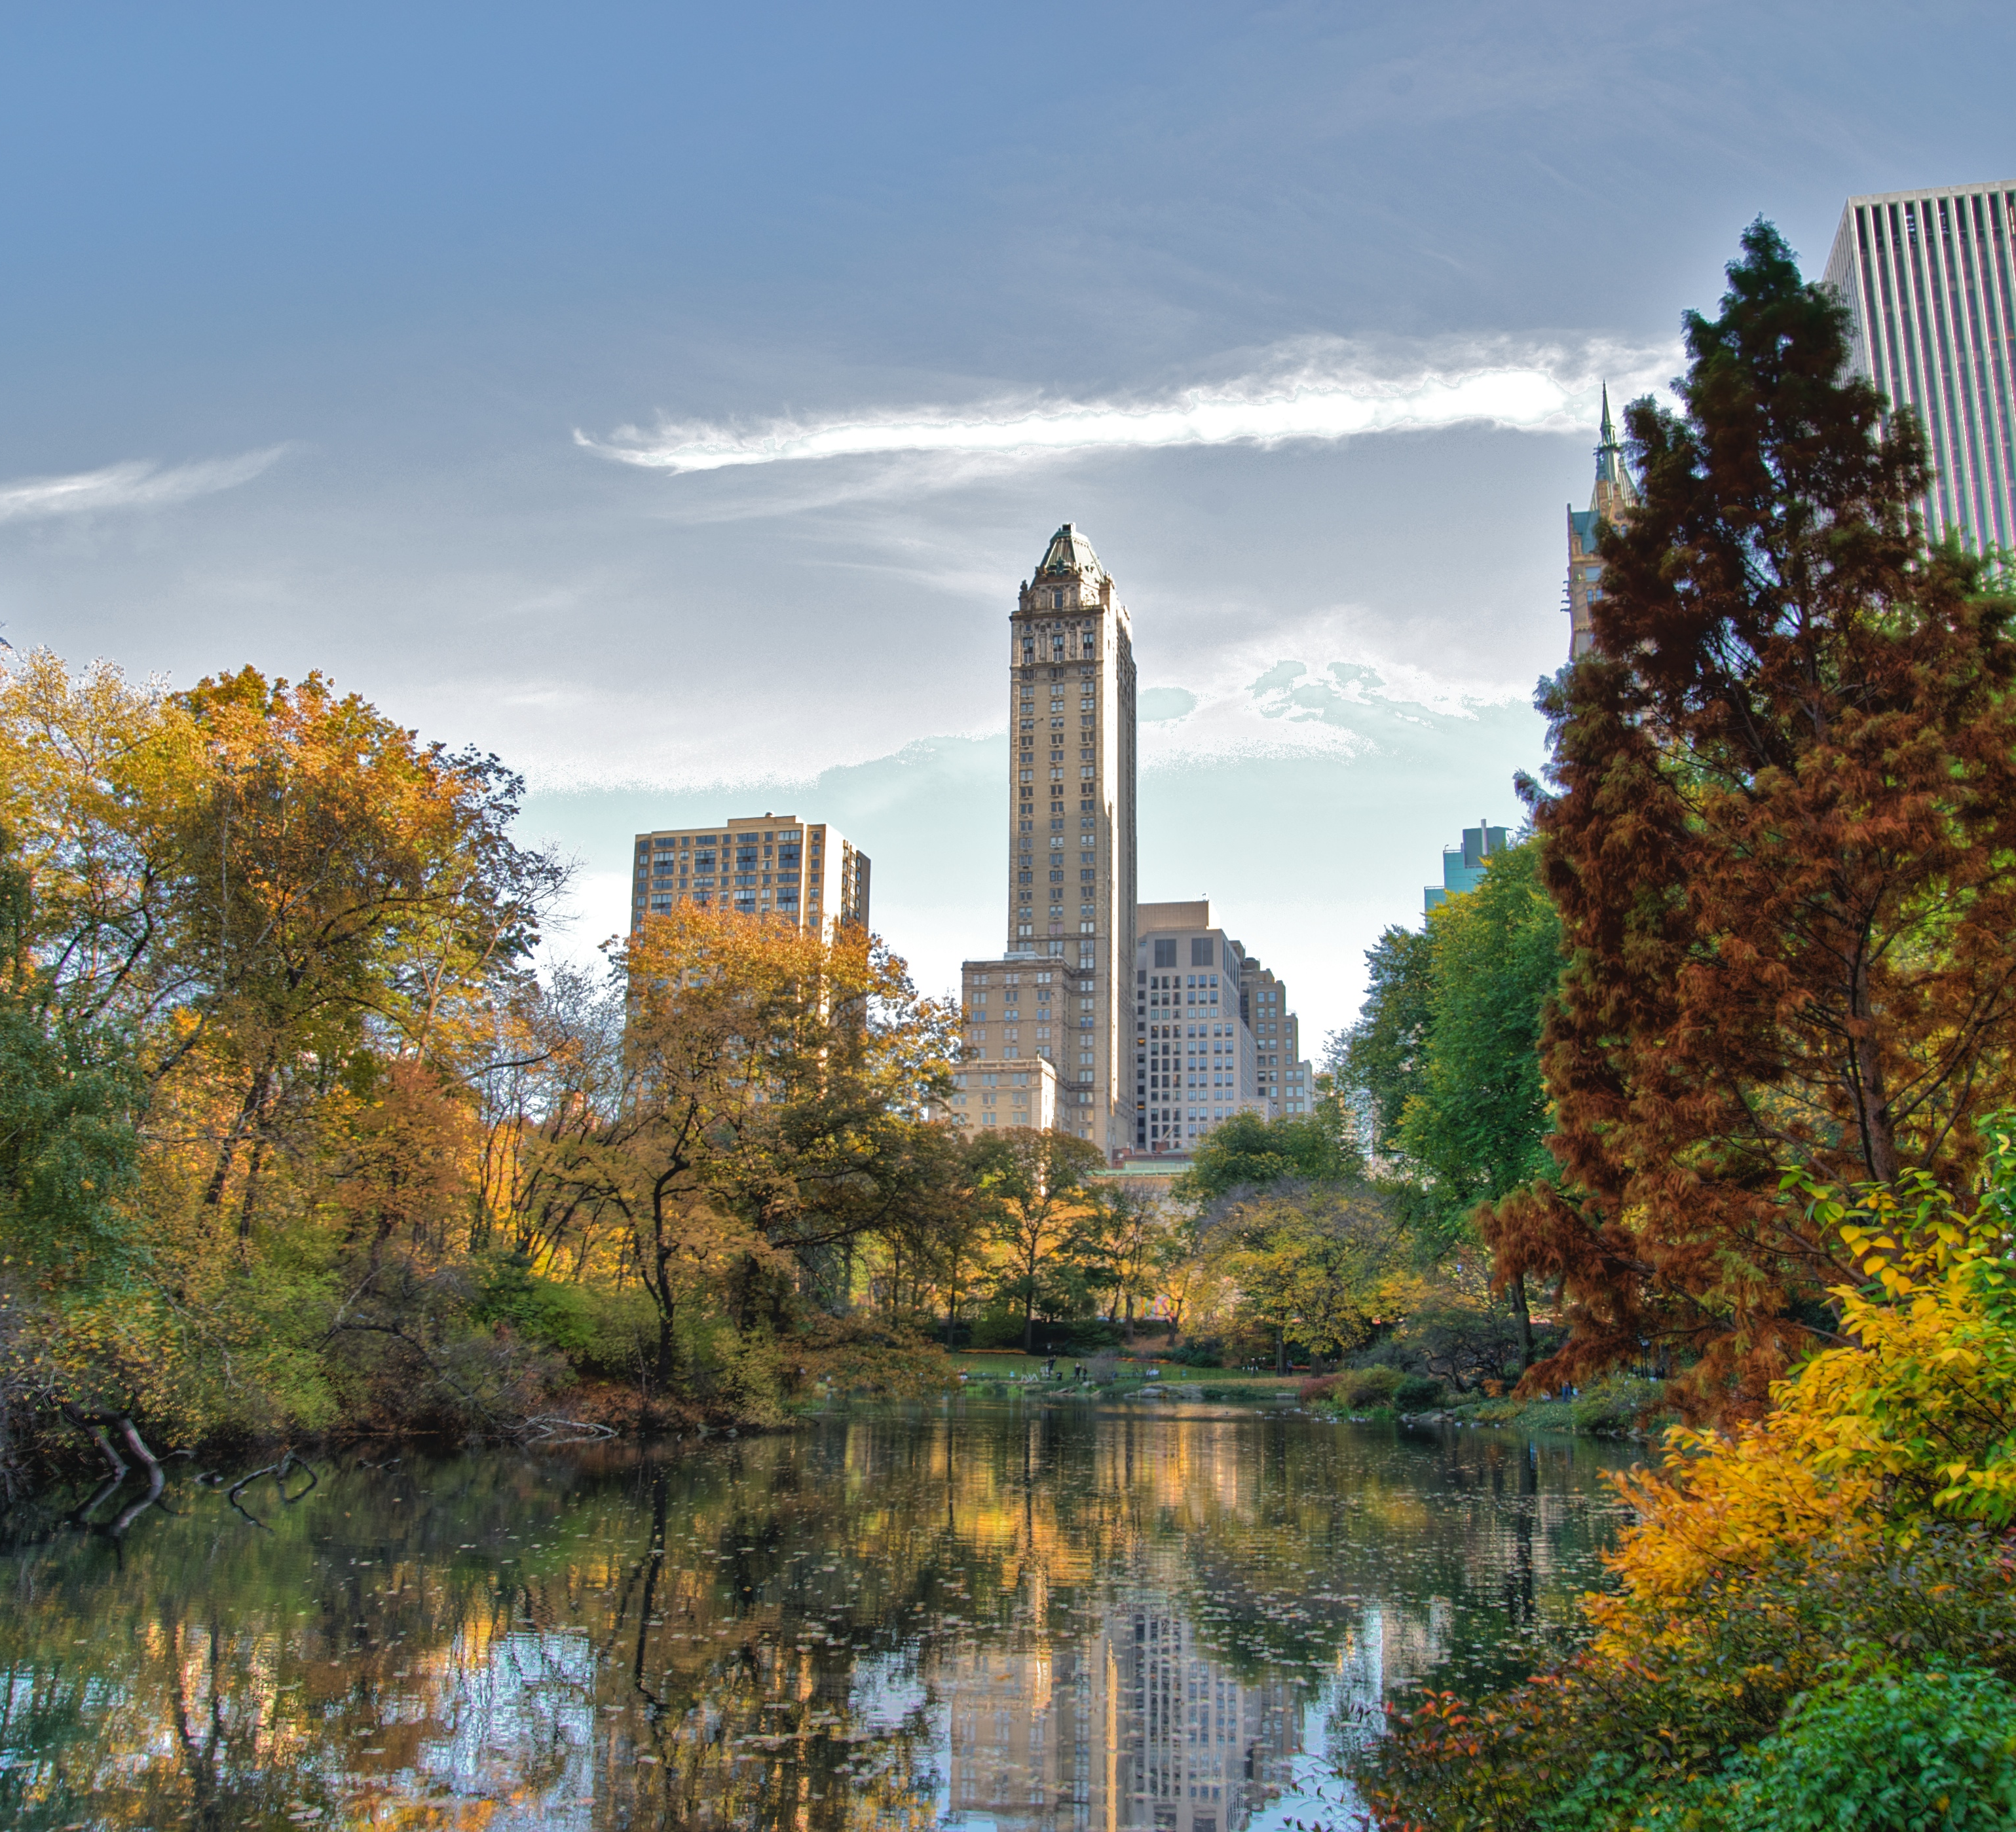
Thematic Curriculum Unit: Nature in the City

Slide 16
Theme: | Nature in the City
Subthemes | Observing Our Urban Environment | Urban Habitats | Leaf Study: Trees and Plants in the City | Birds and Animals in the City | Protecting Our Natural Urban Environment
Goals | Students will explore their urban environment to discover how we live with nature in the city. | Students will recognize different natural habitats in the city and the flora and fauna that live in these urban habitats. | Students will use their observation skills, especially of color, shape and size, to learn about trees and plants in the city. | Students will learn about the birds and animals that make their home in natural habitats in the city. | Students will apply what they have learned about nature in the city to explore ways to protect the natural environment.

Slide 17
Leaf Study: Trees and Plants in the City
This is one sub-theme of my curriculum unit. I anticipate these lessons will be implemented over one-two weeks.

Slide 18
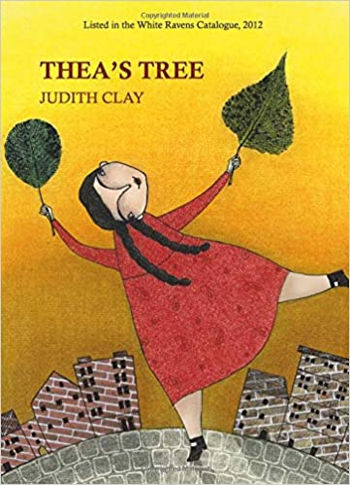

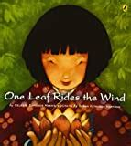
High-Quality Children’s Literature
High-quality children’s literature sparks imagination, opens new windows onto the world and connects to children’s prior knowledge and experience
Reading aloud, books in the reading center, and books placed in different learning centers offer children multiple ways to understand and explore the topic through both teacher-guided and independent learning.

Slide 19

The First Spark: A Read Aloud
To begin this sub-theme of my curriculum unit, I will spark children’s interest and imagination with a read aloud of Red Leaf, Yellow Leaf by Lois Ehlert during the whole group meeting.
I may follow the read aloud with a song or movement activity about leaves.
If you can’t see the video, cut and paste this link in your browser: https://www.youtube.com/watch?v=PJPAcC7tQto

Slide 20
Activities for Teacher-Guided and Independent Exploration
Nature walk: Take a walk with my students through the neighborhood or to a nearby park and let them collect leaves.
Sorting and classifying: Back in the classroom, leaves can be added to my Sensory Center or Science Center. Children can sort leaves, observe them closely with a magnifying glass, and compare attributes of different leaves.
Observing change: Over time, the leaves will change color and texture. Children can document those changes.

Slide 21
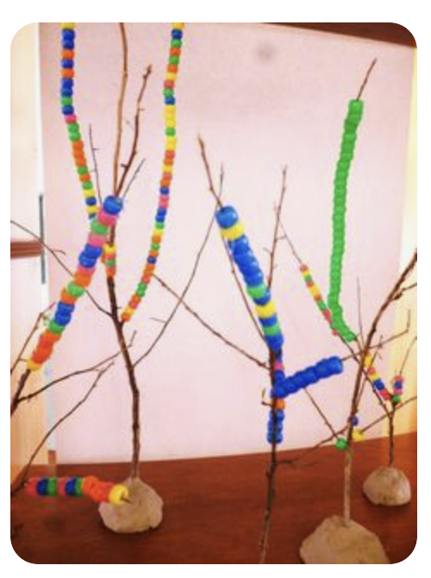
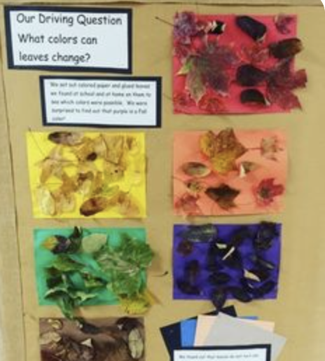
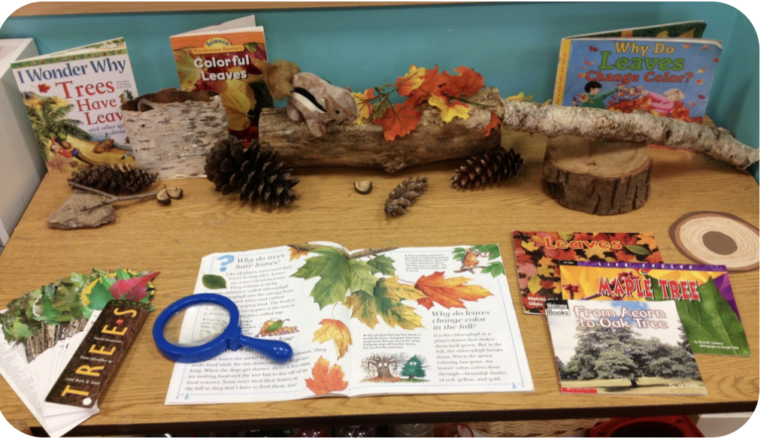
Bringing the sub-theme into your learning centers
Sensory Center: Add leaves, seeds, fir needles, pinecones, to the sensory center and allow children to look, touch, and explore
Science Center: Books, magnifying glasses, leaves, seeds, pinecones to examine and document
Art Center: Experiment with autumn colors at the easel, create leaf collages and twig sculptures
Library: Add books about trees, leaves, autumn, seasonal change
Dramatic play: Create a farm/harvest theme for autumn
Music: Add music about leaves and autumn, include music to support creative movement and dance (e.g., leaves dancing in the wind)

Slide 22
The Next Day…
We will continue to explore the leaves we collected on our nature walk, but with some variety to help the children go deeper into their understanding about the colors and shapes of leaves.
I will read One Leaf Rides the Wind
I will play music and students will dance in the wind, first alone, then find a partner to dance to re-enact the story.
We go outside and collect more leaves, twigs, pinecones, etc. for the sensory bin, science center and art center

Slide 23
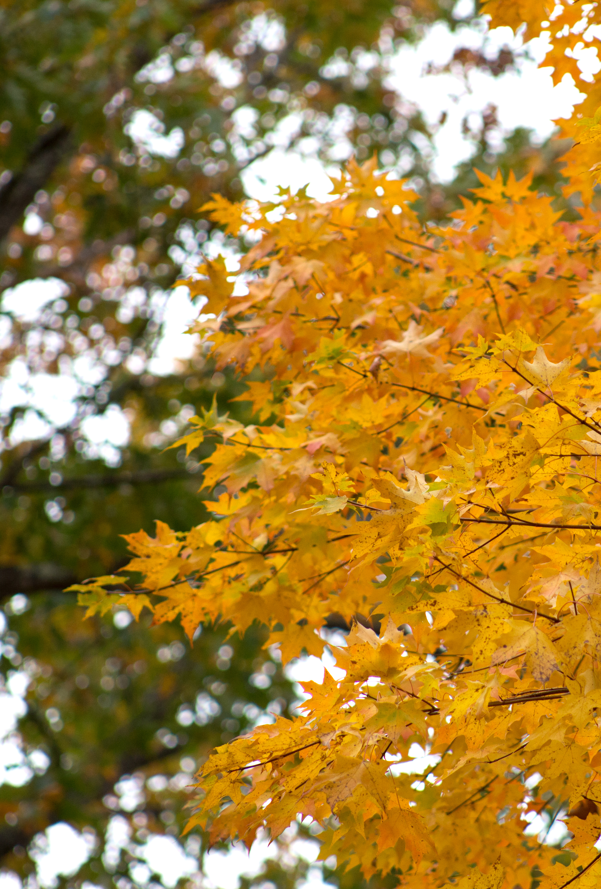
Continuing the learning at meeting time…
The following day, I will re-read Red Leaf, Yellow Leaf. New ideas and deeper understanding emerge when you revisit a story.
We will explore the social-emotional lessons in the story.
I will engage the children in a dramatic re-enactment of the story or play music and have the children imagine through movement the leaves changing as the seasons change.
We will take another nature walk and collect more leaves, etc.
Now we are ready to extend our learning by exploring a Work of Art…

Slide 24
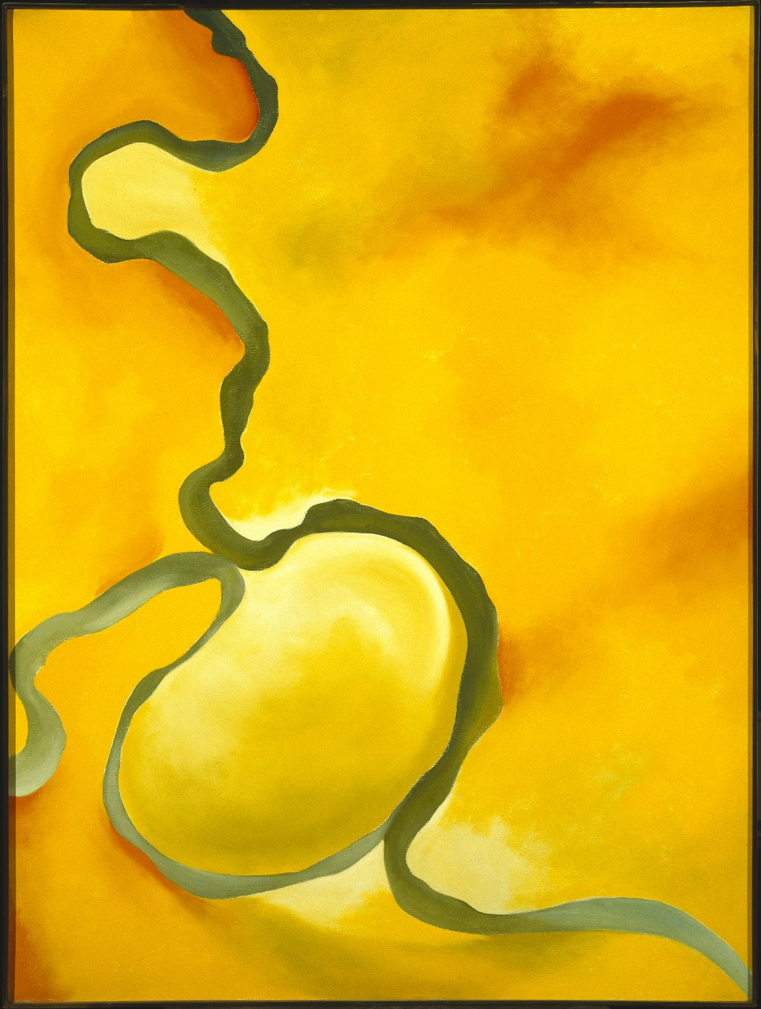
The Lesson: Building a Lesson Around a Work of Art
Georgia O’Keeffe. Green, Yellow and Orange, 1960. Oil on Canvas.
Georgia O’Keeffe. Two Yellow Leaves, 1928. Oil on Canvas

Slide 25
Overview of my planning process
I have selected two Georgia O’Keeffe paintings of leaves. First, I will get to know these works of art:
What do I notice in the work of art?
What questions occur to me about the work of art?
What is the social, cultural and historical significance of the work of art?

Slide 26
Another day, another spark…
Now that students have spent some time exploring and observing leaves, I will scaffold the learning to help students go deeper into their leaf study.
First, we will look closely at this painting, Two Yellow Leaves by the artist Georgia O’Keeffe.
Georgia O’Keeffe closely observed nature and then created her own interpretations of what she observed.
What do you notice?
What colors do you see?
What shapes do you see?
How do you think these leaves might feel to touch? Why?
What else do you notice.
Now, let’s look at another painting by Georgia O’Keeffe…

Slide 27
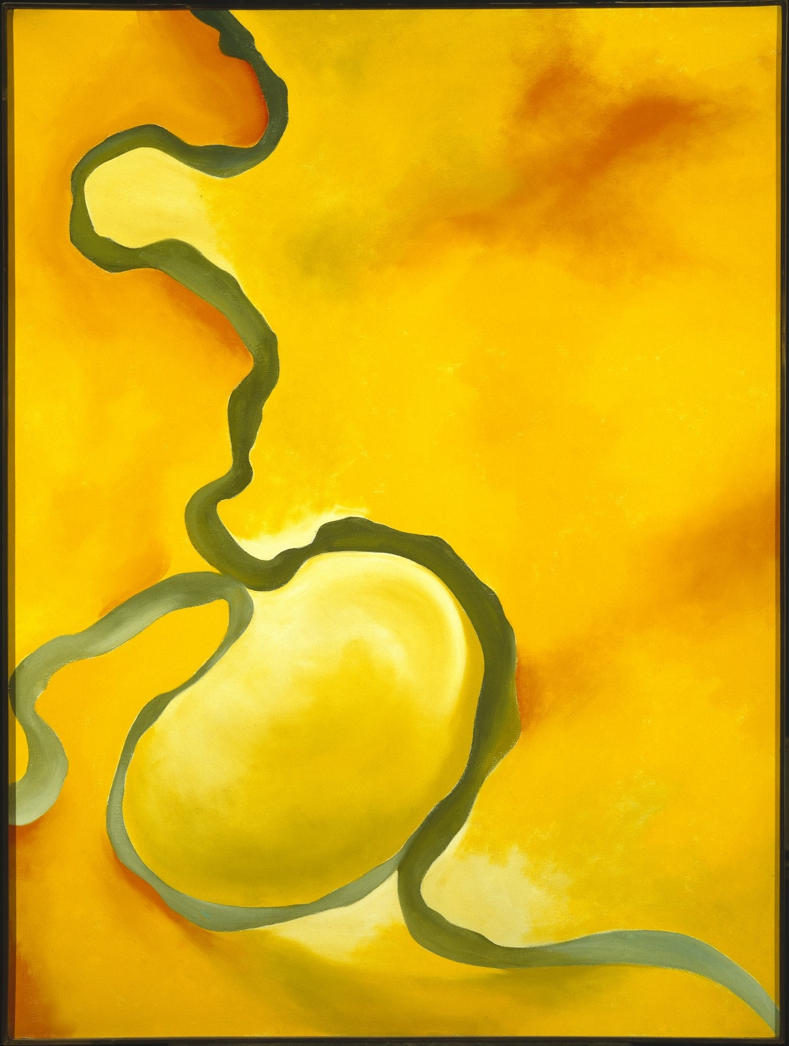
Introducing the Learning Activity…
Georgia O’Keeffe also made this painting.
How are they the same? How are they different?
Trace the green line with your finger. What do you notice?
Introduce the learning activity:
Today, we are going to make leaf portraits, just like Georgia O’Keefe did with her leaves.

Slide 28
The Learning Activity
Classroom Set-Up and Materials:
Art Center
Table set for four students
Tray with leaves and magnifying glasses.
Tray with art-making materials
Books on topic in library, science center, art center
Materials:
Leaves
Magnifying glass
A pencil
Paper
Watercolor paints
Paint brushes
A sharpie or a black crayon

Slide 29
The Learning Activity
Teacher Guidance
I will model how I closely observe one leaf and encourage students to observe.
Talk together about what we notice.
Students will draw what they see.
I will encourage students to make the leaves in their own way, like Georgia O’Keeffe did
I will remind them that this is their own interpretation of what they see, not an exact copy.
After drawing, they will trace over the lines with sharpie or crayon.
Finally, they will paint with watercolors.

Slide 30
Creativity and Exploration
“All children learn differently and use their own unique skills to demonstrate knowledge. We should give our students the ability to create their own meaning or interpretations to classroom activities. It is so important to allow our students to express themselves in all the ways that they feel comfortable doing so. Authentic performance-based assessments and other imaginative activities in the classroom, enable the children to reflect on their own learning and identify what they need to work on in the future.”
Student Reflection on a Pre-Service Teacher Aesthetic Education Workshop

