Slide 1
How the Pandemic Affected Delis
Duriana

Slide 2
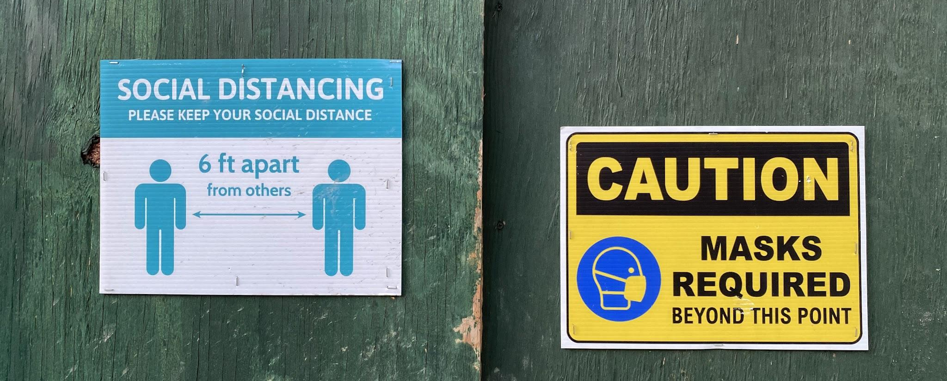
DO NOT GO OUT OR GO OUT WITH CAUTION

Slide 3

IT DEPENDS on how far away the STUDENTS are from the BODEGA

Slide 4
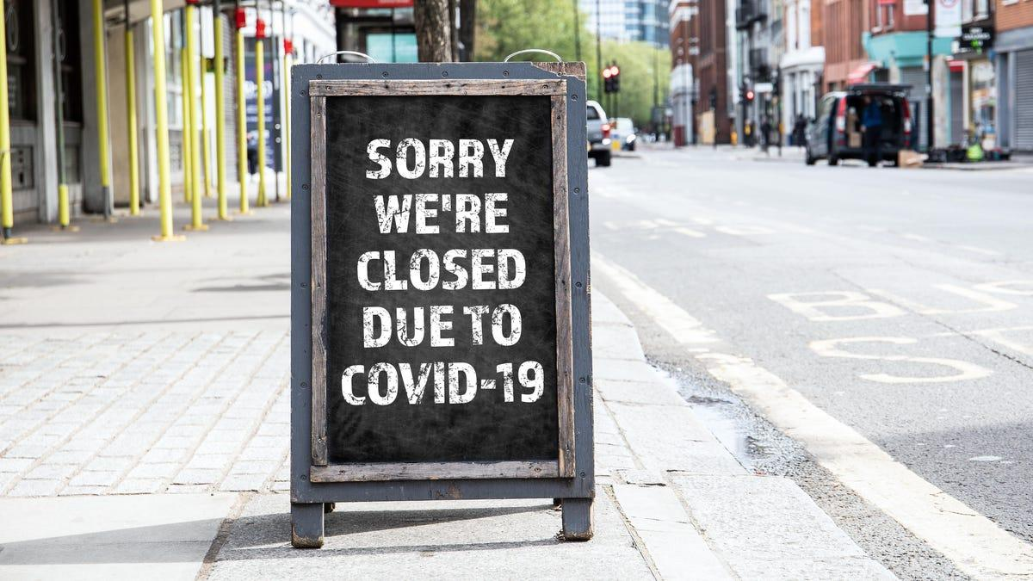
BETWEEN APRIL and MAY, businesses were CLOSING

Slide 5
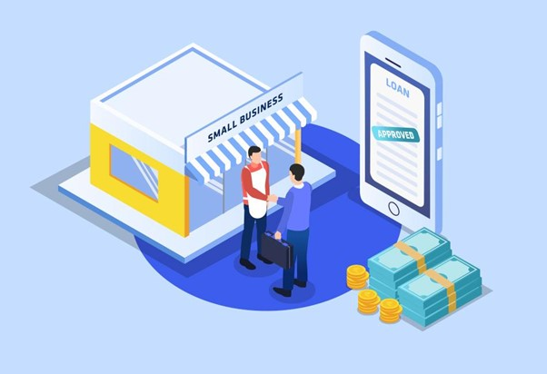
THE GOVERNMENT PROVIDED MANY LOANS

Slide 6
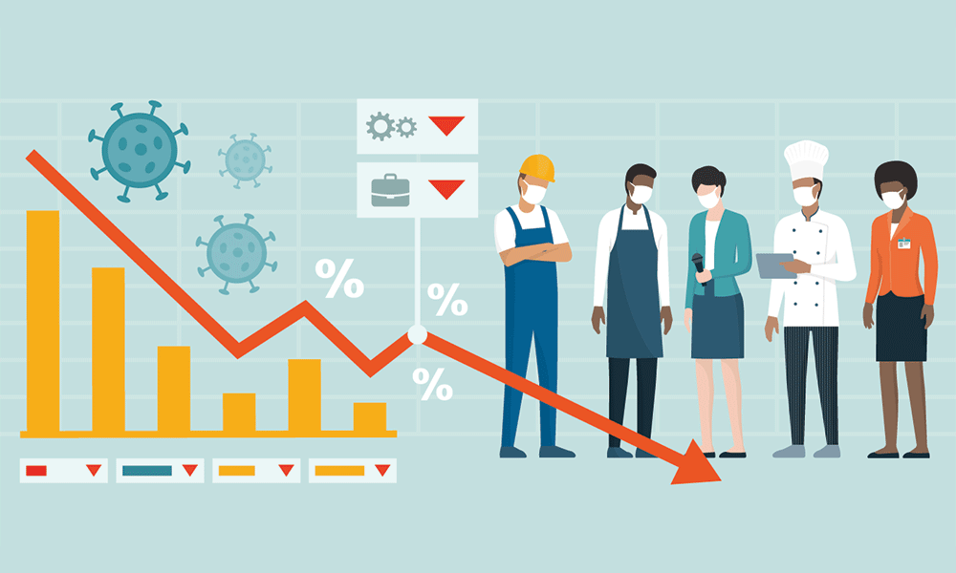
REVENUE was LIMITED AND THE PRODUCTS DID NOT SHOW UP
Notes:
DURING THE PANDEMIC

Slide 7
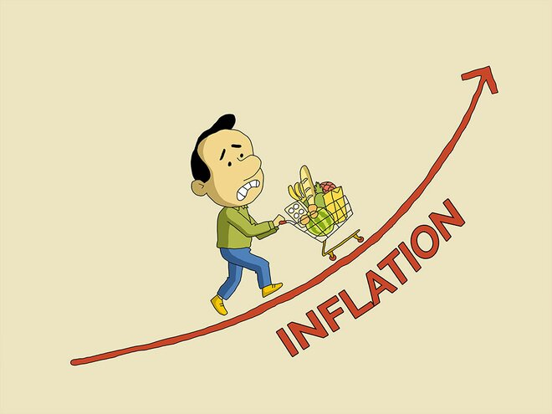
PRICES HAVE CHANGED AND HYGIENE MEASURES

Slide 8
“It wasn't us that raised the prices but the wholesalers.”

