Slide 1
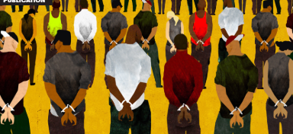
Prisons and the lived experiences of correctional staff and the incarcerated
Notes:
Ear Hustle –
https://www.earhustlesq.com/episodes
Raised in the system
https://www.youtube.com/watch?v=yq3uVJQN8Gw
Frontline Prison State
https://www.pbs.org/wgbh/frontline/film/prison-state/
CBS – lynching
https://www.vera.org/publications/people-in-prison-in-2018
Prison riots
https://www.youtube.com/watch?v=3M-hPpuAqwQ
https://www.youtube.com/watch?v=bXgP0lkqPNk&index=57&list=PLY24ILZ8Y5SqgU8BVjAAC12E0q_EZXNlL

Slide 2
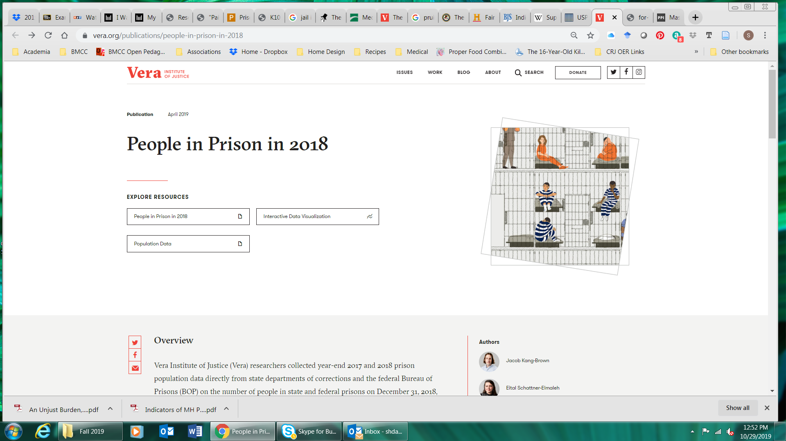
People in Prison

Slide 3
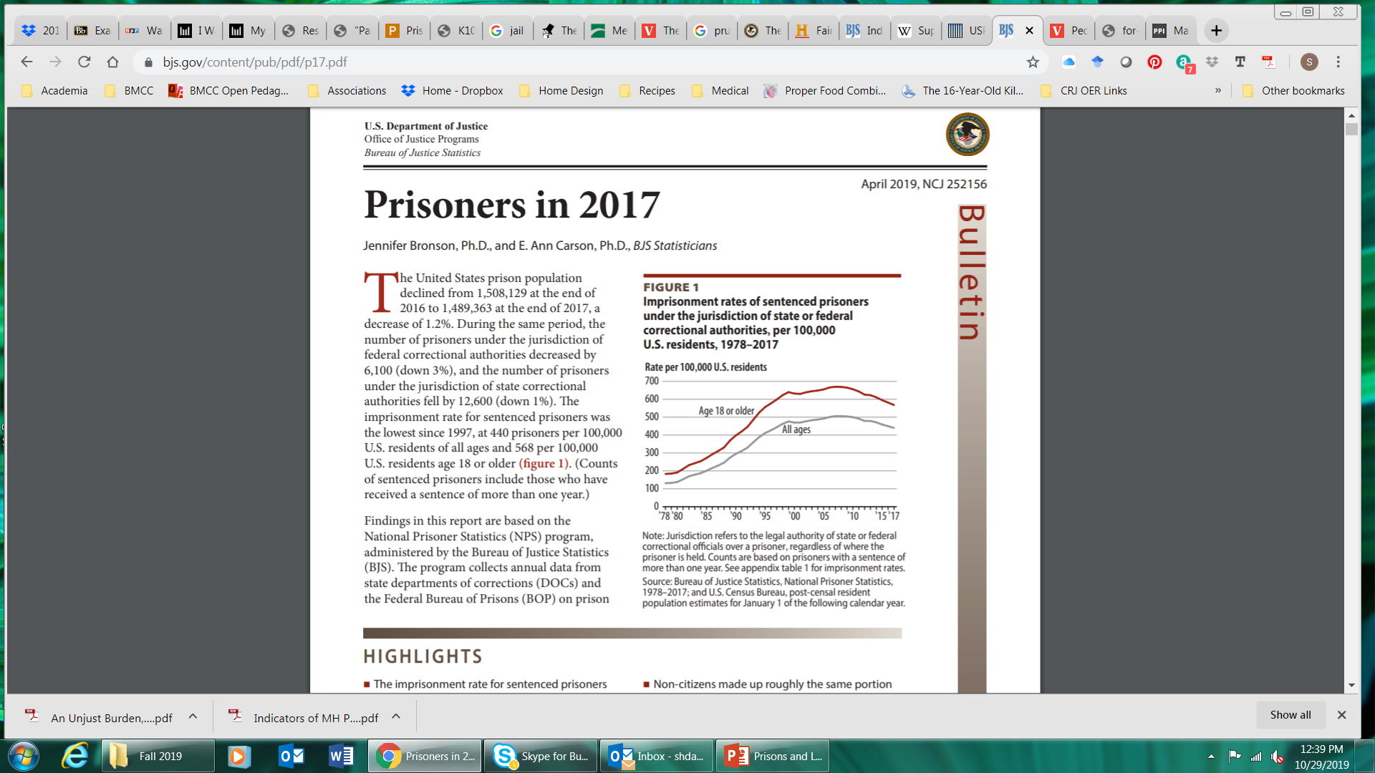
Notes:
https://www.bjs.gov/content/pub/pdf/p17.pdf

Slide 4
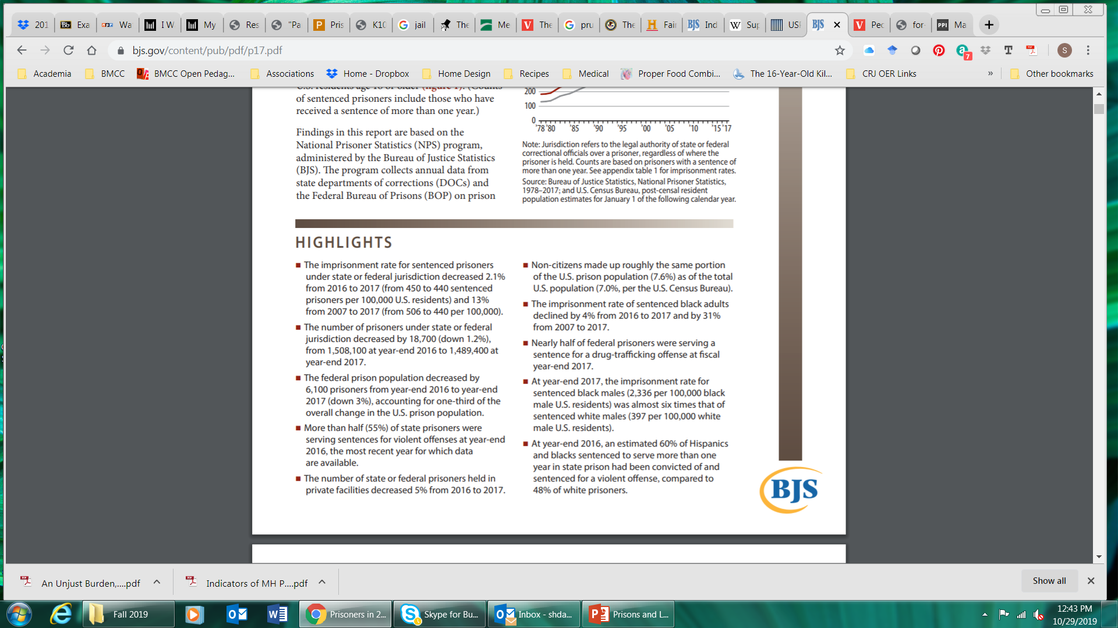

Slide 5
That’s #facts
The imprisonment rate for sentenced prisoners under state or federal jurisdiction decreased 2.1% from 2016 to 2017 (from 450 to 440 sentenced prisoners per 100,000 U.S. residents) and 13% from 2007 to 2017 (from 506 to 440 per 100,000).
More than a tenth (12%) of prisoners sentenced to more than one year in state or federal prison at year-end 2017 were age 55 or older.
At year-end 2017, an estimated 7% of white males in state and federal prison were ages 18 to 24, compared to 12% of black and 11% of Hispanic males.
More than 2% of black male U.S. residents were in state or federal prison on December 31, 2017 (2,336 per 100,000 black residents)
Black males ages 18 to 19 were about 12 times more likely to be imprisoned than white males of the same age. Tis age group had the highest black-to-white racial disparity in 2017.

Slide 6
That’s #facts
Black males age 65 or older were 4.5 times more likely to be imprisoned than white males age 65 or older.
The imprisonment rate for black females (92 per 100,000 black female residents) was almost double that for white females (49 per 100,000 white female residents).
Among females ages 18 to 19, black females were 4.4 times more likely than white females and 1.8 times more likely than Hispanic females to be imprisoned in 2017

Slide 7
That’s #facts
Twenty percent of federal prisoners (35,900 of 183,100) at year-end 2017 were non-U.S. citizens (excluding persons detained by the U.S. Department of Homeland Security).
Data from 45 states show that an estimated 69,300 non-U.S. citizens were held in public and private state prison facilities at year-end 2017.
Twenty-seven percent of sentenced non-U.S. citizens in state or federal prison were females.
At year-end 2017, a total of 13 states and the BOP met or exceeded the maximum capacity of their prison facilities, and 24 states and the BOP had a total number of prisoners in their custody that met or exceeded their minimum number of beds

Slide 8
Test your knowledge | Prisons
The incarceration rate in the U.S. remains the highest in the world.
Most incarcerated people serve out their sentence in max-security prisons.
What factors describe medium security prison? How is it similar to and different from max- and min-security facilities?
What are prisonization and importation in the prison context?

Slide 9
Concepts to cover for the Midterm
What is the idea of a total institution? How do these aspects affect the lives of incarcerated individuals?
What are the pains of imprisonment? In general, what influences the degree to which these pains are experienced by incarcerated individuals?
What are the various management/security levels in prisons? Why is the classification process important?
What factors determine where an individual will be incarcerated/placed?
What is prisonization? Who is affected by the process of prisonization (remember, officers are affected as well)?

Slide 10
Prison as a Total Institution

Slide 11
“His life in prison is the role of prisoner”
(Moerings, 1984. p. 156)
Total institution:
“a place of residence and work where a large number of like-situated individuals, cut from society for an appreciable period of time, together lead enclosed, formally administered round of life” (Goffman, 1961, p. xiii)

Slide 12
Prison as a Total Institution
…from morning bell to lights-out, is strictly regulated, with exact times for washing, eating, working, recreation, etc. There is hardly any room for individual initiative. Characteristic of a total institution is the complete dependence of the individual on the (prison) system.
All the important functions take place within it: sleeping, eating, working, recreation (insofar as one can speak of recreation in a prison), all take place within a single community and under the continental surveillance of wardens or other prison functionaries.
Furthermore, these activities are not separated from each other: A prisoner who has misbehaved in the workshop in the morning may still be reproached for it in the evening through the spy-hole cell (Moerings, 1983, p. 156).

Slide 13
Prison as a Total Institution
Goffman’s Total Institutions
  What is a total institution?
  What are their characteristics?
  To what extent are today’s prisons total institutions?
  What roles do various rites of passage and the entire dehumanization process play in prison operations and suggest about prisoner reentry?
  Related questions: What other kinds of institutions are total institutions? Are some a bit more and others a bit less total in their control? Why does it matter?

Slide 14
Disconnected
A barrier is placed between the “criminal” and society, marking “the first curtailment of self” (Goffman, 1961, p. 14).
Most total institutions have physical barriers such as visible gates and barbwire that separate the facility from the rest of the community. Others lack devices of division, but the separation between society and the institution is apparent through factors such as the remote location of facilities, identification of inmates as numbers, the presence of correctional officers, the stringent schedules, and the uniformity of the inmate attire.

Slide 15
Pains of Imprisonment

Slide 16
Pains of Imprisonment
“These deprivations of frustrations of the modern prison may indeed be the acceptable or unavoidable implications of imprisonment, but we must recognize the fact that they can be just as painful as the physical maltreatment which they have replaced” (Sykes, 1958, p. 64).

Slide 17
Pains of Imprisonment
Deprivation Model
Prison subculture develops as a way to adapt to deprivations faced by inmates:
  Liberty
  Goods and Services
  Autonomy
  Personal Security
  Relationships (absence of voluntary sexual relations)

Slide 18
Classification

Slide 19
Prison Organizations: Classification
Begins when first entering prison
What factors do you think correctional staff consider when assigning the classification level/status to individuals?
Based on numerous factors:
  Crime
  Criminal history
  Escape risk
  Behavioral issues
  Health and programming needs

Slide 20
Prison Organizations: Classification
Women and children classified into separate facilities from males
Individuals sent to facilities based on
  First-Supervision level
  Second-Space available
  Third-Specific treatment/program needs
  After time, may request to transfer to specific facilities

Slide 21
Classification
Reception center personnel review assessment materials and conduct additional tests and observations regarding level of dangerous and amenability to treatment.
Staff must assign inmates to the least-restrictive security level possible to provide safety of the community at large, the staff, and other inmates.
The system must incorporate the assessment of needs on a regular and recurring basis, while not excusing inmates from responsibility for their own behavior.
Staff members should encourage prosocial change by extending positive incentives to those individuals who exhibit control over their own behavior.

Slide 22
Prison Organizations: Prison Types and Levels
Prisons used for long-term and people convicted of more serious offenses
  Simultaneously utilizes numerous philosophies and justifications for punishment
As numbers expanded, diversity has increased
Institutional goals: What’s the difference? What is the primary responsibility?
  Custody
  Treatment

Slide 23
Types of Prisons
Security levels
  Supermax security – approx. $50K per year
  Maximum security
  Medium security
  Minimum security
Men
Women
Children
Military personnel
Prisons
Prison farms
Prison hospitals
Boot camps
Reception centers
Community corrections facilities

Slide 24
Supermax Prison – Administrative Maximum Security Unit
What is a federal supermax prison?
How did they get there?
Who are they?

Slide 25
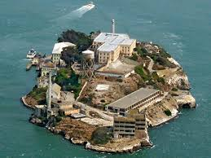
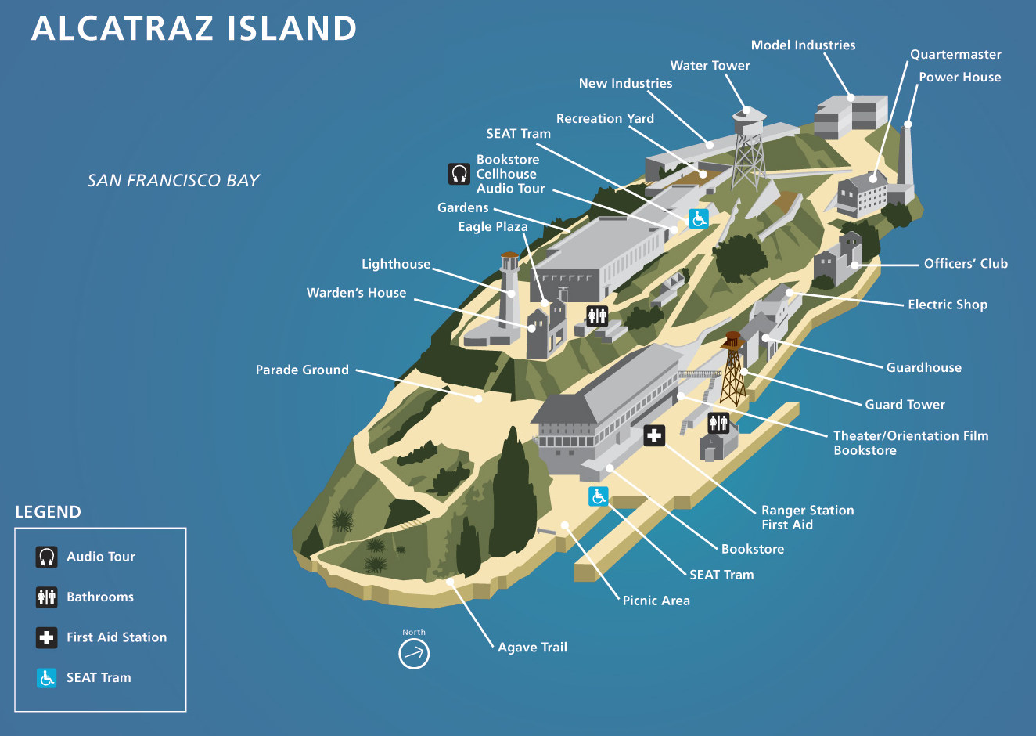
Alcatraz, San Francisco Bay
Military prison (1868)
Federal prison (1934-1963)
Supermax
Holds most dangerous and disruptive individuals
Confined in windowless cells 24 hours per day, except for showers (3 x per week)
Physical contact is prohibited unless restrained
Food – nutraloaf
Notes:
https://www.history.com/topics/alcatraz

Slide 26
Prison Types and Levels: Supermax Prisons
Arguably first was Alcatraz Prison (1934-1963)
Other facilities
  Federal
    Marion, IL (1963)
    Florence, CO (1994)
  States
    Began building in 1980s and 1990s
    44 states as of 2004 have some form
Existence is to serve as general deterrent
Incarceration costs more expensive
  Heightened security
  Material costs
'The architecture is the control’:
23 hours a day alone in 7-by-12-foot concrete cells.
Meals are slid through small holes in the doors.
Bed is a concrete slab dressed with a thin mattress and blankets.
Notes:
Life in supermax https://www.cnn.com/2015/06/25/us/dzhokhar-tsarnaev-supermax-prison/index.html

Slide 27
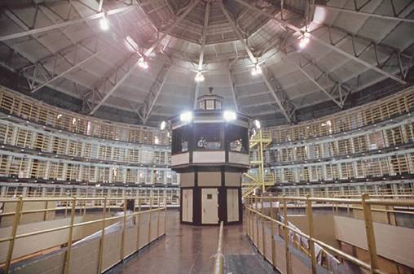
Administrative Maximum Unity Prison (ADX) Colorado
Notes:
ADX was designed to replace Alcatraz in 1963, and when it opened in 1994 it took imprisonment to a whole new level. The prison strictly enforces repressive techniques of isolation and sensory deprivation. Those incarcerated are only allowed out of their cells for nine hours each week, and all prisoners are required to eat, sleep and defecate in their cells. They even go so far as to severely limit the amount of sunlight and artificial light received by inmates, and it’s described as being locked in your bathroom for 22 hours a day.
The worst part: There is almost complete and total lack of human interaction. The steel and cement cages effectively destroy any possibility of communication between the prisoners, and even contact with guards is extremely limited. "These guys will never be out of their cells, much less in the yard," says Russ Martin, the Florence prison project manager. Oscar Lopez Rivera, a prisoner of war, states: "Isolation is perfected here, both in the structure of the cell and in the very limited communication. People don't realize the value of human intercourse until it's denied."

Slide 28
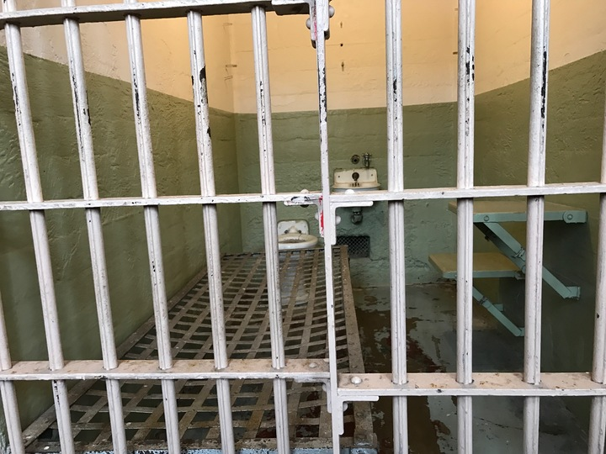

Slide 29
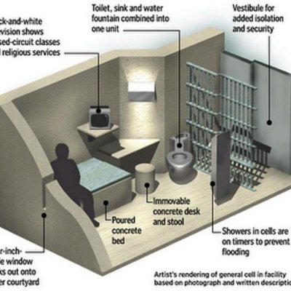
Notes:
https://twitter.com/usprisons

Slide 30
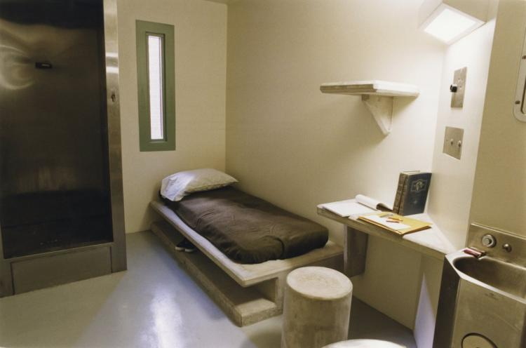
Notes:
https://carrington.edu/blog/administrative/anatomy-of-a-supermax-prison/
In Colorado
https://www.mysanantonio.com/news/local/slideshow/Photos-show-the-Supermax-prison-in-Colorado-189962/item-85307.php

Slide 31
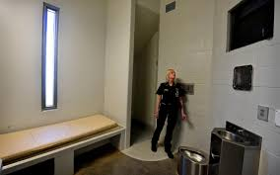

Slide 32
Maximum Security Prison
What is a maximum security prison?
How did they get there?
Who are they?

Slide 33
Maximum Security Prison
People who committed most serious offenses
Unable to handle or manage in a less restrictive environment
People on death row
  Usually housed in a separate building with assigned staff
Incarcerated for most hours of the day; however, some programming is made available
  Access to the yard
  Cafeteria
  Chapel
May or may not be double bunked
Visits and contact are permitted, not held in restraints

Slide 34
Medium Security Prison
What is a medium security prison?
How did they get there?
Who are they?

Slide 35
Medium Security Prisons
People who committed different type of crimes (murder to drugs)
Exterior may resemble higher level of security facility
Interior, permits more movement
Resemble a college campus with several buildings
  Attend school
  Treatment programming
  Church
  Work (mostly industrial work)
Dorm style, singles cells, double-bunked
Visiting and contact are less restrictive
May permit individuals to leave for work

Slide 36
Minimum Security Prison
What is a minimum security prison?
How did they get there?
Who are they?

Slide 37
Minimum Security Prison
Much more relaxed security
More programming and work options
Diverse housing options
Inmates can roam more freely during prescribed times
Visiting options more liberal
Work is promoted

Slide 38
Security Levels
Minimum Security
Least restrictive form of custody
Maximum
Greatest internal and external security
Razor wire, walls, lights, cameras, armed guards, attack dogs on patrol
Medium
Restrictive external security, more relaxed internal security
More serious crimes, those unable to conform to medium or min security
Unable to control behavior
Death row
May be double bunked, usually some access to the yard, cafeteria, and yard
More opportunities to attend school, treatment, religious festivities, programming
House people who have committed various levels of crimes
College campus interior with several buildings
Involved in industrial work
Soon to be released
Not likely to be an escape risk
External security may not have wall or fence
Provided with additional programming, may be a work release setting

Slide 39
Prison Value?
Prison very expensive
Governments spend at least $20,000 per year for adults
  More than that double for women and children
Cost not always considered by policy makers
Consideration given to achieving goals of punishment
Measuring whether prison has desired effect is not always obvious or easy
Any positive value must be assessed based on what is desirable outcome

Slide 40
Prison Location
Most early prisons tend to be located in remote areas of the state, away from metropolitan areas.
Some are in urban areas especially if the prison itself houses individuals with serious medical needs or provides other such specialized services.

Slide 41
Coping strategies to the pains of imprisonment:
Prisonization
Importation
Mortification

Slide 42
Individual Responses to Prison
Prison culture is not distinct or even greatly different from the culture in free society (Clemmer, 1958, p. 86).
Mortification: Suffer from the loss of the many roles s/he occupied in the wider world.
Importation: To bring or import aspects of his or her own culture from the outside world, such as values, roles, and behaviors.
Prisonization: Adopt the “inmate subculture” of the institution
Notes:
Also referred to as the indigenous model of prison culture.
The pains of imprisonment is a term that refers to the various inconveniences and deprivations that occur as a result of incarceration:
The loss of liberty
The loss of goods and services readily available in society
The loss of heterosexual relationships, both sexual and nonsexual
The loss of autonomy
The loss of personal security
With the loss of liberty, inmates’ ties are severed from family, relatives, and friends. Inmates within the institution Sykes (1958) studied (New Jersey State Prison) stated that their outside connections weakened as the months and years passed. For example, 41 percent of the prisoners received no visits in a one-year period. The lack of outside contact may result in feelings of deprivation, frustration, loneliness, and boredom (Sykes, 1958). The loss of material goods and intimate heterosexual relationships makes it increasingly difficult for inmates to define themselves. The loss of material goods and services represents the loss of self. Stripping an inmate of his material possessions removes his individuality. Material deprivation is equated with personal inadequacy (Sykes, 1958). The imprisoned man is unable to interact with those individuals and goods that inform and give his social role meaning (Goffman, 1961; Sykes, 1958). In order to manage the deprivations caused by imprisonment Sykes (1958) found that inmates adapted to prison life by acquiring various roles specific to the prison in an “attempt to reduce the rigors of prison life at the expense of fellow prisoners and the individual pursues his own interests, his own needs, without regard for the needs, rights, and opinions of others” (Sykes, 1958, p. 107). Adaptation strategies centered on physical escape, psychological withdrawal, rebellion, or innovation.

Slide 43
Deprivation vs. Importation
Deprivation Model
Prison subculture develops as a way to adapt to deprivations faced by inmates:
  Liberty
  Goods and Services
  Autonomy
  Personal Security
  Relationships
Importation Model
Incarcerated people bring values, roles, and behaviors with them from the outside world when they enter prison.
In other words, the prison subculture is reflective of the subculture on the streets.
Behaviors respected behind the walls of a prison are similar to behaviors respected among the criminal population outside of the prison.
Notes:
Also referred to as the indigenous model of prison culture.
The pains of imprisonment is a term that refers to the various inconveniences and deprivations that occur as a result of incarceration:
The loss of liberty
The loss of goods and services readily available in society
The loss of heterosexual relationships, both sexual and nonsexual
The loss of autonomy
The loss of personal security
With the loss of liberty, inmates’ ties are severed from family, relatives, and friends. Inmates within the institution Sykes (1958) studied (New Jersey State Prison) stated that their outside connections weakened as the months and years passed. For example, 41 percent of the prisoners received no visits in a one-year period. The lack of outside contact may result in feelings of deprivation, frustration, loneliness, and boredom (Sykes, 1958). The loss of material goods and intimate heterosexual relationships makes it increasingly difficult for inmates to define themselves. The loss of material goods and services represents the loss of self. Stripping an inmate of his material possessions removes his individuality. Material deprivation is equated with personal inadequacy (Sykes, 1958). The imprisoned man is unable to interact with those individuals and goods that inform and give his social role meaning (Goffman, 1961; Sykes, 1958). In order to manage the deprivations caused by imprisonment Sykes (1958) found that inmates adapted to prison life by acquiring various roles specific to the prison in an “attempt to reduce the rigors of prison life at the expense of fellow prisoners and the individual pursues his own interests, his own needs, without regard for the needs, rights, and opinions of others” (Sykes, 1958, p. 107). Adaptation strategies centered on physical escape, psychological withdrawal, rebellion, or innovation.

Slide 44
Prisonization: A coping strategy

Slide 45
Prisonization
The process of being socialized into the prison culture.
This process occurs over time as the inmate or correctional officer adapts to the informal rules of prison life.
Prisonization impacts both inmates and staff.

Slide 46
Prisonization
The process of being socialized into the prison culture.
Incarcerated people become alienated from conventional life and the larger society and participate in the “the taking on in greater or less degree of the folkways, mores, customs, and general culture of the penitentiary,” which includes,
    acceptance of an inferior role, accumulation of facts concerning the organization of the prison, the development of somewhat new habits of eating, dressing, working, sleeping, the adoption of local language, the recognition that nothing is owed to the environment for the supplying of needs, and the eventual desire for a good job…(Clemmer, 1958, p. 299-300)

Slide 47
Prisonization
Most likely to occur with those who –
  Are serving a long sentence
  Have an unstable personality originating outside the prison walls
  Lack positive relationships outside the prison
  Exhibit a readiness and capacity for integration into the inmate subculture
  Accept the inmate code as a reflection of the subculture’s norms and values
  Live in the same cell or in close proximity with others of like persuasion
  Participate in gambling

Slide 48
Adaptive Behaviors
Doing time
  “temporary break in their careers, one which they take in stride”
  Keep busy, pass the time, keep out of trouble
Jailing
  Prison is home; raised as wards of the state
  Went from “my parents telling me what to do, to the state telling me what to do”
Gleaning
  Using the opportunity to take advantage of programs; time for self-improvement

Slide 49
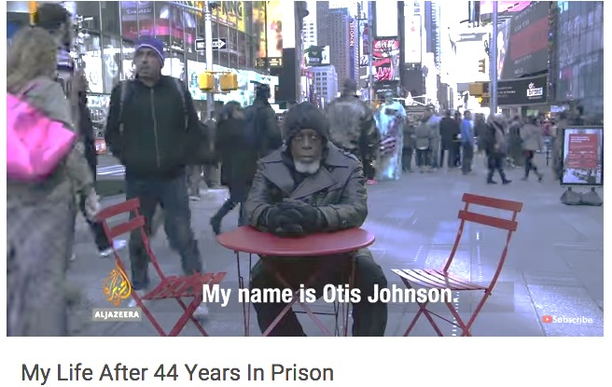
Notes:
https://www.youtube.com/watch?v=OrH6UMYAVsk

Slide 50
Test your knowledge | Prisons
TRUE. The incarceration rate in the U.S. remains the highest in the world.
FALSE. Most incarcerated people serve out their sentence in max-security prisons.
What factors describe medium security prison? How is it similar to and different from max- and min-security facilities?
  Exterior similar between max and medium
  More movement permitted in minimum security
  Visiting and contact less restrictive
What are prisonization and importation in the prison context?
  Importation – bring in
  Prisonization – adopt

Slide 51
Prison Subculture

Slide 52
Prison Subculture
Newly incarcerated people undergo a process of prisonization, through which they learn the values, attitudes, roles, and language that make up the prison subculture.
Prison staff are not immune to the prison subculture.
Correctional staff interact with offenders on a daily basis.
  A sense of understanding develops both among correctional staff and between staff and the inmate population.

Slide 53
Prison Subculture
Subset of culture with its own norms, values, beliefs, traditions, and even language of the prison.
Inmate Roles –
The right guy
The rat or squealer
The center man
The tough
The gorilla
The merchant or peddler
The weakling
The fish
The wolf
The punk
The square john

Slide 54
The Code Behind the Wall/“Inmate or Convict Code”
A set of standards in behavior attributed to those who have proven themselves and earned the respect of other incarcerated individuals.
Set of beliefs that incarcerated people live by.
  Emphasizes oppositional values to conventional society in general and to prison authorities in particular.
  The most serious infraction against this code is for an inmate to cooperate with the officials as a snitch.
  Snitches are more commonplace in modern prisons.

Slide 55
Respect
This fundamental issue is paramount among inmates.
  Respect represents inmates’ sense of masculine standing within the prison culture.
If a person is disrespected, they are honor-bound to avenge that disrespect, or they are considered weak by other inmates.
  Any failure to preserve their sense of respect will lead to a question of inmates’ manhood and their ability to handle prison, and will lead others to think that they are perhaps weak.

Slide 56
What is the “Inmate Code?”
Never interfere with the interests of other inmates. Do not betray other inmates.
Don’t lose your head. Play it cool.
Don’t exploit other inmates. Keep your word.
Don’t be weak (you will be taken advantage of).
Punish violators quickly and severely.

Slide 57
Unique Challenges: Elderly Population
The cost of incarceration increases to accommodate the extra medical care needed to maintain older people.
Less able to work in, or for, the prison, making them a further economic drain.
May require housing that is separate from younger inmate who may prey on them.
Less likely to have supportive family or friends waiting for them on the outside, which make reintegration more challenging.

Slide 58
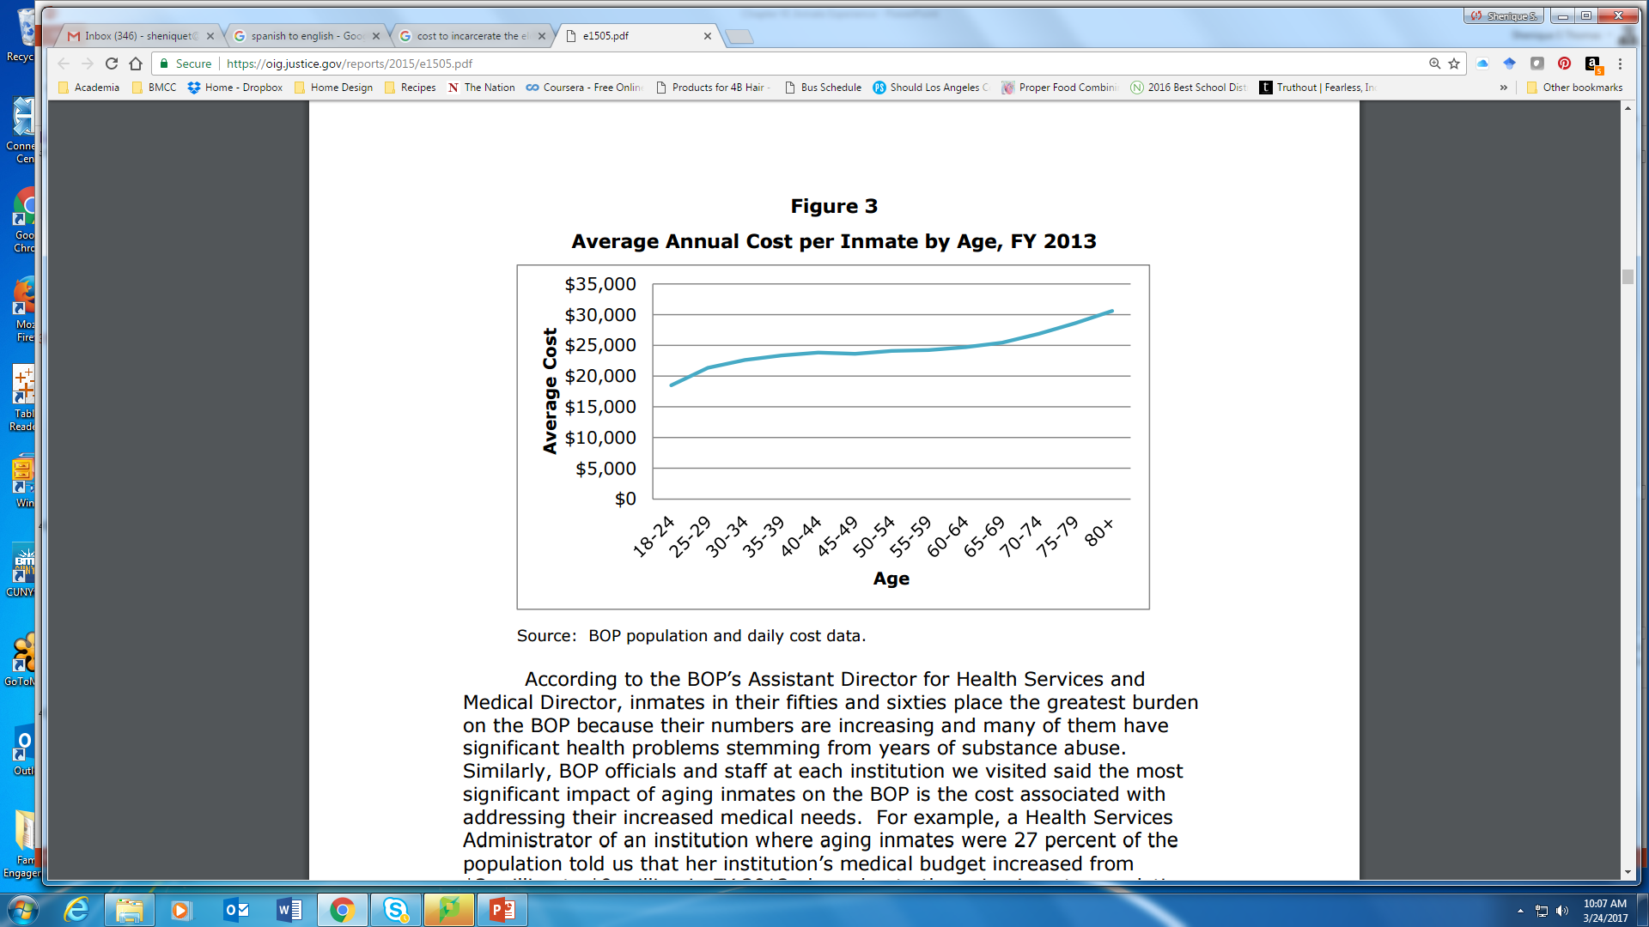
Impact of an Aging Population on the Federal Bureau of Prisons (2015)
Notes:
For example, in FY 2013, the average aging inmate cost $24,538 to incarcerate, whereas the average younger inmate cost $22,676. We also found that average cost per inmate rises with age, with the 8,831 inmates age 18 to 24 costing an average of $18,505 each and the 157 inmates age 80 and older costing an average of $30,609 each. While the aging inmate population represents only 19 percent of the BOP’s total population, the costs to incarcerate them are increasing at a faster rate than for younger inmates. For example, the cost of incarcerating aging inmates grew 23 percent, from $715 million in FY 2010 to $881 million in FY 2013, while the cost of incarcerating younger inmates grew 3 percent, from $3.5 billion to $3.6 billion over the same period.
https://oig.justice.gov/reports/2015/e1505.pdf

Slide 59
Unique Challenges
Initial considerations:
  Booking name
  Forms of address
  Searches
Policies and Practices
  Housing assignments: protective custody/segregation unit or general population
    May be classified according to the current gender identity and housed accordingly
Notes:
http://www.nytimes.com/2015/09/25/us/ashley-diamond-transgender-inmate-out-of-prison-but-not-fully-free.html
Conjugal visits: States include – CA, CT, MS, NM, NY, WA

Slide 60
Unique Challenges
Other forms of victimization
  Sexual victimization
  Publicly ridiculed
  Housing
  Treatment by staff
Specialized medical needs
  Needs of those undergoing sex reassignment surgery (SRS)
  Hormone treatments
  No legal authority must assist with completing SRS, however, rules have been developed to respond to the vulnerability associated with the LGBT population
    Training of staff on how to conduct respectful searches
    Cannot be assigned to a housing unit solely on anatomy
    Provided with the opportunity to shower separately
Notes:
http://www.nytimes.com/2015/09/25/us/ashley-diamond-transgender-inmate-out-of-prison-but-not-fully-free.html

Slide 61
Riots

Slide 62
Assignment
Research prison riots that have occurred in the U.S. since 1970.
  What were the incarcerated fighting for?
  Length of the riot
  How did they riot?
  How did the riot end?
Type up and bring to class information on two prison riots.
  1 paragraph each

