Slide 1
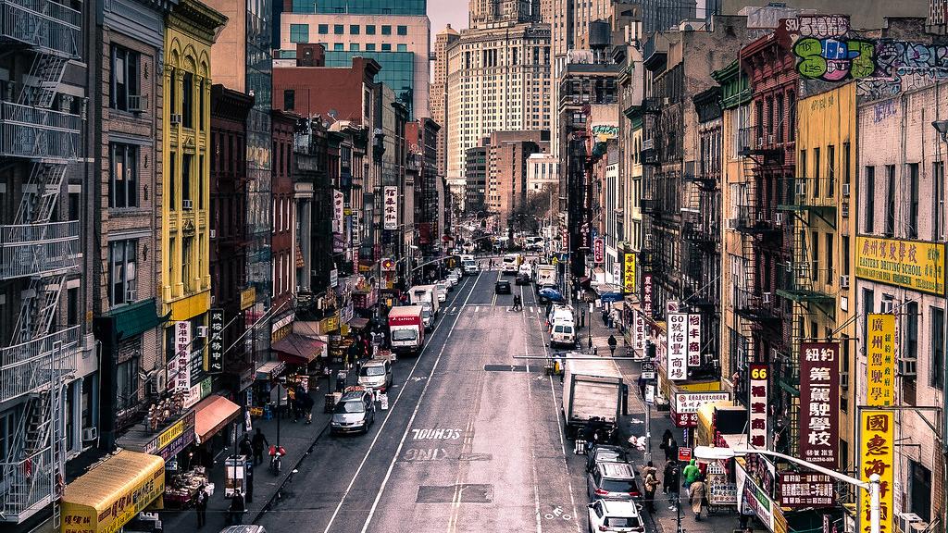
Chinatown Gentrification
By David Zheng
This Photo by Unknown Author is licensed under CC BY

Slide 2
What is Gentrificaiton
-A group of wealthier people moving into an area and displacing the old population.
Tourism Gentrification
- Defined as process of socio-spatial change in which neighborhoods are transformed according to the needs of affluent consumers, residents and visitors alike

Slide 3
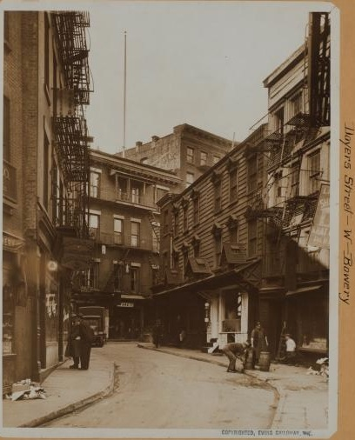
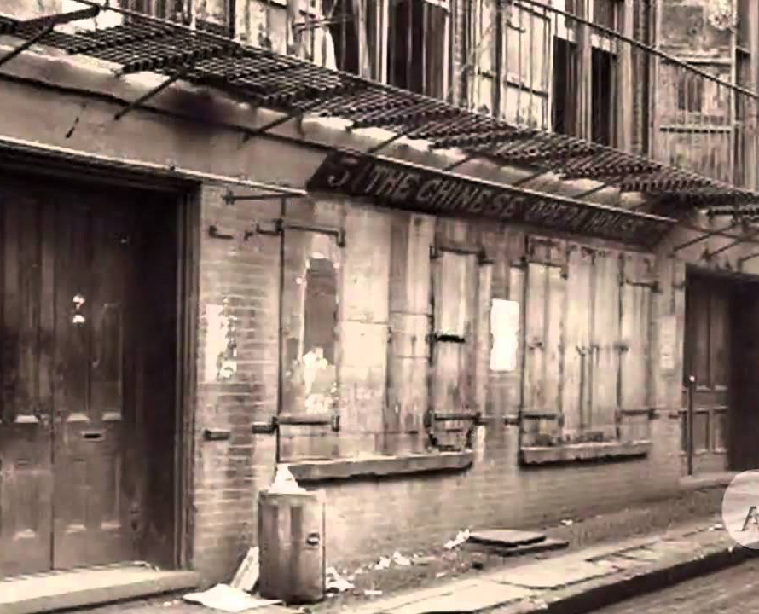

Slide 4
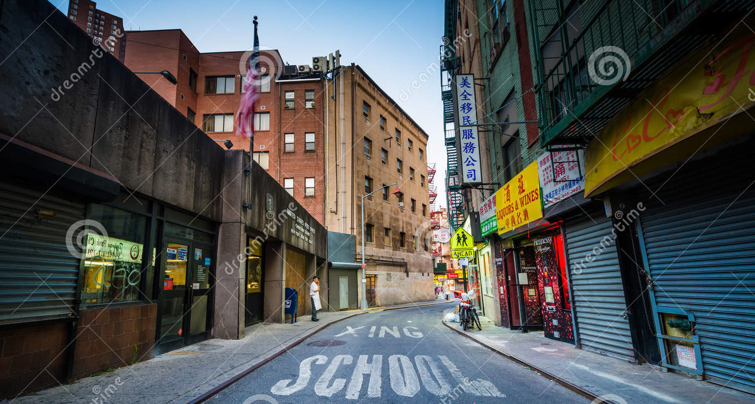
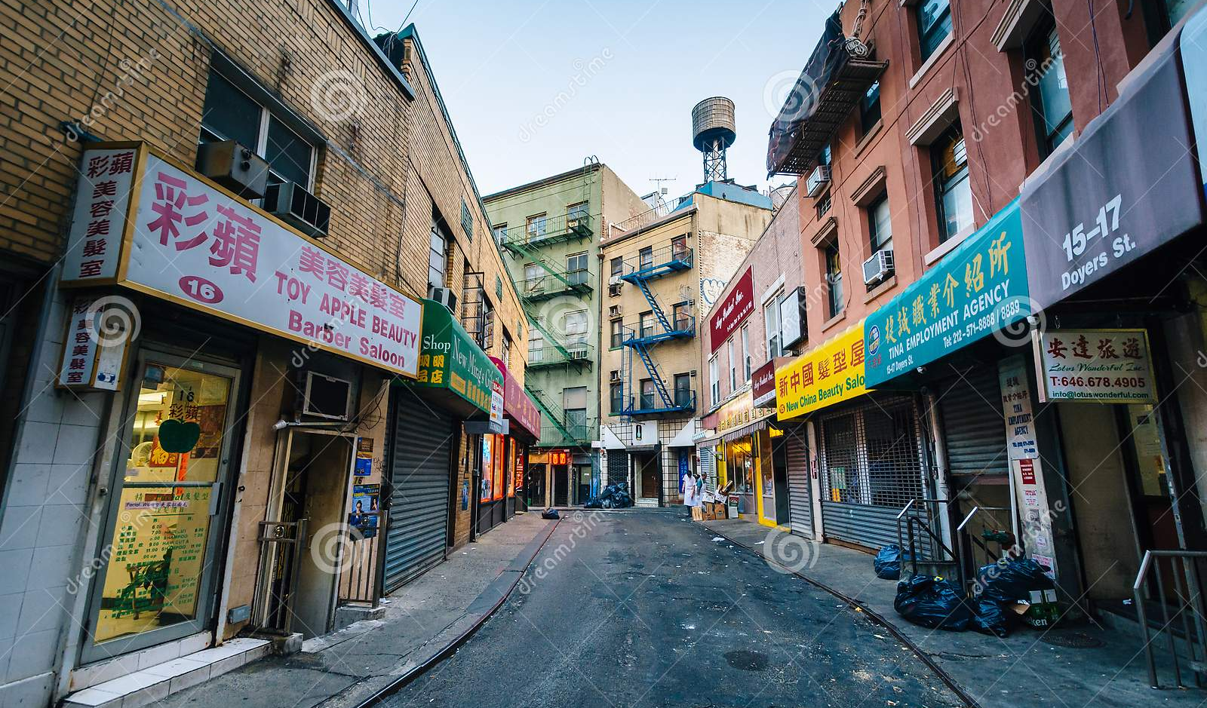

Slide 5
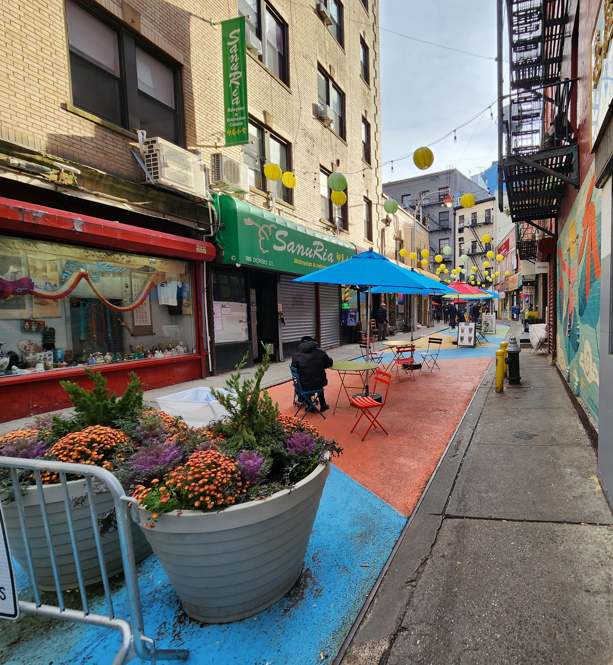
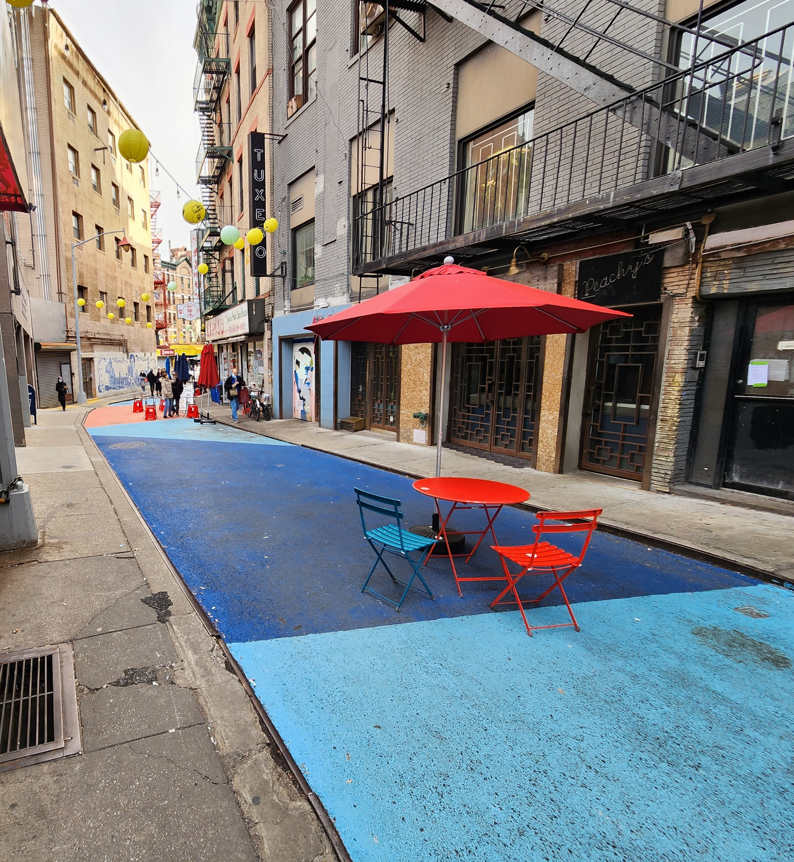

Slide 6
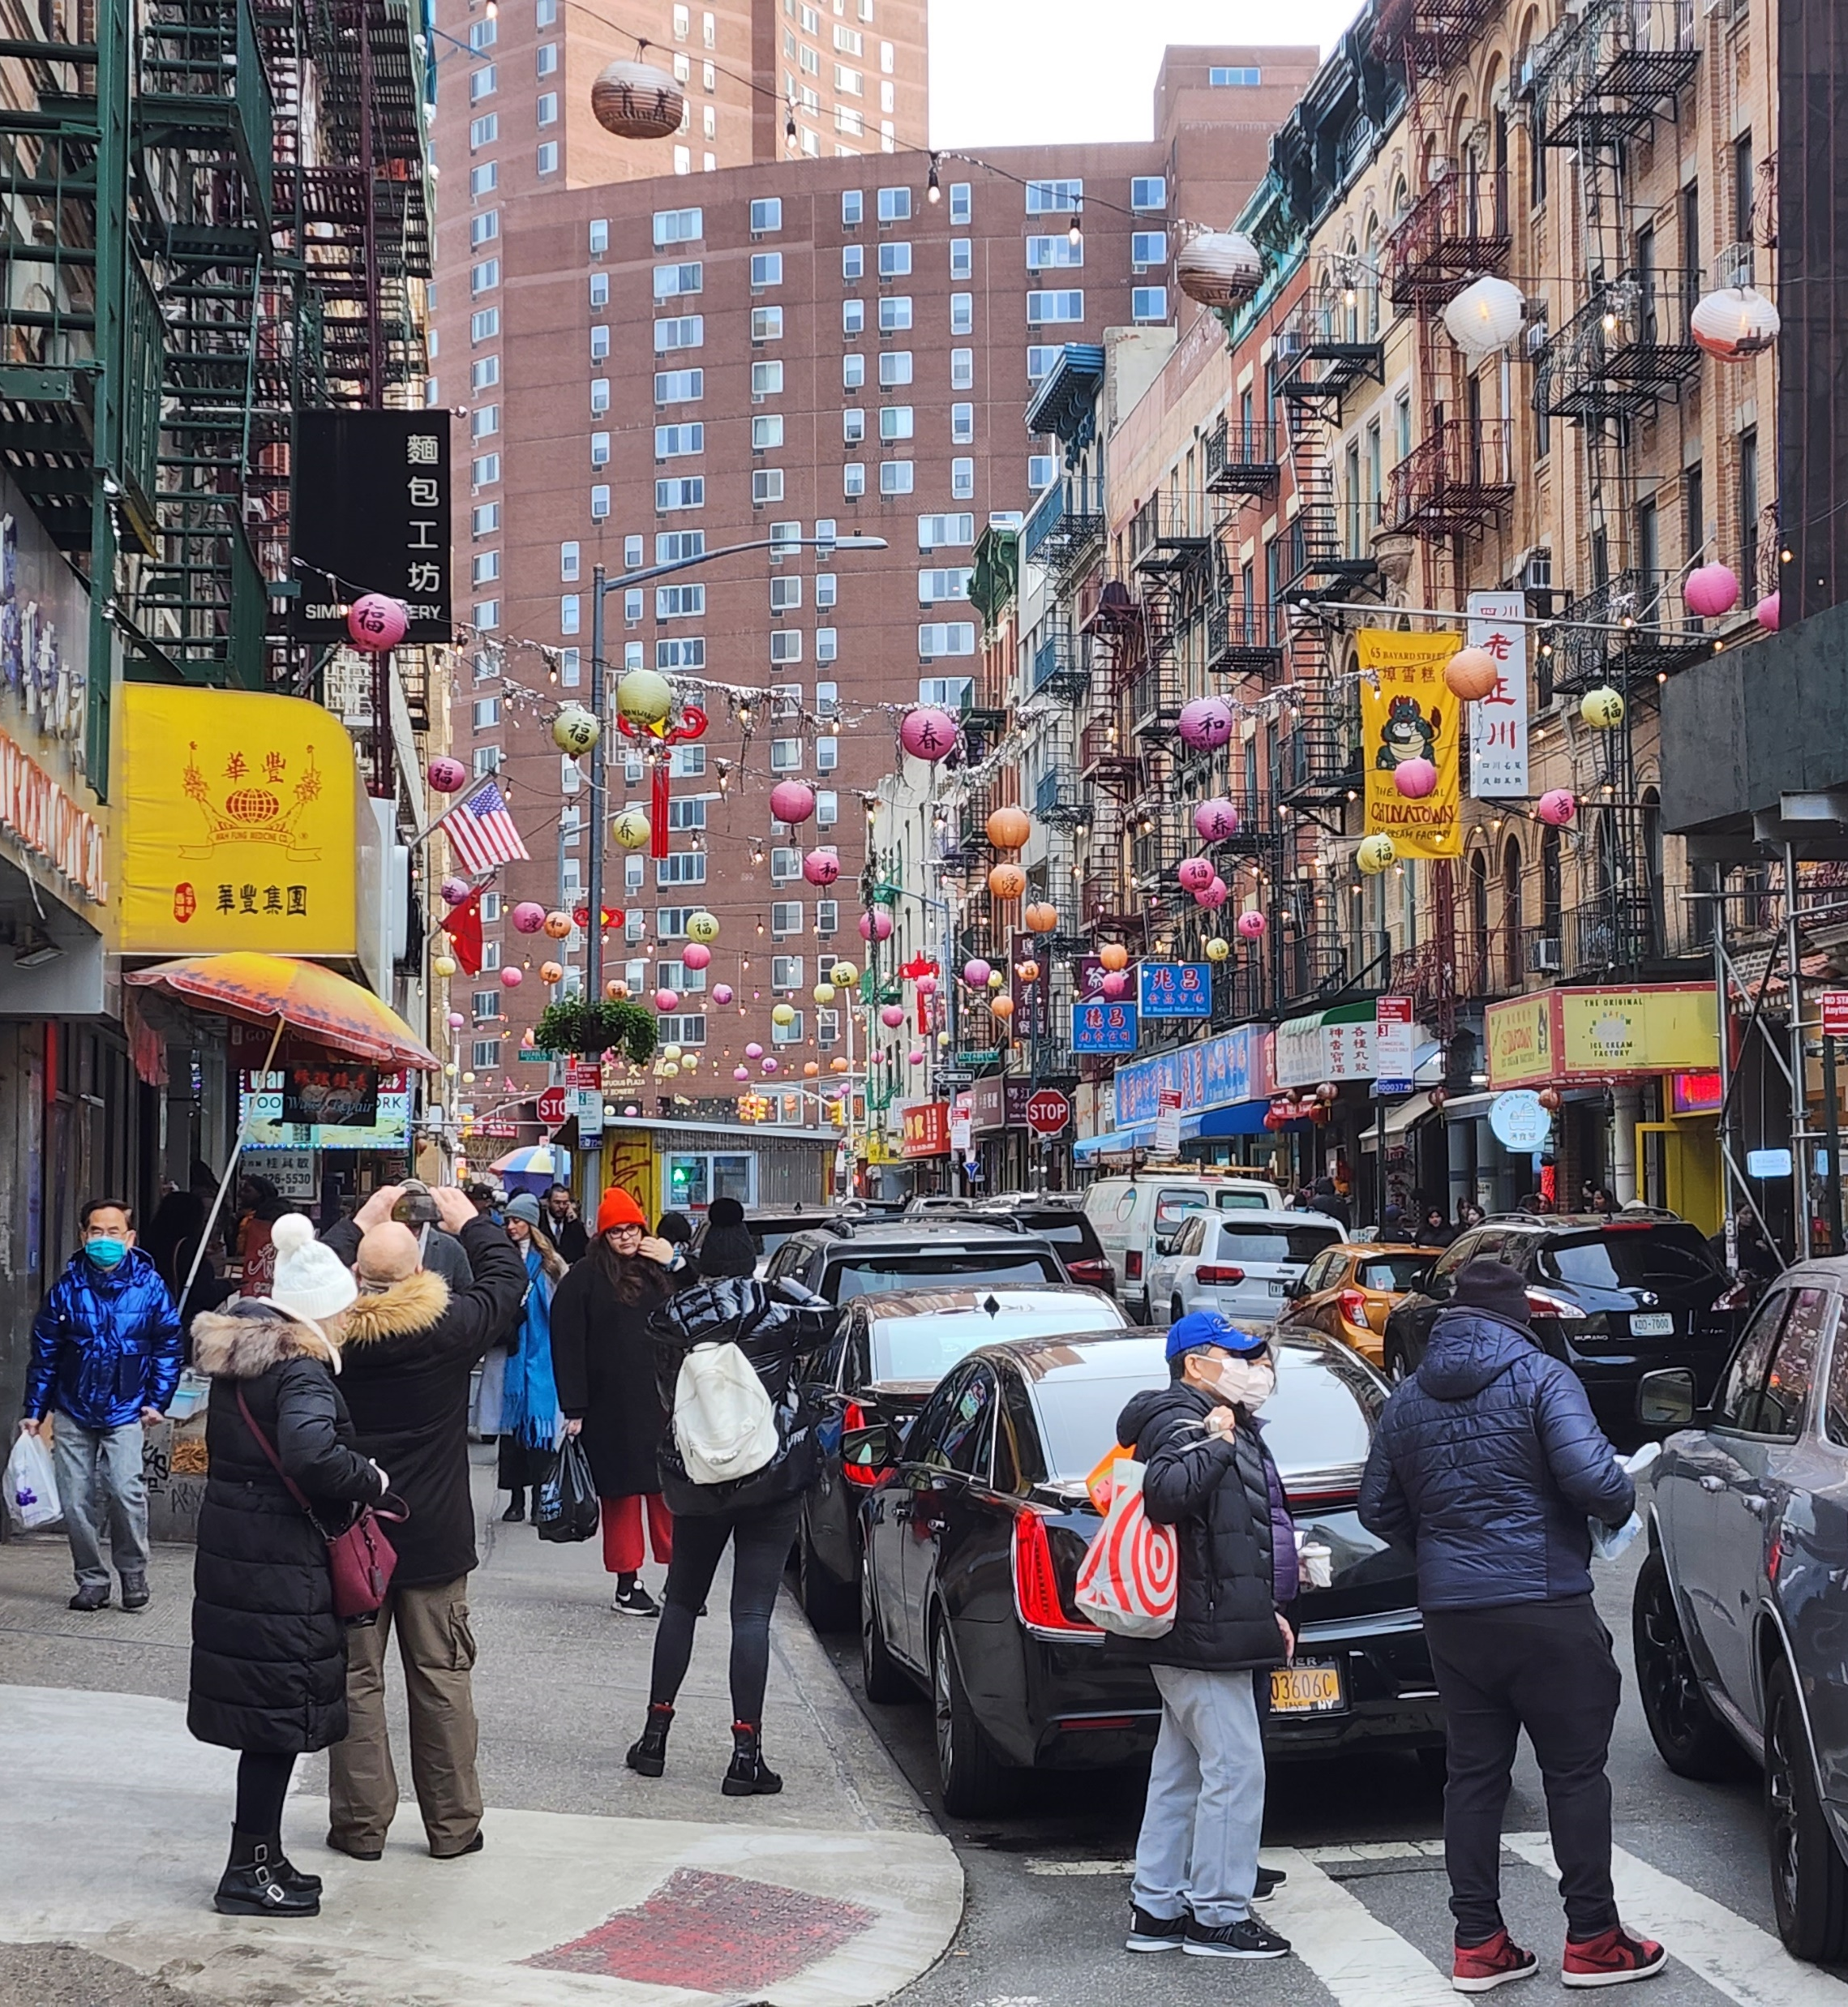
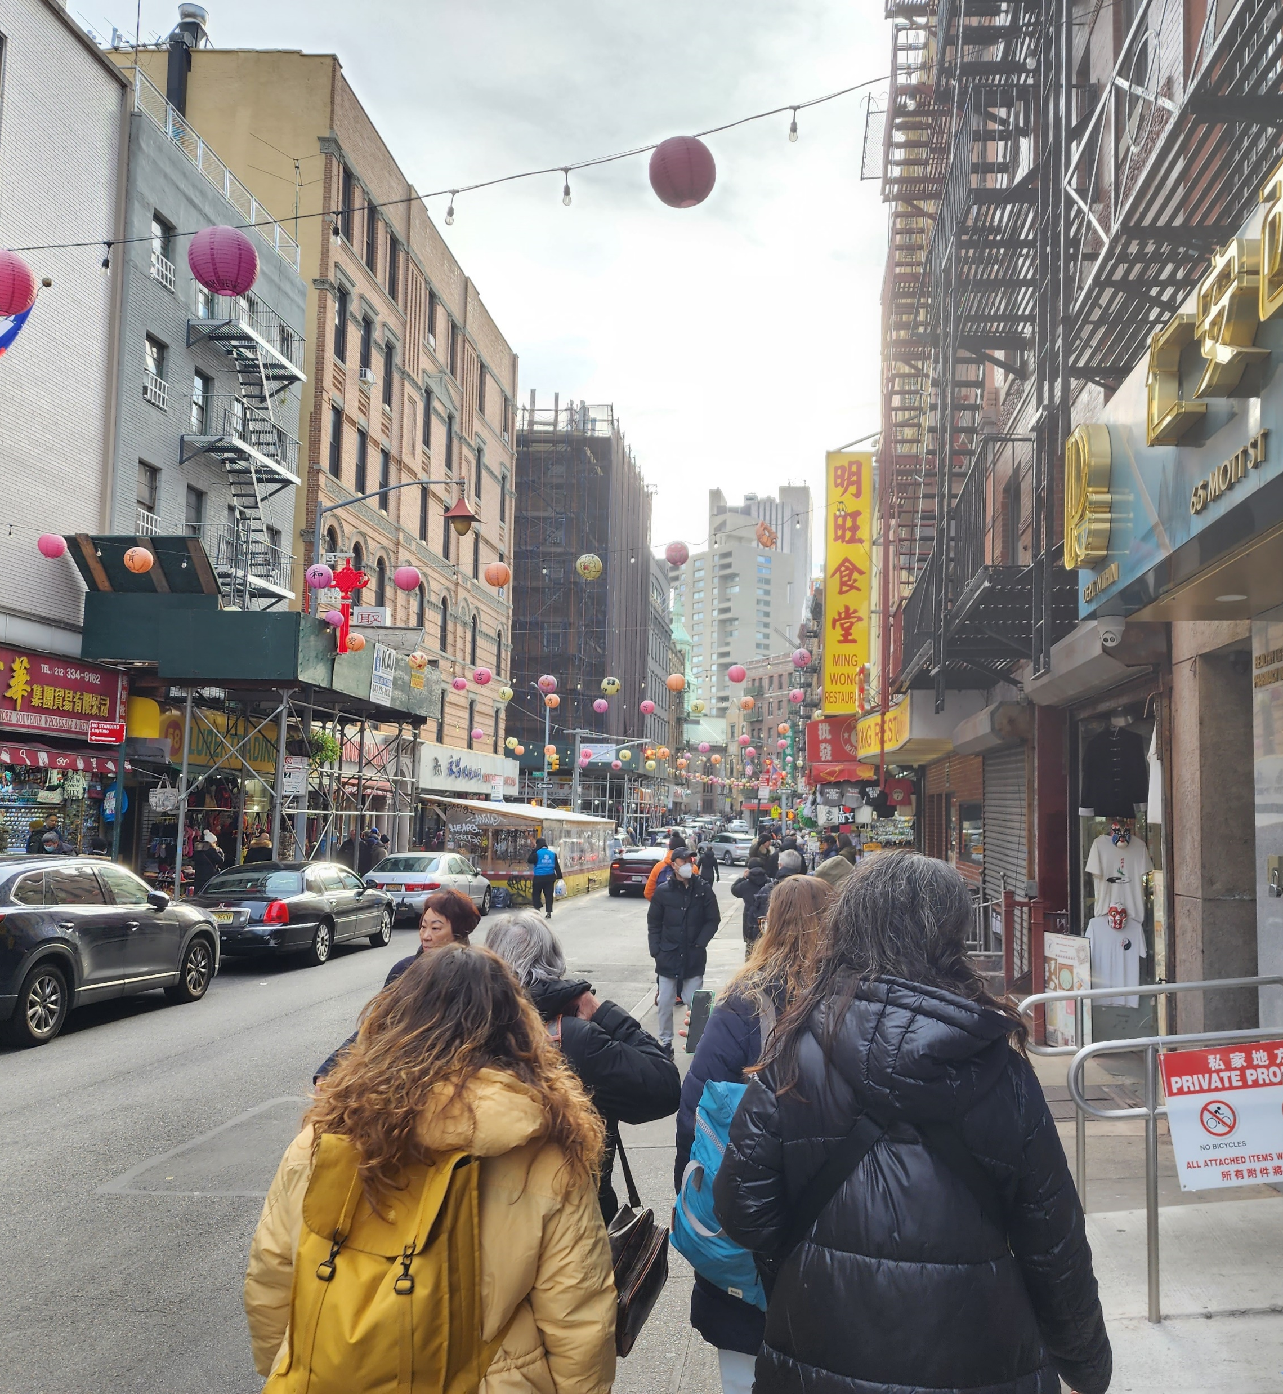

Slide 7
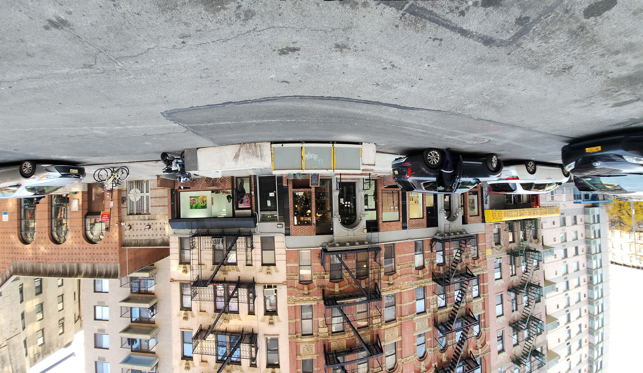

Slide 8
Statistics

