Slide 1
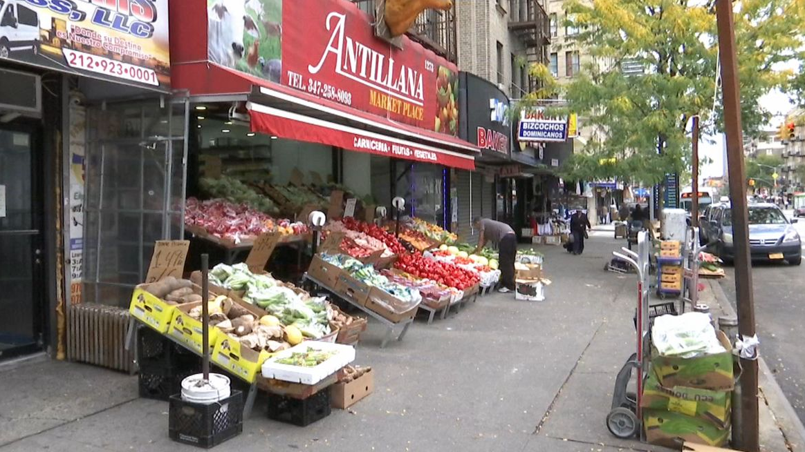
Washington Heights
By: Bryan Urgiles

Slide 2
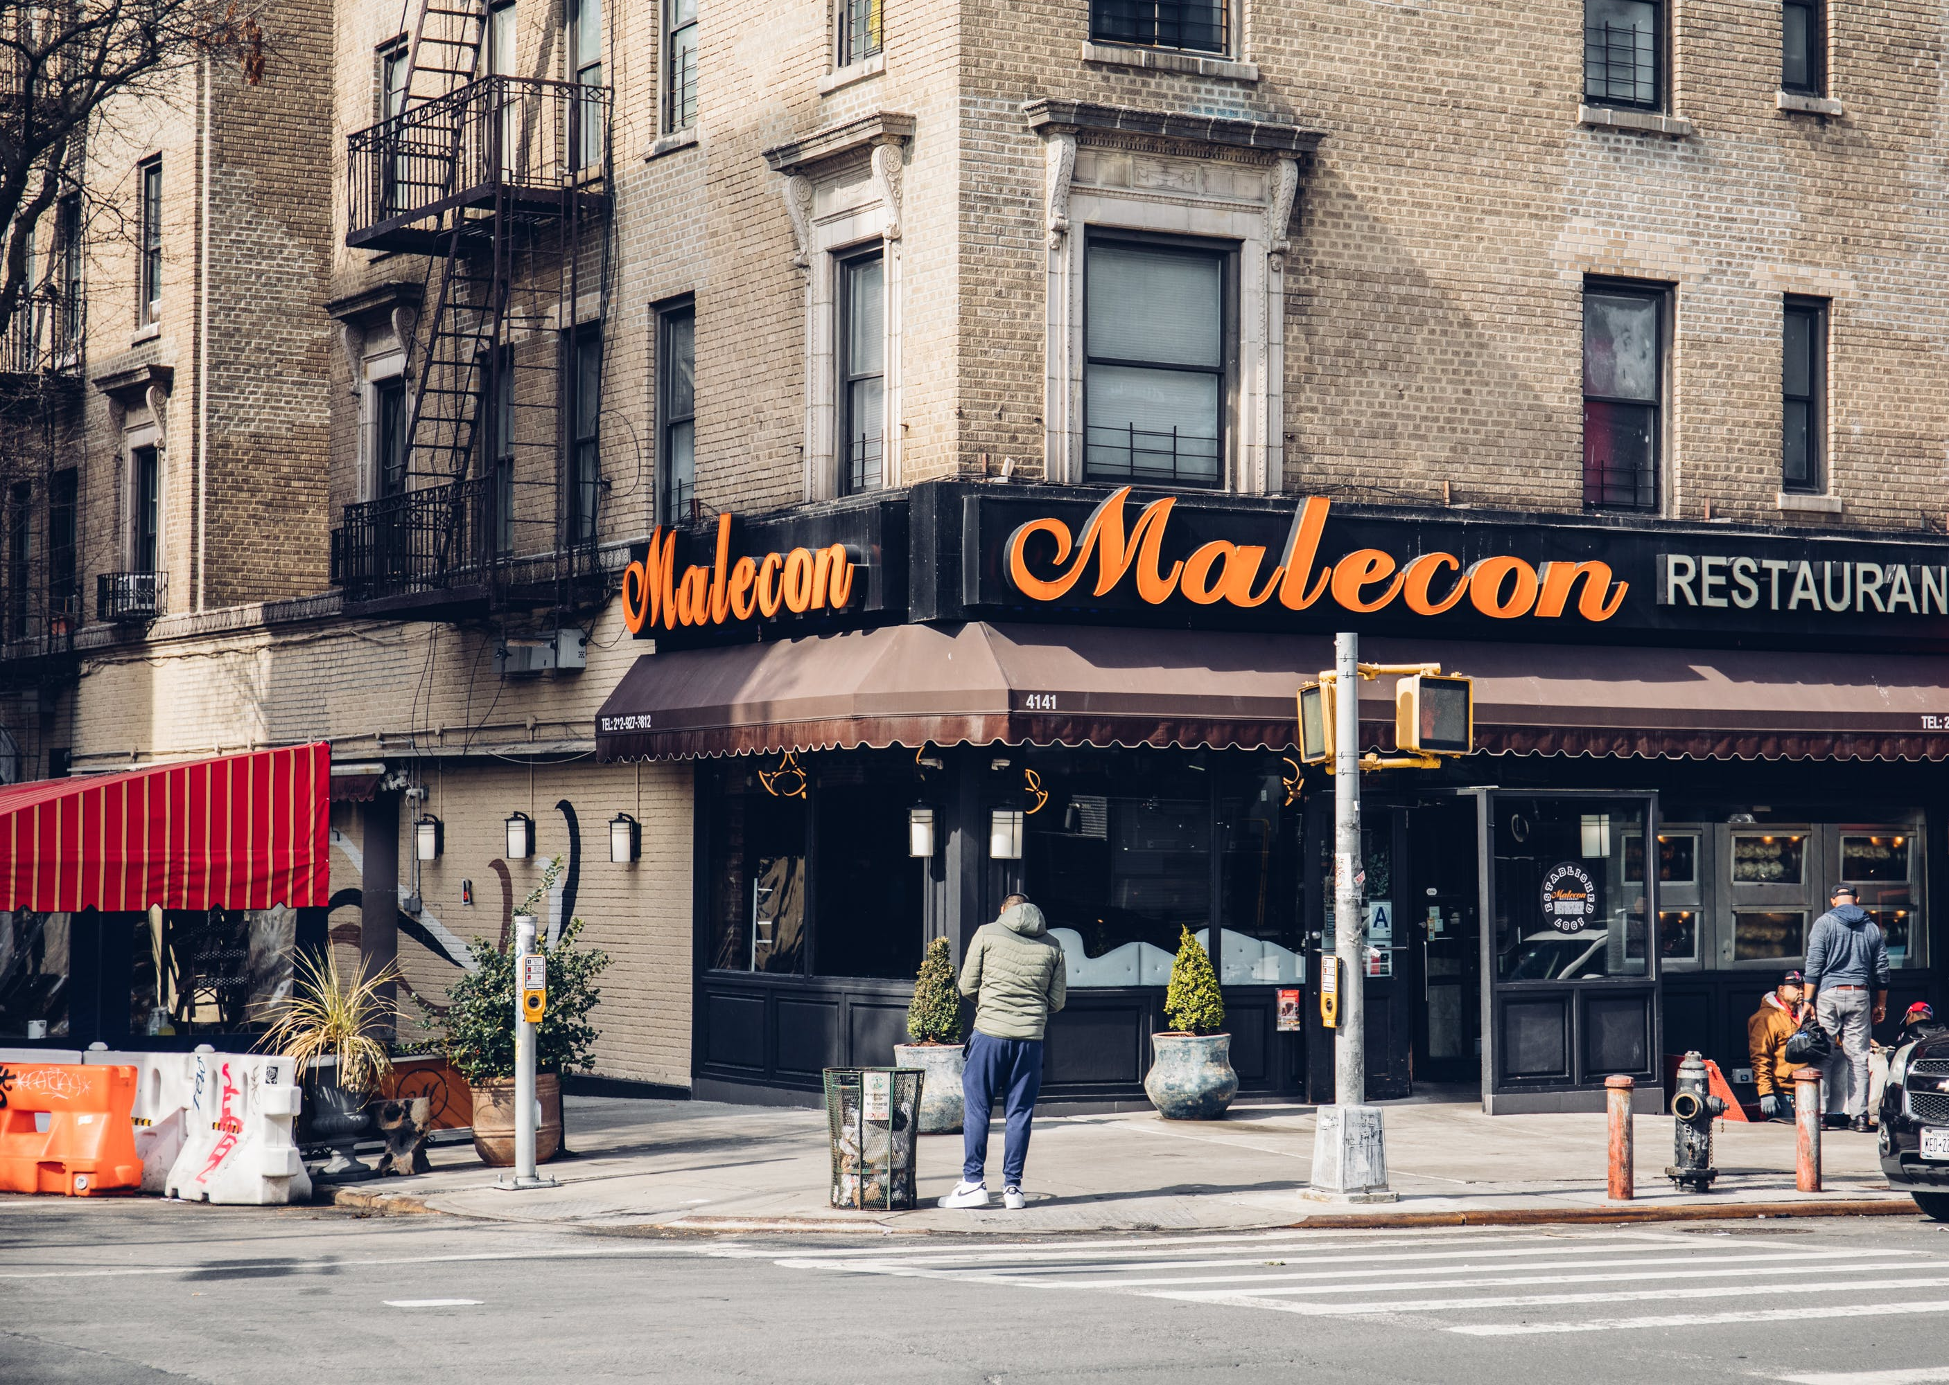
The population in Washington Heights is 143,879.
Starts from 155th street of the south all the way to Inwood and Dyckman Street.
Train to go around are A, C, and the 1, and buses are M100, M101, M3, M4, M5 and the M2.
Taxi bases are around the area transporting people Uptown and Downtown.

Slide 3
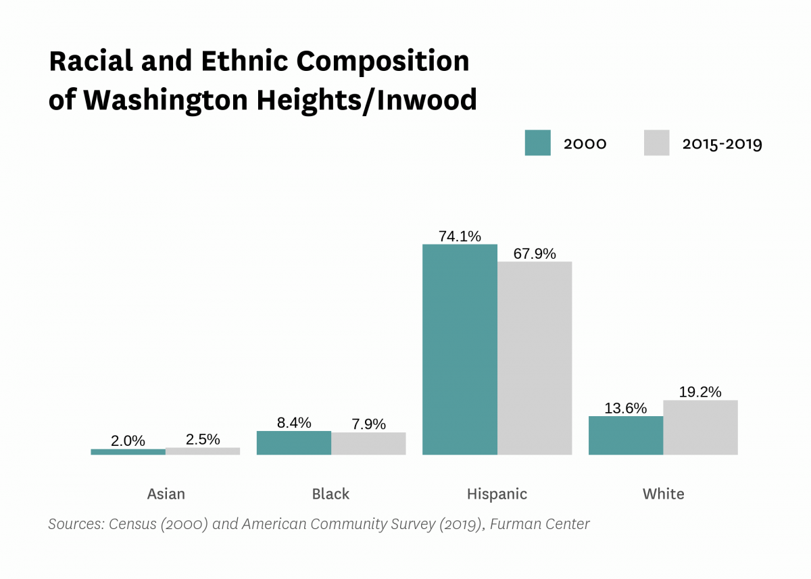
Both of the Census from 2000 and 2015-19 the Hispanic population had dominated with having a 74.1% and later having a 67.9%.
Asian population having the lowest with one year having 2.0% and the following having a 2.5%.
The Black and white population are in the middle with the Black population having a 7.9% and the white population having a 19.2%.

Slide 4
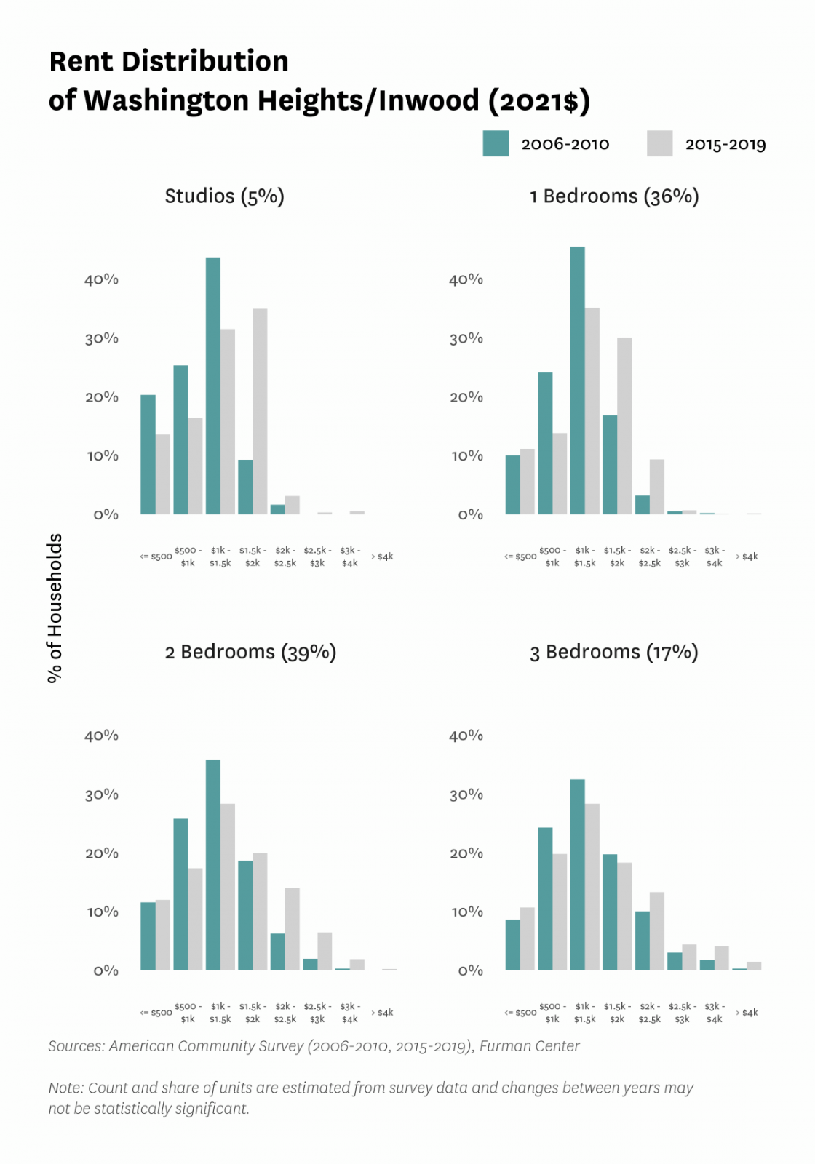
Rents in Washington Heights haven’t been a cheap place to live with the amounts that its rising. For example, 3-bedroom apartments only a 30% of household can afford a rent of $1,000 to $1,500.
Studios only a 35% of households can afford a $1,500 - $2,000 worth of rent.
1 bedroom in the Census of 2006-2010 a 45% of households afforded to live with a rent of $1,000 to $1,500 but it decrease to only 35% of them affording to live there.

Slide 5
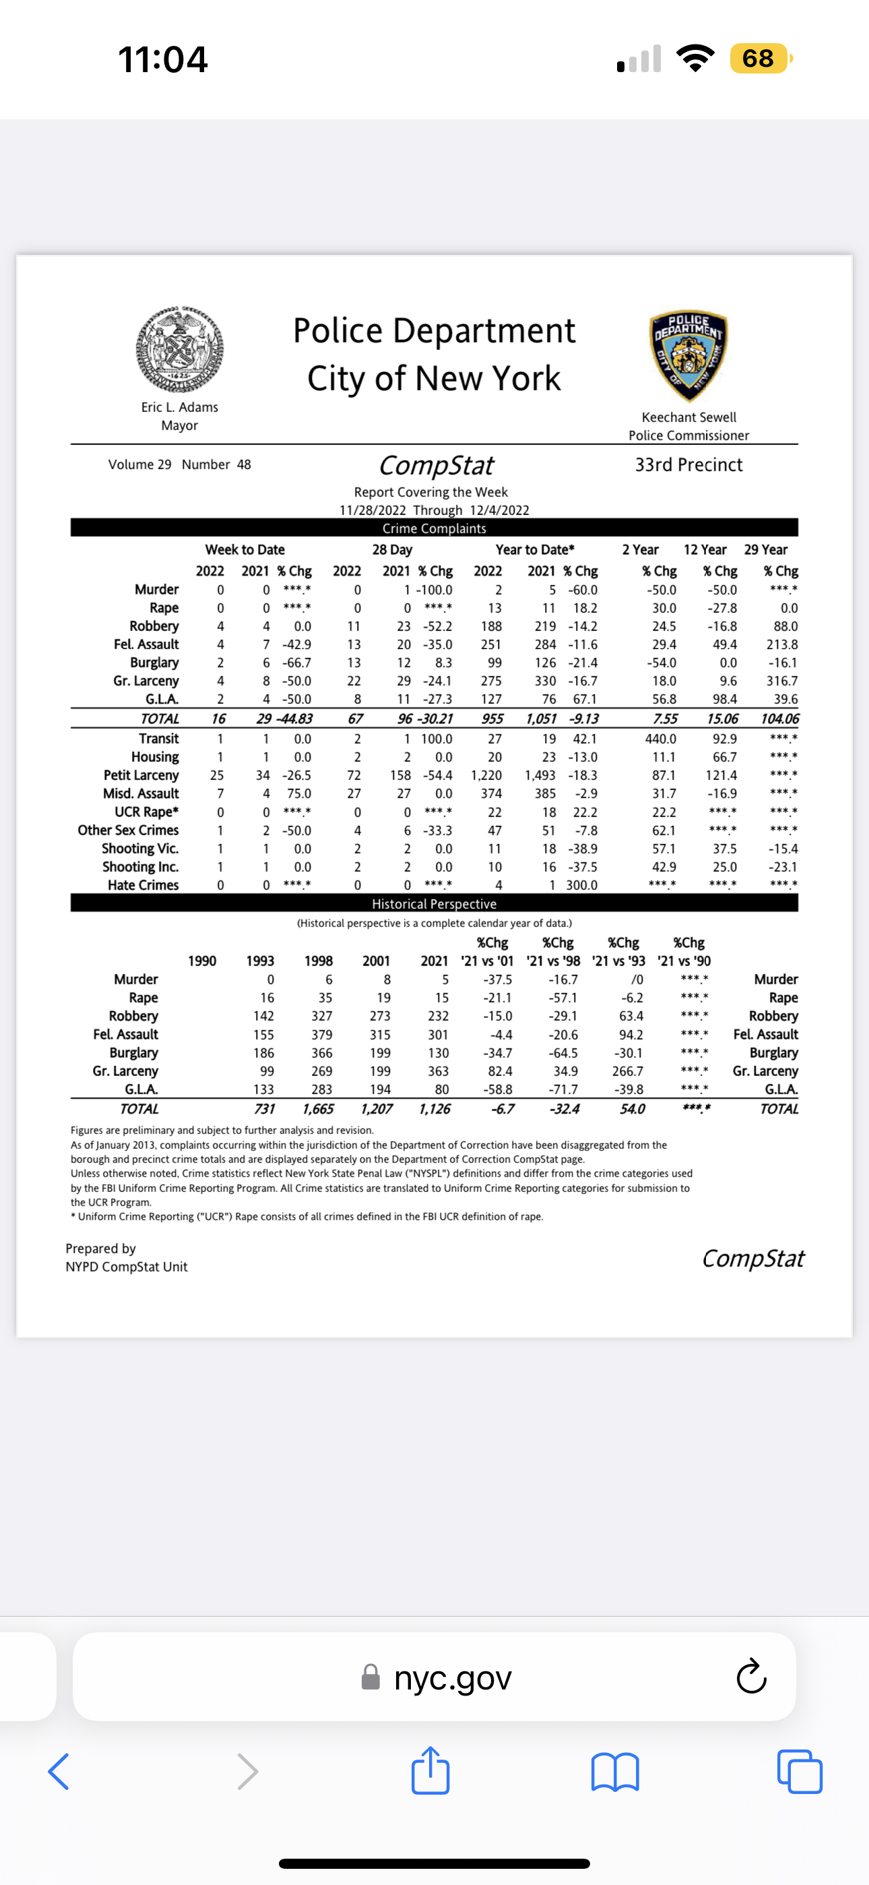
The top scares in the list are murder and rape which from the records from the Precinct 33 marks no murder or rape cases.
In 2022 and 2021 there has been a total of 8 reports of Robbery and it’s a major problem in our area.
In 2021 there were 6 burglary cases but it has decreased to only 2 burglaries.

Slide 6
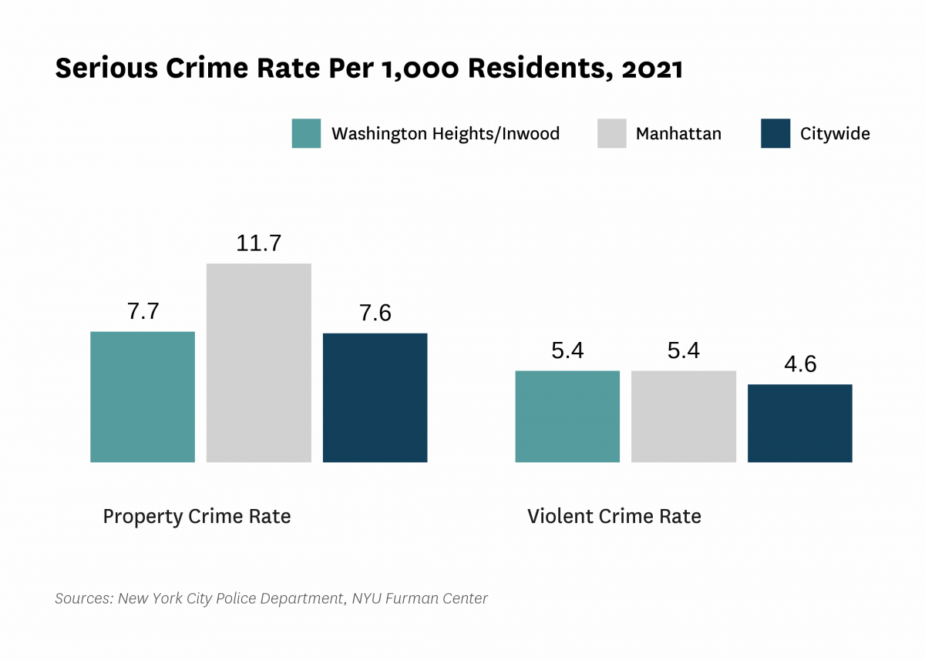
Property Crime rates have a much higher rate than violent crime rates.
7.7 of property crime in Washington Heights compared to the citywide having 7.6.
Violent crimes in Washington Heights has the same numer of crimes there is in Manhattan,

