Slide 1
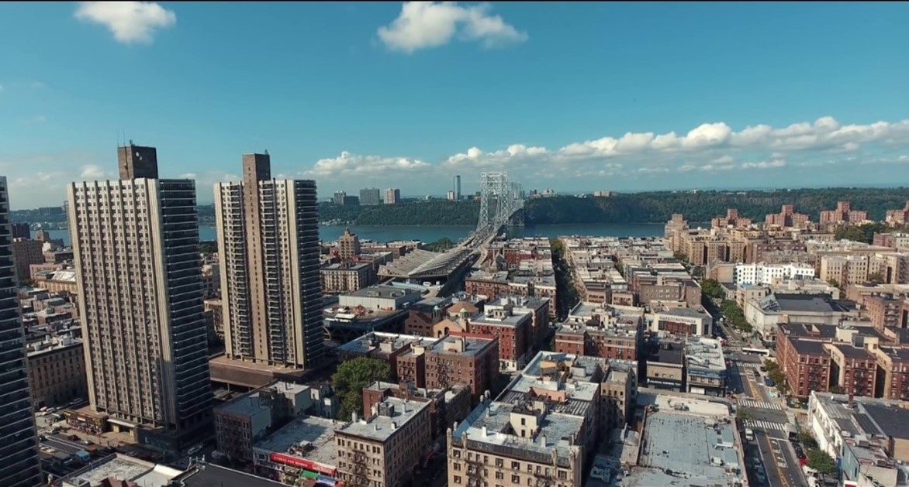
Washington Heights

Slide 2
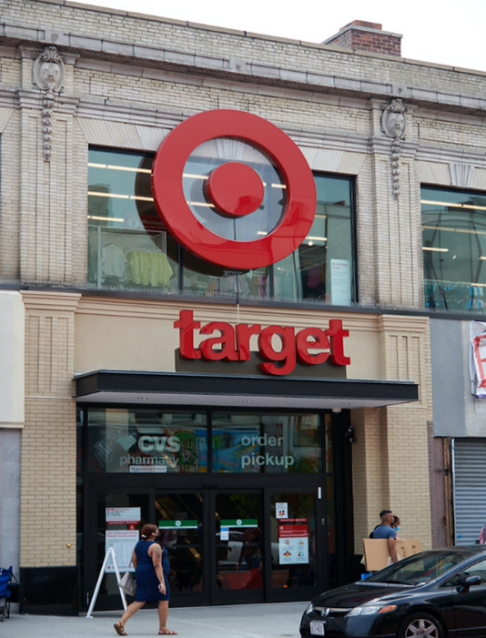
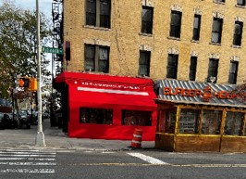
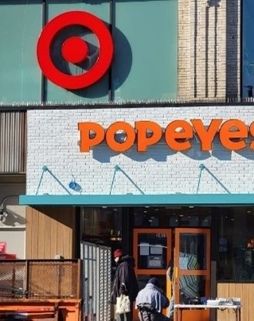
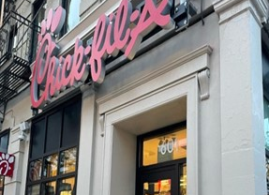
Washington heights extends from 155th street to 200th street in Manhattan filled with numerous stores,delis,restaurants,convenience stores, fast foods etc.

Slide 3
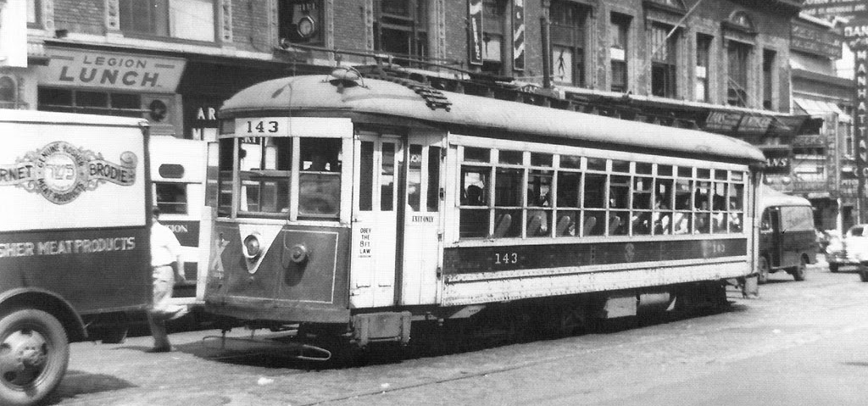
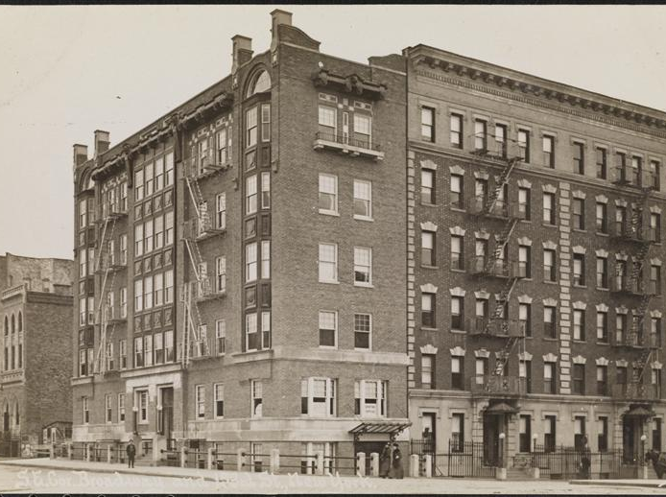
During the 1900s Washington Heights was the home of middle-class citizens that were mostly European,irish,german, Greeks, and Russian immigrants who fled their country to achieve the “American dream”.

Slide 4
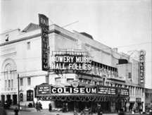
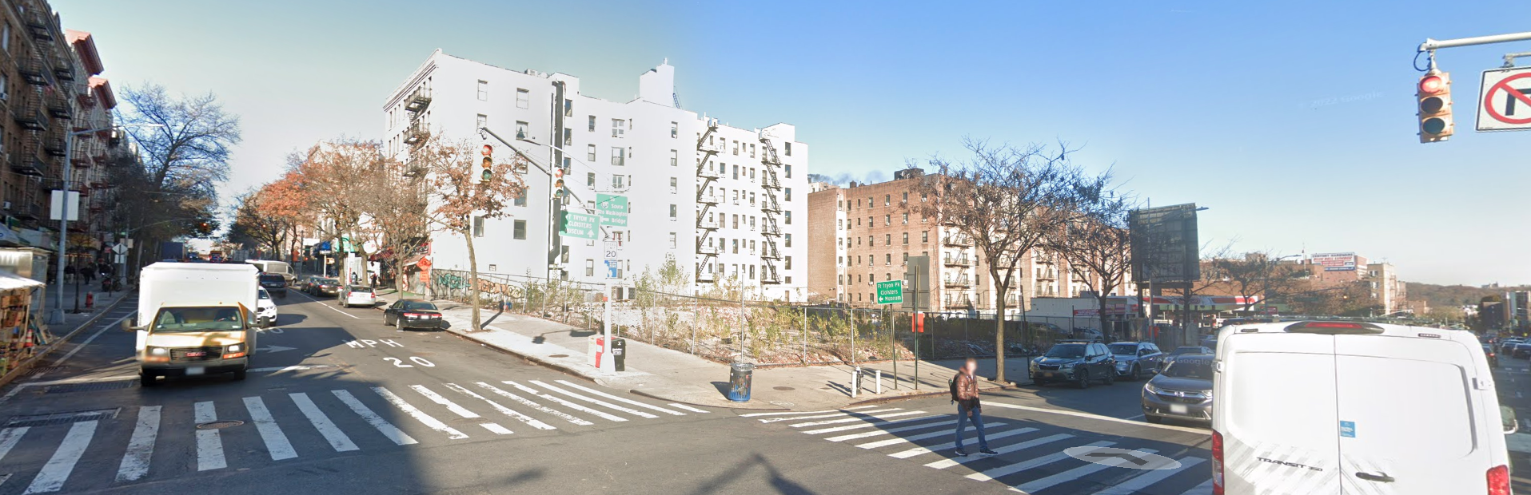
The White Flight
B.S. Moss' Coliseum Theatre
located at 4260 Broadway between West 181st and 182nd Street, Built in 1920 originally as a movie palace designed by architect Eugene De Rosa. Coliseum consisted of marble interiors and more luxurious designs.
During the early 1960s and 1970s there was a “white flight” in Washington Heights due to blacks and Latinos moving into the neighborhood, this led to many people leaving the neighborhood and moving to nearby suburbs like Riverdale,yonkers,new jersey and other nearby suburbs.
@2022 Google

Slide 5
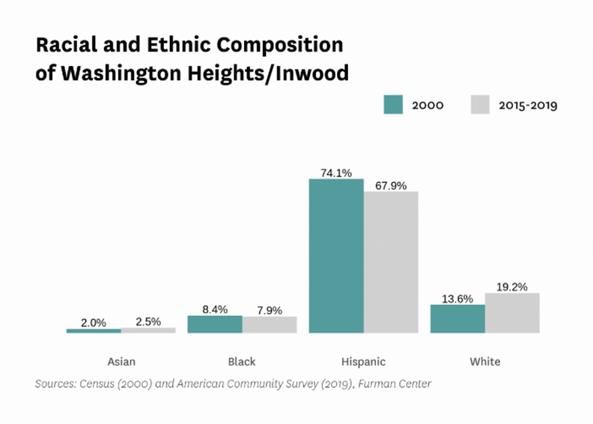
After the “white flight” Washington heights transformed and turned into a neighborhood consisting dominantly of Hispanic people specifically people from the Dominican republic.

Slide 6
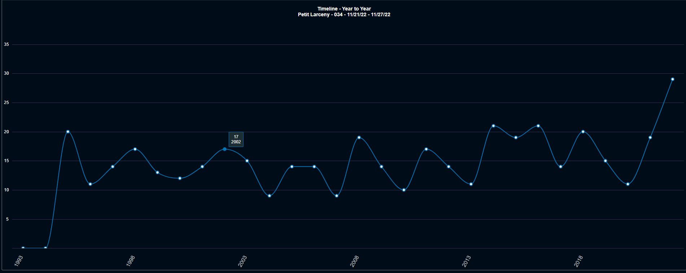

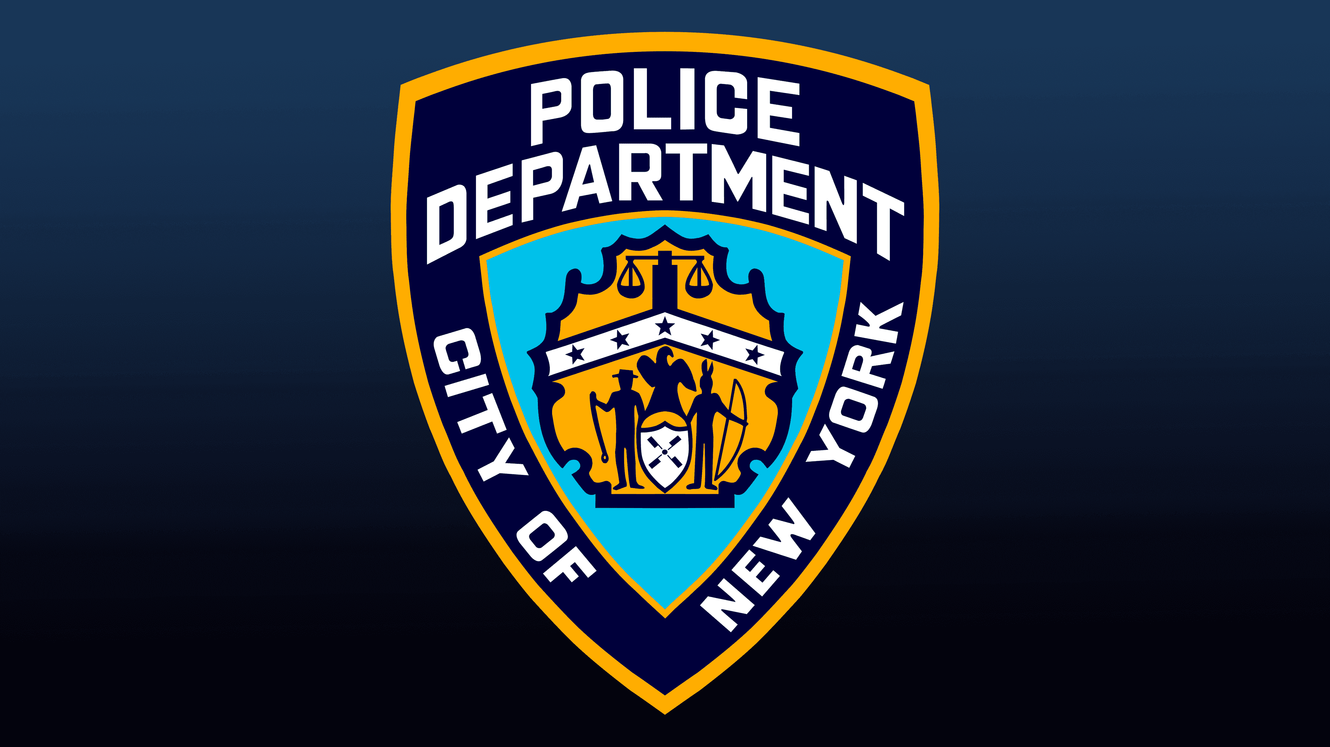
Petty larceny crimes reported by the NYPD 34th precinct from 1993 to 2018.

Slide 7
Number of people in prison from my zip code(2020)
Zip code | city | Number of people in state prison | Census population 2020 | Total population,2020 | Imprisonment rate per 100,000
10033 | New York City | 123 | 50,085 | 50,208 | 245

