Slide 1

Red Lining and the White Flight
Week 10

Slide 2
Layers of Structural Inequality
Racial Zoning
Race-Restrictive Covenants
“Redlining”
Racial Steering
Block Busting
Expulsive Zoning
Exclusionary Zoning
Highway Construction
Slum Clearance & Public Housing Administration
School Segregation
Notes:
This is a list of specific tactics generated by people both in decision making roles at the federal, state, and local level as well as average day professionals and citizens that were used to create the very conditions this board and administration are attempting to ameliorate. This is not a comprehensive list, but at the least it provides some of us with a place to begin understanding or others to remember.
I won’t have time to describe all of these things, but I want to highlight a few to help drive home my point.

Slide 3
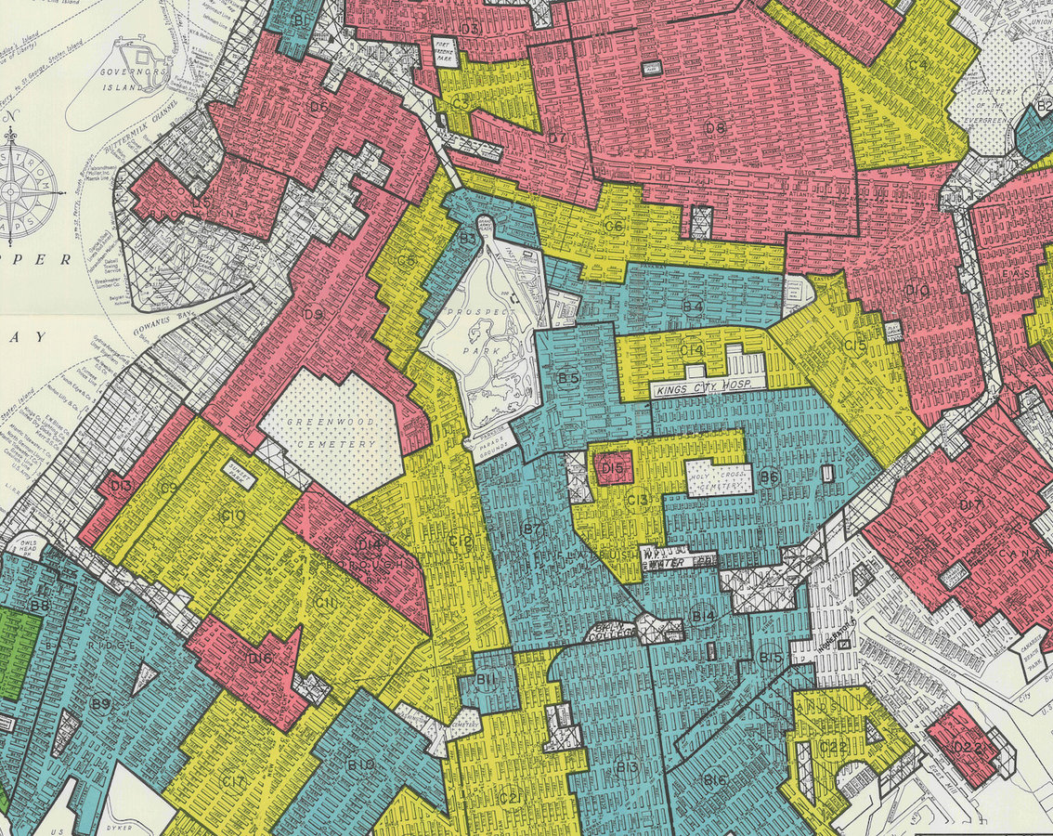
“Redlining”
During the 1930s, the Federal Housing Authority’s Home Owners’ Loan Corporation (HOLC), a New Deal agency formed to refinance mortgages during the Great Depression, explicitly practiced a policy of “redlining” when determining which neighborhoods to approve mortgages in.
Redlining is the practice of denying or limiting financial services to certain neighborhoods based on racial or ethnic composition without regard to the residents’ qualifications or creditworthiness.
The term “redlining” refers to the practice of using a red line on a map to delineate the area where financial institutions would not invest.
The federal government set the standard for redlining, and the practice spread throughout the mortgage industry and beyond, preventing investment in black neighborhoods and reinforcing a segregated, unequal society.
Redlining was made illegal by the 1968 Fair Housing Act
Notes:
The first is the concept of redlining.

Slide 4
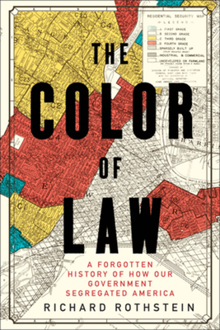
The Role of the Federal Government
Federal Housing Administration (est 1934):
Refused to insure mortgages in and near African-American neighborhoods — a policy known as "redlining."
At the same time, it subsidized builders who were mass-producing entire subdivisions for whites — with the requirement that none of the homes be sold to African-Americans.

Slide 5
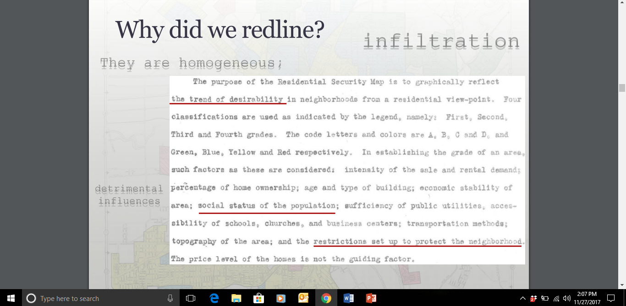
Notes:
During the 1930s, the Federal Housing Authority’s Home Owners’ Loan Corporation (HOLC), a New Deal agency formed to refinance mortgages during the Great Depression, explicitly practiced a policy of “redlining” when determining which neighborhoods to approve mortgages in.
Redlining quickly became the practice of denying or limiting financial services to certain neighborhoods based on racial or ethnic composition without regard to the residents’ qualifications or creditworthiness.

Slide 6
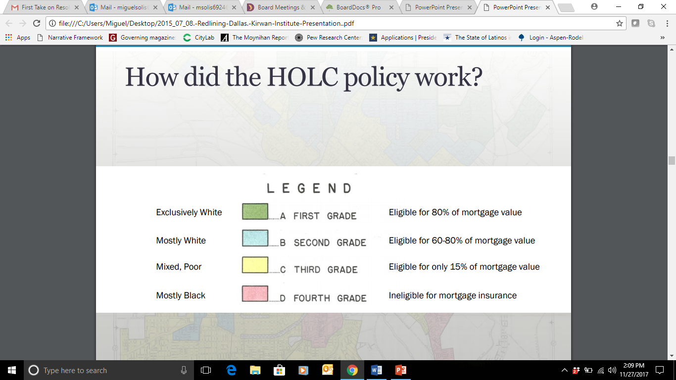
Notes:
The federal government set the standard for redlining, and the practice spread throughout the mortgage industry and beyond, preventing investment in black neighborhoods and reinforcing a segregated, unequal society.
The term “redlining” refers to the practice of using a red line on a map to delineate the area where financial institutions would not invest.

Slide 7
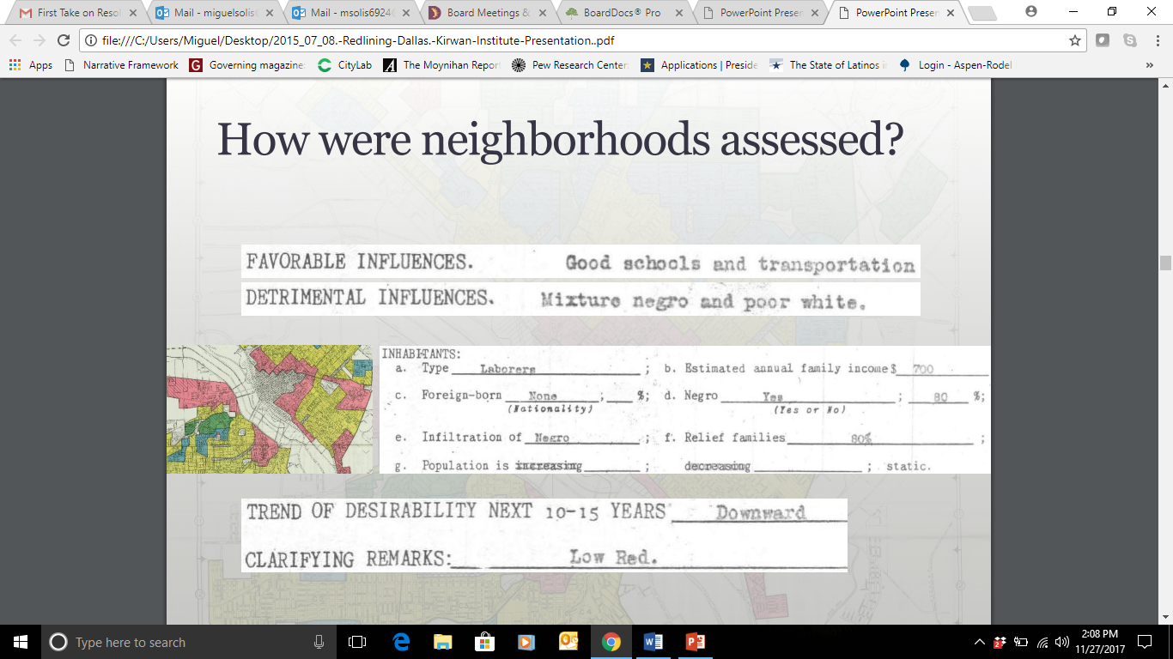
Notes:
Here you can see how neighborhoods were judged. Detrimental influences included race and socio-economic status. Basically if you were minority and poor, your neighborhood was labeled low desirability and you did not receive federal, state, and local investment.

Slide 8
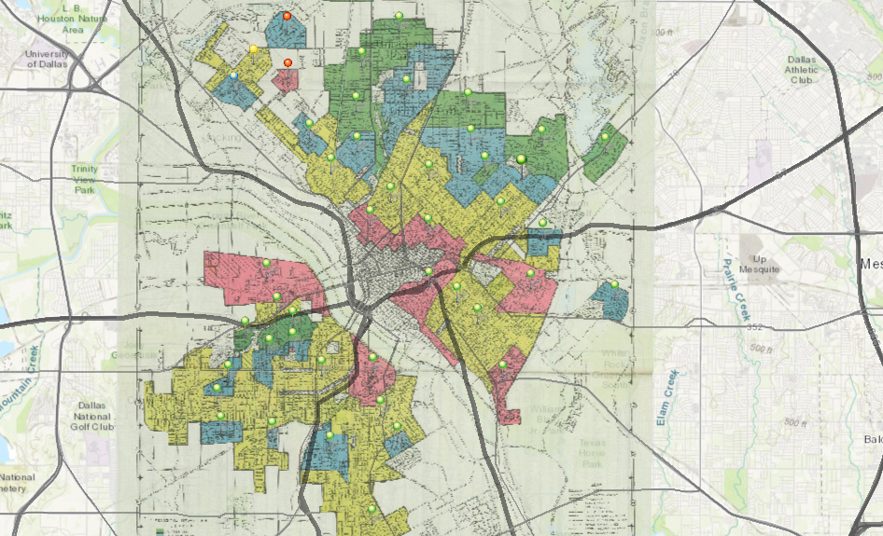
Notes:
This was the federal redline map for Dallas.

Slide 9
Notes:
Let’s take a look at a green

Slide 10
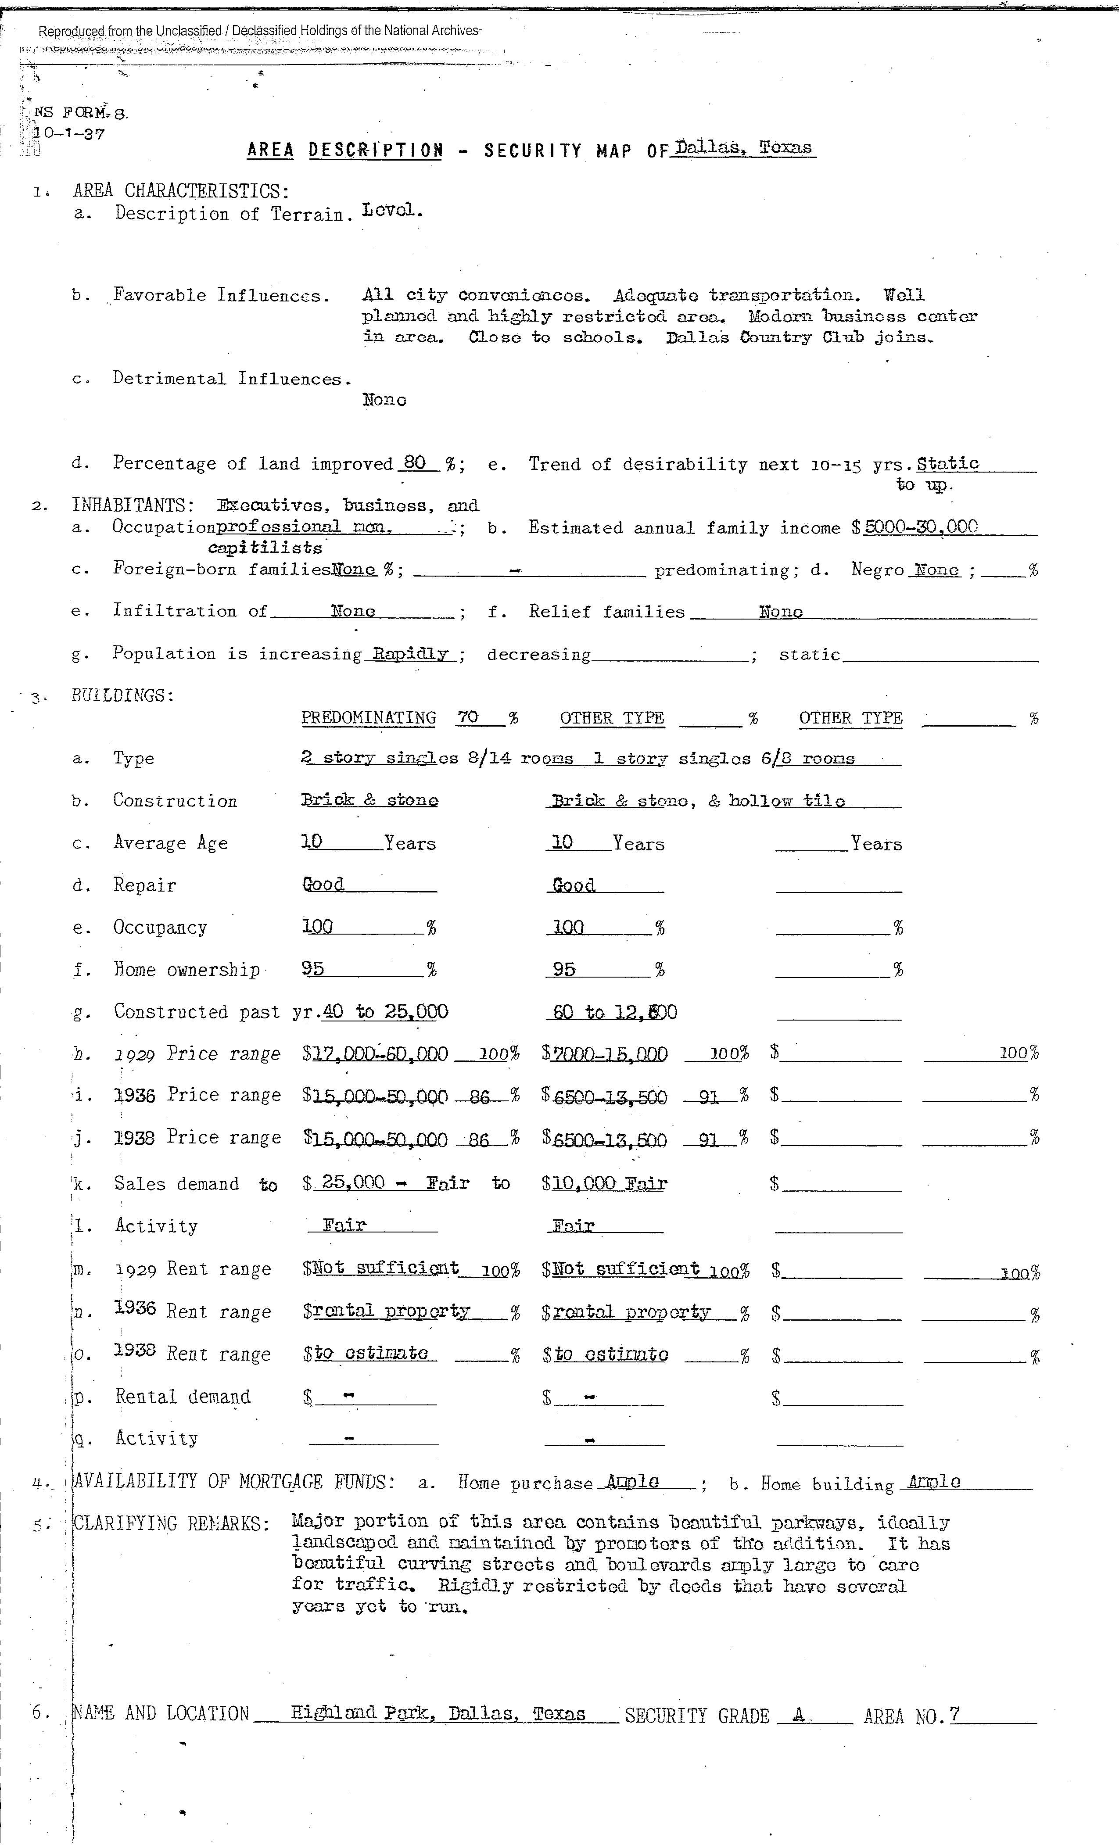

Slide 11
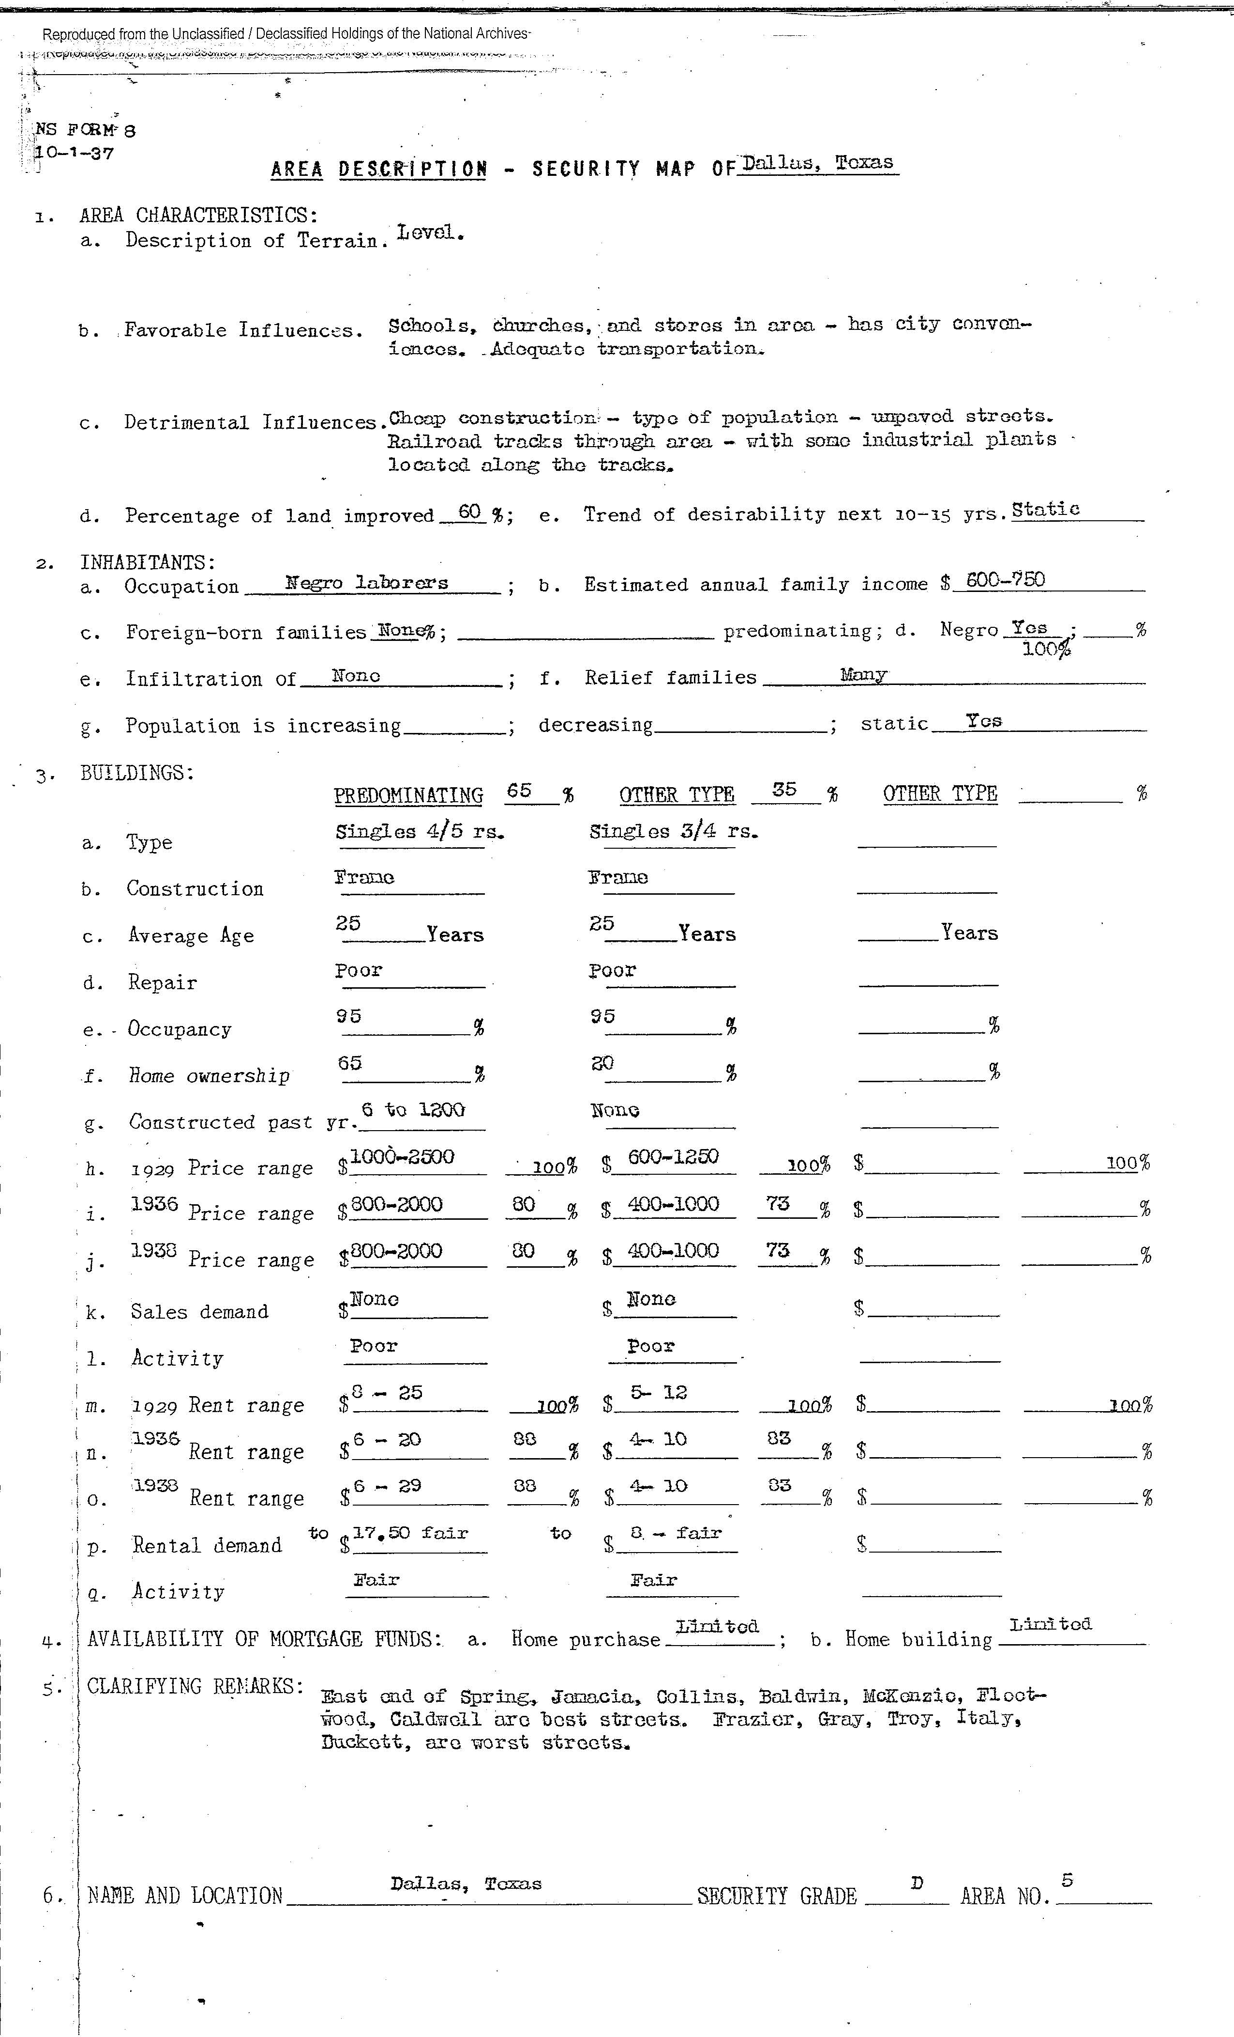

Slide 12
The Impact of “Redlining”
Bias
Low SES and Black population viewed as detrimental influence that posed risk to public health and property value
Disinvestment
Structural disinvestment in people & place
Denied access to capital
Decline
Inability to maintain property
Abandonment & blight
Future investment is even more discouraged

Slide 13
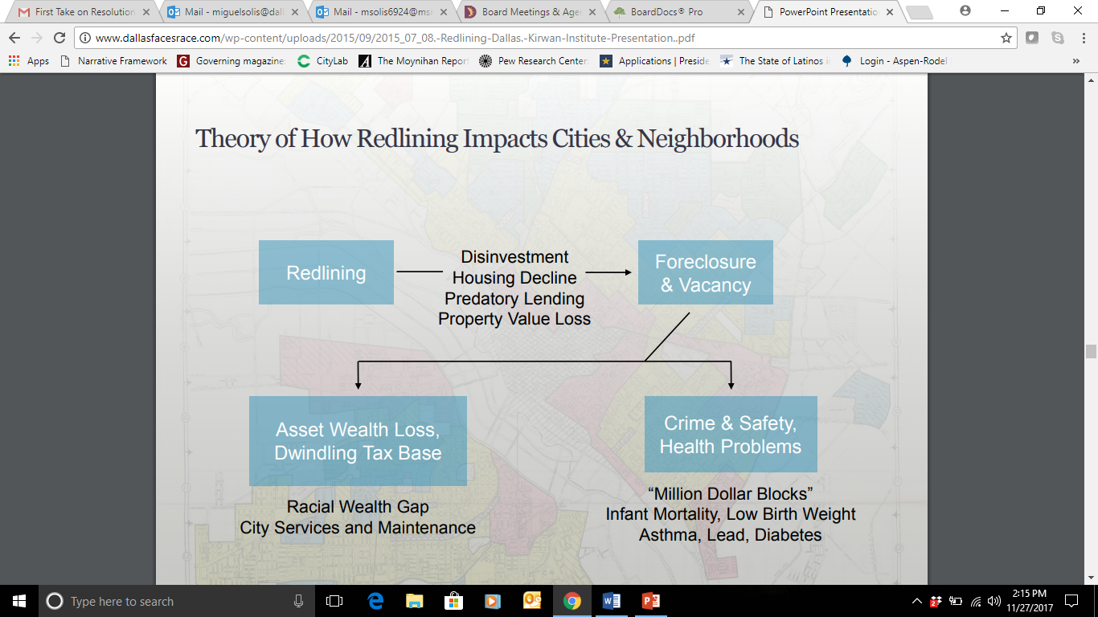

Slide 14
The effects of redlining were compounded by other discriminatory de jure and de facto practices…

Slide 15
Exclusionary Zoning
Prescribed separate residential areas for blacks and whites
Dallas passed its segregatory zoning ordinance in 1917
The Supreme Court ruled this form of zoning unconstitutional twice
  Buchanan v. Warely (1917)
  Harmon v Tyler (1927)
Elements persisted

Slide 16
Race-Restrictive Covenants
Racial covenants became common after the Civil War.
The Supreme Court overturned laws that forbade blacks to live in particular neighborhoods, covenants in deeds became the only way to maintain legally enforceable racial segregation.
The Federal Housing Administration, established in 1934 to spur home-ownership by providing mortgage-loan guarantees, actually required real estate developers to include racial covenants in their deeds as a condition of FHA financing.

