Slide 1

Victor Rios’s Punished
Week 2
Chapters 2-5

Slide 2

Introduction
In preface and chapter 1, Victor Rios sets forward his research questions and the method of data collection:
Research Questions:
How do surveillance, punishment and criminal justice practices affect the lives of the marginalized boys?
What patterns of punishment do young people encounter in their neighborhoods in Oakland?
What effects do these patterns of punishment have on the lives of young men in this study?
How do punitive encounters with police, probation officers, teachers and administrators, and other authority figures shape the meaning that young people create about themselves and about their obstacles, opportunities and future aspirations?

Slide 3
Goal of the Study
To understand how boys in these networks of crime, criminalization, and punishment made sense of these processes and to observe their interactions with authority figures

Slide 4
Terms to Remember from Chapter 1
Moral panics- often constructed as a result of economic and cultural crises
Example: Black muggers, pregnant teens, gang members
Media and politicians create moral panics
Critical criminology- the study of crime in relation to power, examining crime as a socially constructed phenomenon
Urban ethnography- the systematic and meticulous method of examining culture unfolding in everyday life

Slide 5

Chapter 2: The Flatlands of Oakland and the Youth Control Complex
population of 460,000- 6th most populous metropolitan area in the US (San Francisco Bay Area: total population of approximately 7.9 million)
Whites: 36% Blacks: 30% Latinos: 26% (as of 2006)
10,000 gang members live in the district
4th largest violent crime rate in the country
33% of the population live below the poverty line (US Bureau Census 2000)
Unemployment rate: 17.7% as of 2010

Slide 6
Why Oakland?
Large Black and Latino Communities
Pervasive system of policing and surveillance
Dynamic youth subcultures
Large working class and poor population
These factors make a compelling place for the study of inner-city youth and social control, as well as a social landscape of other cities with large Black and Latino/a populations throughout the US

Slide 7
Oakland: A Punitive Sandbox
Since the 1960s, Oakland has been one of the cities where policies, before being implemented throughout the US, are put into practice, such as:
  zero tolerance
  mandatory sentencing
  gang enhancements- committing a crime to benefit a gang
  mass incarceration

Slide 8
Youth control complex:
“a ubiquitous system if criminalization molded by the synchronized, systematic punishment meted out by socializing and social control institutions” (p. 40)
takes a toll on the mind and future outcomes of a particular young person
example: being called a “thug,” being told by your teacher you won’t amount to anything, and frisked by a police officer all in the same day
composed of material and symbolic criminalization

Slide 9
Material criminalization
Police harassment, exclusion from businesses and public recreation spaces, and the enforcement of zero tolerance policies that lead to youth detention, suspensions, expulsions and incarcerations
Symbolic criminalization
The surveillance, profiling, stigma and degrading interactions that young people regularly endure
Recognized as "racial microaggressions"
Subtle acts of racism that people of color experience on a daily basis

Slide 10
Chapter 3: The Labeling Hype: Coming of Age in the Era of Mass Incarceration
In the era of mass incarceration, labeling is a process by which agencies of social control further stigmatize and mark the boys in response to their original label. This in turn creates a vicious cycle that increases the boys’ experience with criminalization, this is called labeling hype.
Criminalization became internalized

Slide 11
Spiral of Criminalization
“This kid comes from a bad family and is at risk”
1
“This kid is delinquent, and he is at risk”
2
“This kid is a gang member”
3
“This kid is dangerous”
4

Slide 12
Over policing-under policing paradox
Officers police certain kinds of deviance and crime, while neglecting or ignoring other instance when their help is needed.
Promoted street violence “be a grown man and defend yourself”
By criminalizing all of the boys, the police, it seemed could not tell the difference between criminals and innocent young people try to live their lives.

Slide 13
Institutions passed on their punitive approaches to treating deviant and delinquent behavior
Police and probation officers became involved in non-criminal justice matters at school and in the community.
Police officers would advise parents and students on academic matter.

Slide 14
Code of the street
Assumed that all the boys were actively engaged in criminal and violent activity
Provide the boys little choice but to engage in the code.
Officers would refuse to provide protection
The code of the street allowed the police to justify harassment and arrest, schools to punish and suspend students for defiance, and community members to fear young people.
Self-defense
The code offers individuals a way to protect themselves from victimization in violent communities and to build respect from others

Slide 15
Don’t snitch campaign
The “don’t snitch” campaign among the boys in this study was an attempt to avoid further criminalization and unjust arrests and sentencing and to protect them from being “ratted out” by the police
Youth were being incarcerated through false accusation, police “step-ups”, entrapment, and forced testimonies led many of the boys to declare a vow against ever providing information to police, even when they were victims.
Resist the over policing-under policing paradox and mass incarceration.

Slide 16
Chapter 4: The Coupling of Criminal Justice and Community Institutions
Problem: Mostly white, middle-class, college-educated men are trying to solve the issue of disproportionate black crime.

Slide 17
Criminalizing The Victim
School personnel, police officers, probation officers and other adults in the community had created an environment that made young people feel criminalized from a very young age, even when they had good intentions. (82)
Disadvantaged youths “play”, how they spend their time given the resources available to them, has become criminalized.
Gang database accentuates criminalization, as it allows police to keep track of most “at-risk” youth and impose tougher policing and harsher sentencing.
Community Categorization

Slide 18
Parenting
“Courtesy Stigma”
Parents turn to Probation officers for parenting advice.
Parents begin acting similarly and thus often break trust with youth.

Slide 19
Probation
According to the boys, P.O. served the purpose of punishing them by branding them criminals in front of the rest of the community.
Most had high and unrealistic expectations of the boys, but did not provide the resources necessary to meet these expectations.
Probation generated desire to change but did not provide the resources to do so.
A good P.O. would provide access to programs and jobs.
Reinforces the idea of overpolicing/underpolicing.
Leads to stigmatization in the community, victimization by peers, and rearrests for minor infractions.
Youth learn to manipulate the system

Slide 20
Community Centers
When asked “Would you join a program that took you on field trips or where you could play sports or talk to a mentor or get a job?” all of them responded yes.
Because of declining funds to community programs:
Programs turn to county probation department, or other state funds, which then require programs to be advised by P.O. and the county.
Unable to support “at-risk” youth; only invest in those they deem as potentially responsive to their programming.
Conclusion: The key is to invest enough resources in social programs which are independent from and set clear parameters between themselves and criminal justice institutions.

Slide 21
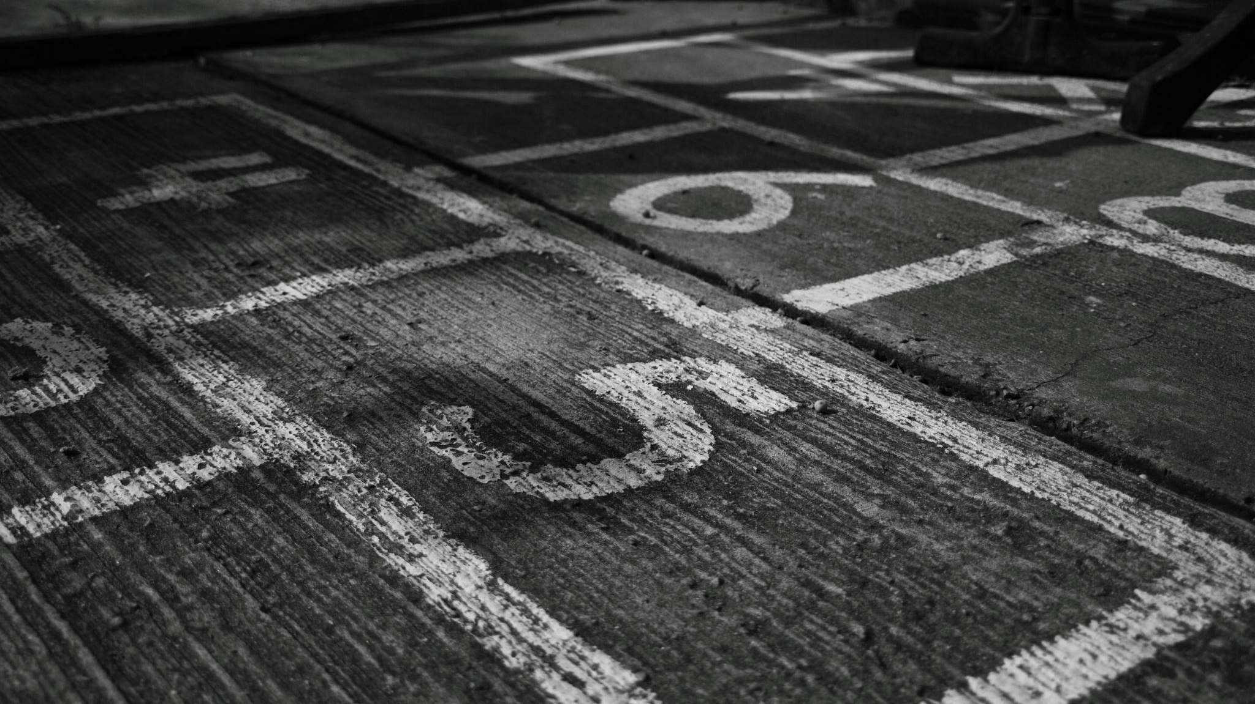
Chapter 5
“Dummy Smart” Misrecognition, Acting Out, and “Going Dumb”

Slide 22
Resistance
Page 123:
“In an environment where there were few formal avenues for expressing dissent toward a system, which the boys believed to be extremely repressive, they developed forms of resistance that they believed could change, even if only temporarily, the outcome of their treatment”
Non-serious offenses were committed as acts of resistance to being criminalized
Youth labeled as deviants participated in everyday practices of resistance

Slide 23
Crimes of Resistance
Young men self-consciously “acted stupid” as a strategy to discredit the significance of a system which had excluded and punished them.
“Dummy Smart”
Misrecognition
“Acting Dumb”

Slide 24
Chapter 6:Proving Manhood
Masculinity as a rehabilitative tool
Institutions and societal structures challenge these boys' masculinity
Forced into hyper masculinity because they are made our to be something they are not
If they don't follow the masculinity code, then they are put in a vulnerable position on the streets and within institutions

Slide 25
Double Bind
When expectations pull someone in two opposite directions
Affects the boys in this book by forcing them to choose between complying with authority, but increasing their vulnerability and following the code of the streets, but having trouble with the police
This is a system to further criminalize and punish these young boys

Slide 26
Real Men
Society tells them that real men need a job to support their family, but there are a lack of employment opportunities, leading to frustration, which pushes them into hyper masculinity
Hyper masculinity: the exaggeration of stereotypical male behavior, such as an emphasis on physical strength, aggression and sexuality
It is "taught, learned, challenged and embraced" (page 138)
Serves as a resource for resistance and self-affirmation
Police officers threaten them with incarceration to learn how to be real men (page 139)
Jose states, "the probation officers tell us to be "real men," to show respect, but they don't see that if we show respect, we'll get treated like punks...being a man is different out here“
Not just young boys proving masculinity
  Police officers abusing power and disciplining them to prove their manhood as well. Trying to gain respect by humiliating them (page 136)
  Women proving masculinity to an extent to gain respect and security while still being seen with a "good" reputation

