Slide 1
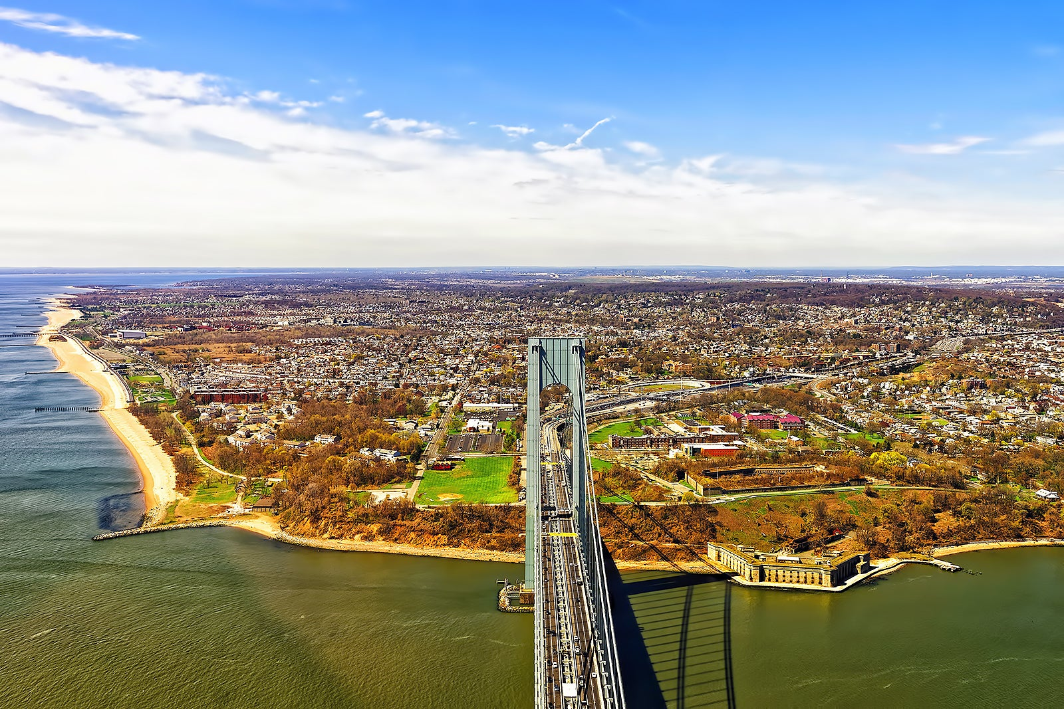
Staten Island
By: Natalie Morales

Slide 2
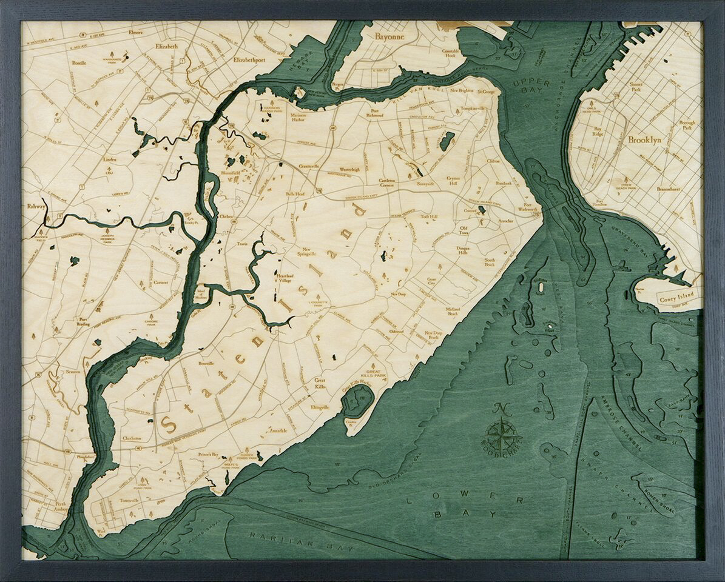
The History Of Staten Island
1524
Staten Island was first founded by Giovanni Da Verrazano in 1524, but it was mostly populated by Indians until 1630 when the Dutch began to settle on the island and called it ”Staaten Eylandt”.
1641
The Dutch and the Indians had many wars against each other, such as The Pig War (1641), The Whiskey War (1642), and The Peach War (1655), it ended with the Dutch finally establishing a colony in 1661 called Old Town.
1833
There was a dispute between New Jersey and New York over the land of Staten Island for about 200 years only until 1833 when both states had a mutual agreement and Staten Island became a part of New York.

Slide 3
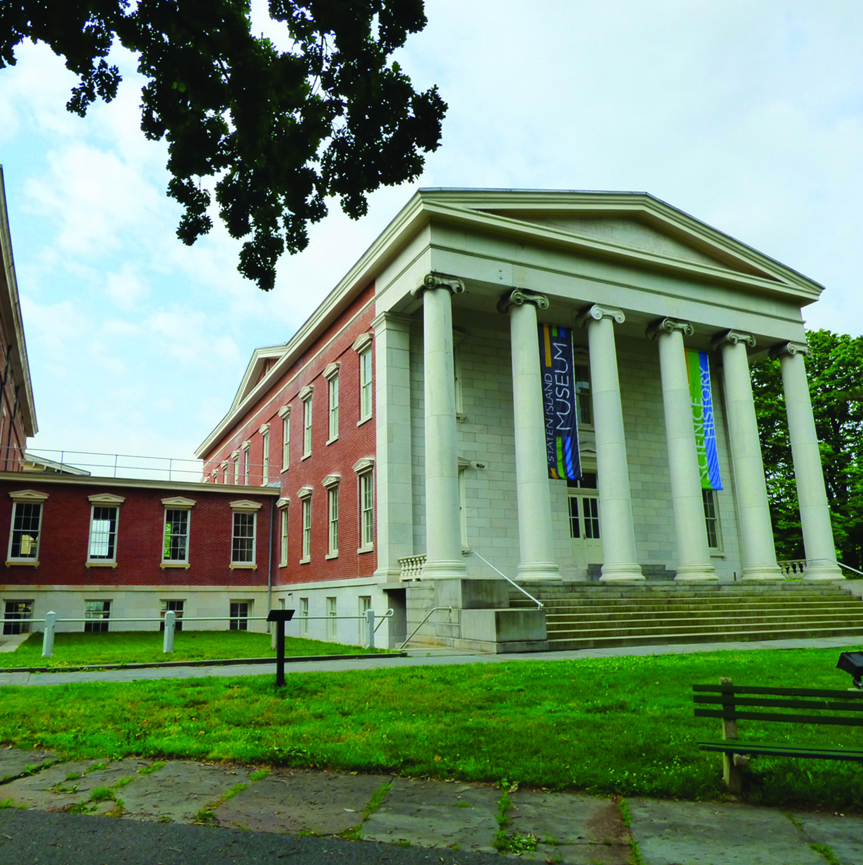
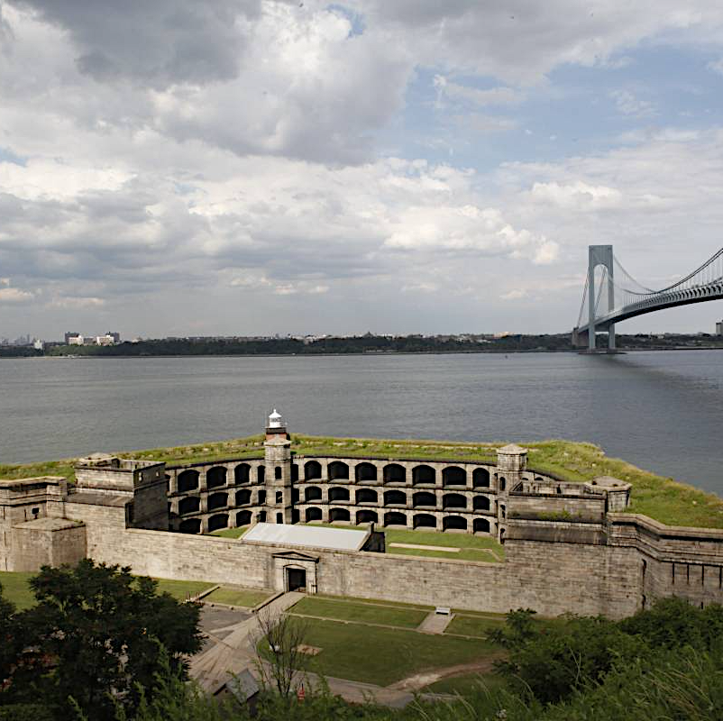
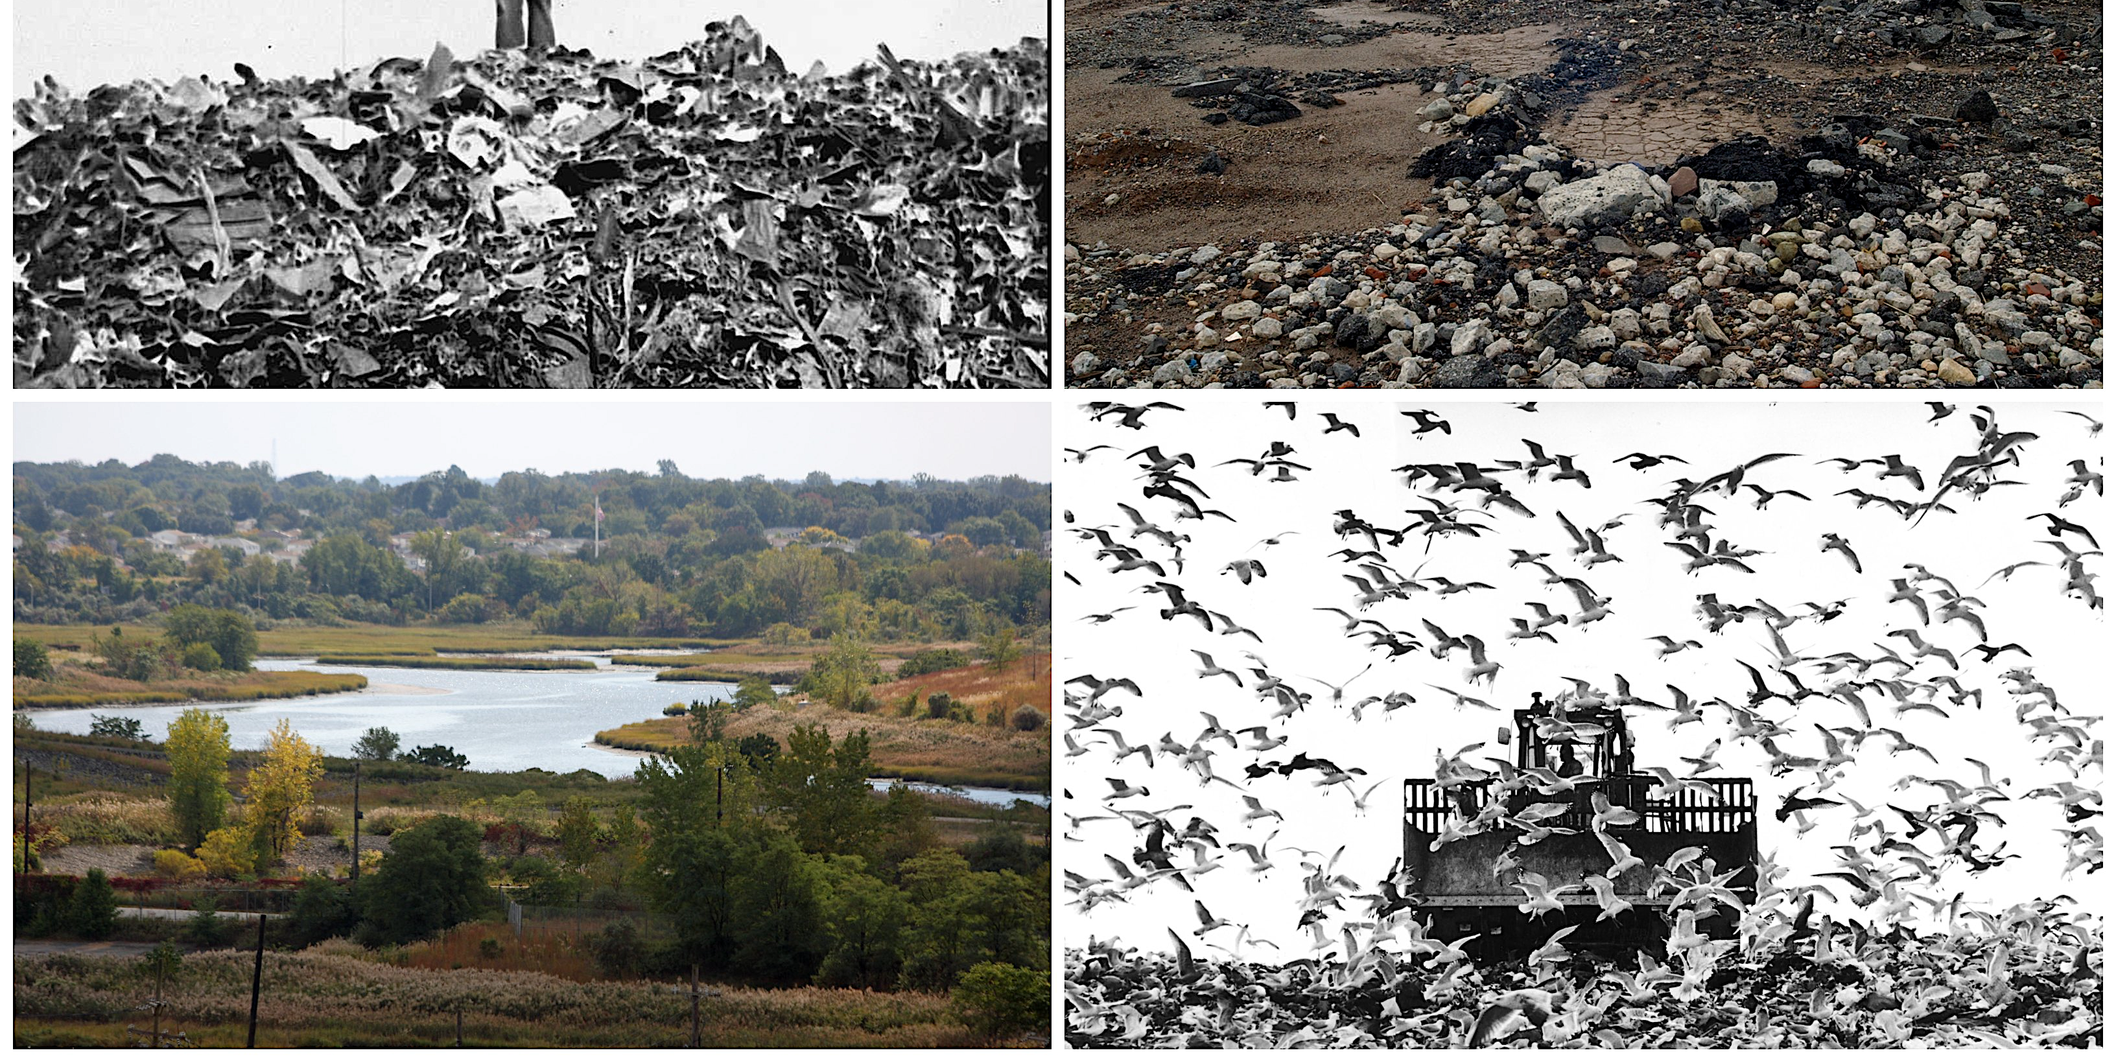
More on Staten Island
Staten Island has many parks such as Clove Lakes, High Rock Park, Silver Lake Park,
There are many museums you can visit, like the Children’s Museum, National Lighthouse Museum, and the Staten Island museum, which has art, history, and nature exhibits.
There are historical landmarks such as Fort Wadsworth, which was once a military site but is now open to the public for sightseeing. It’s also right under the Verrazano bridge and it's great for taking pictures. You can also see a bunch of deer around the area.
Staten Island is also known for there massive landfill, which had a lot of garbage and everything you could possibly think of but now it’s cleaned up and they made a big park.

Slide 4
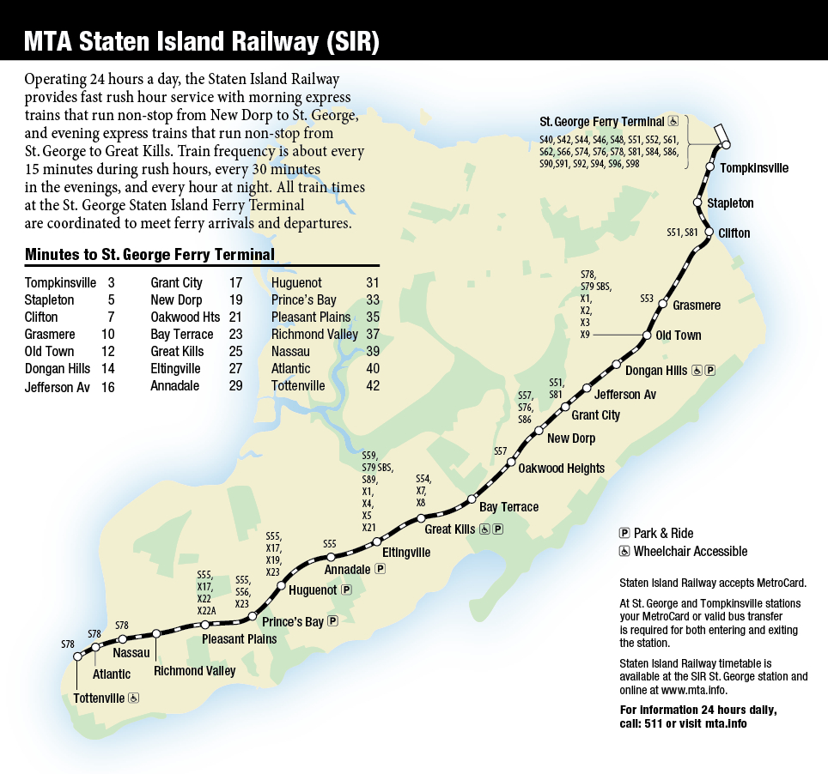
transportation
Staten Island has many buses to get you anywhere around the island, also buses that travel into the city and Brooklyn.
There's also only 1 subway line throughout the island, that travels from Tottenville to St. George Ferry Terminal.
The St. George Ferry Terminal is one of the main ways how people travel to and from the city.
The Verrazano Bridge is the only way into Staten Island by car from New York's side, but there are 3 other ways to get in from New Jersey’s side.

Slide 5
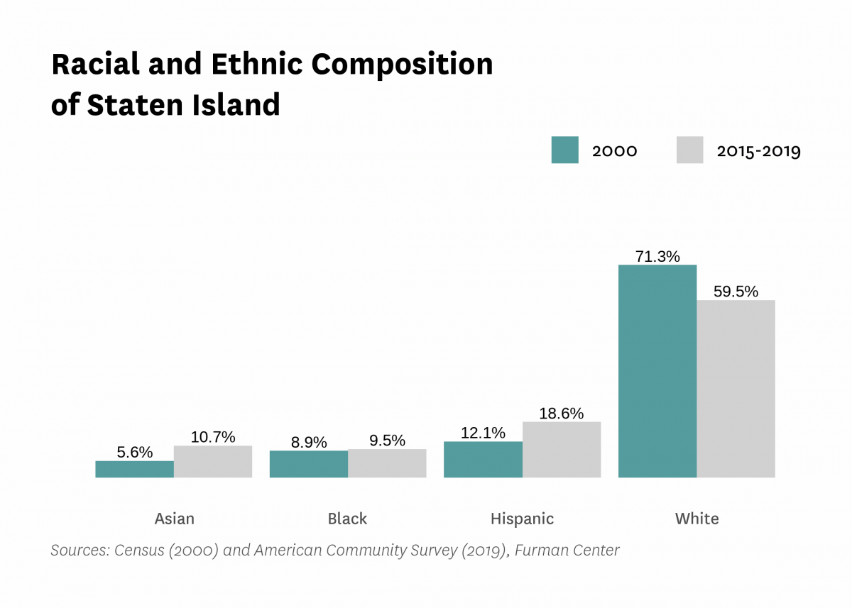
Demographics
As of 2019, there are about 476,143 people living on Staten Island.
10.7% are Asian, 9.5% are Black, 18.6% are Hispanic and 59.5% are White.
As you can see on the chart, In 2015-2019 each race for the most part increased except the White Americans. They went from 71.3% to 59.5%.

Slide 6
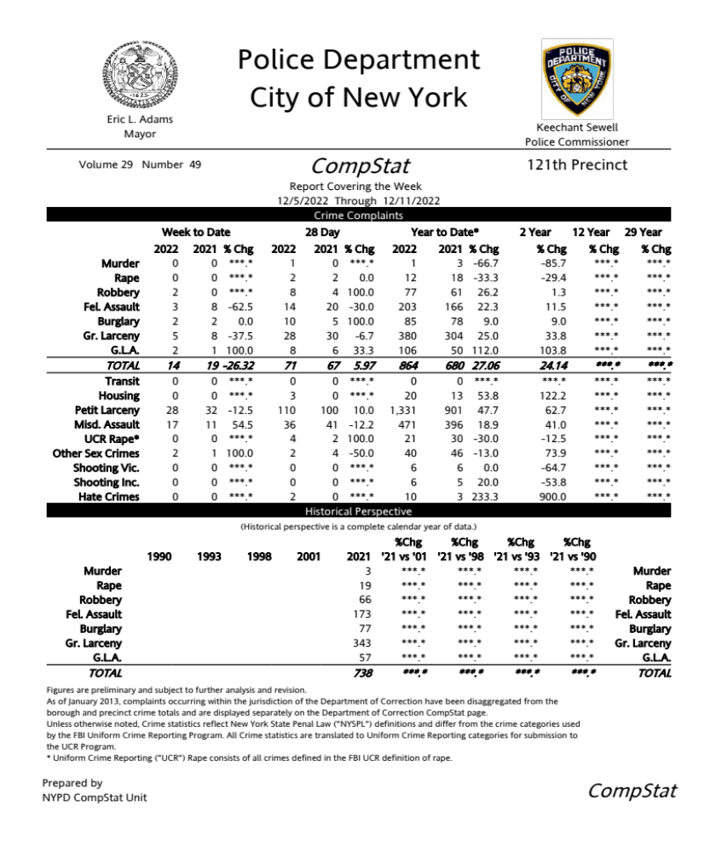
Crime
The crime in my neighborhood in 2021 was on the low side but there were still crime complaints such as 8 felony assaults, 2 burglaries, and 8 grand larceny complaints.
In 2022 crime went down a little, felony assaults went down to 3, burglary stayed the same, and grand larceny went down to 5.

