Slide 1
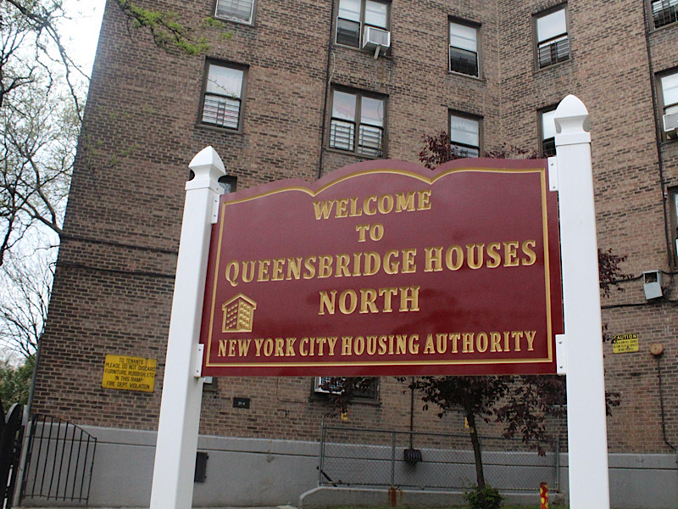

Homelessness and Homeless Shelters in Queensbridge, NY
Joanne Lam

Slide 2
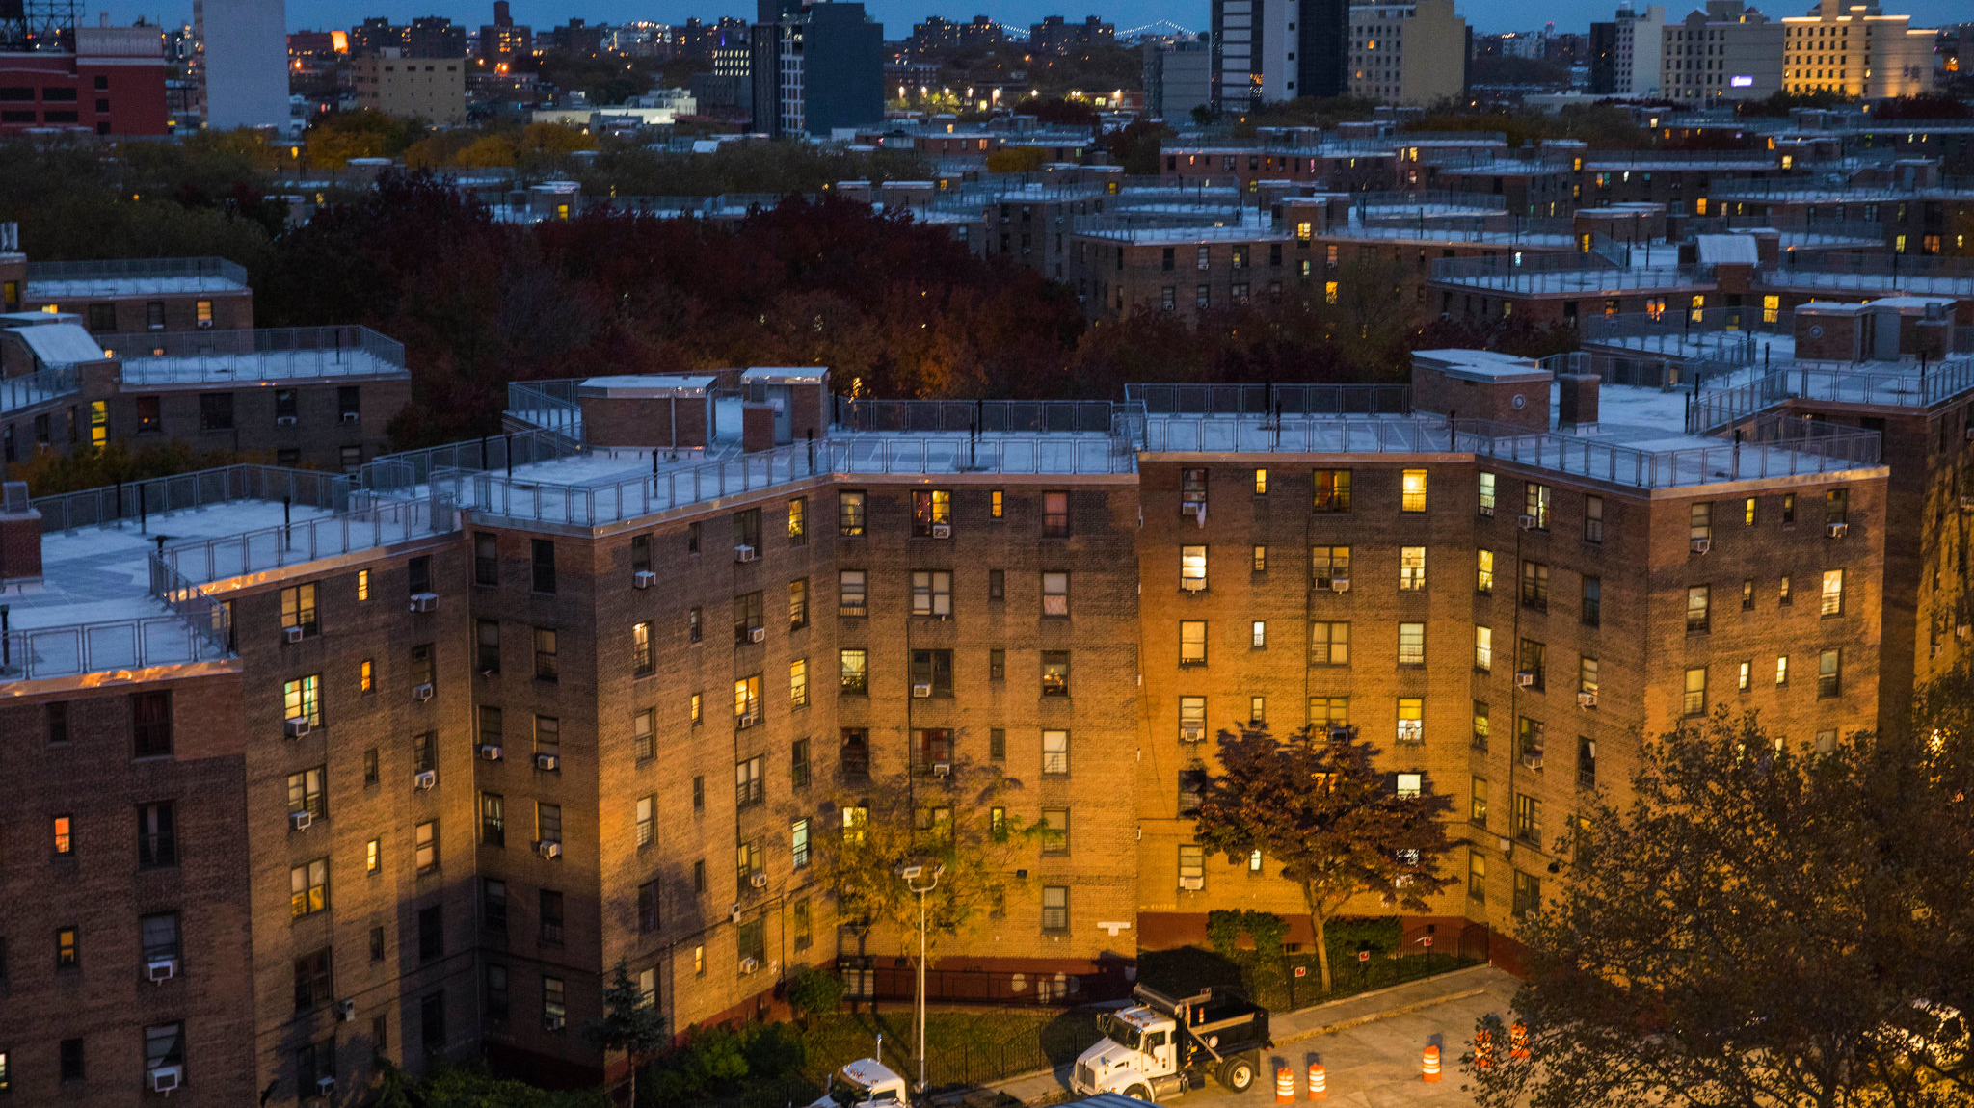
Queensbridge, NY
A neighborhood located in Long Island City, Queens
Known for their public housing (projects)
Majority of the community consists of minorities (Hispanics and Blacks)
Population of approximately 7,000 people
29 buildings consisting of over 3,000 units

Slide 3
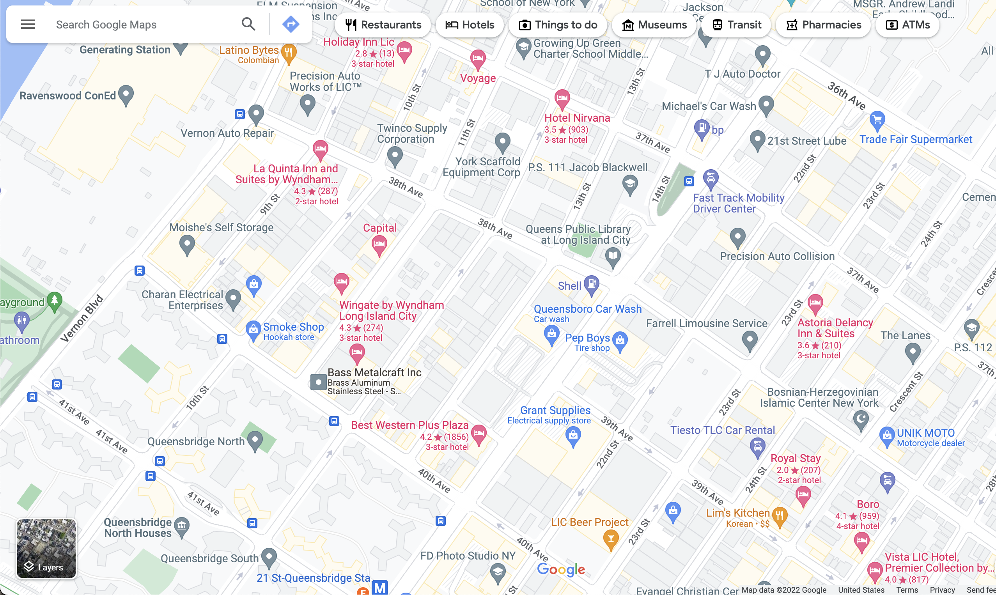
Hotels in Queensbridge, NY
Many hotels in Queensbridge are being utilized as homeless shelters
All of the hotels are within close proximity to each other
Substance abusers/junkies and ex-felons would all hang around outside these hotels
The hotels would still be shown as open for bookings online despite them being shelters, deceiving people looking for hotels to stay at
When you google “Queensbridge hotels homeless,” it shows results of different articles talking about hotel shelters and how people are complaining about it because of them destroying their neighborhood

Slide 4
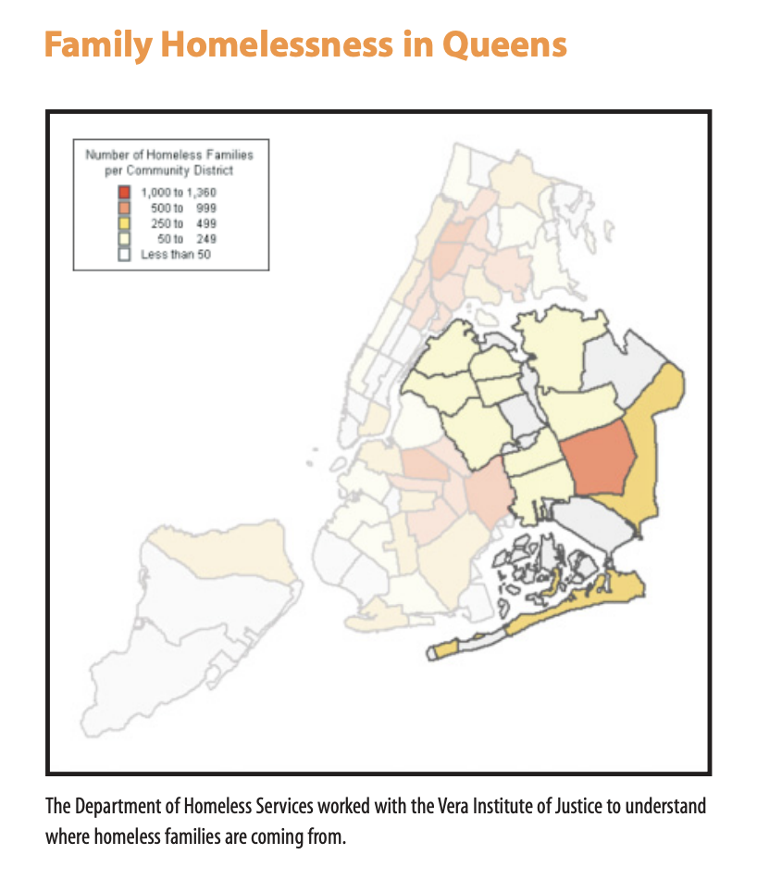
Unsheltered Homeless
Many unsheltered homeless individuals are resistant to homeless shelters
Unsheltered homeless individuals account for 37% of the homeless population
Those who are physically disabled, mentally ill, or suffer from substance abuse disorders are more likely to resist services and long-term housing
Two things unsheltered homeless individuals need are free, accessible bathing, showering, and laundry facilities, and assistance in applying for social security disability benefits
  Access to showers and laundry facilities allow the homeless to bathe and clean their clothes to maintain good hygiene for them to apply to jobs
  Assistance in applying for social security disability benefits allows them to properly apply and get taught how to take care of their finances as well

Slide 5
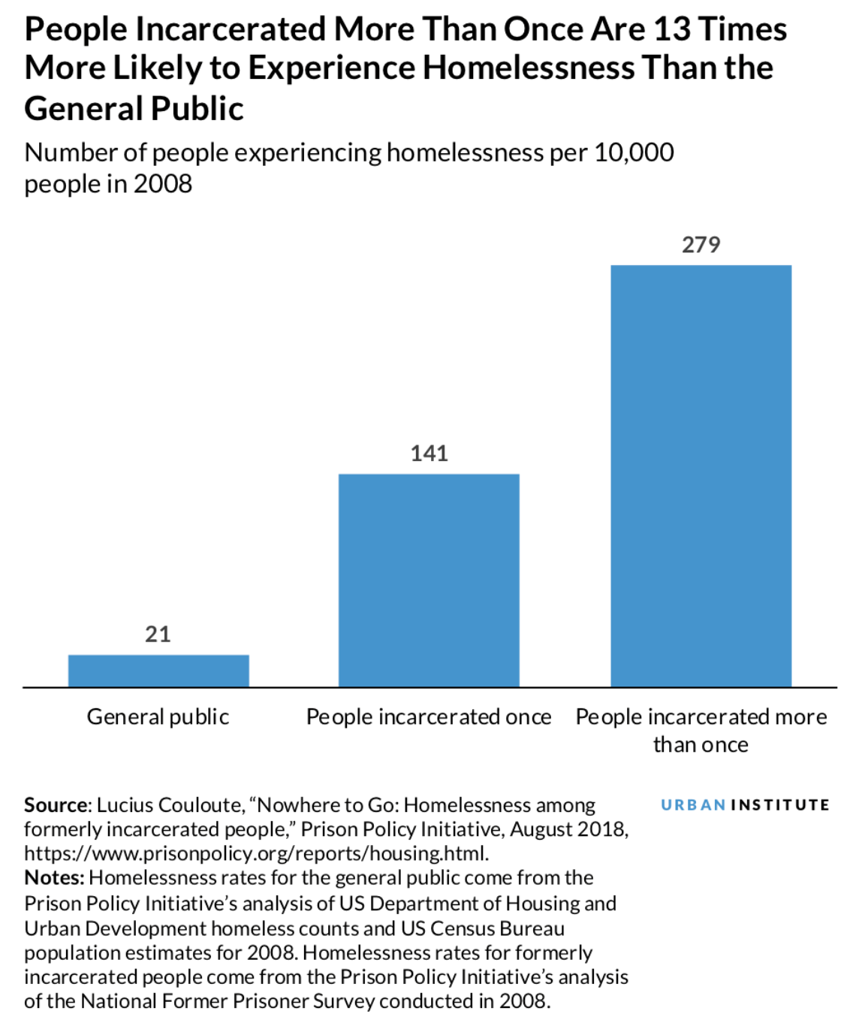
Homelessness and Incarceration
Those who have a history of incarceration or have been incarcerated are at a higher risk of being homeless
Even long after an individual’s release from prison, they can still be at risk of becoming homeless
49.6% of individuals who relied on homeless shelters, used them even after over two years of their release, highlighting the problem of reintegration
92.6% of individuals who have not used shelters previously had used them after being released, highlighting incarceration as a trigger
Those who have used shelters prior and received mental health treatment during their time in prison also increase their risk of using shelters again, but being married will slow their risk
Someone with a maximum sentence is more at risk of using shelters compared to those with a shorter sentence because those with a shorter sentence receive less stigma
Older and Black men are at higher risk due to race and poverty as well as older people receiving less social support after being released

Slide 6
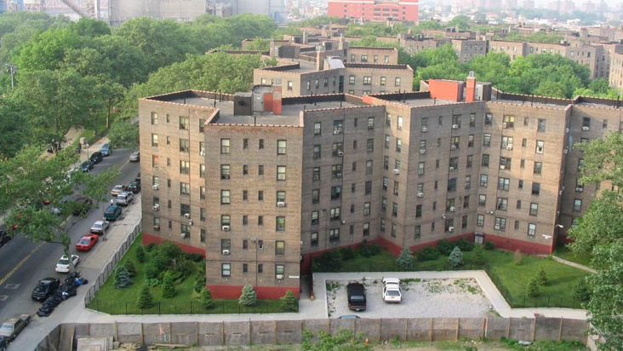
Homelessness and Mental Illness
Unstable housing can increase the risk of criminal behavior, especially for individuals who have been recently released from being incarcerated
Housing can be used as a protective factor to prevent individuals from criminal behavior by easing stressors that might contribute to criminal behavior
Providing homeless individuals with stable housing eliminates the stress of job loss or homelessness, allowing them to receive treatment for substance abuse or mental illness to successfully reintegrate society
The public is still resistant to public transitional housing programs, believing that it may impact public safety or impact them economically
With the use of educational campaigns that target the public’s concerns about social welfare, self-interest, and retributive values, we can shape their opposition to a program that can aid in the success of the homeless
Notes:
2. It serves as a shield against self-destructive and pro-criminal influences, securing employment by providing their employer with residential information, improving workplace performance by eliminating the stress of being homeless or losing their job, and unstable housing making connections with treatment providers more difficult

