Slide 1
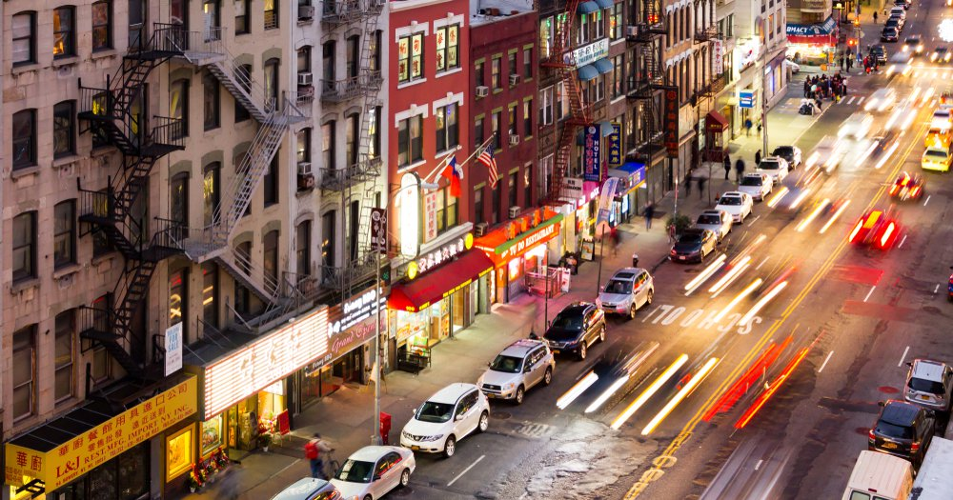
The Lower East Side by Kianna Talley

Slide 2
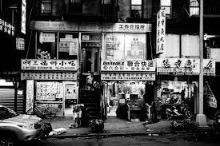
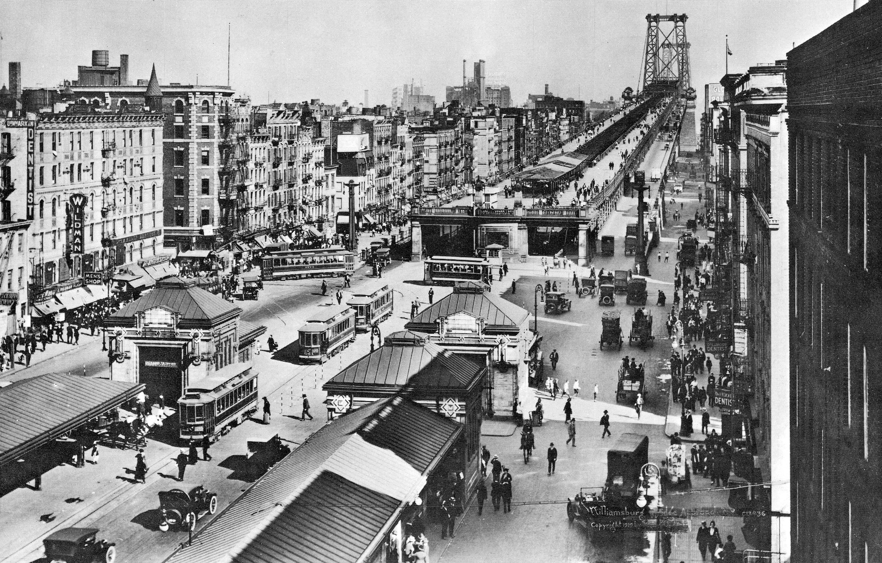
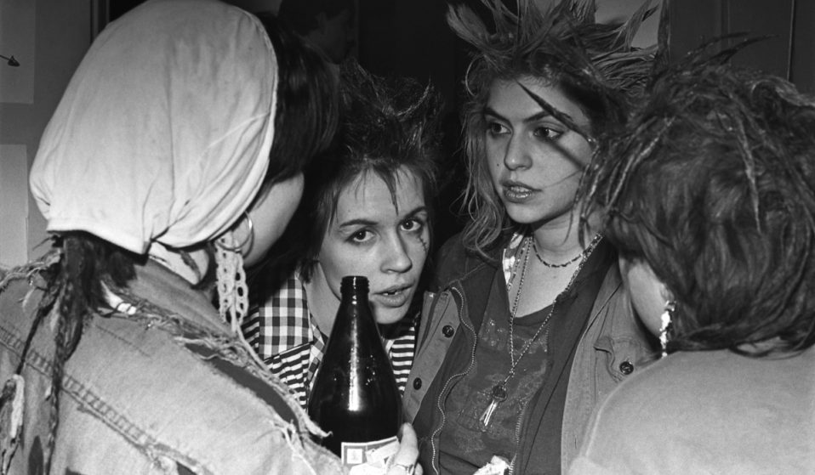
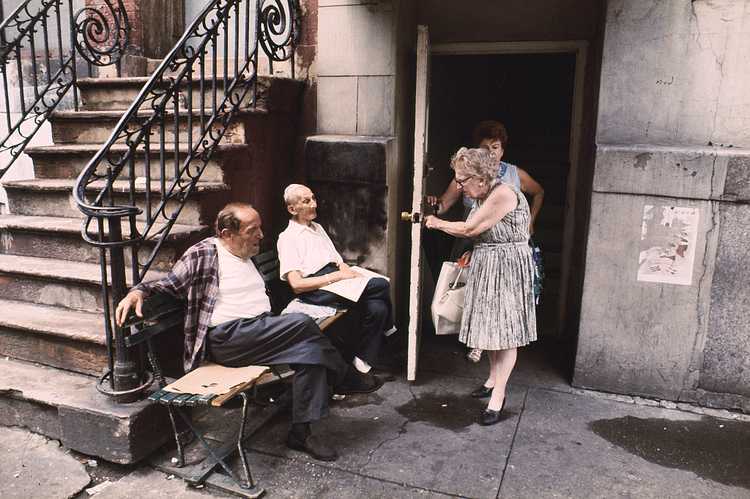
The Lower East Side was once home to immigrants, specifically Jewish, Italian and Irish.
Later welcoming a large Chinese population, along with Puerto Rican
Home of the working class and poor and known for its tenements.

Slide 3
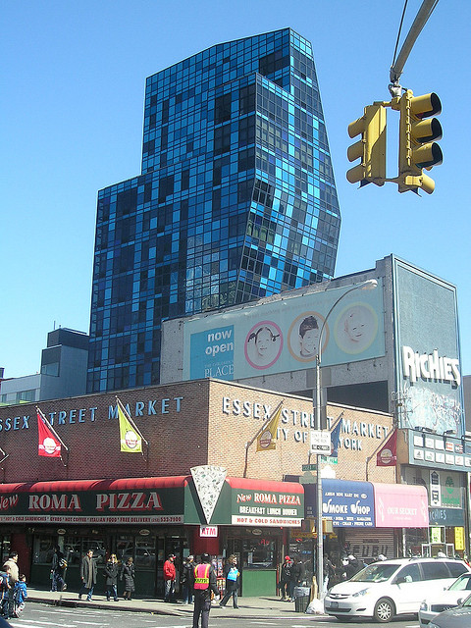
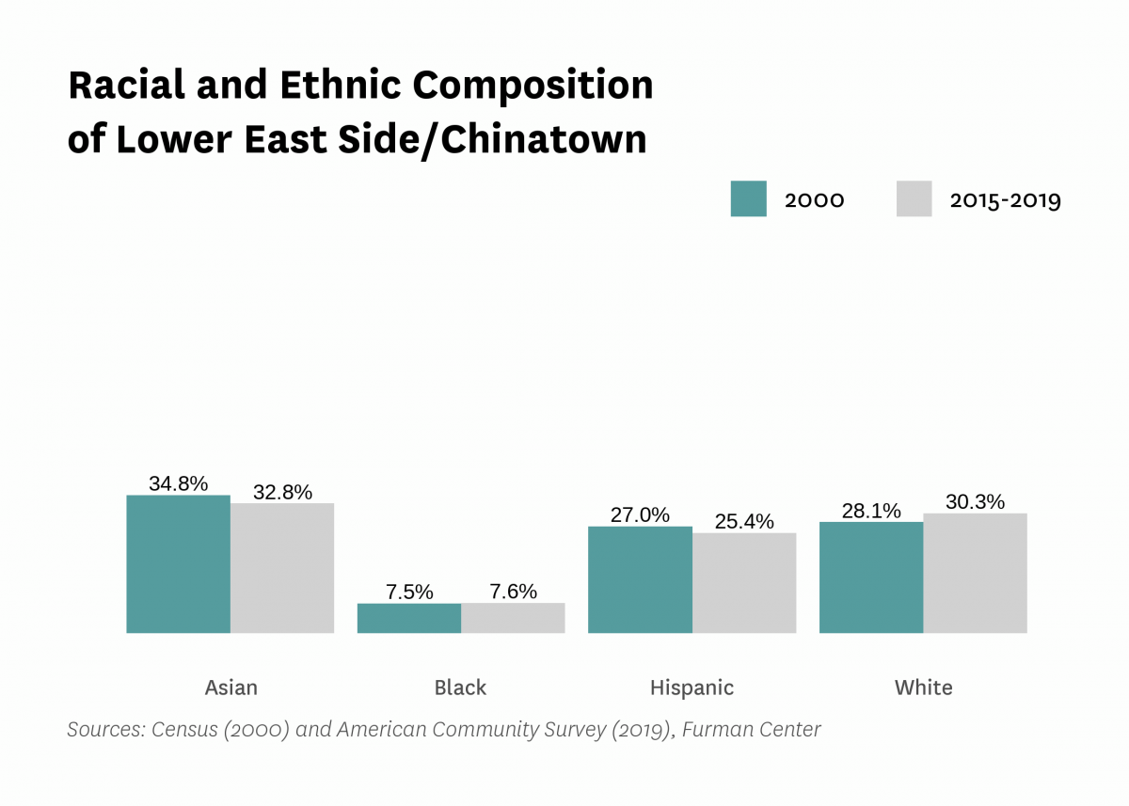
Fast-Forward:
The scene of the Lower East Side changed
A vast nightlife scene emerged
Still home to people of the working class and low income
In 2010, the population was around 159,009

Slide 4
The Black Population was and still is the lowest on the Lower East Side
However, when observing the environment, there is a large black and Hispanic presence
Whites and Asians make up the largest population of the L.E.S.
As of 2019, the population was 167,128

Slide 5
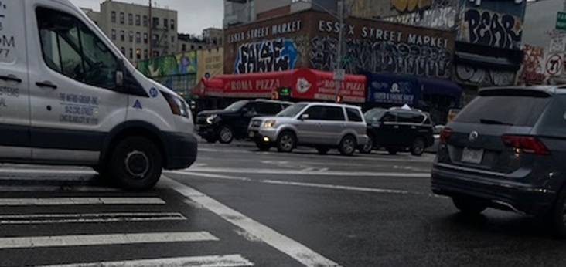
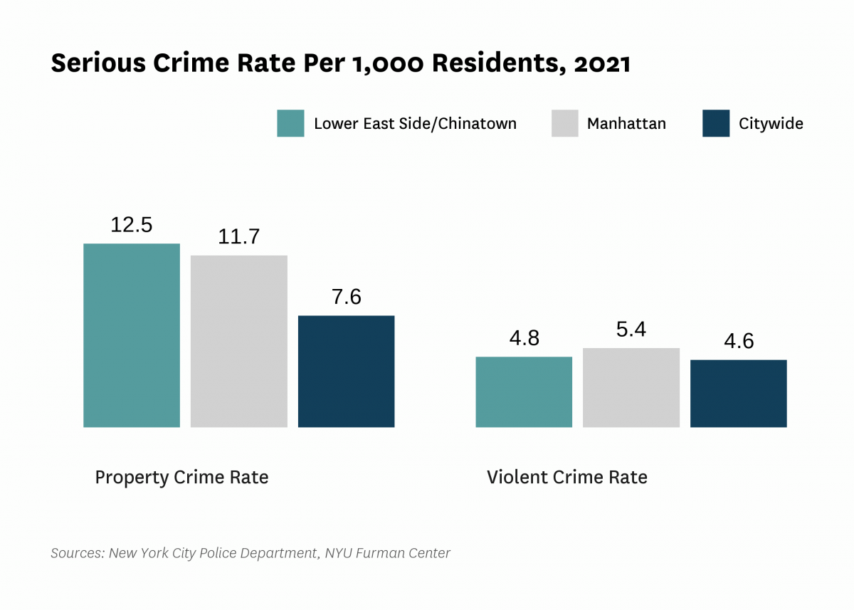
With new developments being put up rapidly, the neighborhood is also deteriorating
An increase in crime rate can be attributed to the increase of homelessness, drugs, and marijuana stores.
This photo was taken December 7th, 2022

Slide 6
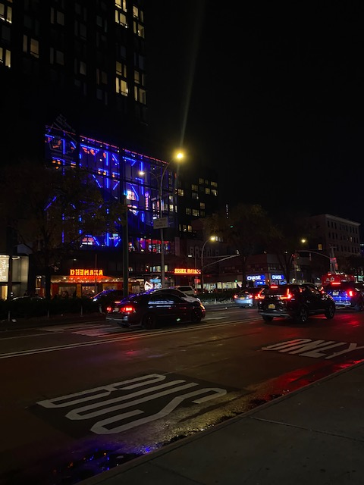
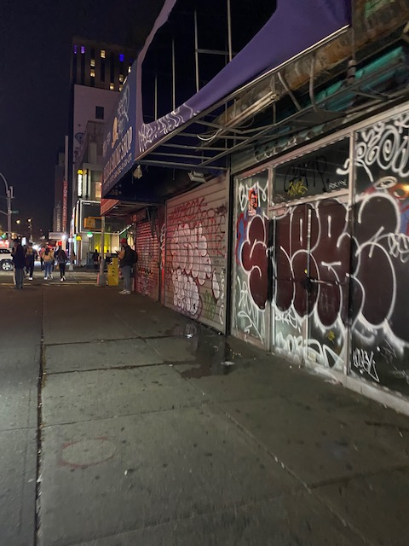
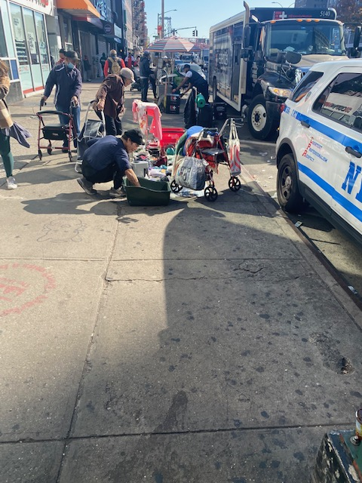
Photo on the left: New movie theater and Essex Street Market
Middle: Abandoned and run-down store fronts that have closed due to rent inflation and/or lack of business
Right: A homeless, addict set up shop with personal and other items to sell in front of the Essex train station entrance

Slide 7
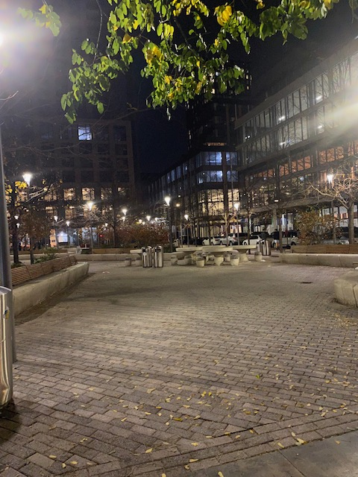
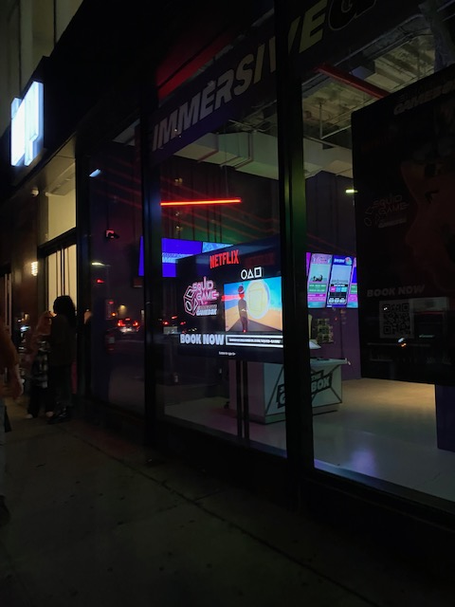
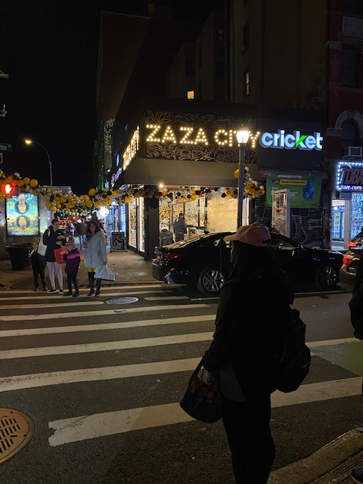
Left: New private owned public park around new 3 new housing developments.
Middle: A Netflix Immersive Experience (Virtual Reality) of show Squid Games
Right : New weed dispensary right off the Williamsburg Bridge

Slide 8
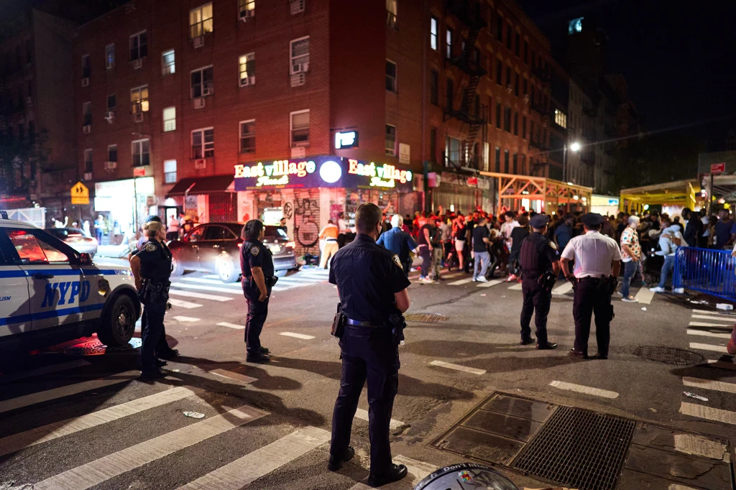
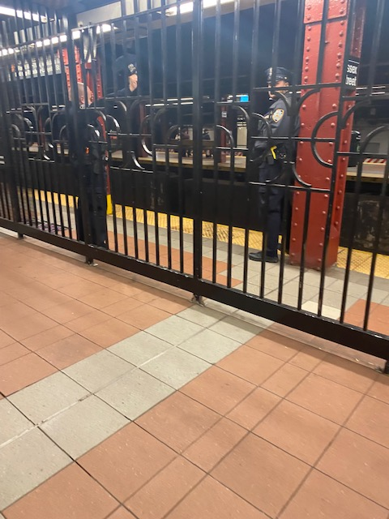
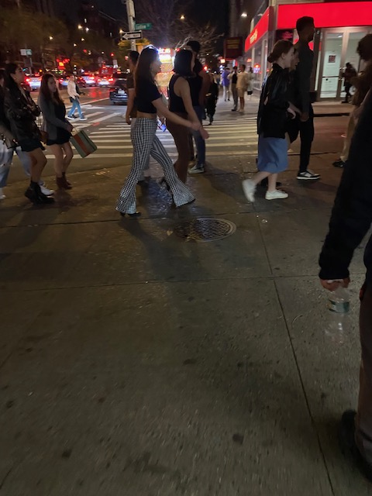
An increase of police presence due to nightlife activity, homelessness and disruption in the train station

