Slide 1
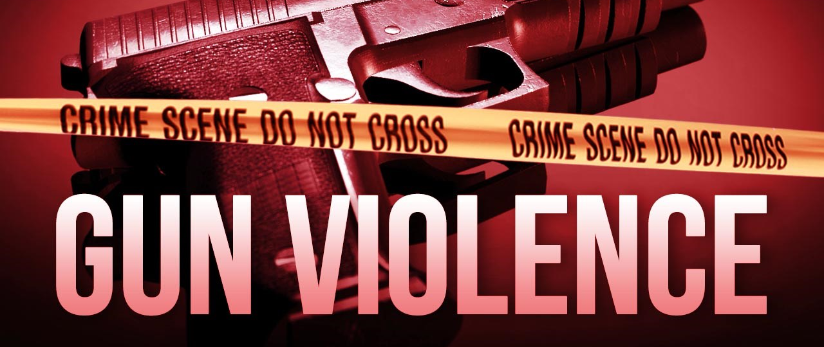
The Increase in gun violence in My Neighborhood (East Flatbush)
Name: Shanique Stephenson

Slide 2
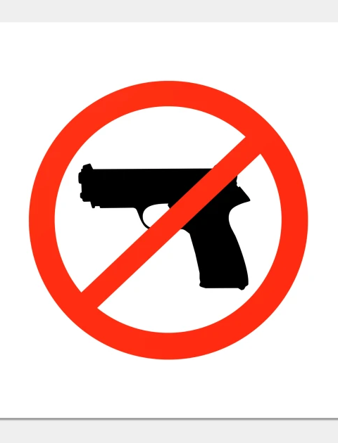
What is Gun Violence?
Gun related violence, is violence committed with the use of a firearm, which includes homicide, violent crime, assault with a deadly weapon, suicide or attempted suicide, depending on the jurisdiction.

Slide 3
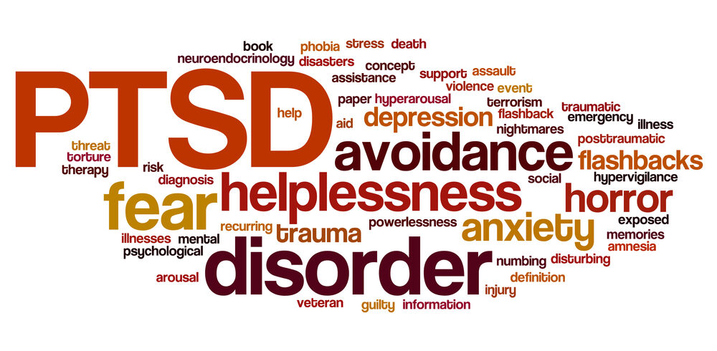
How has gun violence affected the society, especially people within the neighborhood?
Gun violence has been one of the most common crimes that has been consistently increasing on a day-to-day basis and it is deeply implanted in the American society, especially in the neighborhood. The rise in gun violence within my neighborhood has left a negative impact, where it as felt unsafe to walk in certain places such as the park, the deli or even the bodegas. It has also caused people to relocate into different and calmer neighborhoods, upstate or even out of state in-order for their families to feel safer especially the children, has the exposure to gun violence can cause emotional scars that are long-lasting, depression, phobia, helplessness, anxiety, fear and more so, PTSD.

Slide 4
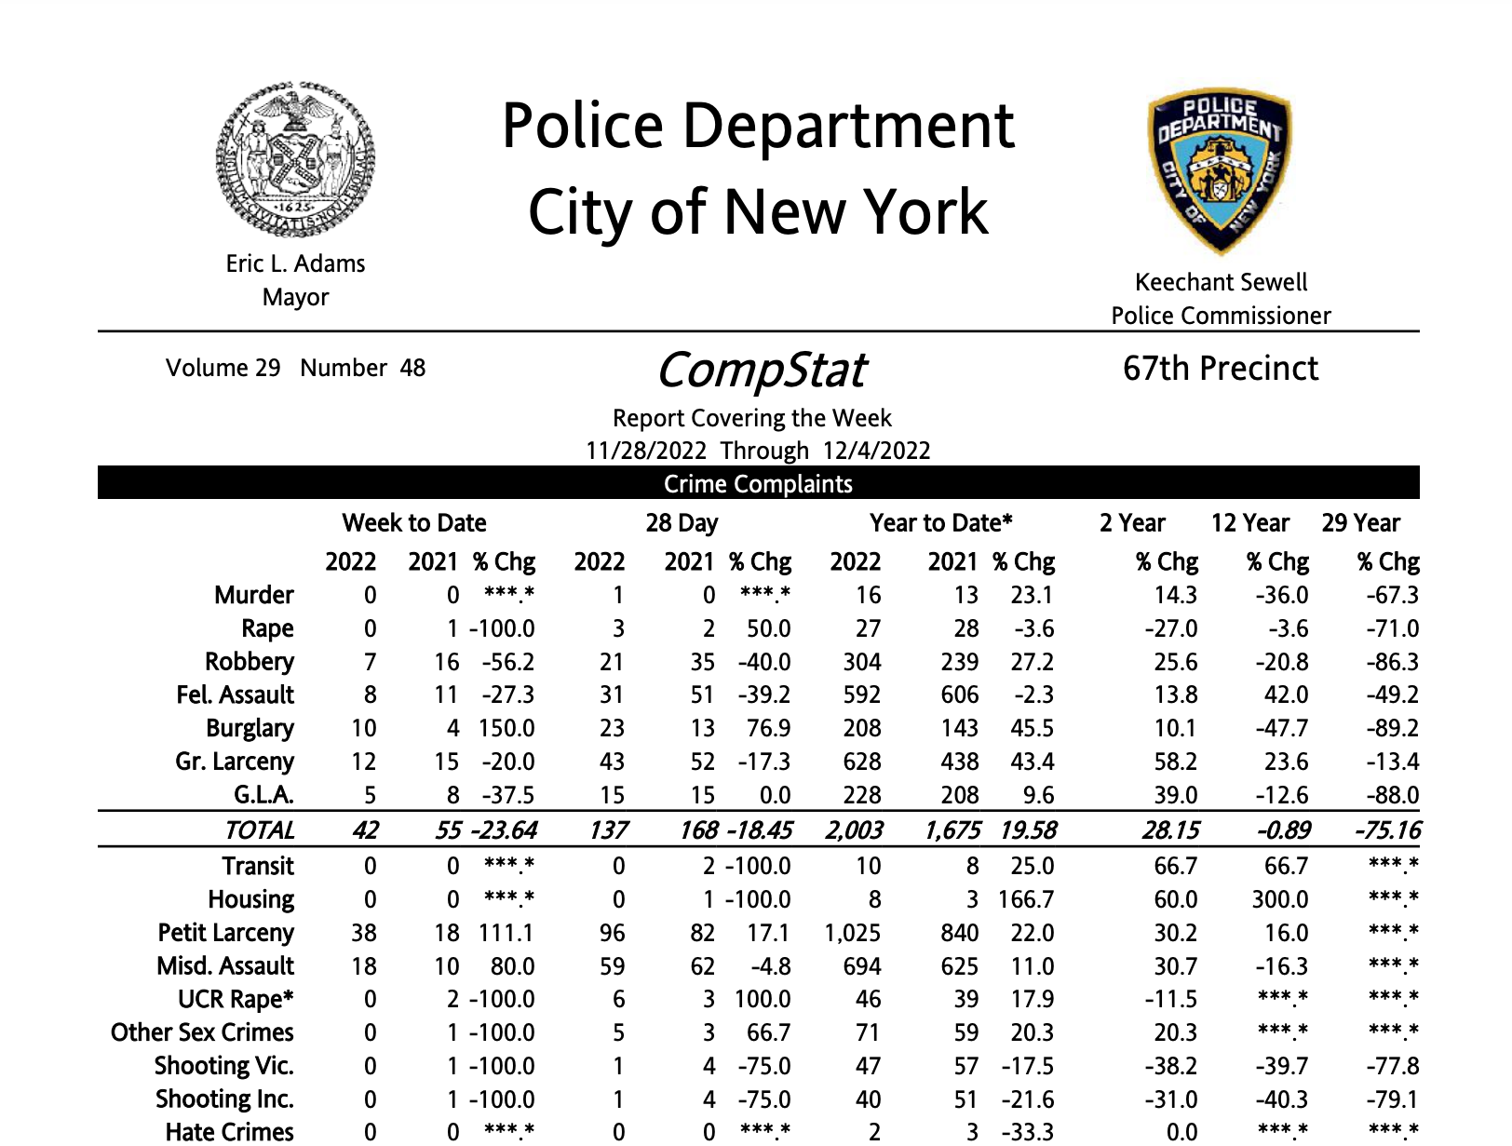
The 67th Precinct Crime Statistics Report

Slide 5
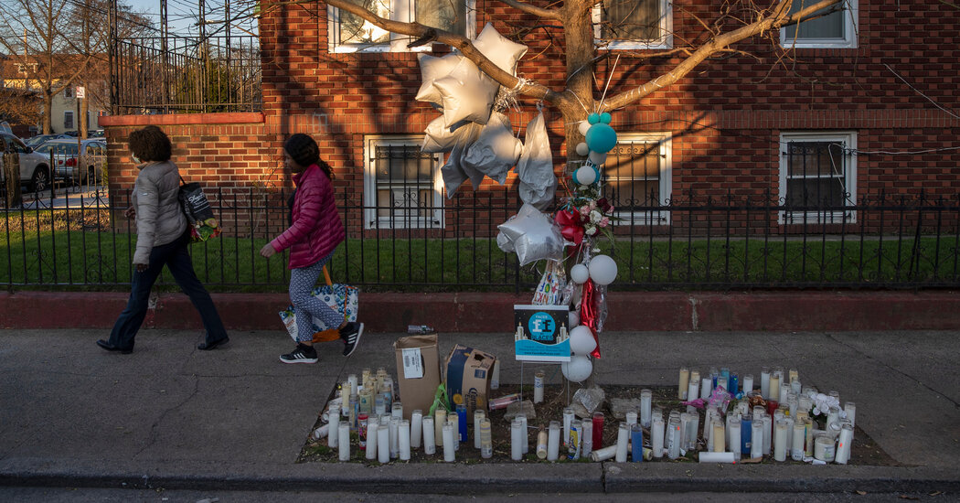
This is a memorial that happened earlier this year for Kade Lewin, a 12-year-old honor roll student who was killed and mistakenly identified as someone else, sitting in a parked car with cousins having dinner in East Flatbush. The involvement of gangs and the competitive drug market has contributed to gun violence in so many ways and the police have stated that the violence and criminals in East Flatbush have become more brazen and a few people within the neighborhood also stated that the violence today has reminded them of the same violence or even worse, in the 1990s.

Slide 6
