Slide 1
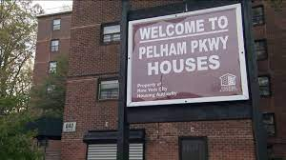
Pelham Parkway
By: Anderson Huerta

Slide 2
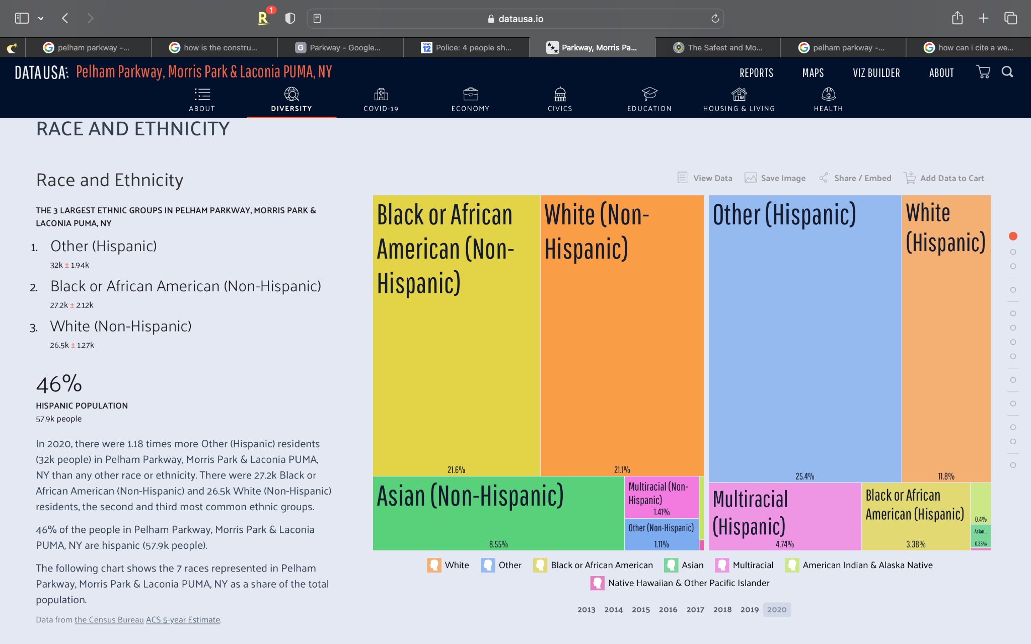
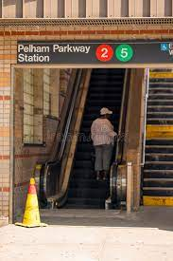
My Neighborhood
Pelham Parkway was established in 1911 and is a working, middle-class residential neighborhood located in the center of the Bronx.
The neighborhood has a remarkably diverse community including Albanians, African Americans, Arabs, Dominicans, etc.
In 2018, an estimated 21% of Pelham Parkway and Morris Park residents lived in poverty, compared to 25% in all of the Bronx and 20% in all of New York City. One in eight residents (12%) were unemployed, compared to 13% in the Bronx and 9% in New York City. Rent burden, or the percentage of residents who have difficulty paying their rent, is 55% in Pelham Parkway and Morris Park, compared to the boroughwide and citywide rates of 58% and 51% respectively.

Slide 3
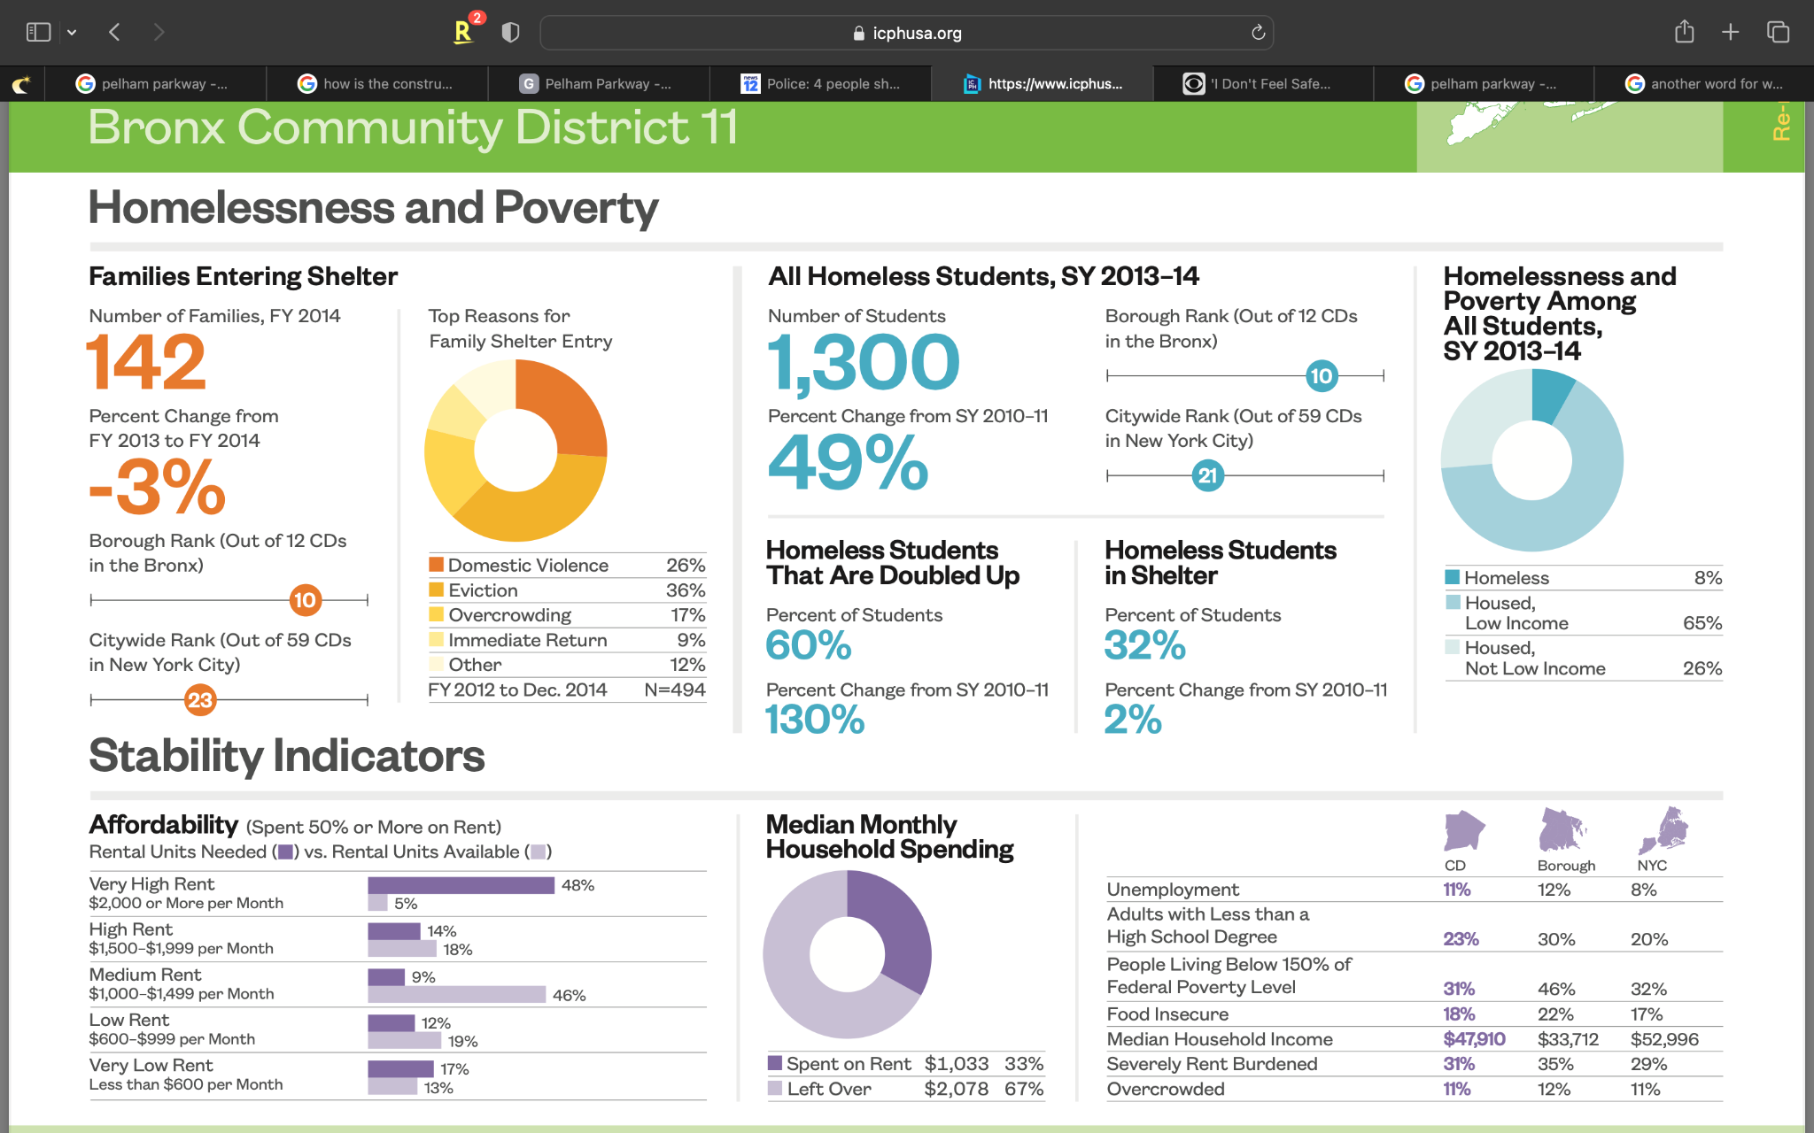
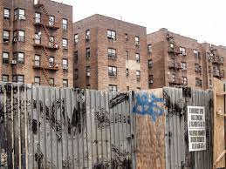
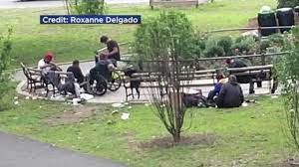
Poverty and the homeless
Residents say a park in the Bronx recently beautified for the community's enjoyment has instead become a magnet for homelessness, drug use, and unsanitary conditions. - CBS NY
Since this property is owned and managed by a Public Housing Authority, all of the rents at this property are based on tenant incomes. Tenants will make a monthly contribution toward rent equal to 30% of their adjusted income. A housing authority may establish a minimum rent of up to $50.

Slide 4
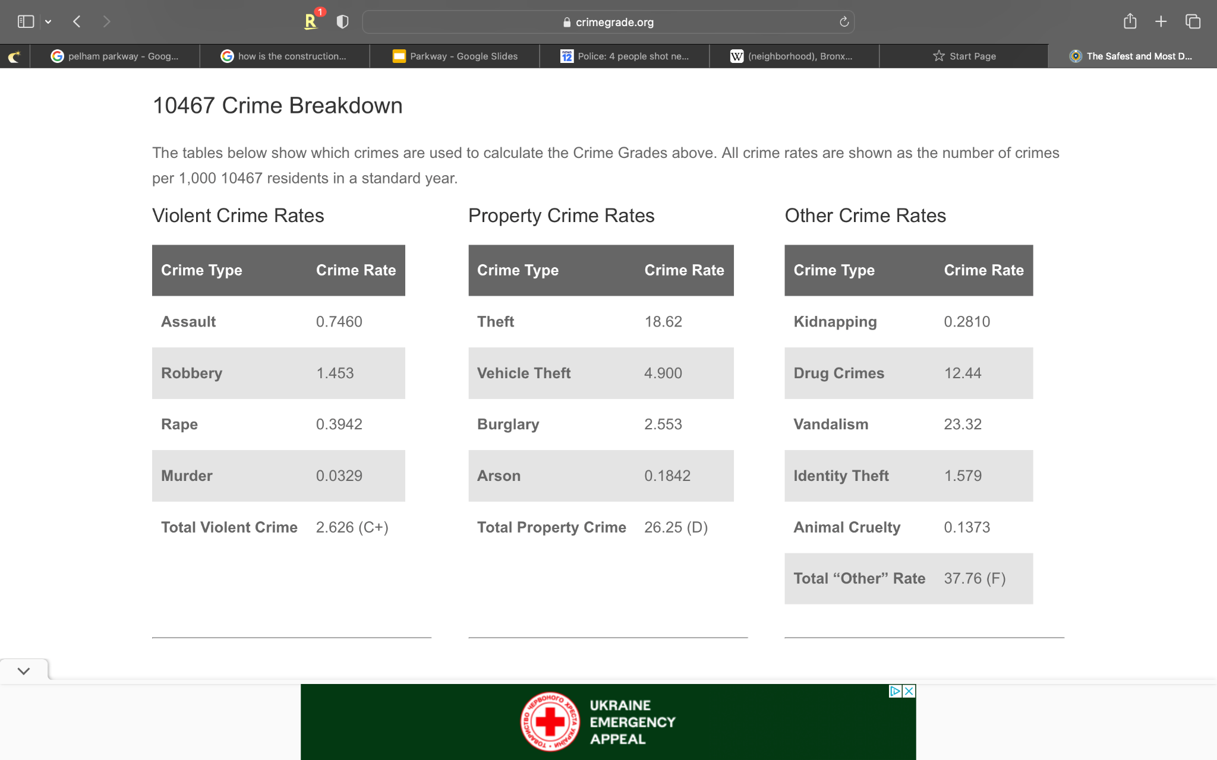
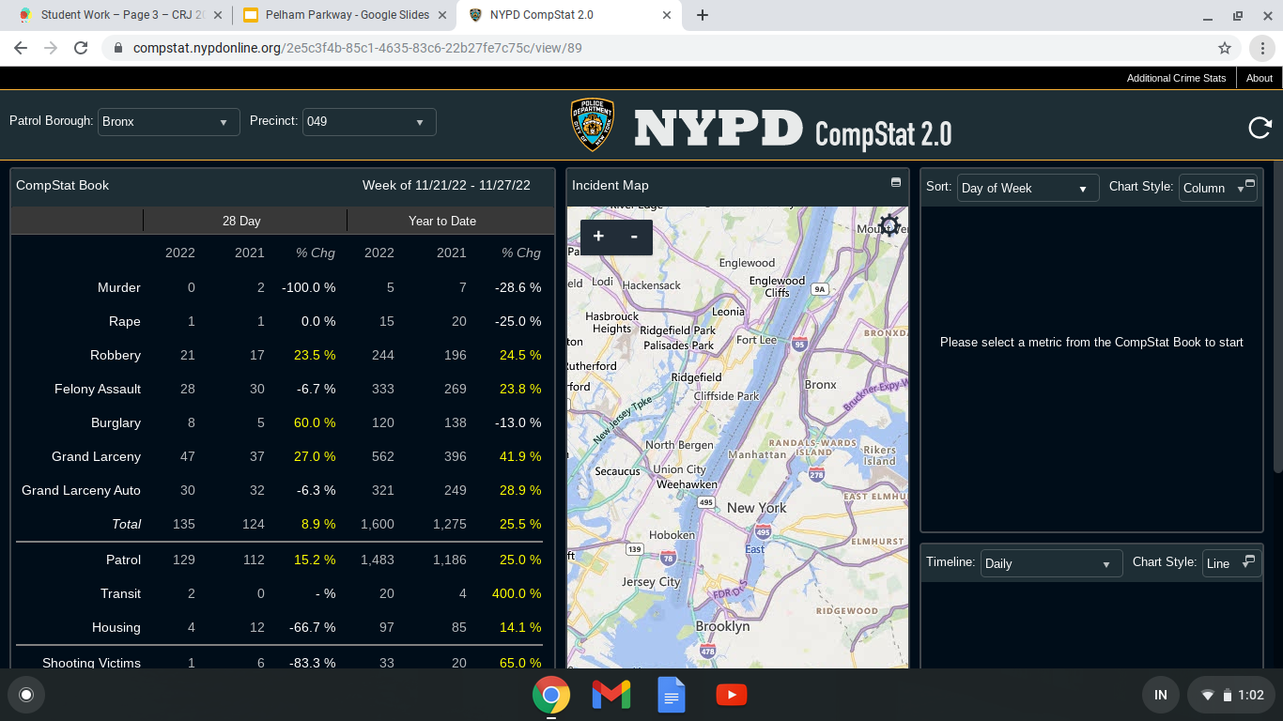
Crimes
Robbery, Felony Assault, Grand Larceny, and Grand Larceny Auto have increased since 2021.
Many residents have claimed “they do not feel safe anymore” as crime rates continue to grow. What is being done about this?
The 49th is the local precinct for Pelham Parkway and they are #43 ranked for safest precincts out of 77.

Slide 5
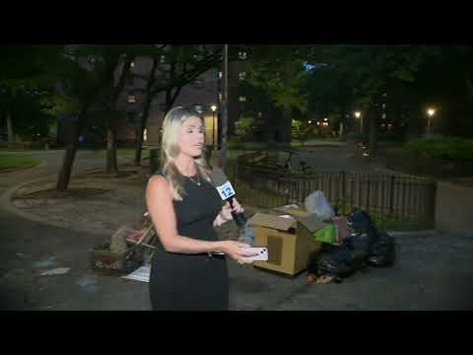

Examples:
Homeless man disturbing the neighborhood with public nudity
4 People shot in Pelham Parkway Houses

Slide 6
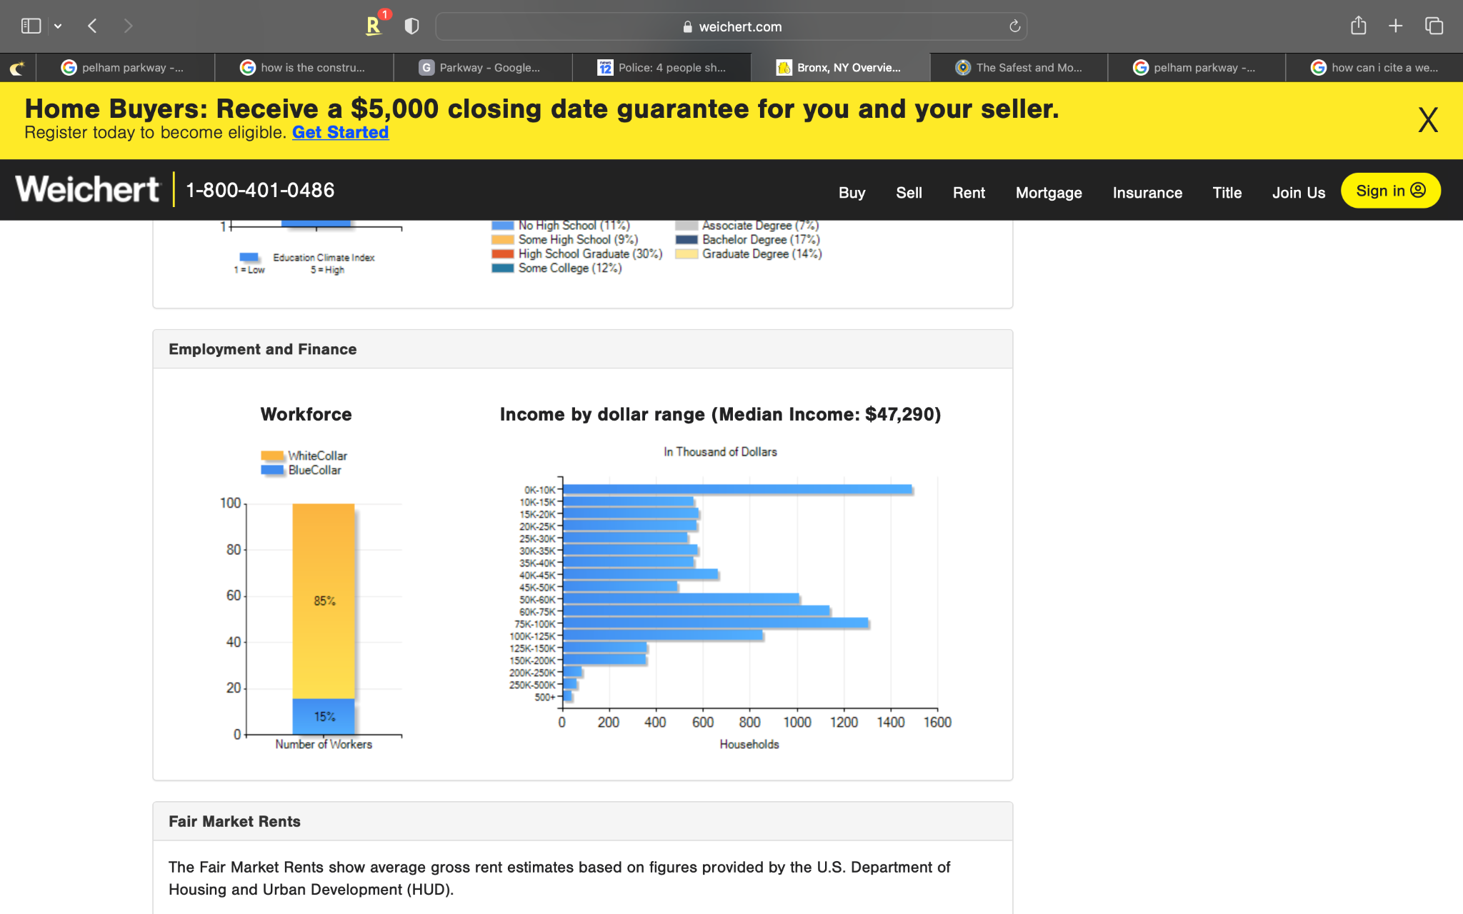
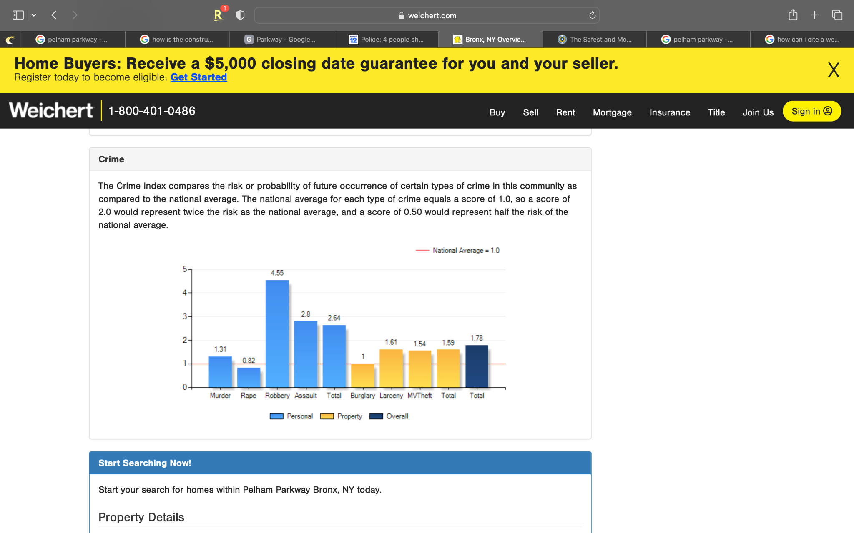
Poverty & Crime
Over 1,400 households in Pelham Parkway incomes range between 0-10k, which is a majority of the population.
Almost every crime is above national average of 1.0 which demonstrates the crimes are twice as likely to happen in this neighborhood.

Slide 7
