Slide 1
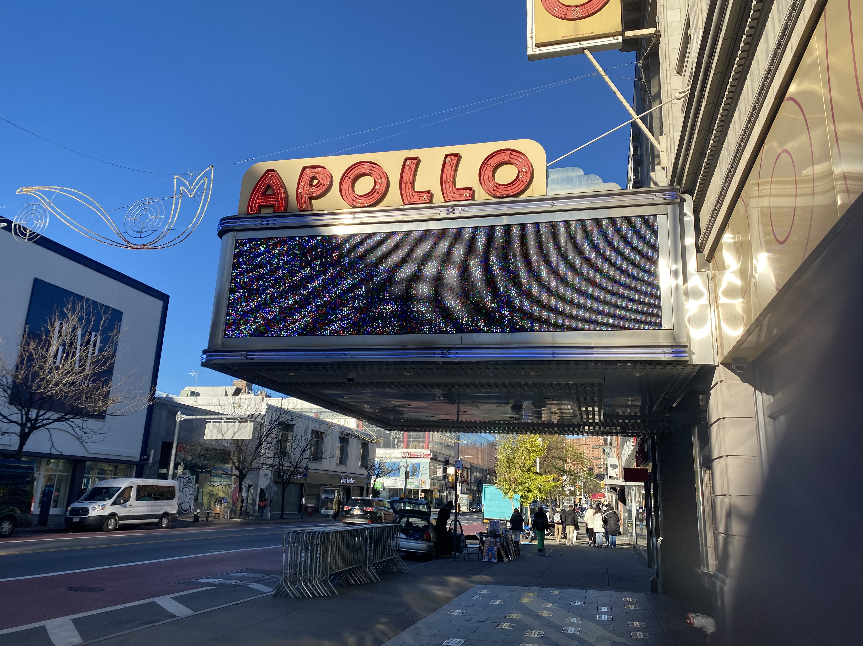

Neighborhood
Report: Harlem

Slide 2
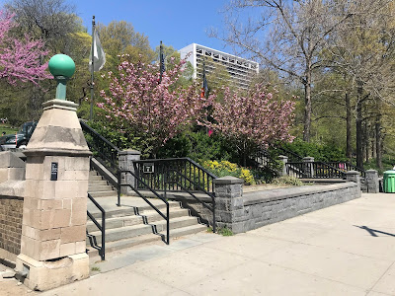
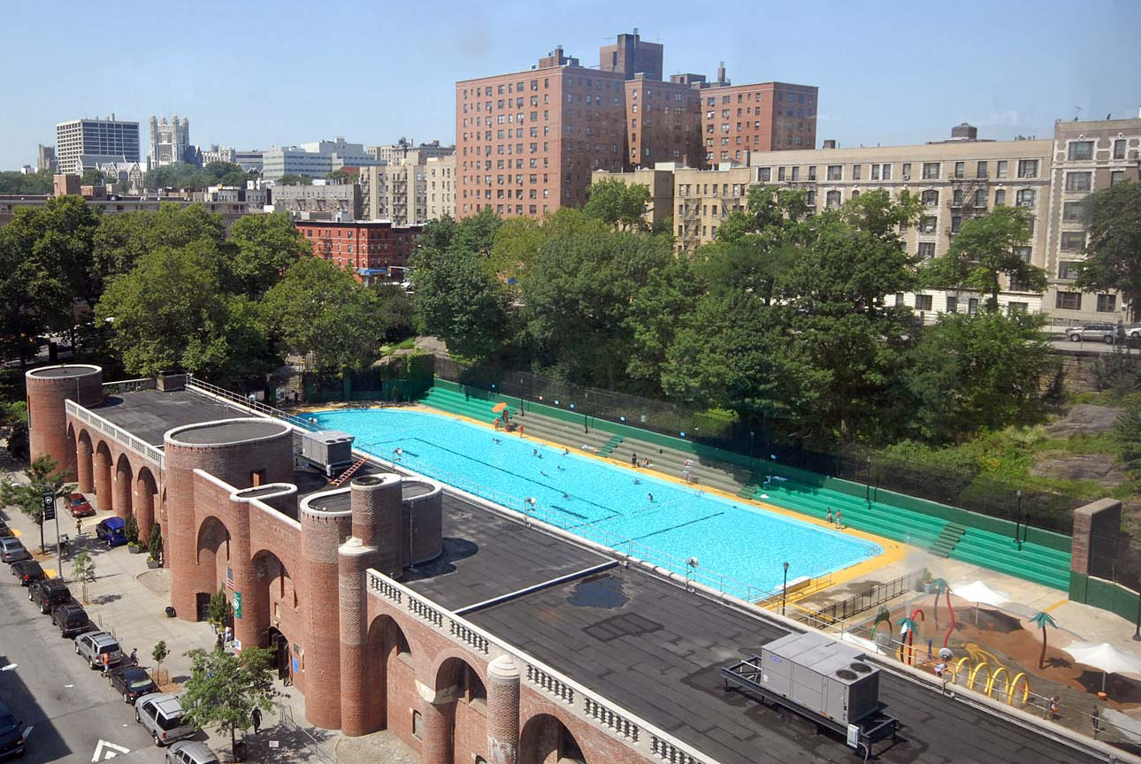

Slide 3
Neighborhood Parks
St. Nicholas Park
- 128TH ST to 141st ST
- Play grounds, picnic, BBQ areas
- Hamilton Grange national memorial
Jackie Robinson Park
- 145th ST to 155th ST
- Public swimming pool

Slide 4
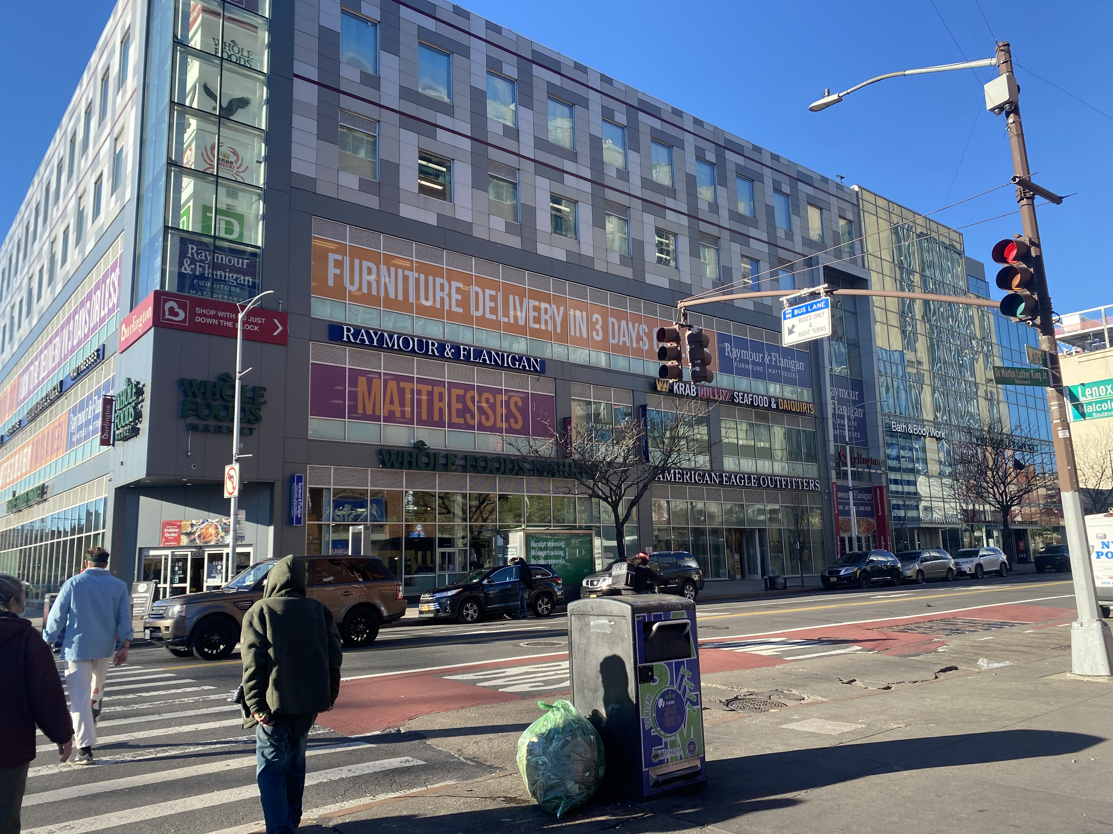
The Growing presence of “Big Box”

Slide 5
Historical demographic data
136,351 Residents (central Harlem)
54.3% Black or African American
23.6% Hispanic
15.5% White
3.6% Asian
(The NYU Furman Center)

Slide 6
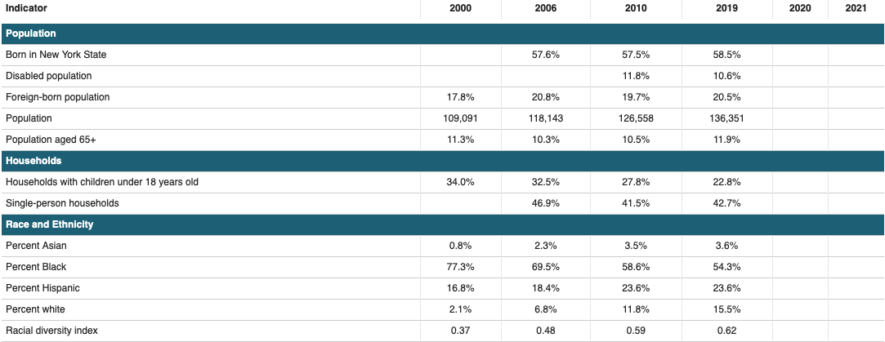

Slide 7
Incarceration data (10030)
Number of citizens in state prison - 203
Imprisonment rate per 100,000 - 679
(Prison Policy Initiative)

