Slide 1

Researching the Community: Community as a Criminal Culture and a Broken Window
WEEK 6

Slide 2

Cultural and Subcultural Theories of Crime
Unique groups in society: Socialize their children to believe that certain activities that violate conventional law are good and positive ways to behave.
Notes:
Satisfies Learning Objective 9.3 Identify some current, modern-day examples of specific cultures or subcultures in the United States and how they relate to crime.

Slide 3
Cultural and Subcultural Theories of Crime
Early Theoretical Developments and Research in Cultural/Subcultural Theory
Ferracuti and Wolfgang’s primary conclusion: violence is a culturally learned adaptation to deal with negative life circumstances.
No subculture can be totally different from or totally in conflict with the society
Cultural/subcultural theory.
Notes:
Satisfies Learning Objective 9.3 Identify some current, modern-day examples of specific cultures or subcultures in the United States and how they relate to crime.
Ferracuti and Wolfgang’s primary conclusion: Violence is a culturally learned adaptation to deal with negative life circumstances and that learning such norms occurs in an environment that emphasizes violence over other options.
Cultural/subcultural theory: A perspective on criminal offending that assumes that many offenders believe in a normative system distinctly different from and often at odds with the norms accepted by conventional society.

Slide 4
Cultural and Subcultural Theories of Crime (3 of 4)
Early Theoretical Developments and Research in Cultural/Subcultural Theory
Miller’s theoretical model: Entire lower class had its own cultural value system.
  Six focal concerns: Fate, autonomy, trouble, toughness, excitement, and smartness.
Model proposed by Elijah Anderson.
  Code of the street: Maintain one’s reputation and demand respect.
Notes:
Satisfies Learning Objective 9.3 Identify some current, modern-day examples of specific cultures or subcultures in the United States and how they relate to crime.
Miller’s theoretical model: Miller presented a theoretical model that proposed that the entire lower class had its own cultural value system.
Six focal concerns: In this model, virtually everyone in the lower class believed in and socialized the values of six focal concerns:
Fate: The concern of luck, or whatever life dealt you; it disregarded responsibility and accountability for one’s actions.
Autonomy: The value of independence from authority.
Trouble: The concern of staying out of legal problems, as well as getting into and out of personal difficulties.
Toughness: Maintaining your reputation on the street in many ways.
Excitement: The engagement in activities (some illegal) that helped liven up an otherwise mundane existence of being lower class.
Smartness: The emphasis on “street smarts” or the ability to con others.
Model proposed by Elijah Anderson: This theory focuses on African-Americans and claims that due to deprived conditions in the inner cities, black Americans feel a sense of hopelessness, isolation, and despair.
Code of the street: According to Anderson, “the code of the streets”—also the title of his book—is to maintain one’s reputation and demand respect. For example, to be disrespected (“dissed”) is considered grounds for a physical attack.

Slide 5

Street Codes -- Code of the Street, Elijah Anderson
This theory focuses on African-Americans and claims that due to deprived conditions in the inner cities, Black Americans feel a sense of hopelessness, isolation, and despair.
According to Anderson, “the code of the streets”—also the title of his book—is to maintain one’s reputation and demand respect. For example, to be disrespected (“dissed”) is considered grounds for a physical attack.

Slide 6
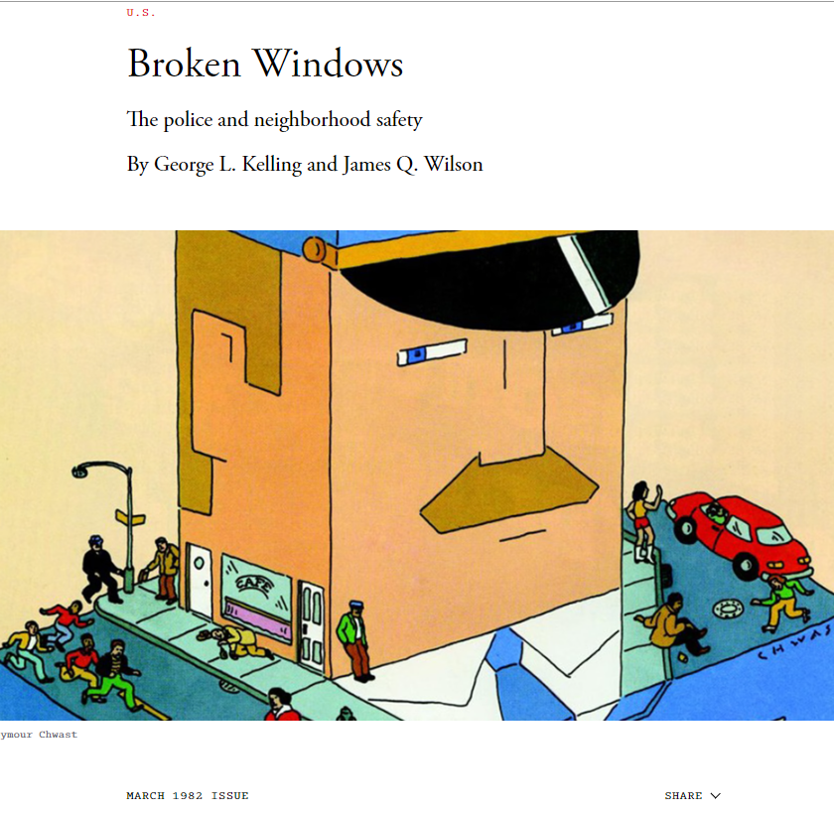
Broken Windows Theory
James Q. Wilson & George L. Kelling, 1982

Slide 7
If a window in a building is broken and is left unrepaired, all the rest of the windows will soon be broken. One unrepaired broken window is a signal that no one cares, and so breaking more windows costs nothing.

Slide 8
A house in which a window is broken:
If Pane of Glass is replaced; it implies
  Owner is present
  Cares about the property; and
  Will not tolerate its disrepair

Slide 9

A house in which a window is broken:
But If→ window remain broken: it implies;
  The property has no guardian
  An invitation
  Every window will be broken
  Vandalism of the house will implies

Slide 10
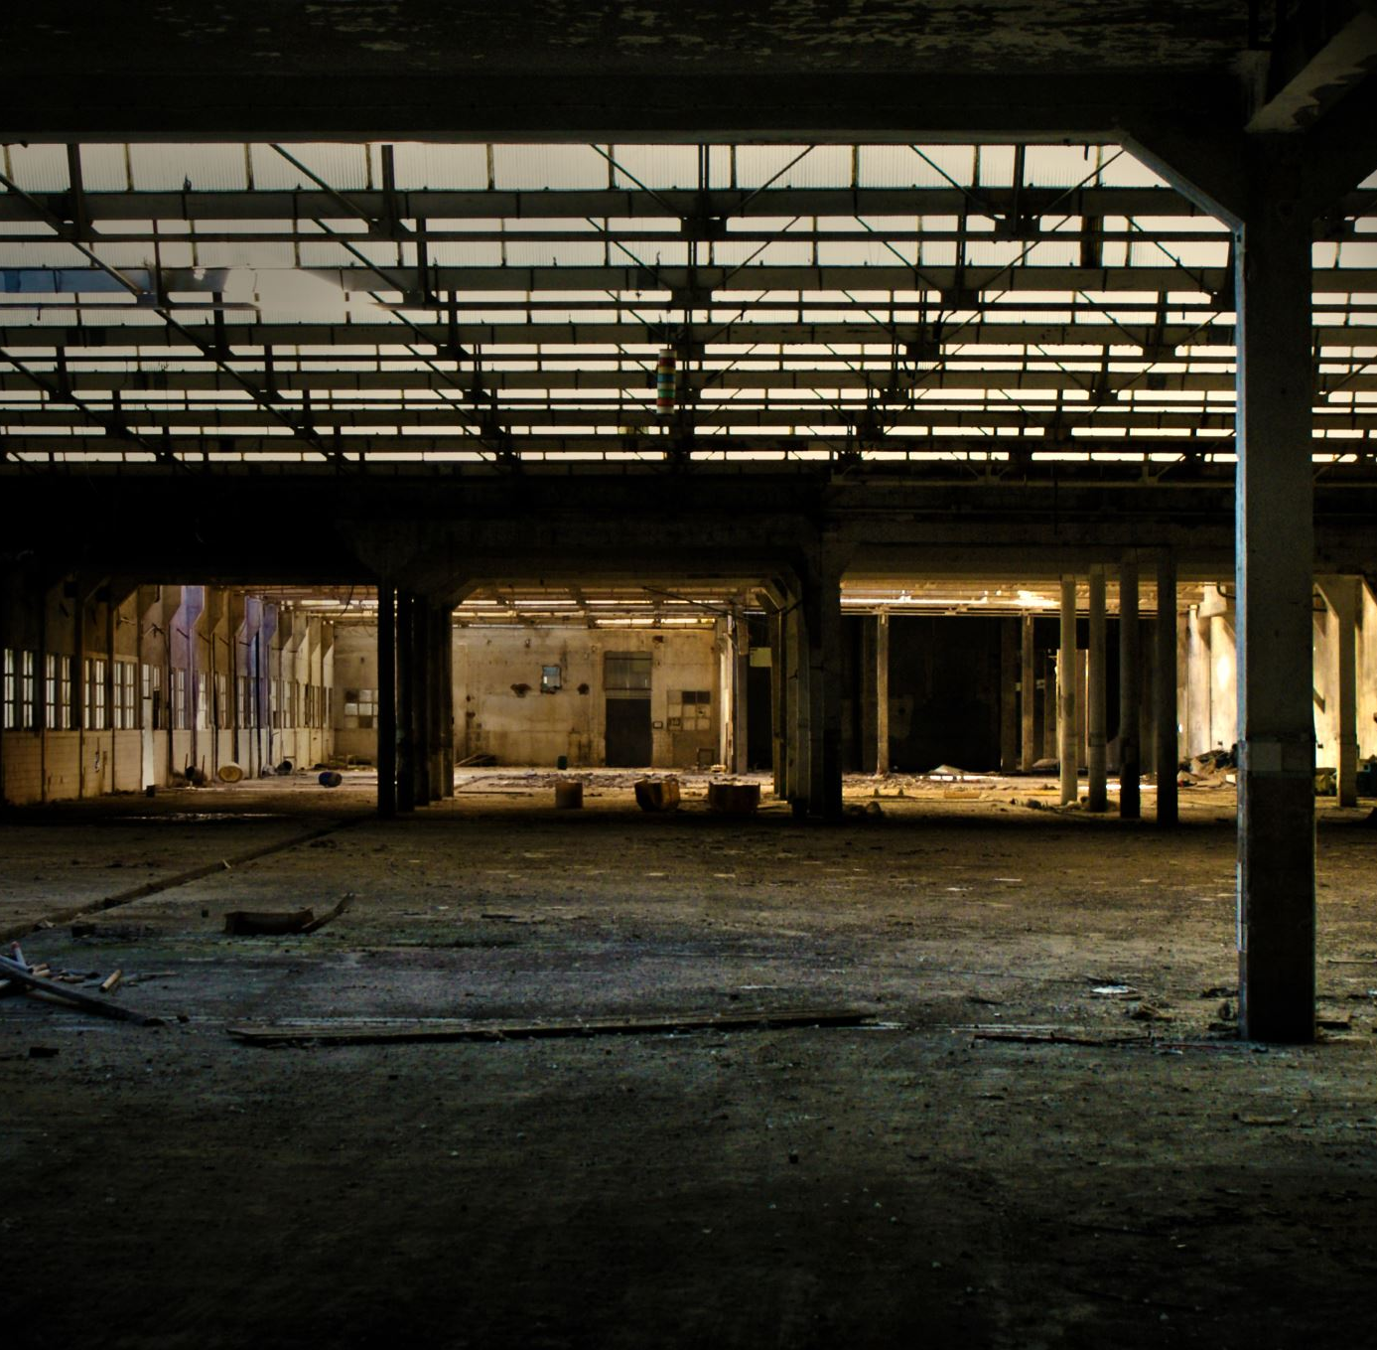
“Consider a building with a few broken windows. If the windows are not repaired, the tendency is for vandals to break a few more windows. Eventually, they may even break into the building, and if it's unoccupied, perhaps become squatters or light fires inside.”
“Or consider a pavement. Some litter accumulates. Soon, more litter accumulates. Eventually, people even start leaving bags of refuse from take-out restaurants there or even break into cars.”

Slide 11
Philip Zimbardo,
Zimbardo arranged for an automobile with no license plates and the hood up to be parked idle in a Bronx neighbourhood and a second automobile in the same condition to be set up in Palo Alto, California.
The car in the Bronx was attacked within minutes of its abandonment.
Zimbardo noted that the first "vandals" to arrive were a family – a father, mother and a young son – who removed the radiator and battery. Within twenty-four hours of its abandonment, everything of value had been stripped from the vehicle. After that, the car's windows were smashed in, parts torn, upholstery ripped, and children were using the car as a playground.
At the same time, the vehicle sitting idle in Palo Alto sat untouched for more than a week until Zimbardo himself went up to the vehicle and deliberately smashed it with a sledgehammer. Soon after, people joined in for the destruction. Zimbardo observed that a majority of the adult "vandals" in both cases were primarily well dressed, Caucasian, clean-cut and seemingly respectable individuals. It is believed that, in a neighborhood such as the Bronx where the history of abandoned property and theft are more prevalent, vandalism occurs much more quickly as the community generally seems apathetic.

Slide 12

Broken Windows Theory
Individuals will begin to commit crime such as Panhandling, prostitution and drug dealing
1
These crime will become part of the regular activities taking place in the abandoned building and will then spread out into neighborhood
2
Create more problems for the whole neighborhood and the society, due to less involvement of community
3

Slide 13
How it can be halted?
Fix the broken windows;
Attack the initial factor of the Causal Chain
Disorder caused by disreputable people
Breakdown in informal control
Invitation of predatory criminal
High crime rate in the neighborhood

Slide 14
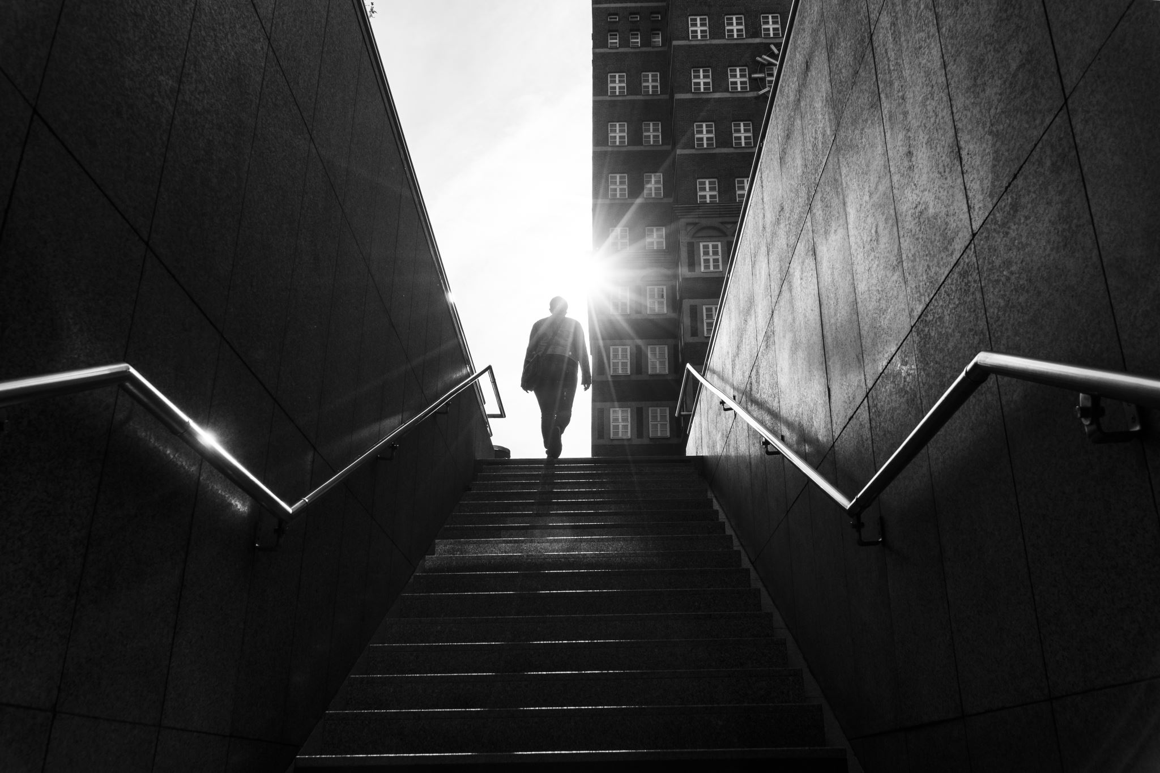
Conclusion
Little things matter- Take care of little things and the Big things will take care of themselves
“if a window is broken and left unrepaired, people walking by will conclude that no one cares and no one is in charge
Carelessness implies vulnerability

Slide 15
“Above all, we must return to our long-abandoned view that the police ought to protect communities as well as individuals. Our crime statistics and victimization surveys measure individual losses, but they do not measure communal losses. Just as physicians now recognize the importance of fostering health rather than simply treating illness, so the police—and the rest of us—ought to recognize the importance of maintaining, intact, communities without broken windows.”

