Slide 1

The Geography of Mass Incarceration
WEEK 4

Slide 2
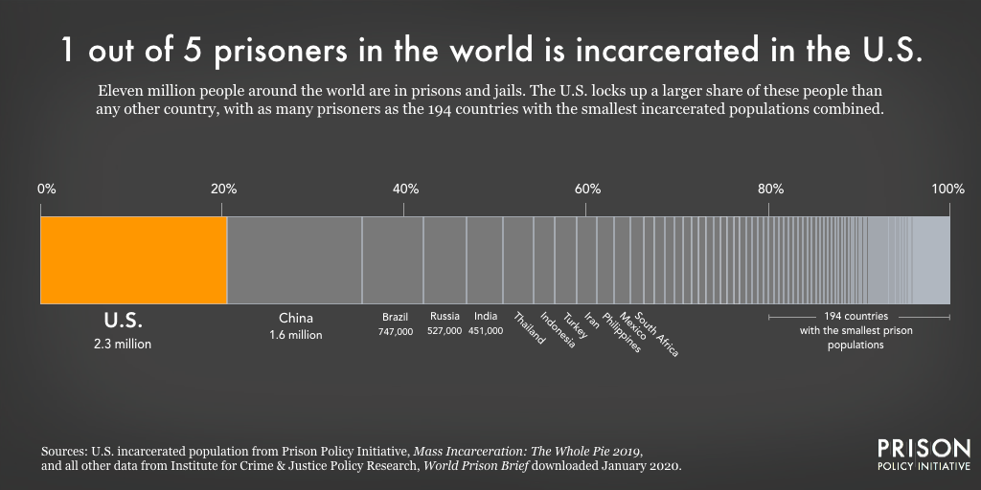
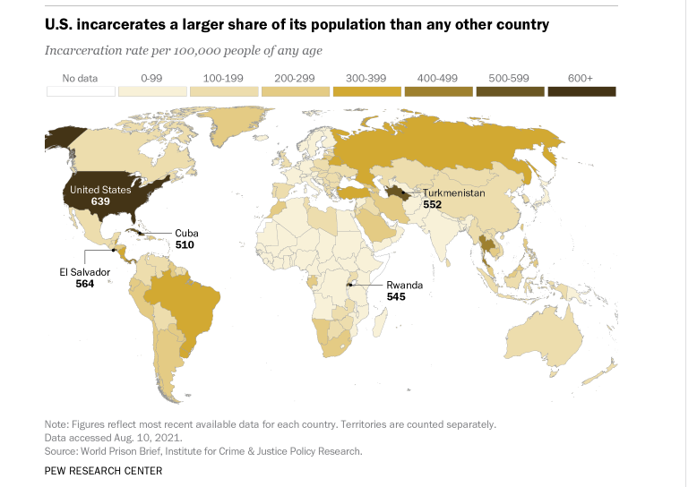
Introduction

Slide 3
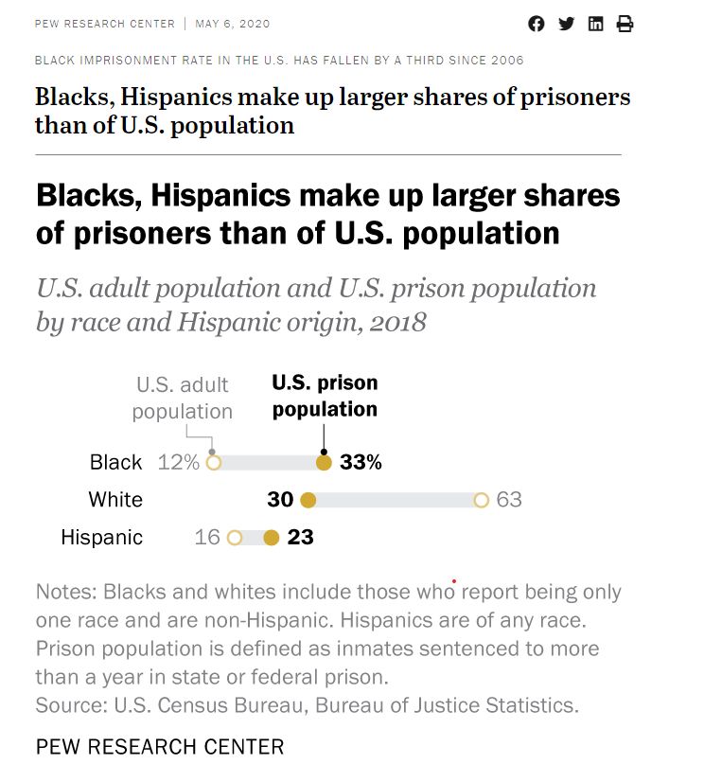
Racial Disparity of Mass Incarceration in the United States
According to Prison Policy Initiative Report, Racial Geography of Mass Incarceration (2015):
Blacks are incarcerated at a rate about 5 times higher than whites, but prisons are disproportionately located in majority-white areas
In the vast majority of counties, the prisons have proportionately larger Black populations than the surrounding county does.
Many counties have only very small Black populations while their prisons have much larger Black populations.

Slide 4
The Spatial Character of Incarceration
The studies show extreme spatial inequities in incarceration within urban cities and metro areas.
At the same time, the highest rates of incarceration are found in small cities and nonmetropolitan counties.
Mass incarceration is consequence and a legacy of racial segregation in the United States.

Slide 5
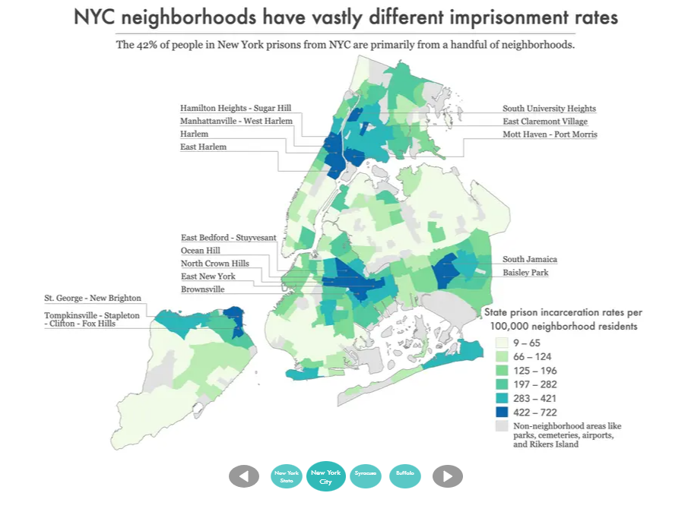
The Geography of Mass Incarceration in New York
New data shows that no community in New York is spared from the harms of mass incarceration. https://www.prisonpolicy.org/origin/ny/2020/report.html via @prisonpolicy

Slide 6
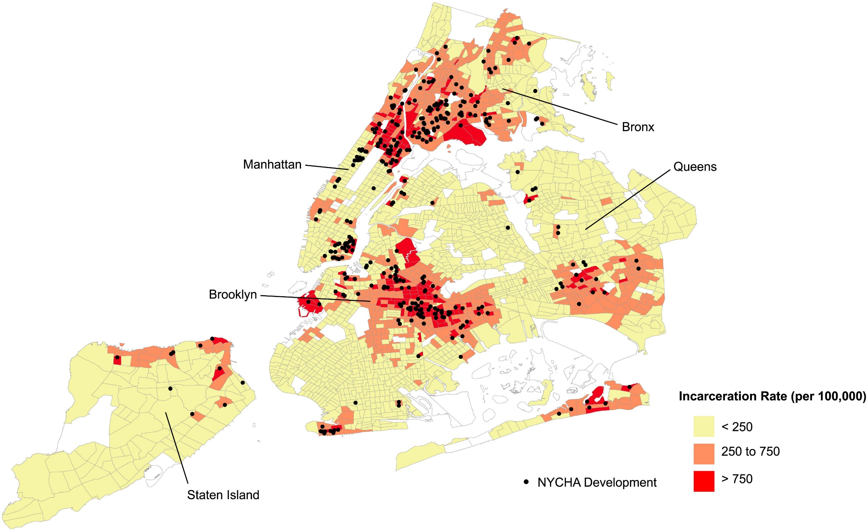
Public Housing to Prison Pipeline
According to a recent study (Holder et al, 2022)
Incarceration rates in NYCHA tracts are 4.6 times higher than those in non-NYCHA tracts
17% of New York State’s incarcerated population originated from just 372 NYCHA tracts.
Compared with non-NYCHA tracts, NYCHA tracts had higher shares of Black residents and were significantly more disadvantaged.
Hypersurveillance and hyperpolicing are key mechanisms underlying this public-housing-to-prison pipeline.
NYCHA housing developments and concentrated incarceration by census tract in New York City in 2010. Incarceration rate is the number of incarcerated individuals per 100,000 in a census tract. The colors represent three categories based on Jenks natural breaks algorithm in the distribution of incarceration rates across all tracts – from Holder J, Calaff I, Maricque B, Tran VC. Concentrated incarceration and the public-housing-to-prison pipeline in New York City neighborhoods. Proc Natl Acad Sci U S A. 2022 Sep 6;119(36):e2123201119. doi: 10.1073/pnas.2123201119.

Slide 7
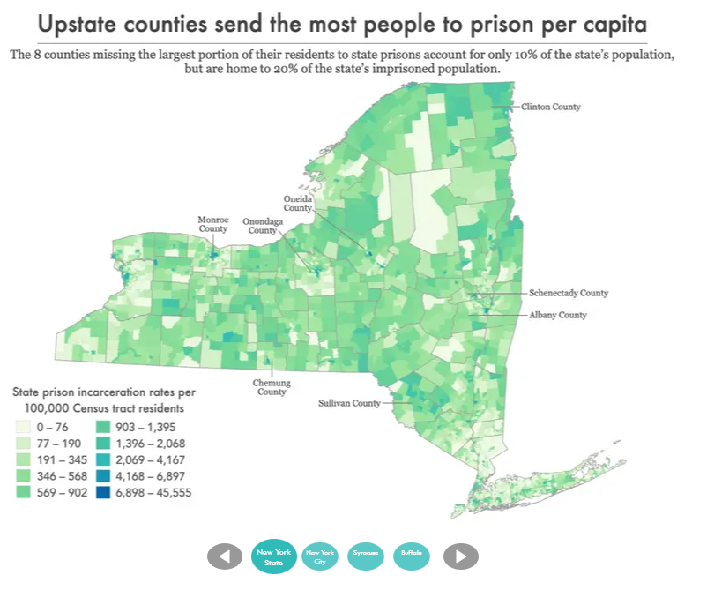
The idea that incarceration is a problem unique to big cities is a myth, and our residence data shows that upstate community leaders should be worried about incarceration, too.
Prison Policy Initiative (2022)
Some of the least populous upstate counties—Montgomery, Fulton, Genesee, Yates, and Franklin—have some of the highest imprisonment rates in the state.

Slide 8
The Effects of Spatial Concentration of Incarceration
Within cities and counties, incarceration tends to be concentrated in a relatively small number of geographic areas and neighborhoods — ones that tend to be systemically under-resourced.
At the same time, “investments” that these communities receive are in the form of criminal justice expenditures (on policing, jails, and prisons)
The impact of the spatial concentration of mass incarceration results in community harms, in addition to individual harms.
Cumulative loss of years to the prison system
Life expectancy
Community health
Mental health
Exposure to environmental dangers
Education
Community resources and engagement

Slide 9

Questions? Reflections?

