Slide 1

Week 2
What makes a community?

Slide 2
Where do you live?
Why does it matter?

Slide 3
Tasks at Hand:
Define what makes an urban community.
Engage with concepts from The Death and Life of Great American Cities by Jane Jacobs.
Discuss how criminologists see communities and neighborhoods.
Develop submissions for Step 1 of the course project.

Slide 4
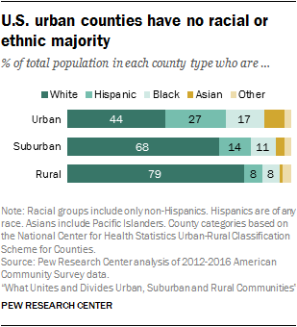
What is an Urban Community?
Community
  Social group of any size whose members reside in
  a specific locality, share government, and may
  may have a common cultural and historical heritage.
Urban communities
  ▪ Role of money
  ▪ Access to services
  ▪ Social capital
  ▪ Vulnerability, inequality and power

Slide 5
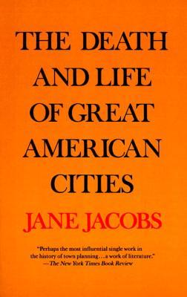
Jane Jacobs
(1916 –2006)
“Cities have the capability of providing something for everybody, only because, and only when, they are created by everybody.”
Cities are their streets.
  Streets are not a city’s veins but its neurology, its accumulated intelligence.
Urban diversity and density reinforce each other in a virtuous circle.
    The more people there are on the block, the more kinds of shops and social organizations—clubs, broadly put—they demand; and, the more kinds of shops and clubs there are, the more people come to seek them. You can’t have density without producing diversity, and if you have diversity things get dense.

Slide 6
Sidewalks: Safety (according to Jane Jacobs)
3 factors contribute to street safety:
  A clear line between public and private spaces.
  The eyes of the neighborhood must be on the street/sidewalks
  The sidewalks and streets must be in constant use.
    Small business must flourish in neighborhoods as it attracts people. More people means safety.
    Streets need lights. Streets need intersections. They attracts people and safety.
3 ways to deal with city insecurity:
  Ignore the situation and allow it to continue.
  Spend time in vehicles instead of walking on sidewalks.
  Territory or Turf: developed by gangs, the aim is to keep rival gangs from entering the neighborhood. City planners use to concept to tacitly enforce segregation and lack of diversity.
  Fear keeps people out of a neighborhood. Fear also keeps people from leaving the neighborhood. The quality of everyday life diminishes rapidly.

Slide 7
Criminology and Communities
Criminologists have long focused on American cities where predatory crimes disproportionately occur.
They argue that crime is an enduring challenge for those living in urban American cities.

Slide 8
Criminological Theories on Communities and Crime
Community as socially disorganized
Shaw and McKay and Chicago School of Criminology
Community as the truly disadvantaged
Based on the work of William Julius Wilson “The Truly Disadvantaged” (1987)
Community as a Broken Window
James Q. Wilson and George Kelling (1982)
Community as criminal opportunity
Lawrence Cohen and Marcus Felson
Community as collective efficacy
Robert Sampson

Slide 9
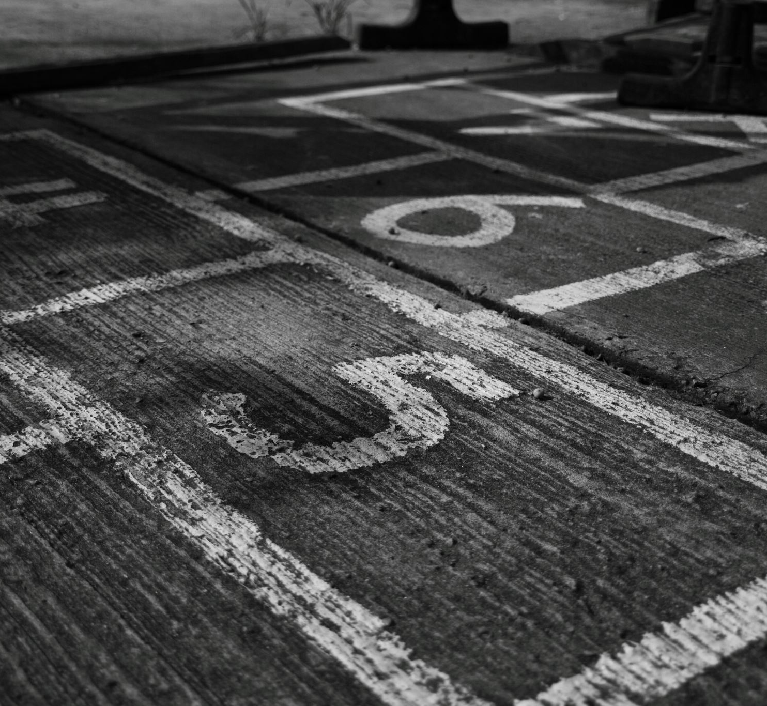
Step 1
Questions
  How to approach the research question?
  How to post in Open Lab?
  How to research?

