Slide 1


Sociological Imagination
CRJ 204
WEEK 1

Slide 2
Introduction
Sociology is the systematic study of human society.
The definition requires a comprehension of what society is.
Auguste Comte, who coined the word sociology, sought to understand how society worked, as well as the effect of larger processes on society and the people living in it.
Society: It is the largest-scale human group that shares a common geographic territory and common institutions.

Slide 3
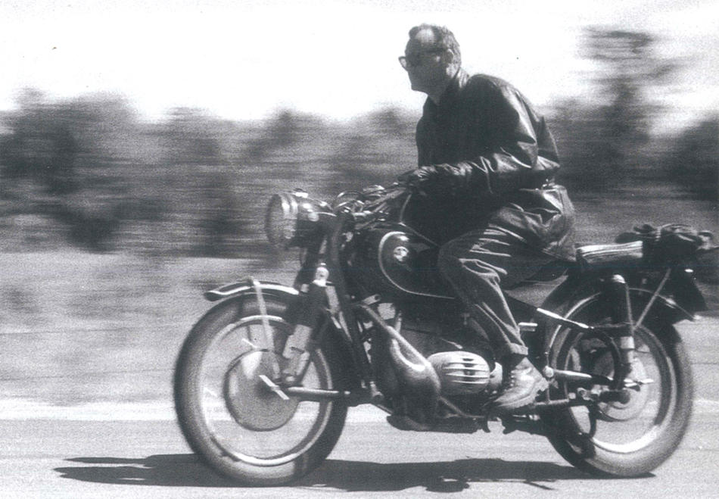
Sociological Imagination
C Wright Mills (1916-1962)
https:/ ps://magazine.columbia.edu/article/review-radical-ambition

Slide 4
Sociological Imagination
The sociological imagination: a skill and a perspective that permits us to understand our own biography by understanding history and the social structure (or social forces that impact our lives)
It also offers a way to seek solutions to the public issues we face and often experience as private troubles
  PRIVATE troubles: within the character of the individual
  PUBLIC issues: involves a crisis in institutional arrangements

Slide 5
Let’s Look at an Intersection of Private Troubles And Public Issues
New Orleans Braces for Hurricane Ida
Hurricane Katrina made landfall in the early hours of August 23rd, 2005. This anomalous weather event would eventually claim the lives of nearly 2,000 people and rendered much of the Gulf Coast city of New Orleans uninhabitable for months. In fact, many places in New Orleans would never recover from the devastation brought upon by Hurricane Katrina. A similarly strong storm, Hurricane Ida, made landfall on the anniversary of Hurricane Katrina. Ida came at a time when COVID-19 cases – especially the Delta variant – were rising in the area. As most catastrophes do, like Hurricane Katrina and the COVID-19 pandemic, they revealed true divisions among human beings living in the United States. See here: https://www.nytimes.com/live/2021/08/29/us/hurricane-ida-live-updates-new-orleans-louisiana

Slide 6
Discussion Questions
How can the experience of preparing to survive a storm be influenced by the social class of the individual and/or their family? What options are available for those with access to resources like reliable transportation, discretionary income, and free time to prepare their home and belongings to avoid submersion and destruction? What options are available for those without resources?
How are social norms that govern social interaction and maintain a sense of stability in a community disrupted by disasters? Why might sanctions such as arrest for theft of food be waived during times of crisis? What new norms might emerge to preserve a sense of cohesion and order within a community impacted by disaster?
How might one’s role set be influential in determining their response to the disaster? Why might some people take to their boats and go house to house looking for people who need help while others do not? How might one’s socialization experience with their family, peers, media, and education cultivate a sense of duty to help others in some and relative selfishness in others?
Why might families continue to rebuild and restore their homes after experiencing tragedy related to catastrophe? Especially for families with deep history to the area, why might generations of families living in an area that could be – and has been – washed away in a weekend decide to stay there? Why might others move? Why are others forcibly displaced?
What is the role of environmental racism in causing non-White individuals and families to be more vulnerable to the harmful after-effects of natural disasters? Why are communities of color that exist on the brink of peril the least likely to receive infrastructure investment to preserve their existence? How do natural disasters reveal more about the true nature of social order for people of different races and ethnicities?

Slide 7
Step One Overview
Overview of the Research Topic: The focus on your research project will be on a social problem in your community today. In class, we will be looking at the idea of the Sociological Imagination and how much creativity within sociology comes from being able to step back from our private troubles and look at the larger, public issue implications of our own personal experiences. This is what I would like you to accomplish in your research project: begin with a private trouble of your own and research the public issue dimensions of that same problem.

Slide 8

Questions

