Slide 1

Researching the Community: Community as a Broken Window
WEEK 6

Slide 2
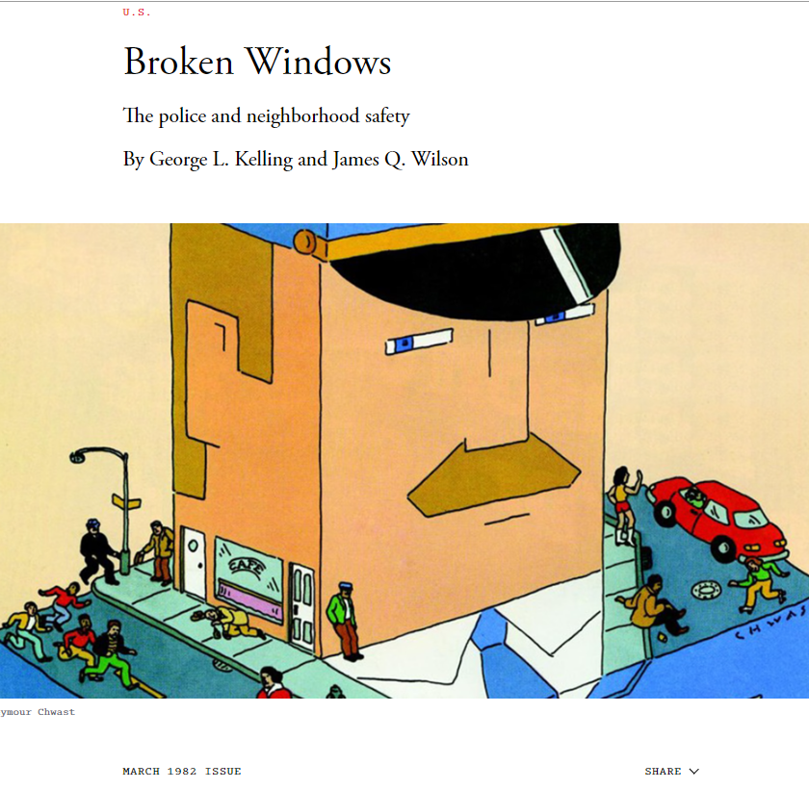
Broken Windows Theory
James Q. Wilson & George L. Kelling, 1982

Slide 3
If a window in a building is broken and is left unrepaired, all the rest of the windows will soon be broken. One unrepaired broken window is a signal that no one cares, and so breaking more windows costs nothing.

Slide 4
A house in which a window is broken:
If Pane of Glass is replaced; it implies
  Owner is present
  Cares about the property; and
  Will not tolerate its disrepair

Slide 5

A house in which a window is broken:
But If→ window remain broken: it implies;
  The property has no guardian
  An invitation
  Every window will be broken
  Vandalism of the house will implies

Slide 6
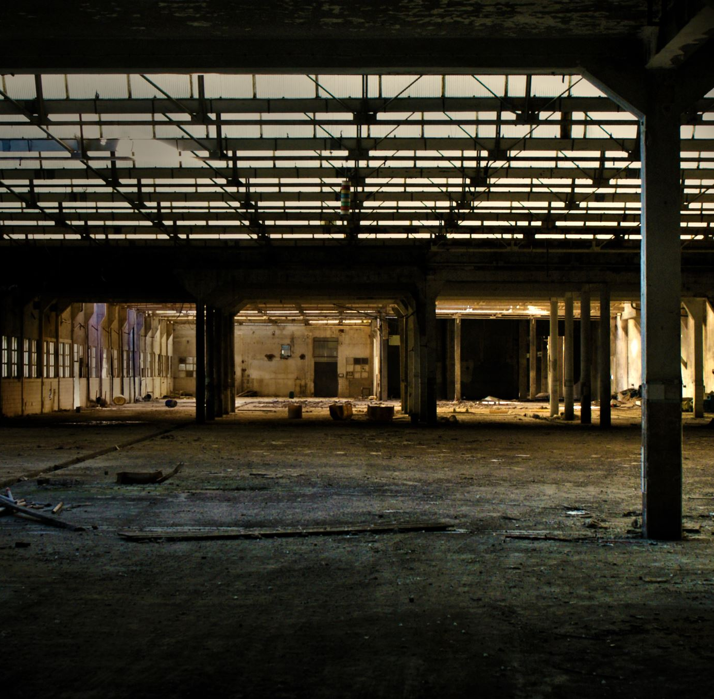
“Consider a building with a few broken windows. If the windows are not repaired, the tendency is for vandals to break a few more windows. Eventually, they may even break into the building, and if it's unoccupied, perhaps become squatters or light fires inside.”
“Or consider a pavement. Some litter accumulates. Soon, more litter accumulates. Eventually, people even start leaving bags of refuse from take-out restaurants there or even break into cars.”

Slide 7

Broken Windows Theory
Individuals will begin to commit crime such as Panhandling, prostitution and drug dealing
1
These crime will become part of the regular activities taking place in the abandoned building and will then spread out into neighborhood
2
Create more problems for the whole neighborhood and the society, due to less involvement of community
3

Slide 8
How it can be halted?
Fix the broken windows;
Attack the initial factor of the Causal Chain
Disorder caused by disreputable people
Breakdown in informal control
Invitation of predatory criminal
High crime rate in the neighborhood

Slide 9

Conclusion
Little things matter- Take care of little things and the Big things will take care of themselves
“if a window is broken and left unrepaired, people walking by will conclude that no one cares and no one is in charge
Carelessness implies vulnerability

Slide 10
“Above all, we must return to our long-abandoned view that the police ought to protect communities as well as individuals. Our crime statistics and victimization surveys measure individual losses, but they do not measure communal losses. Just as physicians now recognize the importance of fostering health rather than simply treating illness, so the police—and the rest of us—ought to recognize the importance of maintaining, intact, communities without broken windows.”

Slide 11

Criticism of Broken Windows Theory
Racial Profiling: Critics argue that enforcement of minor offenses (like vandalism or fare evasion) disproportionately targets communities of color, leading to racial profiling and perpetuating social inequalities.
Policing Priorities: The Broken Windows theory has been criticized for redirecting law enforcement resources away from more serious crimes, leading to the neglect of more severe offenses and the over-policing of minor infractions.
Effectiveness: The effectiveness of the Broken Windows theory in actually reducing crime rates is a hotly debated topic. Some studies support the theory, while others do not find a significant correlation between enforcement of minor offenses and a reduction in serious crimes.
Civil Liberties: Concerns are raised about the impact of heavy-handed policing of minor offenses on individual rights and liberties. Critics argue that it leads to harsh penalties for minor infractions and erodes individuals’ rights.

Slide 12

Questions?

Slide 13

Thank you!

