Slide 1
CRJ 204
SPRING 2021 – ONLINE TRANSITION

Slide 2


MAJOR THEMES OF THE COURSE
CLICK HERE FOR AUDIO
SPACE
BUILT ENVIRONMENT
PUBLIC POLICY
PERCEPTIONS OF CRIME v. REALITY OF CRIME

Slide 3
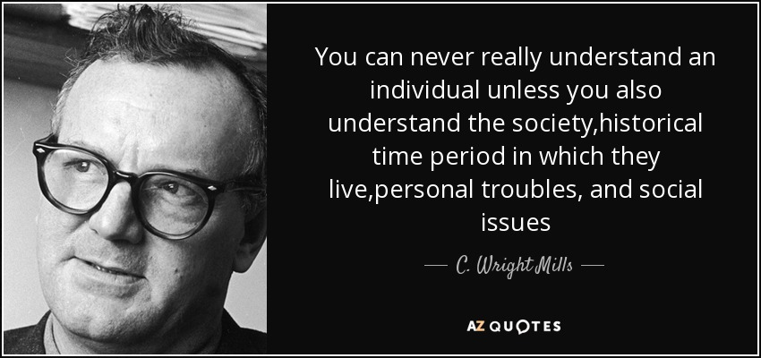
THE SOCIOLOGICAL IMAGINATION
CLICK HERE FOR AUDIO
PERSONAL v. SOCIETAL
Problems faced by individuals have social roots
  These problems are shared by many others.
  These roots are often related to the structure of the society
Public Policy

Slide 4
PUBLIC POLICY
CLICK HERE FOR AUDIO
The means by which the government maintains order or addresses the needs of its citizens; a collection of laws, mandates, or regulations established through a political process.
Title I
Title II
The city and the built environment we live in and experience today are the legacy of the above

Slide 5
SPACE
CLICK HERE FOR AUDIO
Groups do not merely react to the environment, but act on the meaning of the environment
    Meaning of environment is based on a personal interpretation
MEANING OF SPACE
  Natural = literally air over dirt
  Natural space becomes a social phenomenon, or social space, once people begin to use it, boundaries are put on it, and meanings (including ownership, price, etc.) are attached to it. (Gans, 2002)
A city’s shape and form not only influence social action, but are also a reflection of society’s values and culture
There is an interactive effect of environment, value, and behavior
City planners many times reflected their own underlying ideas of the nature of the city

Slide 6
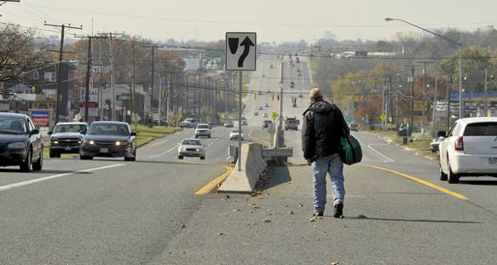
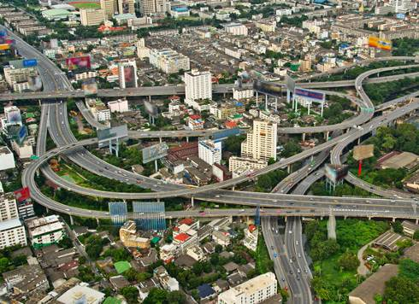
Defining the Built Environment
CLICK HERE FOR AUDIO
constructed places, features, and elements that together make our cities, villages, and towns
varies from large-scale urban areas to rural development and personal space
includes indoor and outdoor places
Notes:
Other definitions: “Built environments are the urban and rural human-made surroundings that provide the setting for human activity. Built environments encompass buildings and spaces (e.g., homes, schools, workplaces, neighbourhoods, parks/recreation areas, industrial/commercial areas, and other settings), the products they contain, and the infrastructure (e.g., transportation, energy, and agricultural systems) that links and supports them.” BC Ministry of Healthy Living and Sport
Definition: “The built environment encompasses all of the buildings, spaces and products created… by people. It includes our homes, schools and workplaces, parks, business areas and roads. It extends overhead in the form of electric transmission lines, underground in the form of waste disposal sites and subway trains, and across the country in the form of highways.”
Health Canada (1997) Health and Environment

Slide 7
Built environment is shaped by
CLICK HERE FOR AUDIO
Climate and geology
Economy
Government
Culture and fashion
Technology
Customers
Legacy of early urban planning ideologies

Slide 8
Legacy of early urban planning ideologies
CLICK HERE FOR AUDIO
Robert Moses
  High-rise, high density residences
  Low density areas
  Main objective was to make city amenable to the AUTOMOBILE
  Destroyed ethnic neighborhoods
  Influenced by Le Corbusier
    Cities with large blocks of park or grassland with many buildings on that parcel of land. Each building would be extremely tall and even be entirely self-sustainable in terms of shopping, etc
    no congested streets and sidewalks
    no more bustling public squares
    no more untidy neighborhoods

Slide 9
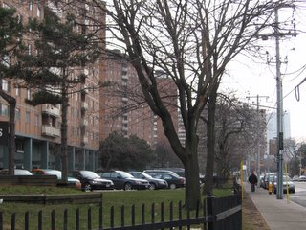
SUPERBLOCKS
CLICK HERE FOR AUDIO
MOSS PARK, TORONTO

Slide 10
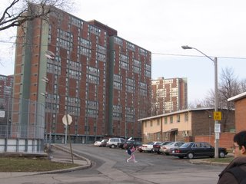
REGENT PARK, TORONTO

Slide 11
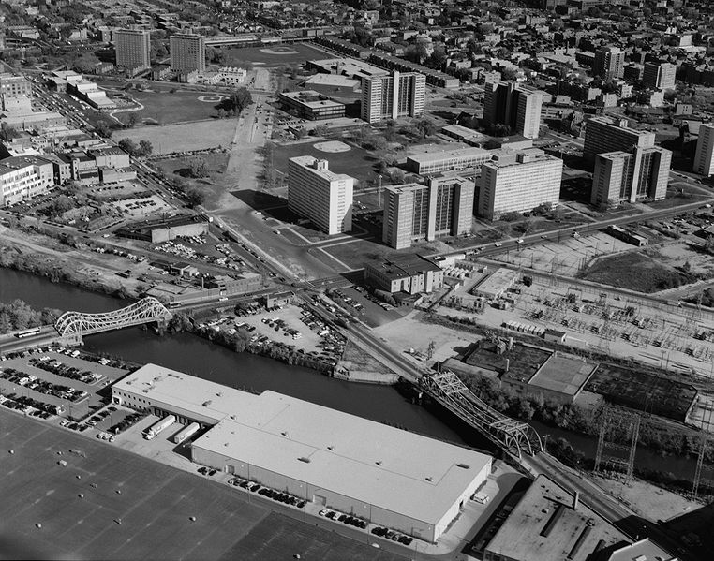

Slide 12
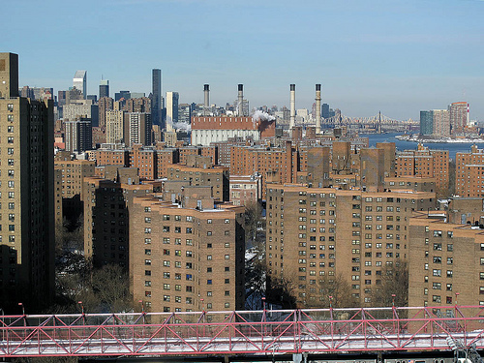
Bernard Baruch Houses, Lilian Wald Houses, and Jacob Riis Houses

Slide 13
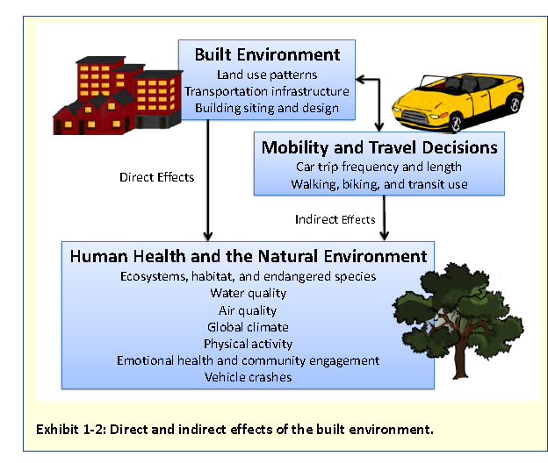
The Built Environment Has Direct and Indirect Effects on the Natural Environment
CLICK HERE FOR AUDIO
Notes:
This slide sums up the rationale for the whole report:
Patterns of development, transportation infrastructure, and building location and design—all of these things we call the built environment—directly affect human health and the natural environment.
But there are indirect effect as well because how we develop influences decisions people make about how to get around and determines how much people travel.
We’ll go through all of these effects on human health and the natural environment in more detail later.

Slide 14
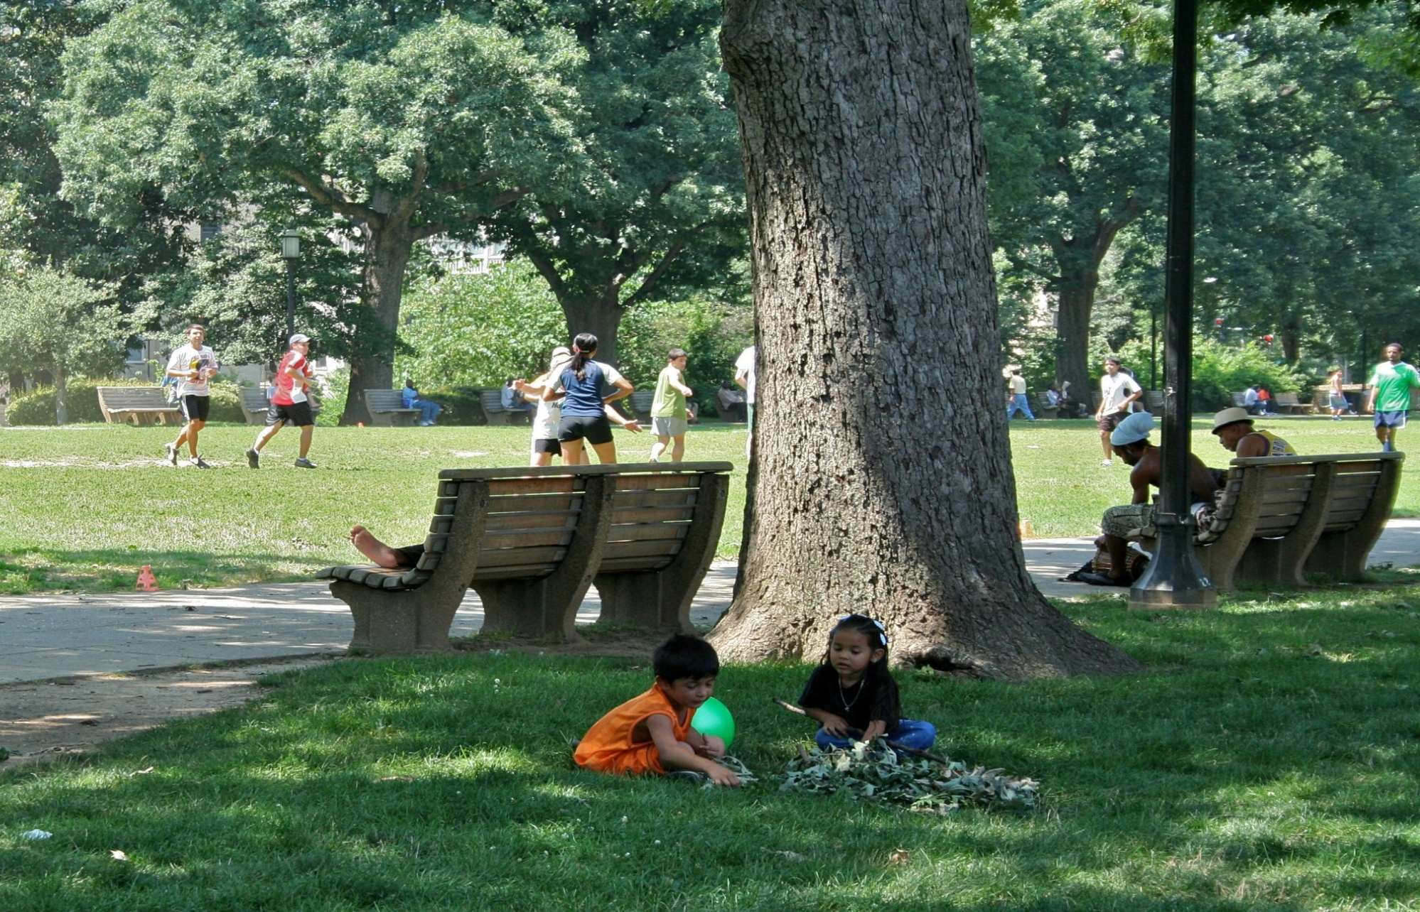
Activity Levels, Obesity, and Chronic Disease
CLICK HERE FOR AUDIO
How we build our communities affects:
  The amount of time we spend in cars.
  The opportunity, practicality, and necessity of physical activity.
The degree of land use mix and county-level measures of sprawl both likely affect the incidence of obesity.
As the number of minorities and poor increases in an area, the number of facilities for physical activity and recreation often decreases.
Sources: Frank et al. 2006; Frumkin 2002; Feng et al. 2010; Ferdinand et al. 2012; Gordon-Larson et al. 2006
Notes:
The heat island effect and global climate change affect public health, but there are other public health impacts from the built environment.
How we build affects the amount of time people spend in their cars and the opportunity, practicality, and necessity of walking and biking.
These factors can influence overall physical activity levels and therefore the risk of obesity and chronic disease.
There is a lot of work on the association between the built environment and obesity, but broad conclusions are hard to reach due to differences across studies. Nevertheless, a 2010 literature review found the evidence was strong enough to conclude that the degree of land use mix and county-level measures of sprawl likely affect the incidence of obesity.
Some subpopulations are more affected by obesity and related chronic disease than others.
A possible contributing explanatory factor is the number and quality of recreational facilities available.
A national analysis showed that as the number of minorities and people of lower socioeconomic status increases in an area, the number of physical activity and recreational facilities often decreases.

Slide 15
Why are some people healthy while others are not?
CLICK HERE FOR AUDIO
people with lower income and less education consistently have worse health status than those with higher income and more education
these inequalities in health are called the socio-economic determinants of health (including occupation, income, education, housing, and access to transportation)
good planning and design can help people avoid or change unhealthy physical environments
Notes:
“In relation to the built environment, the poor live downwind, downstream, downhill (but uphill if the slopes are dangerous), on floodplains and other marginal lands, near landfills, industrial plants and hazardous sites, in damp, unsafe, unhealthy housing, in dangerous neighbourhoods, and they work in unsafe, unhealthy workplaces. So place matters when it comes to their health.” (Trevor Hancock)
The last bullet is the most important message in the presentation: Good planning and design can help people avoid or change unhealthy physical environments.

Slide 16
Why do built structures matter?
CLICK HERE FOR AUDIO
Chronic illness and injury are a risk to both public health and our universal health care system.
Promoting healthy lifestyles is not enough. Effects of the built environment must also be addressed.
Environmental health, planning, and design professionals share the responsibility to promote environments that enhance public health.
accessibility of buildings, programs, and services
injuries from poorly maintained or poorly designed built elements
mental health and social inclusion
physical activity, transportation, and recreation
indoor and outdoor air quality
water quality
food security
noise
Notes:
Chronic Diseases and Injuries in Canada
Chronic diseases such as diabetes, kidney disease, heart disease and respiratory conditions account for 89% of deaths in Canada. Chronic diseases are expected to cause the death of two million Canadians over the next decade. Cardiovascular disease (CVD) is the leading cause of death in Canada and accounts for a loss of 4.5 years of life. In 2003, injuries were the second leading cause of death before age 70, in Canada.
In this presentation we use the term “environmental health professionals” to include environmental health officers, public health inspectors, public health doctors and medical health officers.
The term “planners and design professionals” refers to urban and community planners, social planners, architects, landscape architects, engineers, transportation engineers, and interior designers.
Environmental health professionals and health and design professions all share an ethical duty to improve the health and wellbeing of all those who use their services.

Slide 17
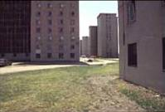
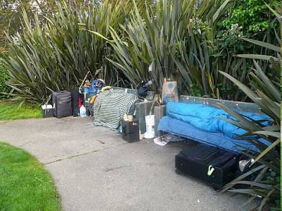
Ensure Access and Inclusion to Improve Health
CLICK HERE FOR AUDIO
loneliness and isolation are toxic
social relationships can promote health
people with strong social networks:
  live longer
  have less heart disease
  are less depressed; use alcohol and drugs less
  have fewer teen births
  are healthier overall
Notes:
“The built environment can also provide opportunities for social interaction through an array of social networks and organizations. Generally, the larger the urban centre, the greater the number and complexity of social networks. Social engagement in the community builds trust, efficacy, and a sense of belonging associated with improved mental and immunological health. Urban centres tend to be less culturally and socially homogeneous and have diverse populations. Within these cities, communities comprised of close networks of people of similar cultural and social perspectives offer the benefits of community, such as social support. For example, research has shown that recent immigrants can better integrate into Canadian cities that have communities with strong social and cultural support networks. Although urban areas provide many opportunities for social contact with others, they can also create anonymity and isolation. Regardless of neighbourhood density, many urban dwellers say they do not know their neighbours, a number of elderly residents live alone, and those who are not connected with the greater community can experience isolation.” Public Health Agency of Canada http://www.phac-aspc.gc.ca/publicat/2008/cphorsphc-respcacsp/cphorsphc-respcacsp07d-eng.php

Slide 18
ORDER, DISORDER AND ECOLOGY OF FEAR
CLICK HERE FOR AUDIO
Jane Jacobs
  A successful city = people who feel personally safe and secure in this world of strangers
NEIGHBORHOOD CIVILITY
  Familiar strangers
    Everyday routine behavior = familiarity and information social control
    Successful street is self-policing
  This is possible through constant use of public places
Walzer
  Without regular and confident users of the public realm the these will be abandoned and will give way for deviance
  People will continue to withdraw into their private realms and crime will rise

