Slide 1


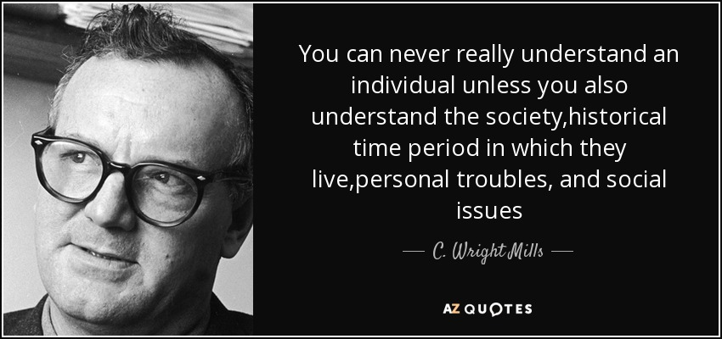
THE SOCIOLOGICAL IMAGINATION
CLICK HERE FOR AUDIO
PERSONAL v. SOCIETAL
Problems faced by individuals have social roots
  These problems are shared by many others.
  These roots are often related to the structure of the society
Public Policy

