Slide 1

Cities and Representation and Decision Makers in Urban Communities
UNIT 2

Slide 2

What Makes a City?

Slide 3
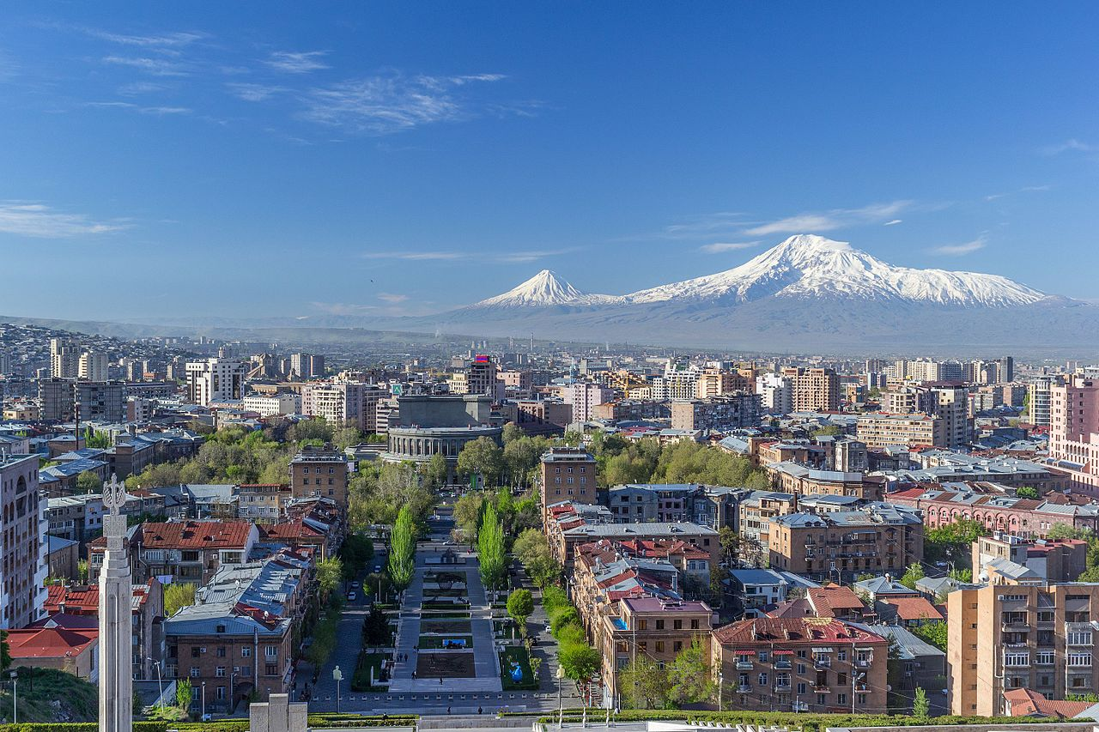
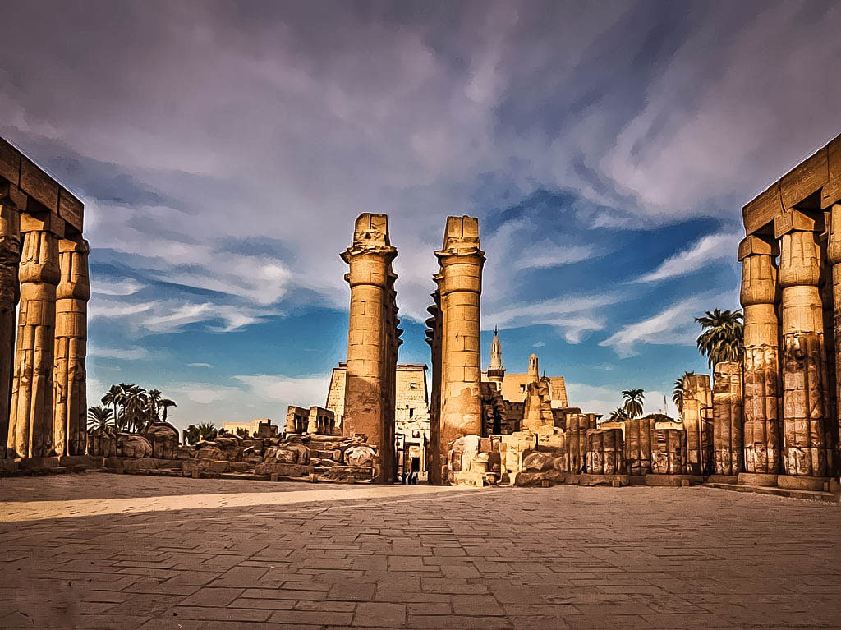
Ancient Cites
Yerevan, Armenia (783 BCE)
Luxor, Egypt (c. 2150 BCE)

Slide 4
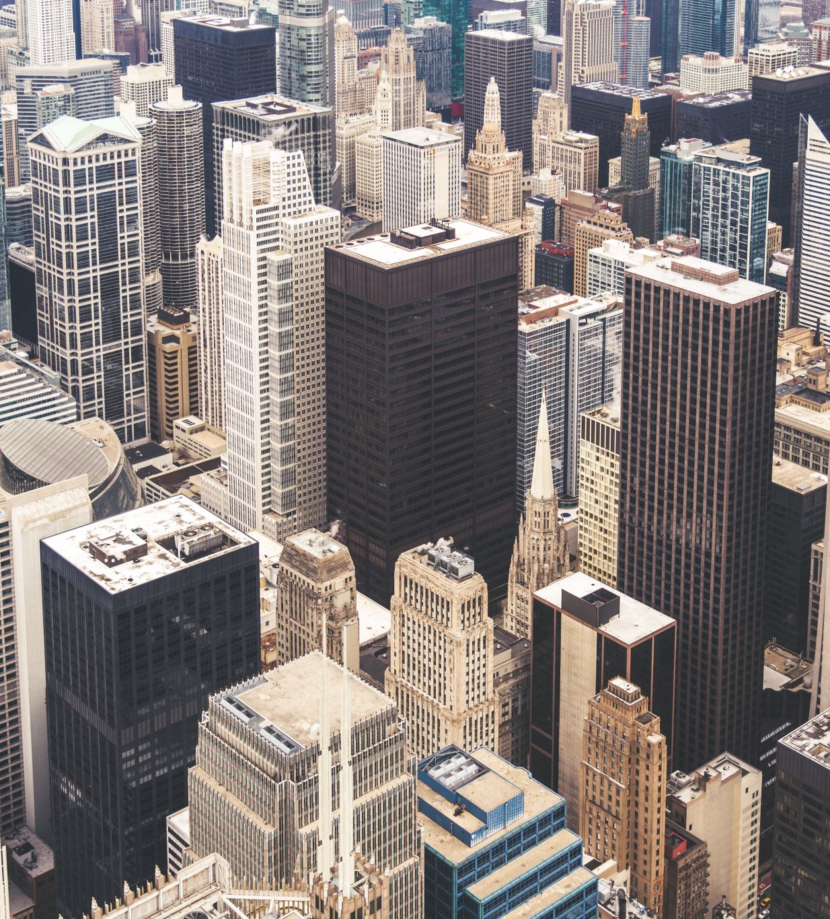
Characteristics of Urban Places
According to U.S. Census Bureau, a community must have at least 50,000 residents to be considered to be a city.
This population needs to be clustered in a fairly compact space with mixed land-uses such as homes, businesses, industries, government institutions and other services.
The large populations create increased specialization and diversity.

Slide 5
Role of Cities in World Economy
600 largest cities in the world are home to just 20% of the global population and generate 60% of the worldwide economic output.
A city with a population of more than 10 million people is called megacity.
Top 10 Megacities
Tokyo 37.39 million
Delhi 30.29 million
Shanghai 27.05 million
São Paulo 22.04 million
Ciudad de México (Mexico City) 21.78 million
Dhaka 21 million
Al-Qahirah (Cairo) 20.9 million
Beijing 20.46 million
Mumbai (Bombay) 20.41 million
Kinki M.M.A. (Osaka) 19.16 million

Slide 6
Three Main Characteristics of Cities
Density
Heterogeneity
Size

Slide 7

Urban Subcultures
A subculture is a community within a larger society that develops a set of values, norms or behaviors that is different than or in opposition to the dominant culture.
  Fashion, music, hairstyles or leisure activities become key symbols.
    Punk culture (UK)
    Hip Hop (New York subculture)

Slide 8
Are Cities a Network of Villages?
Presence of tight-knit community structures
Strong reliance on communal bonds among the residents
Low-income neighborhoods pool their resources and spread the limited income and material goods.
Residents who feel a strong sense of attachment to their neighbors are less afraid of crime than those who are more socially isolated.

Slide 9
Public Spaces
Having adequate public space is important.
Parks, libraries, community centers, streets, shopping areas and transit lines
The Design of a space can affect how it is used.
Public space is used for 3 purposes:
Necessary (traveling to school or work)
Optional (going on a walk, sunbathing)
Social (meeting a friend).

Slide 10
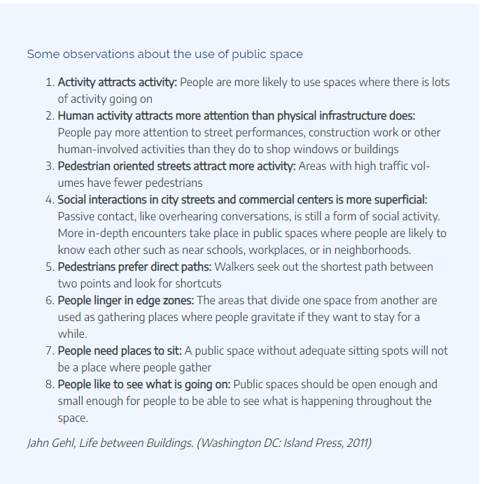

Slide 11

Representation

Slide 12
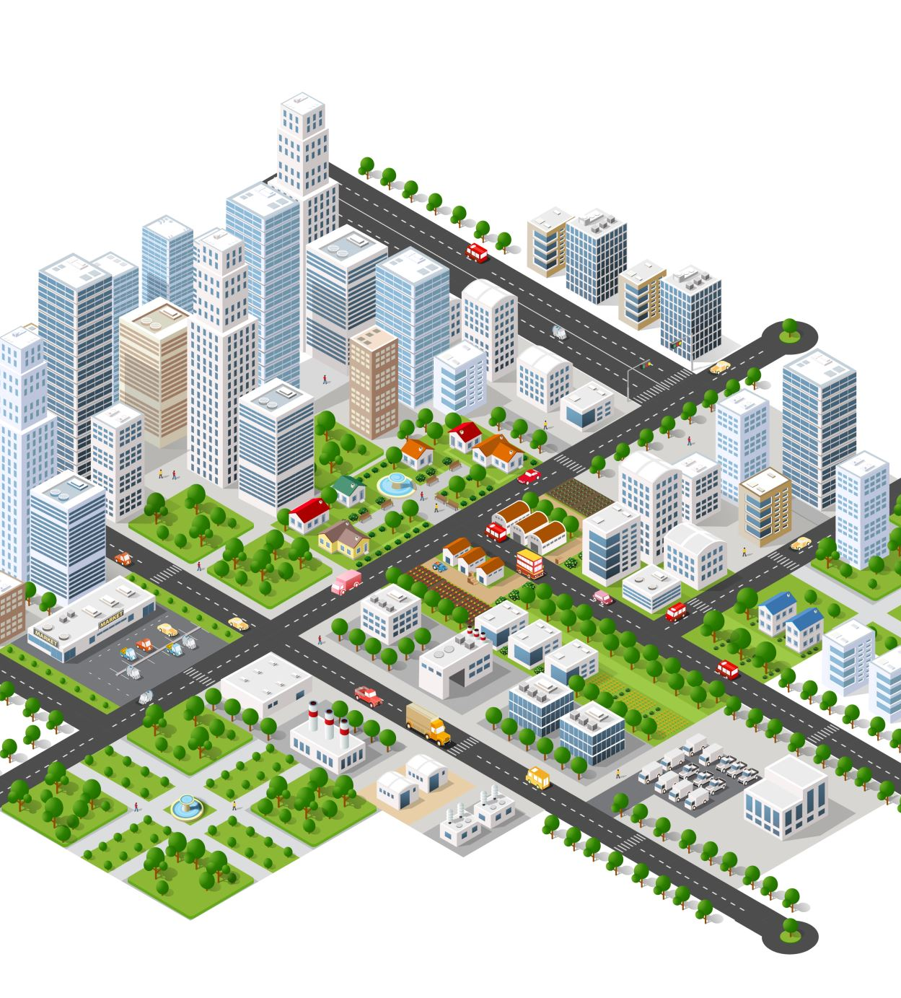
What decision are made on an urban level?
Cities are responsible for the collective consumption needs to their residents and provide transportation, housing, education , and other services.
Attracting investment
Developing urban spaces for consumption
Cities allow resident to participate in varying degrees in political decision-making

Slide 13
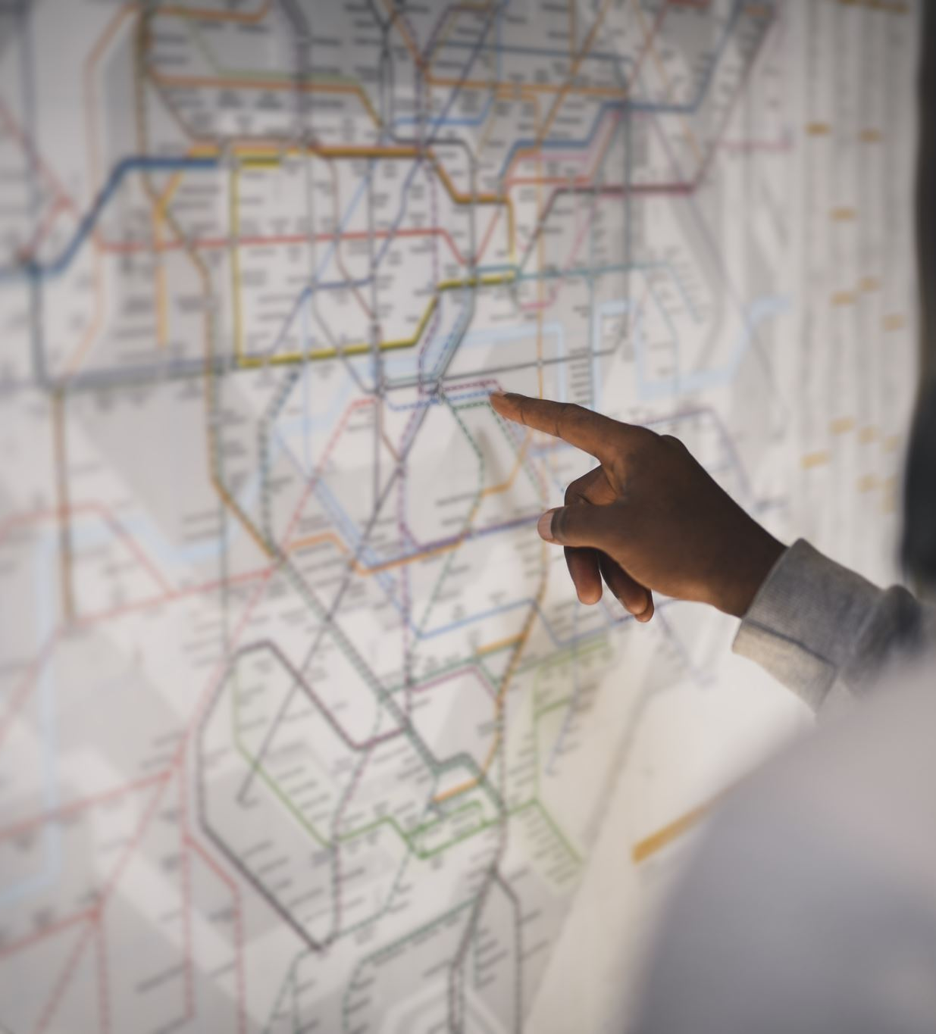
Learn to read the city around you:
Attend a public meeting
Observe how people use public space
Conduct an audit of your city government website
Evaluate the accessibility of your city’s public spaces

Slide 14

Questions

Slide 15

Thank you!

