Slide 1

THIRTIENTH AMENDMENT
ABOLITION OF SLAVERY

Slide 2
History of Abolition
President Lincoln was elected in 1860.
  Soon after many states passed a resolution to withdraw from the Union.
President Lincoln was faced with trying to keep the Union together.
He promised to abolish slavery in the territories, but under the Constitution, slavery was legal in the states where it had been established.
Notes:
LO1: Understand the significance of the Thirteenth Amendment.

Slide 3
Dred Scott v. Sandford (1857)
  Supreme Court ruled that even free blacks could not be citizens of the United States and that they “had no rights which a white man was bound to respect.”
  The southern states were not convinced, and the Civil War ensued.
    It pitted American against American and sometimes brother against brother.
    Hundreds of thousands wounded and killed.
    Caused a divide that still affects the country to this day.
Notes:
LO1: Understand the significance of the Thirteenth Amendment.

Slide 4
Emancipation Proclamation
April 1862: slavery was abolished in the District of Columbia and 2 months later in all the territories.
January 1, 1863: President Lincoln declared free all the slaves in all districts of the United States in his Emancipation Proclamation.
  Set a national tone toward abolishing slavery.
13th Amendment was ratified in 1865 and abolished slavery.
Notes:
LO1: Understand the significance of the Thirteenth Amendment.

Slide 5

The Emancipation Proclamation (1863)
“I issue the Emancipation Proclamation in January 1863 using my war powers as commander-in-chief. I believe that freeing the slaves will help win the war, and that the Constitution gives me all the authority I need to issue that order. I also believe that once enslaved people taste freedom they can never be made slaves again, but what about the courts and Congress? When the war is over, will they see it that way? Might they overturn my emancipation policy, saying it was merely a wartime measure that now lacks legal force? What should I do?”

Slide 6
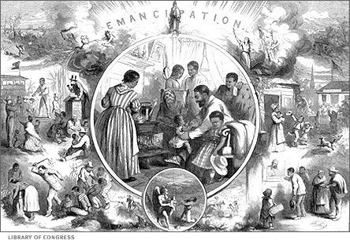
FREEDOM…

Slide 7
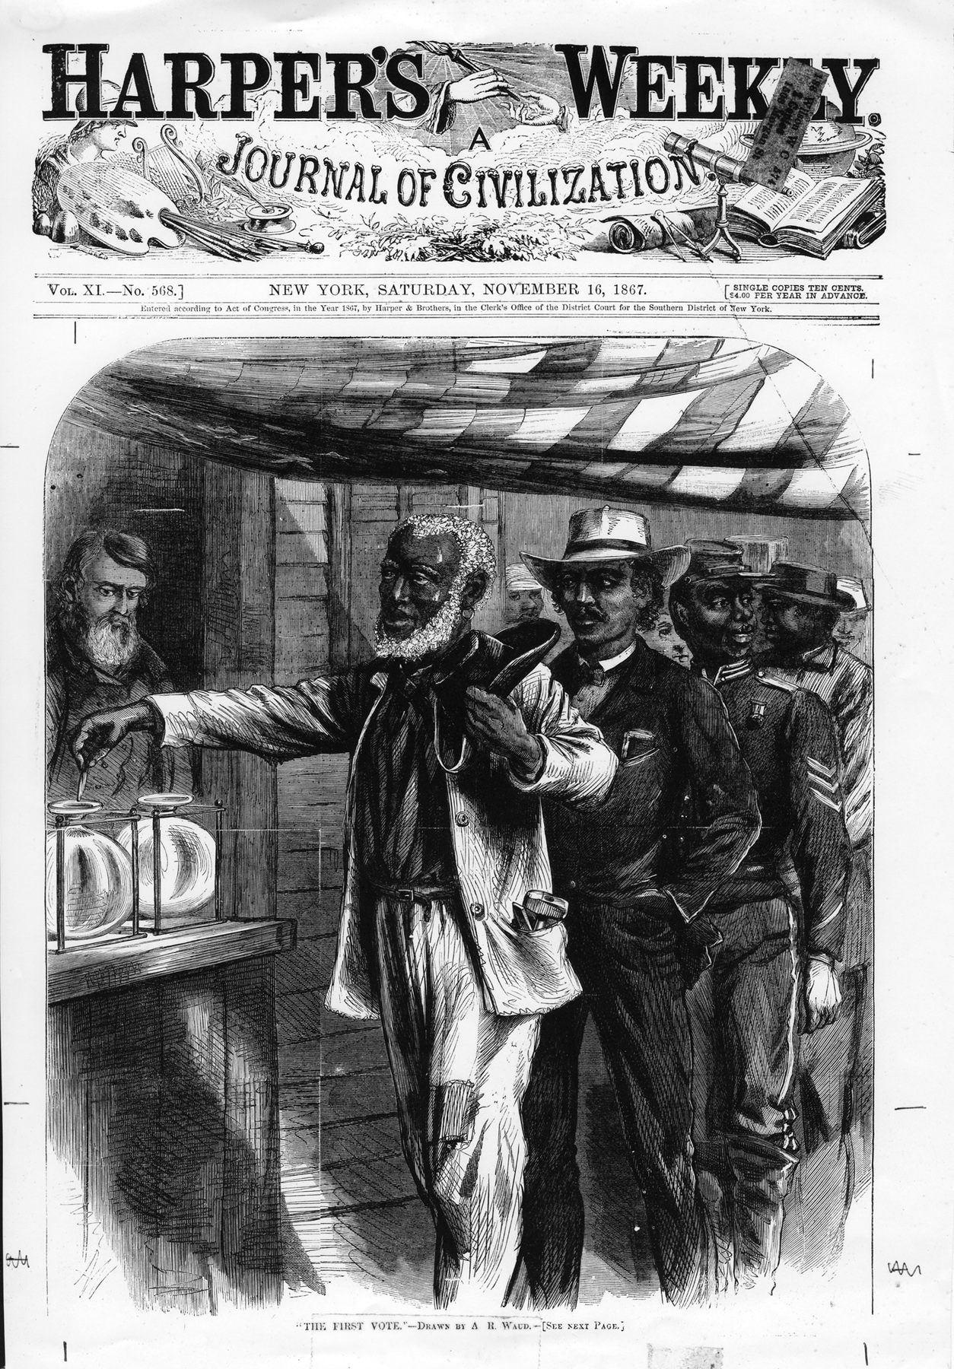
Freedom from Slavery
During the Civil War, U.S. President Abraham Lincoln signed the Emancipation Proclamation freeing slaves in the states in open rebellion only.
Following the Civil War, during Reconstruction, several amendments and acts were added to the U.S. Constitution.
  13th Amendment in 1865 – outlaws slavery.
  Civil Rights Act of 1866 – tried to give citizenship to all native-born Americans.
  14th Amendment in 1868 – grants African Americans equal protection under the law.
  15th Amendment in 1870– grants African American males the right to vote.
  Civil Rights Act of 1875 – grants equal access to public accommodations.
Freedmens Bureau – A federal bureau organized to help freed slaves adjust to their new lives.
Ku Klux Klan – is founded in Tennessee but spreads across the south in reaction to Radical Republican control.
Image courtesy of Mississippi Department of Archives and History
Notes:
The states in open rebellion did not include the “border states” – Delaware, Maryland, Kentucky, and Missouri.
What is an Amendment?
Why were these three amendments important?
Civil Rights Act of 1866 – granted citizenship to all but Native Americans.
Freedmens Bureau – was a federal organization started by the U.S. War Department. “The Bureau of Refugees, Freedmen, and Abandoned Lands… ...often referred to as the Freedmen's Bureau, was established in the War Department by an act of March 3, 1865. The Bureau supervised all relief and educational activities relating to refugees and freedmen, including issuing rations, clothing and medicine. The Bureau also assumed custody of confiscated lands or property in the former Confederate States, border states, District of Columbia, and Indian Territory. The bureau records were created or maintained by bureau headquarters, the assistant commissioners and the state superintendents of education and included personnel records and a variety of standard reports concerning bureau programs and conditions in the states.” (http://freedmensbureau.com/freedmens-bureau, September 16, 2010.)

Slide 8
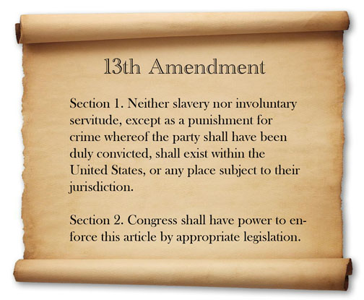
The Thirteenth Amendment
Notes:
Slavery or other forms of forced labor were not allowed in America or any other place where America had power, UNLESS it was a punishment for a crime. Congress has the power to enforce the law justly.

Slide 9
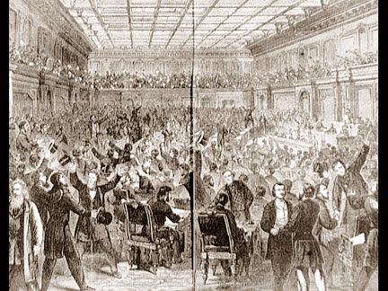
Thirteenth Amendment
The Thirteenth Amendment permanently abolished (ended) African-American slavery in the United States.
The House of Representatives on January 31, 1865, as it voted for the Thirteenth Amendment to the Constitution, which abolished slavery. Proposed early in 1865 as the Civil War was winding down, it was ratified by three-fourths of the states on December 18, 1865, removing any lingering doubt about the legality of emancipation. President Andrew Johnson, who had succeeded Lincoln as president, reluctantly agreed to include ratification of this amendment as a requirement for readmission of the former Confederate states to the Union as part of his reconstruction plan.

Slide 10
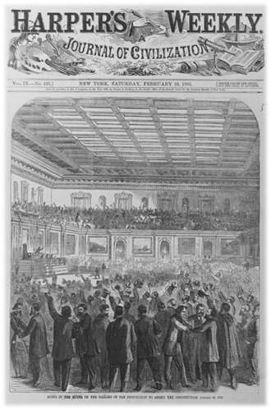
13th Amendment
January 31, 1865
“The final announcement of the vote was the sequel for a whirlwind of applause wholly unprecedented in Congressional annals,” reported the Chicago Tribune. “The galleries led off, giving cheer after cheer. The members on the floor then joined in the shouting, throwing up their hats and clapping their hands.”
Library of Congress
Notes:
On this date, the House passed the 13th Amendment to the Constitution, abolishing slavery in the United States. After the House had failed to follow the Senate in mustering the two-thirds majority necessary to amend the Constitution the previous June, Representative James Ashley of Ohio revived the amendment. He noted that “the genius of history with iron pen is waiting to record our verdict…which shall declare America is free.” The 119 to 56 vote sealed victory for abolitionists’ long battle against the “peculiar institution.” Despite rules dictating decorum in the House Chamber, the roll call vote instigated jubilant celebration. “The final announcement of the vote was the sequel for a whirlwind of applause wholly unprecedented in Congressional annals,” reported the Chicago Tribune. “The galleries led off, giving cheer after cheer. The members on the floor then joined in the shouting, throwing up their hats and clapping their hands.” The requisite three-quarters of the states ratified the amendment with the state of Georgia’s approval on December 6, 1865.
http://clerk.house.gov/art_history/highlights.html?action=view&intID=5

Slide 11
The Flaw of the Thirteenth Amendment
After slavery ended, Southern states tried to control the African Americans through Black Codes, a series of laws which enforced segregation, limited black job opportunities, and kept African Americans from voting.
These concerns were addressed with the Fourteenth Amendment.

