Slide 1

The Constitution and Its Origins
Professor Daniel DiPrenda
(OpenStax, Rice University some content modified)

Slide 2
The Pre-Revolutionary Period and the Roots of the American Political Tradition
Learning Objectives
By the end of this section, you will be able to:
Identify the origins of the core values in American political thought, including ideas regarding representational government
Summarize Great Britain’s actions leading to the American Revolution.

Slide 3
The Pre-Revolutionary Period and the Roots of the American Political Tradition
The U.S. Constitution is the oldest, and shortest written constitutions still in existence – (20 pages).
Not a beginning, but rather the culmination of American (and British) political thought about government power as well as a blueprint for the future.
Constitution was created out of necessity (first revolutionary government failed).
Featured pragmatic compromises among its disparate stakeholders.

Slide 4
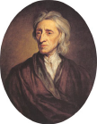
Political Thought in the American Colonies
John Locke seventeenth century philosopher, was one of the most influential thinkers of the Enlightenment.
Most significant contributions were his ideas regarding the relationship between government and natural rights, which were believed to be God-given rights to life, liberty, and property. Thus, could never be abolished by human beings, royals or institutions.
Social contract give up some rights to be ruled by gov’t. and have protections of life, lib. Etc.
1215 Magna Carta (Great Charter) life, liberty and property, judgement by peers.
John Locke

Slide 5
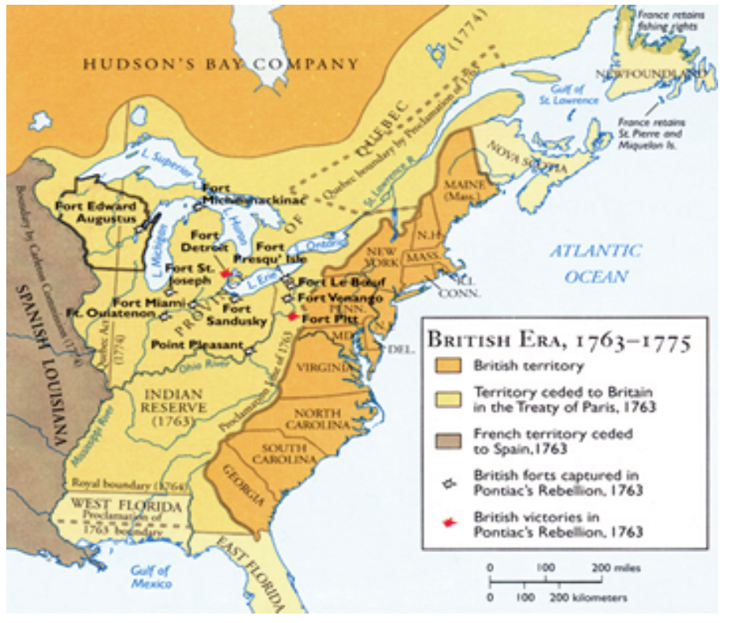
Pre-Revolutionary Period
French and Indian War 1754 -1763

Slide 6
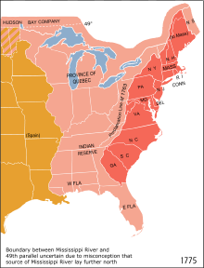
Proclamation of 1763
On October 7, 1763, King George III issued a proclamation that forbade colonial settlement west of the Appalachian Mountains. In so doing, he hoped to placate Native Americans who had sided against him during the recently concluded Seven Years’ War. Enforcement was so weak, however, that it did very little to curb the westward flow of pioneers. Even prominent figures such as George Washington paid it no heed, except as a source of anti-British sentiment leading up to the American Revolution.

Slide 7
American Revolution
By 1776 the colonists had been living under the rule of the British government for more than a century.
England treated the colonies with benign neglect.
Each colony had its own legislature.
People were loyal to the king.
Change began at the end of the Seven Years War 1763.
Parliament paid for the war by directly taxing individuals; instead of transactions.
Colonists felt their status as free men was reduced.

Slide 8
Events That Led to American Independence
January 1, 1754, French and Indian War begins
October 7, 1763, Proclamation of 1763
December 31, 1763, French and Indian War ends
January 1, 1764, Sugar Act
March 22, 1765, Stamp Act
March 24, 1765, Quartering Act
March 18, 1766, Declaratory Act
June 29, 1767, Townshend Acts
March 5, 1770, Boston Massacre
May 10, 1773, Tea Act
December 16, 1773, Boston Tea Party
March 31, 1774, Intolerable Acts
September 5, 1774, First Continental Congress
April 18, 1775, Battle of Lexington and Concorde
May 10, 1775, Second Continental Congress
June 17, 1775, Battle of Bunker Hill
January 10, 1776, Common Sense

Slide 9
Events That Led to American Independence
July 4, 1776, Declaration of Independence
November 15, 1777, Articles of Confederation (Ratified in 1781)
October 19, 1781, Battle of Yorktown
September 3, 1783, Treaty of Paris (Jay Treaty)
May 25, 1787, Constitutional Convention is convened
September 17, 1787, Constitution is signed
March 4, 1789, First Congress begins

Slide 10

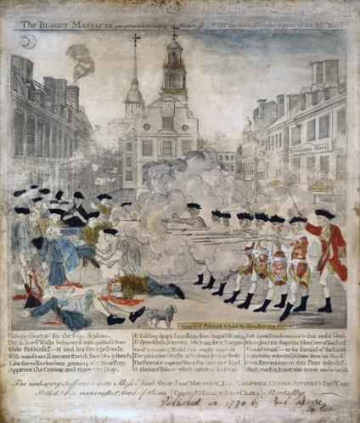
Figure 2.3
The Sons of Liberty circulated this sensationalized version of the events of March 5, 1770, in order to promote the rightness of their cause; it depicts British soldiers firing on unarmed civilians in an event that became known as the Boston Massacre.
Later portrayals would more prominently feature Crispus Attucks, an African American who was one of the first to die.
Eight British soldiers were tried for murder as a result of the confrontation.

Slide 11

Boston Massacre
Townshend Acts (1767) imposed taxes on everyday objects such as glass, tea and paint.
Massachusetts legislature asked Parliament for relief, but Parliament threatened to suspend the legislatures of the colonies.
Britain sent a warship in response to a request by Boston’s Customs Collector.
Altercation led to the Boston Massacre. Several people hit, three died immediately. Britain taxed the colonists without their consent . Now, British soldiers had taken colonists’ lives.
Eight British soldiers on trial for murder.
Resistance grew – December 1773, Boston Tea Party.
Boston Massacre
March 5, 1770

Slide 12
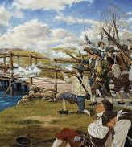
“The Shot Heard Around the World”
War begins
Battle of Lexington and Concorde
May 1775 Second Continental Congress meets.
Congress drafts Declaration of Causes explaining colonies’ reasons for rebellion.
July 2, 1776, Congress declares American independence from Great Britain.
Declaration of Independence is signed July 4, 1776.

Slide 13
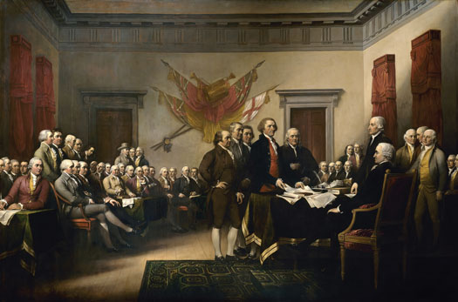
Presentation of the Declaration of Independence
The presentation of the Declaration of Independence is commemorated in a painting by John Trumbull in 1817. It was commissioned to hang in the Capitol in Washington, DC.
Adams to Abigail: “The Second Day of July 1776, will be the most memorable Epocha, in the History of America.—I am apt to believe that it will be celebrated, by succeeding Generations, as the great anniversary Festival. It ought to be commemorated, as the Day of Deliverance by solemn Acts of Devotion to God Almighty. It ought to be solemnized with Pomp and Parade, with Shews, Games, Sports, Guns, Bells, Bonfires and Illuminations from one End of this Continent to the other from this Time forward forever more.” National Archives

Slide 14
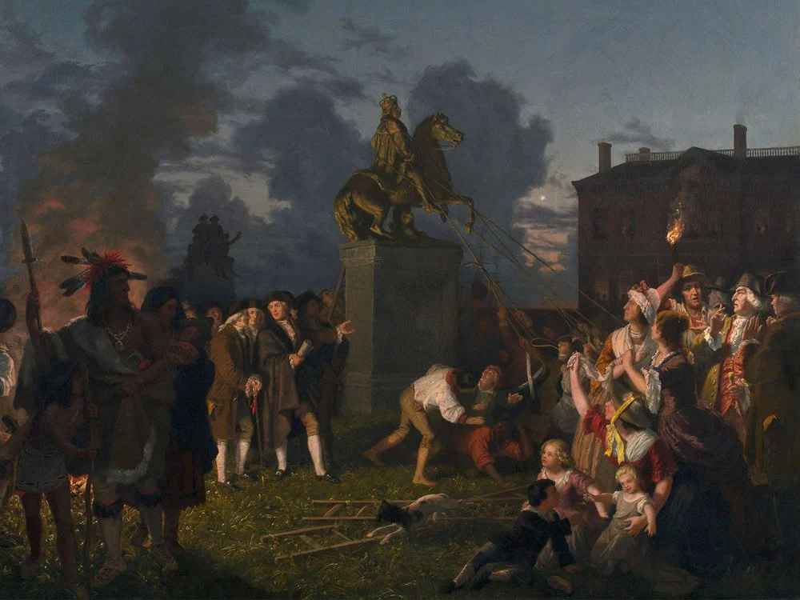
King George Statue at Bowling Green toppled July 9, 1776
March 21, 1770, Statue of King George depicted as Marcus Aurelius erected.
1771 Fence surrounding the statue is erected (parts still there).
July 9, 1776, Declaration read for first time in NY in front of Washington and his troops. He felt it would inspire “fidelity and courage”. Statue is toppled later that day by Sons of Liberty shouting, “We Will be Free! We Will be Free! Down with the Statue! Down With the Emblem of Tyranny!”
Statue is taken to Connecticut and melted down to make 42,088 musket balls or bullets (very accurate records were kept).

Slide 15
The Articles of Confederation
Learning Objectives
By the end of this section, you will be able to:
Describe the steps taken during and after the American Revolution to create a government.
Identify the main features of the Articles of Confederation
Describe the crises resulting from key features of the Articles of Confederation.

Slide 16
The Articles of Confederation
November 1777
Waging a war against Great Britain required that the individual colonies form a unified nation with a central government capable of directing the country’s defense.
The colonies were sovereign states that often distrusted each other.
A national government would be able to borrow money and negotiate treaties.
Second Continental Congress called upon the delegates to create a new government strong enough to win the country’s independence but not so powerful that it would deprive people of the very liberties for which they were fighting.

Slide 17
Problems with the Articles of Confederation
Weakness of the Articles of Confederation | Why Was This a Problem?
The national government could not impose taxes on citizens. It could only request money from the states. | Requests for money were usually not honored. As a result, the national government did not have money to pay for national defense or fulfill its other responsibilities.
The national government could not regulate foreign trade or interstate commerce. | The government could not prevent foreign countries from hurting American competitors by shipping inexpensive products to the United States. It could not prevent states from passing laws that interfered with domestic trade.
The national government could not raise an army. It had to request the states to send men. | State governments could choose not to honor Congress’s request for troops. This would make it hard to defend the nation.

Slide 18
Problems with the Articles of Confederation
Weakness of the Articles of Confederation | Why Was This a Problem?
Each state had only one vote in Congress regardless of its size. | Populous states were less well represented.
The Articles could not be changed without a unanimous vote to do so. | Problems with the Articles could not be easily fixed.
There was no national judicial system. | Judiciaries are important enforcers of national government power.

Slide 19
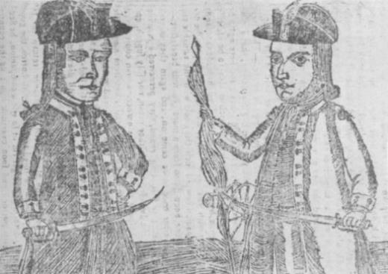
Shays Rebellion
This contemporary depiction of Continental Army veteran Daniel Shays (left) and Job Shattuck (right), who led an uprising of Massachusetts farmers in 1786–1787, “Shays Rebellion”, that prompted calls for a stronger national government, appeared on the cover of Bickerstaff’s Genuine Boston Almanack for 1787.

