Slide 1
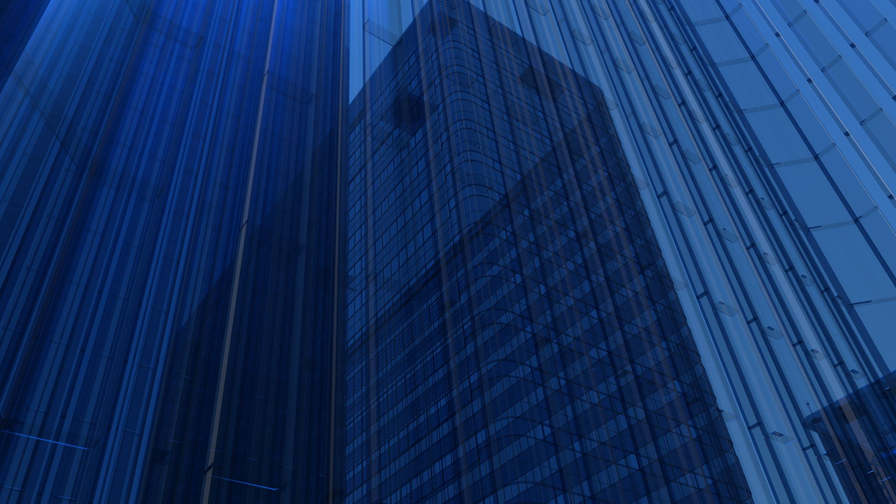
Karina Echeverri
CRJ 102-110W
March 10, 2024
Assignment #2

Slide 2
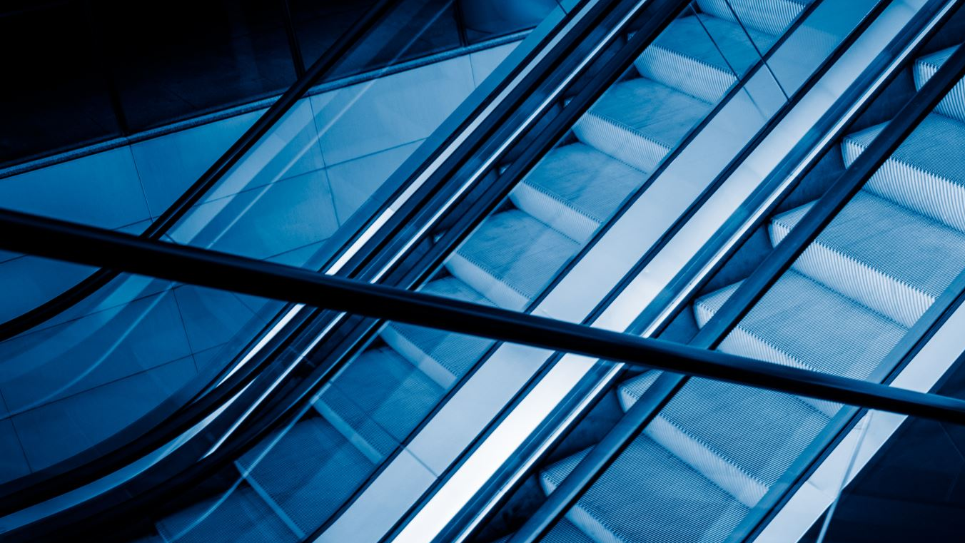
How my neighborhood tries to prevent criminal activity

Slide 3
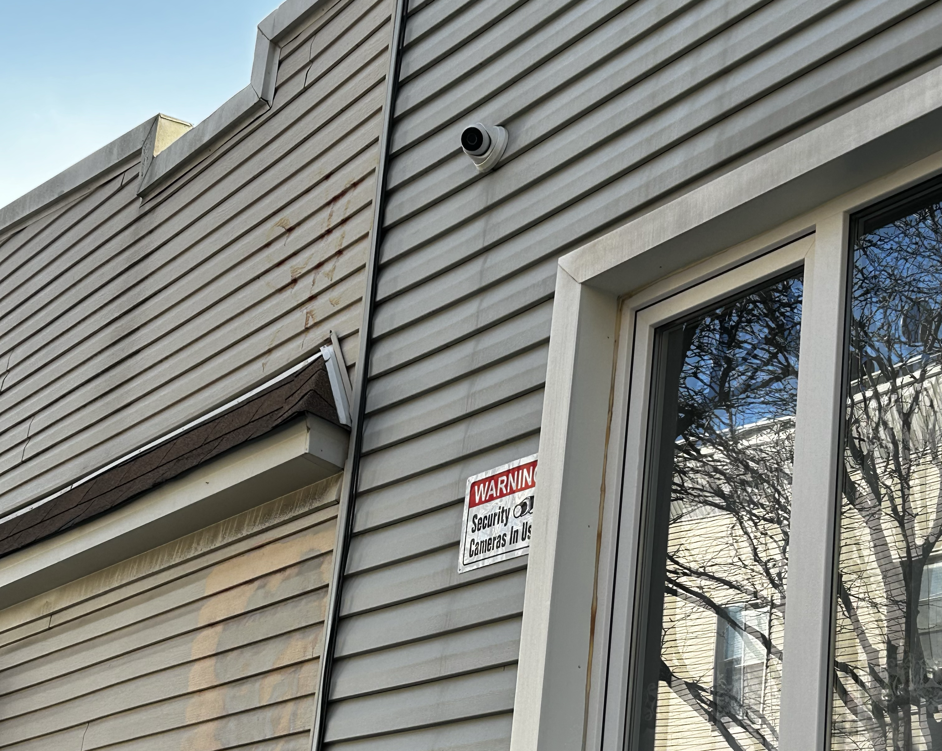
Security Camera
As I walked in my neighborhood, I realized that all of the houses have installed, at least, one security camera. That’s because whenever something happens, it is all being recorded by everyone. I will share an example that happened in my neighborhood a while ago. In the apartment that I live, people from the second floor usually orders a lot of things from Amazon. When the delivery person arrives with the package, he leaves it at the front door. One day, the same happened, but the package was stolen by a guy. We couldn’t have known who it was, if it weren’t because of the security cameras that are working at any time, 24 hours. They called the police and thanks to this, the police got the guy a few weeks later.

Slide 4
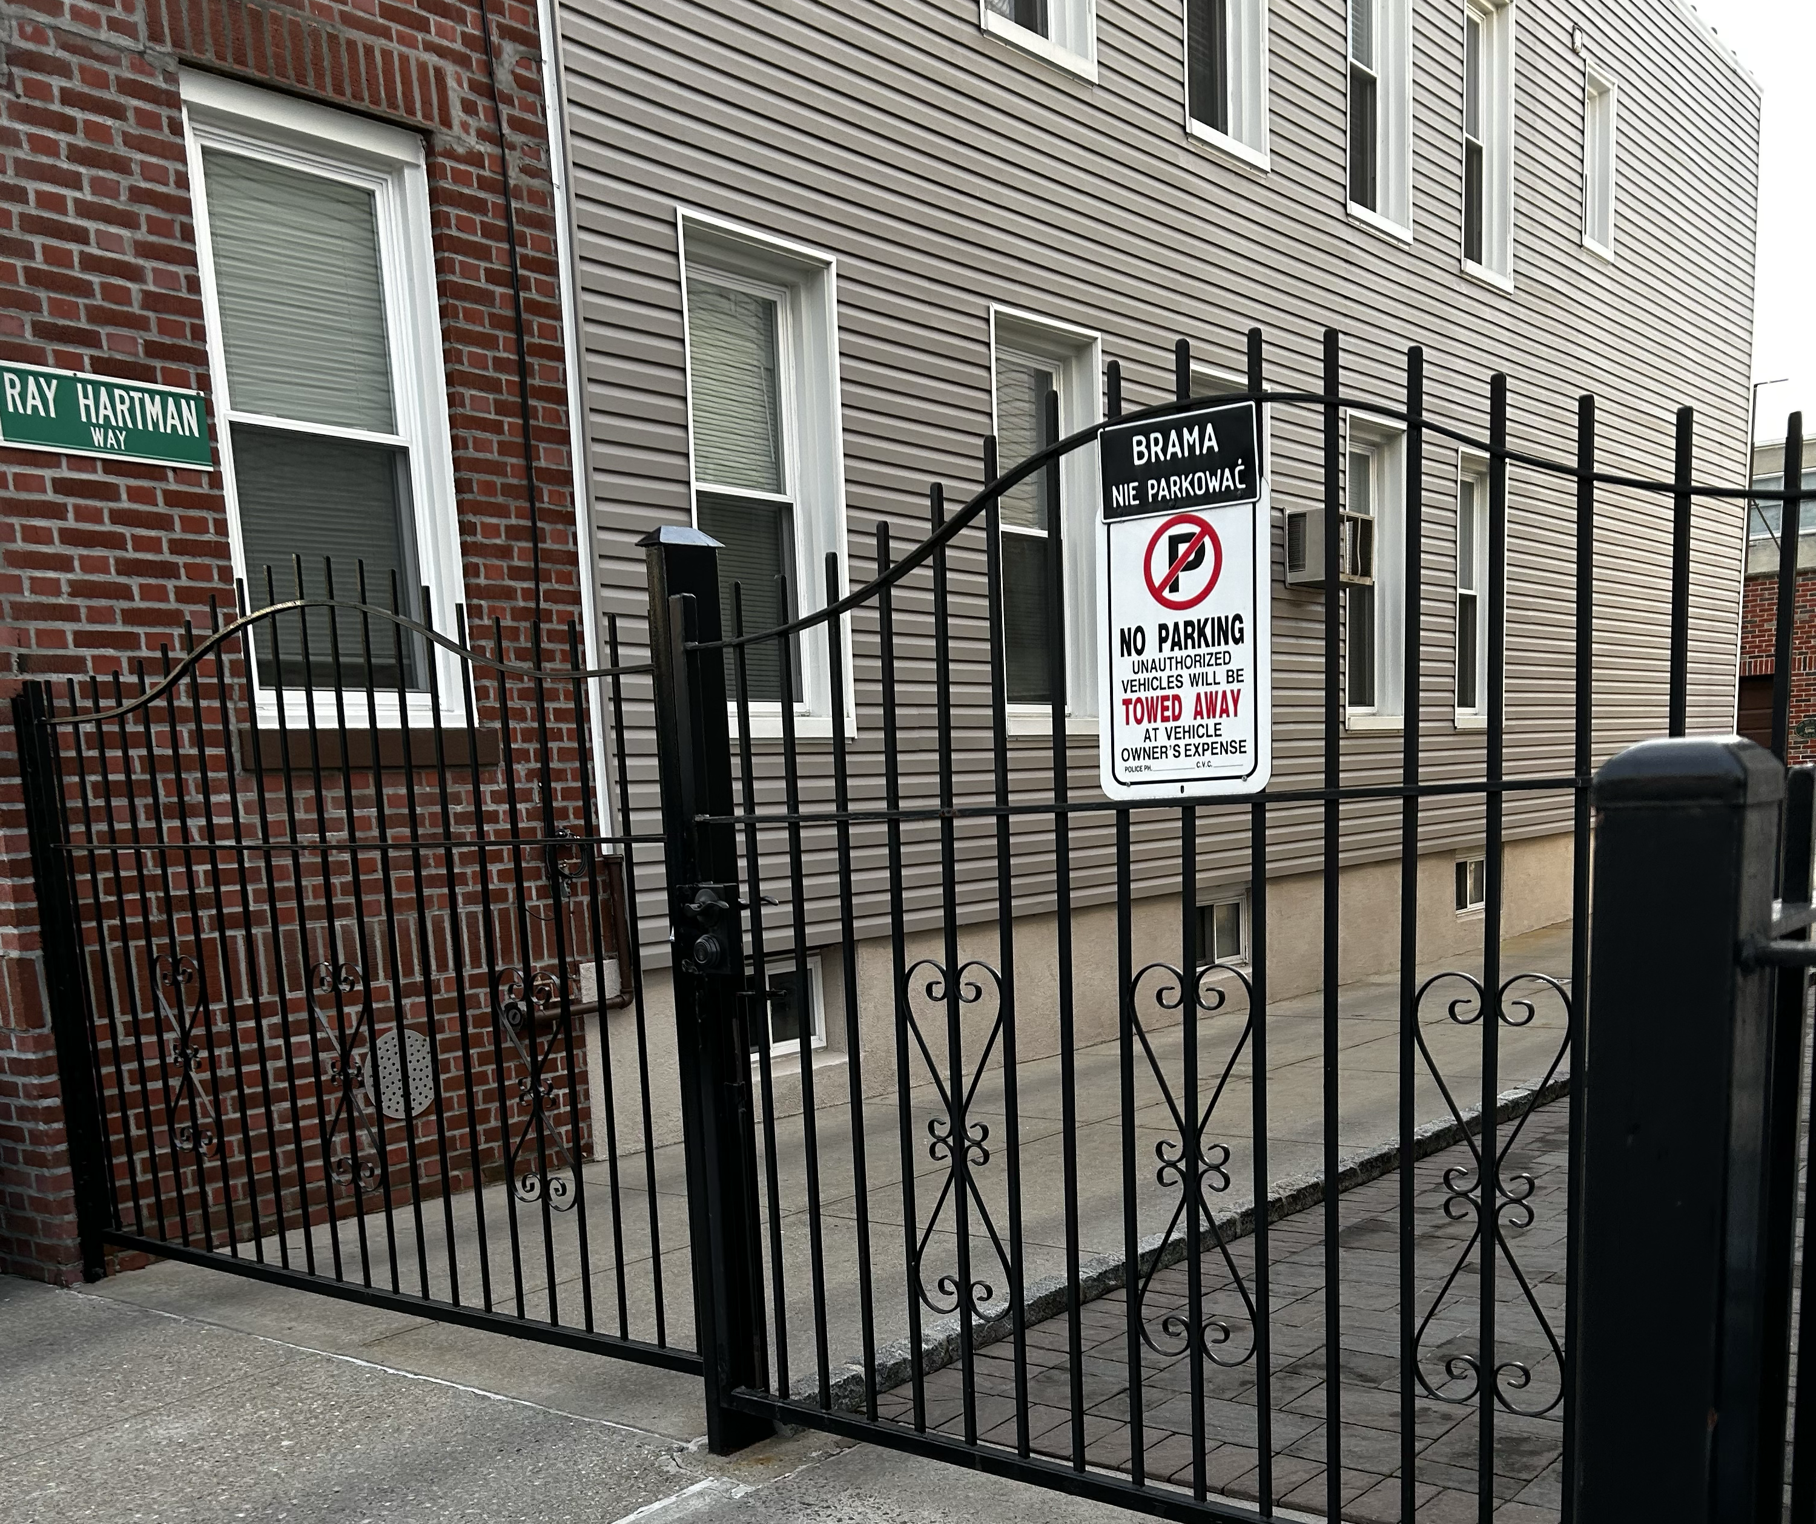
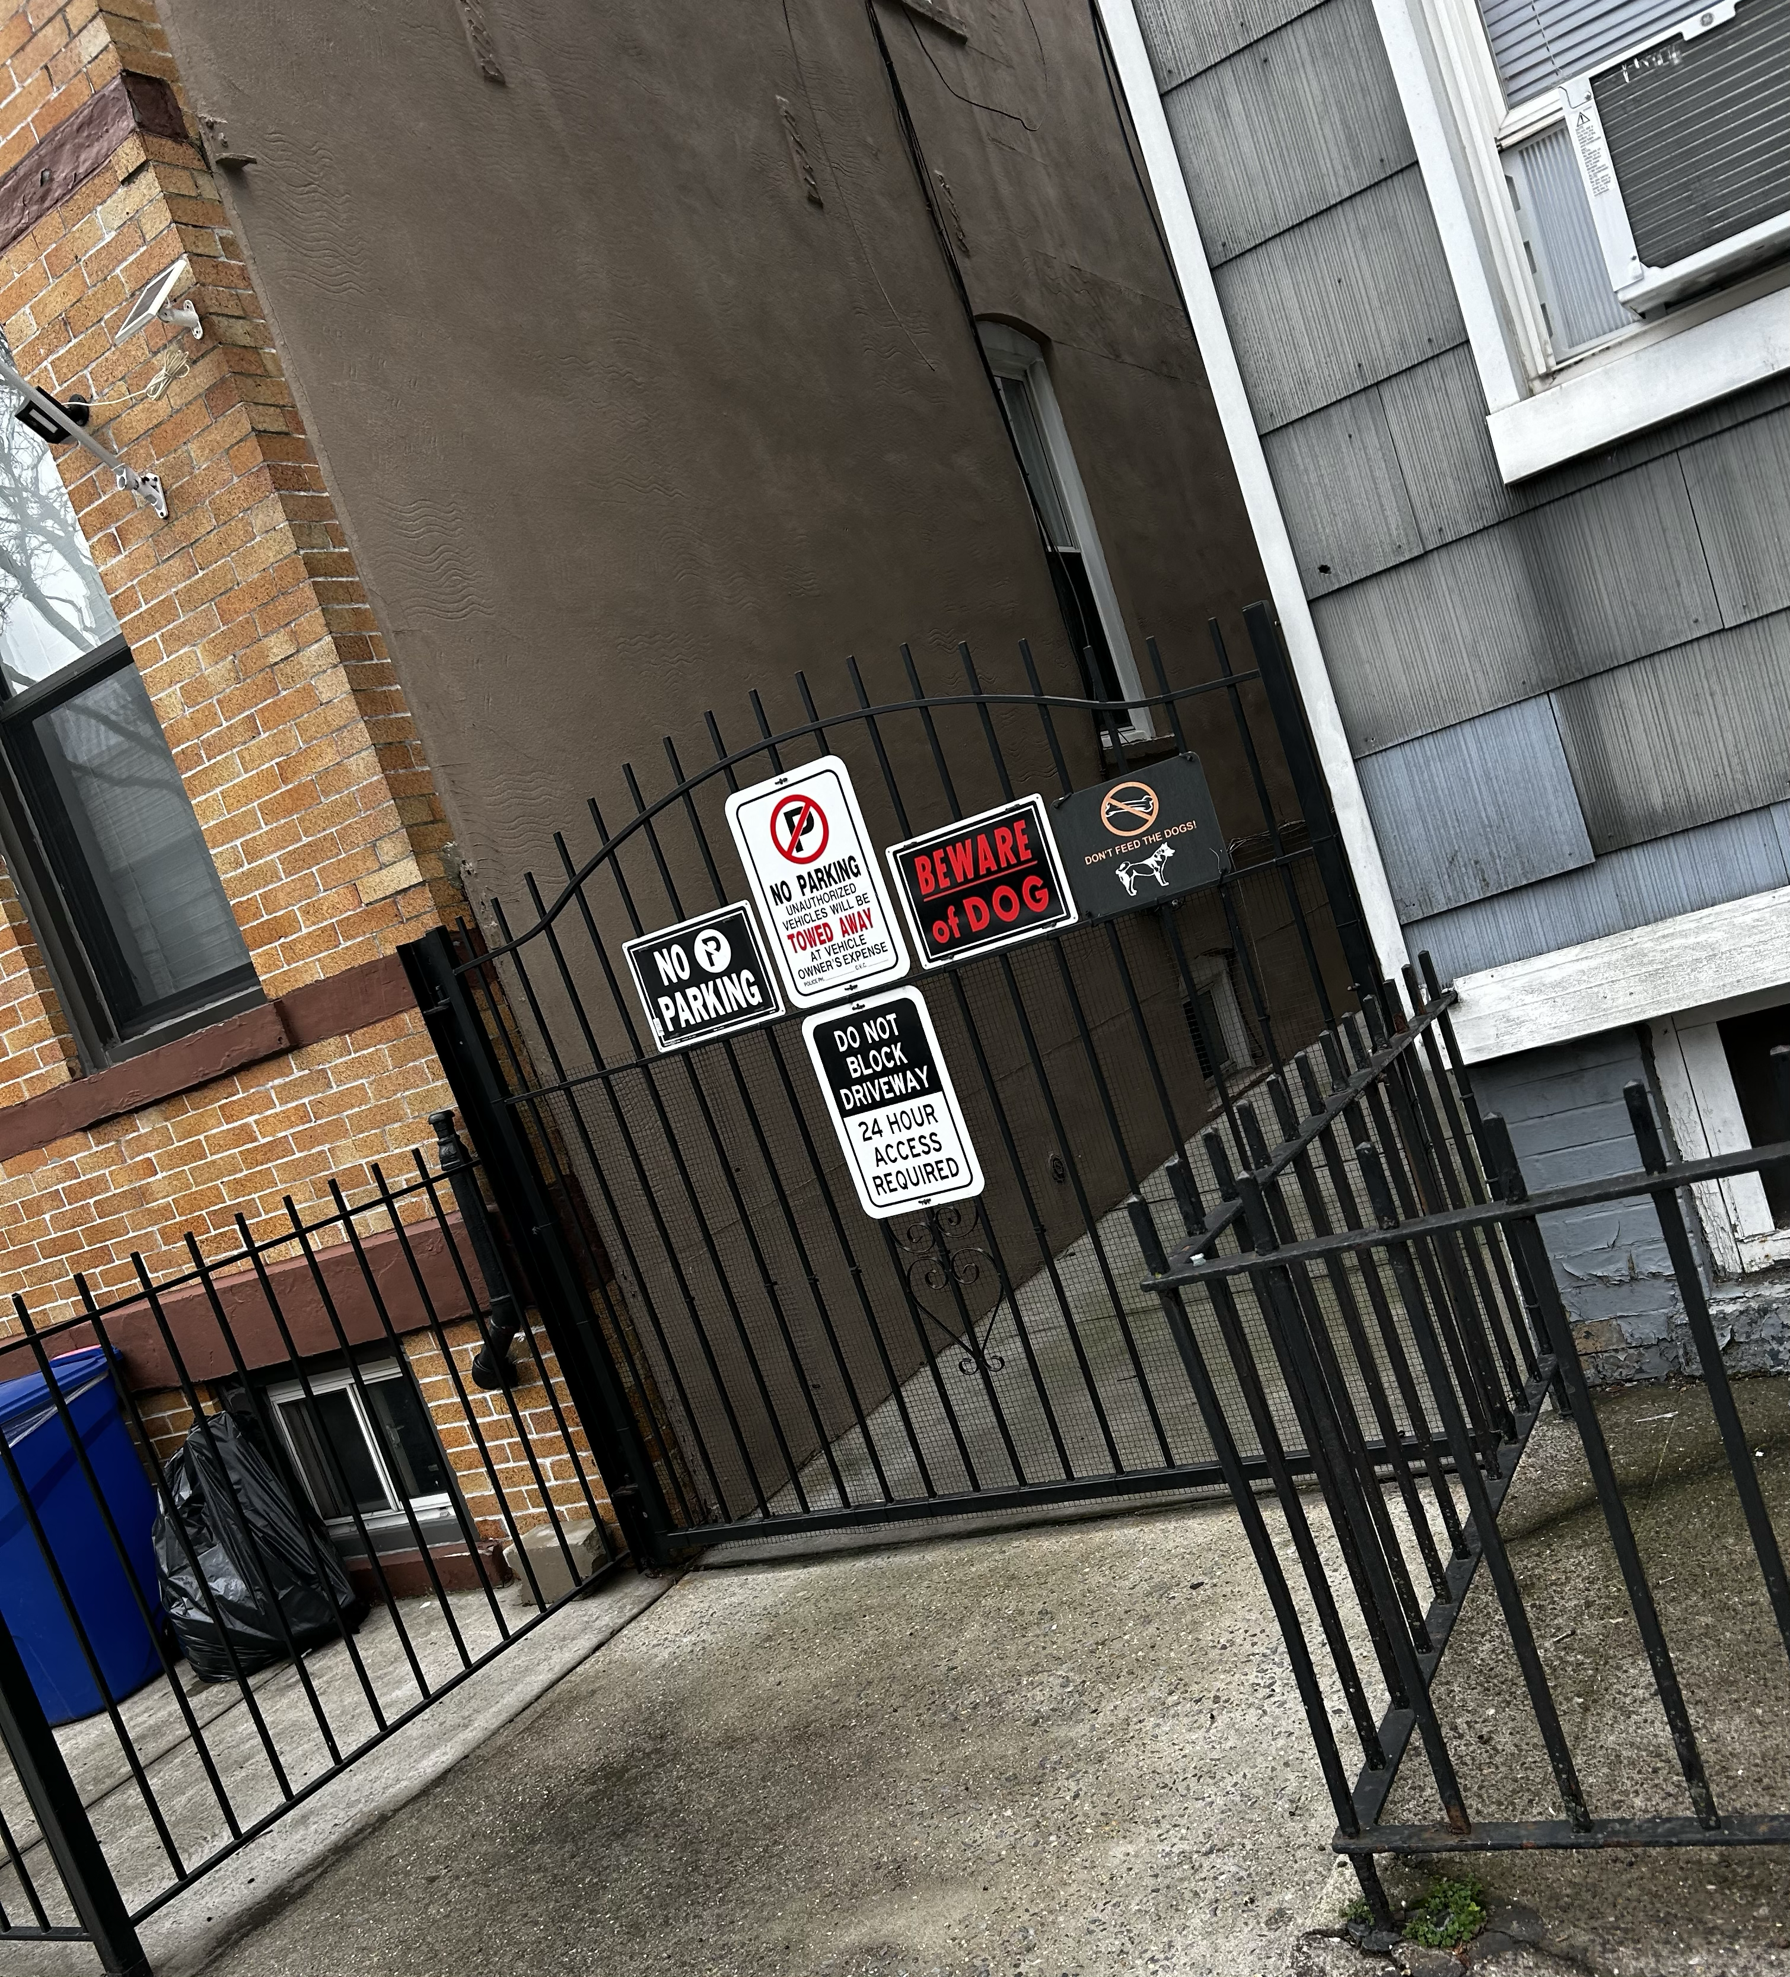
“NO PARKING” Sign
In my neighborhood, people try to prevent criminal activity by using “NO PARKING” sign and “BE AWARE OF DOG.” In my opinion, this is a good start for crime prevention. The two houses from where I got these two photos are next to mine. As it is shown, one of the houses have a dog inside. The dog is very quiet and doesn’t really bark. Neighbors have never complained about the dog, but one afternoon, the dog was barking a lot. I have a dog, so my dog was barking as well because of the other dog. Later on, I saw a police car outside of that house. The next day, my neighbor told us that someone was trying to get into the house, and they couldn’t have noticed it without the dog. So, I believe people should be really aware when there are these kind of signs, so they don’t commit a crime at the wrong place.

Slide 5
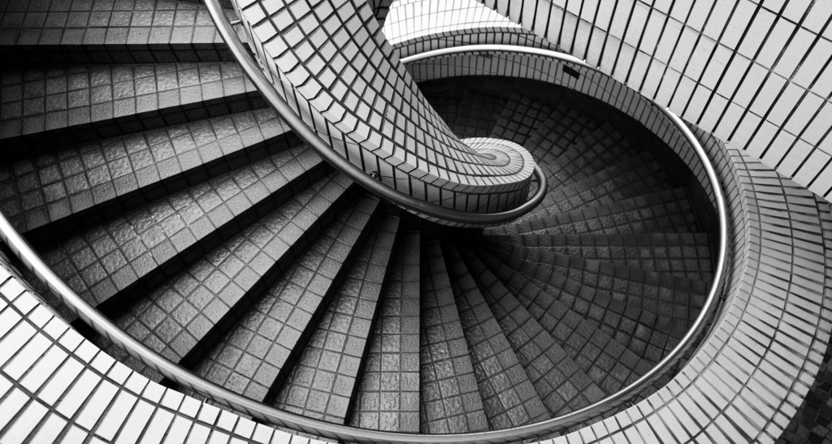
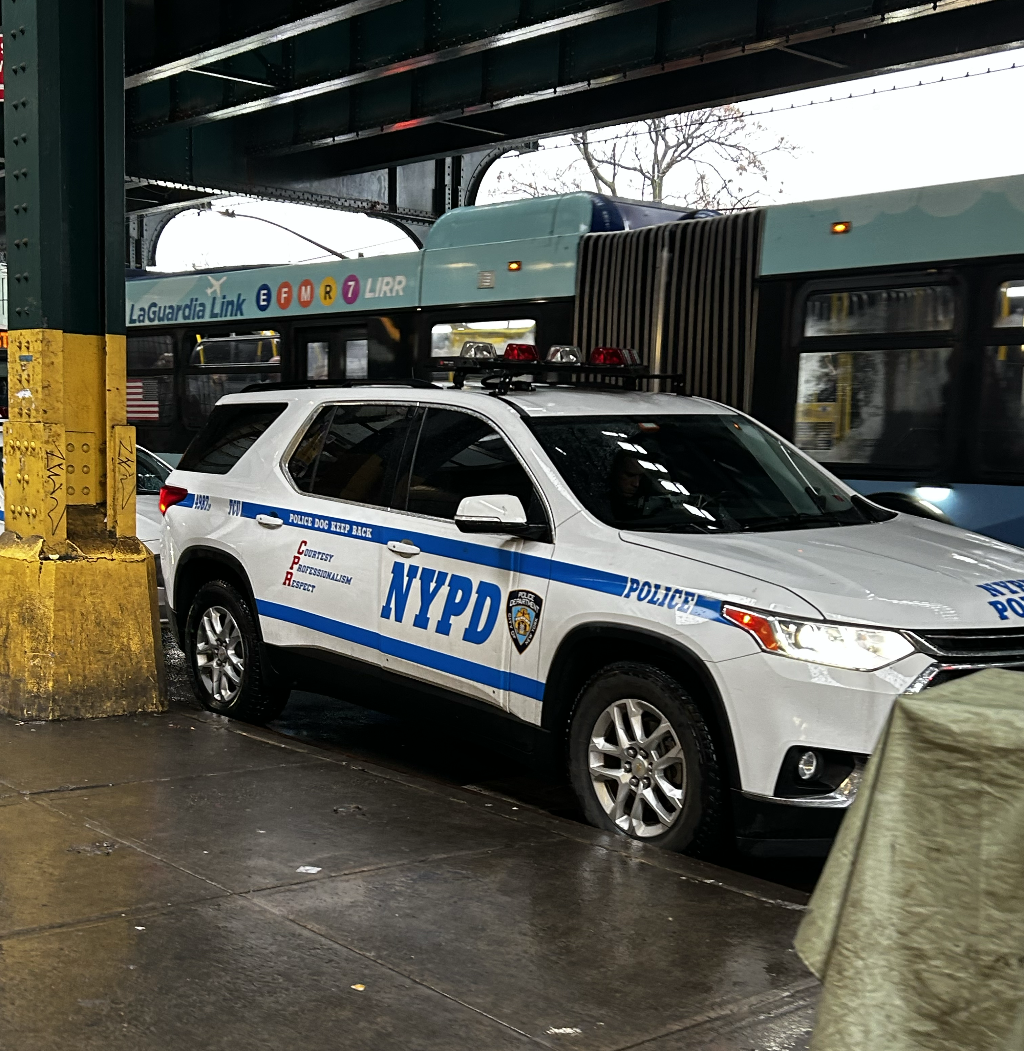
Police Car Patrolling
While doing my research, in the public area of my neighborhood, I realized that almost always there’s a police car with two police officers. They’re patrolling the area because it is a really crowded zone. This is also a way my neighborhood and the NYPD try to prevent criminal activity. Based on what I’ve seen, I have never seen the police officers arresting or warning someone. Even though it’s a crowded zone, there’s no much criminal activity.

Slide 6

Conclusion
In my neighborhood, we all try to prevent criminal activity by using security cameras 24 hrs., there are a lot of “no parking” and “be aware of dog” signs, and of course, the NYPD do their job by patrolling and keep a good communication with my community.

