Slide 1

CRJ 102
Online Instruction
SOCIAL STRUCTURE

Slide 2
SOCIOLOGICAL DETERMINISM
Looks to the environment
Major Perspectives Of Sociological Determinism:
  Social Structure Theories
    Looks at the literal structure of society as well as societal structure
    Crime is a function of where one lives, not individual pathologies
      Chicago School – aka The Ecological School
        Named after the sociologists from the University of Chicago
        Social forces operating in urban areas which create criminogenic environments
  Social Process Theories
    Criminal behavior involves psychological development fostered by the social environment
  Conflict Theory
    Rooted in Marx’s writings
    Economic system produces the conditions that support the high crime rate

Slide 3
SOCIAL STRUCTURE PERSPECTIVE
Society’s social structure is stratification
Stratification: dividing or categorizing people into groups
  Results in the uneven distribution of societal resources according to the group
Types of stratification categories:
  Class
  Race
  Gender
Even if they don’t engage in criminality, people’s their apathetic attitudes promote it in others

Slide 4
CONCEPTS OF THE SOCIAL
STRUCTURE PERSPECTIVE
Social forces
Lower class areas are scenes of inadequate housing and health care
  Association between family poverty and children’s health, achievement and behavior impairments
Children raised in low-income homes are less likely to achieve in school, less likely to complete their schooling
  Adolescents in the “worst” neighborhoods share greatest risk of dropping out
The makeup of the city is a social force
  Struggle for urban space led to competition between groups and to the division of urban space
Most social structure theories focus on children's law-violating behavior. The social forces that cause crime begin to affect people while they are relatively young and continue to influence them throughout their lives

Slide 5
THEORIES BASED ON THE SOCIAL
STRUCTURE PERSPECTIVE
CONCENTRIC ZONE THEORY
Park & Burgess
  From the Chicago School (see slide 2)
    Cities take the form of concentric circles or zones
      Rings with areas of social and physical deterioration concentrated near the city center and more prosperous areas located near the city’s edge
      5 zones:
        Zone 1: The City Center or the Loop
        Zone 2: Zone of Transition – poorest zone
        Zone 3: Working Man’s Zone - Area of low cost homes
        Zone 4: Professional Zone – zone of better residences
        Zone 5: Commuter Zone
Not a criminological theory, but speaks to environment where social forces exist and develop

Slide 6
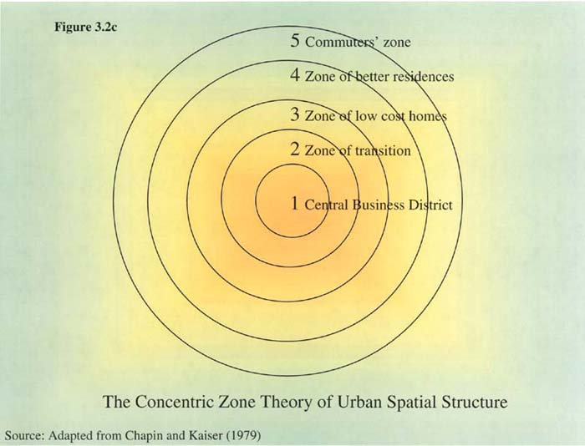

Slide 7
SOCIAL DISORGANIZATION THEORY
SHAW & MCKAY
Builds upon Park & Burgess’s Concentric Zone Theory
  Looks at Zone 2 - transitional Neighborhoods
    Area undergoing shift in population and structure
  the breakdown of effective social bonds and social controls leads to inability to self-regulate and held to result in deviance
  Factors that lead to breakdown of social bonds:
    Poverty
    Ethnic heterogeneity
    Residential mobility
    Family disruption

Slide 8
STRAIN THEORIES
Seeks to explain crime rates in lower class neighborhoods
Social and economic forces push many residents into criminal behavior patterns because of the strain caused by disadvantaged economic position
Several theories explain criminality as a result of strain

Slide 9
STRAIN THEORY aka THEORY OF ANOMIE
Robert Merton
  Society’s emphasis on achieving economic goals but limited opportunity to achieve them due to stratified economic structure leads to strain and anomie
    Anomie: breakdown of social norms and rules
  Social Adaptations to Strain:
    Conformity
      Does not involve criminality
    Innovation
      Creates illegitimate ways to achieve economic goals (ex.: Stealing)
    Ritualism
      Gives up the pursuit of any goals
    Retreatism
      Escapes the strain via drugs and alcohol
    Rebellion
      Replaces goals with their own but involves illegal activity (ex.: militia groups)
  Evaluation of Strain Theory
    Only looks at lower class areas – what about crime by the rich?
    Only looks at crimes with material goals – what about terrorism or murder?

Slide 10
GENERAL STRAIN THEORY
ROBERT AGNEW
  Sought to generalize Robert Merton’s Strain Theory
  Stated there were multiple sources of strain:
    Failure to achieve positively valued goals
    Disjunction of expectations and achievements
    Removal of positively valued stimuli
    Presentation of negative stimuli
  Vicarious Strain
    Strain experienced on behalf of a another person or group
      Ex.: person’s who take on the ideology of a group and commits acts of terrorism on their behalf
Similar to what Merton said

Slide 11
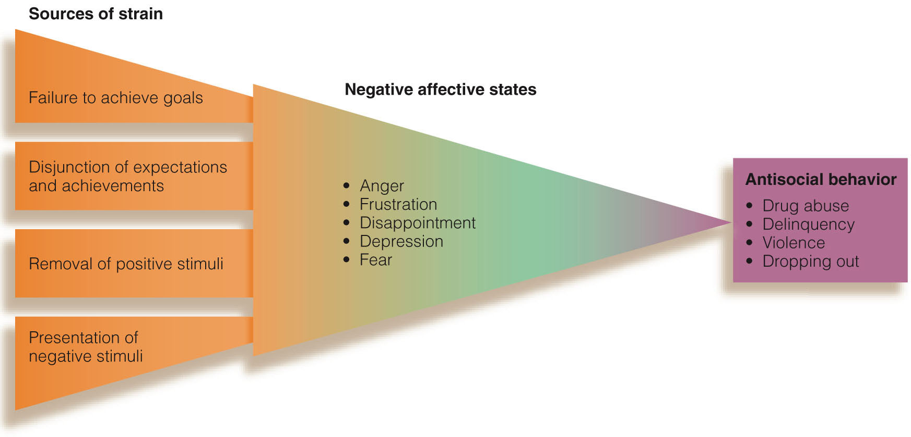
VISUALIZATION OF GST

Slide 12
INSTITUTIONAL STRAIN THEORY
MESSNER & ROSENFELD
  Crime and the American Dream (2004)
    Overvaluation of economic goals leads to strain among society’s institutions
      Family
      School
      Church
    Breakdown of societal institutions leads to crime

Slide 13
THEORY OF DELINQUENT SUBCULTURES
ALBERT COHEN
  Delinquent Boys (1955)
  Status Frustration leads to the formation of Deviant Subcultures
    Strain is result of age-based frustrations
      Middle-Class Measuring Rod
      Strain caused by failure to meet the standards of their middle-class teachers
    Strain leads them to form their own value system. One of three groups form:
      Corner Boys
        Eventually age out of crime
      College Boys
        Try to conform
      Delinquent Boys
        Gangs

Slide 14
THEORY OF DIFFERENTIAL OPPORTUNITY
CLOWARD & OHLIN
  The different opportunities to engage in criminality are also determined by economic structure of society
    The opportunity to engage in criminality is not available to anyone and everyone
    Delinquent subcultures develop according to the socio-economic condition
      Criminal gangs
        Organized; engage in legitimate and illegitimate businesses
      Conflict gangs
        Less organized; more violent
      Retreatist gangs
        Unable to join legitimate world or illegitimate world (think: motorcycle gangs)

Slide 15
ADDITIONAL LINKS
POVERTY AND INEQUALITY: https://www.openbookpublishers.com/htmlreader/PDS/chap03.html
MERTON'S STRAIN THEORY: https://www.youtube.com/channel/UCmtTkP9e8v004htk9onZKQQ
THE FUNCTIONALIST PERSPECTIVE: https://courses.lumenlearning.com/boundless-sociology/chapter/the-functionalist-perspective-on-deviance/

