Slide 1

CRJ 102
ONLINE INSTRUCTION
CONFLICT

Slide 2
CONFLICT PERSPECTIVE
Rooted in Marx’s writings
  Communist Manifesto (1848)
  Did not talk about crime per se, but views about society and conflict became the foundation for conflict theorists in criminology
  For Marx & Engels, conflict is inherent in the nature of the social arrangements under capitalism
    Ex: immigration
  Capitalism generates a vast difference in interests – gives the very few at the top a lot of power over the many at the bottom
Economic system produces the conditions that support crime

Slide 3
CONCEPTS OF CONFLICT
Conflict theorists view criminal behavior as the inevitable outcome/reaction to the unfair distribution of wealth and power in society.
Conflict and Crime
  Those in power shape the context of the law
    White-collar crimes causing large quantities of damage punished leniently
    Petty crimes causing small amounts of damage punished severely
Criminal law is the tool of those in power
  Ex.: crimes by the wealthy are adjudicated differently than so-called “crimes by the lower class (white-collar v. street crimes). Same type of murder is seen as class-based (trespassing okay by wealthy, murder to others)

Slide 4
SOCIAL REACTION (LABELING) THEORY
“It is not the act itself, but the reactions to the act, that make something deviant.” – Howard Becker, 1966
Social Reaction Theory (aka Labeling Theory) is also a conflict theory
Crime is defined by those in power
Differential Enforcement
  Not everyone is labeled
  People with power do not get labeled

Slide 5
CRITICAL CRIMINOLOGY
Foundation is the conflict perspective
Crime is a political concept designed to protect the power and position of the upper classes at the expense of the poor
  Themes and Concepts
    Connection between social class, crime, and social control
    Role of the government in creating a criminogenic environment
    Relationship between personal/group power and shaping of criminal law
    Race and gender bias in the justice system
    Misuse of political/social/media power to control behavior of others and shape public opinion

Slide 6
FEMINIST CRIMINOLOGY
Critical Feminist Theory
Based on the conflict perspective
  Explains both victimization and criminality among women in terms of gender inequality, patriarchy, and the exploitation of women under capitalism
  Patriarchy and Crime
    Double marginality
    Powerlessness

Slide 7
CURRENT ISSUES THAT CONCERN
FEMINIST CRIMINOLOGISTS
Approximately two-thirds of girls in the United States juvenile system are young women of color, mostly African-American and Latina. Studies have shown that girls of color are arrested at three times the rate of white girls (ABA and NBA, 2001).
Previous research has shown that female offenders, compared to male offenders, are more likely to have a history of victimization themselves, either in childhood or as adults (Chesney-Lind and Shelden, 1992; Widom, 1989).
Cauffman et al found that the rate of post-traumatic stress disorder was higher for adolescent females in the delinquency system, compared to both the general population and to their male counterparts in the justice system (1998).

Slide 8
CONCEPTS OF FEMINIST CRIMINOLOGY
Social life and institutions are shaped by gender (Miller & Mullins, 2009)
  Gender is not a natural fact, but rather a constellation of social, historical, and cultural elements.
    Biological sex differences are only one small part of how we construct gender (Daly and Chesney-Lind, 1988).
    Our constructions of masculinity and femininity are based on an organizing principle of male superiority and male social and political dominance over women (Daly and Chesney-Lind, 1988).
    Therefore, our systems of knowledge reflect male views of the natural and social world (Daly and Chesney-Lind, 1988).
Feminists are concerned not only with the treatment of women, but of men as well.

Slide 9
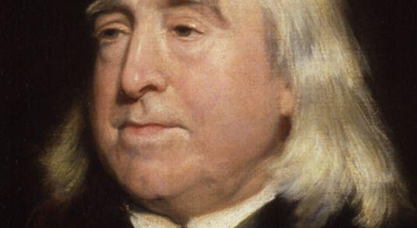
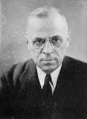
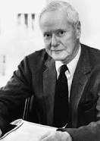
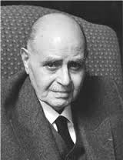
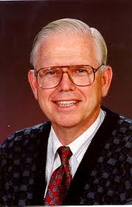
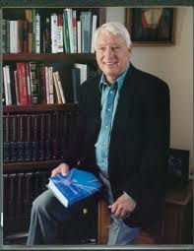

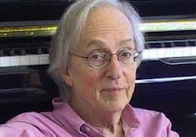
WHAT DO ALL THESE PEOPLE HAVE IN COMMON?

Slide 10
WHERE THE LADIES AT?
In several classic criminological theories, girls and women have been ignored or stereotyped:
Hirschi’s Causes of Delinquency (1969, p. 36):
  “In the analysis which follows… the girls disappear… Since girls have been neglected for too long by students of delinquency, the exclusion of them is difficult to justify. I hope to return to them soon.” He never did.
Albert Cohen’s Delinquent Boys: The Culture of the Gang (1955):
  “…the female’s station in society, the admiration, respect and property she commands, depend to a much greater degree on the kinds of relationships she establishes with members of the opposite sex” (p. 141).
  Because girls are so concerned with boys (“boys collect stamps, girls collect boys” – p. 142), they only engage in delinquent behavior as it relates to boys: “sexual delinquency or involvement in situations that are likely to ‘spill over’ into overt sexuality” (p. 143).
  Romanticized the “rogue male”

Slide 11

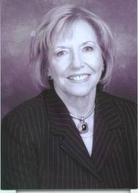
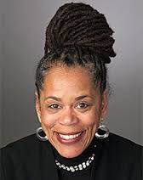

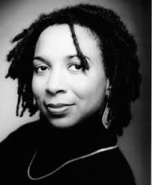
Feminist Criminologists
Freda Adler
Meda Chesney-Lind
Beth Richie
James Messerschmidt
Kimberlé Crenshaw

Slide 12
TOWARD A FEMINIST THEORY OF DELINQUENCY
Chesney-Lind (1989) challenges us to think twice about adapting male-oriented theories to the issues of women and girls.
Many mainstream theories are inadequate for boys, too, because they neglect gender as a variable
Instead, we should examine:
  Female lives and behavior in their patriarchal context
  How social control agencies reinforce stereotypical gender expectations
  Contextual factors in girls’ and boys’ lives, including racism, poverty, and abuse

Slide 13
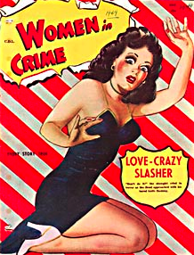
EARLY FEMINIST CRIMINOLOGY
        The Masculinization Hypothesis: Freda Adler attributed the rise in female crime rates in the 1960s & 1970s to an increasing number of females adopting “male” roles, and by doing so increasingly masculinizing their attitudes and behavior
        The Emancipation Hypothesis: Rita Simon claimed that increased participation in the workforce affords women greater opportunities to commit crime

Slide 14
ADDITIONAL LINKS
THE CONFLICT PERSPECTIVE: https://courses.lumenlearning.com/boundless-sociology/chapter/the-conflict-perspective-on-deviance/

