Slide 1



Social Learning Theory: Understanding Crime and Deviance

Slide 2

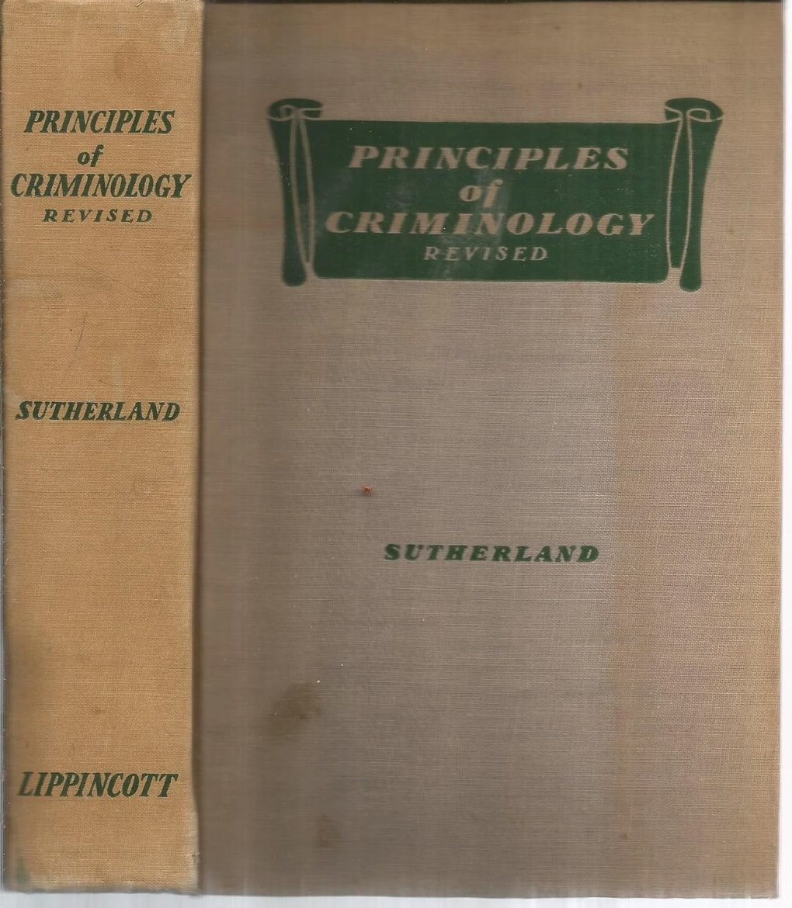
Theoretical Origins
Social learning theory originated as an effort to link elements of Sutherland's differential association theory with principles of behavioral psychology. Sutherland proposed nine propositions illustrating his theory, with the sixth principle being particularly influential: individuals learn either favorable or unfavorable definitions for behaviors.
According to this principle, the probability of criminal behavior increases when a person learns definitions favorable to violating the law in excess of unfavorable definitions.

Slide 3





Differential Association Theory
Edwin Sutherland's Differential Association Theory posits that criminal behavior is learned through social interaction. It emphasizes that this learning primarily occurs within intimate personal groups, not through broader media or abstract concepts.
Learning in Association
Techniques & Motives
Criminal behavior is learned through interaction with others, especially in close, personal groups.
Learning includes specific techniques for committing crime, and the associated motives, drives, rationalizations, and attitudes.
Definitions of Law
Varying Associations
A person becomes delinquent when exposed to an excess of definitions favorable to violating the law over those unfavorable to it.
Differential associations vary in frequency, duration, priority, and intensity, influencing the learning process.

Slide 4
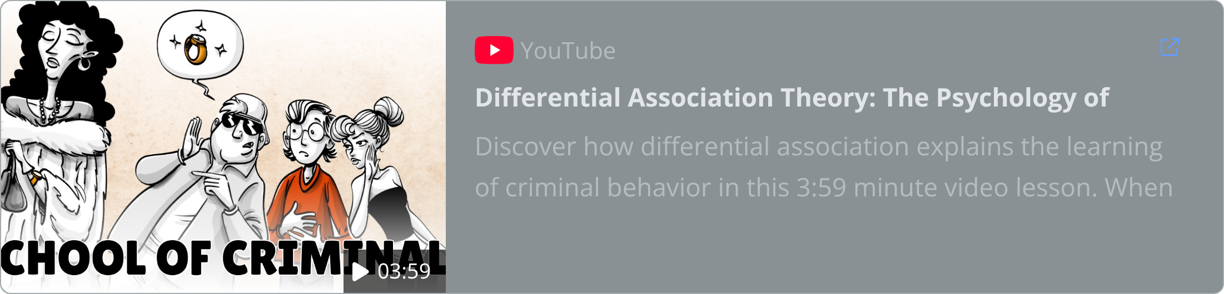
Differential Association Theory: Edwin Sutherland

Slide 5


Ron Akers and Social Learning Theory
Ronald Akers’ Social Learning Theory (1977, 1998) built upon and refined Sutherland’s differential association theory. Akers' contribution was to go beyond merely identifying who individuals associate with, to instead investigate how criminal behavior is actually learned through those associations.

Slide 6
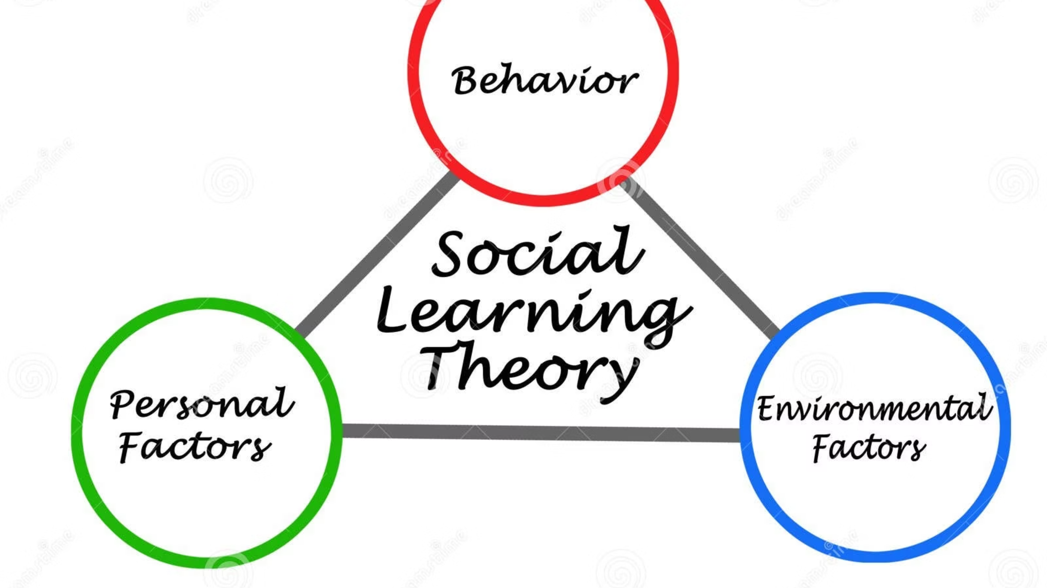
Social Structure Social Learning (SSSL)
Social Structure Social Learning (SSSL) theory expands upon Akers' Social Learning Theory by integrating macro-level social structural factors into the explanation of crime and deviance.
It posits that an individual's position within the social structure—such as their neighborhood, community, or socioeconomic status—influences their exposure to specific learning environments, thereby mediating their acquisition of criminal or conforming behaviors.

Slide 7

Core Elements of Social Learning Theory
1
2
Differential Association
Definitions
Focuses on the importance of interactions with peers, neighbors, authority figures, and "virtual groups." These interactions provide the context for social learning. The probability of engaging in crime increases when individuals associate with peers who hold pro-criminal attitudes.
Refers to attitudes, values, and orientations toward crime and conforming behavior. These can be general or specific, positive or neutralizing. Personal definitions operate on a continuum from strongly held conforming beliefs to strongly held non-conforming beliefs.
3
4
Differential Reinforcement
Imitation
Concerns the balance of perceived, experienced, or anticipated rewards and punishments. Value is attributed to behaviors that are rewarded, and the more frequently a behavior is rewarded rather than punished, the higher its value becomes.
Similar to vicarious reinforcement, where individuals observe behaviors performed by others and their consequences. If someone observes another person commit a criminal act and receive rewards without punishment, they may imitate that behavior.

Slide 8


Definitions: A Closer Look
The definitions component of social learning theory encompasses the attitudes, values, and orientations individuals hold toward crime, deviance, and conforming behavior. These personal definitions can be:
General (covering a wide range of behaviors) or specific to particular behaviors
Positive definitions ("It is fun to steal") or neutralizing definitions ("I'm just taking what I deserve")
Akers conceptualizes these definitions as operating on parallel continua, from strongly held conforming beliefs to strongly held non-conforming beliefs.
The strength of these definitions significantly influences whether an individual will engage in criminal or conforming behavior, with stronger definitions having greater impact on behavioral choices.

Slide 9




Differential Reinforcement and Imitation
Reinforcement Process
Observation of Models
Behavioral Imitation
Value is attributed to behaviors that are rewarded. The more frequently a behavior is rewarded rather than punished, the higher its value becomes and the more likely it will be repeated.
Individuals observe others performing behaviors and note the consequences. The characteristics of the model, the behavior itself, and the observed consequences all influence the likelihood of imitation.
If the observed behavior appears to be rewarded or goes unpunished, the individual is more likely to imitate it. This process of vicarious reinforcement is a powerful mechanism for learning criminal behavior.
These mechanisms explain how individuals learn to engage in criminal behavior through direct and indirect experiences with rewards and punishments, as well as through observing others.

Slide 10

But What Does “Social Structure” Add?
Akers’s SSSL theory (1998) suggests:
People learn criminal behavior through social interactions, but whether and how they learn it depends on their place in the social structure (like class, race, gender, neighborhood, etc.).
Your position in society significantly affects who you associate with and what behaviors you learn. For example, several social structural factors play a role in shaping these influences:
Race & Ethnicity
Poverty
Racial and ethnic contexts can shape social networks, which behaviors are adopted, and how behaviors are reinforced or sanctioned within a community.
Economic disadvantage can influence an individual's associations, normalizing certain behaviors and affecting the perceived rewards or punishments for actions.
Neighborhood Crime Rates
Family Breakdown
High crime rates in a neighborhood can expose individuals to more pro-criminal associations, normalize deviant behaviors, and change the balance of rewards and punishments experienced.
Instability in family structures can alter an individual's primary socializing agents, influencing the definitions of behavior and the patterns of reinforcement.

Slide 11

Cross-Cultural Applications
Puerto Rican Adolescents
South Korean College Students
Bolivian College Students
Miller et al. (2008) found that definitions and differential association were generally predictive of substance use among Puerto Rican adolescents, with findings holding across public and private schools and biological sex.
Meneses & Akers (2011) demonstrated that social learning theory had larger effects compared to other general theories when explaining marijuana use among Bolivian college students, despite cultural differences in usage patterns.
Jennings et al. (2011) found that both self-control and social learning emerged as significant predictors of dating violence perpetration and victimization among South Korean college students.
These cross-cultural studies provide strong evidence for the international applicability of social learning theory as an explanation for various types of crime and deviance across different cultural contexts.

Slide 12

Delinquency and Drift (Matza)
Matza's theory of "Delinquency and Drift" (1964) suggests that delinquents are not deeply committed to deviant values. Instead, they "drift" between conventional and deviant behavior, often adhering to a subculture of delinquency that only temporarily neutralizes conventional moral ties.
This perspective emphasizes that individuals are not entirely constrained by either law-abiding or law-violating norms but are capable of shifting between them.

Slide 13
Techniques of Neutralization
Matza's techniques of neutralization provide insight into the cognitive mechanisms individuals use to justify deviant acts, allowing them to "drift" in and out of delinquency. These learned rationalizations serve as crucial "definitions favorable to crime" within the Social Learning Theory framework.
Temporary Suspension
Rationalization
Learned Definitions
They temporarily suspend moral binds, enabling individuals to engage in behavior they would otherwise find objectionable.
These are learned justifications that precede or accompany deviant actions, mitigating guilt and allowing for continued conventional self-perception.
Crucially, neutralization techniques are themselves learned definitions that influence the likelihood of engaging in and maintaining criminal behavior.
Understanding these techniques highlights the fluid nature of deviant behavior and the powerful role of cognitive definitions in influencing choices, bridging individual psychology with learned social norms.

Slide 14






Types of Neutralization
Matza's techniques of neutralization provide distinct psychological strategies individuals employ to temporarily suspend moral obligations and justify deviant acts. Each technique addresses a different aspect of culpability or consequence:
Denial of Responsibility
Denial of Injury
Denial of the Victim
Attributing behavior to external forces beyond one's control.
Minimizing or negating the harm caused by the act.
Portraying the victim as deserving of the harm inflicted.
Condemnation of Condemners
Appeal to Higher Loyalties
Justifying the act as necessary to serve a more important group or cause.
Shifting blame by questioning the motives or integrity of those who disapprove.

Slide 15

Directions for Future Research
Cross-Cultural Testing
1
Continue to focus on the cross-cultural and international generalizability of social learning as an explanation for crime and deviance across diverse societies and contexts.
2
SSSL Development
Further unpack the mediating and moderating effects in the Social Structure Social Learning model to better understand how structural factors influence individual behavior through social learning processes.
Theoretical Integration
3
Explore integration of social learning principles with other general theories of crime to build theoretical models with greater explanatory power, rather than focusing on competition between theories.
Social learning theory has earned its place as one of the core general theories of crime. Continued commitment to replicate its effects globally, further test the SSSL extension, and engage in theoretical integration discussions are key directions for 21st century research.

Slide 16


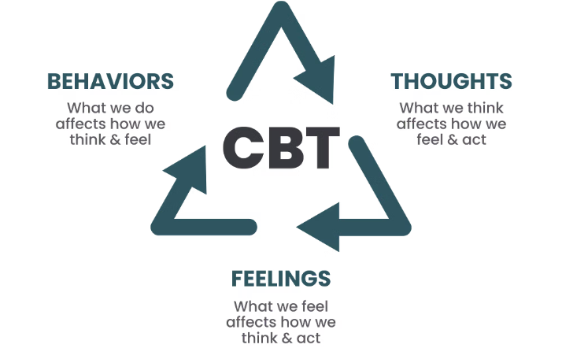

Social Learning Theory in Practice
Peer Influence Programs
Cognitive Restructuring
Reinforcement Systems
Intervention programs targeting peer associations and group norms to reduce delinquent behavior by restructuring social learning environments.
Therapeutic approaches that address definitions favorable to crime by helping individuals develop prosocial attitudes and beliefs.
Programs that systematically reward prosocial behavior and provide consequences for antisocial behavior to alter the reinforcement balance.
Social learning theory has significant practical applications in crime prevention and rehabilitation programs, informing interventions that target the key mechanisms through which criminal behavior is learned and maintained.

Slide 17
Conclusion: The Legacy of Social Learning Theory
Social learning theory stands as one of the most empirically supported explanations for crime and deviance in criminology. Its strength lies in its ability to explain the process through which individuals learn criminal behavior through social interaction, observation, and reinforcement.
As research continues to validate social learning theory across cultures and contexts, its principles remain fundamental to our understanding of criminal behavior and to the development of effective prevention and intervention strategies in the 21st century.

Slide 18




Limitations
While widely influential, Social Learning Theory has some recognized limitations that warrant consideration.
Measurement Challenges
Individual Factors
Structural Gaps
Difficulty in empirically measuring abstract concepts like "definitions" and "differential association" in real-world contexts.
Less emphasis on biological, psychological, or genetic predispositions that might influence an individual's susceptibility to learning deviant behaviors.
Despite extensions like SSSL, the core theory still tends to underemphasize broader macro-level structural causes of crime and deviance.

